Slide 1


Welcome!
Promising Programs & Practices (P³)
Hosted by the Space Grant Communications Working Group
Co-Chairs: Colleen H. Fava colleenf@lsu.edu & Michelle Coe macoe@arizona.edu
June 15, 2026
Notes:
Welcome - COLLEEN

Slide 2
It’s been a minute
  A few quick reminders
Who we are: The Space Grant Communications Working Group (SG Comms WG) is one of five official working groups established by the National Council of Space Grant Directors Executive Committee (Ex-Comm) and began in 2018. The SG Comms WG is also responsive to general communications needs of the national network and advises the Ex-Comm as requested on communications initiatives.
What is a P3? Promising Programs & Practices is a monthly info session organized by the SG Comms WG. Typically held on the second Monday of the month, we feature promising programs or practices from members of the National Space Grant community.
You can find recorded P3 sessions dating back to 2020 at: https://laspace.lsu.edu/promising-programs-practices-p3/
Notes:
Welcome - COLLEEN

Slide 3

• Reconnecting Through P3: Communications Updates and Future Opportunities
Today’s Session:
Presented by Ellen Brennan (VT), Brie Farina (MI), Kam Yee (WA)
with P3 updates by Michelle Coe (AZ), and Colleen Fava (LA)
Description: This session will serve as a reintroduction to the P3 series and provide updates on several ongoing communications initiatives. We'll hear from two Space Grant Communications Committee tiger teams about their recent work, receive an update from Washington Space Grant on its Astronaut Alessandra media collaboration, and get a brief overview from the Space Grant Communications Working Group on mentorship pods and upcoming P3 sessions. Come ready to learn, ask questions, share ideas, and help shape future P3 topics!
June 15, 2026
Notes:
Welcome - COLLEEN

Slide 4

But first…let’s break the ice:
Who is your favorite Muppet?
Notes:
Welcome - COLLEEN

Slide 5
Today’s Agenda
Metrics and Continuous Improvement Tiger Team Update – Ellen Brennan
Channels and Platforms Tiger Team Update – Brie Farina
Astronaut Alessandra Update – Kam Yee
SG Comms Working Group Pods Update – Michelle Coe
Request for Future P3 Topics and Speakers – Group Feedback
Final Wrap-Up and Open Discussion (not recorded) – Remaining time
June 15, 2026

Slide 6

When Did the Comms Tiger Team Start?
February 2, 2026
Team,
We’re standing up a Space Grant External Communications Tiger Team to help us tell the Space Grant story more clearly, consistently, and powerfully—across campuses, consortia, NASA, and our broader partners. I will work closely with Coleen to ensure there is no conflict with the existing internal communications group.
Mission
This small, focused group will develop a strategy that will help shape key messages, lift success stories from across the network, and make sure our impact on students, faculty, and communities across the country is visible and compelling. We will develop new tools we all can use for success.
If you’re excited about storytelling, branding, outreach, or just have strong ideas about how Space Grant should show up to the US, we’d love to hear from you. Please reach out to me via email by your COB on February 6, 2026 to be considered for the Communications Tiger Team.
Best,
 | Gamaliel Cherry, Ph.D. [GUH] + [MAY] + [LEE] + [UHL] Project Manager, Space Grant E: Gamaliel.r.cherry@nasa.gov P: 757-506-4095 NASA Office of STEM Engagement Johnson Space Center
 | stem.nasa.gov
June 15, 2026

Slide 7
Most Recent Update: June 4, 2026 Space Grant Weekly Update
Communication Committee Update
The Communication Committee has been actively coordinating efforts to strengthen Space Grant communication practices across all consortia. Building on recent committee discussions, members are working toward greater consistency, transparency, and shared resources across the community. To accelerate progress, the committee has launched two focused tiger teams, each tackling high‑priority needs identified during recent meetings.
Channels and Platforms Tiger Team: Currently compiling existing data to determine what platforms are being used by each Consortium…
Metrics and Continuous Improvement Tiger Team: Defining key performance indicators, categories, working definitions, example measures, and more….
June 15, 2026

Slide 8
Today’s Presenters
June 15, 2026

Slide 9

Metrics & Continuous Improvement
Action Item: Identify multiple core communication KPIs that could be useful at both the national and consortium level.
Bonus: Choose KPIs that do not create unnecessary burden, instead leveraging data already collected.
KPI = Key Performance Indicator = a concrete data point that measures progress toward specific goals

Slide 10
Metrics & Continuous Improvement
Goal 1: Increase awareness of Space Grant activities through a wide Reach of communication.
Goal 2: Increase simple Outreach interactions that engage a broad audience.
Goal 3: Increase meaningful Engagement with Space Grant activities.
Goal 4: Expand the Space Grant network by engaging Partners across disciplines, from academic to industry to informal education.

Slide 11
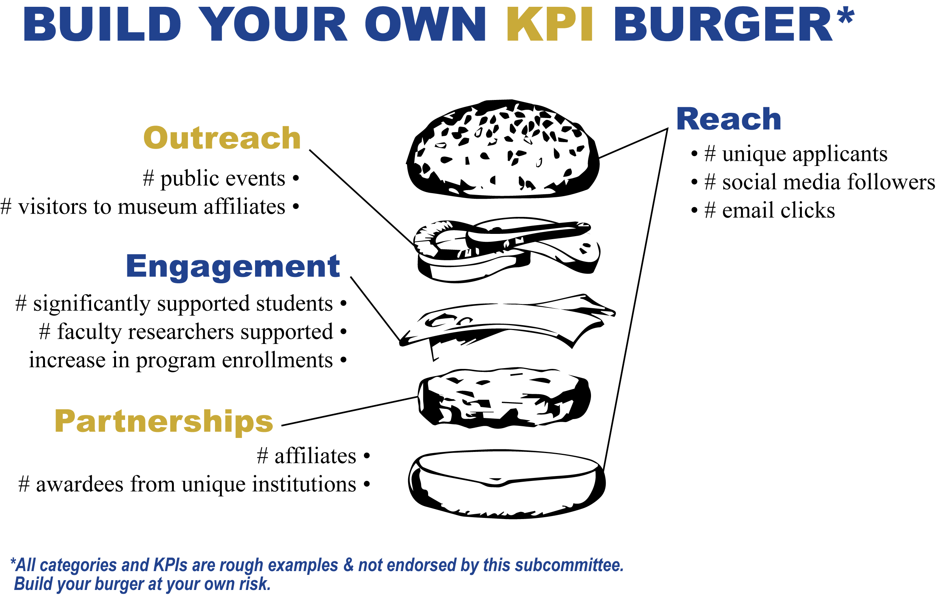
*all categories and KPIs are stand-in examples and not endorsed by this committee. Build your burger at your own risk.
Notes:
Right now, we’re defining our goals and what these broader categories mean. Once we have clear working definitions for each category, we will identify KPIs that inform progress in each category and are already accessible through existing data collection avenues like Gateway, built-in social media analytics, and longitudinal tracking. Consortia can then choose the measures that best fit their own communication strategies and the data they already have available using this menu as inspiration.

Slide 12

Notes:
The plan is to have all working definitions, goals, and KPI options ready for community discussion and feedback in Omaha this fall.

Slide 13
Channels & Platforms Tiger Team Update
Space Grant P3 Session
June 15, 2026
Brie Farina
MI Space Grant Program Coordinator
C&P Tiger Team Lead

Slide 14
Two Main Deliverables
Space Grant P3 Session | Channels & Platforms Tiger Team | June 15, 2026
Comprehensive, internal directory that includes each Space Grant’s:
  social media accounts & followings
  websites, blogs, newsletters, etc.
  communications POC
Multi-Channel Communications Best Practices Guide that covers:
  formal communications strategies
  social media engagement
  websites & web analytics
  news media interaction

Slide 15
Timeline
Space Grant P3 Session | Channels & Platforms Tiger Team | June 15, 2026
June
July
Aug - Sept
Sept - Oct
Draft Communications Directory, send to comms POCs to verify and add information, directory complete by end of June
Conduct in-depth survey to gather each Space Grant’s best practices for communications, ask for volunteers to participate in focus groups or 1:1 discussions
Analyze survey results, conduct focus groups and 1:1s, present progress at Fall National Meeting in Omaha
Compile findings into Multi-Channel Best Practices Guide, complete by October 30

Slide 16

We need your help!
Space Grant P3 Session | Channels & Platforms Tiger Team | June 15, 2026
If you handle communications for your consortium…
This week: be on the lookout for an email with the draft Communications Directory to fill in your social media handles, followers, websites, and other channel links.
In July: look out for a survey with questions about your communications best practices
Consider volunteering to discuss your best practices further in our focus groups or 1:1 conversations

Slide 17
Thank You!
Space Grant P3 Session | Channels & Platforms Tiger Team | June 15, 2026
Channels & Platforms Tiger Team
Kristyn Damadeo (VA)
Patricia Gillis (NASA)
Constance Meadors (AR)
Meghan Megowan (OR)
Michelle Stella Riordan (NJ)
Veronica Wilson (NASA)
Brie Farina (MI, Chair) – gfarina@umich.edu

Slide 18

Astronaut Alessandra’s Space Grant Adventure SIGN UP HERE
Goal:
Infuse fun to our work and build bonds between the Space Grant network.
Launched Feb 2026
21 Space Grant participating (so far)
What worked? Not one size ﬁts all!
  Self-directed sign-up
  Flex timing

Slide 19
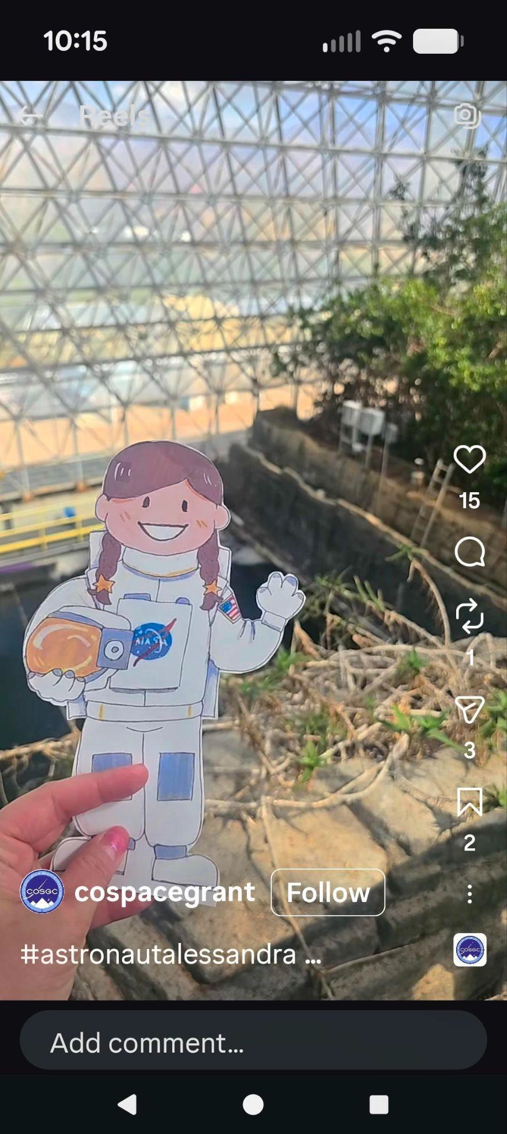
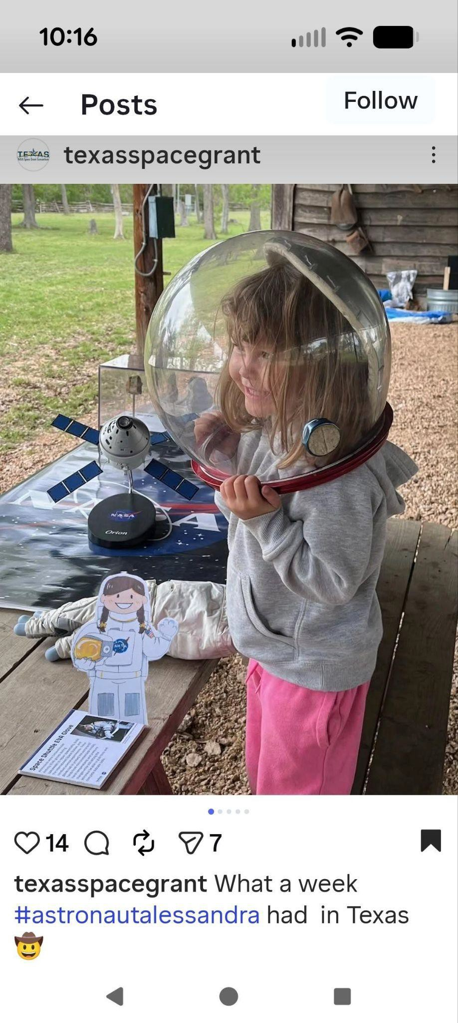

Tips
One or multiple posts
Low to no cost
Digital asset for wider reach

Slide 20
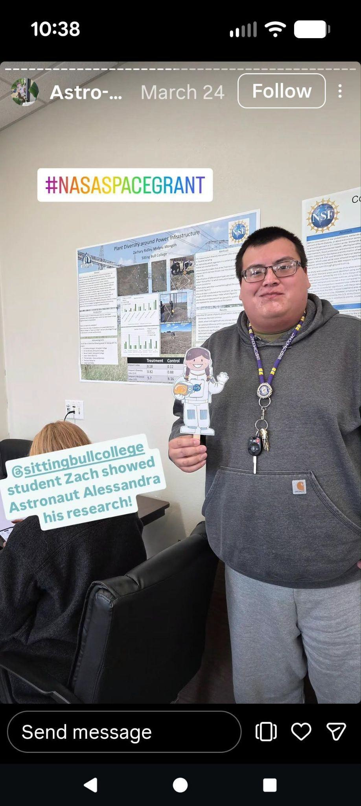
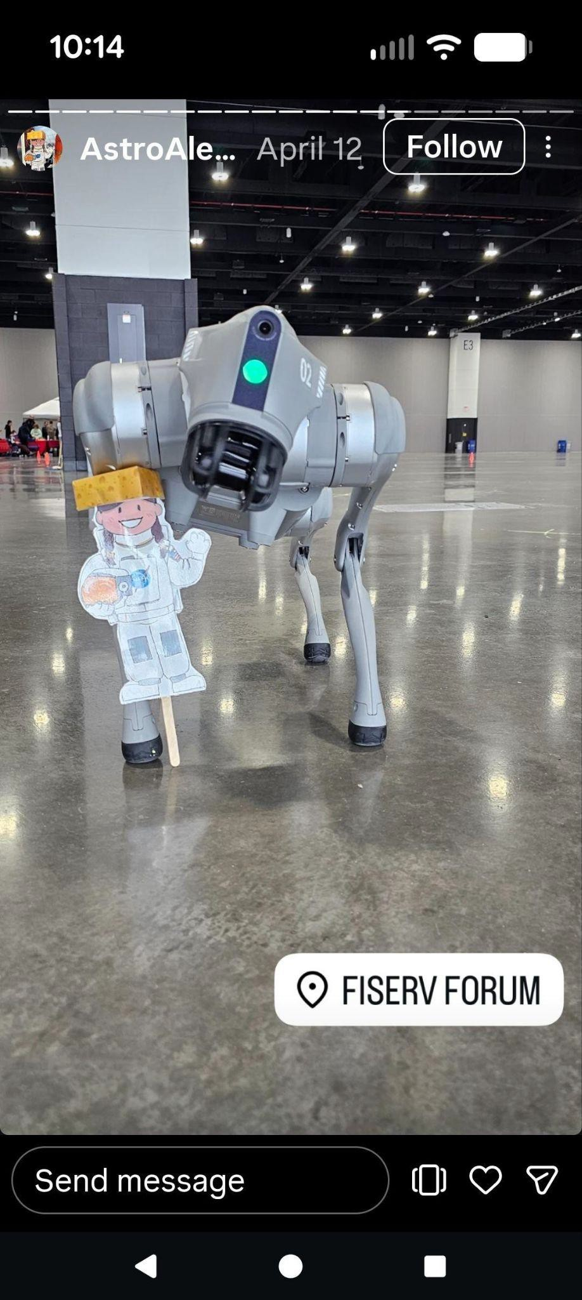
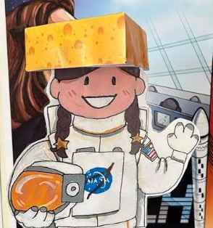
Tips
Involve aﬃliates
Add some ﬂare

Slide 21
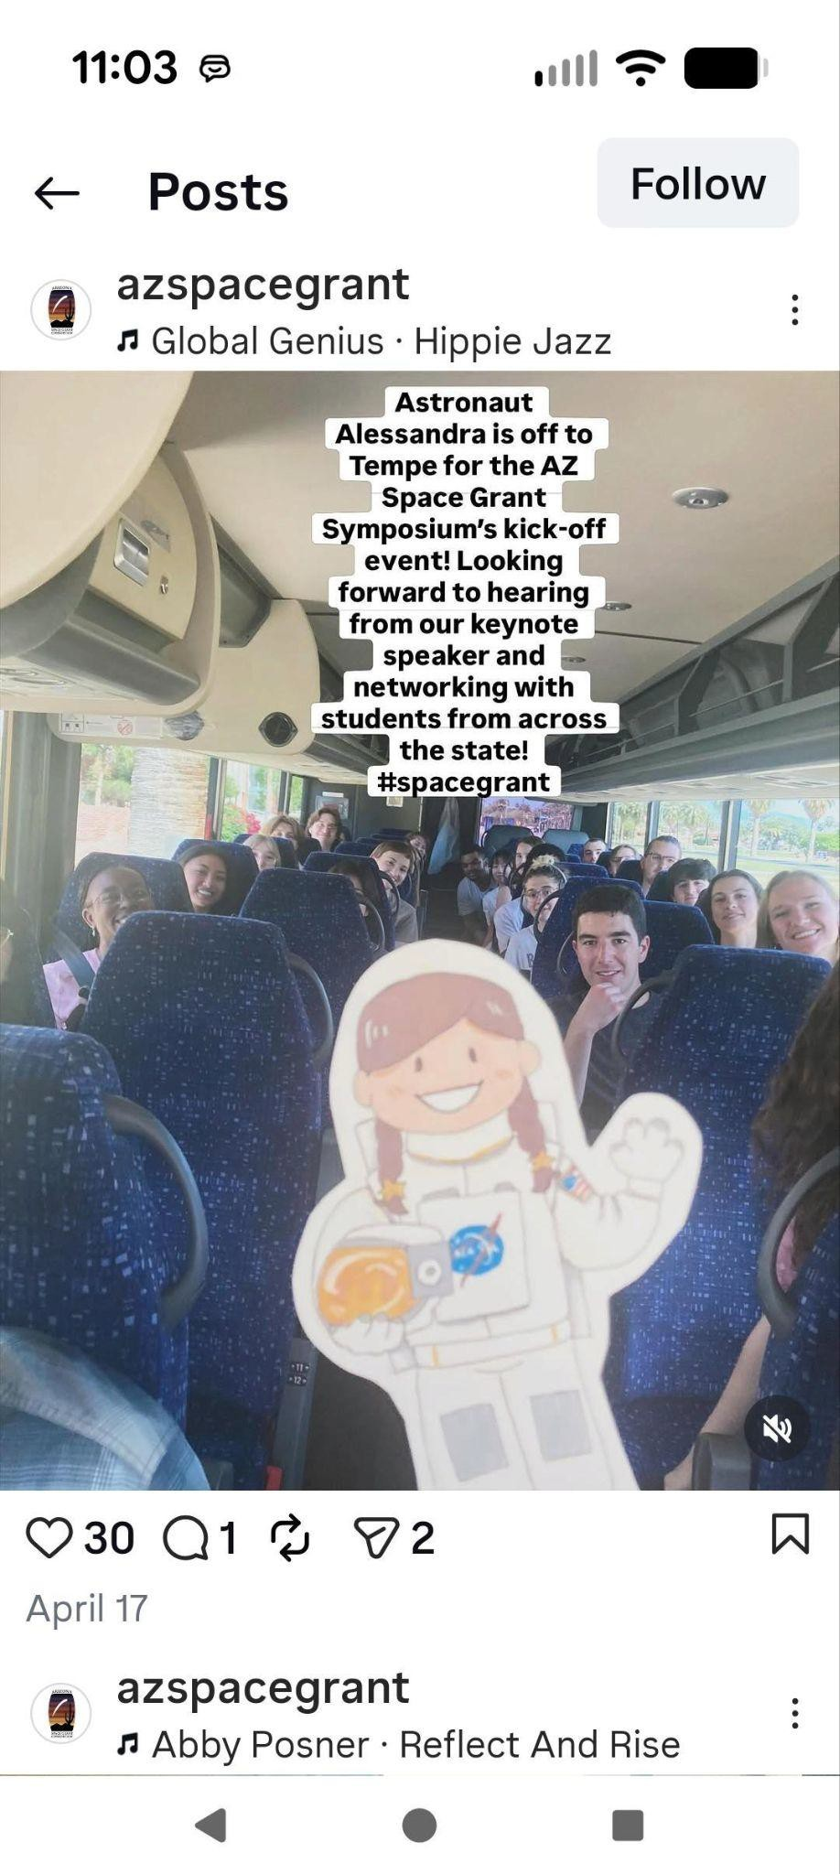
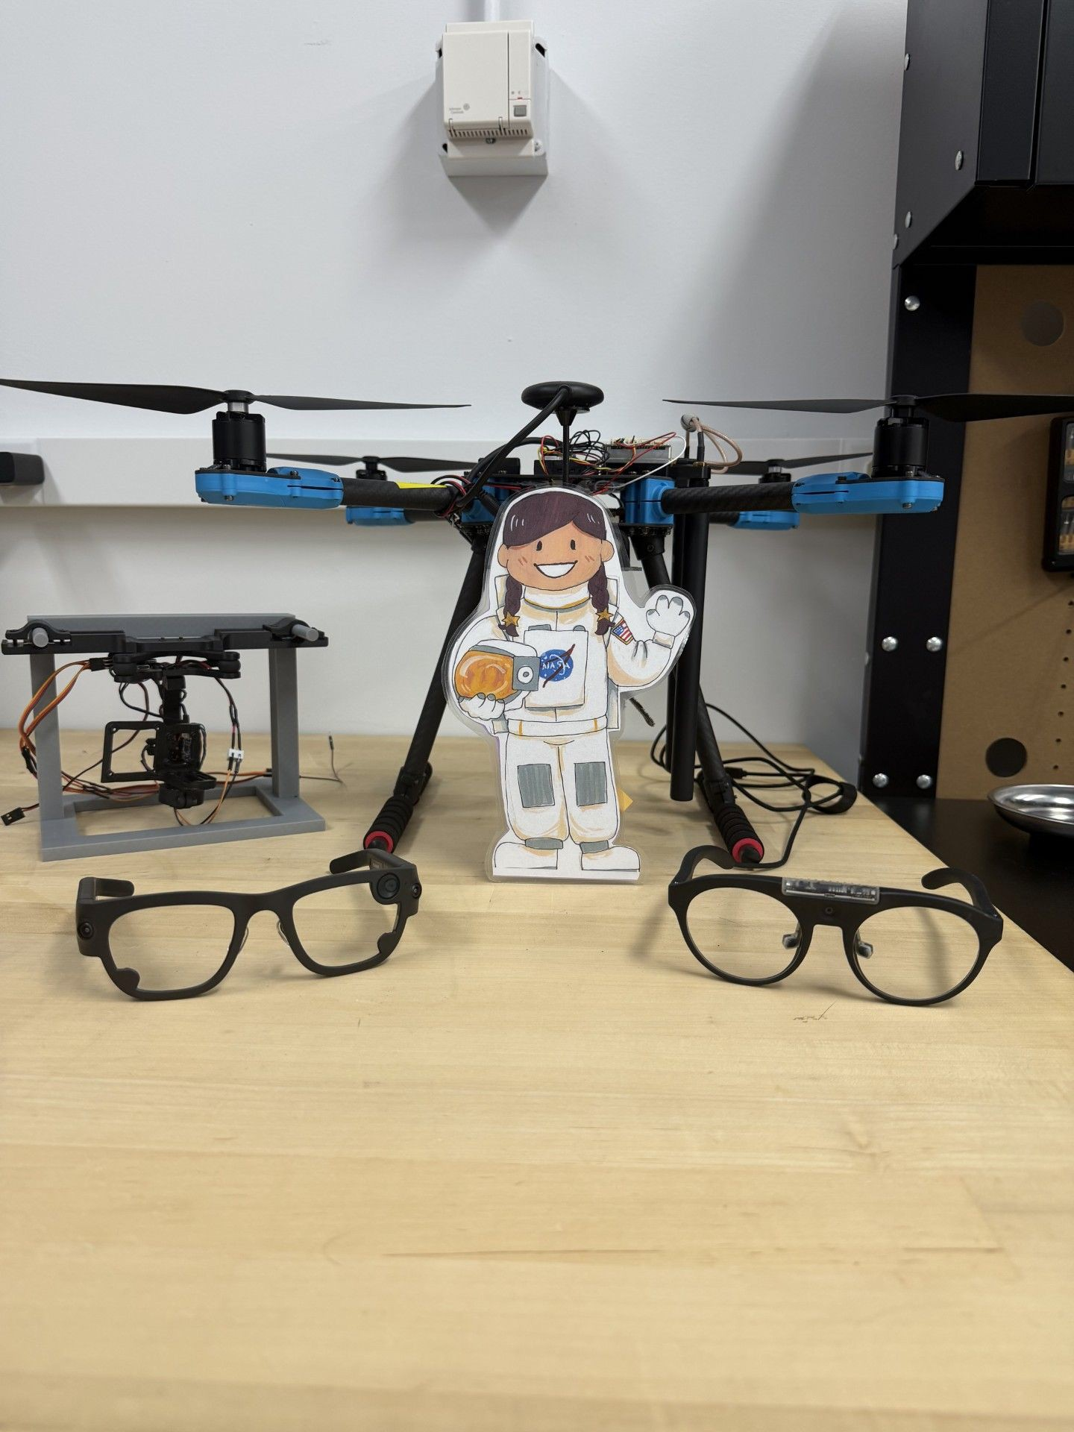
Tips
Center students’ work
Have FUN!!!

Slide 22

Mentor Pods: Updates
The Space Grant Communications Working Group Mentorship Pod Initiative connects Space Grant affiliates in small peer groups ("pods") to share knowledge, support one another, and build professional connections.
What is a Pod?
A pod is a small peer-mentoring group that expands on the traditional mentor-mentee model. Rather than relying on a single expert mentor, pod members learn from one another, share experiences, and provide ongoing support.
Why Participate? Pods help:
Welcome and support new Space Grant members
Provide resources and fresh perspectives for experienced members
Share knowledge and best practices across the Space Grant network
Strengthen connections within the Space Grant community
June 15, 2026

Slide 23
Current sign-up, people join pods for :
Grant and Program Management: Seeking support and ideas for grant management, sustainability, and growth, as well as learning from the successes and failures of programs elsewhere.
Outreach and Engagement: Interested in learning about successful practices for outreach, especially student engagement, and securing support with reaching students and mentors.
Space Grant Operations and Networking: Members want to better understand how the Space Grant network operates, gain knowledge about other Space Grant groups and the overall program, and share ideas.
Administrative and Technical Support: Seeking ideas on communication strategies (like affiliate meetings), website maintenance (specifically WordPress), social media/outreach channel management, and utilizing the NASA STEM Gateway platform.
June 15, 2026

Slide 24
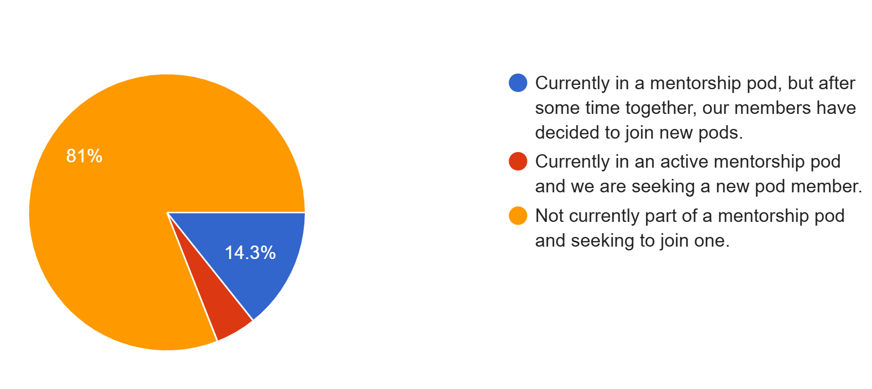

Pods Form Open through End-of-Day!
21 responses so far
There’s still time to join a pod!
June 15, 2026

Slide 25
1. Identify a speaker for the topic, if possible
2. Email macoe@arizona.edu & colleenf@lsu.edu
3. Remember, P3 sessions typically happen the 2nd Monday of the month and are for 1.5 hours. This includes opening comments, Q&A, and additional discussion time in addition to the presentation.
Future Promising Programs & Practices (P3) Sessions
Do you have a program to share? A method for best practices? An idea to pitch/collaborate with other Consortia?

Slide 26
Thank you for joining us!
Promising Programs & Practices (P³)
Hosted by the Space Grant Communications Working Group
Co-Chairs: Colleen H. Fava colleenf@lsu.edu & Michelle Coe macoe@arizona.edu
June 15, 2026
Notes:
Welcome - COLLEEN

