Slide 1


Space Grant Finance Survey
Summary
Susie Johnson

Slide 2

Survey Purpose
  Find common ground - and differences
  Figure out where there are questions and disconnects
  Identify topics for deeper dive at National meeting(s)

Slide 3

Survey Details
  30 responses
  Anonymous, unless willing to share
  Multiple choice and open-ended questions

Slide 4
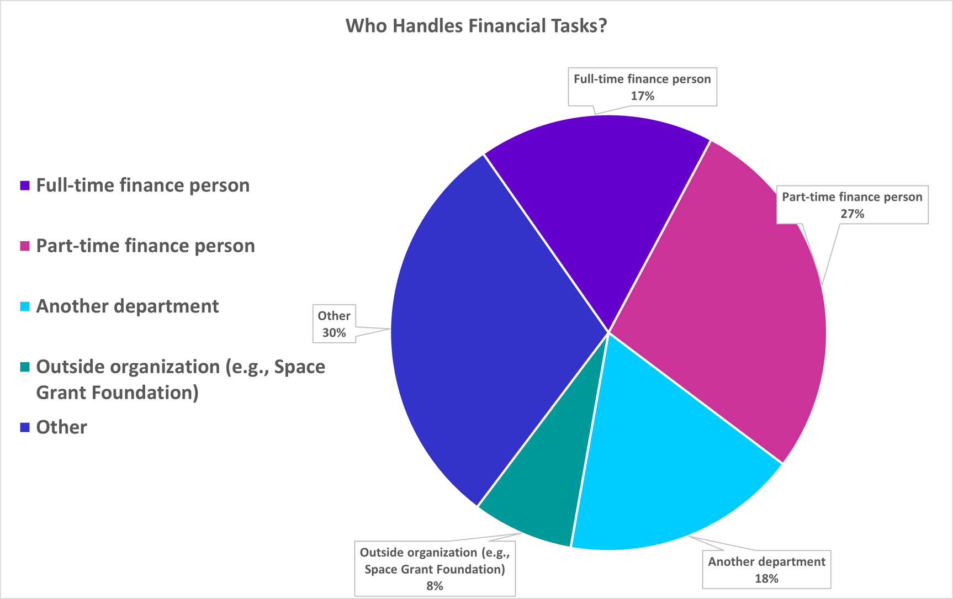
Finance Personnel
Who Handles Financial Tasks?
As expected, we all do things a little differently!

Slide 5
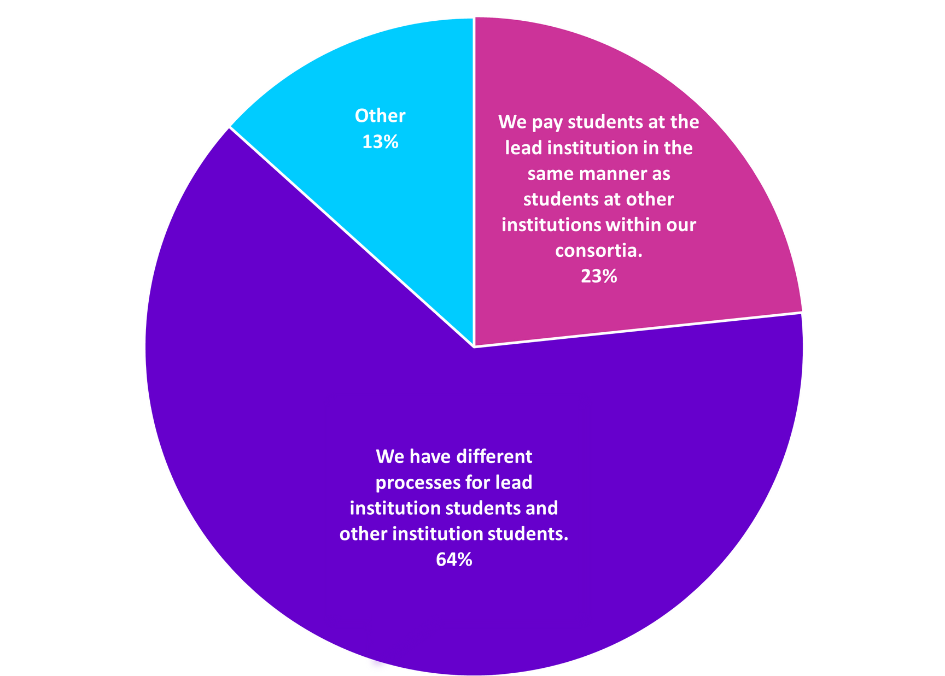
Paying Students
Lead Vs. Other Institutions
A majority of us have different processes for the lead institution vs. other institutions in our consortia

Slide 6
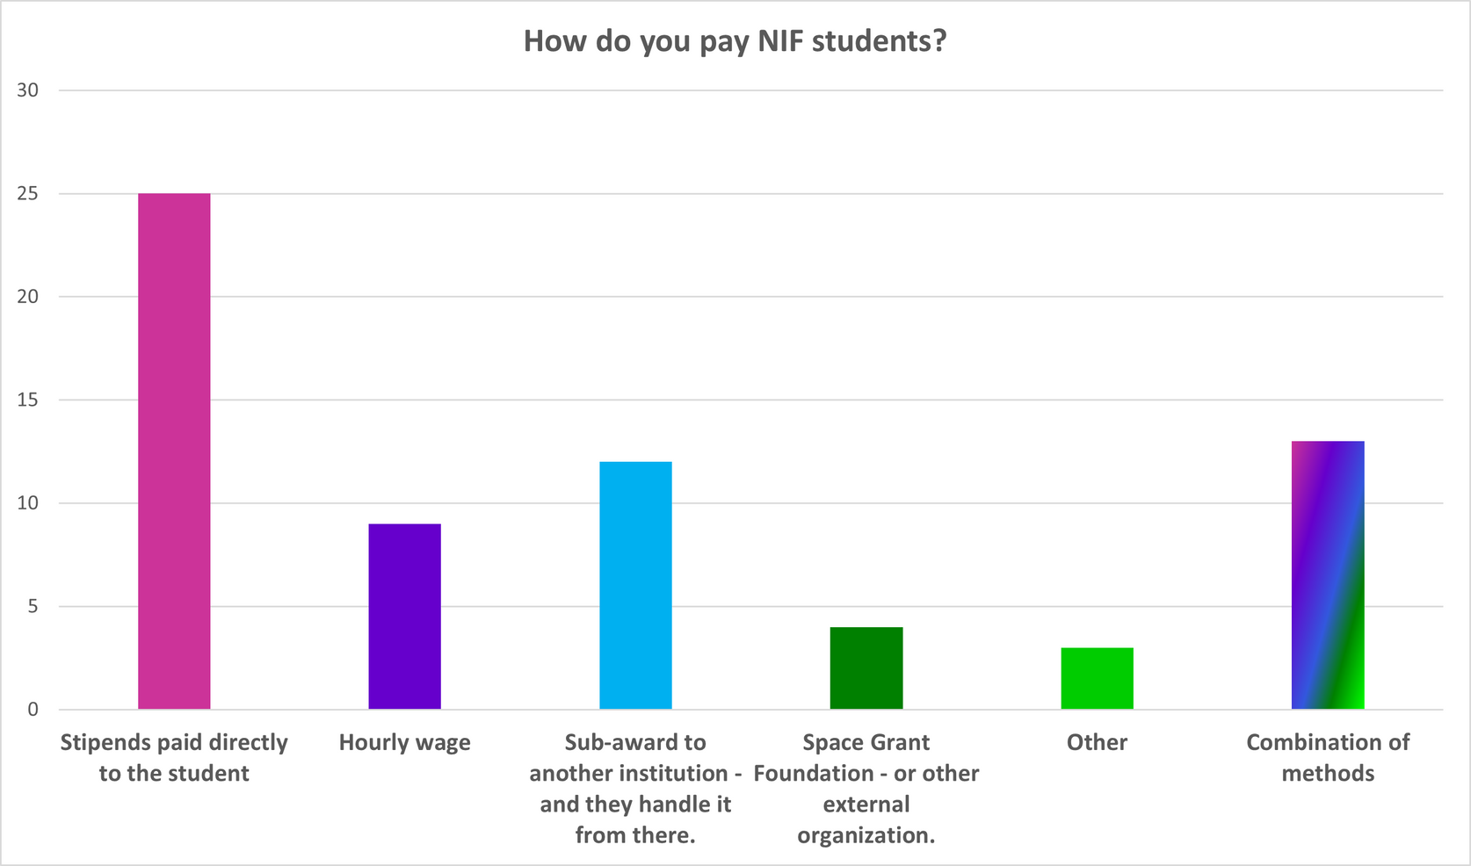
Paying Students
HoW Do you pay NIF Students?
  Most of us pay NIF students directly via stipend.
  A good number of us use multiple methods.

Slide 7
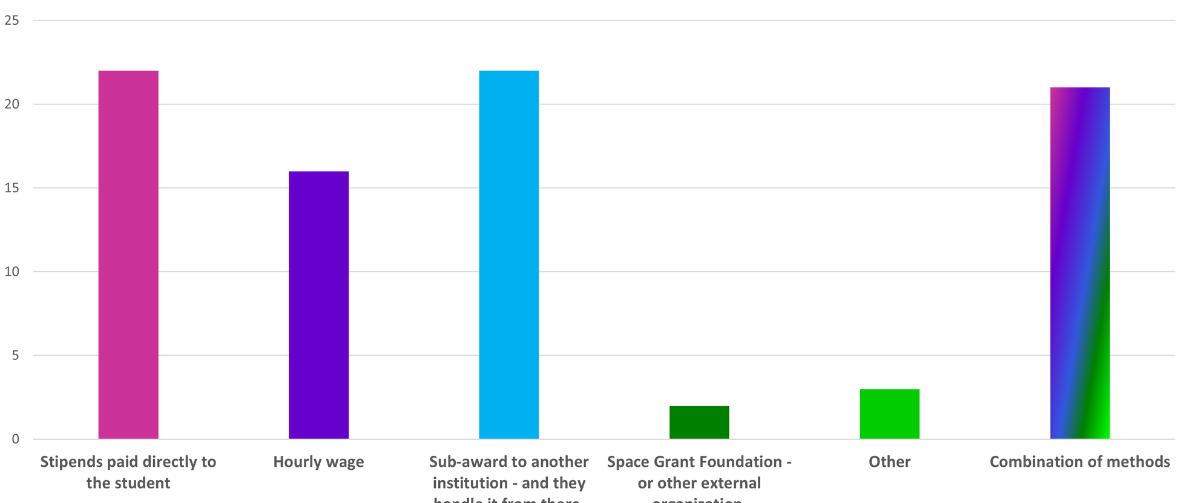
Paying Students
HoW Do you pay Students On projects?
A wide array of options for students funded on projects with most using a combination of methods.

Slide 8
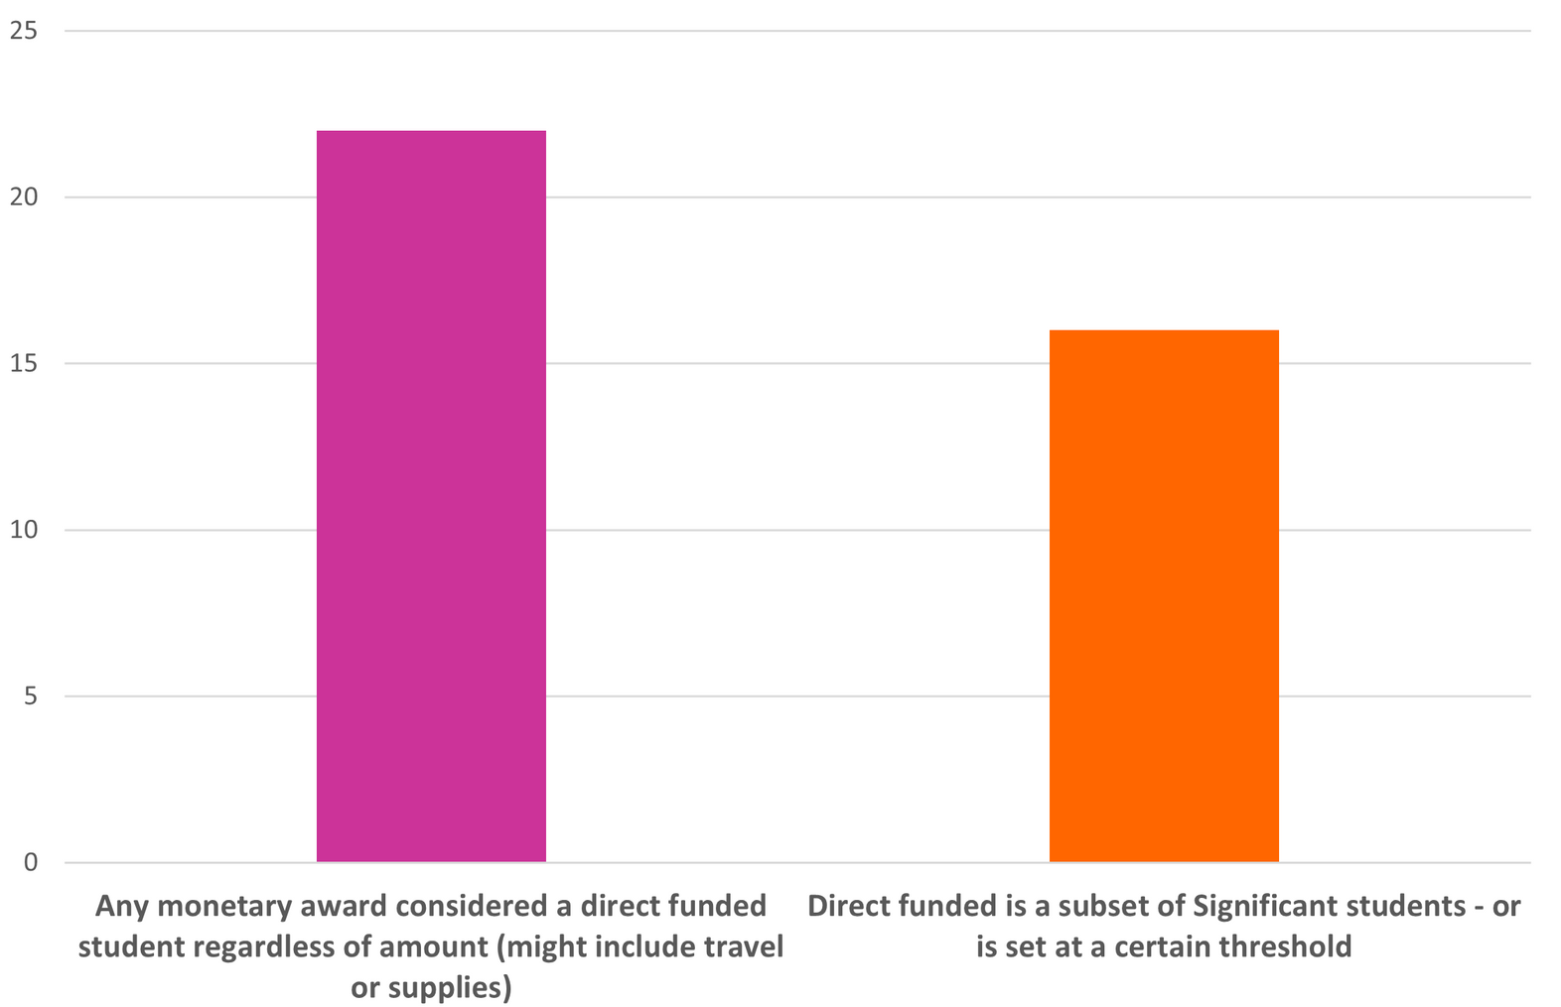
Direct Funded Vs Significant Students
Rough grouping based on open-ended responses.
We may have some disconnects here.

Slide 9
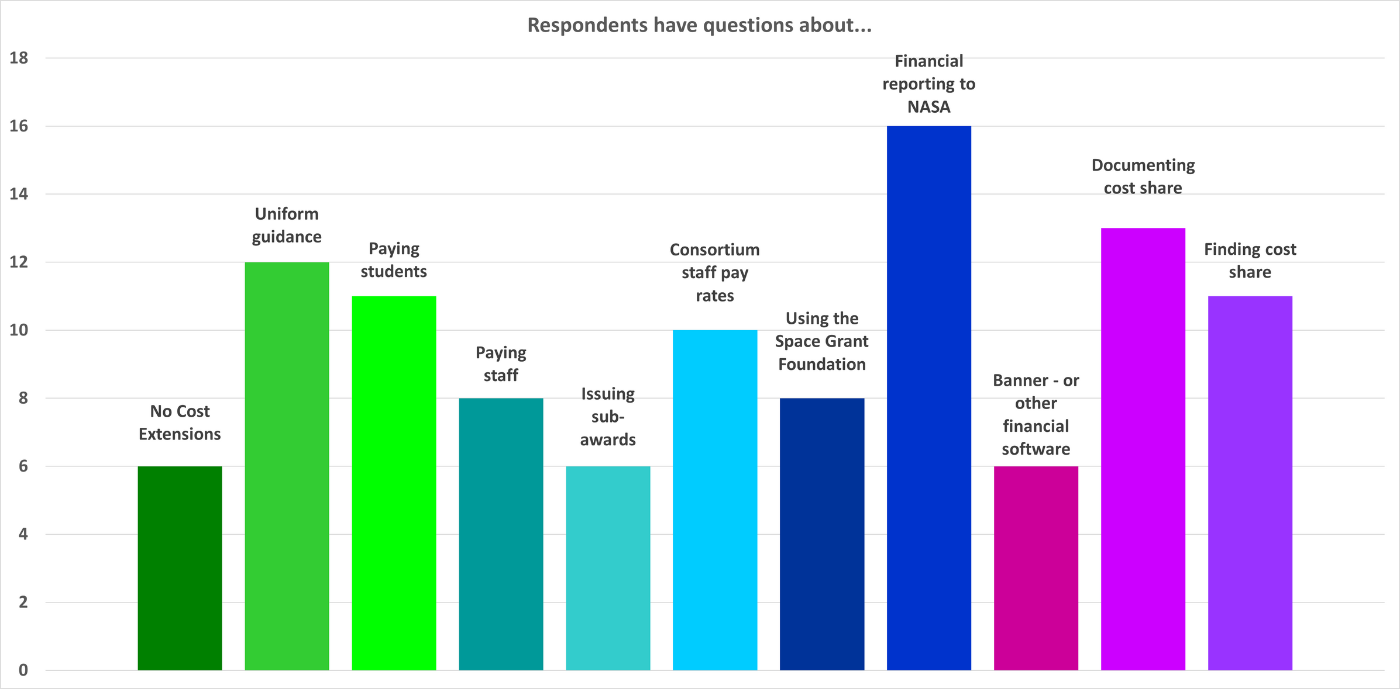
We have a Lot of Questions!

Slide 10
And Additional Areas of Interest
  Best practices for Gateway data collection and reporting, six-month, APD, etc.
  Federal language with regard to stipulation on stipend payments for students receiving financial aid.
  Best practices for accelerating the timeline between allocation and expenditure.
  Consortium staff pay rates and health benefits.
  Director's compensation and shared costs.
  Comparative timelines for competitive project solicitations.
  What kind of difficulties caused Consortia to not meet NASA's expenditure threshold from this past summer?
  Have other Consortia needed to refund sponsor funding after an audit?
  What records do other Consortia keep of sub-award invoice reimbursements, such as supporting financial documentation (receipts, etc)?

Slide 11
And More!!
  Is there a central area where we can access Space Grant related information?
  Would like more documented and uniform guidelines from NASA .
  Best practices for staffing in high-cost areas and how to balance staff salary vs. student support.
  Discussion on incremental funding for a given fiscal year due to Congress passing funding authority in increments (CRs, etc) and how it complicates our subaward paperwork since each increment of funding must be processed as a subaward amendment.
  What are the guidelines in how long a Director can be the Director or is there a process to have another individual compete for the position?
  Paying for NASA Center Internships from State Space Grant Funds.

Slide 12
Next Steps and Action Items
  Identify preferred format for DC meeting (Discussion, panel, speed dating on topics, etc.)
  Identify most useful topics
  Identify volunteers to help facilitate DC meeting

Slide 13

THE END?

