Slide 1

The Maine Space Complex:
Building Maine’s Space Knowledge Cluster
Terry Shehata, Ph.D.
Executive Director
Maine Space Grant Consortium

Slide 2
We want to capitalize on the increasingly accessible Space to..
Encourage people from Maine with STEM education or experience who moved away to return
Retain Maine’s students and Immigrants with STEM degrees.
Attract highly skilled workers and their families from out of state.
Encourage startups and spur development in all seven technology sectors.
Develop globally based applications for research, commercial and consumer uses.
Help our existing industries solve challenging problems and grow.
Facilitate STEM learning opportunities for K-12 and higher education students to aspire for space-related careers in Maine.
Promote economic aspirations for All Mainers.
Advance Maine to a new competitive level in a fast-growing Knowledge Economy.

Slide 3
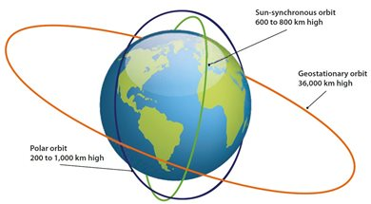
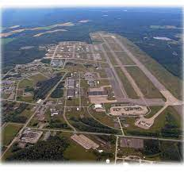
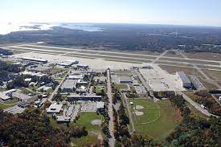
Maine’s Space-Related Assets: People, Organizations and Locations
Sun-synchronous orbit
375 to 500 miles high
Geographic location for polar orbits
Coastline for land-based and sea-based vertical launches
Physical assets for horizontal launches and more
Small but growing supply chain
Maine-based launch providers
Education and public and private R&D assets in Maine and New England
Established Innovation Ecosystem
Geostationary orbit
22,400 miles high
Polar orbit
125 to 620 miles high
Loring Commerce Centre
(former Loring Air Force Base)
Brunswick Landing
(former Brunswick Naval Air Base)

Slide 4

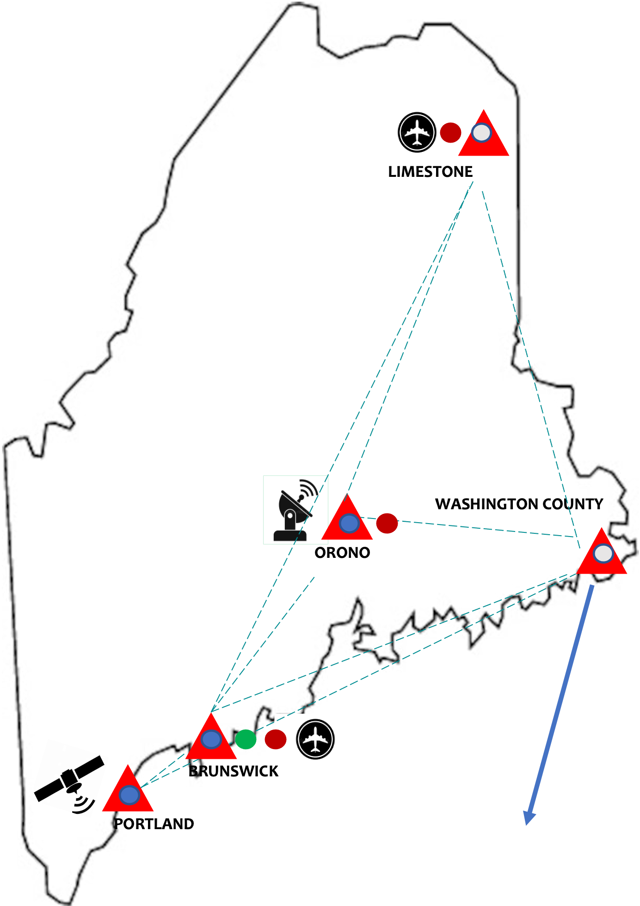
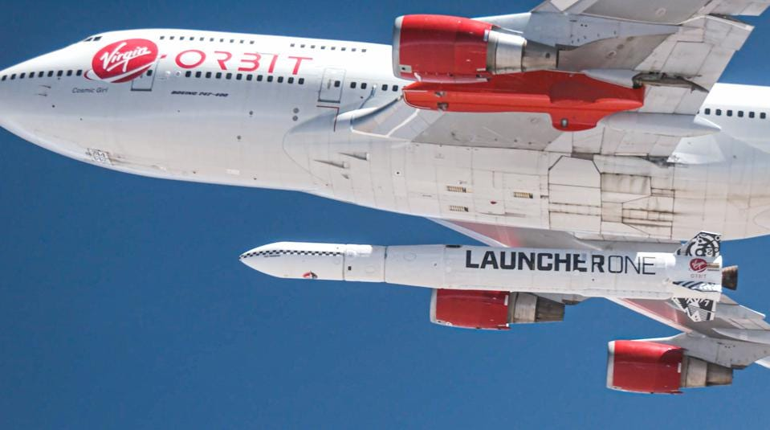
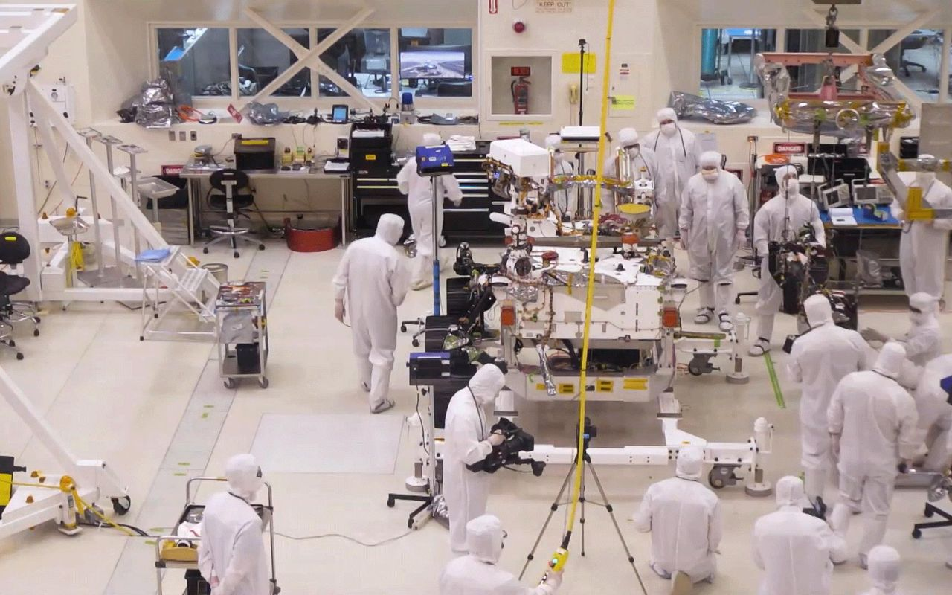
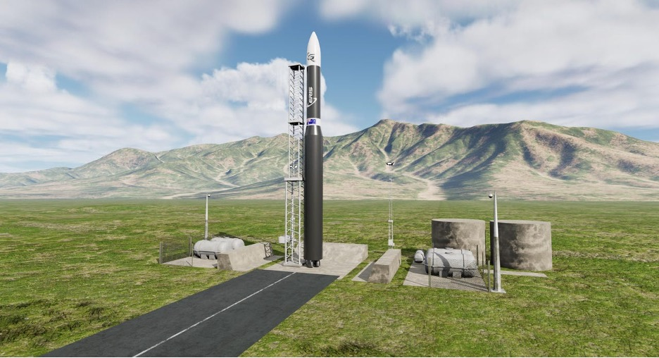
The Maine Space Complex is our North Star that will guide our engagement in the new space economy in a manner that learns from, honors and builds upon Maine’s seafaring heritage while forging forward in an environmentally safe and sustainable way.
Space Data & Advanced Analytics Center
1
The Launch Sites & Services for horizontal and vertical launches
3
The Maine Space Complex includes three shared-resource based and geographically distributed business units, bringing benefits throughout the State
Space R&D and Innovation Hub
2
Notes:
Limestone – large hanger, former AF Base
Orono - ASCC WiSE-Net Labs, UMaine in Orono is the largest R&D entity in the state of Maine with over $160M research, home to ISS Ground Station

Slide 5
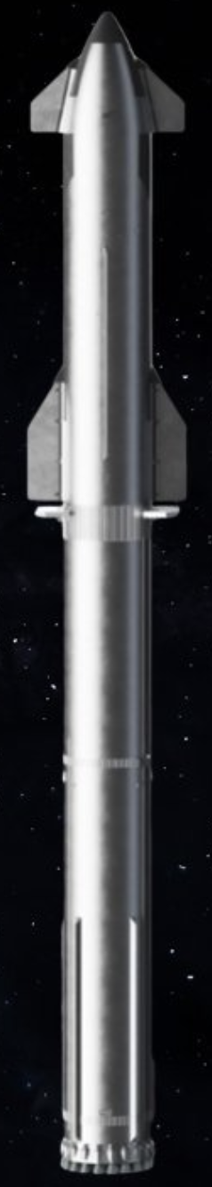
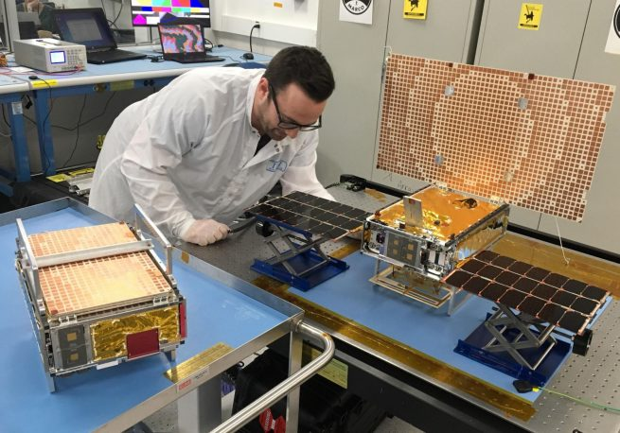
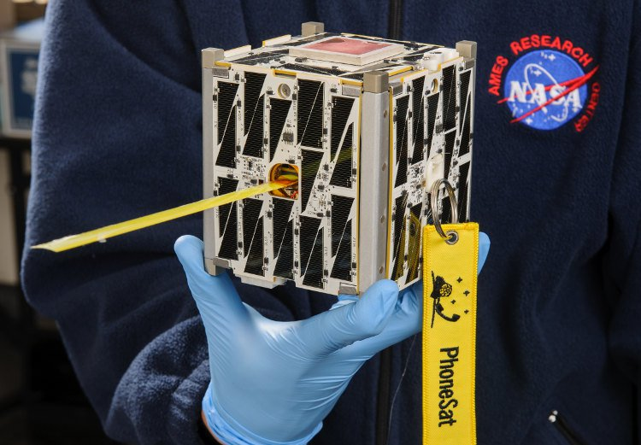
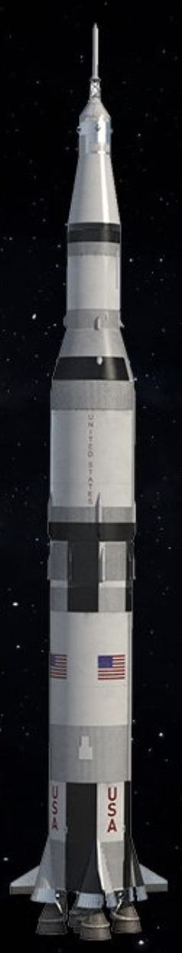
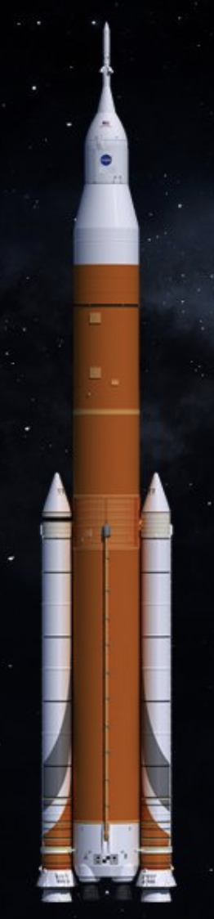

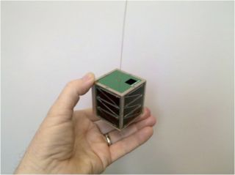
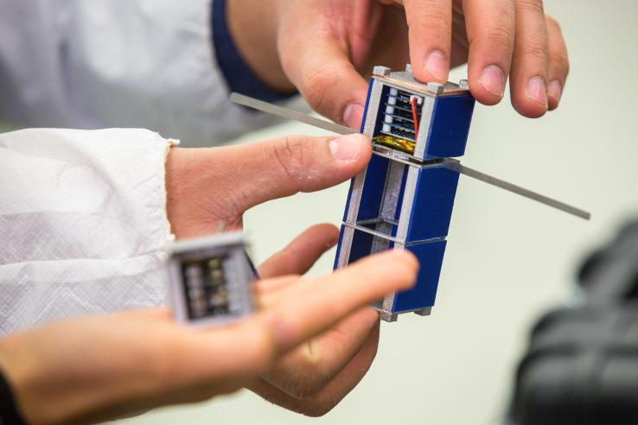
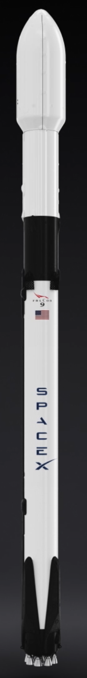
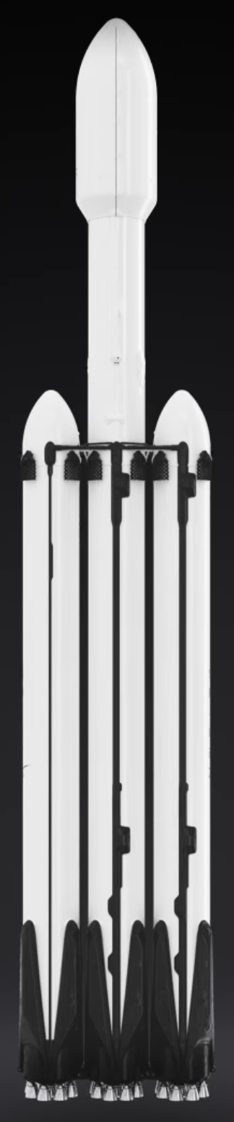
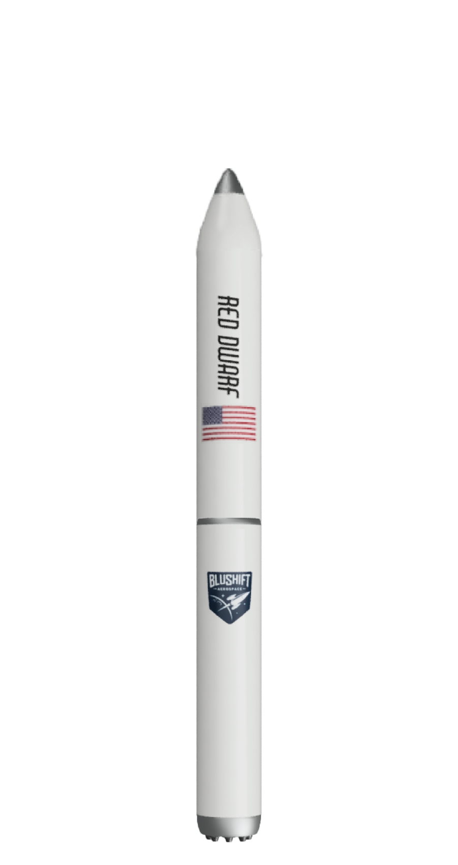
Small Satellites
Small Launch Vehicles
Example of Maine’s focus on small launch vehicles
Micro – NASA’s Mars Cube 1
Nano - CubeSat
Pico
Femto
Size
Wet Mass
Femto-satellite ≤ 0.1kg
Pico-satellite ≤ 1kg
bluShift Red Warf
Statute of Liberty
305 feet from the ground to tip of torch.
NASA Artemus SLS
322 feet
78 ft., polar low-Earth Orbit, green fuel powered hybrid engine, non-toxic, bio-derived solid fuel
SpaceX Falcon 9 and Heavy.
Both 230 feet
NASA Saturn V
364 feet
SpaceX Starship
394 feet
Nano-satellite 1 – 10kg
Micro-satellite 11 – 100kg
Mini-satellite 101 – 500kg

Slide 6


The Maine Space Complex is not simply about launching smallsats and small rockets…
… but about engaging Mainers across the New Space value chain and its underlying infrastructure in a manner that (a) benefits Maine directly, and (b) contributes to the development of technologies that gets us back to the Moon and beyond.
New Space Value Chain
Throughout the space exploration process, we learn and create products and services that help solve problems on Earth and improve our lives.
Applications Tailored to a Variety of Industries

Slide 7
The Maine Space Corporation
(LD 1923 signed into Law on April 18, 2022, became effective August 2022)
17 members Board of Directors
6 ex-officio
11 from business, research, investment, communities
Confirmed by the Legislature
Maine Space Corporation
(5 MRSA c. 393)
Quasi-independent state entity
Tax-free bonding authority
Prioritizes Maine-based businesses for launch sites and services that minimize the environmental effects of their space vehicles and launches
Board of Directors
Center for Space Data & Advanced Analytics
Vertical and Horizontal Launch Sites and Services
Space Innovation Hub
Restricted to research, commercial and education uses
The Corporation shall leverage the State's geographic, rocketry, manufacturing, and higher education assets and capabilities to establish the State as a national and international industry destination and an authority in launching small launch vehicles and small satellites into polar orbit. (signed into law April 18, 2022)
Maine Space Complex
Leveraged Entrepreneurial Ecosystem

Slide 8
Thank You

