Slide 1
Welcome!
Promising Programs
& Practices
November Session

Slide 2
Promising Programs & Practices (P3)
A monthly session for, and by, the National Space Grant Community
November 2022 Session Featuring:
Michelle Coe (AZ), Debbie Murray (VA), and Melanie Page (WV)
Resources & Best Practices for Mentors
November 14, 2022
Colleen Fava (colleen@lsu.edu) and Michelle Coe (macoe@arizona.edu)
Co-Chairs of the Space Grant Communications Working Group

Slide 3
Promising Programs & Practices (P3)
Intent:
Allow community members a dedicated space and time to share promising programs and practices with the greater space grant community.
Format:
2nd Monday each month at 3 pm Eastern (60-75 min)
  Zoom Meeting
  3:00 pm: Ice breaker/Announcements
  3:15 pm: Featured Presentation with Q&A (recorded)
  3:55 pm: General Discussion

Slide 4
ICEBREAKER
The holiday season is upon us! What is one dish your family enjoys during this time of year? Or what is your favorite dish to enjoy this time of year?

Slide 5
Announcements
October 10th P3 Session: Planning Meeting
  19 Participants
  14 unique Space Grant states in attendance
  63 minutes
  Resulted in some great ideas for future P3 sessions
December 12th P3 Session [tentative]: What to expect / how to speak to your Congressional Folks
Coming Soon: Communications Working Group Listserv
Next Round: The Space Grant pod mentorship GoogleForm is opening up this week for pod matching. Make sure to sign up!

Slide 6
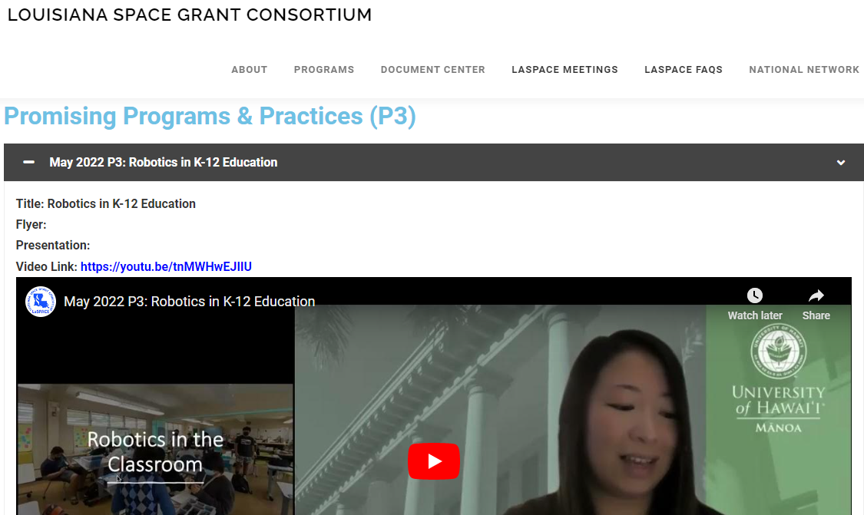
Announcements Continued…
New P3 resources website! https://laspace.lsu.edu/promising-programs-practices-p3/

Slide 7
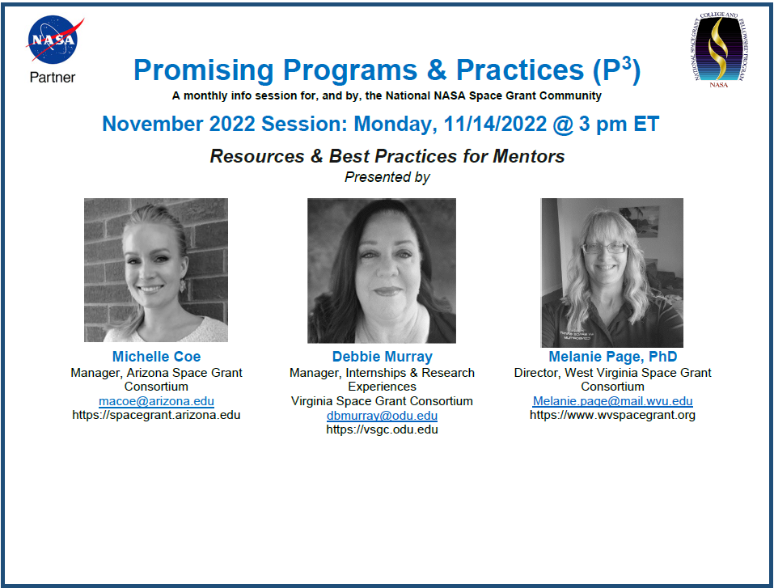

Slide 8
Session Description
Many Space Grant Consortia award undergraduate internships, where students work alongside a mentor at their college or university on a research project. While we as Space Grant management may have a hand in some of the internship process (application, selection, and management), we are not always the person that our interns work with day to day.
Our mentors play a key role in this area and are representatives of the Space Grant program in our state. Mentors are instrumental in how our interns view Space Grant, understand how to act in a professional space, perceive what it’s like to work in a particular field, and how to be excellent mentors themselves in the future.
So how do we prepare our mentors to be the best mentors they can be, and to represent our Space Grant programs? What guides, resources, and trainings are offered to the mentors that work directly with those students, and what do we want to improve upon in the future?

Slide 9
Today’s Outline & Quick Note
Presentation Order: Michelle Coe, Debbie Murray, Melanie Page
Discussion with Attendees
Note: Resources posted to a shared GoogleDrive. The link to this drive will be periodically posted in the chat box and available following this meeting.
https://drive.google.com/drive/folders/1hRdqihhKW8bjOU_94yqoL3I2Ovu0lgvY?usp=sharing

Slide 10
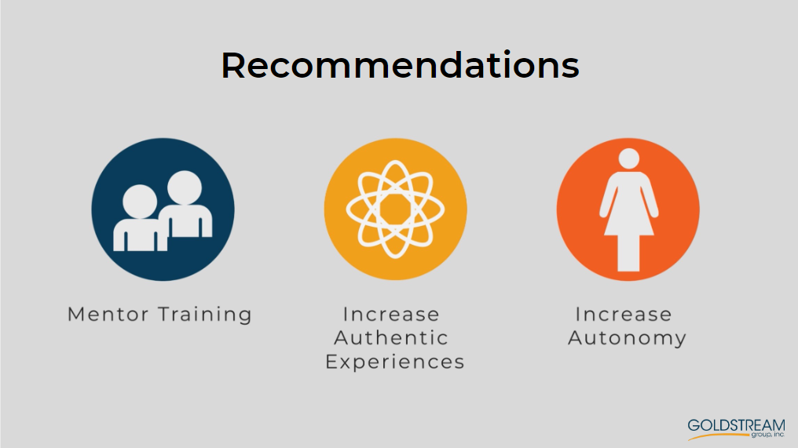
Purpose of Today’s Session
Notes:
Mentors are the face of our programs in a lot of instances. They have the most interactions with our interns. May have the biggest impact in terms of a student’s STEM identity.

Slide 11
Quick Background: Arizona’s Mentors
Focusing on the University of Arizona’s Space Grant undergraduate mentors
Both interns and mentors apply to this program
Space Grant Committee can match interns/mentors if they don’t apply together
Interns and mentors work together on research project during the academic year (August – May)
More than half of selected mentors tend to be repeat mentors of the program
Space Grant provides:
  Intern Hiring and Payroll Approval
  Intern Funding
  Intern activities, workshops, professional development (~2x per month)
  Larger Events (Symposium) and opportunities (NASA Center Internships, etc.)
Mentors are contacted by Space Grant management frequently during the start of the program, and then at least every other week for the duration of the program.
Mentor “face time” only occurs a few times during the year (orientation, some events, Symposium).

Slide 12
Resources Provided to Mentors
A ‘Welcome Packet’
  Invitation to Mentor Orientation
  Information about contacting your intern
  Information so that mentors know what interns are receiving
  Hiring interns, Payable Hours
  Contact Sheet
  Important Dates/Deadlines/Deliverables sheet
  Intern Requirements and dates so mentor is aware
  Miscellaneous: please send us highlight stories, where to submit publications, etc.

Slide 13
Resources Provided to Mentors Cont…
Mentor Resources
  Meeting Your Intern – Outline & Suggestions
    Who contacts who and how
    Responsibilities
    Time Management
    Meetings (one-on-one is key!)
    Goals for the year
    Working Space (virtual & in person)
    Future Meetings
      Timeline to symposium, setting weekly goals
      Tips for a great meeting (weekly goals, review progress, set new goals, repeat)
    Build a network of mentors
    Other Consideration: Covid, family responsibilities, etc.

Slide 14
Resources Provided to Mentors Cont…
  Also included in the Welcome Packet
  Edge Learning (LinkedIn Learning) tutorial, “Becoming an Inspiring Mentor”
  Free materials “Mentoring the Next Generation: Using Undergraduate Research to Broaden Engagement & Impact in STEM”
  Undergraduate Research Mentoring Agreement Form
  Mentor Code of Conduct

Slide 15
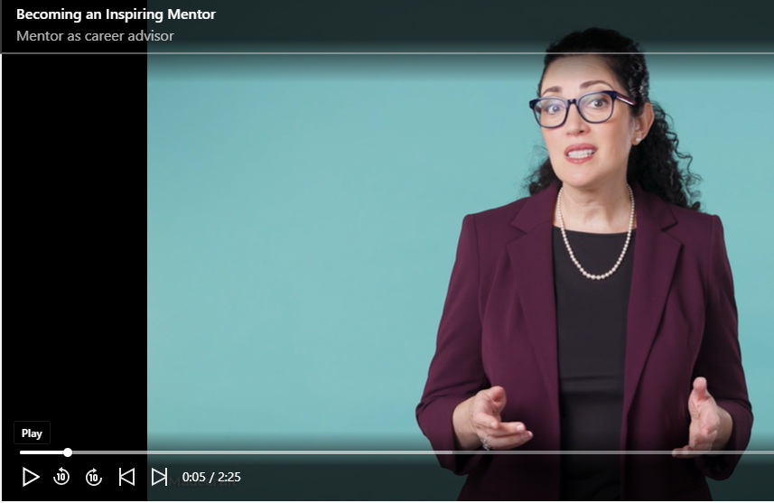
Edge Learning: Becoming an Inspiring Mentor
Your role as a mentor
Helping your mentee overcome self-doubt
Develop goals and milestones
Active mentoring missteps
Passive mentoring missteps
Develop a mentoring team
Mentoring through differences
Amplify your mentee’s work
Notes:
This is 47 mins and doesn’t include breaks for creating your own XYZ form. That’s what some of the other resources are good for is creating an actual written document or self-reflection time. I find this as a great overall guide.

Slide 16
  Mentoring the Next Generation: Using Undergraduate Research to Broaden Engagement & Impact in STEM
Center for the Advancement of Research Impact in Society (ARIS)
Free materials
Comprehensive guidebook broken down in several chapters to review how to be an effective and inclusive mentor, how to build community, interact with mentees, and much more. The information in this material is easy to digest, and the most relevant portions (Destination 2, 3, and 4) take no more than 1 hour to fully read through. If you choose not to review this content, we highly recommend at least reviewing the information in Destination 2: Establish Clear Expectations, which provides an example mentor/mentee undergraduate researcher agreement.
Source: https://broaderimpacts.netlify.app/undergraduate-research/index.html#/

Slide 17
Undergraduate Research Mentor Agreement Form
What is a mentor agreement?
“Mentor agreements outline goals, expectations, accountability and other aspects of collaborative work and are ideally drafted in partnership with students near the beginning of major projects. Given the open-ended nature of academic work, these agreements can be considered "living documents" that can be modified as conditions and goals change.”
Source: https://undergraduate.oregonstate.edu/research/sample-mentoring-agreement
Notes:
This provides templates of different mentor agreements, but also questions / examples that are extremely helpful in figuring out what you want in your mentor agreement as well.

Slide 18
[Example] What I expect of my intern / What my intern can expect of me:
1. Read assigned background information and complete trainings by X date.
2. Send an email update every Friday by 5pm describing 1) the projects/tasks you completed this week, 2) any challenges you are facing or questions you have, and 3) what you plan to do the following week.
3. Attend our research team meetings every other week to discuss all of our individual projects and how to troubleshoot challenges and work collaboratively.

Slide 19
Mentor Code of Conduct Form
Modeled after the Colorado Space Grant Consortium’s Community Guidelines
Includes ways to anonymously submit forms on our website if there is an issue. Includes university-specific ways to take action, and our responsibility as staff
  https://spacegrant.arizona.edu/students/commentform

Slide 20
Evaluations
Weekly email communication with interns (every Friday)
Bi-weekly email communication with mentors (every other Monday)
~2x events per month with interns
October check-ins
Late January check-ins
Mid-Year evaluations (interns and mentors)
Year-End evaluations (interns and mentors)

Slide 21
NASA Langley Research Center
A Beginners Guide for Students Entering their first Research Internship Program
https://www.orau.org/stem-workforce-solutions/opportunities/stem-professional-training-modules.html
The Science of Effective Mentorship in STEMM https://nap.nationalacademies.org/resource/25568/interactive/

Slide 22
Future Changes & Ideas
Future Changes
Do I know if mentors use these resources – no!
  This is an area that I need to start evaluating
Ask mentors to provide evaluation over the summer (~3 months) after the program ends. Evaluation could be anonymous.
Give evaluation feedback to mentors, not just to SG staff.
Ideas
How to make sure mentors are actually doing these trainings?
  There are tons of resources out there. Pick a few (maybe 2-3 hours total) and provide them to mentors. Spread requirement out, at least 1 hour of trainings per semester?
Would be great to have more trainings for interns beyond orientation sessions so that they could better advocate for themselves. Train the students on what makes a good mentor and how to recognize problems.
Provide information on imposter syndrome to interns/mentors. This is a big issue in not only seeing yourself in your research, but not seeing yourself in your mentor.

Slide 23




Space Grant P3 Session:
Internships Best Practices
and Resources
Debbie Murray, Manager, Internships and Research Experiences
Virginia Space Grant Consortium

Slide 24

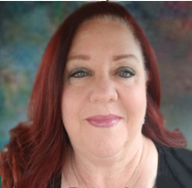
Presenter Information
Brings almost 34 years of student internship and faculty fellowship experience.
NASA Langley Aerospace Research Summer Scholars (LARSS) - 1900+ interns
VSGC’s STEM Takes Flight NASA Research Experience with Virginia’s Community Colleges – 199 student researchers
Commonwealth STEM Industry Internship Program (CSIIP) – 863 intern placements with 126 companies

Slide 25
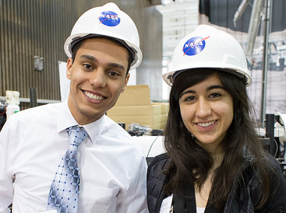
Internships and workforce development are key to the VSGC programs.
Approximately 6,500 students placed in paid internships with NASA, other federal labs and industry.

Slide 26
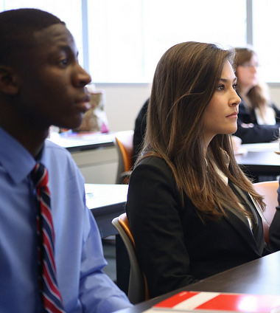
Value Proposition for Students
Why is an internship important to students?
Real world training and knowledge application.
Test drive their interests and career choices.
Hone soft skills - confidence building, teamwork, communication.
A link between academic learning and professional employment.

Slide 27
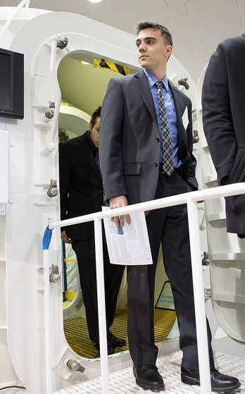
Value Proposition for Students
Professional networking and exposure to field of choice.
Links to mentors and future references.
Make students more competitive for post graduation job market.
Foot in the door to potential permanent employment.

Slide 28
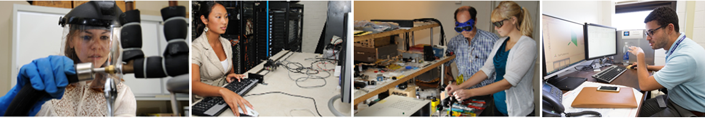
Value Proposition for Companies
Can test drive potential future employees and do so relatively inexpensively.
A way to train future employees.
Previous interns pool first consideration for employment.
For Federal Labs, part of mission to help ensure future STEM workforce.
Students bring fresh energy and cutting-edge ideas.

Slide 29
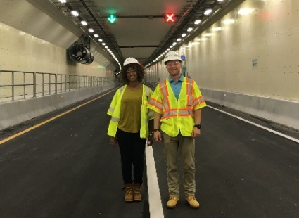
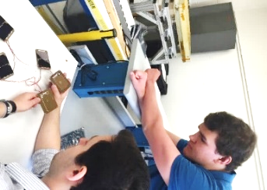
The Telegraph May 6, 2017
Student interns 'three times more likely to get top jobs'

Slide 30

Hart Research Associates – Association of
American Colleges and Universities (2018)
More than 90 percent of the employers surveyed say that they would be more likely to hire a recent graduate who has held an internship. This is huge for STEM graduates.

Slide 31
Internship Best Practices – Host a Mentor Training Session
Engineering for Success
Written job description with tasks utilizing intern’s knowledge and skills.
Ensure that planned work is meaningful to student and employer.
Program guidelines/handbook with intern expectations. It’s important the student understands expectations.

Slide 32
Internship Best Practices – Mentor Training Continued
Engineering for Success
Written job description with tasks utilizing intern’s knowledge and skills.
Ensure that planned work is meaningful to student and employer.
Program guidelines/handbook with intern expectations. It’s important the student understands expectations.

Slide 33
Internship Best Practices
Tips to Being a Successful Mentor
The impact of a mentor and internship can be life changing.
Be passionate about your career and share your story.
Be patient and understanding, the intern is still learning.
Get to know the intern, and their passion and goals.
Introduce them to all employees.
Make them feel welcome and a part of the team.
Be present, be available.
Encourage questions and have discussions.

Slide 34
Internship Best Practices
Host an Orientation
Before the Orientation, share date, time, dress code and what to bring in terms of ID and security checks. If virtual, adjust.
Welcome and overview of the company.
Suggested briefings: security, safety, IT security, sexual harassment, non-disclosure/patent.
If time allows, have an ice breaker activity.
  10 minutes to meet and gather contact info from 2 people
  Share name, school, major, email and phone number
Maybe a tour of the facility.
At conclusion, be sure intern knows where to go.

Slide 35

Internship Best Practices
Where is My Desk? Don’t Forget the Basics.
Set up workstation:
  computer,
  printer,
  desk,
  phone,
  chair,
  trash can.
Provide email and phone number.
Provide list of important contacts.

Slide 36
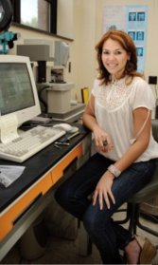
Internship Best Practices
Internship Components – Impact the whole person.
The project – defined, primary objective.
Explain the project value – How it fits into the company Mission.
Introduce to the team/other offices and have them share their roles.
Share available resources.
Shadow and participate in meetings when appropriate.
Host a luncheon with senior management.
Invite to social events for networking, a very important part.
Host a new employees/interns networking event.
Suggest available training and classes.
End with a presentation, report, evaluation and recognition.

Slide 37


Why Network from a Professional Viewpoint
Importance of Networking and Business Etiquette
“It is crucial in terms of career and advancement!”
“It opens the door to resources and opportunities that may not otherwise be opened.”
“It allows you to interact with potential colleagues who can give perspective and share their experience. Why reinvent the wheel when someone has already done it? Learn from their experience.”
“It is a critical skill needed to do your job more effectively.”
“There are limited resources and the job market is very competitive with many people pursuing the same position. Good networking skills can give you the advantage.”

Slide 38
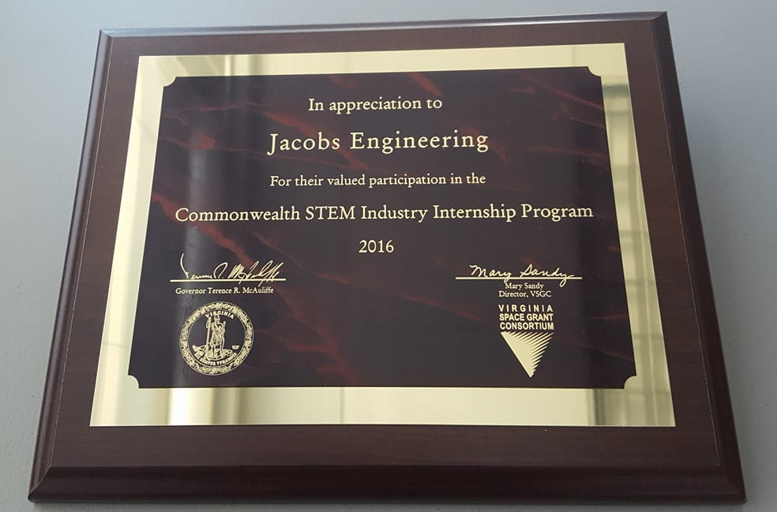
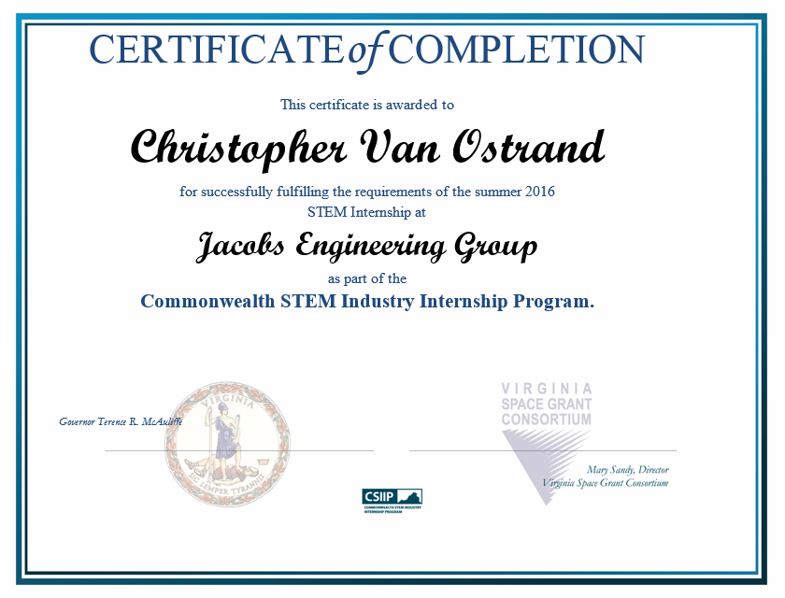
Internship Best Practices
Recognition – Show Mentor/Student are Valued
CSIIP - Participating companies receive plaques signed by Governor.
CSIIP - Students receive certificate signed by Governor.

Slide 39
Meet the Team:
Mary Sandy, Director
msandy@odu.edu; (757) 766-5210
Debbie Murray, Internships Manager
dbmurray@odu.edu; (757) 766-5210 w/(757) 880-6591 c
Scott Bellows, Technical Programs Coordinator
abellows@odu.edu; (757) 766-5210
Nicole Shaw, Program Coordinator
lnshaw@odu.edu; (757) 766-5210
Virginia Space Grant Consortium

Slide 40

NASA West Virginia
Space Grant Consortium
NASA WV EPSCoR
Melanie Page, Director
Candy Cordwell, Assistant Director
Kisstaman Epps, Program Coordinator
Alyssa George, Admin Assistant
P3 November 2022

Slide 41

Who am I?
Faculty member at Oklahoma State University 1998-2013
Primary mentor for 9 PhD students, committee member for 32
6 MS students, 31 committee member
Chaired/second reader for 15 honor or senior thesis committees
Directed an NSF REU program for 8 years
Supervised 29 REU students
Numerous independent study students
Associate Vice President for Creative and Scholarly Activity at WVU since 2013
WV Space Grant Director since Aug 2021 on board since 2013
Notes:
Steve Goodman: Interim Dean Leonard C. Nelson College of Engineering and Sciences Lisa Reilly- Chair, Department of Physical and Computational Sciences . Duncan Lorimer-Associate Dean for External Research Development in ECAS

Slide 42
Mentoring Thoughts
Develop a mentoring vision for your space grant
NASA West Virginia Space Grant Mentor Mission is to provide additional support by developing positive relationships and support with student mentors. The vision of collaborating with student mentors is to build the mentor’s knowledge of WVSGC and enhance communication in which mentors empower mentees with the skills they need to reach their potential. (K. Epps draft 2022)
Notes:
Steve Goodman: Interim Dean Leonard C. Nelson College of Engineering and Sciences Lisa Reilly- Chair, Department of Physical and Computational Sciences . Duncan Lorimer-Associate Dean for External Research Development in ECAS

Slide 43
Mentoring Thoughts
Encourage Mentoring Philosophy Statements for faculty
Formally acknowledge mentoring:
Space Grant can send thank you notes or emails cced to dept chair
Kick off Zoom w a few mentoring tips
DEIA workshops
Encourage Mentoring Contracts
https://www.colorado.edu/urop/mentoring-guide/create-mentor-agreement
Notes:
Steve Goodman: Interim Dean Leonard C. Nelson College of Engineering and Sciences Lisa Reilly- Chair, Department of Physical and Computational Sciences . Duncan Lorimer-Associate Dean for External Research Development in ECAS

Slide 44
Provide more support to the faculty who mentor students – do check ins with them and students
Let them know Space Grant office is here to support them
Open and honest dialogue = great outcomes for students and mentors
Notes:
Steve Goodman: Interim Dean Leonard C. Nelson College of Engineering and Sciences Lisa Reilly- Chair, Department of Physical and Computational Sciences . Duncan Lorimer-Associate Dean for External Research Development in ECAS

Slide 45
NASA West Virginia
Space Grant Consortium
NASA WV EPSCoR
Questions?
mcpage@mail.wvu.edu
www.nasawvepscor.org
www.wvspacegrant.org

