Slide 1
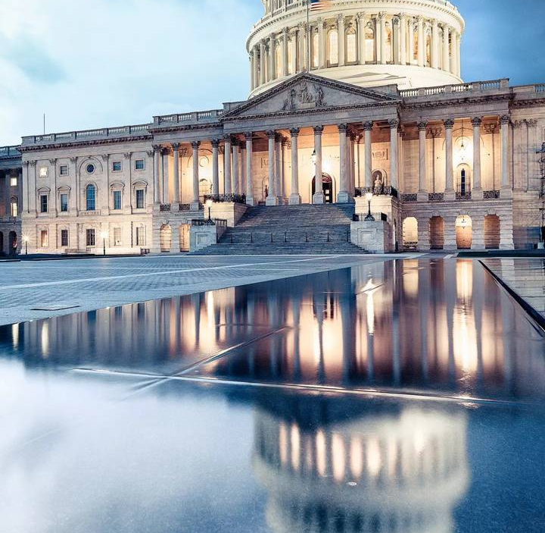
Interacting with our Congressional Delegations
Mary Sandy, Director
Virginia Space Grant Consortium
December 12, 2022

Slide 2
Preparing for Hill Visits
Request appointments with your Congressional Offices:
  We typically call first to get the process for each office and to ensure there have not been staff changes.
  Email meeting request to Office scheduler with copies to key staff contacts.
    Typically work with staffer covering NASA/Education.
    Ask to meet with the legislator, if possible, and key staff.
    Confirm meetings via email when set.
    Generally meet with staff, but legislator will sometimes join if available.
  Allow reasonable time between appointments for security screenings and delays that might take place for scheduled meetings. House will likely be just security screening like pre-COVID. Senate will likely maintain process of you going through screening and then having to be met and escorted by a Congressional staffer.
  We like to do a team of two people (typically me and Chris Carter, Deputy Director) so we can split up visits if needed and better deal with schedule disruptions.
  We have 11 Congressional Districts so with senators, there are 13 meetings. Typically allow two days prior to start of the NCSGD meeting to be sure we can reasonably cover all offices.

Slide 3
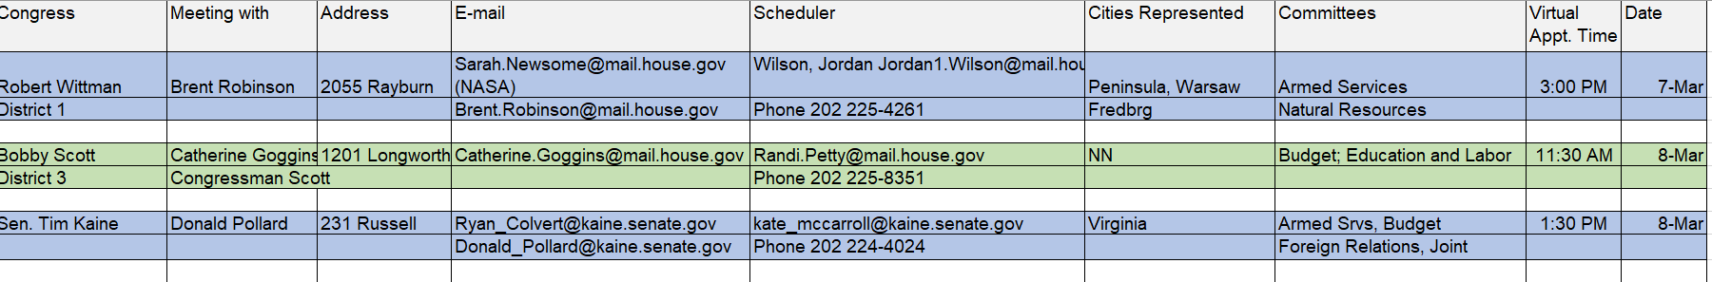
Appointment Schedule

Slide 4
Preparing for Hill Visits
  Print out one-sheet bios on each of your state’s Members of Congress
  Check out their committee assignments, interests and think about how your programs and the Space Grant mission play to those interests.
  Bios are available at each legislator’s website.
  House Appropriations Committee and its Commerce, Justice Science Subcommittee are key to NASA’s budget and therefore our Space Grant appropriations.
  US Senate committee on Science, Commerce and Transportation - Senate Subcommittee on Space and Science has jurisdiction over national and civil space policy; legislation and oversight of science, technology, engineering, and math research, development, and policy; and standards and measurement.
  Leslee Gilbert, Van Scoyoc Associates, and the Space Grant Alliance coordinate with states with key committee members.

Slide 5
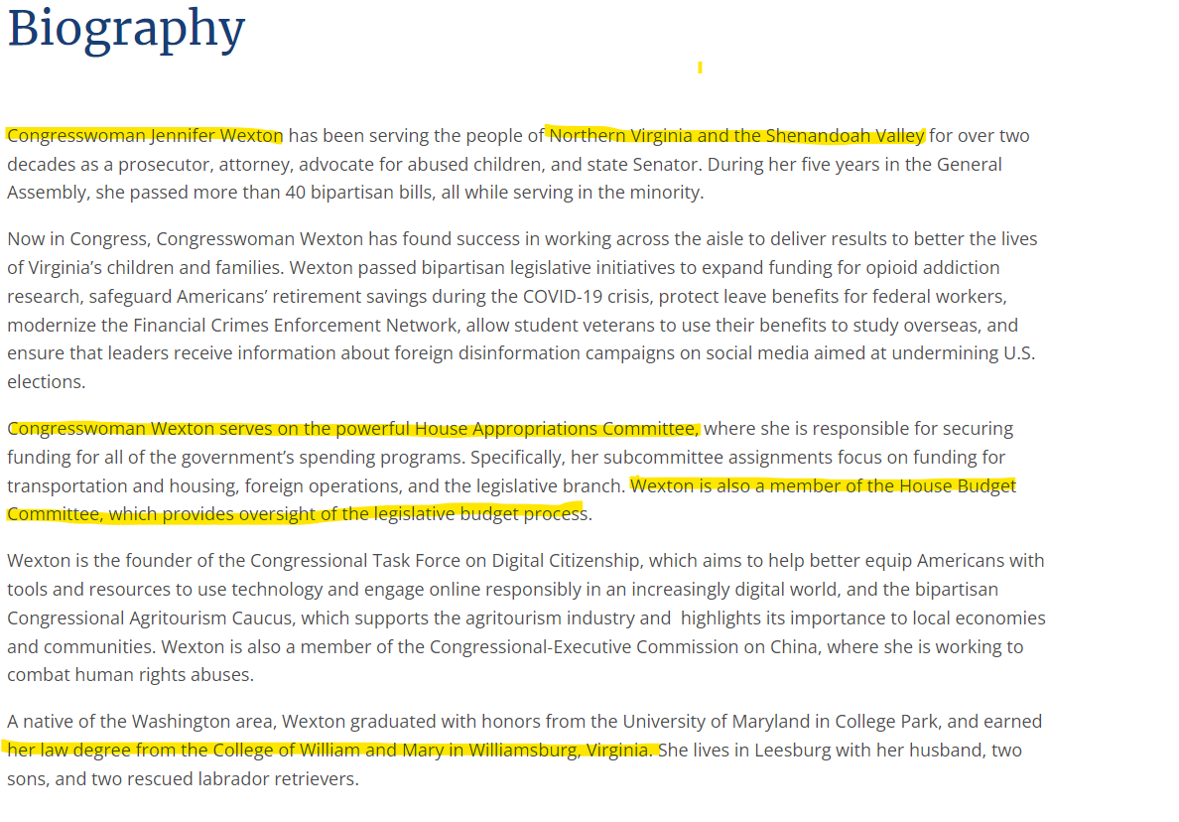

Slide 6
Getting Your Message Together
National Fact Sheet provided by the Space Grant Alliance:
  Provides big Space Grant impact picture.
  Has our budget ask – Key action for your visit is to communicate value of our program and our ask for this year.
Your State Fact Sheet or Infographic.
Impact Data to share on your programs and for that legislative district:
  VSGC compiles detailed impact spreadsheet on the students impacted in each district.
  Helps to make the case for Space Grant as a federal/state partnership where each state and legislative district is getting a good return on investment.
  Do district and statewide data however it best tells your Space Grant’s impact story.

Slide 7
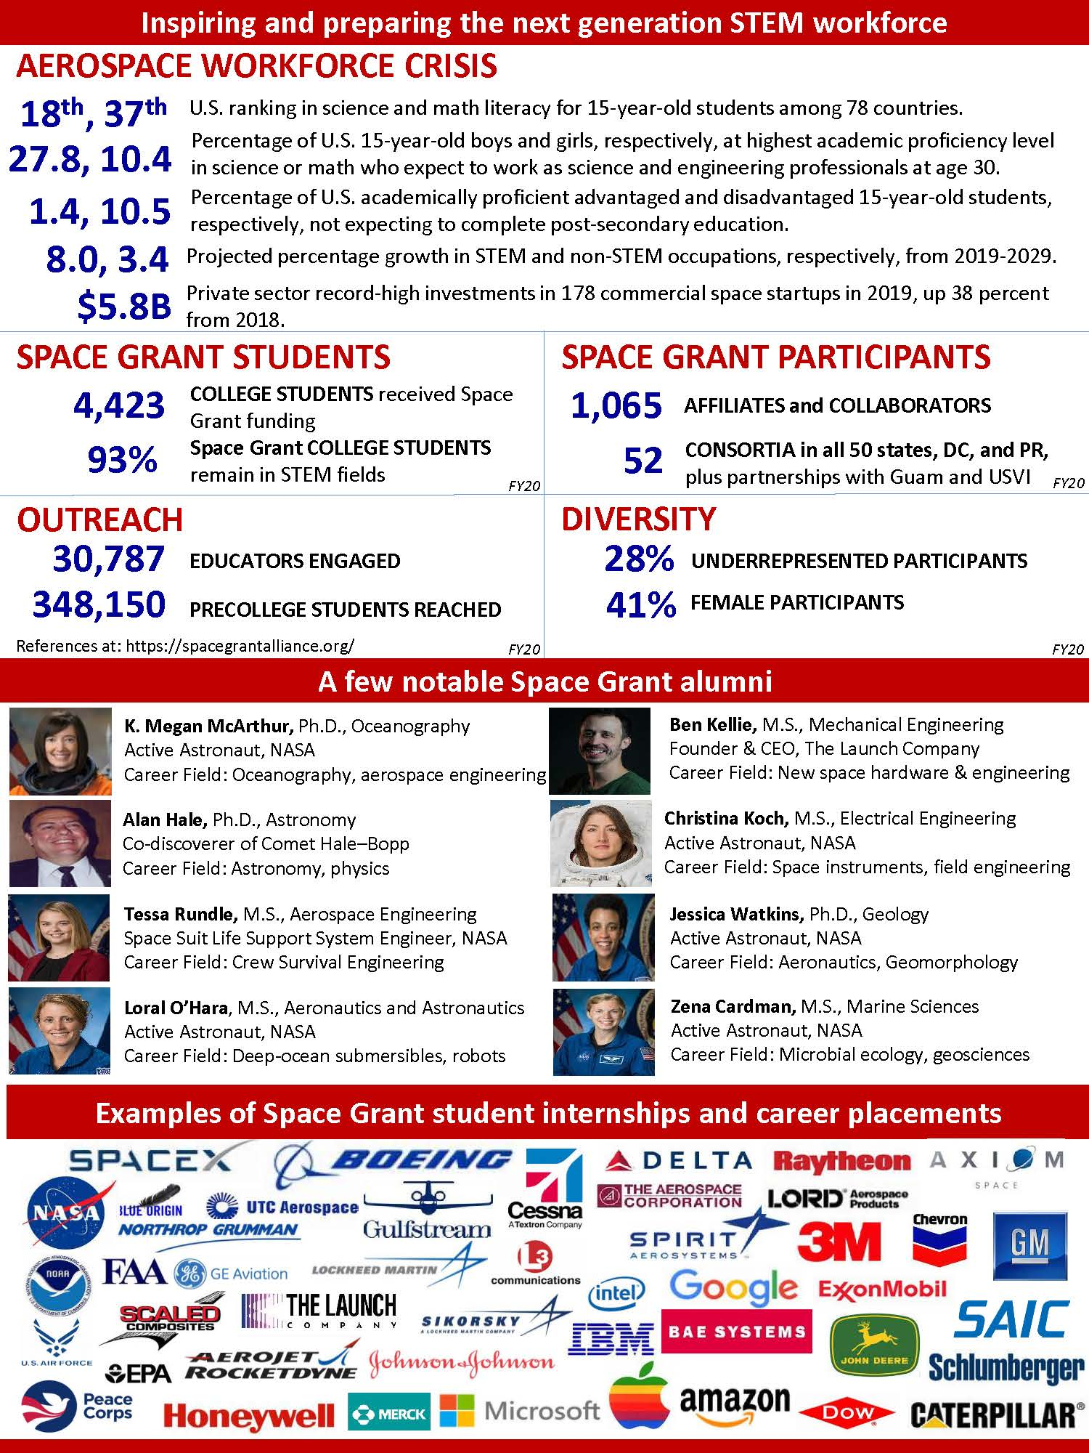


Slide 9


Slide 10
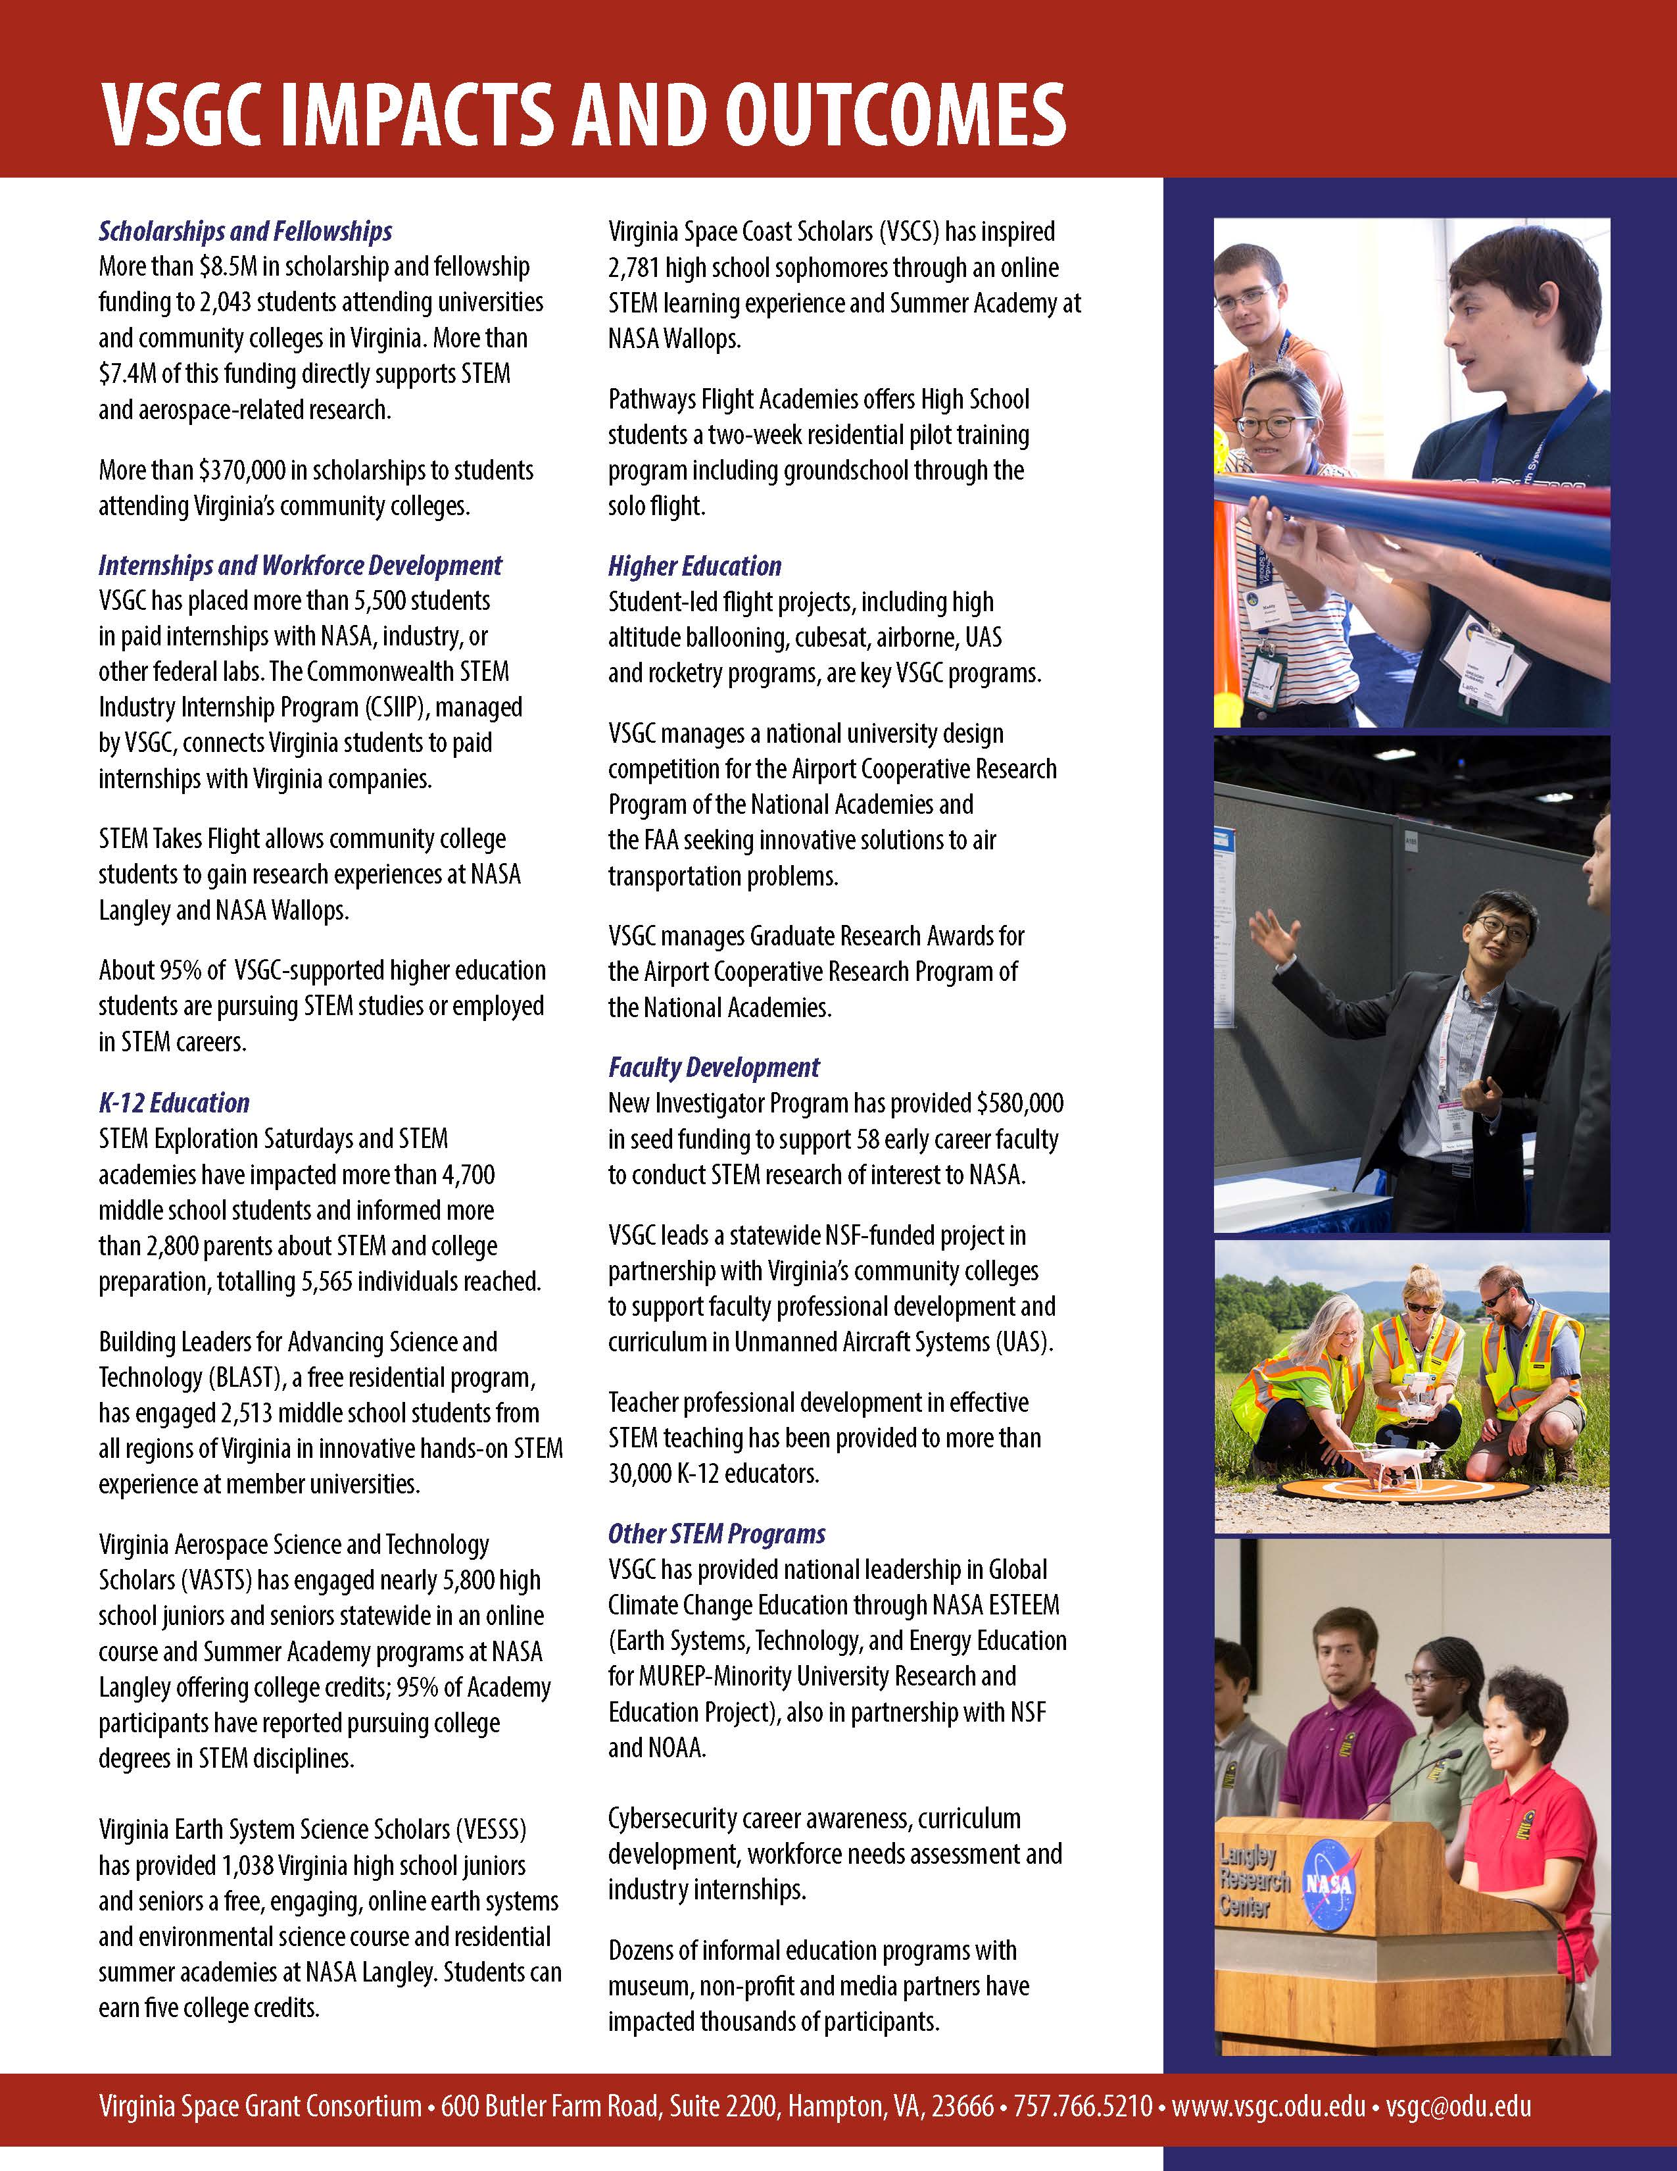

Slide 11
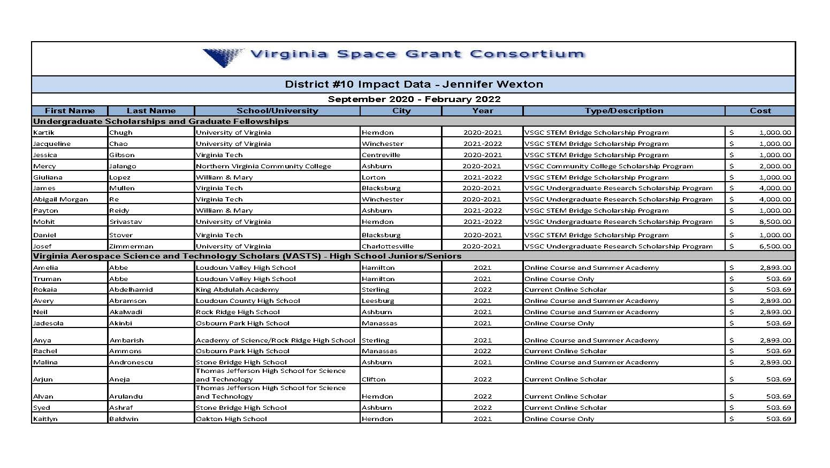

Slide 12
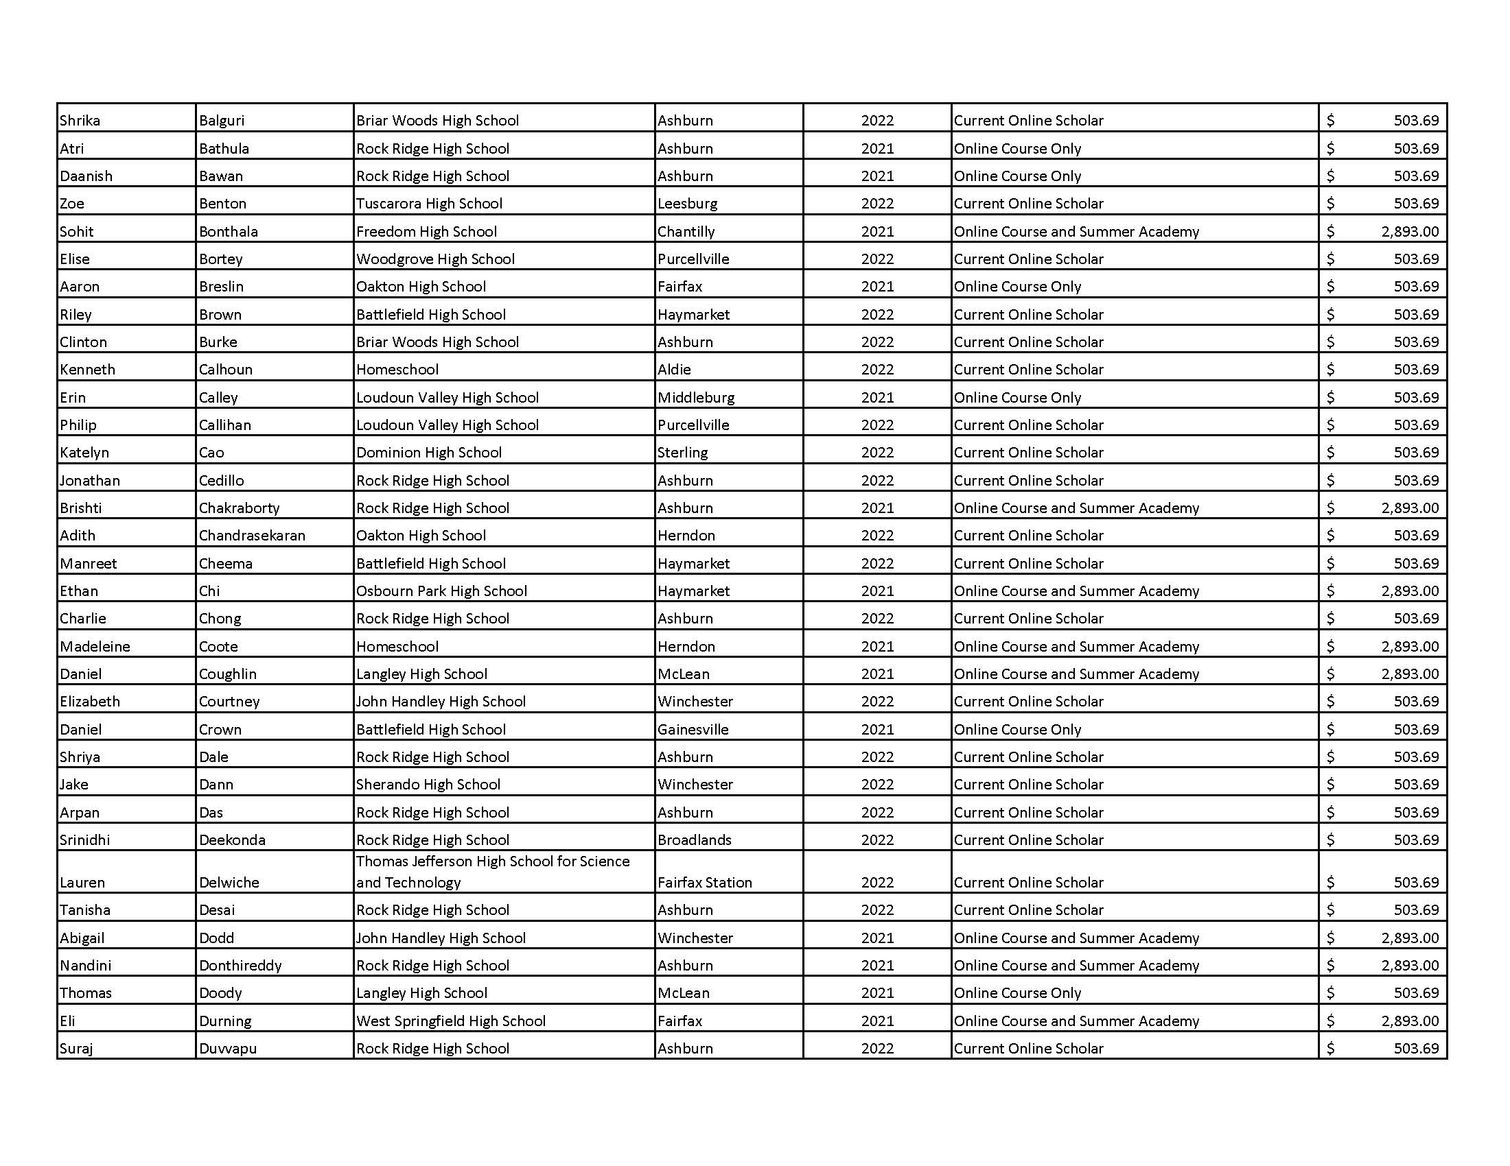

Slide 13
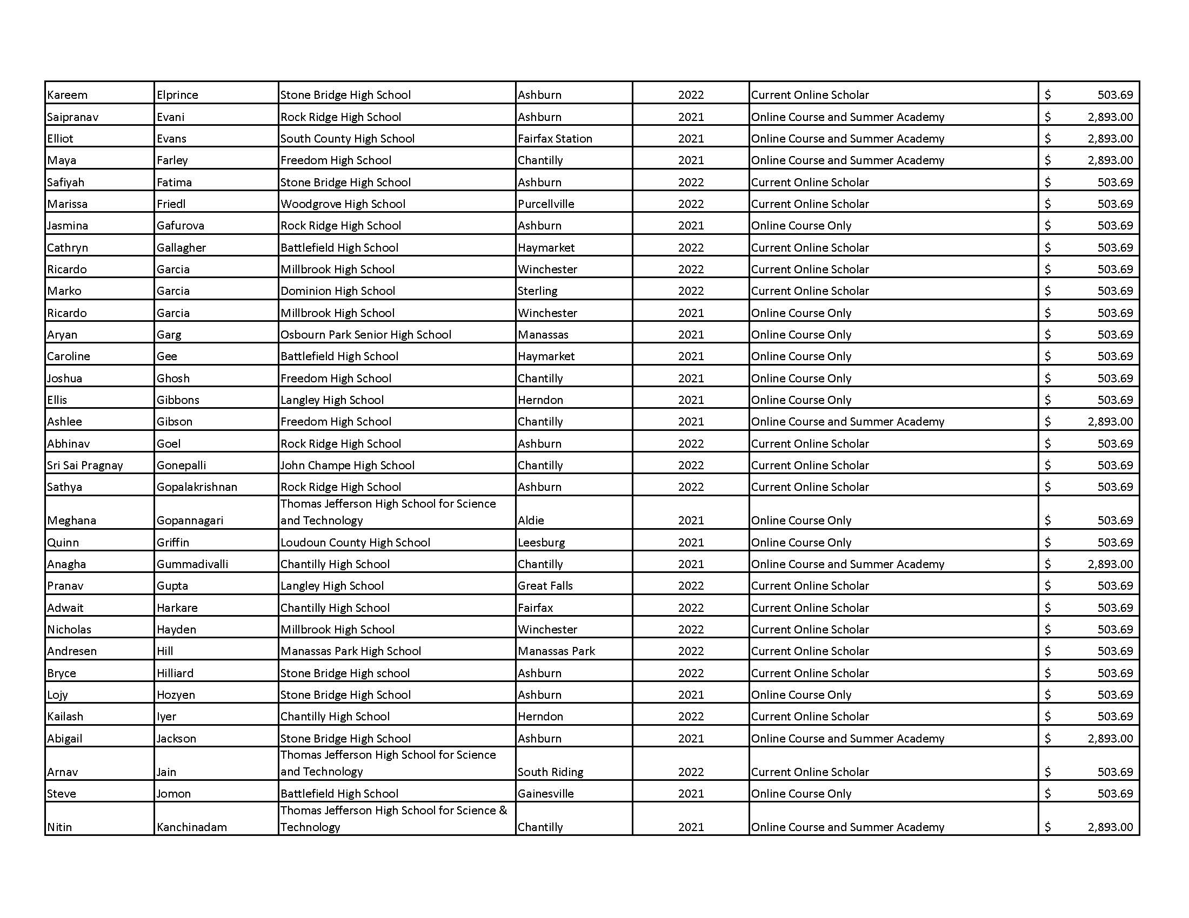

Slide 14
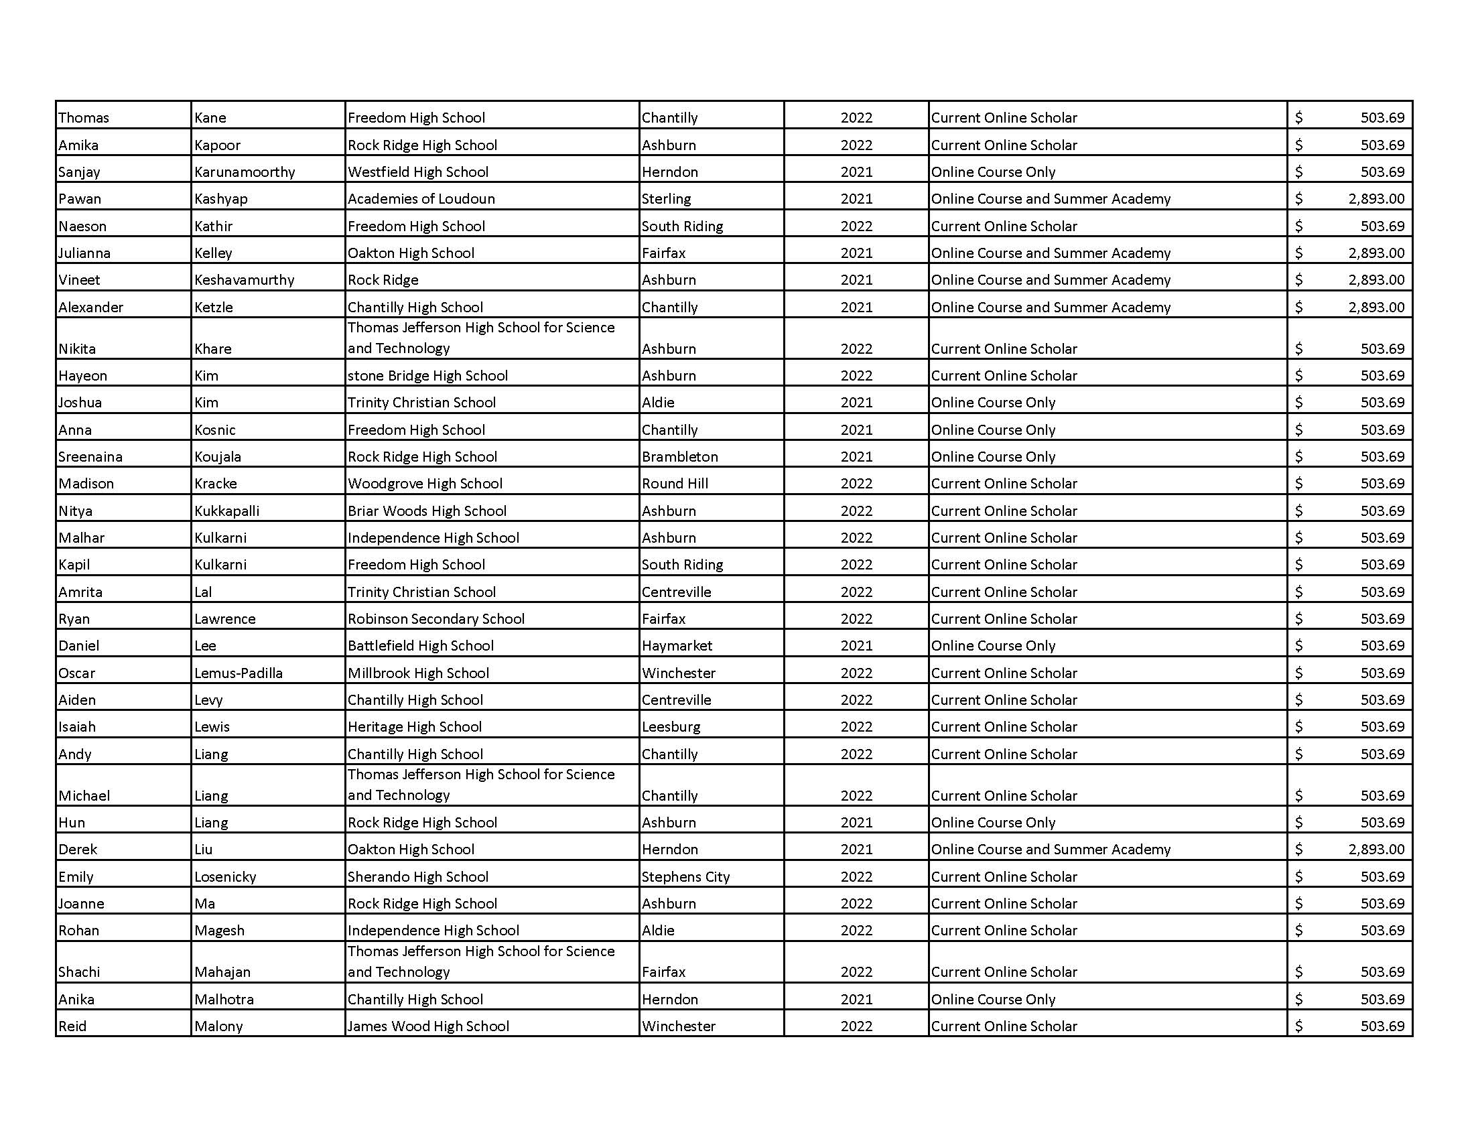

Slide 15
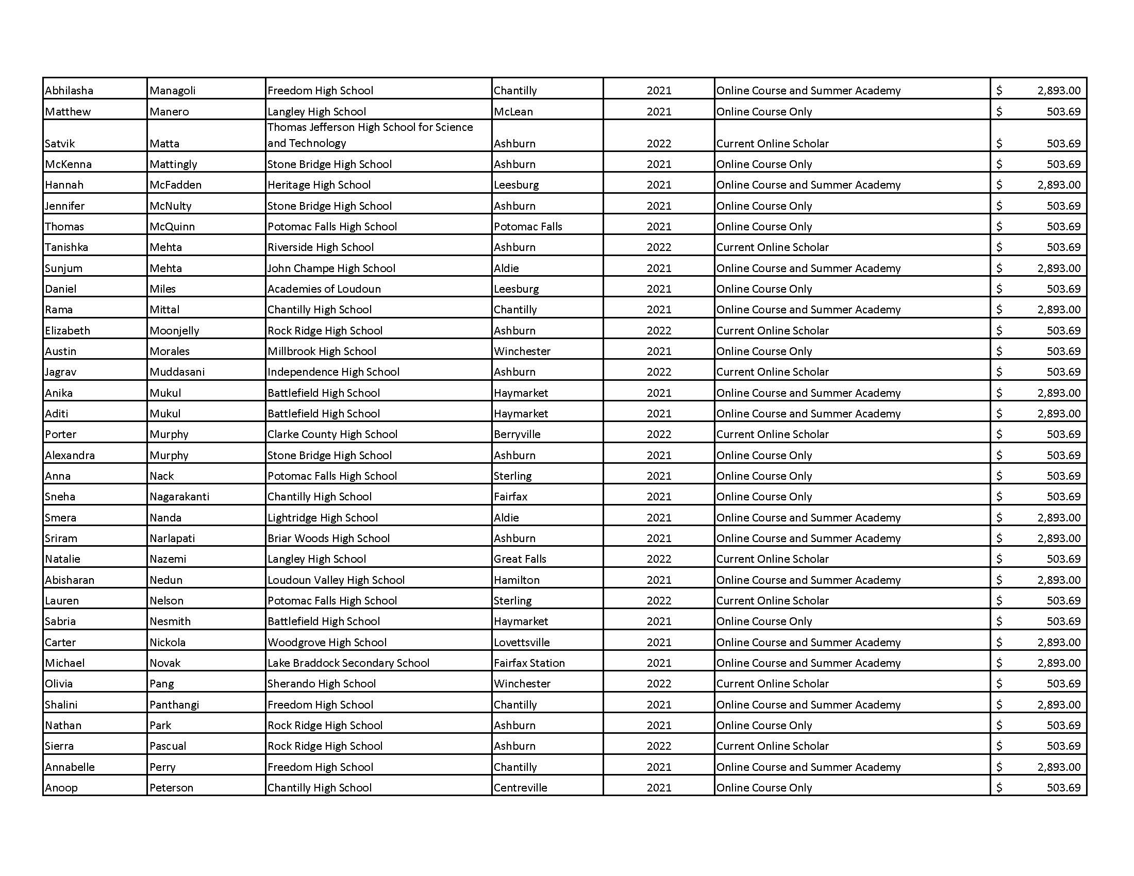

Slide 16
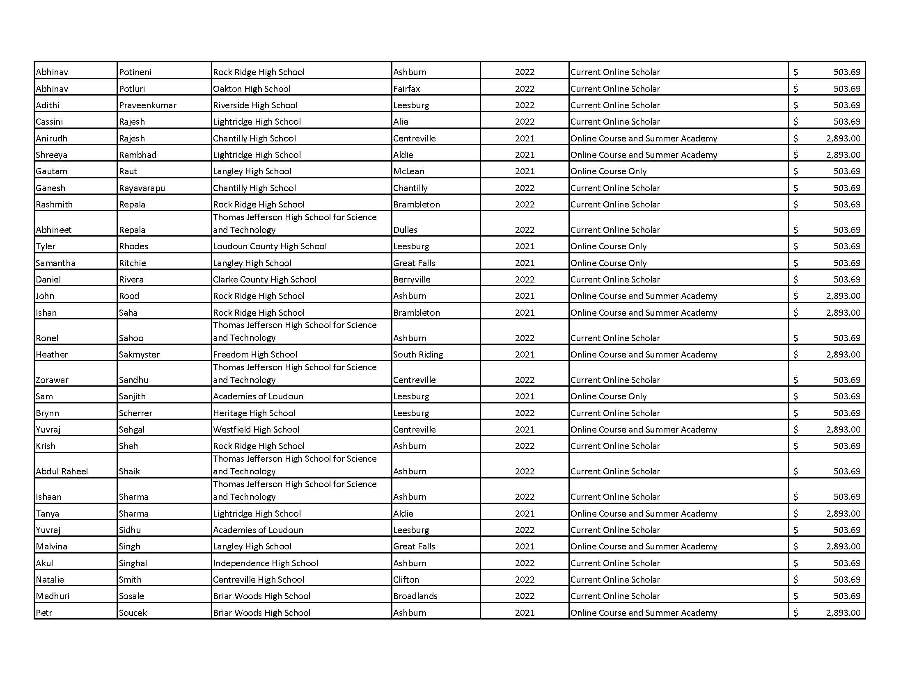

Slide 17
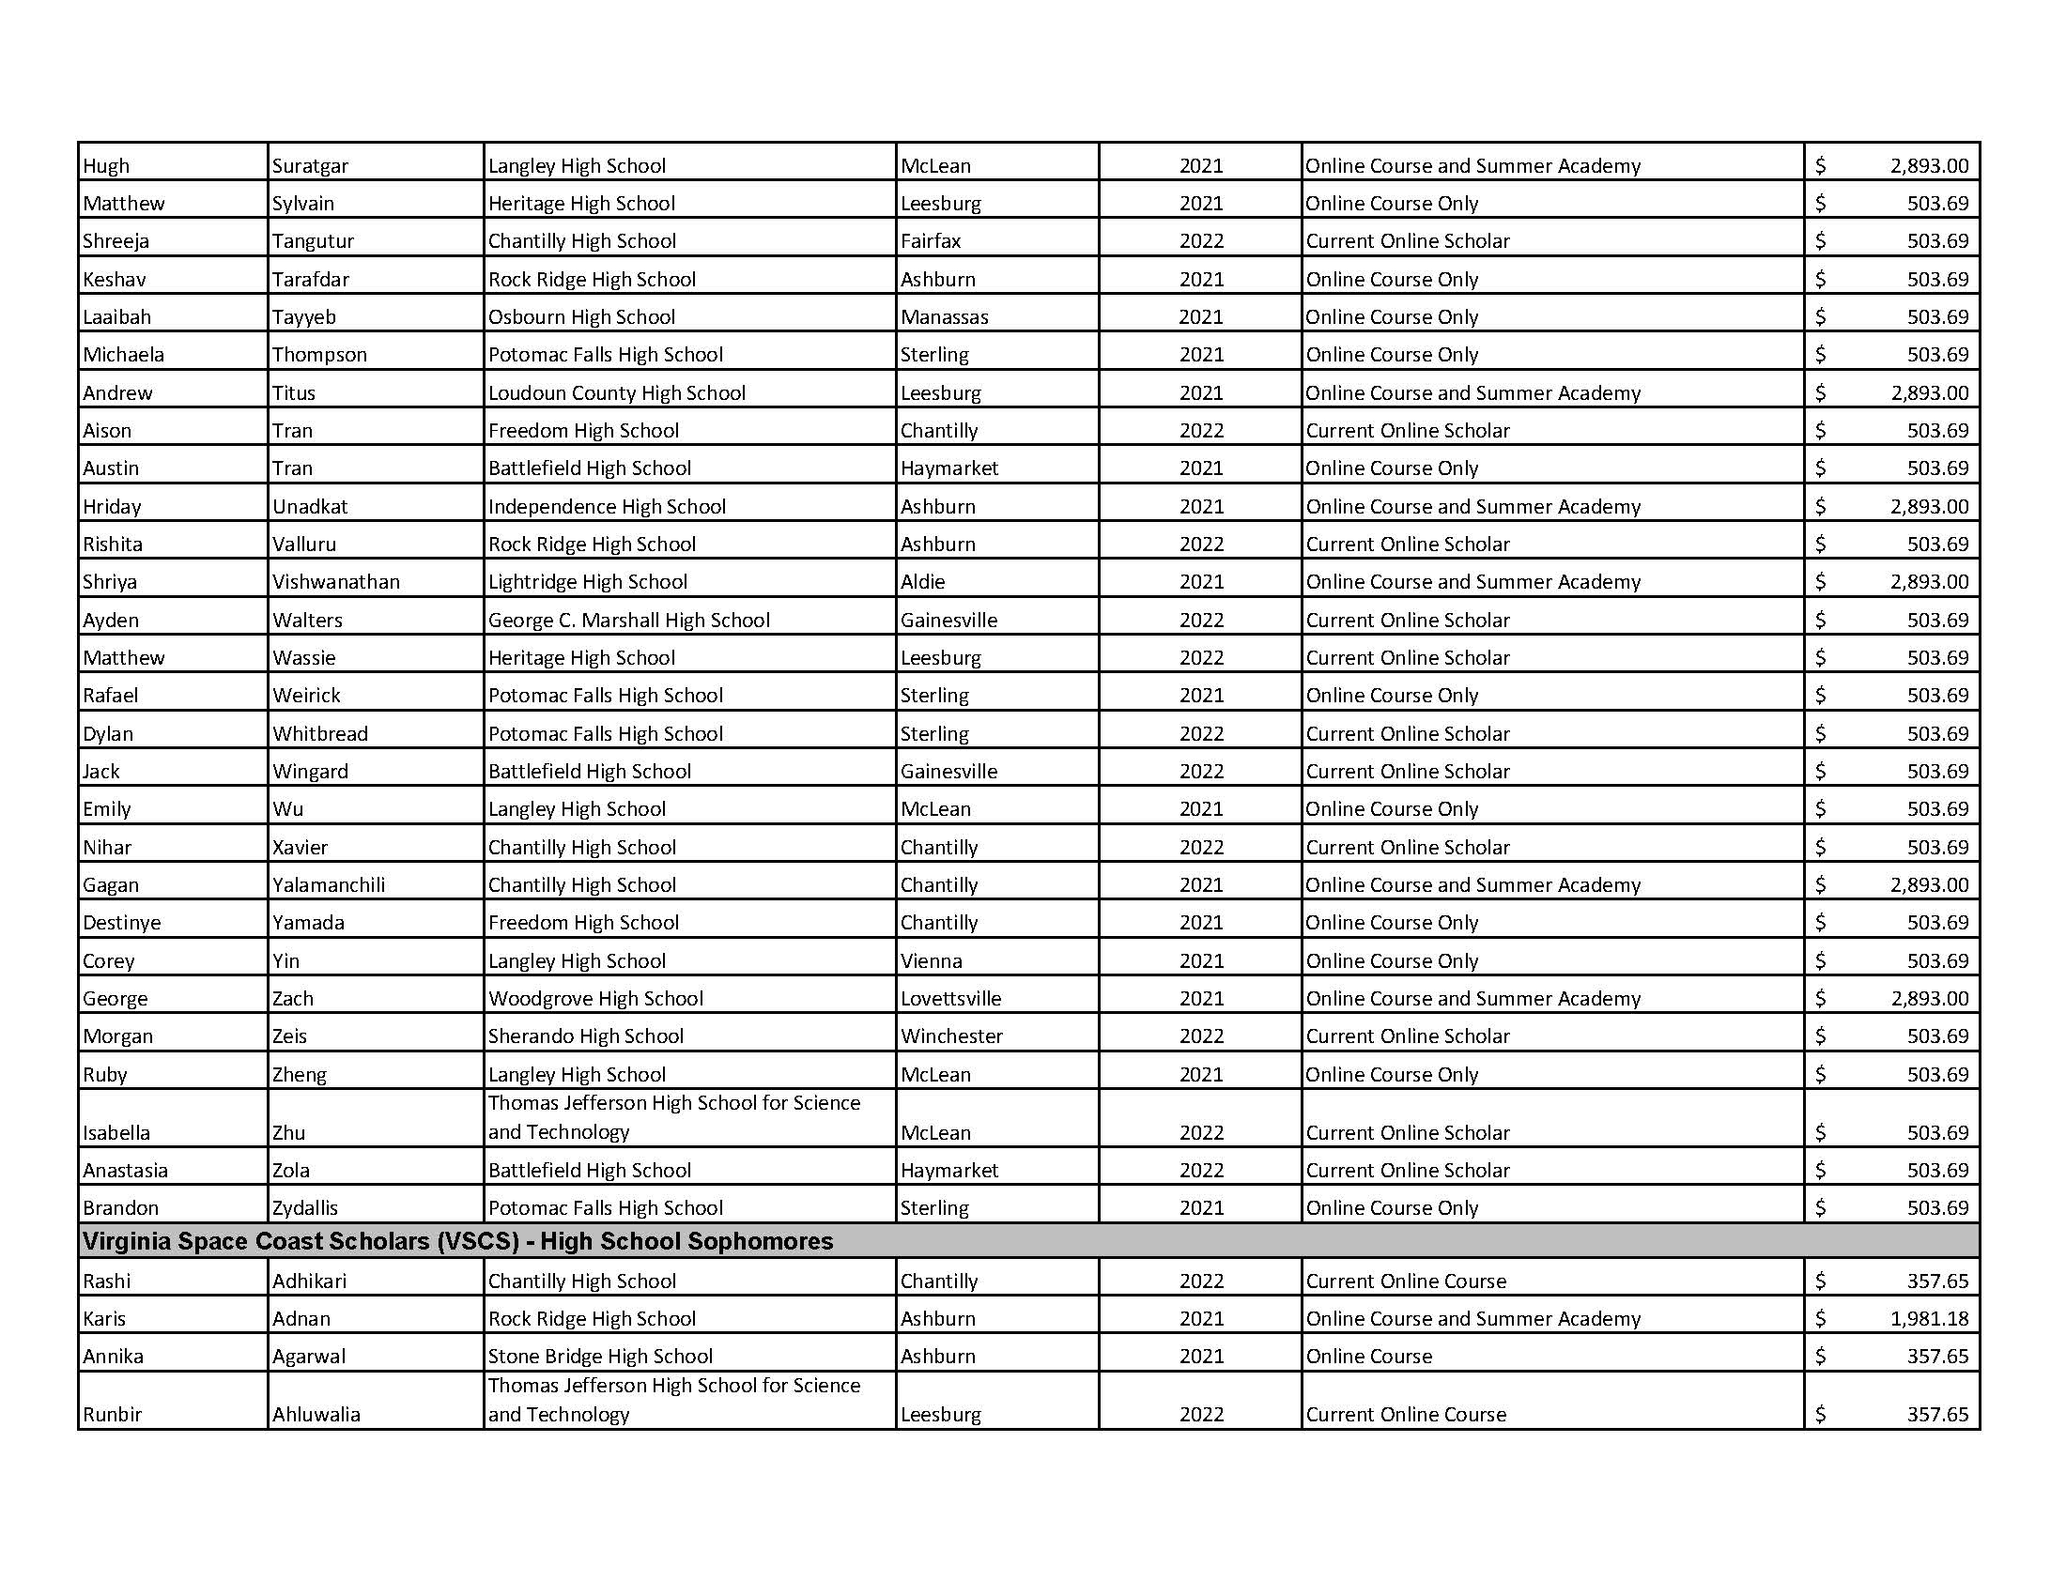

Slide 18
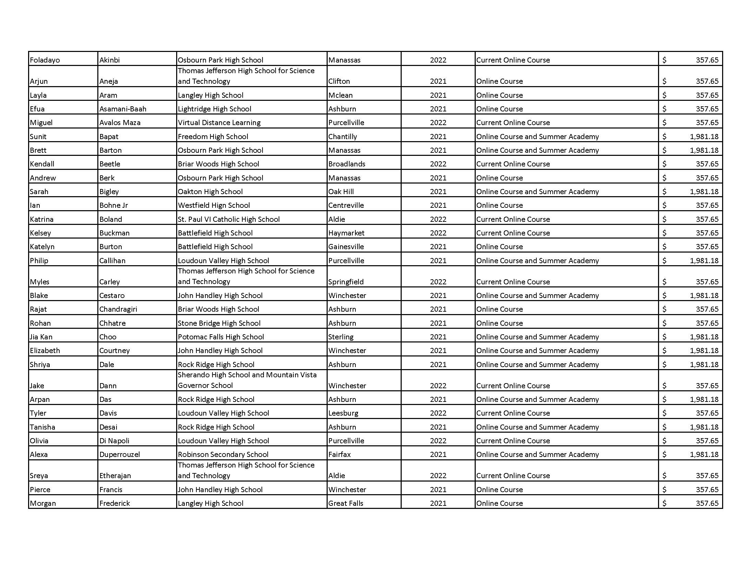

Slide 19
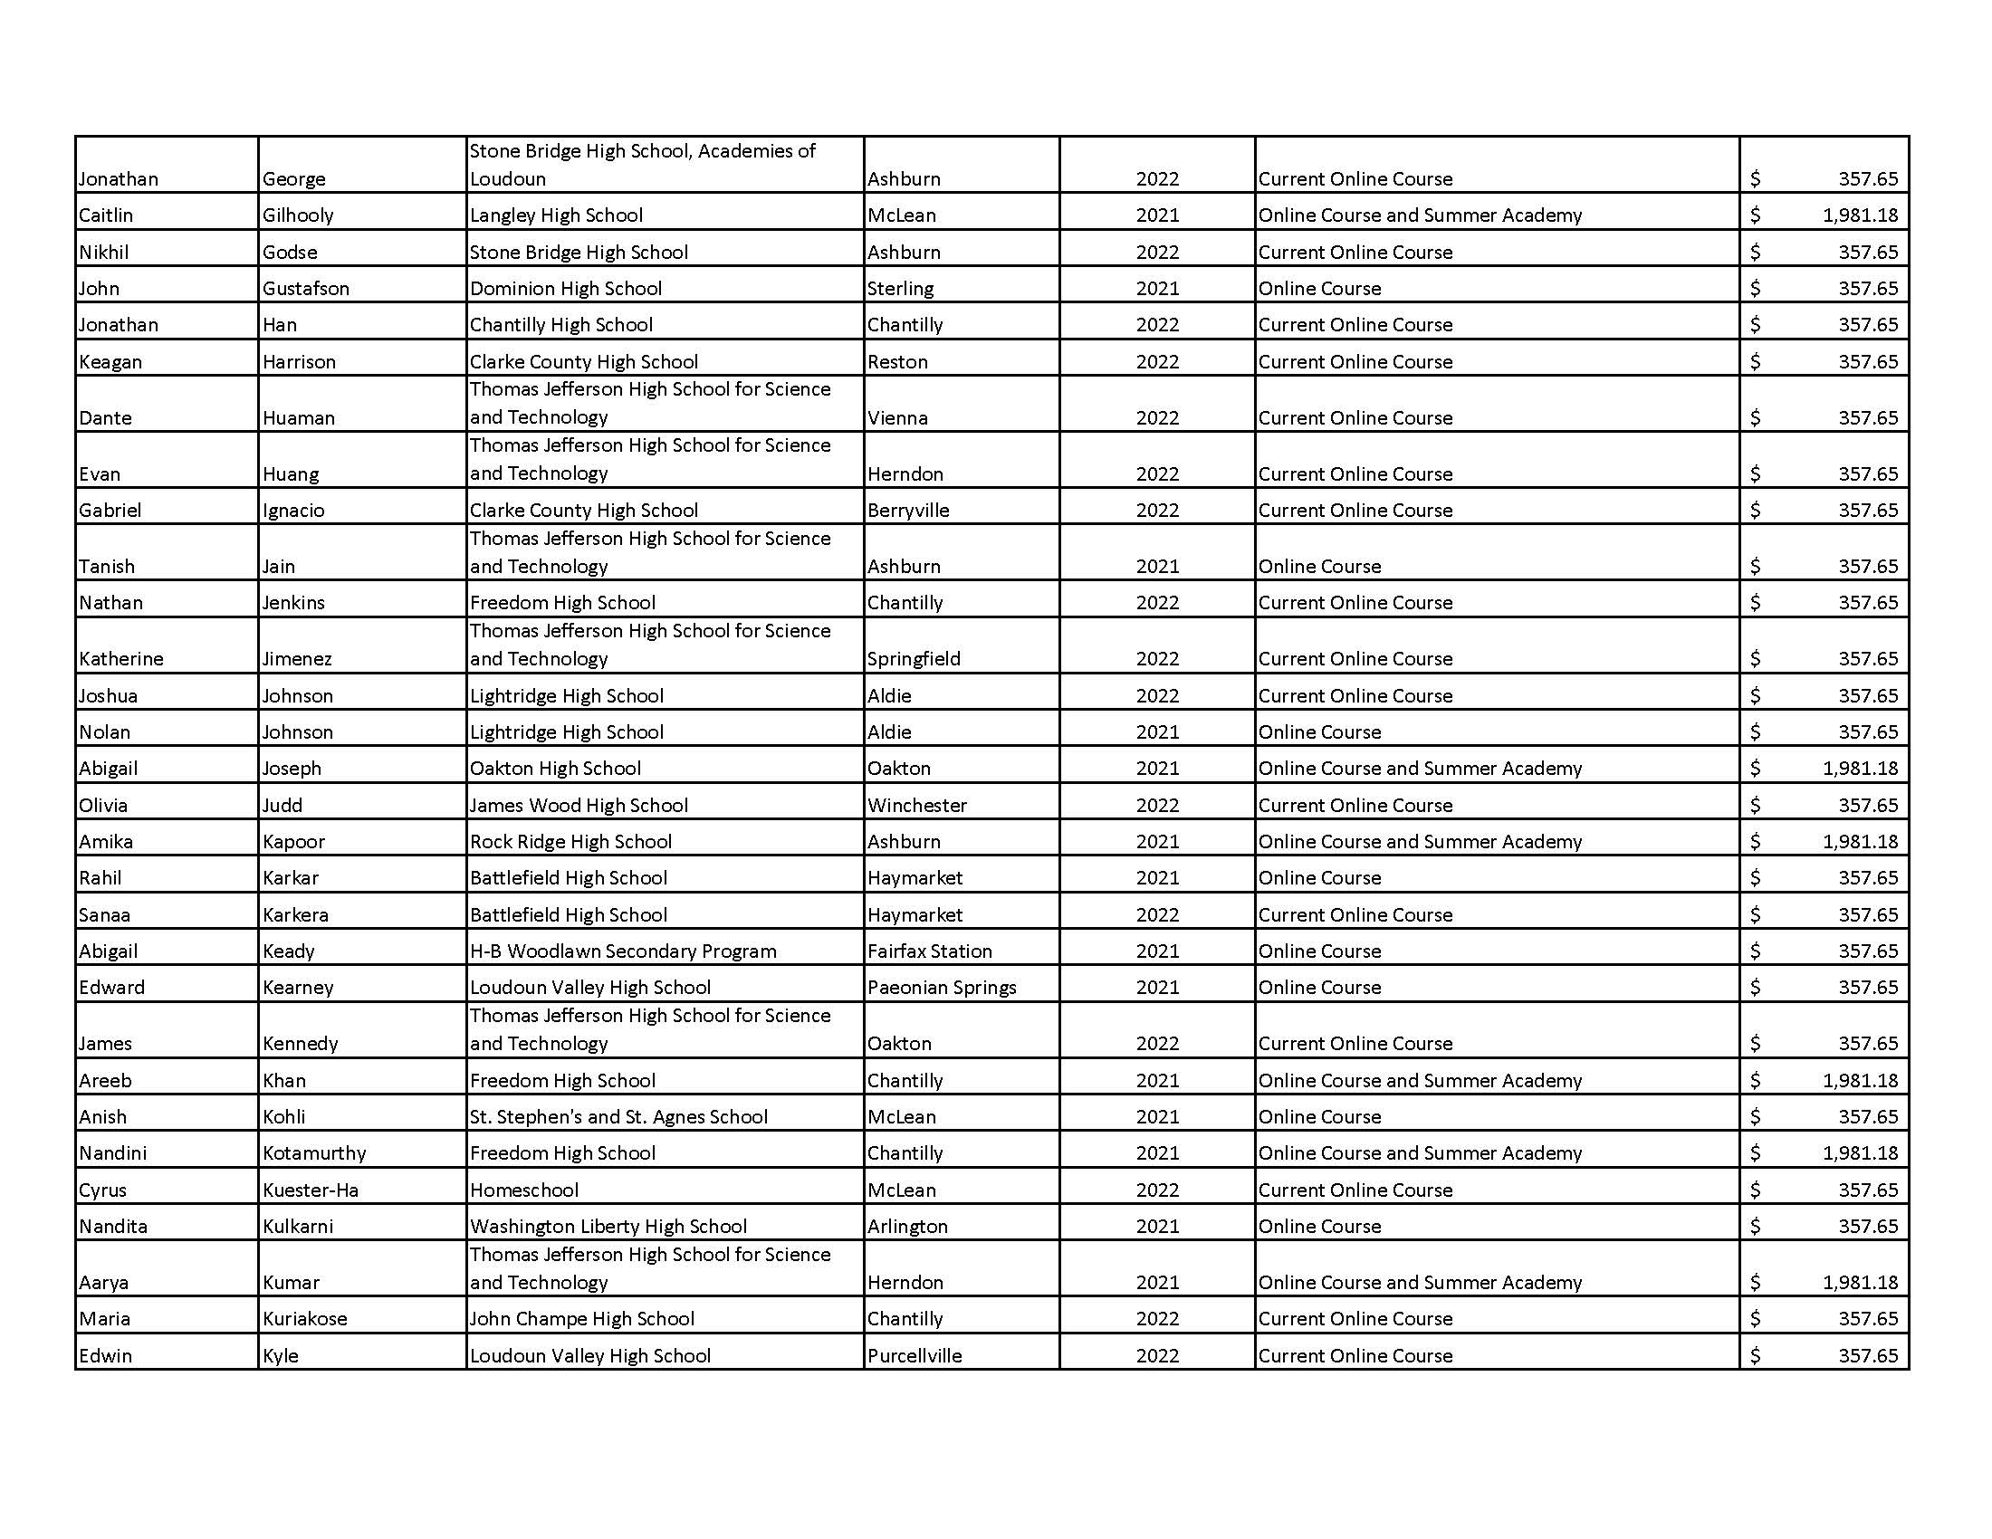

Slide 20
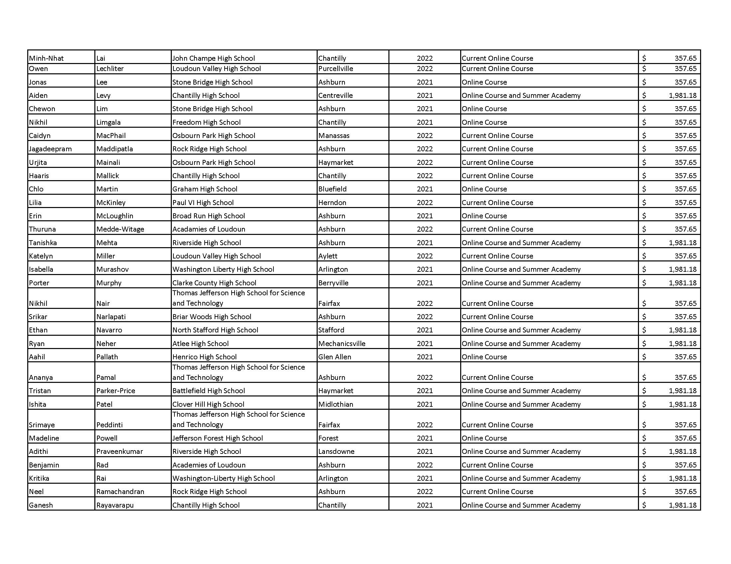

Slide 21
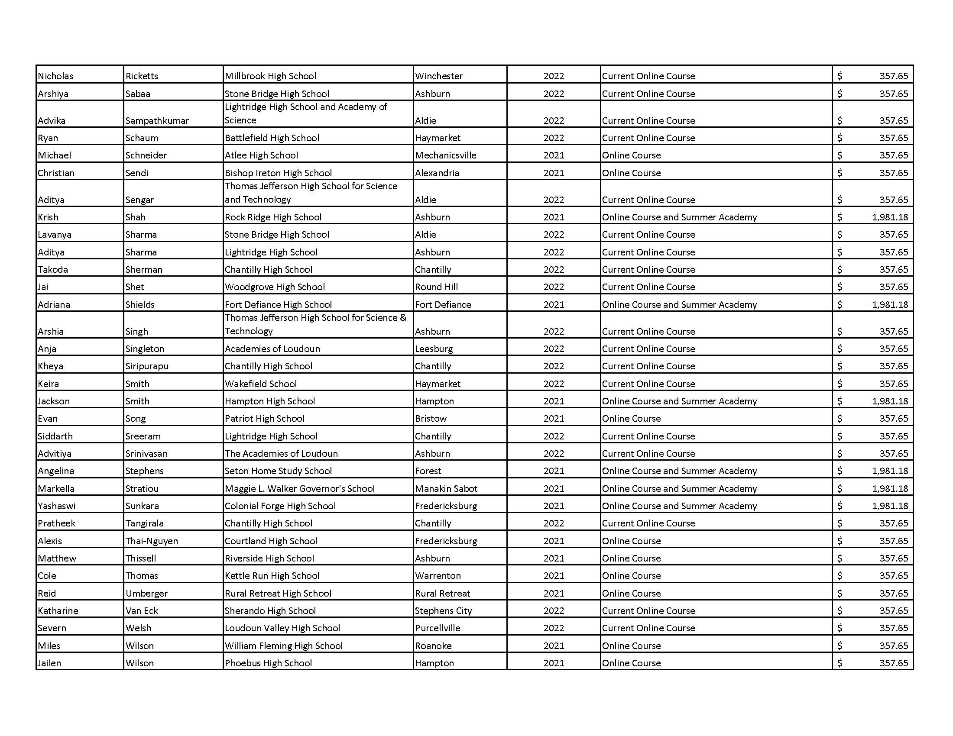

Slide 22
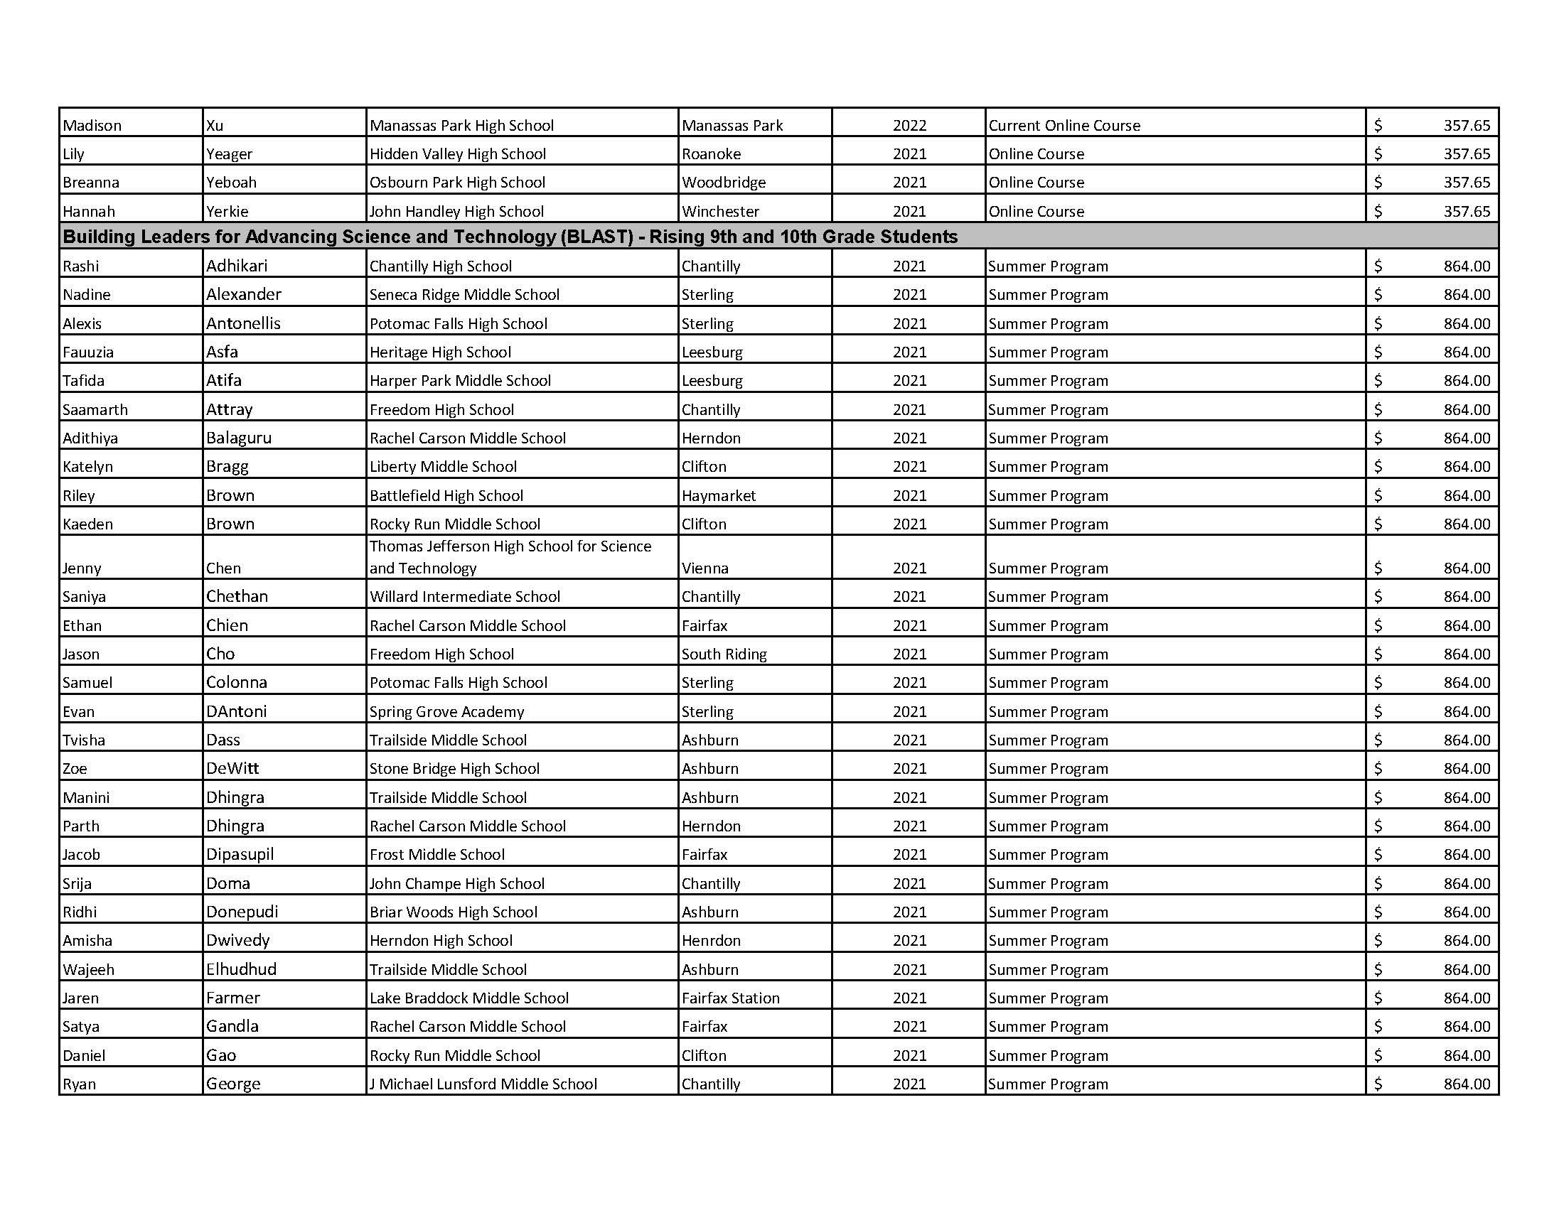

Slide 23
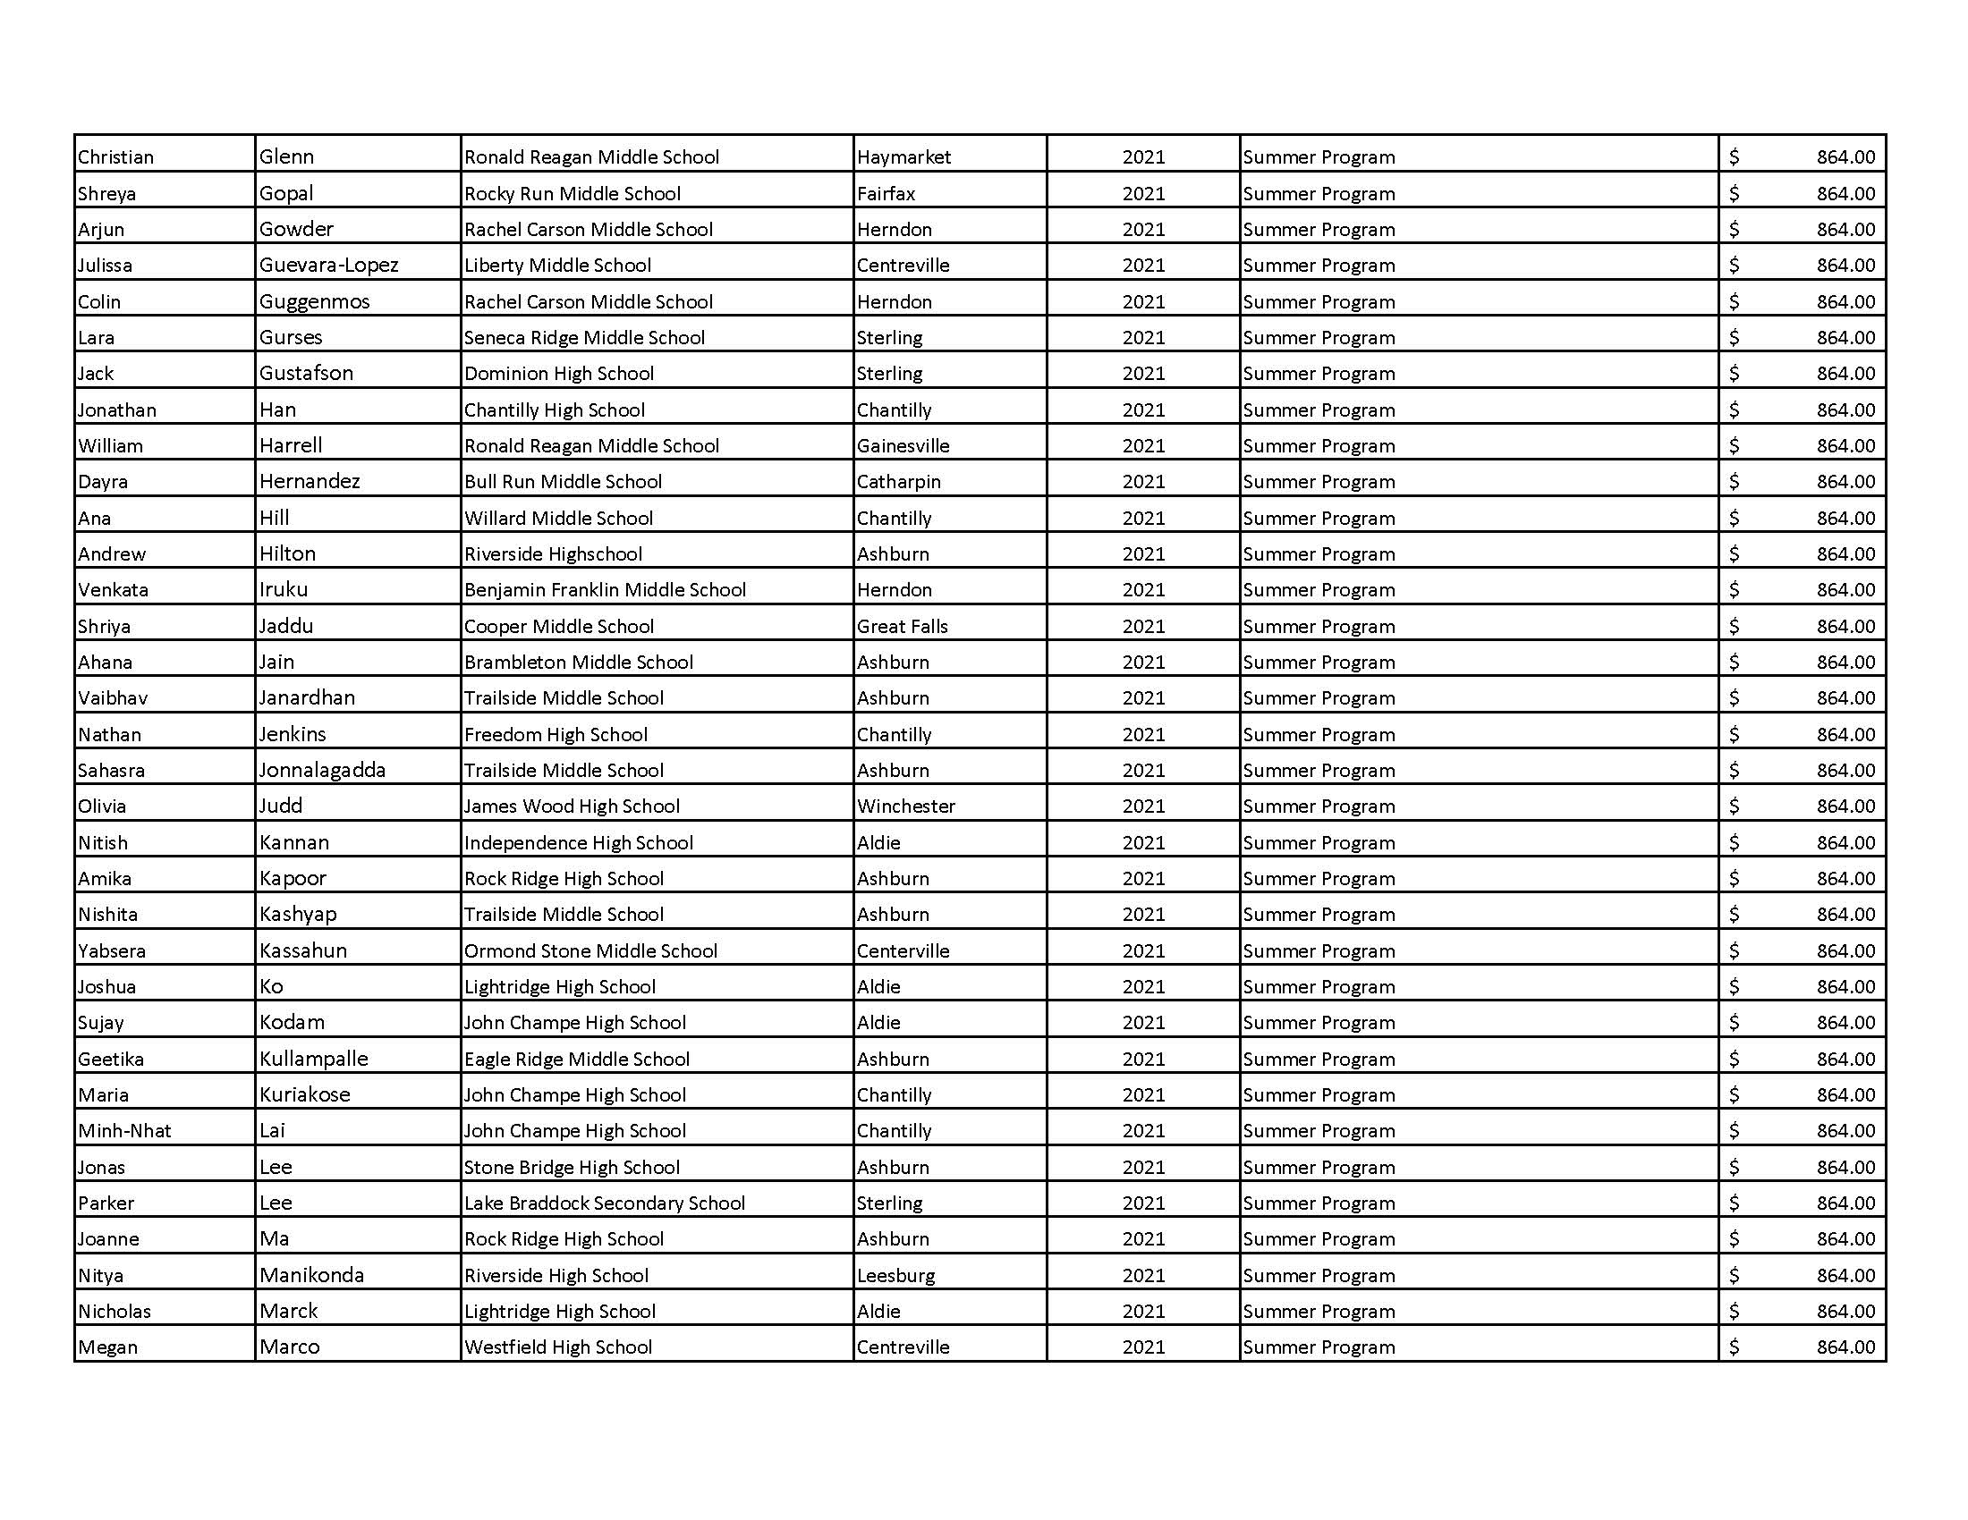

Slide 24
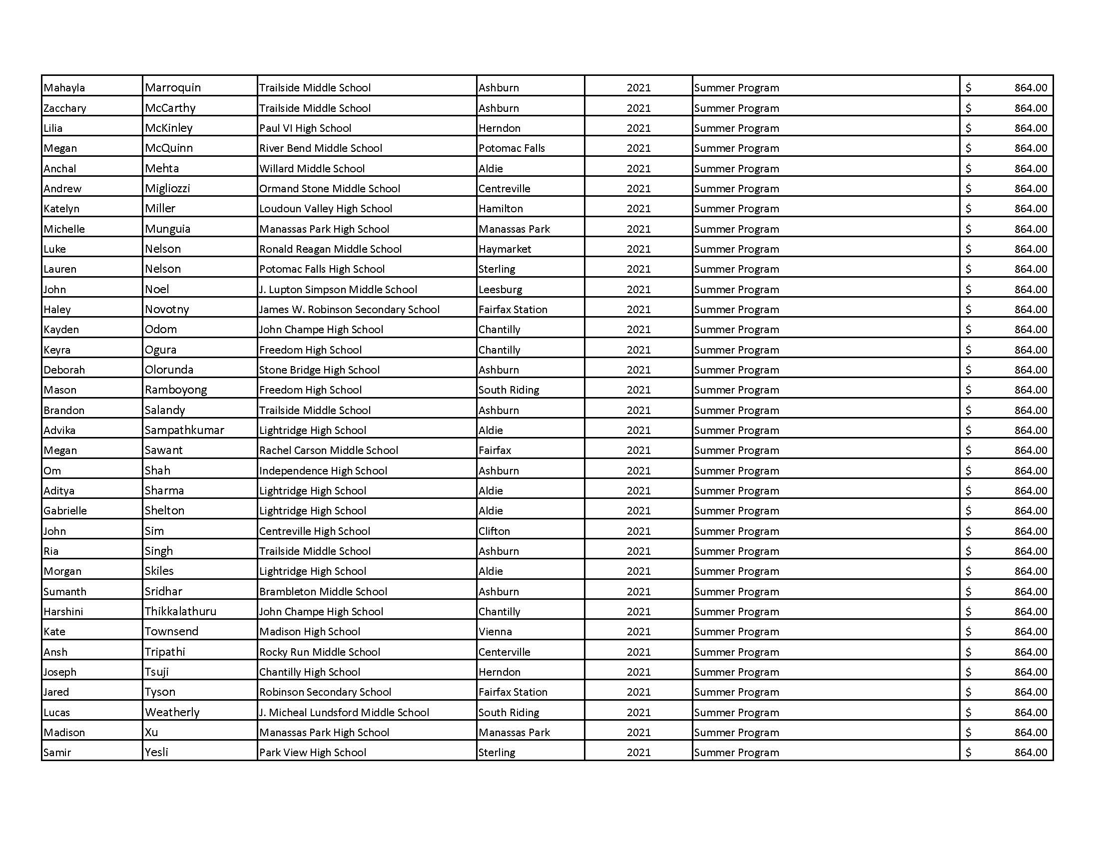

Slide 25
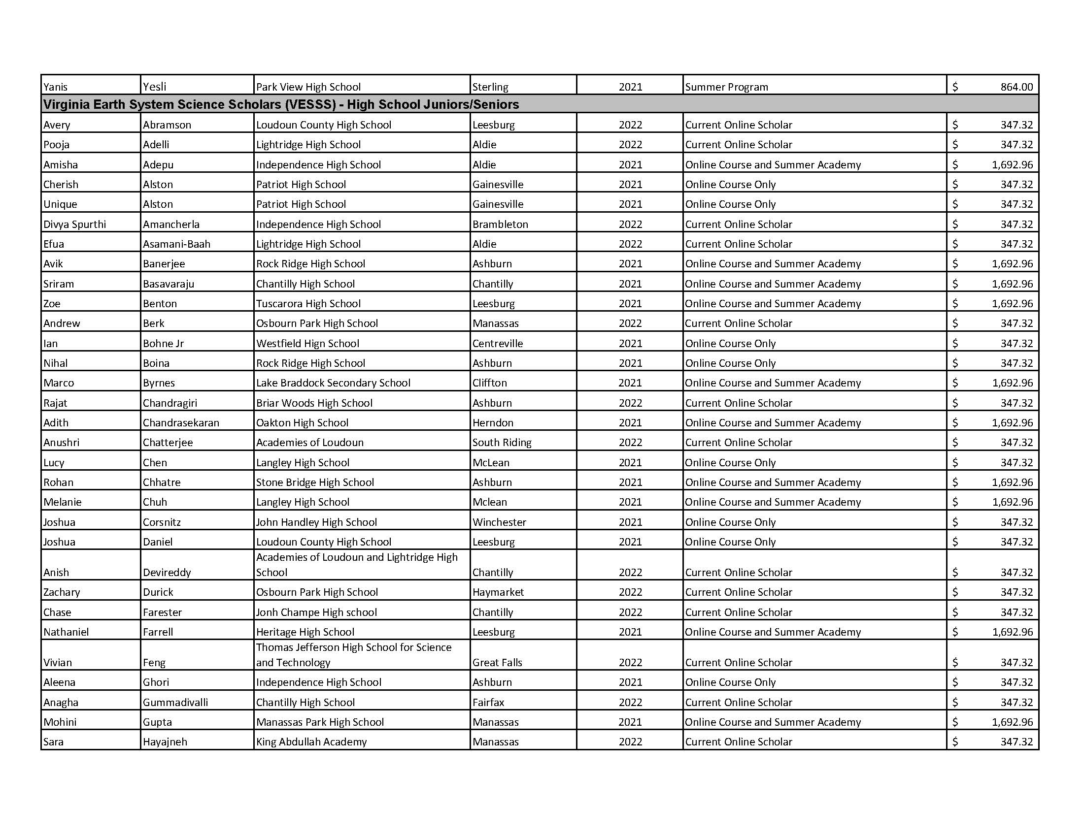

Slide 26
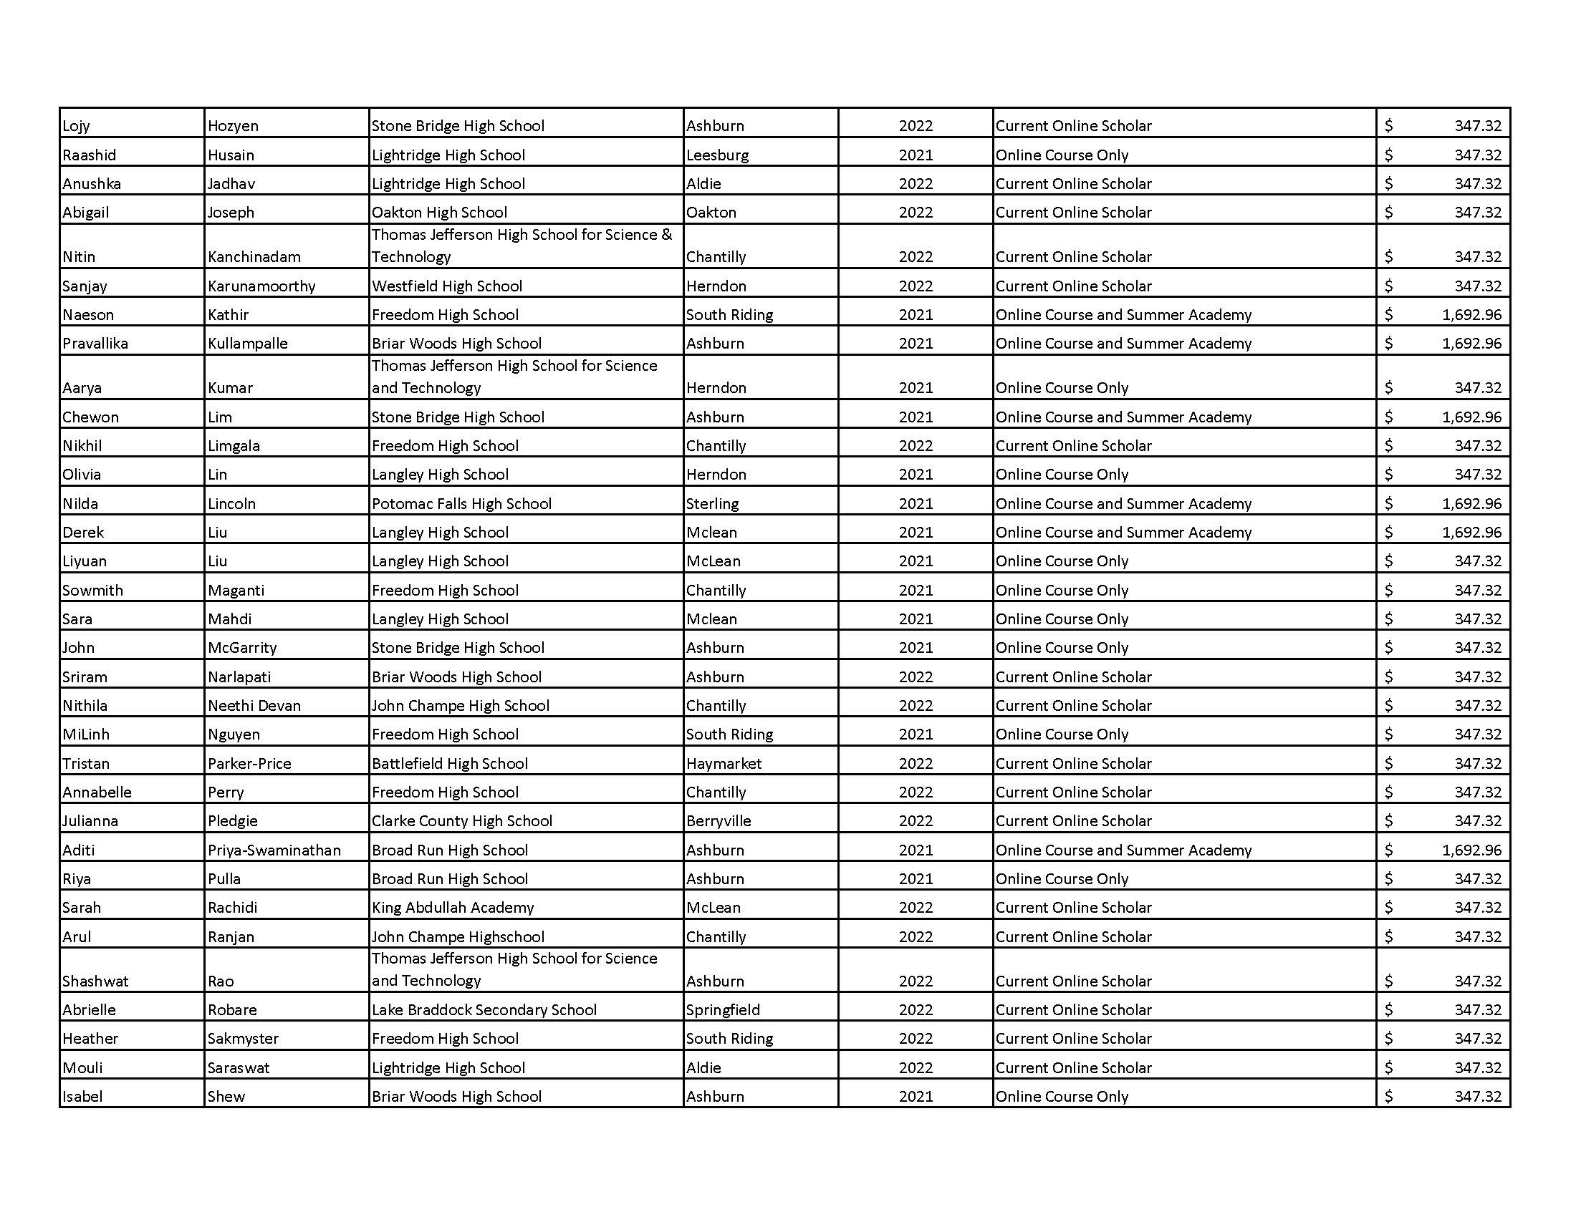

Slide 27
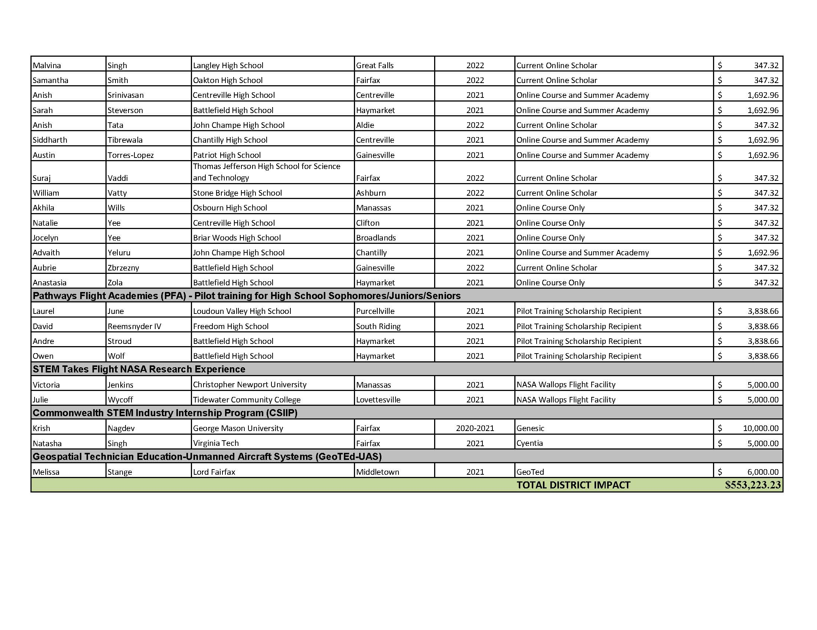

Slide 28
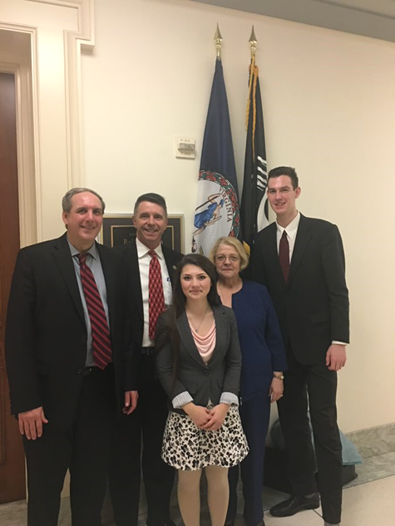
Getting Your Message Together
Consider taking a student, if feasible. Students can very effectively tell the Space Grant story in just a few minutes.
  Doable for all states for virtual meetings.
  Easier for states closer to Washington, DC.
  Help your student(s) craft their message on how Space Grant has impacted them within a few minutes.
  Practice your message. Be enthusiastic, on point and
  strategic with the time you have.

Slide 29
Sample VSGC Message Outline
Greet known staffers and remind them of program and work we do in our state. A bit more in-depth introduction and engagement for “new to you” staffer/legislator. Note some State Fact Sheet highlights.
Share impact data.
Student shares their story.
National Program Impact:
  Use a few facts from fact sheet on the aggregate national impact.
  Speak to and justify our current NASA budget request with emphasis on need for language to ensure funding gets to each for this grass roots, state-based STEM education and workforce development program.
  Most visits about 20 minutes so stay focused and succinct.

Slide 30
Sample VSGC Message Outline - continued
  Ask if the Legislator would include the Space Grant budget request in his/her appropriations request.
  Share completed form that Alliance/VSA will provide.
  Some offices will accept this form; others have their own form that you will need to complete and send post-meeting.
    Timing is critical as Offices have deadlines for appropriations requests.
    Leslee can help with any questions about individual office forms.
    The form is part of their process for making internal decisions on what to include in their requests.
  Ask for the staffer to let you know if the Legislator agrees to include the request.
  We always ask how we can help them with STEM activities in their districts and make sure they know we are a resource. We tell them about upcoming VSGC events that we would like for legislators and staff to attend/participate in. Some do events like a district-wide STEM event and we offer to participate/suggest resources.
  Thank them for their time and interest.

Slide 31
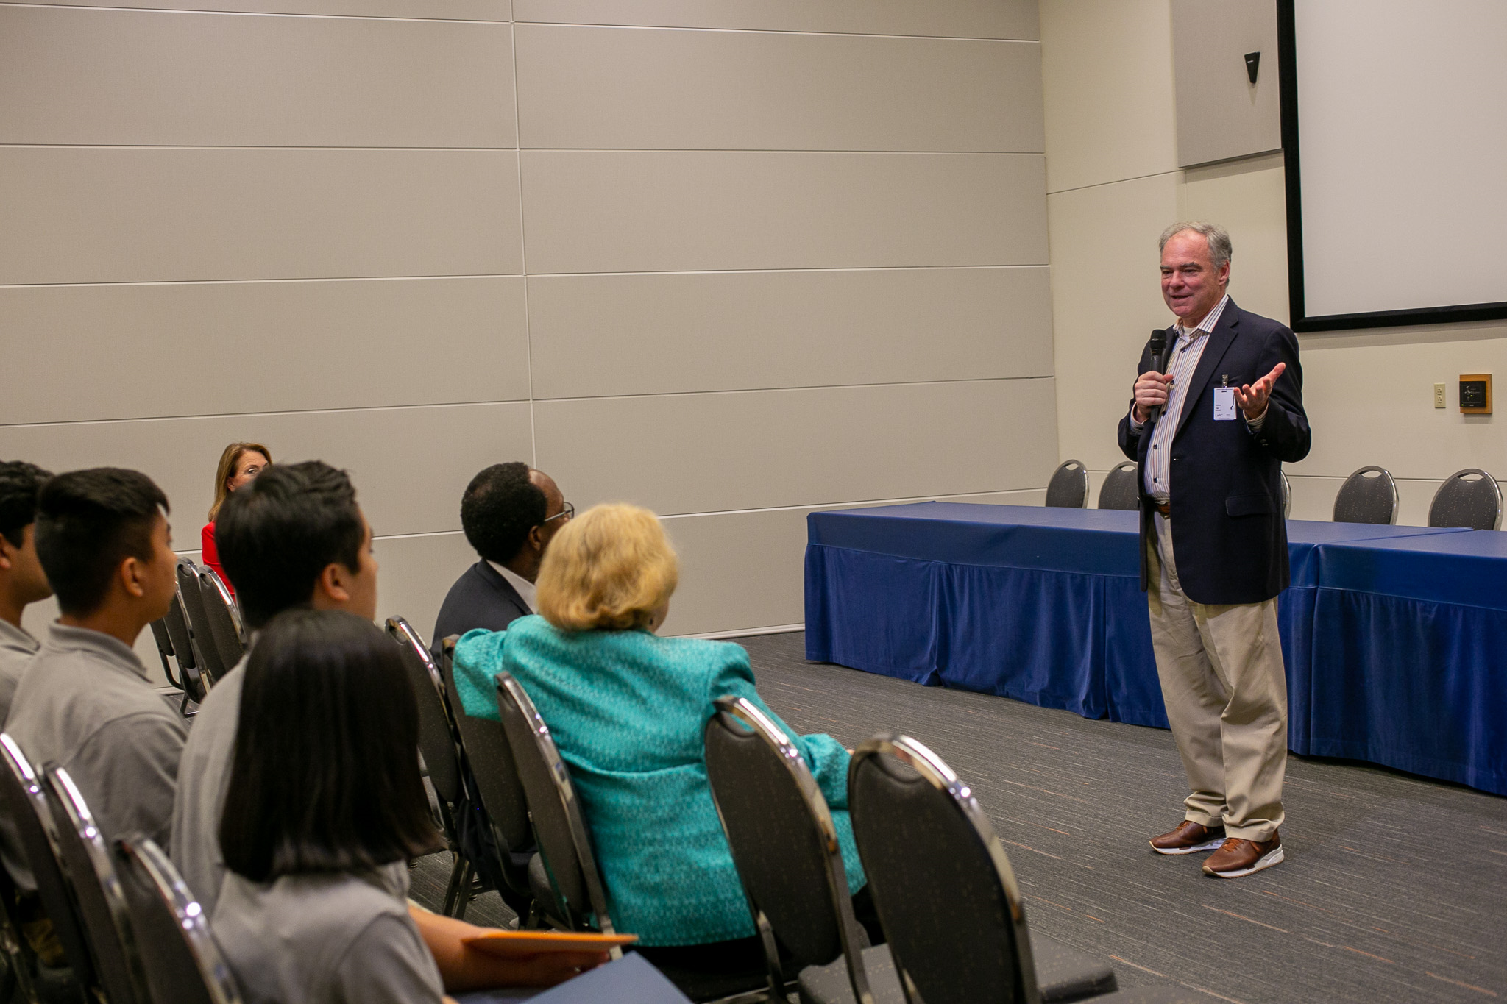
Follow Ups
Send a follow-up note after the meeting.
  Thank them again.
  Provide any budget request documents required.
  Any other follow-up relating to your program or
  arising from the meeting.
Stay in touch year-round.
Send them newsletters, press releases, program announcements, and invitations to your key events. Put them on your distribution lists for these things.
  Invite them to speak at an event. Sometimes if they cannot come, they will send a video greeting or letter of support to share at your event.
  Some of our Congressional offices do congratulatory letters to program participants and awardees.
Senator Tim Kaine speaks to Virginia Aerospace Science and Technology Scholars

Slide 32
Additional Notes
Follow Space Grant Alliance and VSA guidance.
Take photos and use them on website, social media, etc. Copy to staffers.
Share photos back with staffers for their potential use as well. Include suggested captions.
Option of meetings with legislators in their home district.
Also good to get to know key staff members in their district as well as in D.C.

Slide 33
