Slide 1
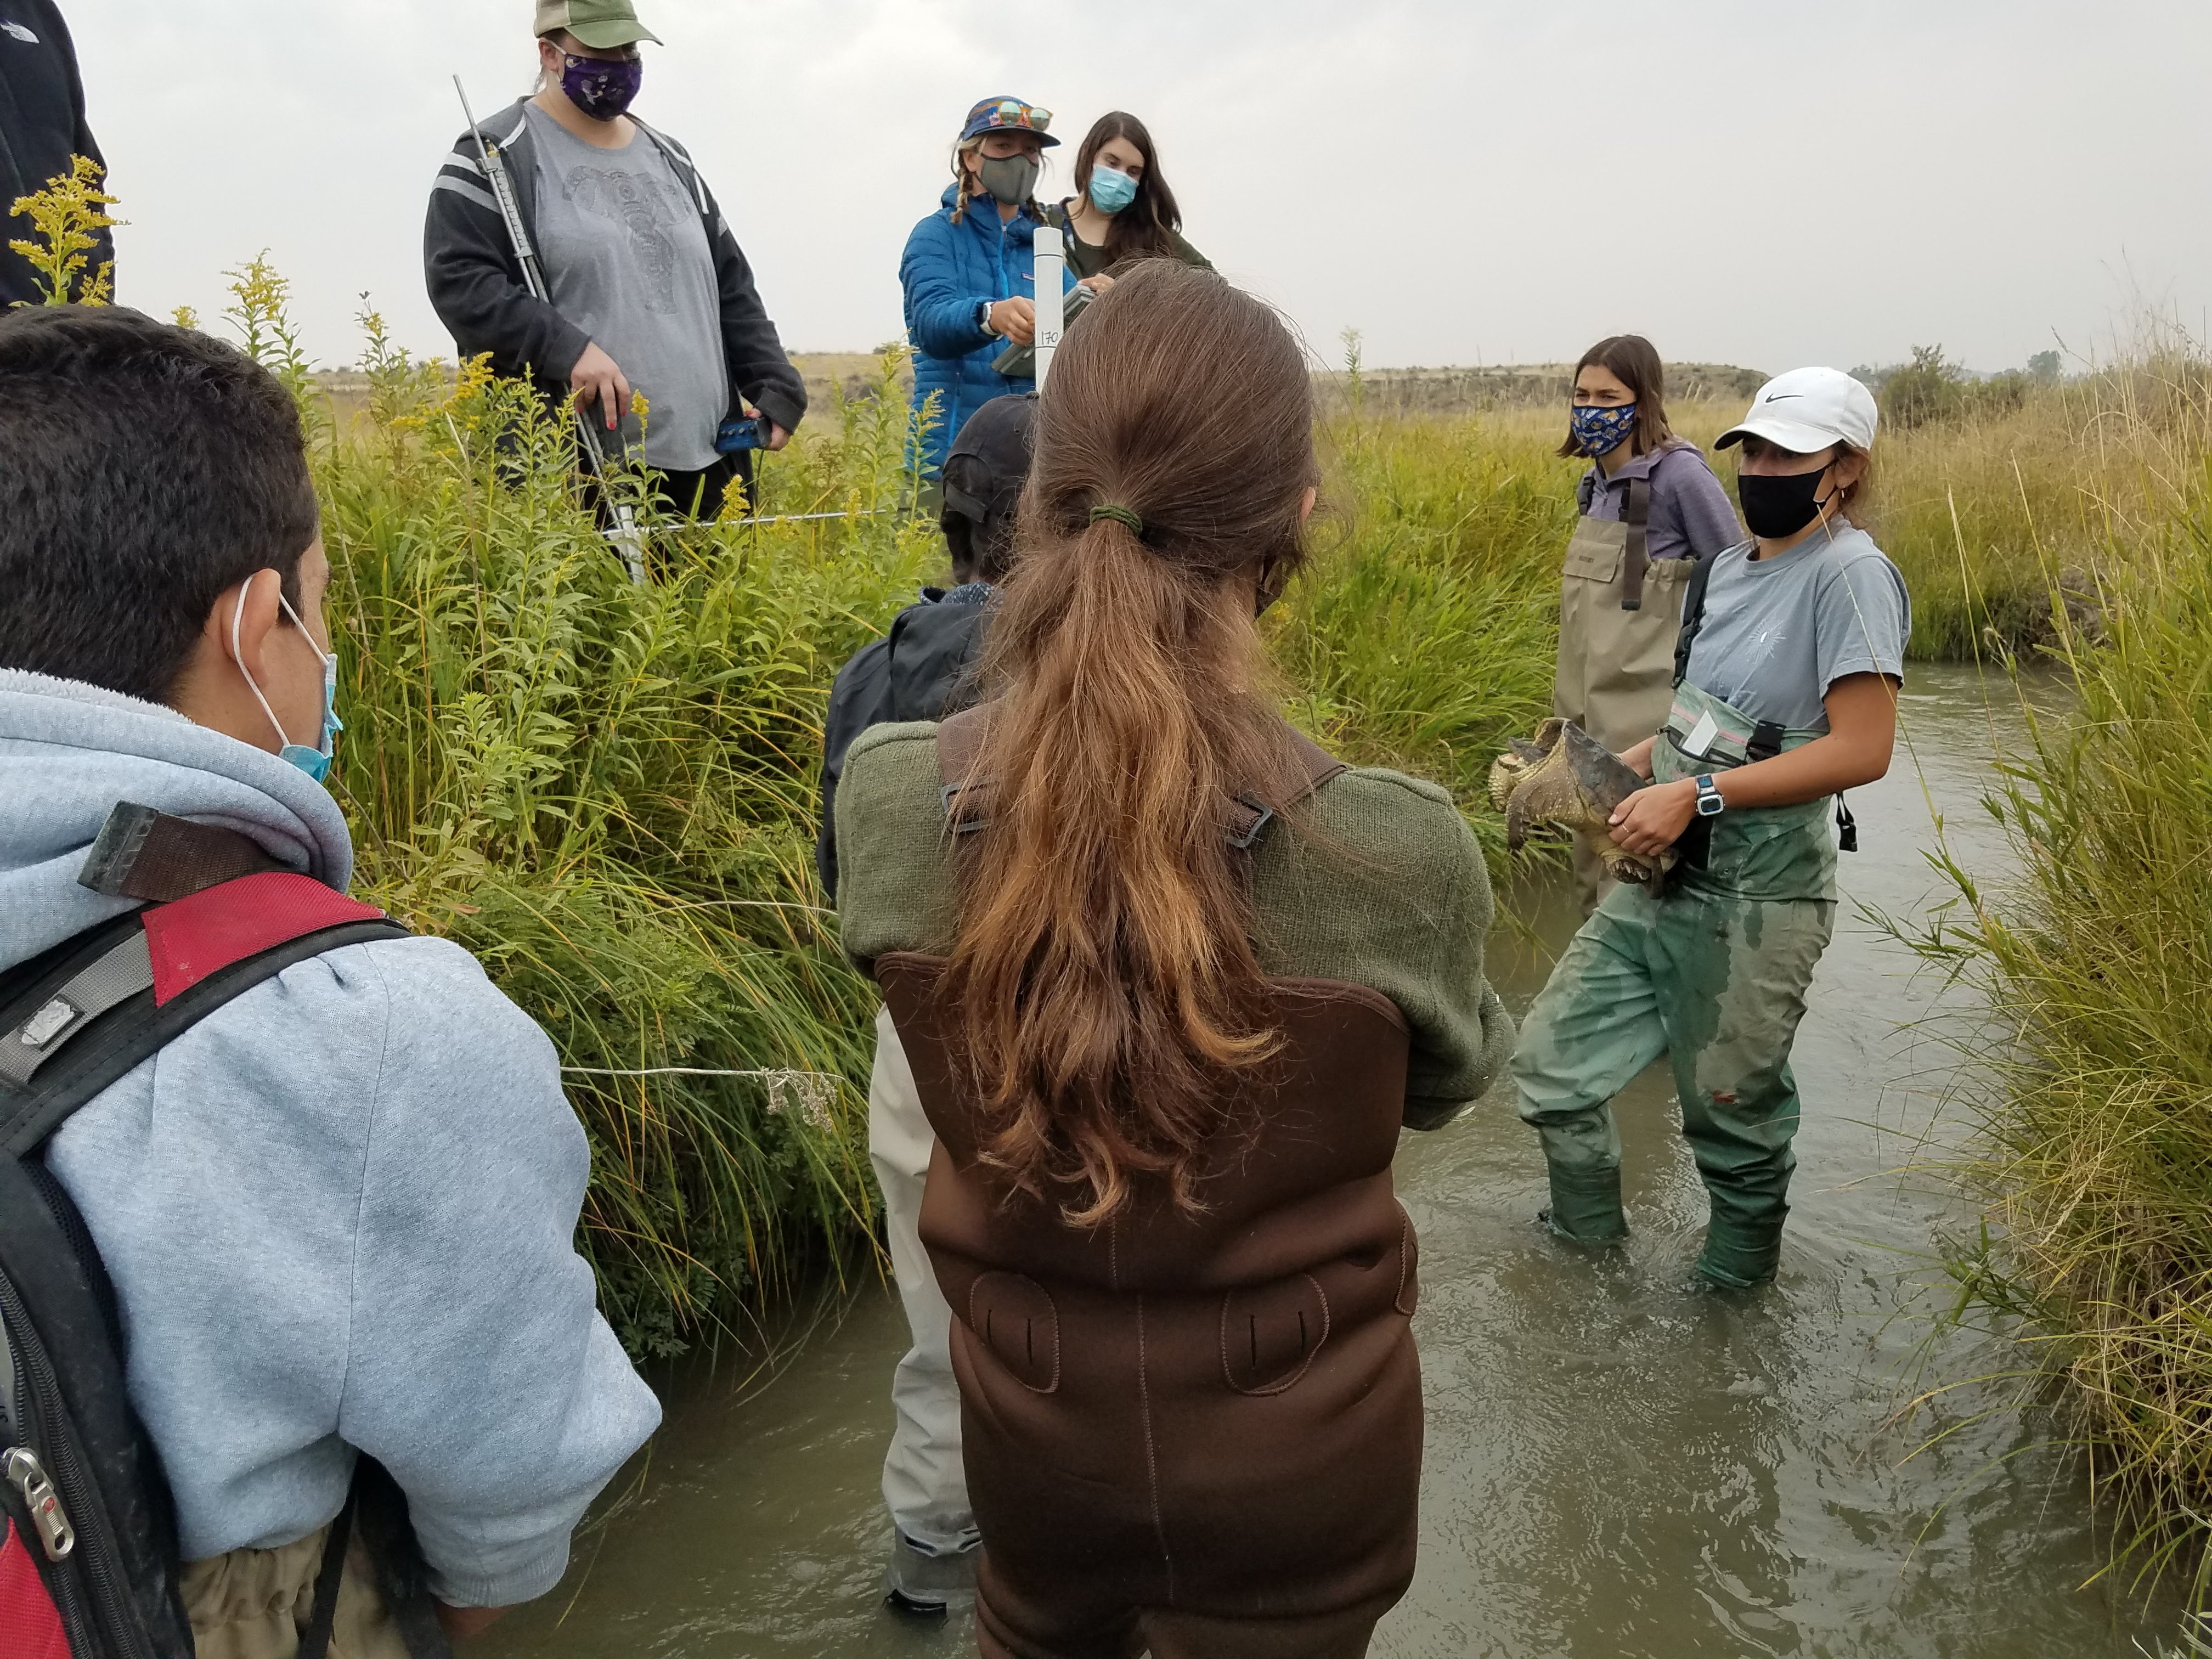
Compensating Interns, Fellows, and Research Undergraduates affiliated with MT Space Grant

Slide 2
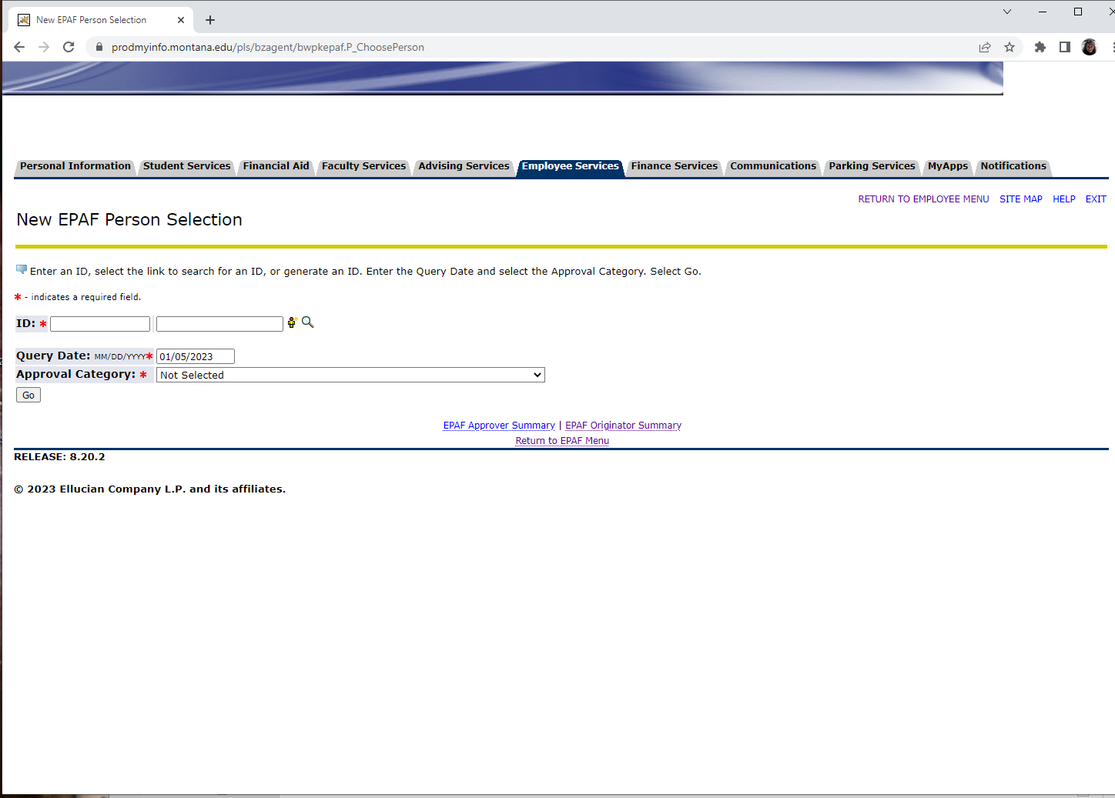
The most used method to compensate students is with Montana State University’s Ellucian payroll system.
All MSU fellows and most state-wide students are hired through this process.
Also requires an I9 and W4 to be processed.

Slide 3
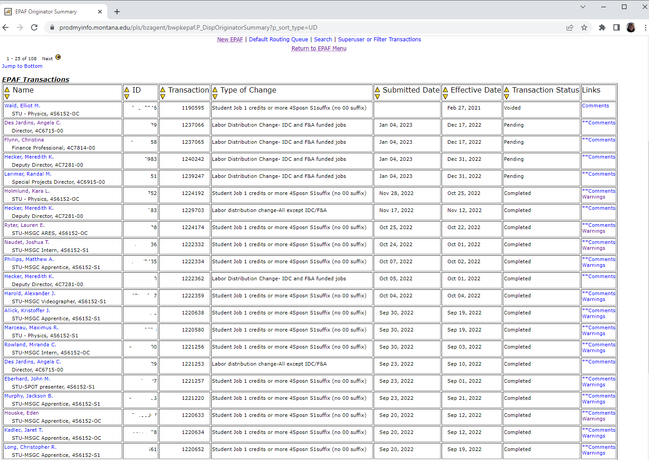

Slide 4
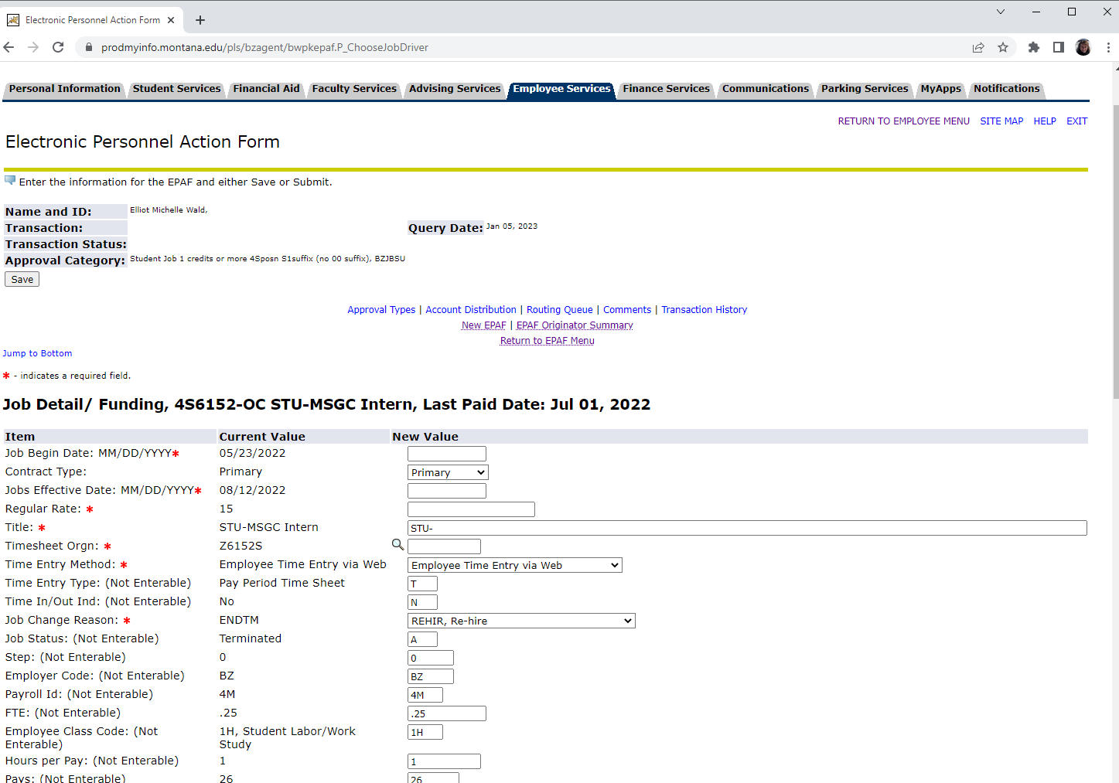

Slide 5
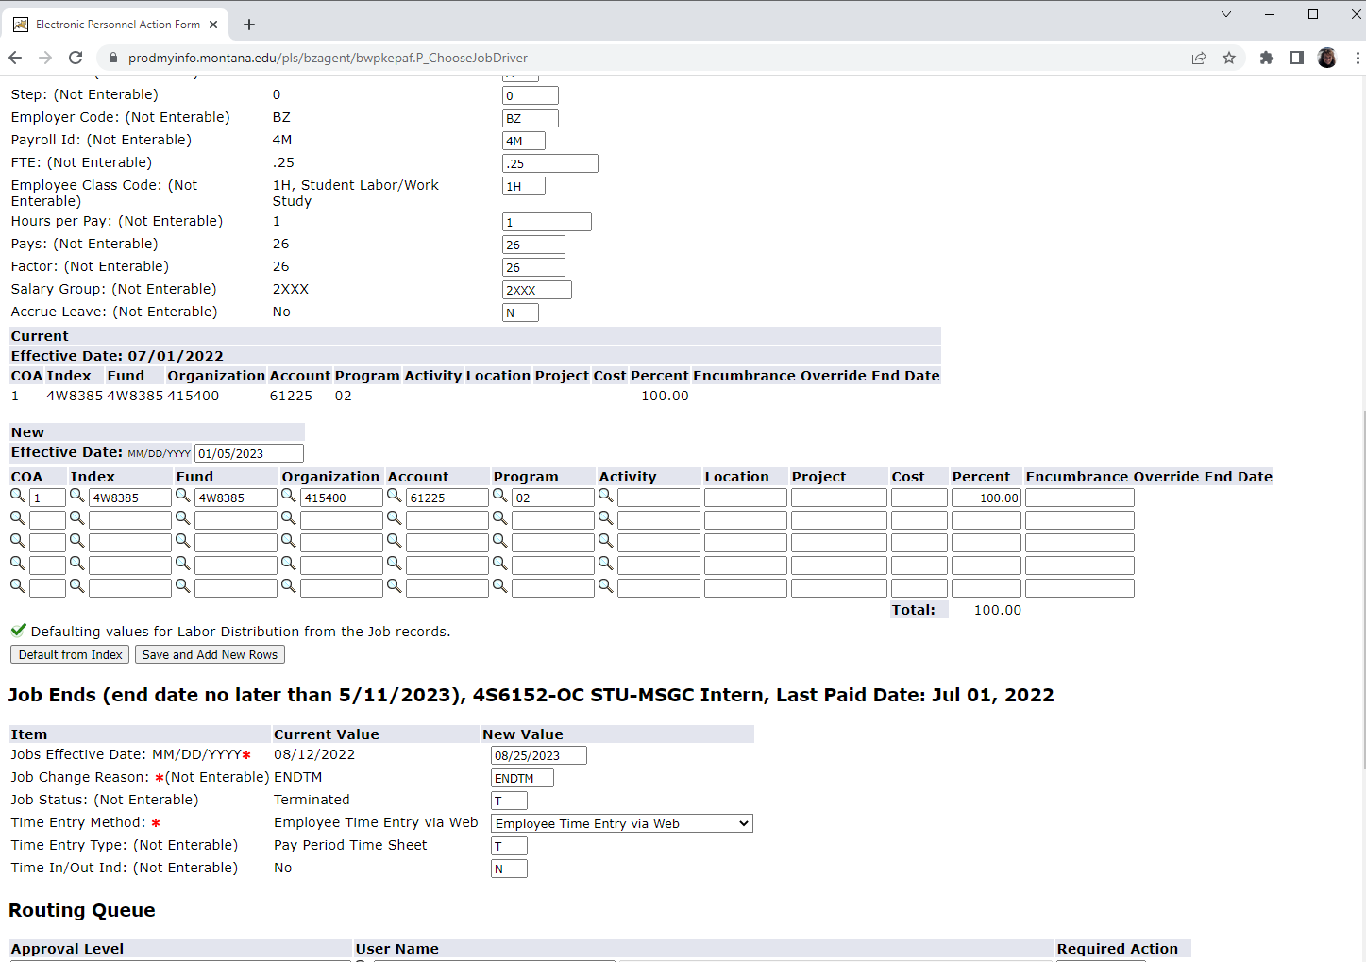

Slide 6
All Interns and all off-campus Fellows are processed on a form designed by MSU’s Office of Sponsored Programs. This form is sent via Docusign for the student, director and OSP signature. Once complete, it is used for each stipend payment transaction with the MSU Business Office.

Slide 7
MSU has a form for departments to use to process tuition and/or fee payments for graduate student fellows on campus.
Payment is applied directly to the student’s account.

Slide 8
Any faculty affiliate that is compensated as a “Fellow” signs a MT Space Grant designed form that is also processed for payment by the Business Office at Montana State University. This is for faculty/research professionals external to MSU only.
We started Faculty Fellowships in 2018.

Slide 9
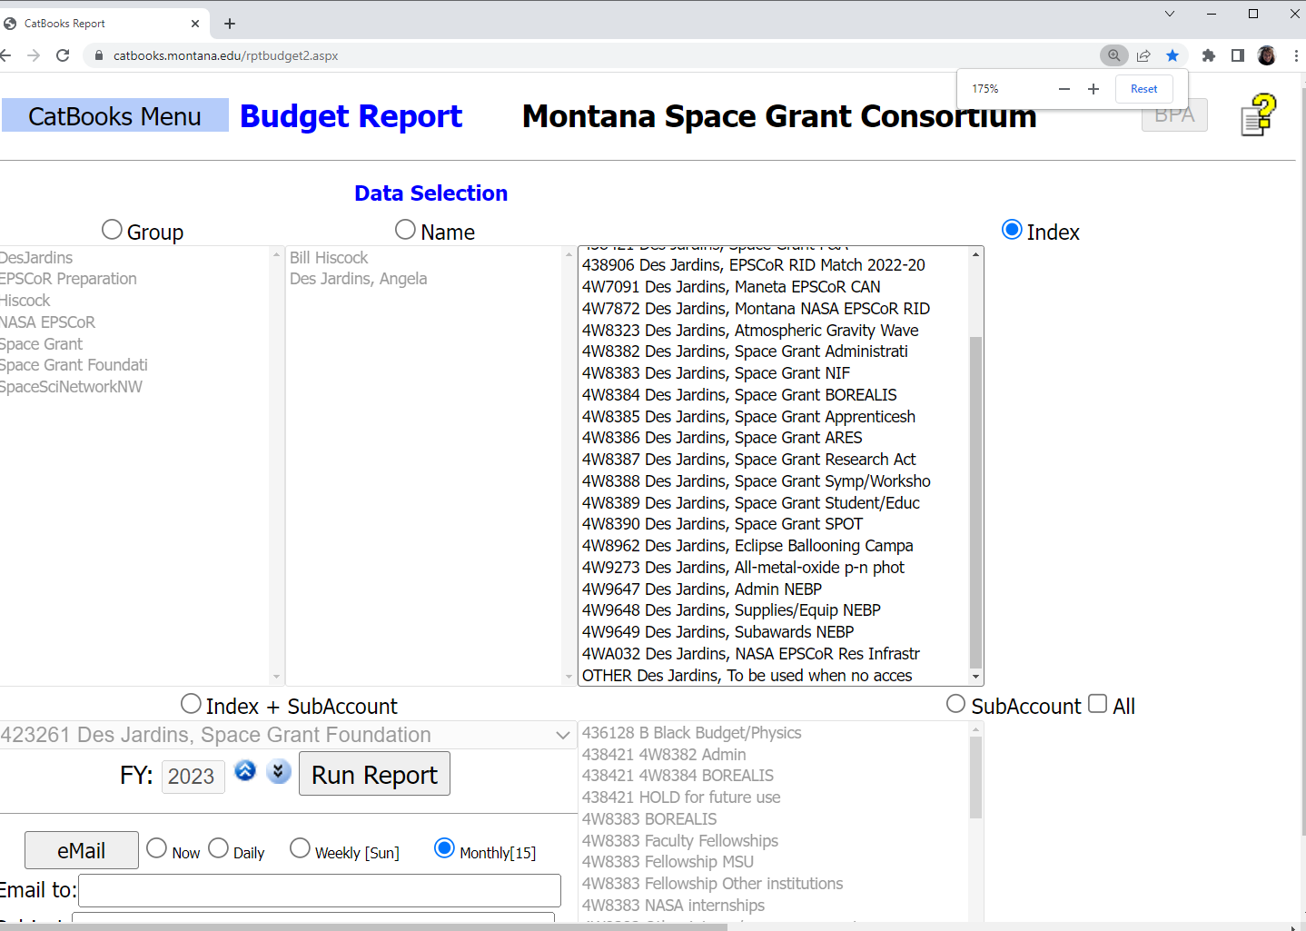
All payments processed from a stipend form are completed using a shadow system that integrates with Banner at MSU.

Slide 10
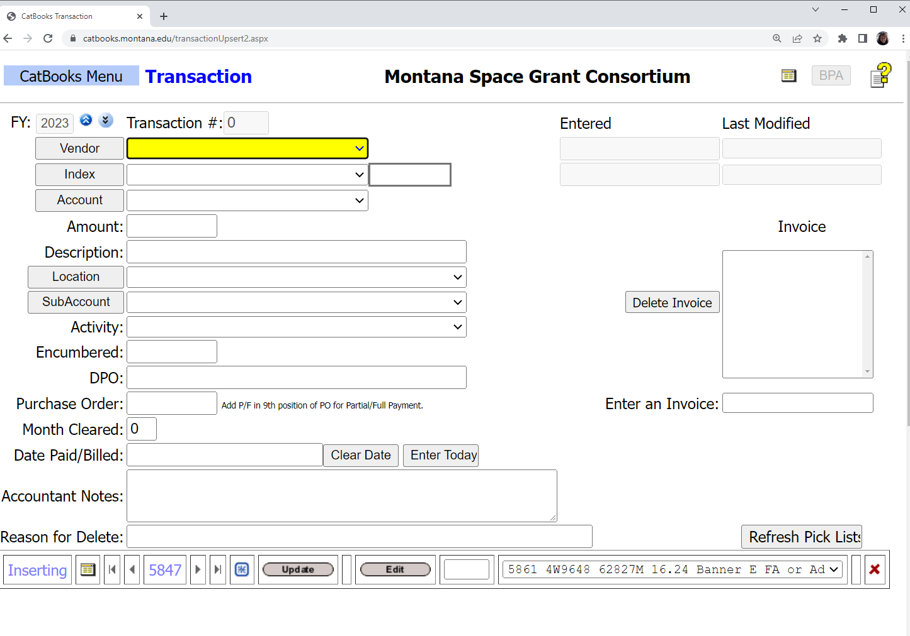

Slide 11
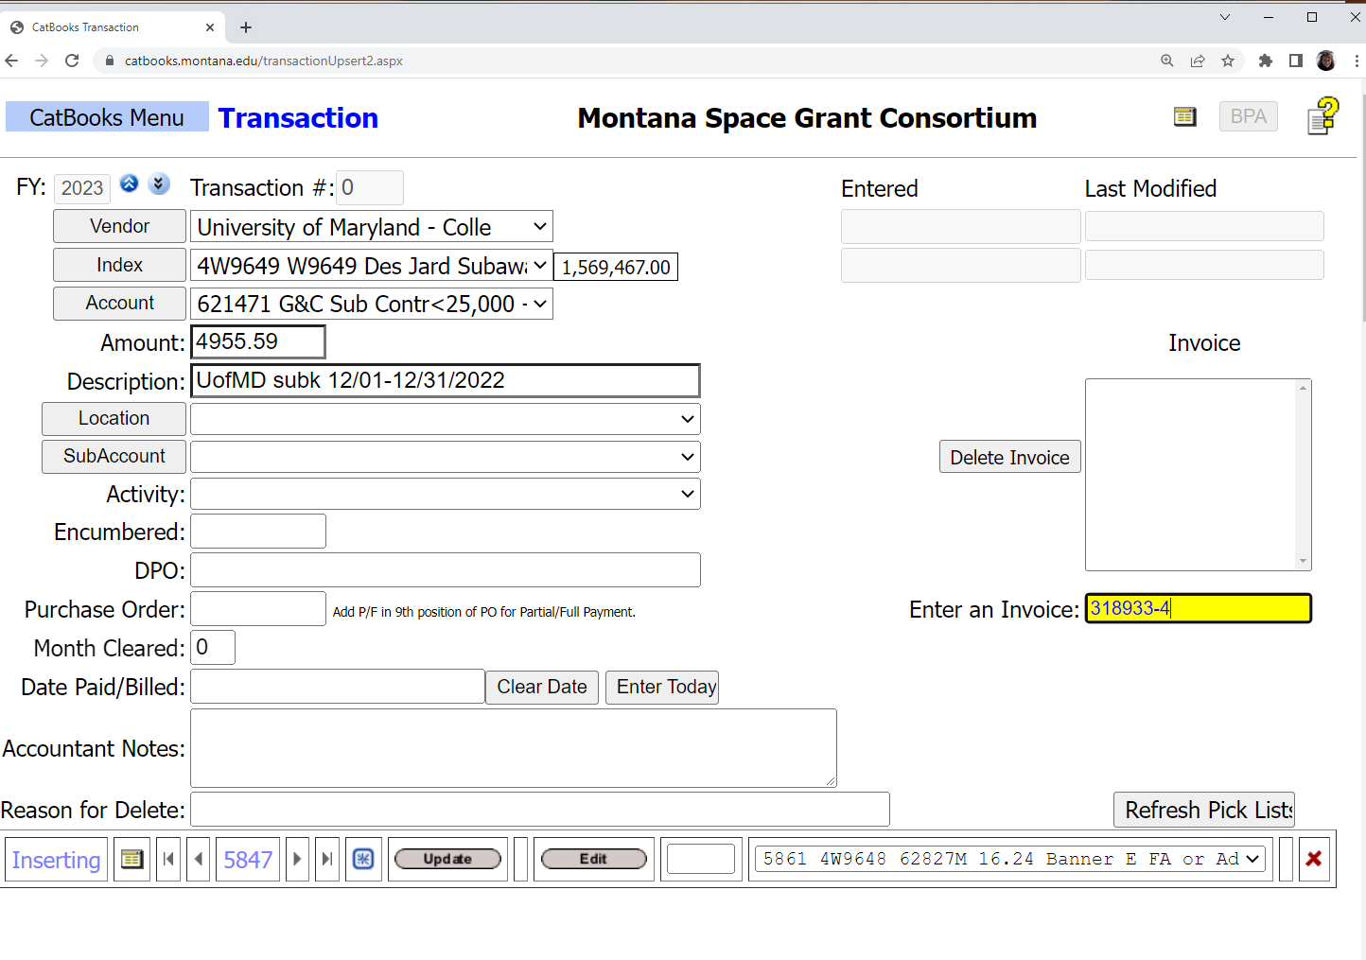

Slide 12
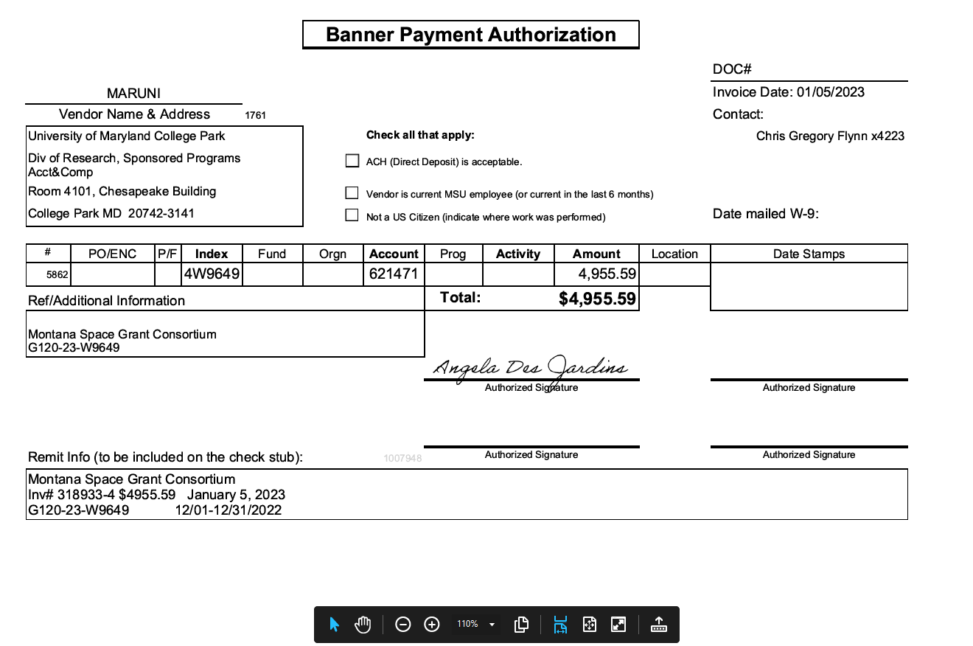
Payment Authorization is sent to MSU’s Business Office via a secure link for routing and processing.

Slide 13
MSU fellows on payroll
MSU fellows’ tuition waivers on student accounts
Off campus fellowship stipend payment
Off campus student tuition payment

Slide 14
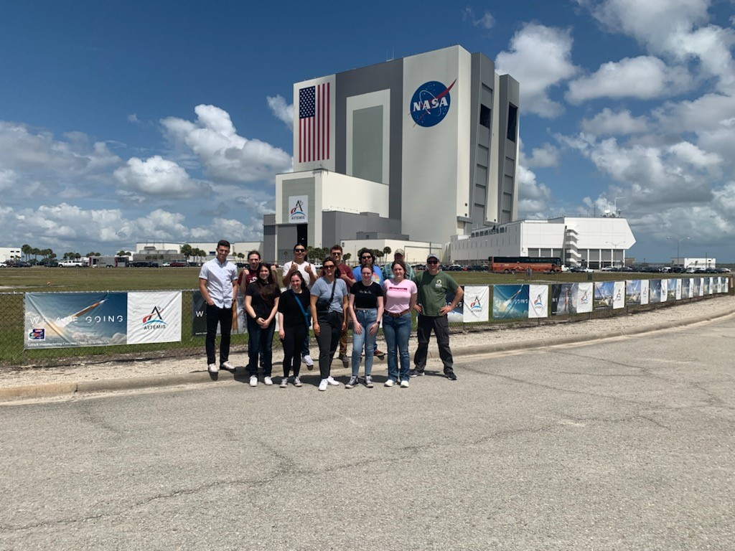
Questions?

