Slide 1



NASA Space Grant College and Fellowship Program
National Council of Space Grant Directors
Communications Working Group
Promising Programs & Practices (P³)
A monthly info session for, and by, the National Space Grant Community
February 2024 Session Featuring:
Chris Carter, (VASGC), Keanno Fausto, Jonelle Sayama, Danielle Hagen (Guam Drone Corps)
Implementing Drone Programs at Your SGC
Hosted by the Space Grant Communications Working Group
Co-Chairs: Colleen H. Fava colleenf@lsu.edu & Michelle Coe macoe@arizona.edu
February 12, 2024

Slide 2
P³: Intent and Format
Intent
Allow community members a dedicated space and time to share promising programs and practices with the greater space grant community.
Format
2nd Monday each month at 3 pm Eastern (60-90 min)
Zoom Meeting
3:00 pm: Ice breaker/Announcements
3:10 pm: Featured Presentation with Q&A (recorded)
4:00 pm: General Discussion
National Council of Space Grant Directors
Communications Working Group

Slide 3
P³: 2023 in Review
Date | Presenter | Presentation Title
January 23, 2023 | Shirley Campbell, NSGF; Chris Flynn, MTSGC; Susie Johnson, IDSGC | Best Practices & Lessons Learned on All Things Finance
February 13, 2023 | Meredith Hecker, (MTSGC); Sarah Krichels Goan; Marie Steckleberg | Space Grant Logic Models
March 2023 | No session / NASA OSTEM Comms Team | Communications Workshop at National Meeting in DC
April 10, 2023 | Angie Verissimo, Indiana; Mary Lara, Arizona | Successfully Engaging with Underrepresented Communities
May 8, 2023 | Ellen Brennan & Chip Cole, Vermont; Dawn Whitaker, Indiana | Developing a Space Grant Operations Manual
June 12, 2023 | Shawna McBride, Wyoming, Chair of the National Space Grant Foundation Board | How to Participate in the next Microsoft Gives Campaign
July 10, 2023 | BREAK
August 14, 2023 | Planning Meeting | Planning Meeting
September 11, 2023 | National Meeting | Hawaii Space Grant National Meeting
October 16, 2023 | Planning Meeting | Planning Meeting
November 13, 2023 | BREAK
December 11, 2023 | Melanie Page and Lynn Michaluk, WVSGC | Cohort Model for External Evaluation
National Council of Space Grant Directors
Communications Working Group

Slide 4
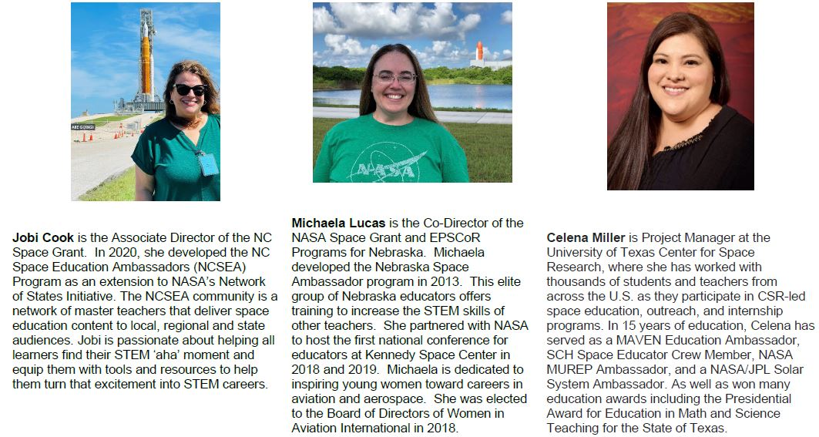
P³: January 2024 Session Recap
Summary of Participation: 30 Unique Attendees, 23 Jurisdictions, 90 min total meeting time, 79 min average time on per attendee
National Council of Space Grant Directors
Communications Working Group

Slide 5
P³: 2024 Looking Ahead
Ideas from Fall 2023 National Meeting in HI
Cost-Share: Getting it from affiliates, holding them accountable, documenting it at your university
NASA Center Interns: Support Beyond Funding (housing)
Virtual and/or Hybrid Symposiums & Poster Sessions
We wanted to know more about…
Embedded Teacher Program in Wisconsin
Plant the Moon Challenge
Chris Koehler’s Coursera, Pathway to Space Program
National Council of Space Grant Directors
Communications Working Group

Slide 6
P³: in Review
Quick Reminder
Revisit the December 2022 presentation on What to Expect on the Hill presented by Mary Sandy.
https://laspace.lsu.edu/promising-programs-practices-p3/
National Council of Space Grant Directors
Communications Working Group

Slide 7
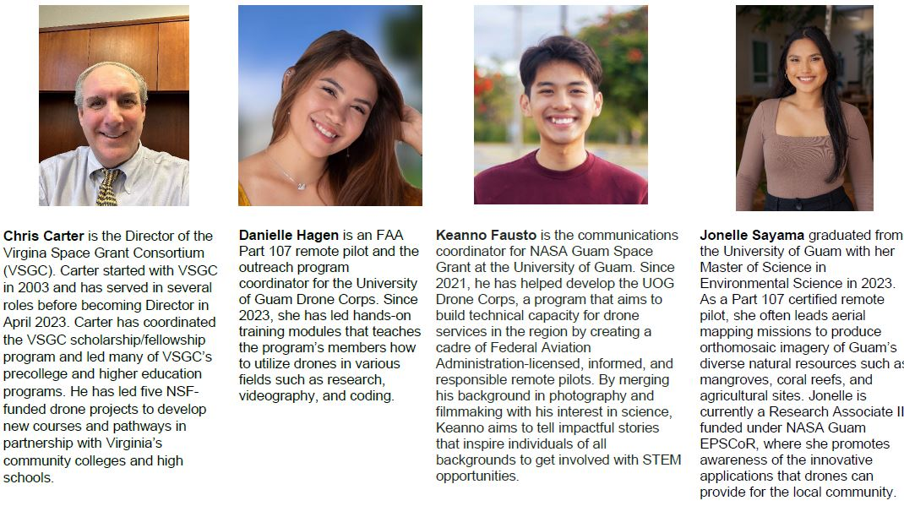
P³: February Session
National Council of Space Grant Directors
Communications Working Group

