Slide 1



NASA Space Grant College and Fellowship Program
National Council of Space Grant Directors
Communications Working Group
Promising Programs & Practices (P³)
A monthly info session for, and by, the National Space Grant Community
January 2024 Session Featuring:
Jobi Cook (NC SGC), Michaela Lucas (NE SGC),
and Celena Miller (TX SGC)
Professional Development Opportunities for Educators
Hosted by the Space Grant Communications Working Group
Co-Chairs: Colleen H. Fava colleenf@lsu.edu & Michelle Coe macoe@arizona.edu
January 22, 2024

Slide 2
P³: Intent and Format
Intent
Allow community members a dedicated space and time to share promising programs and practices with the greater space grant community.
Format
2nd Monday each month at 3 pm Eastern (60-90 min)
  Zoom Meeting
  3:00 pm: Ice breaker/Announcements
  3:10 pm: Featured Presentation with Q&A (recorded)
  4:00 pm: General Discussion
National Council of Space Grant Directors
Communications Working Group

Slide 3
P³: 2023 in Review
Date | Presenter | Presentation Title
January 23, 2023 | Shirley Campbell, NSGF; Chris Flynn, MTSGC; Susie Johnson, IDSGC | Best Practices & Lessons Learned on All Things Finance
February 13, 2023 | Meredith Hecker, (MTSGC); Sarah Krichels Goan; Marie Steckleberg | Space Grant Logic Models
March 2023 | No session / NASA OSTEM Comms Team | Communications Workshop at National Meeting in DC
April 10, 2023 | Angie Verissimo, Indiana; Mary Lara, Arizona | Successfully Engaging with Underrepresented Communities
May 8, 2023 | Ellen Brennan & Chip Cole, Vermont; Dawn Whitaker, Indiana | Developing a Space Grant Operations Manual
June 12, 2023 | Shawna McBride, Wyoming, Chair of the National Space Grant Foundation Board | How to Participate in the next Microsoft Gives Campaign
July 10, 2023 | BREAK
August 14, 2023 | Planning Meeting | Planning Meeting
September 11, 2023 | National Meeting | Hawaii Space Grant National Meeting
October 16, 2023 | Planning Meeting | Planning Meeting
November 13, 2023 | BREAK
December 11, 2023 | Melanie Page and Lynn Michaluk, WVSGC | Cohort Model for External Evaluation
National Council of Space Grant Directors
Communications Working Group

Slide 4
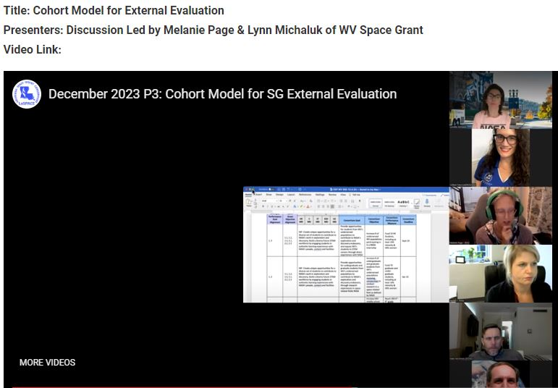
P³: December Session Recap
Summary of Participation:
32 Unique Attendees
20 Jurisdictions
79 min total meeting time
69 min average time on per attendee
National Council of Space Grant Directors
Communications Working Group

Slide 5
P³: Coming Up Next
2024
Up next, Implementing Drone Programs at your SGC!
  Keanno Fausto, Jonelle Sayama, and Danielle Hagen from Guam Space Grant Consortium
  Chris Carter, Virginia Space Grant Consortium
  Hold your calendars: Feb. 12th, 5PM EST
National Council of Space Grant Directors
Communications Working Group

Slide 6
P³: 2024 Looking Ahead
Ideas from Fall 2023 National Meeting in HI
Cost-Share: Getting it from affiliates, holding them accountable, documenting it at your university
NASA Center Interns: Support Beyond Funding (housing)
Virtual and/or Hybrid Symposiums & Poster Sessions
We wanted to know more about…
Embedded Teacher Program in Wisconsin
Plant the Moon Challenge
Chris Koehler’s Coursera, Pathway to Space Program
National Council of Space Grant Directors
Communications Working Group

Slide 7
P³: in Review
Quick Reminder
Revisit the December 2022 presentation on What to Expect on the Hill presented by Mary Sandy
https://laspace.lsu.edu/promising-programs-practices-p3/
National Council of Space Grant Directors
Communications Working Group

Slide 8

P³: Ice Breaker January Session
Happy New Year!
  Who stayed up until midnight?
  What are your NYE traditions?
National Council of Space Grant Directors
Communications Working Group

Slide 9
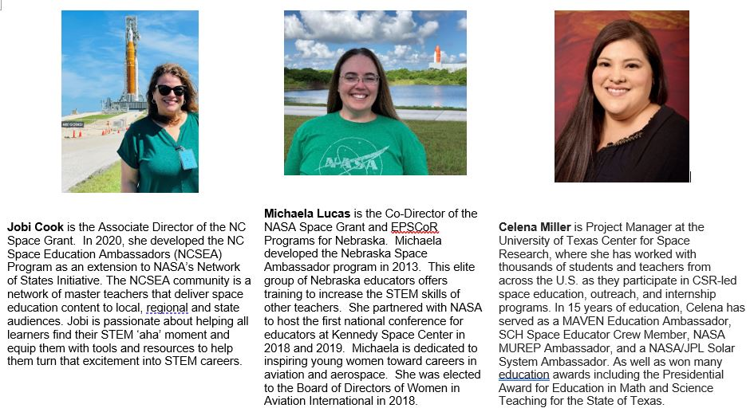
P³: January Session
National Council of Space Grant Directors
Communications Working Group

