Slide 1

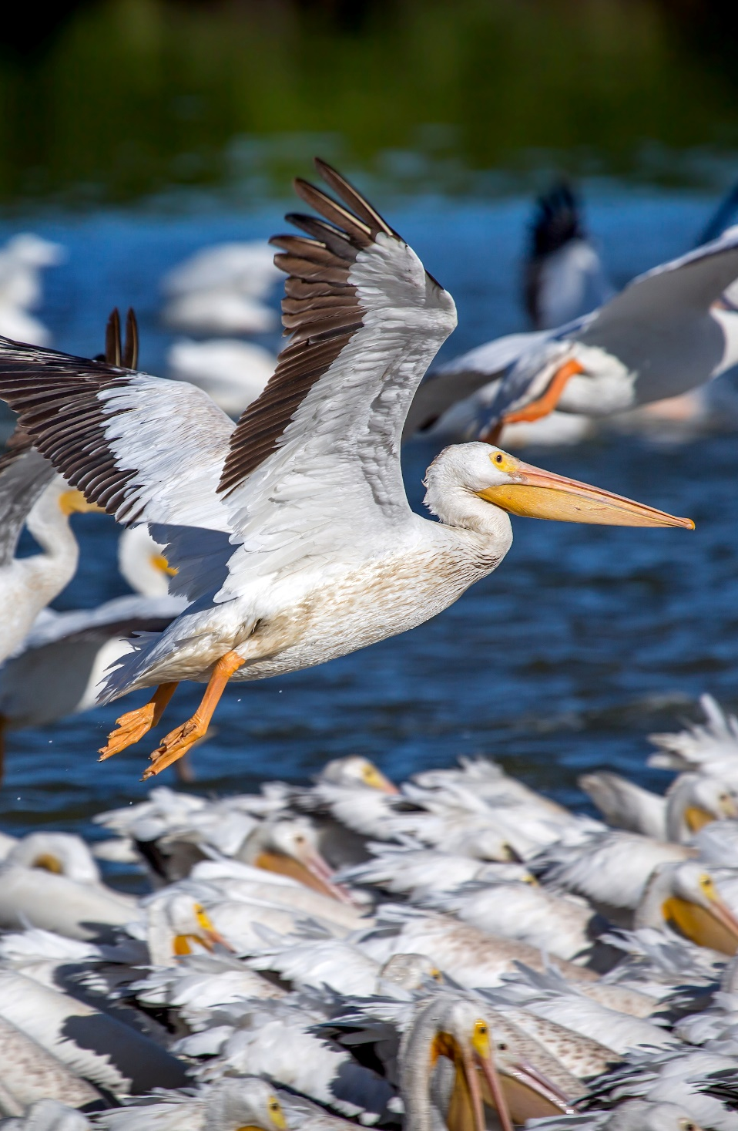

2021 Joint Meeting
Louisiana Space+Sea Grant
Amazing successes for both programs
Board of Regents and University support
Great leadership and staff
Recent Louisiana Sea Grant Program Review: National best practice examples
Innovative student and faculty research and outreach
Exciting crossovers between Coast and Space
Oyster and Carbon projects
Welcome to our NC Colleagues!

Slide 2
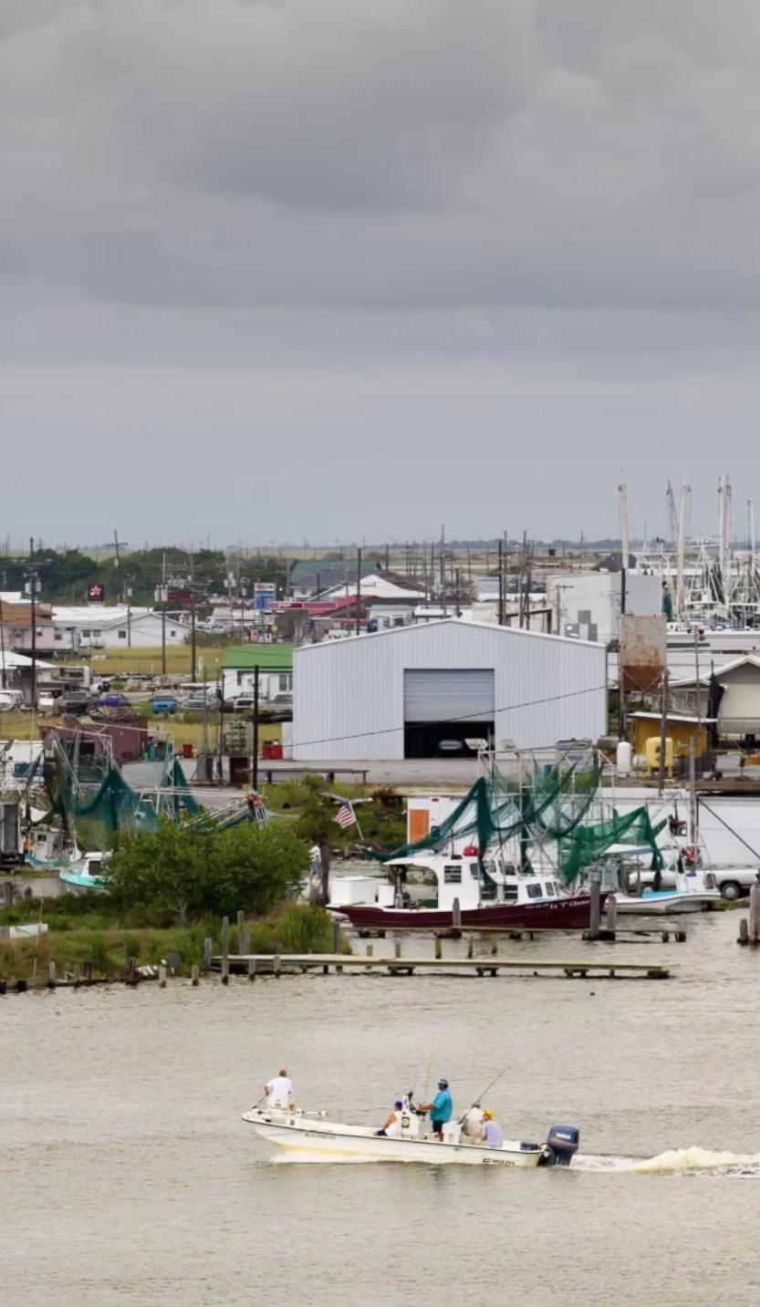
Louisiana Sea Grant
Coast:
our culture, economy, home
Louisiana Sea Grant:
Critical programs in
Education+Outreach+Research
Fisheries
Ecosystems
Community safety and resilience
Examples:
LaDIA Program
Louisiana Direct Seafood

Slide 3
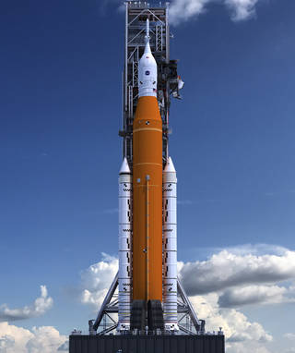
Did you know?
Equipment owned by Louisiana universities is helping build the Space Launch System?
World’s most powerful Rocket
Orion crew vehicle for the Moon and beyond
You will have new chances to work with NASA:
National Center for Advanced Manufacturing
LSU+UNO+NASA
Louisiana Space Campus @Michoud Assembly Facility
Space science and engineering
Education
Industry collaboration
A LIVING LAB

Slide 4
2021 Joint Meeting
Louisiana Space+Sea Grant
It is all about our people.
Thanks for what you do.
Your university research offices are here to help.
Let us know what we can do.
Thanks!

