Slide 1


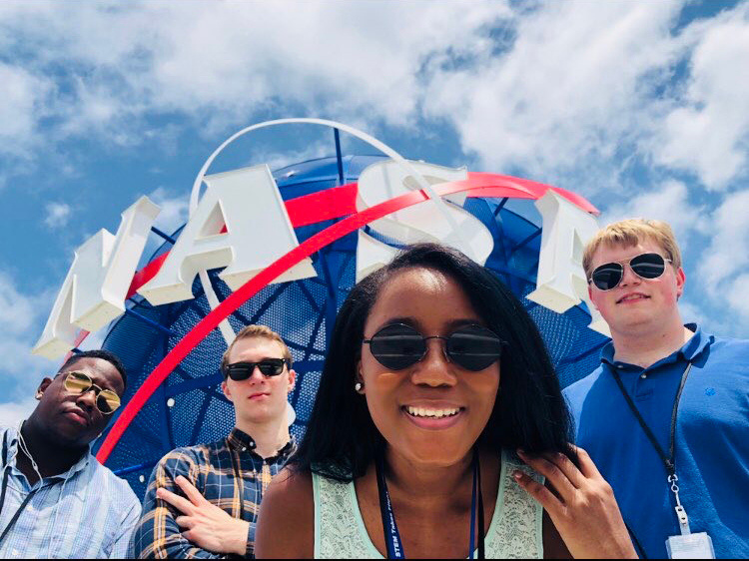



VIRGINIA
SPACE GRANT CONSORTIUM
Overview of Uncrewed Aircraft Systems (UAS)
Chris Carter, Director,
Virginia Space Grant Consortium

Slide 2
VSGC Members
  Hampton University
  Old Dominion University
  William and Mary
  University of Virginia
  Virginia Tech
  NASA Langley Research Center
  NASA Wallops Flight Facility
  Virginia Innovation Partnership Corporation
  State Council of Higher Education Virginia
  Virginia Community College System
  Science Museum of Virginia
  Virginia Air and Space Science Center
  Virginia Department of Education
  Virginia Aerospace Business Association
  Virginia Department of Aviation
  Math Science Innovation Center

Slide 3
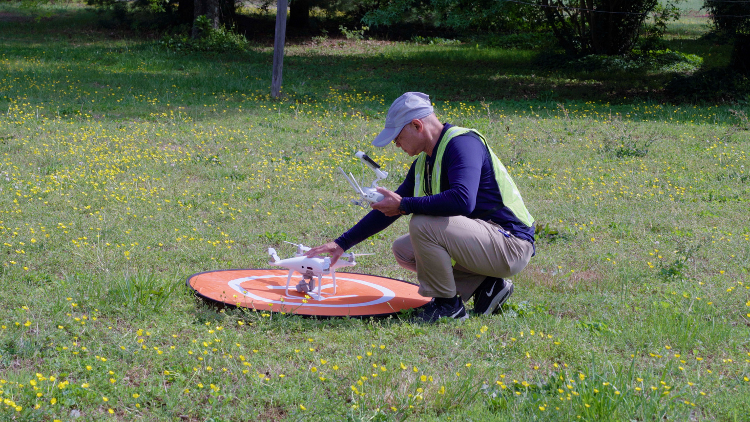




Facilitator for Uncrewed Aircraft Systems (UAS), or Drones
Education, Research, and Workforce Development
Scholarship/Fellowship Support for Research
DACUM Panel
Course Development
Educator Professional Development
Service-Learning Projects
Student Outreach Events
Drone Competition
Drone Workshops for Students With Disabilities
Paid Industry Internships
NASA Research Experiences
Sources of Funding
National Science Foundation (NSF) – Advanced Technological Education (ATE)
FAA – Aviation Workforce Development Program
State Funding
Space Grant Funding
Partnerships with Virginia Tech, Virginia Community College System, Industry and Others

Slide 4
GeoTEd-UAS (Increasing Pathways into the Geospatial and Uncrewed Aircraft Systems (UAS) Technician Workforce)
VSGC has led 5 NSF Advanced Technological Education (ATE) awards (2007 – current) ​
GeoTEd and GeoTEd-UAS
More than $3.6M awarded
Mission: Build community college and educator capacity to educate and train the geospatial and small UAS operations technician (sUAS-OT, or drone) workforce.
GeoTEd-UAS Overview Video (90 second video)
NSF DUE #2000715; #1601614

Slide 5
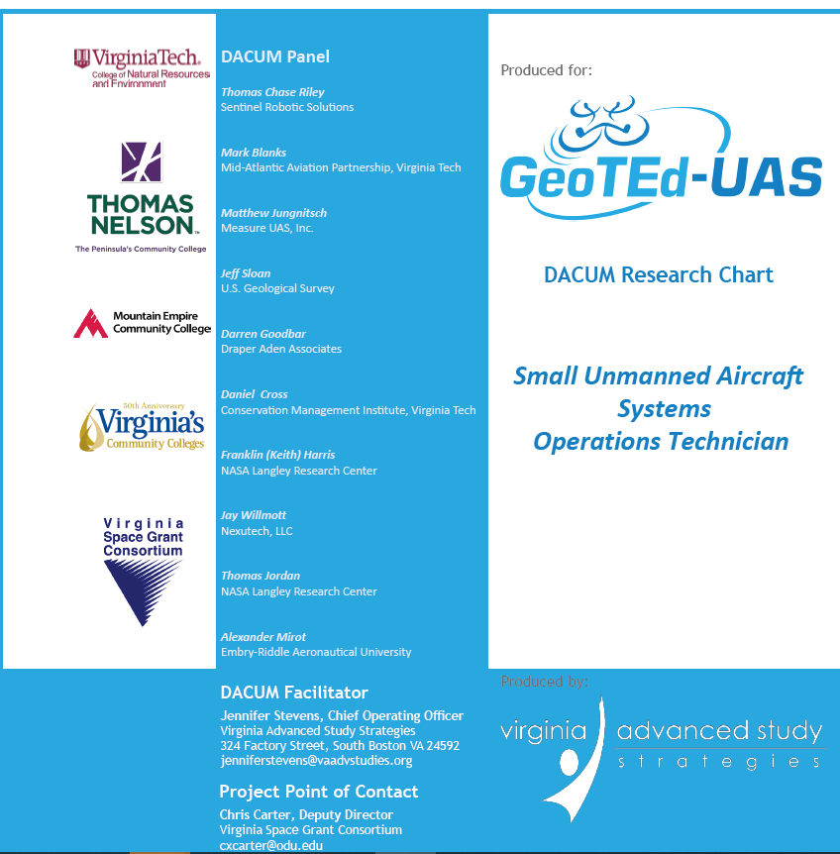
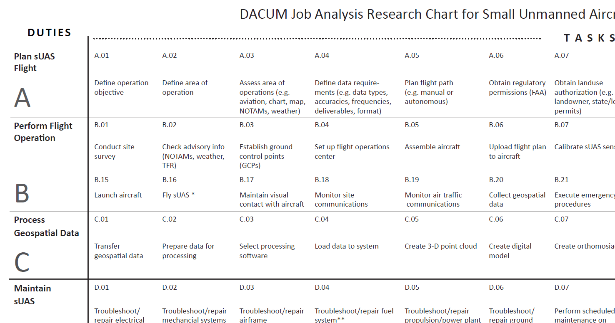

Slide 6
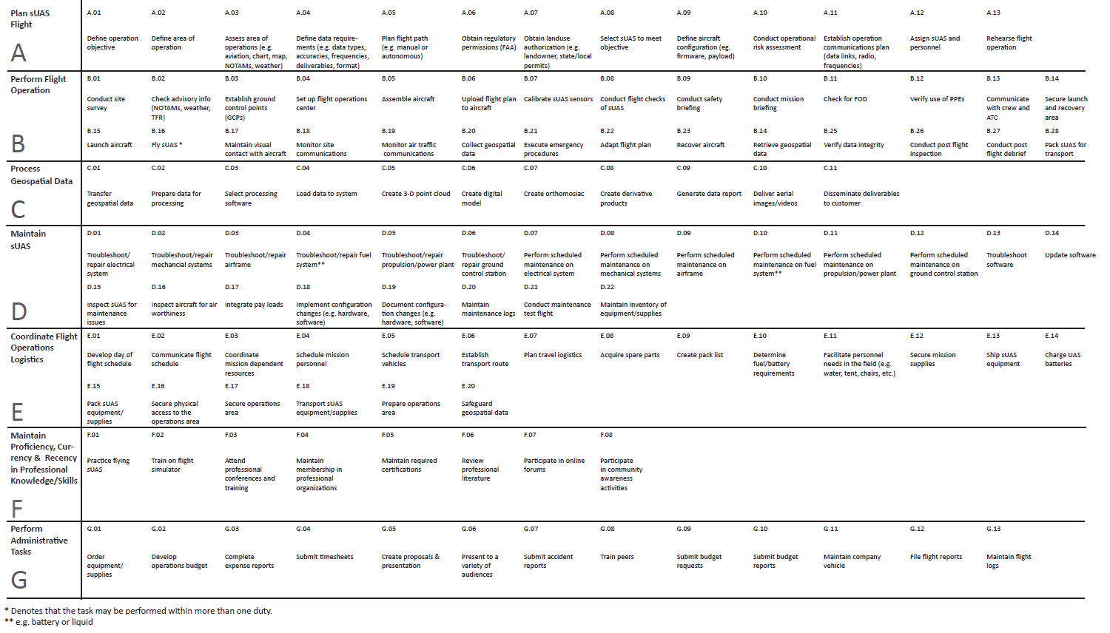

Slide 7
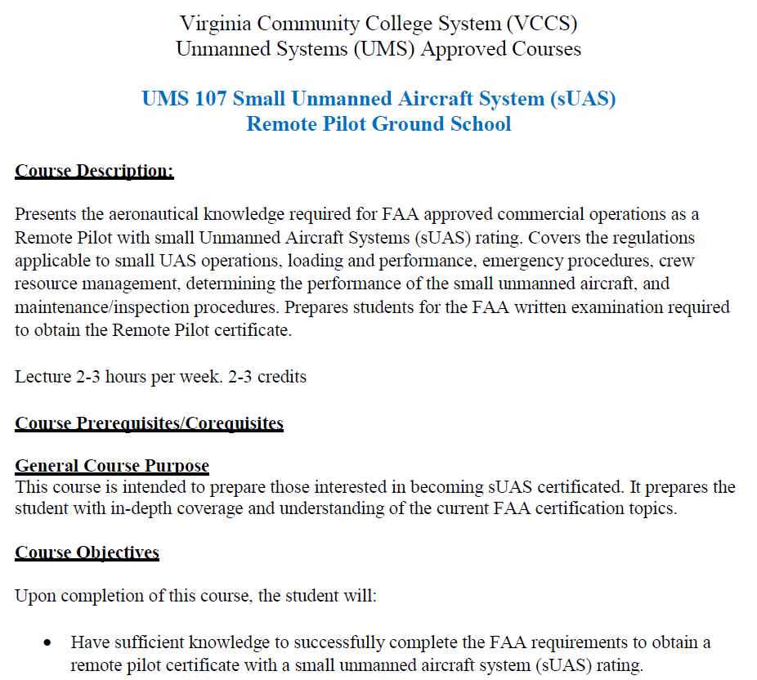
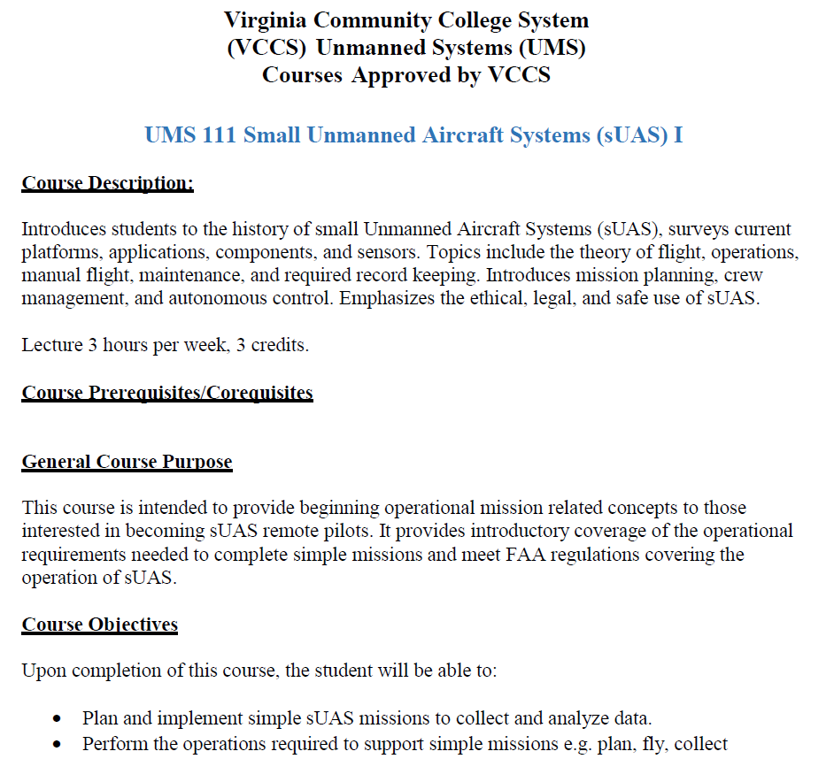

Slide 8
Virginia Community College Courses
UMS 107 sUAS Remote Pilot Ground School
UMS 111 Introduction to Manual Flights
UMS 211 Advanced Autonomous Flights
UMS 177 sUAS Components and Maintenance
UMS 112 Program and Flight Data Management
UMS 290 Coordinated Internship
UMS 120 - Drone Imaging for Immersive Media
Instructional Materials
New and Incumbent Workforce
Service-Learning Projects
Accelerated Courses
Transfer Opportunities

Slide 9
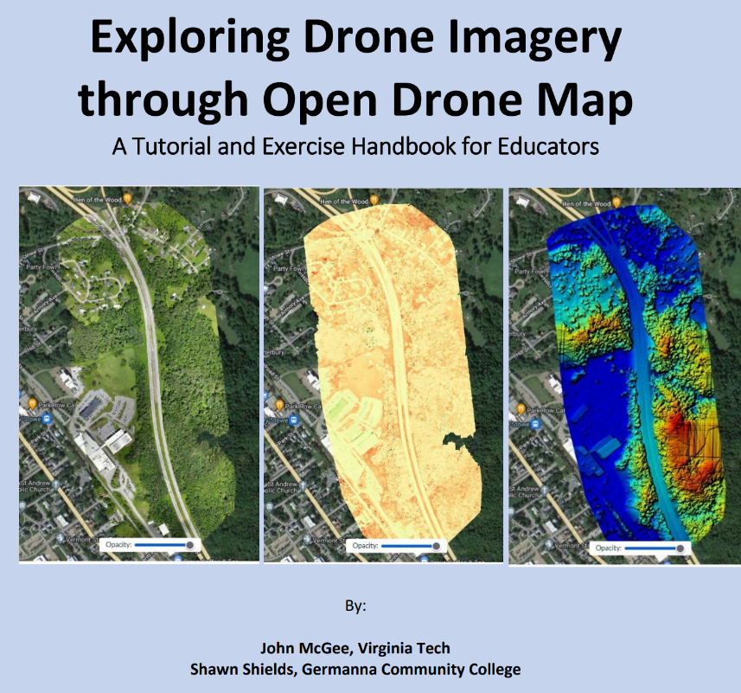
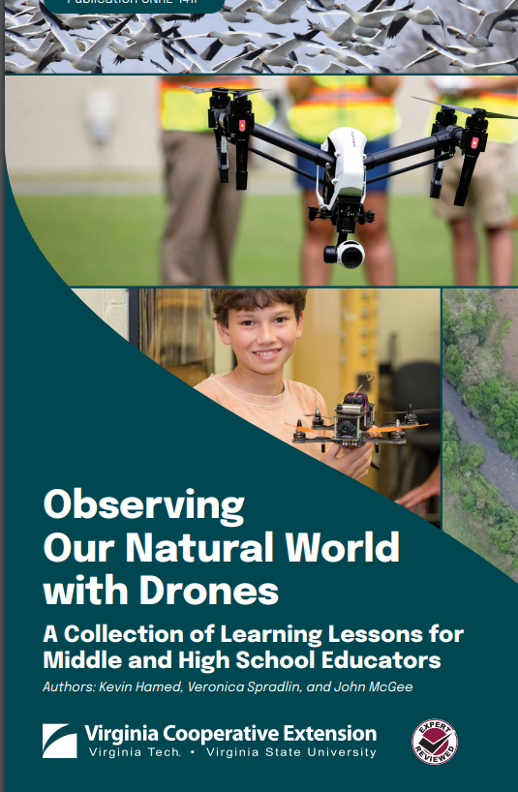
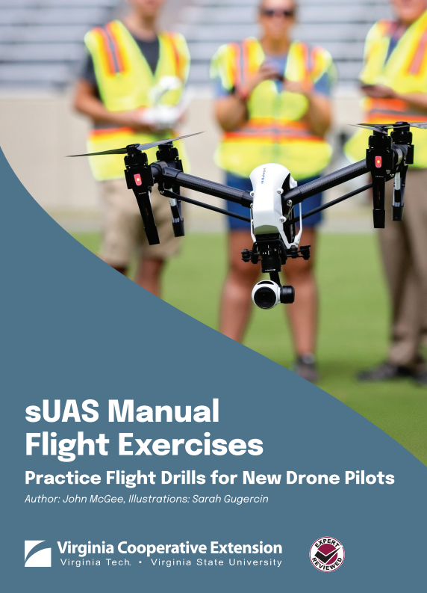
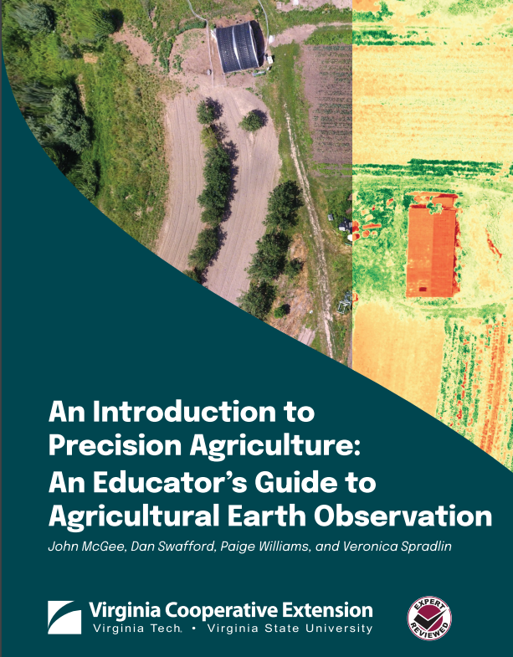
Uncrewed Aircraft Systems (UAS), or Drones
Course Development and Faculty Training

Slide 10
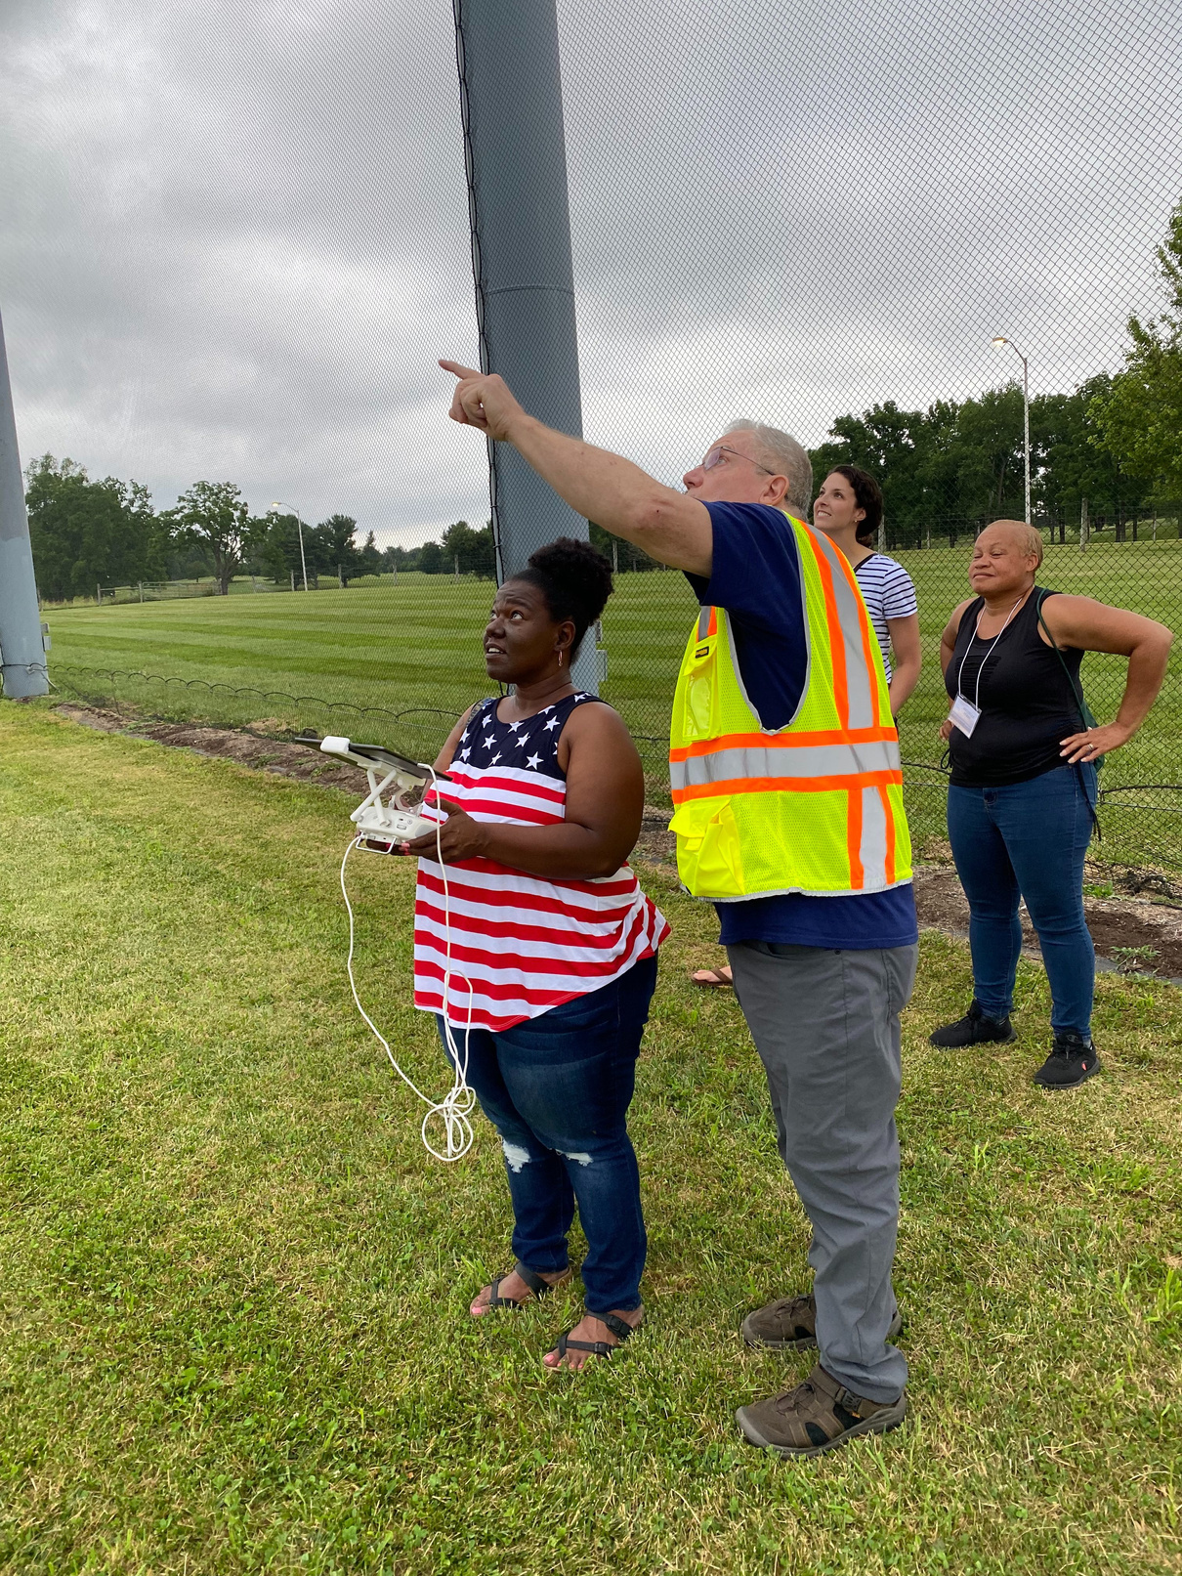
GeoTEd-UAS Faculty Institutes
Hosted by Mid-Atlantic Aviation Partnership at VT (MAAP), one of FAA’s UAS Test Sites
11 faculty institutes hosted by VT (1 at Va Commonwealth University)
  Training faculty to prepare the small UAS operations technician workforce
UAS Institute Video
Service-learning partnerships:
  Virginia Tech – 3D modeling
  The Nature Conservancy – shoreline mapping
  VCU Rice Rivers Center – various projects
  NASA Langley Research Center – tree mapping
  NASA Wallops Flight Facility – vegetation mapping
  U.S. Forest Service – habitat mapping

Slide 11
VSGC UAS Outcomes
3 DACUM Charts (GIS Technician, Small UAS Operator Technician, Unmanned Systems Technician)
Seven New UAS-focused Courses Established in VCCS Catalog
Professional Development: More than 125 educators obtained FAA Part 107 Remote Pilot Certificate and Received Hands-on Training
10 community colleges offering courses; More than 1,100 students completed UAS courses since fall of 2017
At least 20 High Schools Offering UAS Course

Slide 12
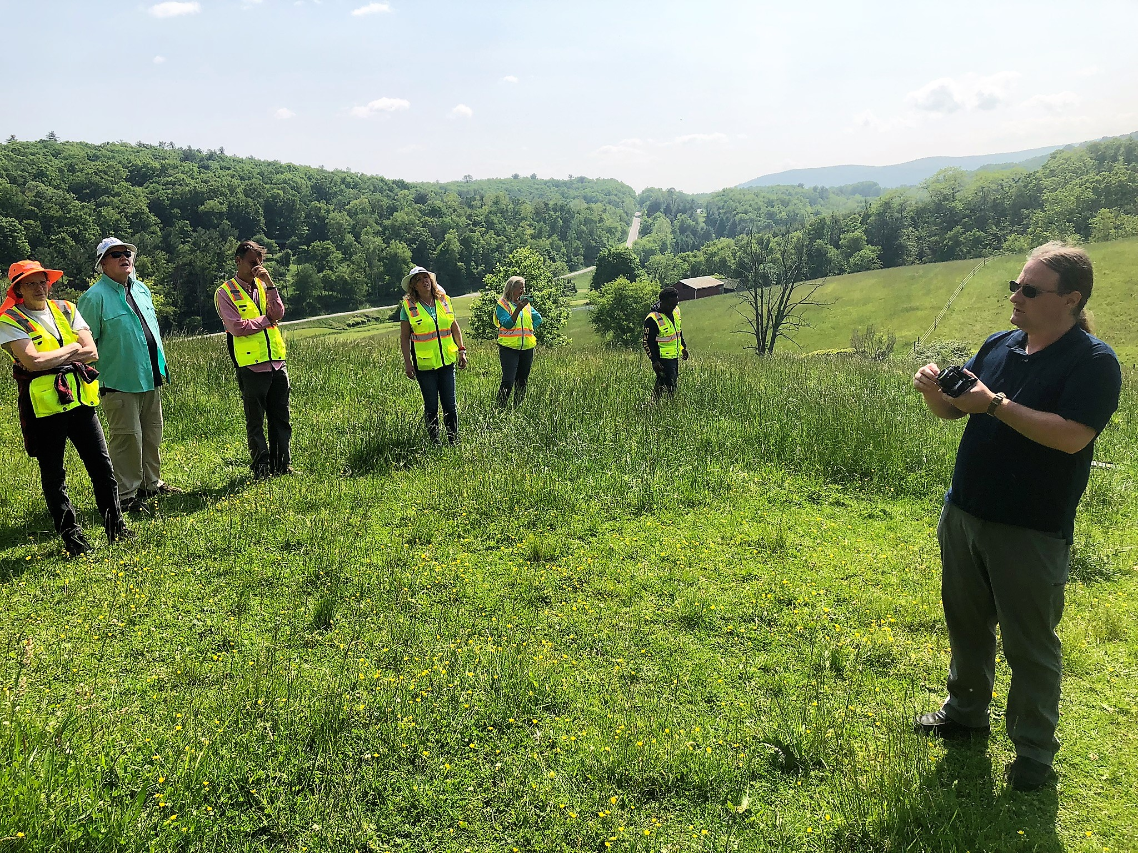
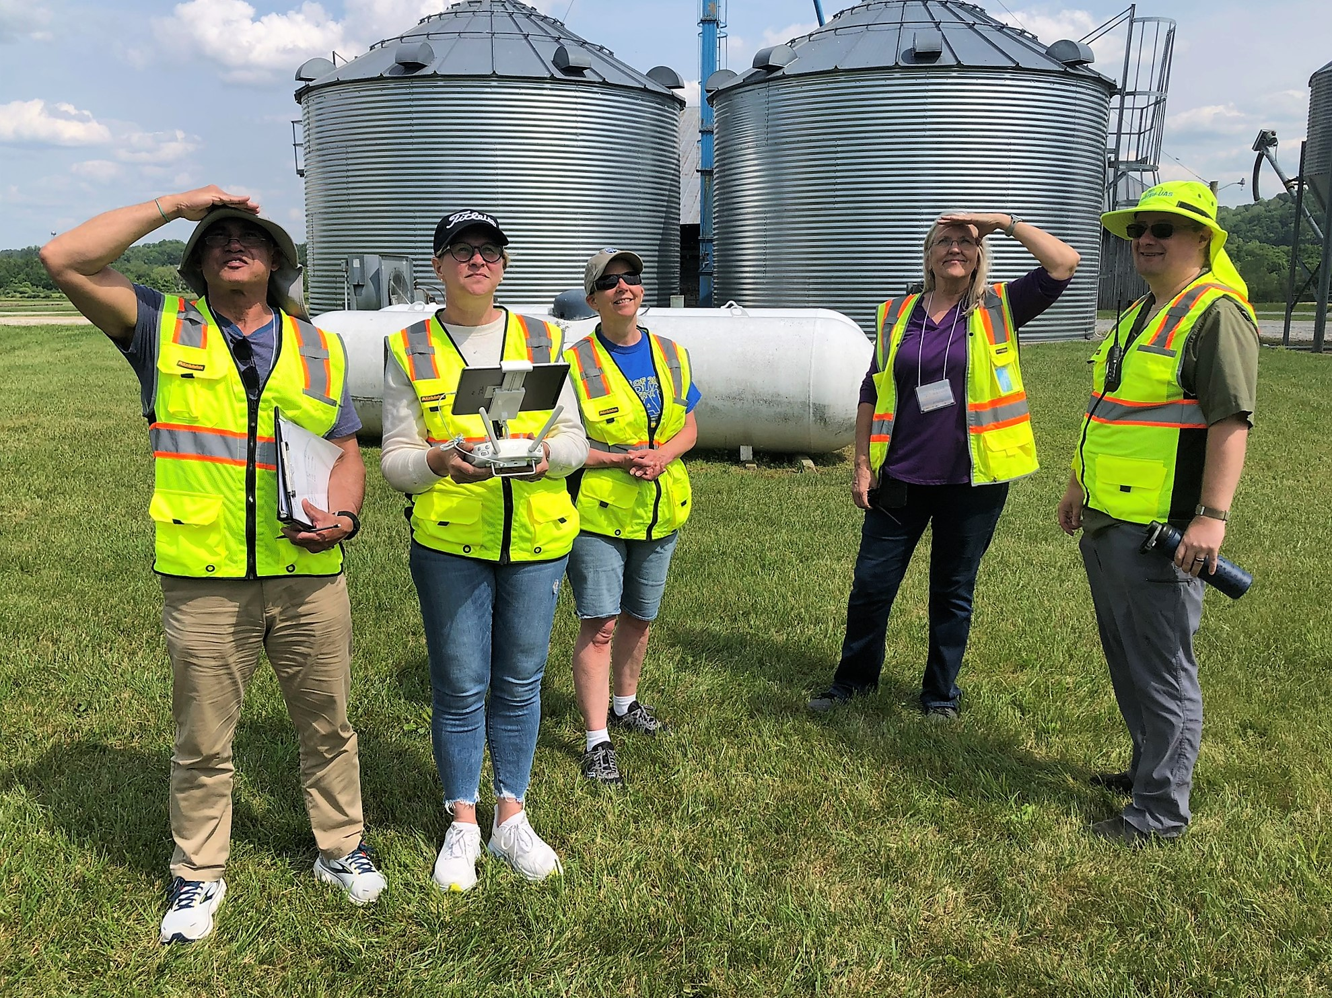
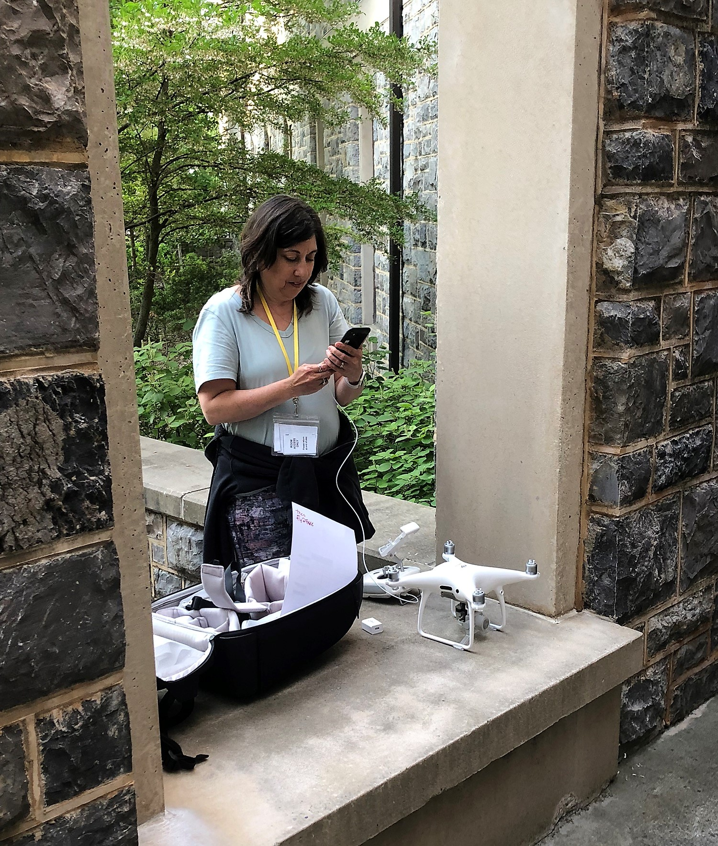
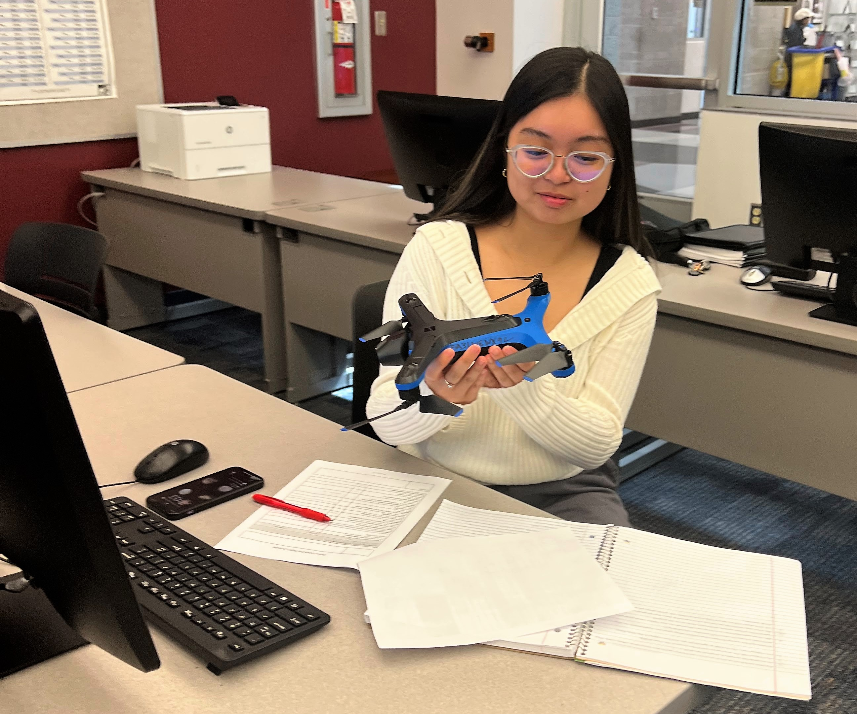
Uncrewed Aircraft Systems (UAS)
High School Career and Technical Education (CTE) Course (#8910)
FAA-funded Virginia Pilot Pathways Project
Commercial Pilot Pathways (high school students)
UAS Pilot Pathways (teachers)
Trained 20 Teachers
Mini-grants and Mentoring for one year
Developed high school UAS course
Dual-enroll with VCCS UMS courses.
Prep for FAA Part 107 Remote Pilot Certificate
Overview of national airspace, regulations, weather, design and operation of small drones
Manual and Autonomous Flying of UAS
Coordinating Flight Operations Logistics
At least 15 schools and 250 students enrolled.
Notes:
Since 2008, VSGC has been active in partnering with Virginia community colleges to develop and offer courses and pathways for the future geospatial technology and uncrewed aircraft systems (UAS, or drones) workforce
VSGC currently leads a statewide project funded by the NSF in partnership with Germanna CC, the VCCS, and Virginia Tech. The project is titled GeoTEd-UAS
The mission of the project is to build community college and educator capacity to educate and train the geospatial and small UAS operations technician (sUAS-OT) workforce
A major goal is to build a culture and community of practice in geospatial and UAS technologies across the commonwealth. Key components include new courses, faculty professional development, student outreach, and service-learning projects
VSGC can do site visits to community colleges to do drone demonstrations and talk about existing model pathways and how your community college can begin a program
VSGC has also trained high school teachers to teach the new CTE UAS course and more and more high schools are beginning to offer this course which can be dual-enrolled with the UMS courses at the community college
VSGC can help identify any high schools in your service region that are integrating drones into the classrooms and help make connections to grow enrollment and interest
VSGC is actively seeking more funding to offer more faculty training and support in the area of drones and their many applications
Active colleges: VPCC, TCC, New River, Mountain Empire, Laurel Ridge, Germann, Eastern Shore, Mountain Gateway, and Virginia Highlands

Slide 13
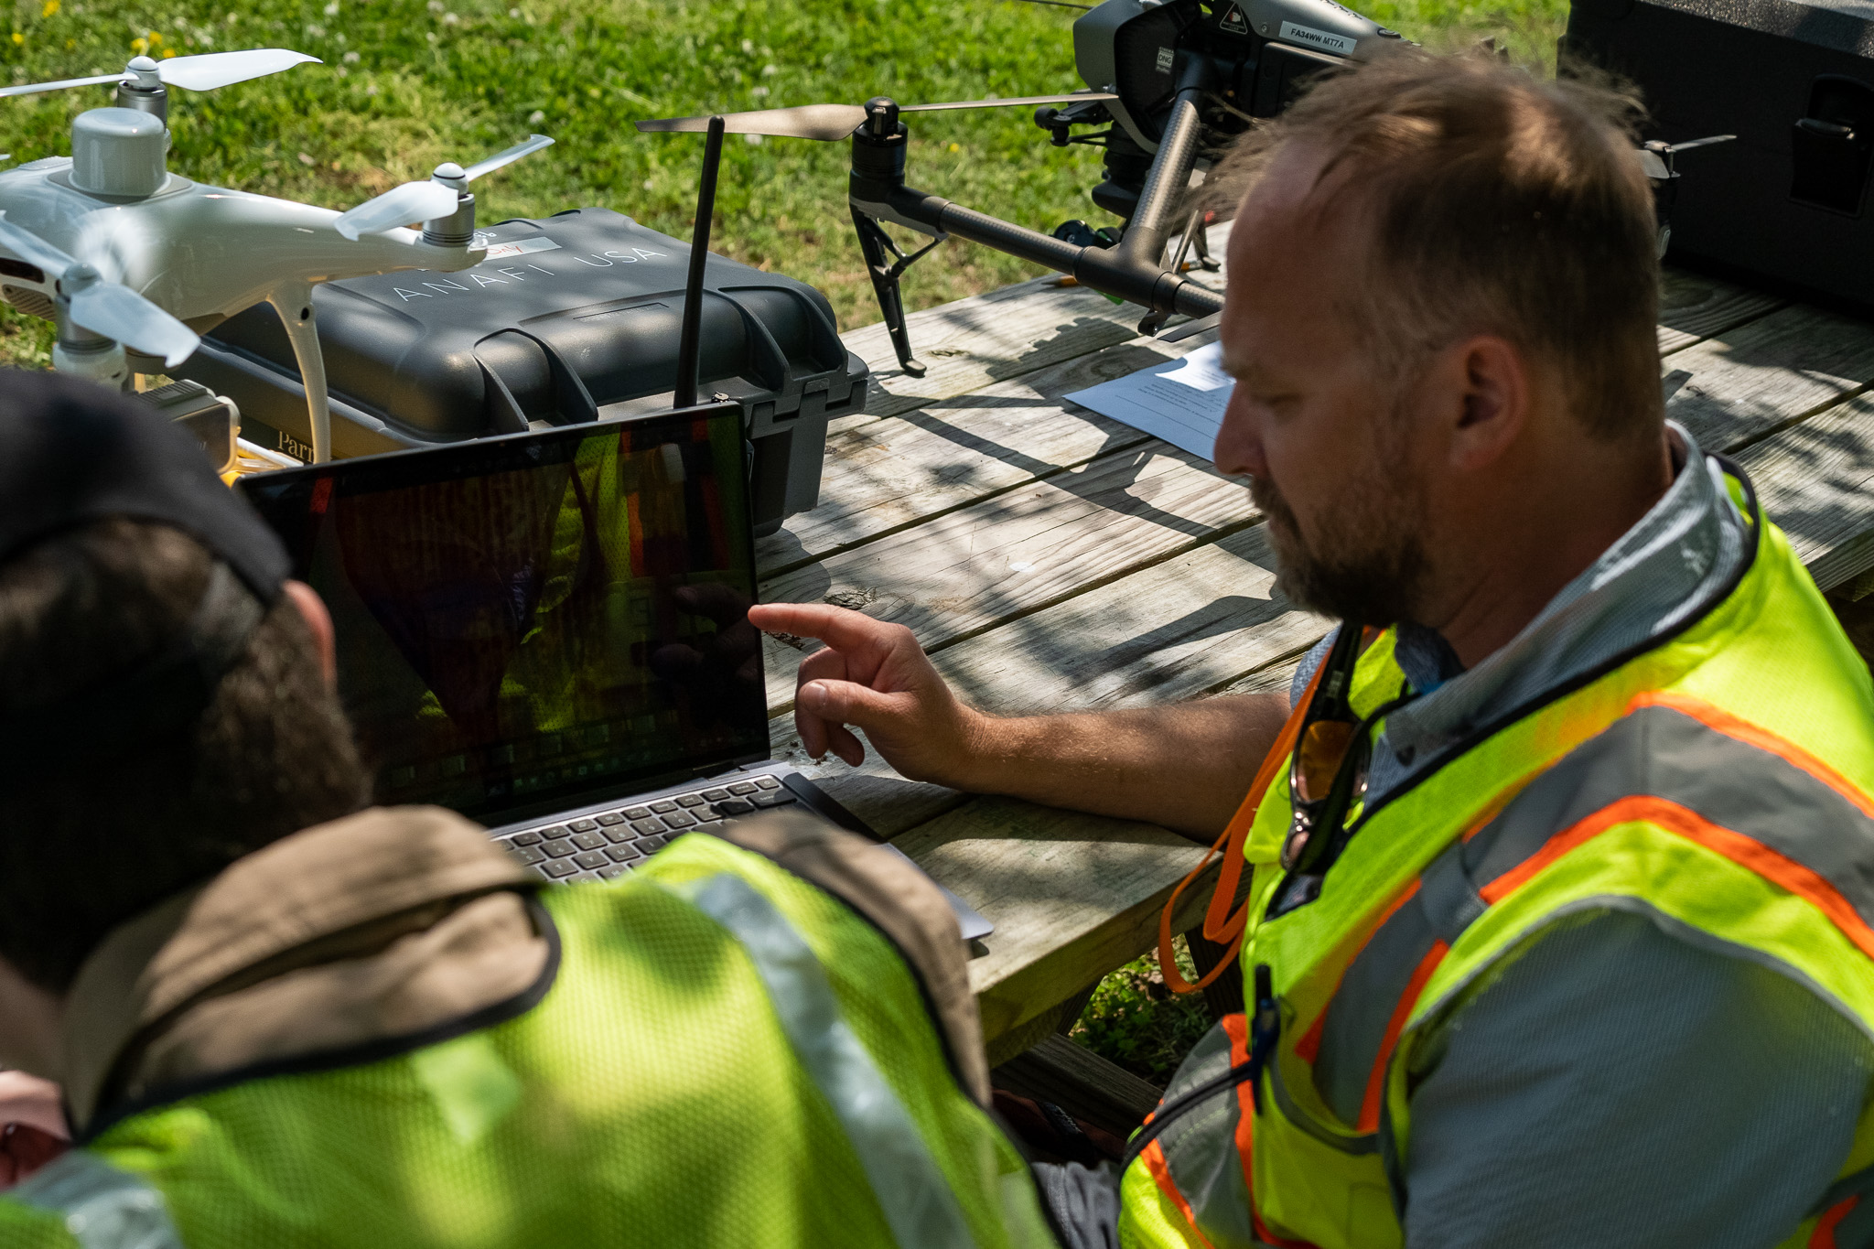
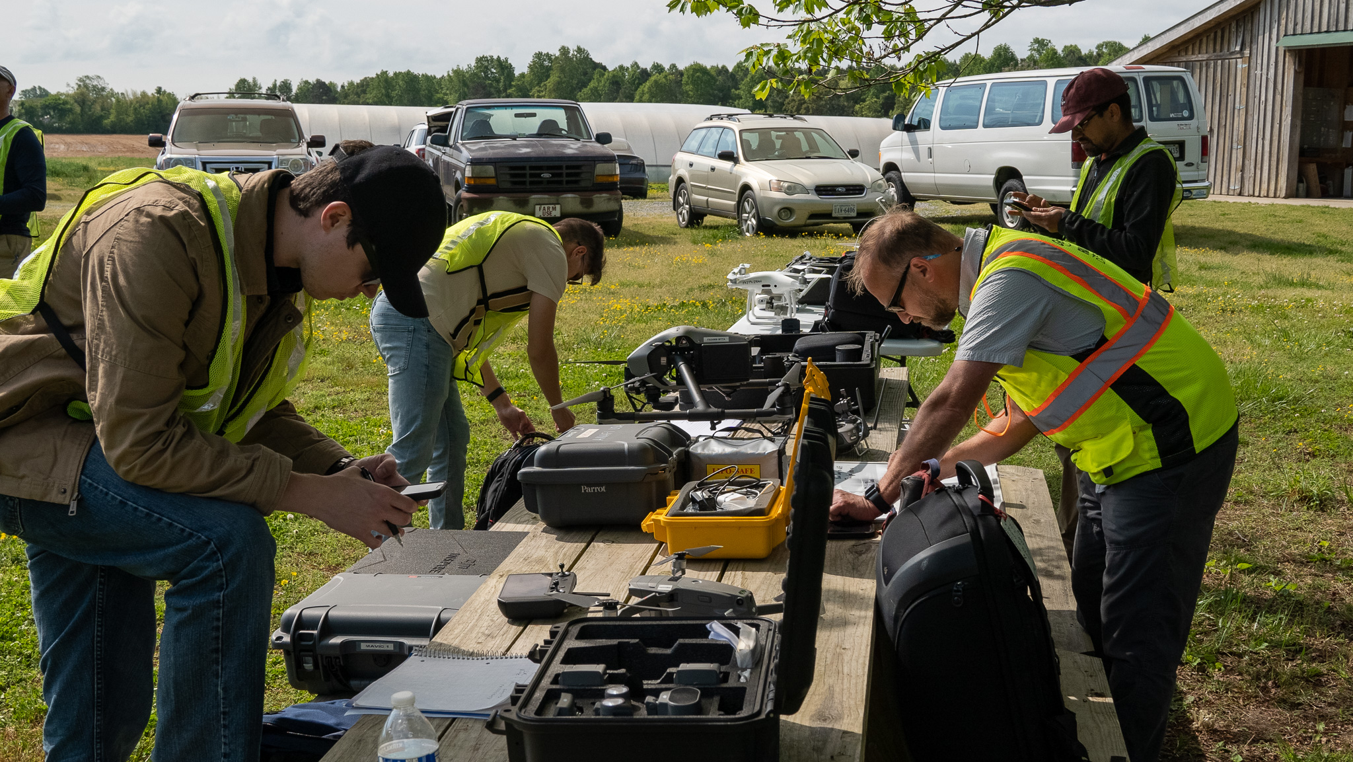
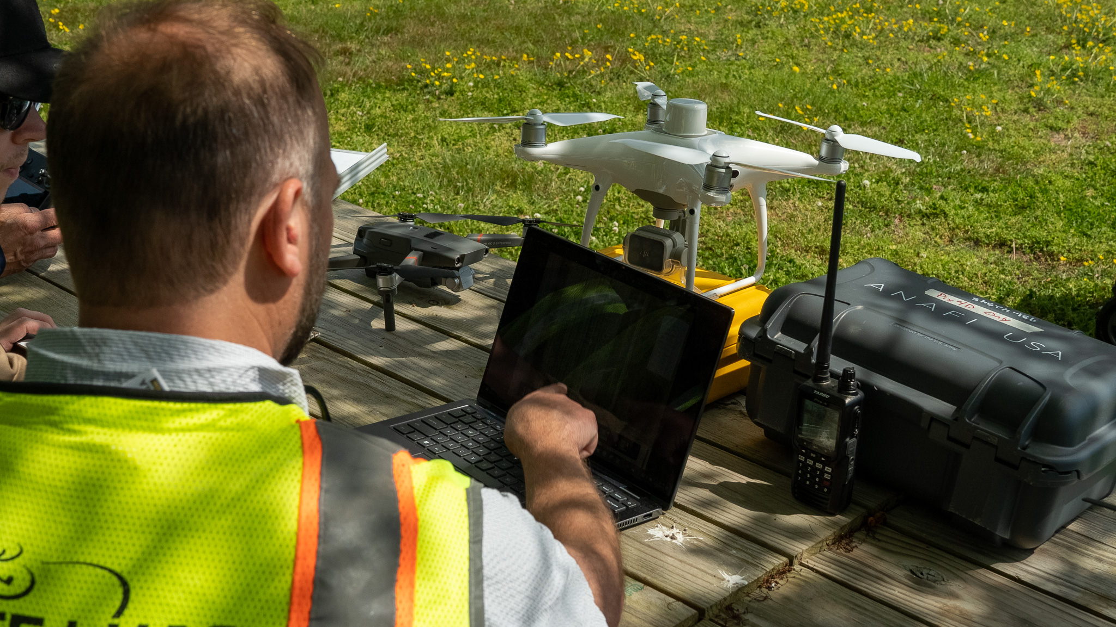
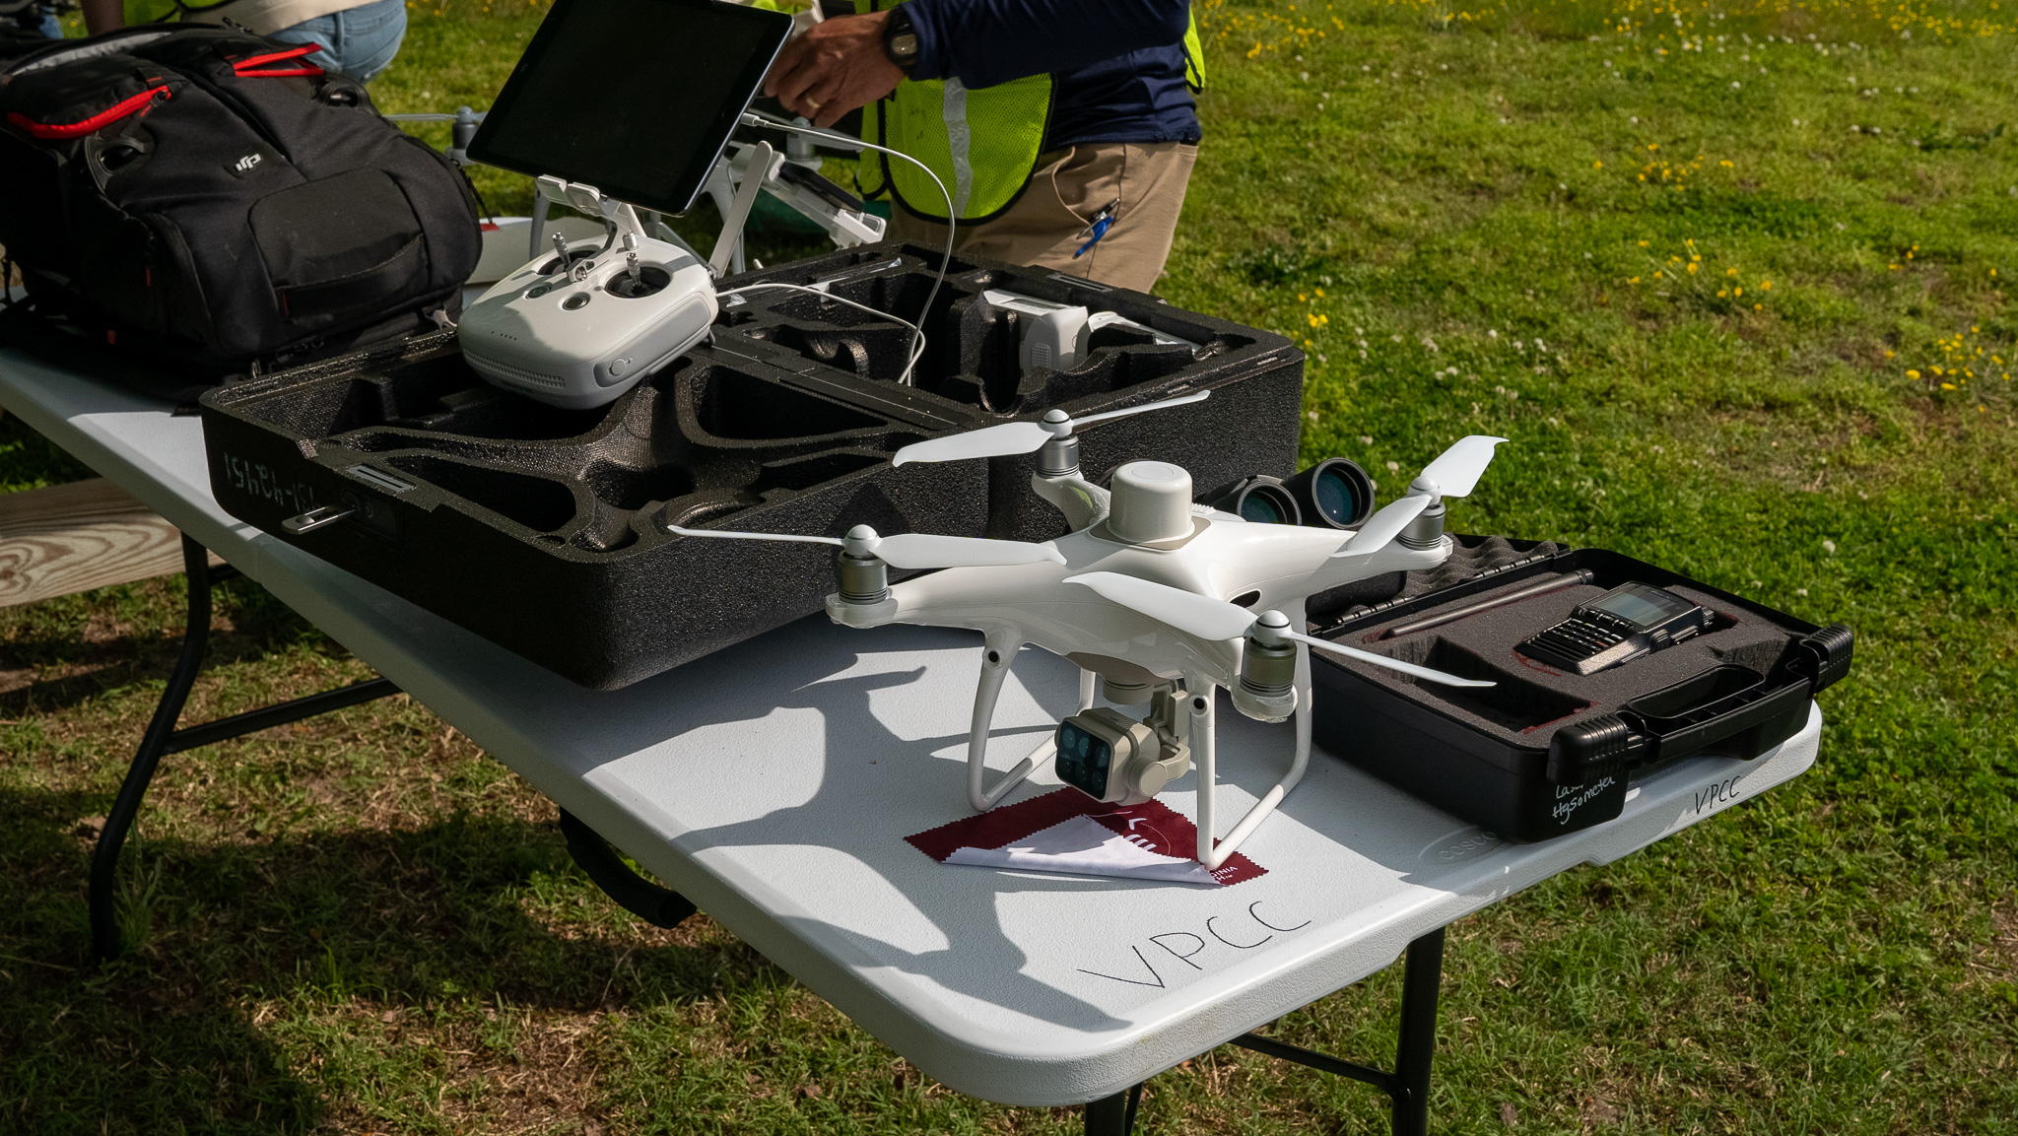
UAS Student and Teacher Outreach
Teacher Outreach Video

Slide 14
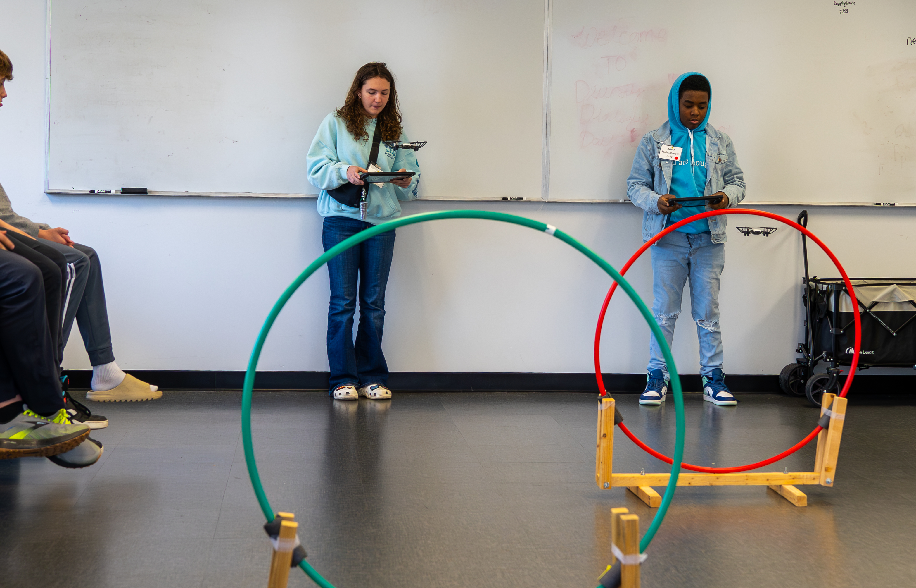
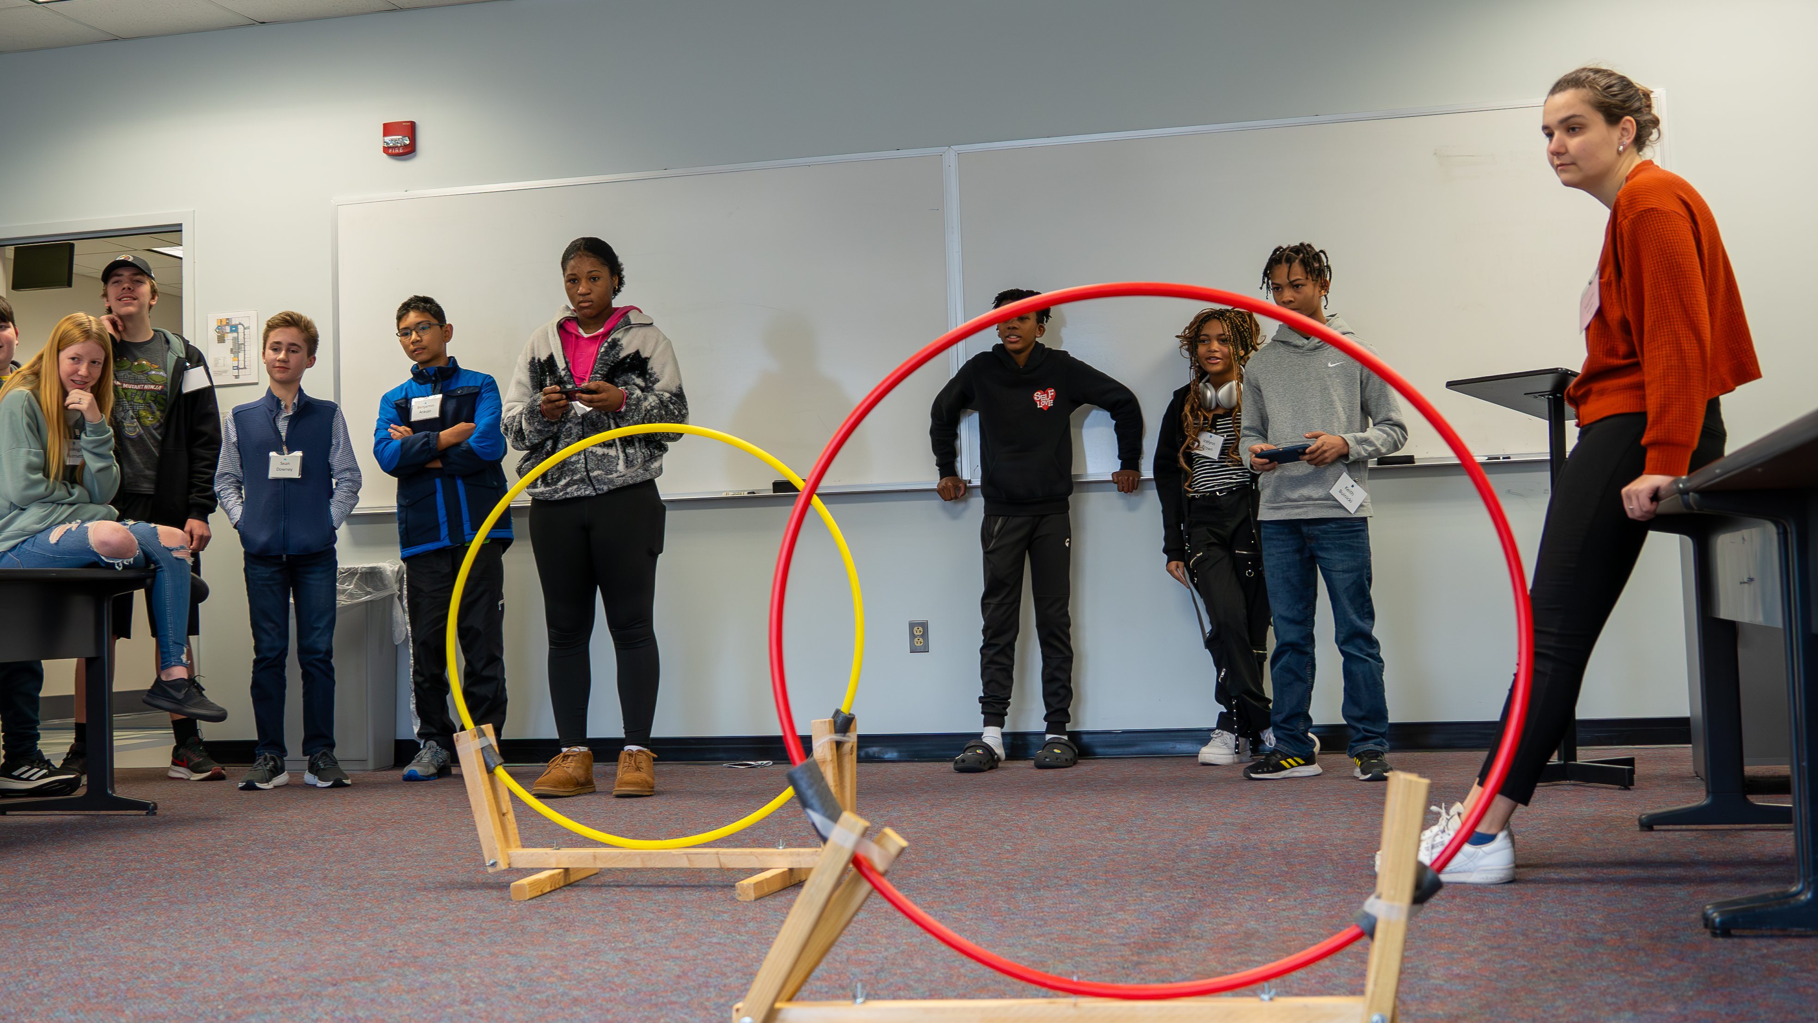
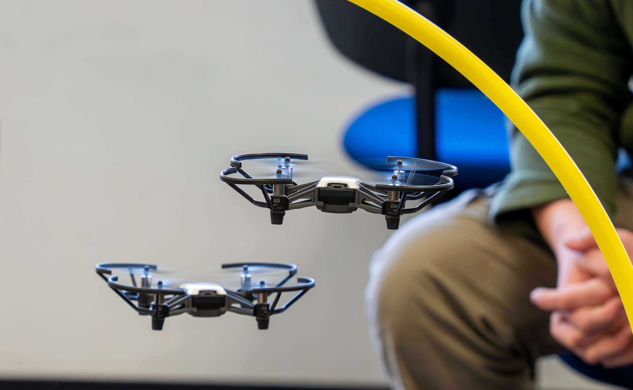
UAS Student and Teacher Outreach

Slide 15
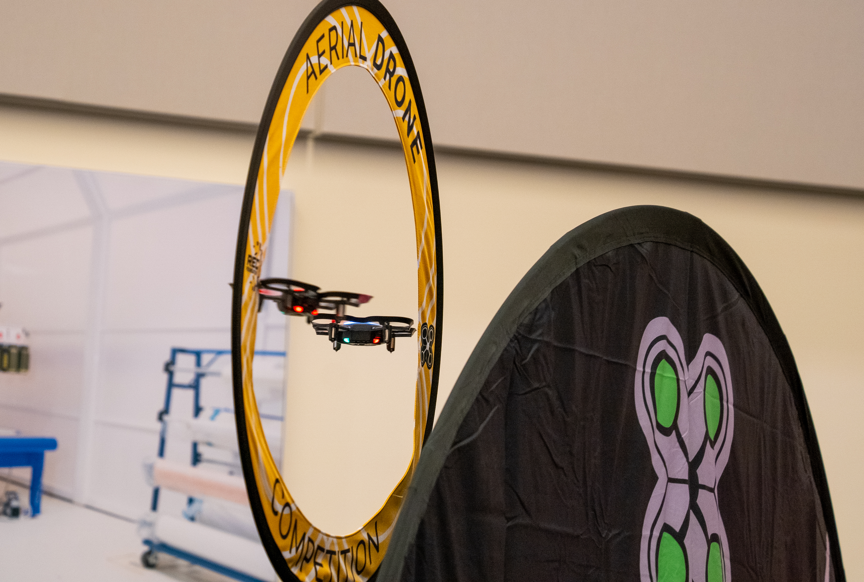
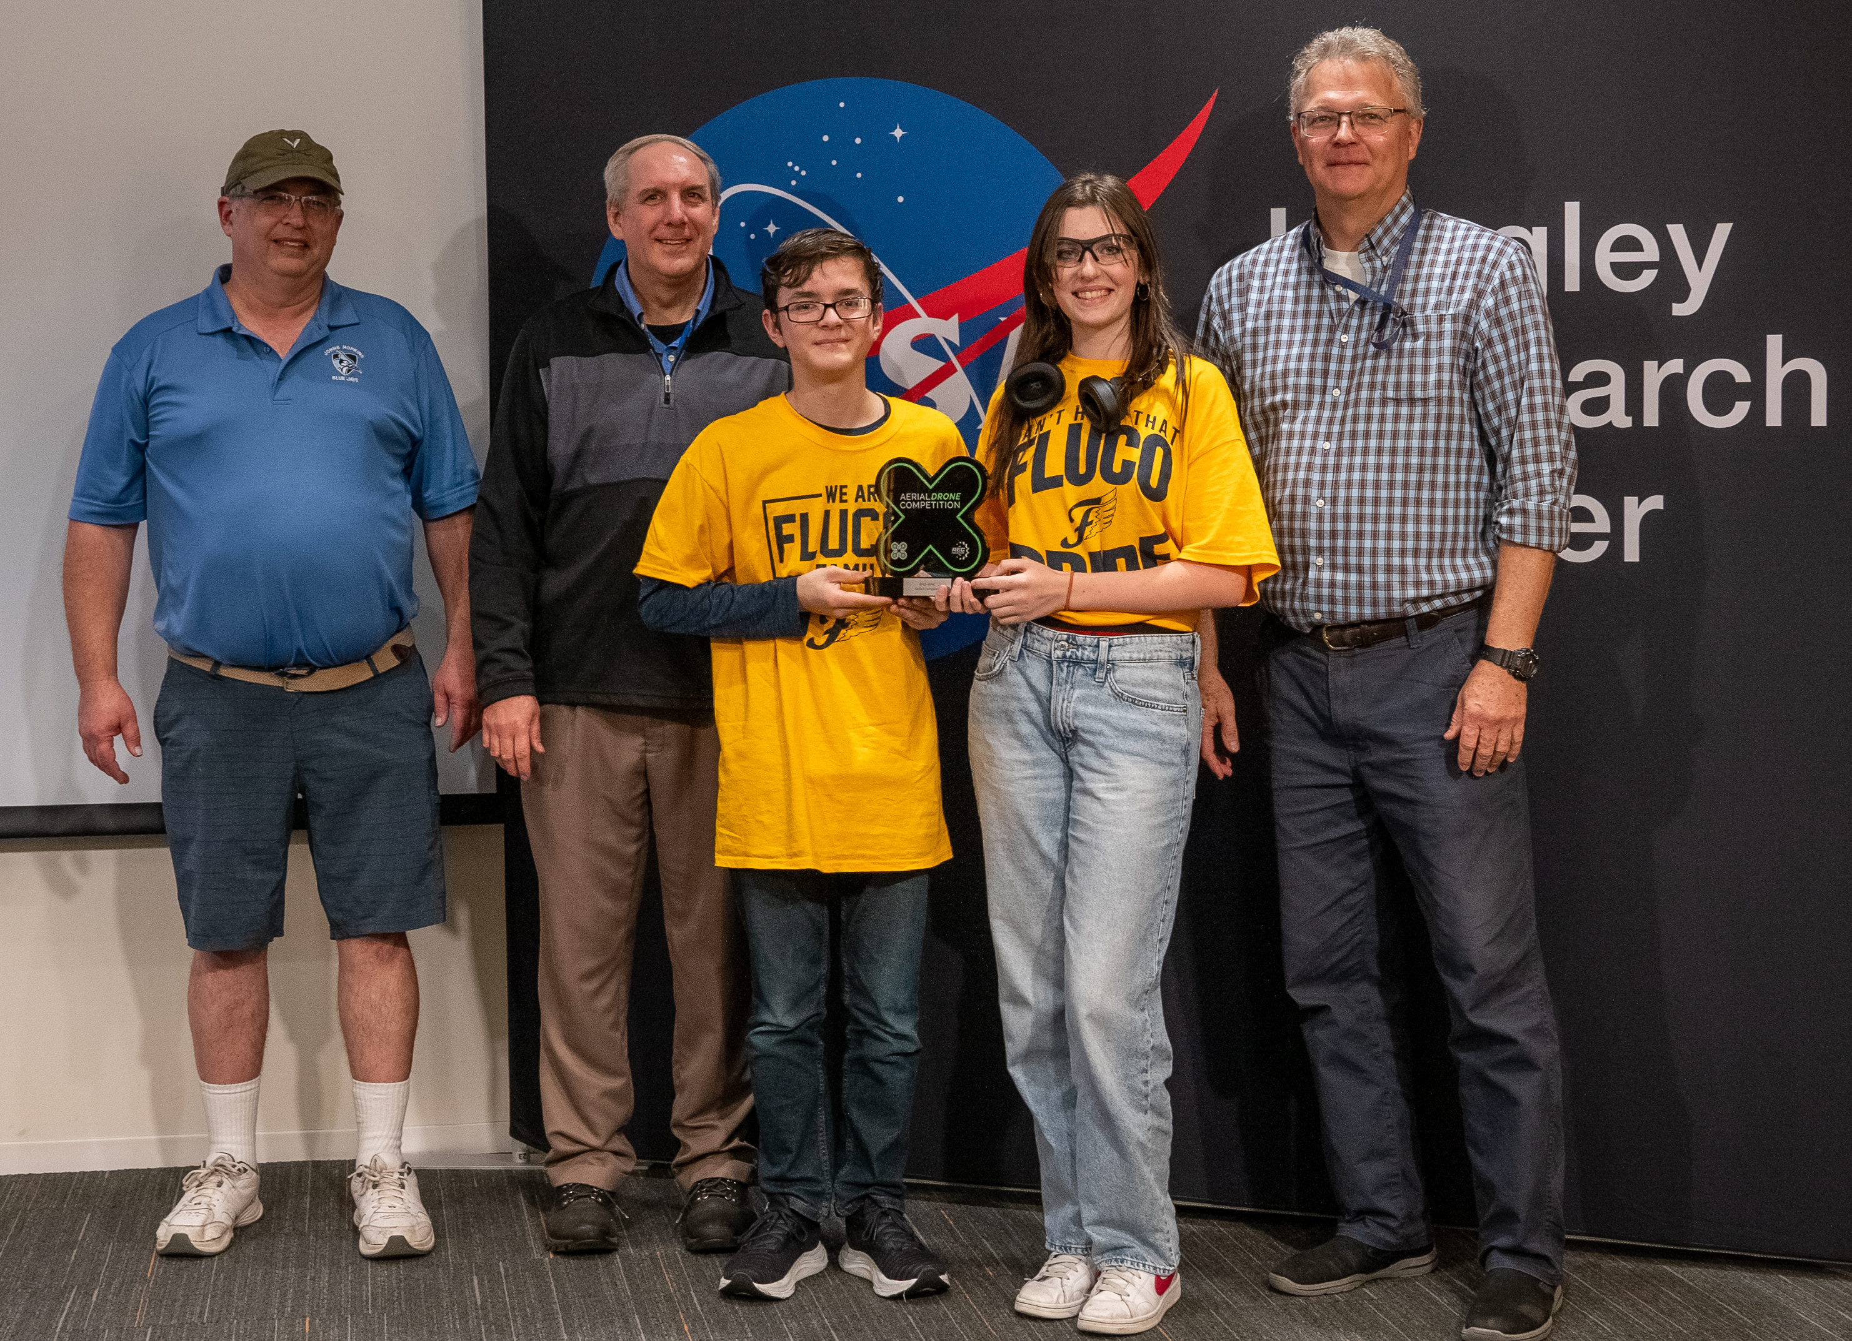
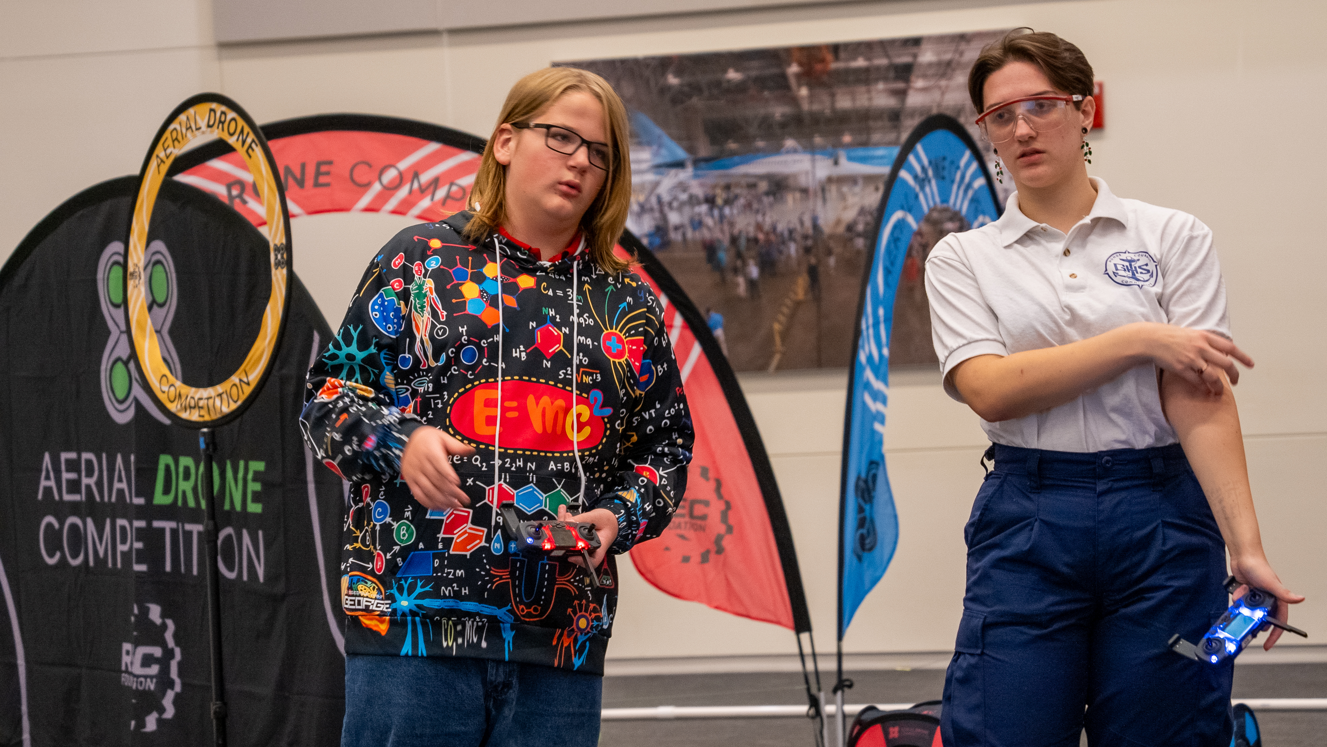
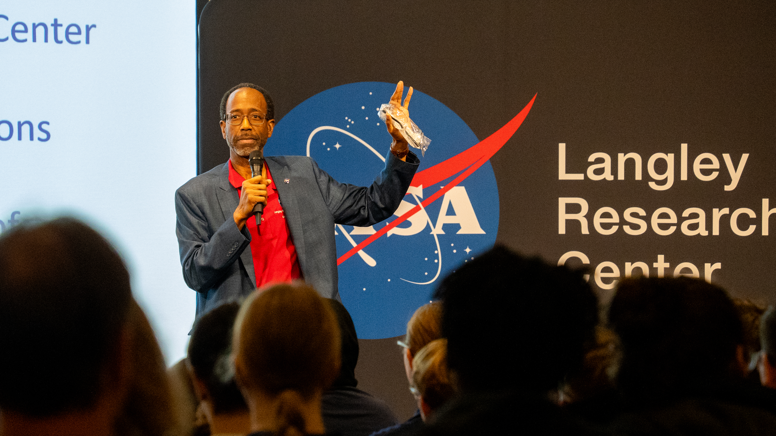
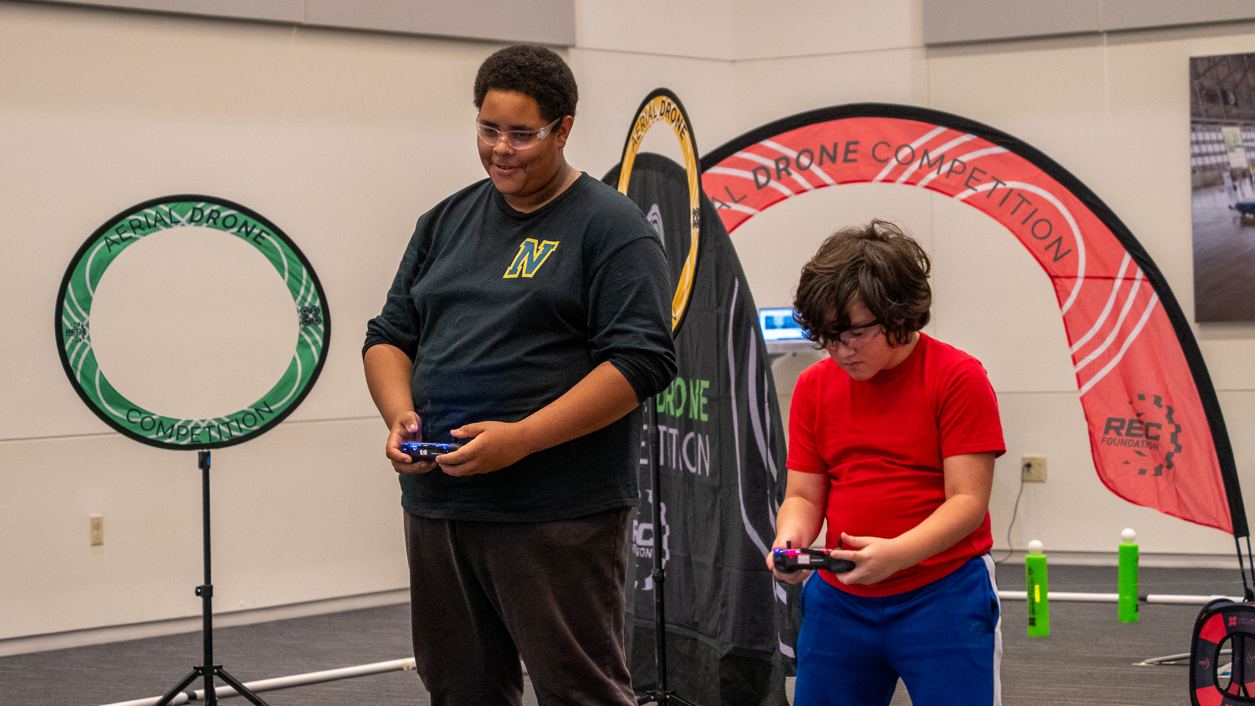
Aerial Drone Competition With NASA Langley
Next Event - Feb 24
REC Partners with NASA

Slide 16

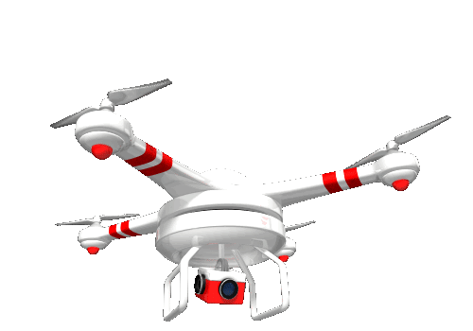

  Summer 2023 DARS Drone Camps
DARS: VA Dept. for Aging and Rehabilitative Services
DARS' mission: to improve the employment, quality of life, security, and independence of older Virginians, Virginians with disabilities, and their families.

Slide 17
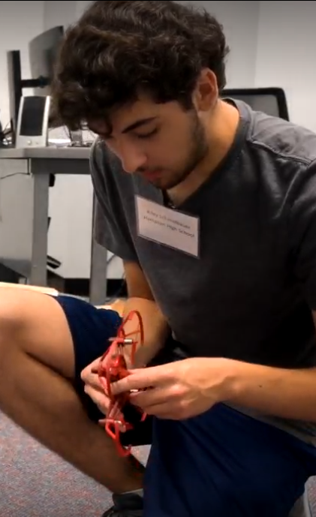





  Summer 2023 DARS Drone Camps
Cooperative effort (reup to two more years (2024 & 2025)…
New for 2023

Slide 18
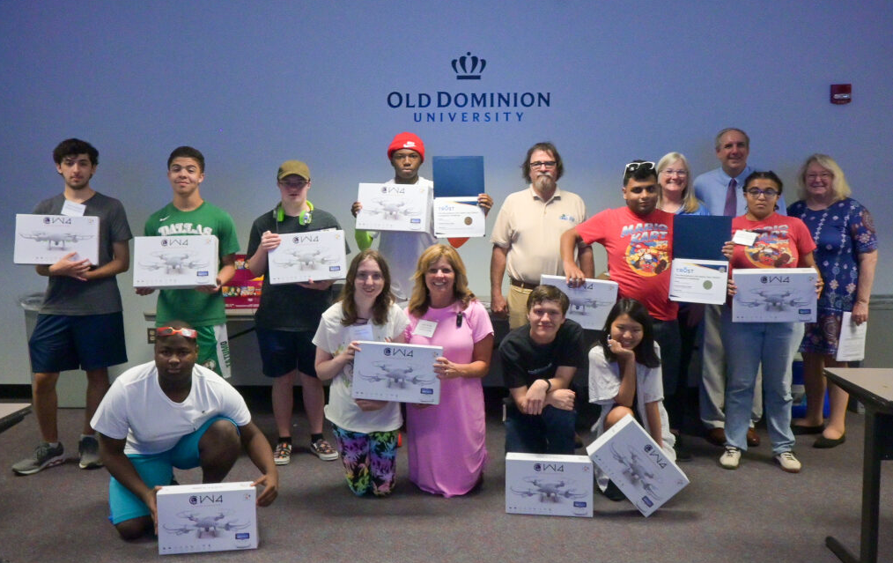
VA Peninsula Community College

Slide 19
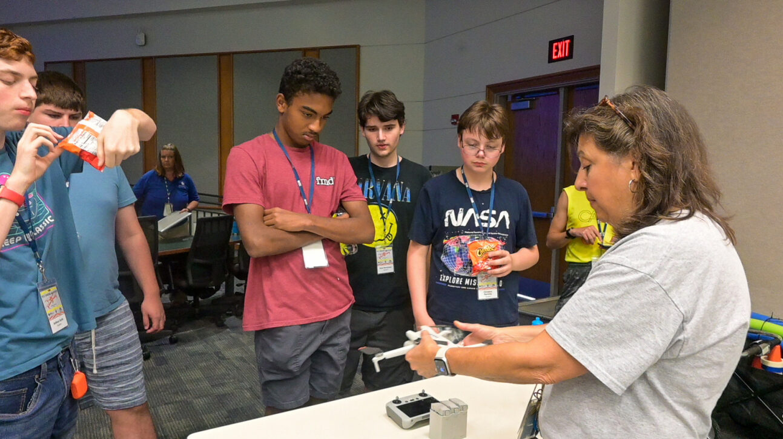
Tidewater Community College

Slide 20
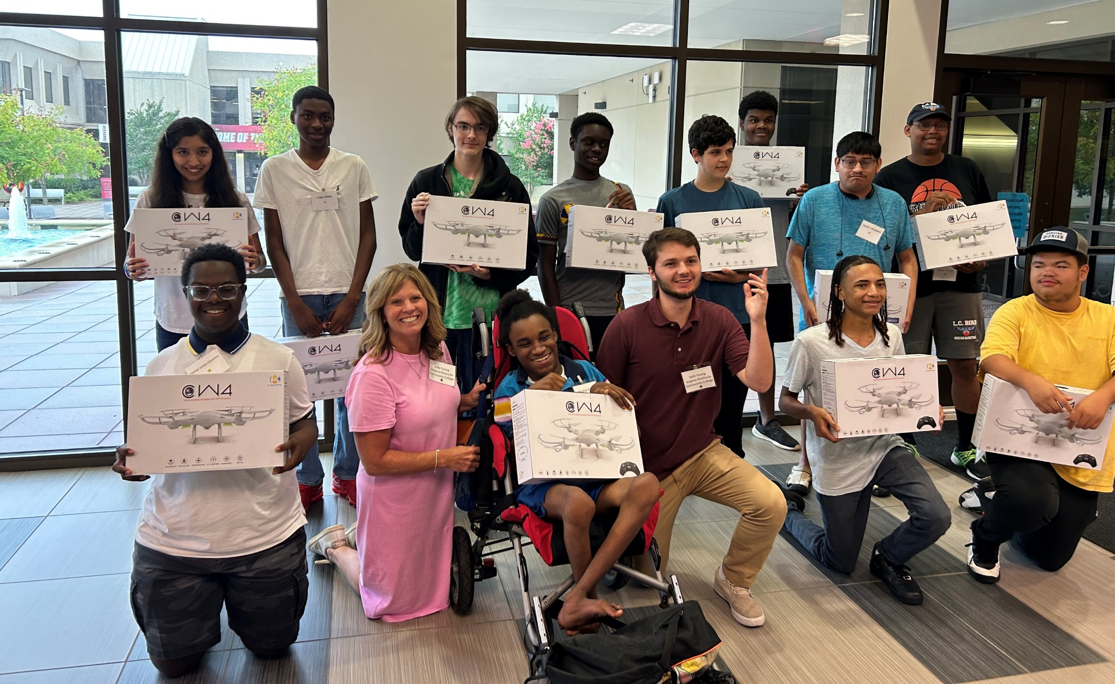
Community College Workforce Alliance (Richmond [JSRCC & JTCC])

Slide 21

What did we do?
LIFT
THRUST
Physics of flight
Drone Safety
TRUST Certificate
UMS applications and careers
Flight instruction
Field experience
Competitive obstacle course race
Drone Drop
VPCC Campus Tour
Air & Space Museum trip (Hampton)
Received their own drone
DRAG
WEIGHT

Slide 22
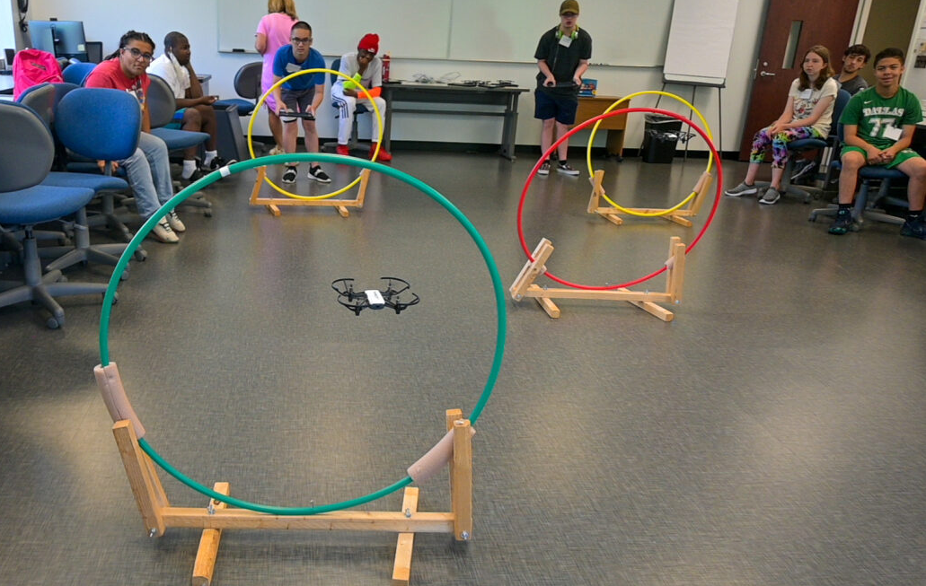
Obstacle Course Competition (VPCC)

Slide 23
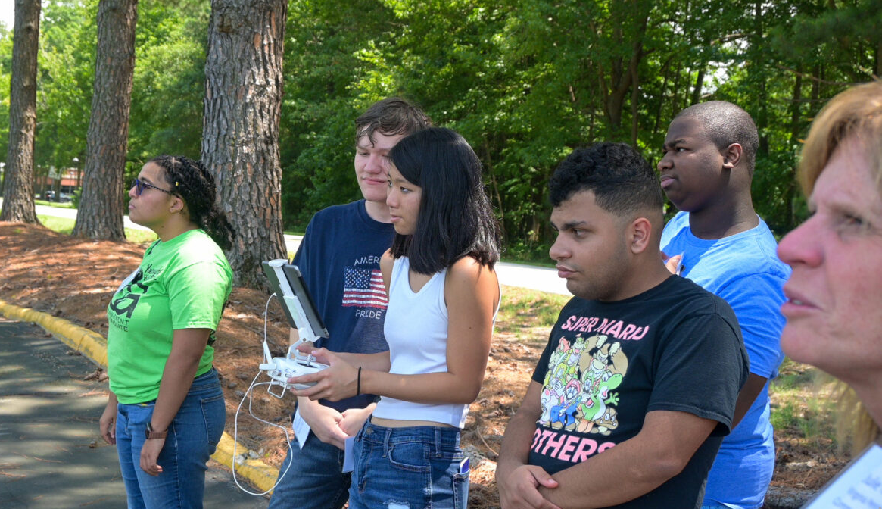
In the Field (VPCC)

Slide 24
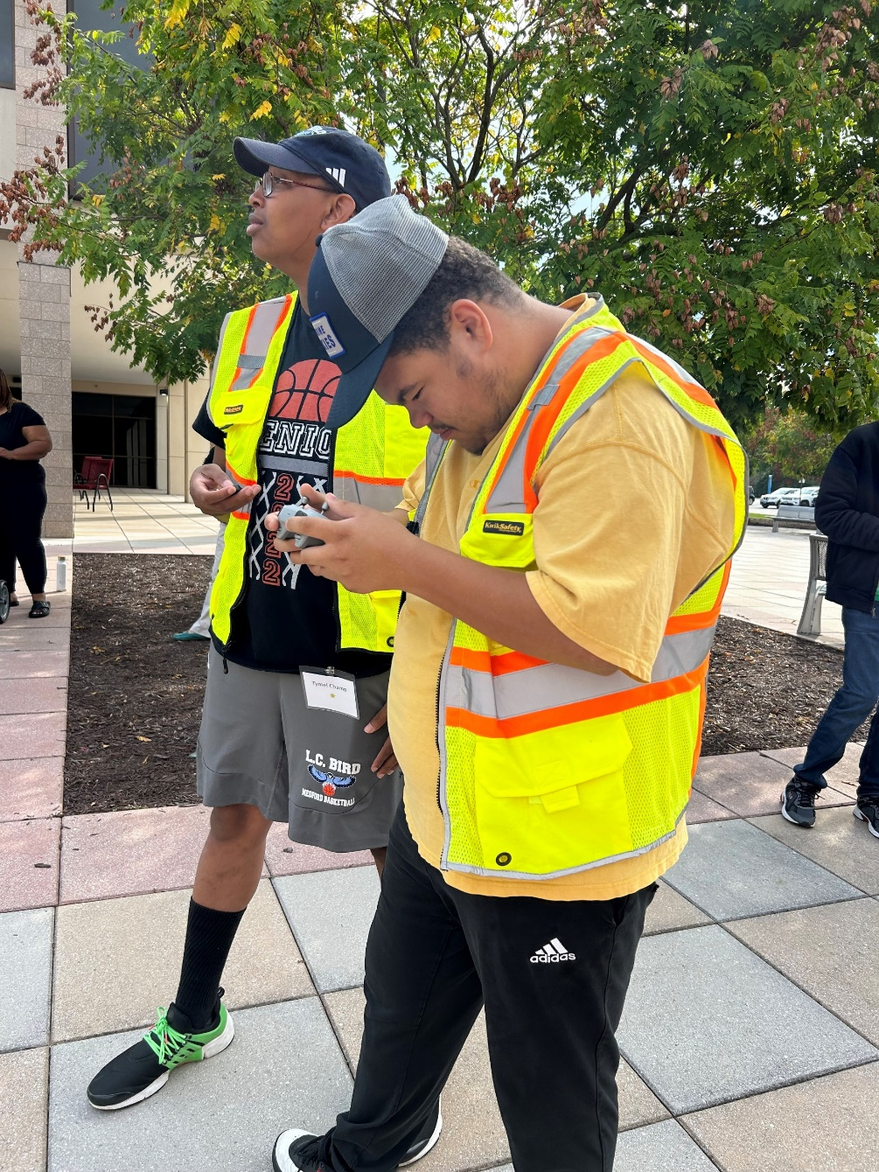
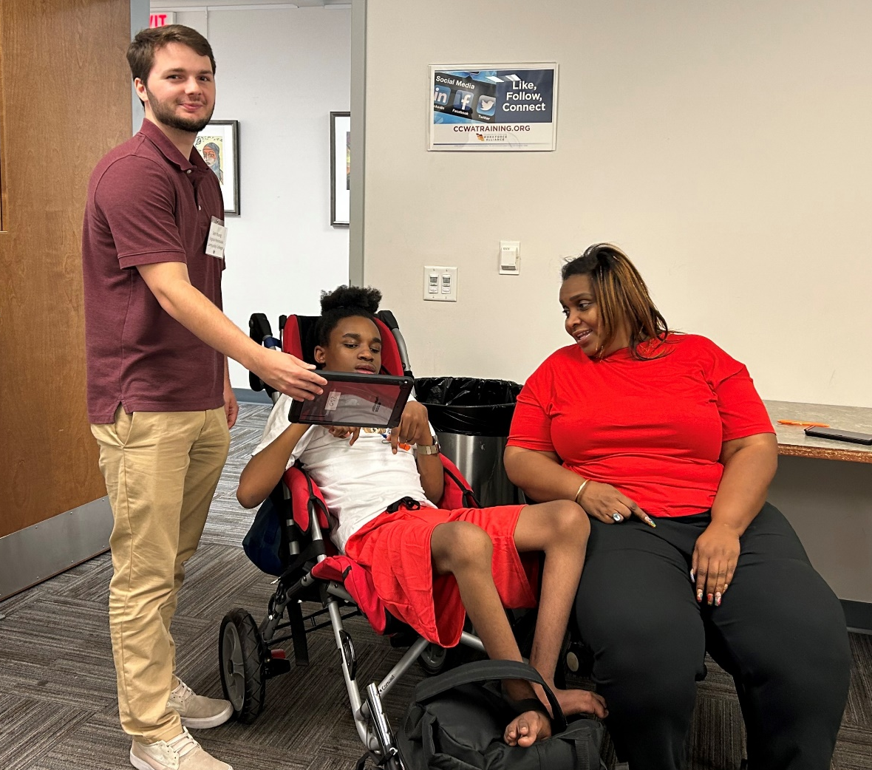
Community College Workforce Alliance

Slide 25
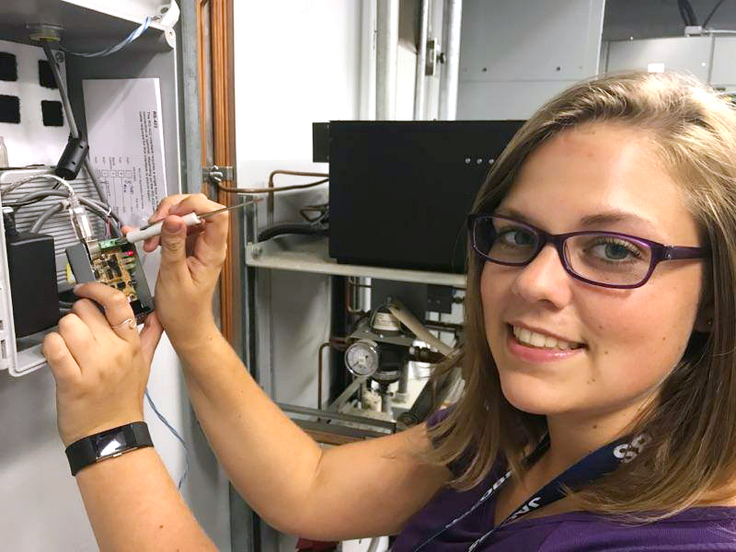
Commonwealth STEM Industry Internship Program (CSIIP)
State funded program supported by the Governor’s Office
Connects Virginia undergraduate students with paid internships with business/industry in Virginia
No deadlines for students or companies. Full-time and part-time.
Companies hire and pay the students.
Eligibility:
  U.S. citizen (permanent resident, depends on company)
  18 years old
  At least 6 credits per semester at a Virginia college
  Completed at least 30 credits
  2.7 GPA
  STEM major
Notes:
According to the National Association of Colleges and Employers, six out of 10 internships lead to a permanent position, more than 51% of interns land a full-time job from their internship, and over 34% of graduates report that internship "significantly" shifted their career direction
Students with internship experience are more likely to get a job and get more job offers after graduation and the average hourly wage for interns is $20.82 an hour
CSIIP is funded by the Commonwealth of Virginia
Some of the internship opportunities are available through the Commonwealth Cyber Initiative
It's a free, convenient, one-application process to reach companies throughout Virginia
CSIIP links companies and students in STEM, including but not limited to high-need areas such as Computer Science, Cybersecurity, Data Science, Information Technology, Engineering, Physical Science and Financial majors
In today's technological arena, there is a strong need for individuals with workforce certifications in aviation maintenance, cybersecurity, mechatronics, and geospatial technology
Excellent opportunity for hands-on experience related to the student's field of study
Ability to check companies' profiles and indicate interest in specific internship opportunities or companies
Submitted applications are always available for update and remain valid for one year after graduation
Access to free and informative webcasts posted on the website

Slide 26
Commonwealth STEM Industry Internship Program (CSIIP)
Students apply once to reach more than 200 companies across Virginia
Subsidies available to companies to offset cost of aerospace/aviation/drones and cybersecurity internships of up to $5,000 (50% of placement).
Sample Internship Job Titles IT Engineer Intern
Aircraft Assembly Tech
Cyber Intern
GIS Intern
Cyber Security Intern
UAS Project Manager Assist
Engineering Intern
Image Recognition of Aquarium Events
PC Technician
Cloud ERP Developer
Cyber Intern
Intern, Information Technology
Jr Programmer & Cyber Analyst
UAS training, safety and operations
Security Analyst

Slide 27
What’s NEXT?
Advanced Air Mobility (AAM)
Movement of goods and people with uncrewed systems.
It’s already here!
DroneUP partnership with WalMart and Hospitals

Slide 28
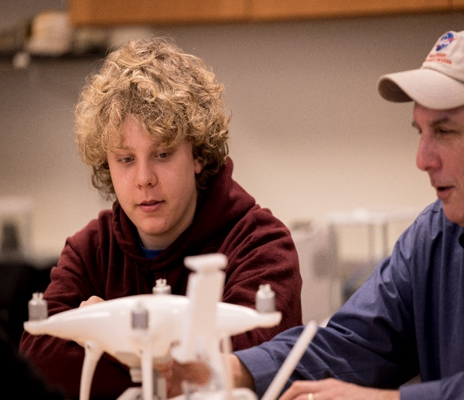
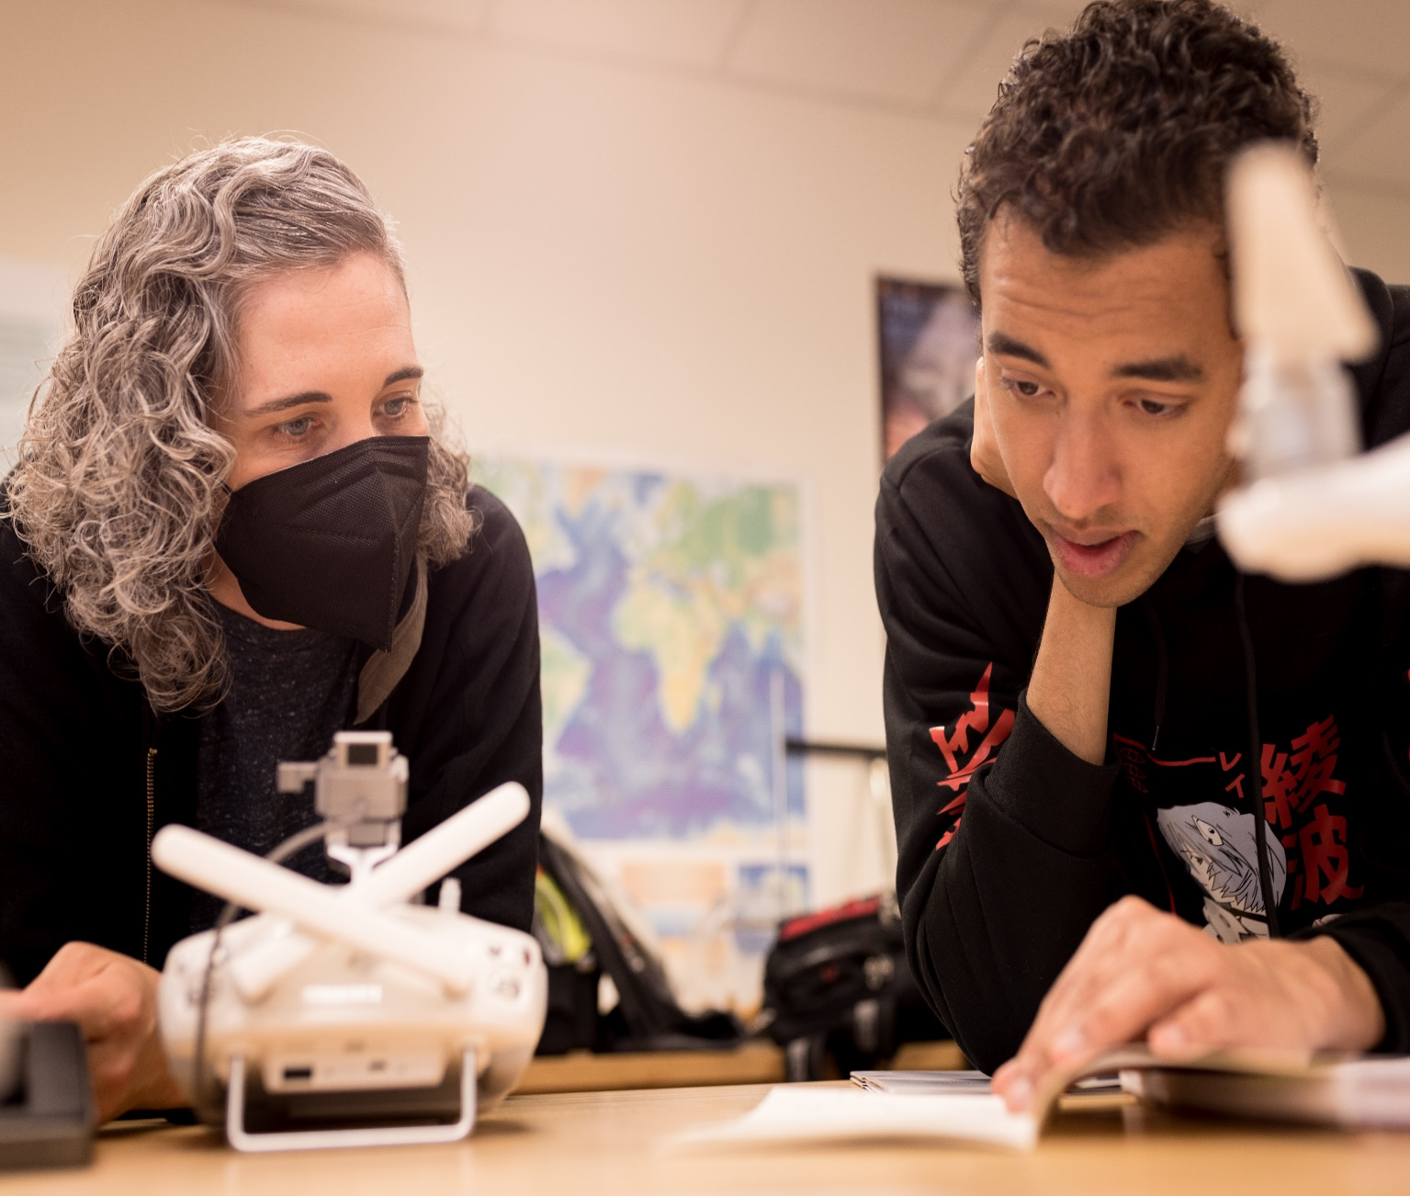
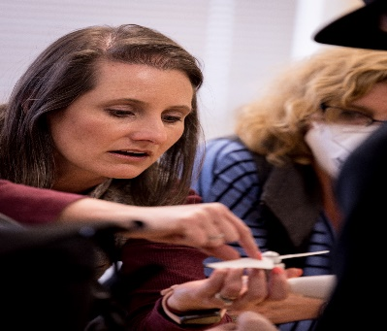
GeoTEd-UAS Internship Program
Six CC students and four faculty participated in UAS research projects in partnership with VT, worked directly with VT students and faculty.
Four-week residential paid internship
Tuition for tow UMS courses at VPCC
Invited to present project at 2022 NSF ATE conference
Saturday Session Video
GeoTEd-UAS Overview Video

Slide 29
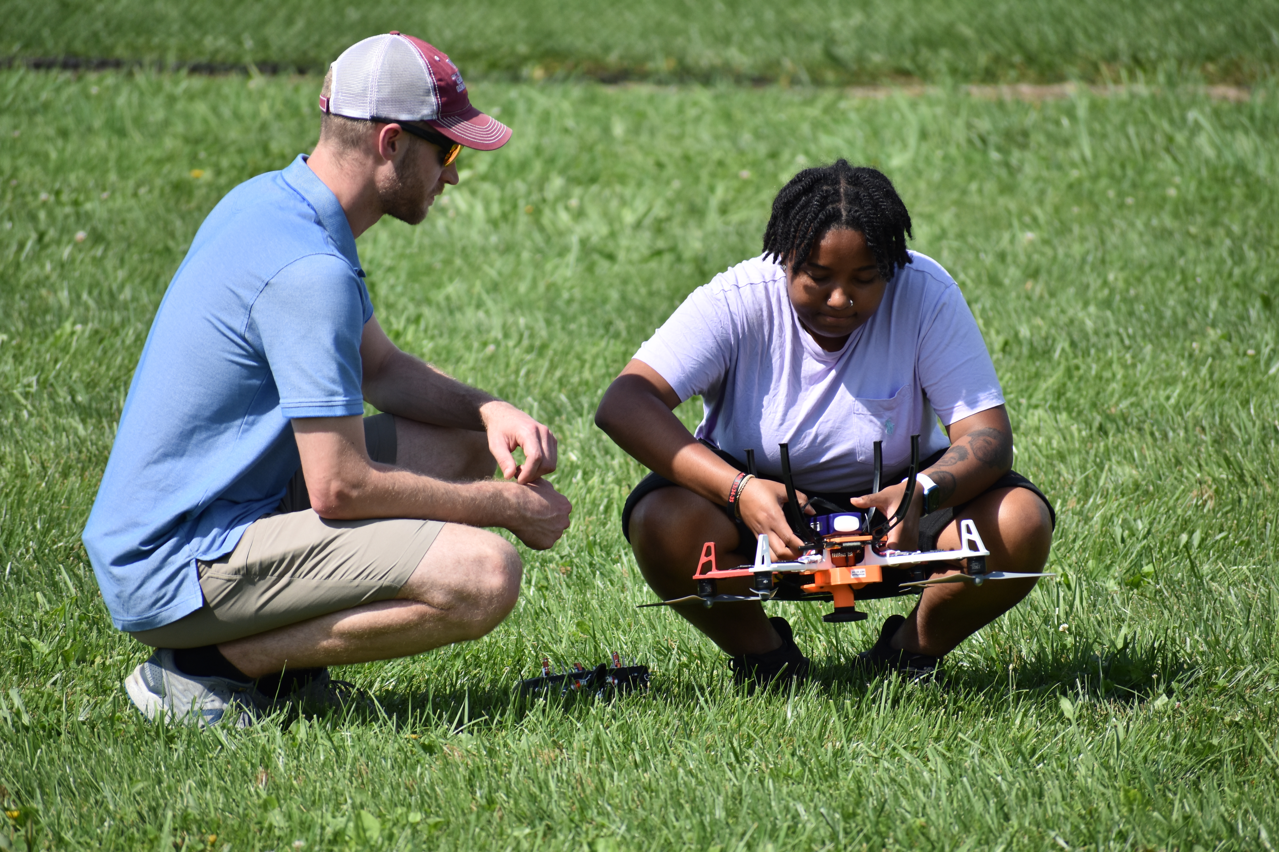
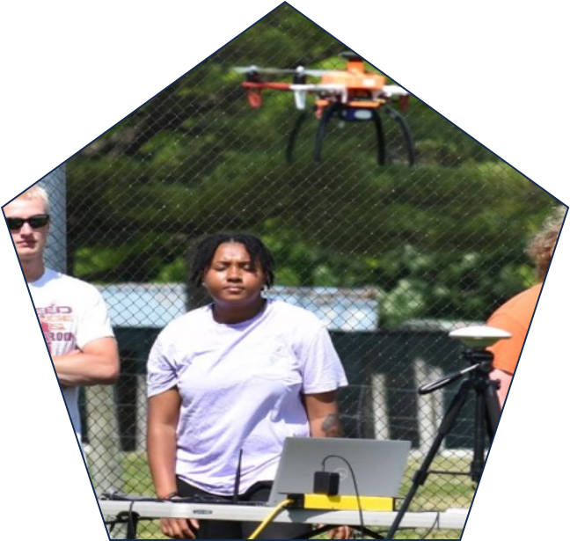
GeoTEd-UAS Internship Program
Jayda Hughes
CSIIP internship placement with GeoTEd-UAS
Took four UMS (unmanned systems) classes at VPCC.
Served an internship conducting UAS research and flight-testing at Virginia Tech's site in the Center for Unmanned Aircraft Systems (C-UAS).
Currently Employed at DroneUp and a project Coordinator and UAS pilot
Saturday Training Video
Teacher Outreach Video
Notes:
According to the National Association of Colleges and Employers, six out of 10 internships lead to a permanent position, more than 51% of interns land a full-time job from their internship, and over 34% of graduates report that internship "significantly" shifted their career direction
Students with internship experience are more likely to get a job and get more job offers after graduation and the average hourly wage for interns is $20.82 an hour
CSIIP is funded by the Commonwealth of Virginia
Some of the internship opportunities are available through the Commonwealth Cyber Initiative
It's a free, convenient, one-application process to reach companies throughout Virginia
CSIIP links companies and students in STEM, including but not limited to high-need areas such as Computer Science, Cybersecurity, Data Science, Information Technology, Engineering, Physical Science and Financial majors
In today's technological arena, there is a strong need for individuals with workforce certifications in aviation maintenance, cybersecurity, mechatronics, and geospatial technology
Excellent opportunity for hands-on experience related to the student's field of study
Ability to check companies' profiles and indicate interest in specific internship opportunities or companies
Submitted applications are always available for update and remain valid for one year after graduation
Access to free and informative webcasts posted on the website

Slide 30
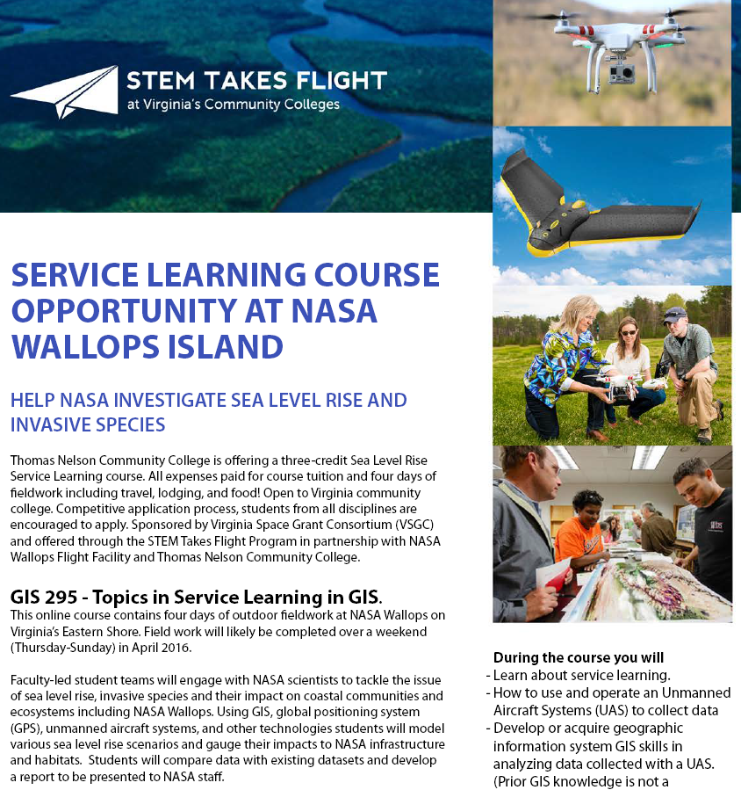
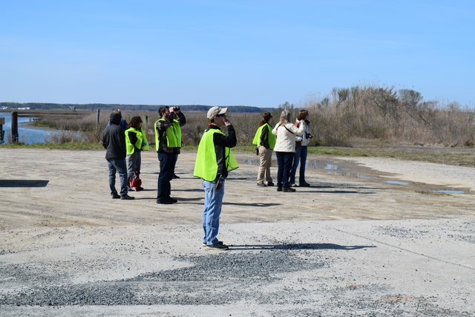
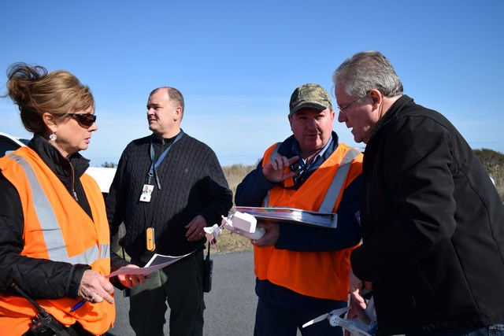
STEM Takes Flight – VPCC Sea Level Rise Course

Slide 31
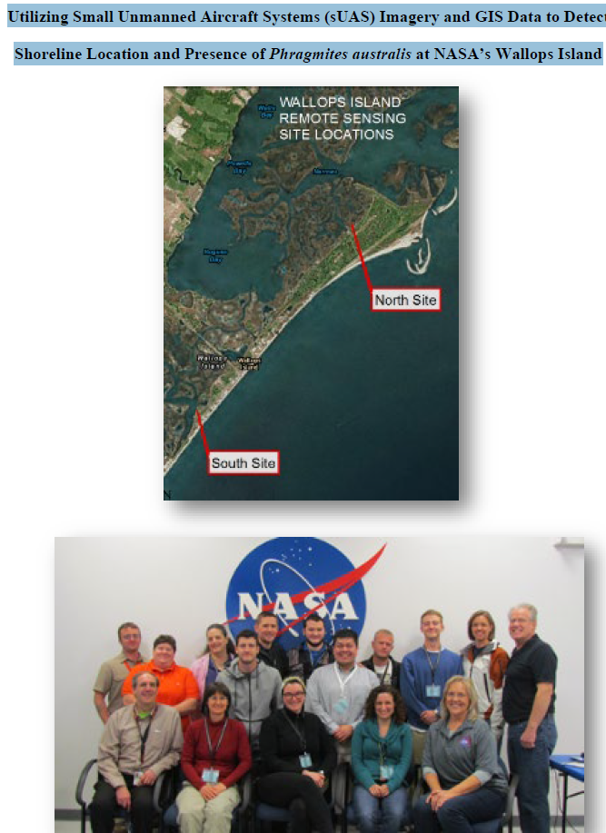
STEM Takes Flight – VPCC Sea Level Rise Course
Service-Learning Project at NASA Wallops

Slide 32

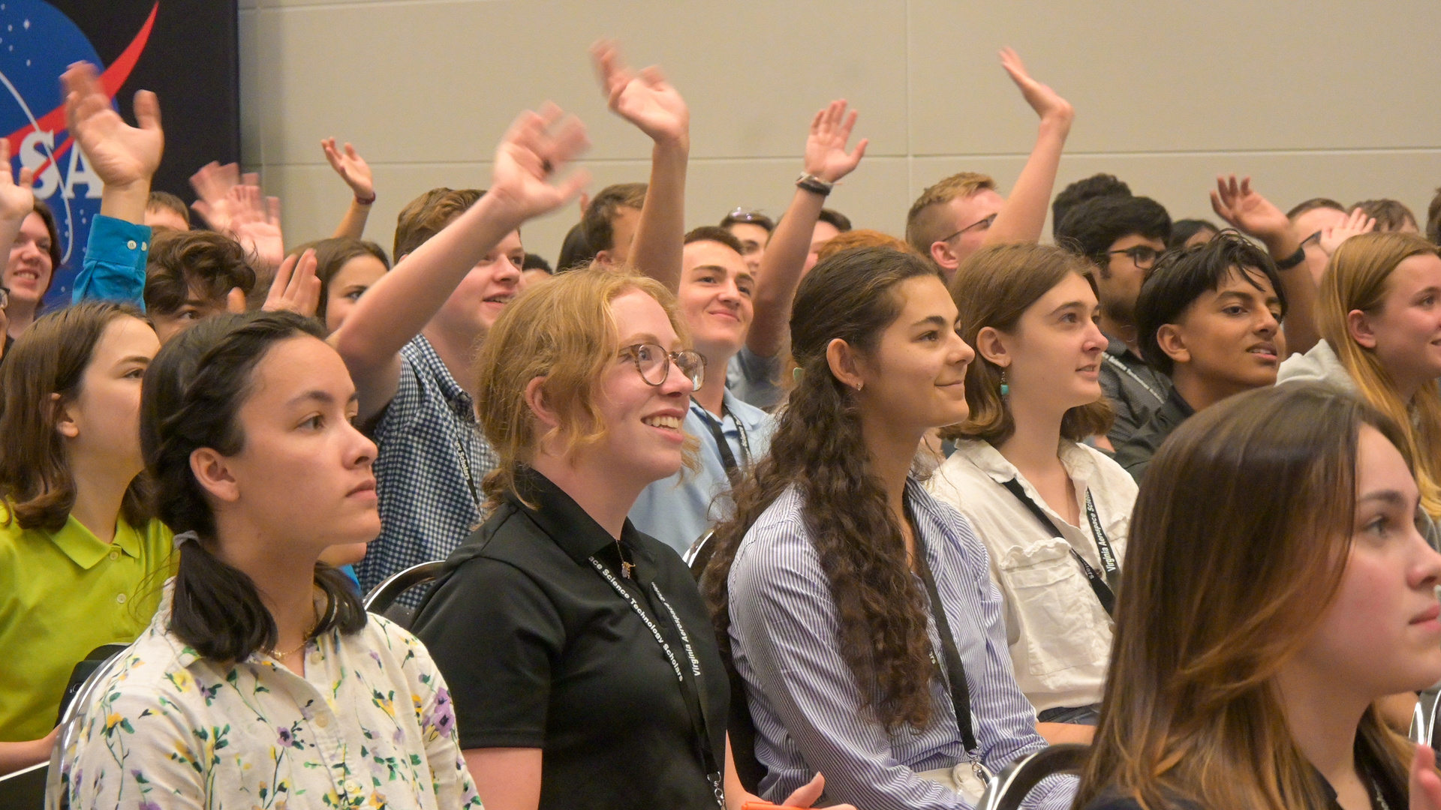




Follow us!
@VASpaceGrantConsortium
@vaspacegrant
@vaspacegrant
@Virginia-Space-Grant-Consortium
@VirginiaSpaceGrantConsortium
Chris Carter, Director
Virginia Space Grant Consortium
cxcarter@odu.edu
757-766-5210
vsgc.odu.edu

