Slide 1
The Operational Amplifier
Basics of Amplifying Circuits
L02.06

Slide 2
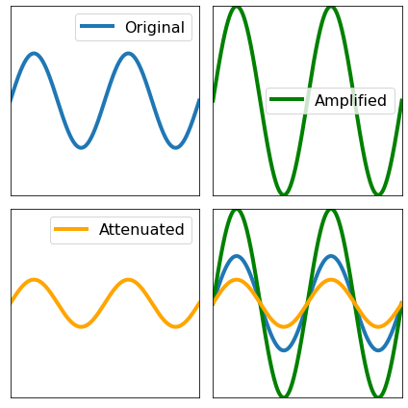
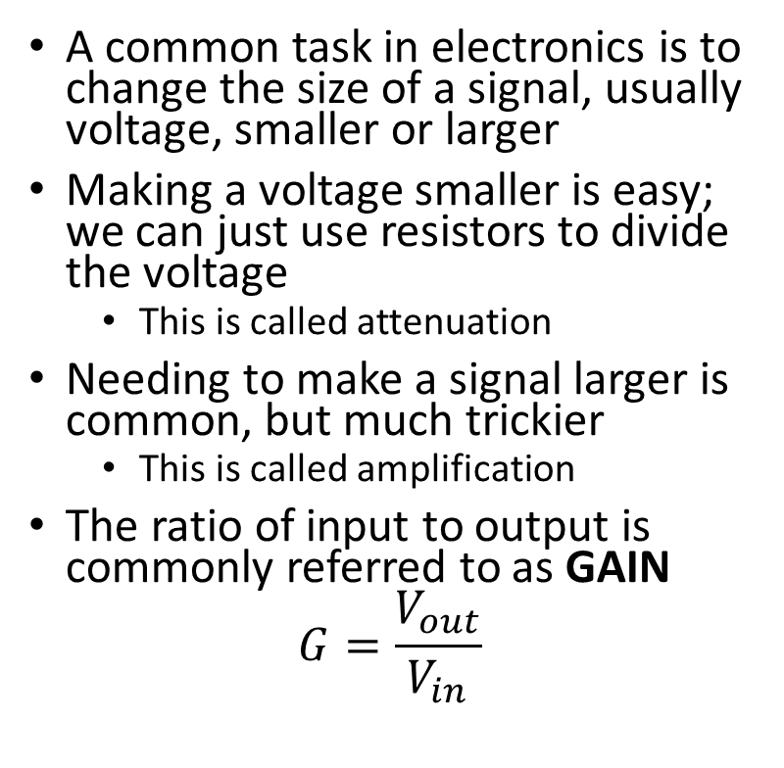
Amplification and Attenuation
A common task in electronics is to change the size of a signal, usually voltage, smaller or larger
Making a voltage smaller is easy; we can just use resistors to divide the voltage
  This is called attenuation
Needing to make a signal larger is common, but much trickier
  This is called amplification
The ratio of input to output is commonly referred to as GAIN
$$G=\frac{V_{out}}{V_{in}}$$

Slide 3
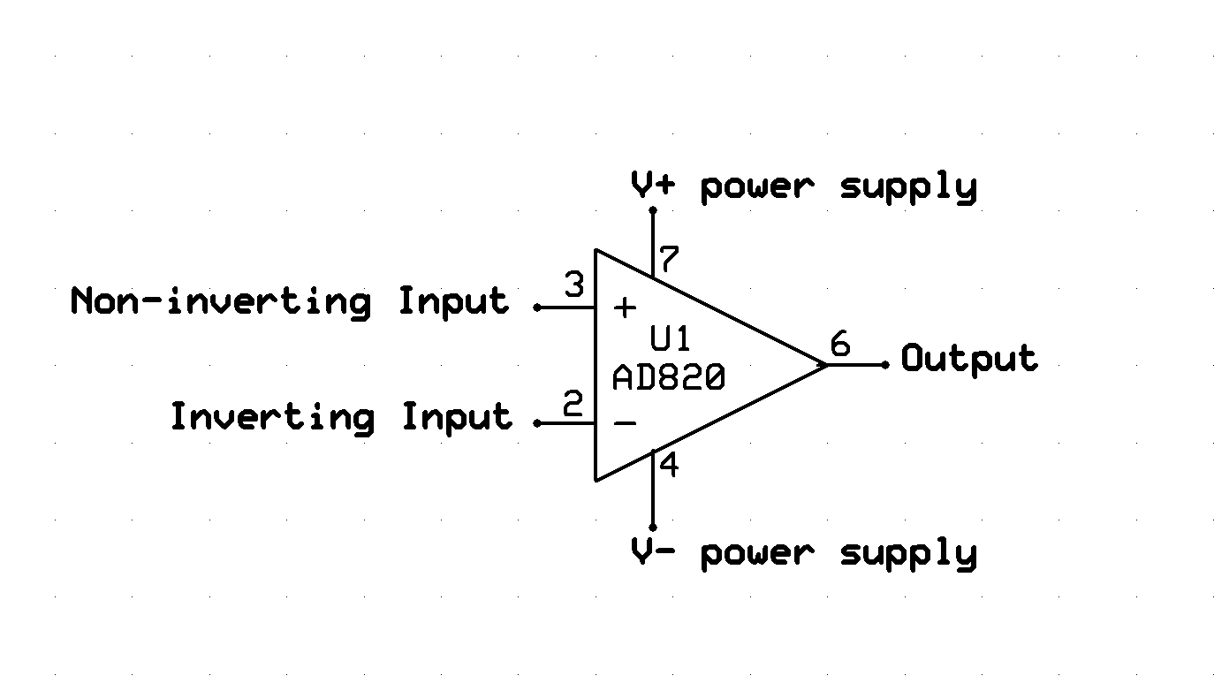
Operational Amplifier or “Op Amp”
An IC, the Op Amp, can be used to do this.
The symbol below is a standard Op Amp; only the part and pin numbers are specific to a part (AD820) number.

Slide 4
Op Amp Connections - Power
Vcc+ Supply
Vcc- Supply
  Often connected to 0V or GND
  Will sometimes be connected to a negative voltage for negative outputs
It is common not to draw these connections on schematics to simplify drawing
Power going out the output pin will come from these connections instead of the input pins

Slide 5
Op Amp Connections - Inputs
V_{in+} (V₊)
  Non-inverting input
V_{in-} (V₋ )
  Inverting input
The signal you want to amplify (V_{in}) will be connected to one of these two pins
  The + or – is used depending on application

Slide 6
Op Amp Connections - Output
V_{out} is the changed output voltage signal
  The amplifying circuit is built to change this to the desired behavior
In addition to sending the output somewhere else, it will be connected to one of the inputs (+ or -)
The voltage value is limited by the voltage supplied at the power pins
  Maximum Out V_{out}=V_{cc+}
  Minimum V_{out}=V_{cc-}

Slide 7
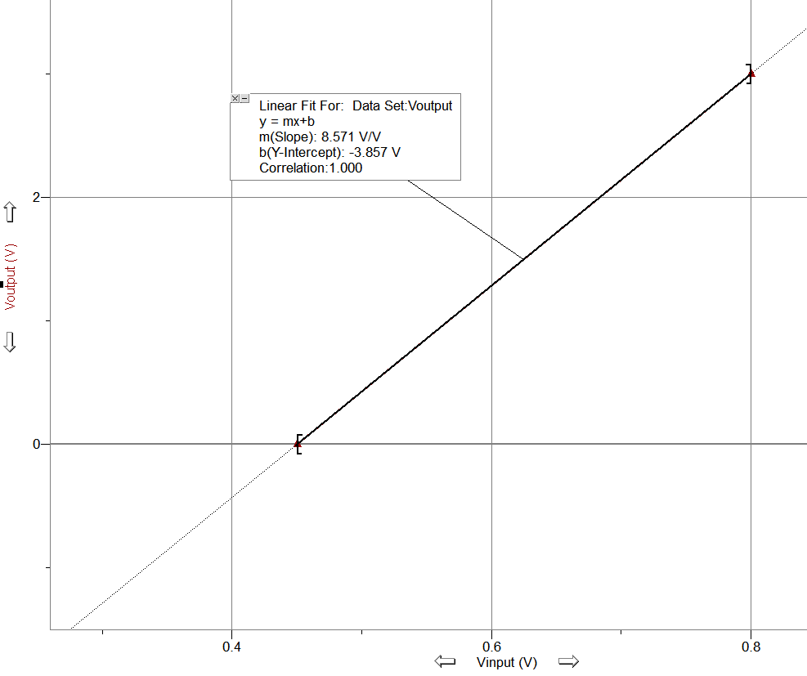
Transfer Function
Op Amps create a linear relation between V_{out} and V_{in}, with V_{out} on the Y-axis and V_{in} on the X-axis
The equation of the line with V_{out} on Y and V_{in} on X is called the TRANSFER FUNCTION
The slope is called GAIN
  Can be positive or negative
  Since it is Volts/Volts, Gain is a unitless number
The intercept is called the OFFSET
  For the simplest amplifier, the offset is 0
  Since it is a shift in the output, Offset has units of Volts

Slide 8
Determining the Amplifier Circuit
Determine your Minimum and Maximum V_{IN}
  For example, this would be the Voltage at the highest and lowest temperatures you are trying to measure
Determine the Min and Max V_{out}
  Ex. The minimum voltage and maximum voltage on the meter you are using to measure the output
Plot the line of V_{out}(y) vs V_{in}(x)to determine gain and offset
Build an amplifier that will give that gain and offset

Slide 9
Op Amp Golden Rules
To determine the circuit needed, we use the following rules:
Infinite Open Loop Gain. (V_{out} will change to meet the other rules)
No voltage difference between the inputs. (V₊=V₋)
No current flow in or out of the inputs (I+=I-=0A)
These are how a perfect ideal Op Amp will function
Connecting the input and output pins with resistors, we can manipulate the behavior of the output voltage.
The Op Amp Rules, Ohm’s law, and Kirchhoff’s Laws allow us to write a system of equations to figure out the specific resistor values we need.
You usually start with the general type of amplifying circuit needed, or just look up a standard design.

Slide 10
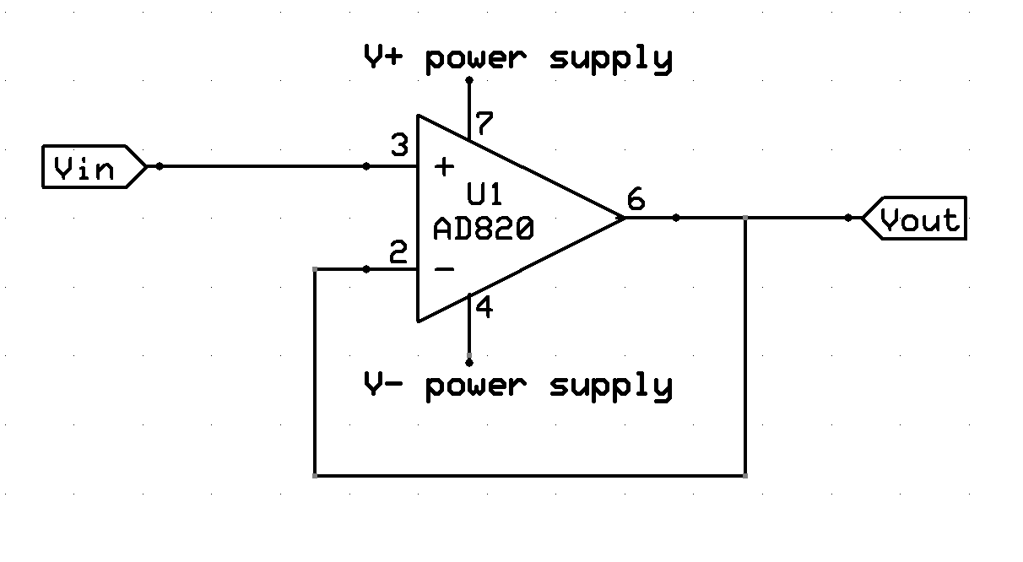
Signal Conditioning Circuit
Example 1: Buffer
Simplest Case:
Connect the V_{out} back to either input
V_{in}=V₊
V₊=V₋ (Rule II)
V₋=V_{out} (Directly Connected)

Slide 11
Signal Conditioning Circuit
Buffer usage
This may seem like a silly example, but it is actually quite useful.
The input is isolated from the output by the Op Amp.
Current on V_{out} comes from the supply, not V_{in}. So a low-power Vin could be used to drive a high-power output.
Gain of Buffer
Vin = Vout
Gain=1

Slide 12
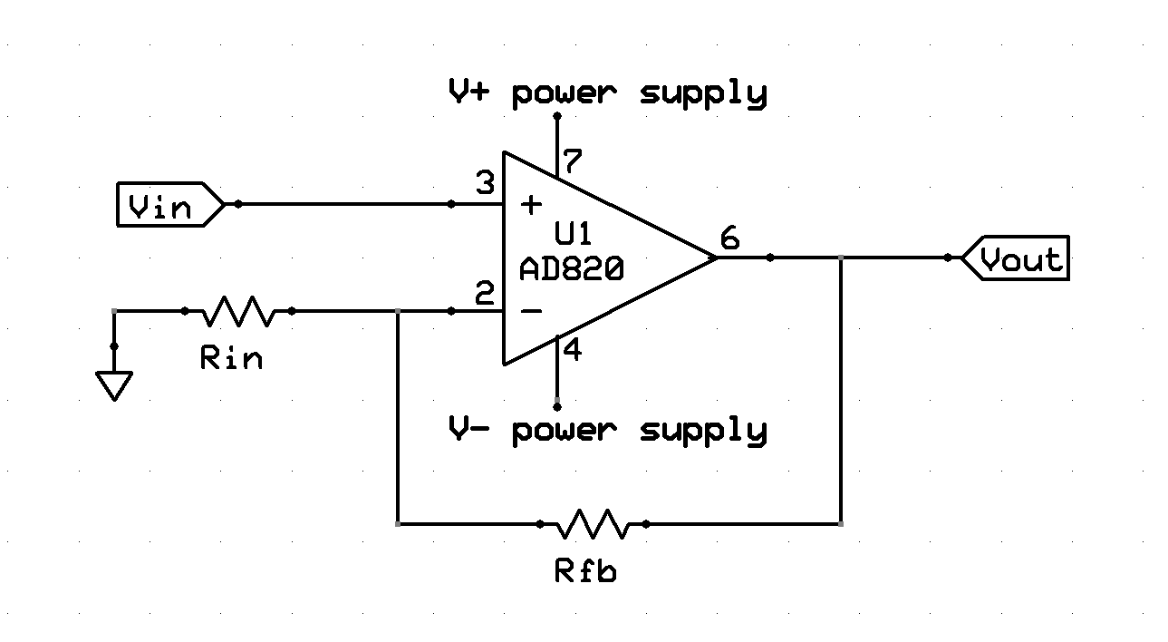
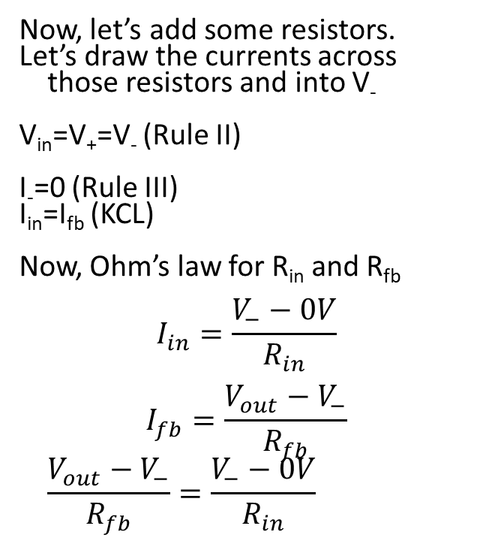
Non-Inverting Amplifier Example
Now, let’s add some resistors.
Let’s draw the currents across those resistors and into V₋
V_{in}=V₊=V₋ (Rule II)
I₋=0 (Rule III)
I_{in}=I_{fb} (KCL)
Now, Ohm’s law for R_{in} and R_{fb}
$$I_{in}=\frac{V_{−}−0V}{R_{in}}$$
$$I_{fb}=\frac{V_{out}−V_{−}}{R_{fb}}$$
$$\frac{V_{out}−V_{−}}{R_{fb}}=\frac{V_{−}−0V}{R_{in}}$$
I_{in}
I₋
I_{fb}

Slide 13
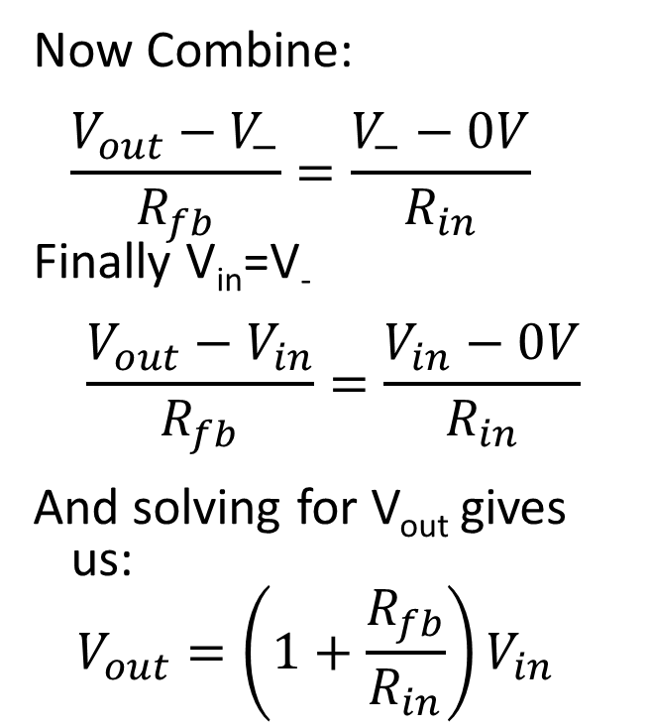
Non-Inverting Amplifier Example
Now Combine:
$$\frac{V_{out}−V_{−}}{R_{fb}}=\frac{V_{−}−0V}{R_{in}}$$
Finally V_{in}=V₋
$$\frac{V_{out}−V_{in}}{R_{fb}}=\frac{V_{in}−0V}{R_{in}}$$
And solving for V_{out} gives us:
$$V_{out}=\left(1+\frac{R_{fb}}{R_{in}}\right)V_{in}$$
I_{in}
I₋
I_{fb}

Slide 14
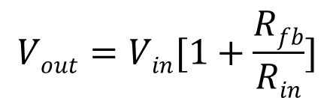
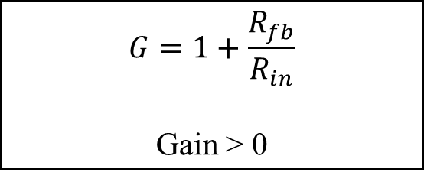
Non-Inverting Amplifier Usage
Non-inverting Op Amps have V_{in} connected to the positive terminal.
It does not flip the signal, so it is “Non-inverting”.
We could do a similar analysis to derive the equations more amplifiers but will just show some common types along with their transfer equations
$$G=1+\frac{R_{fb}}{R_{in}}$$
Gain > 0

Slide 15
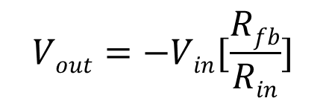
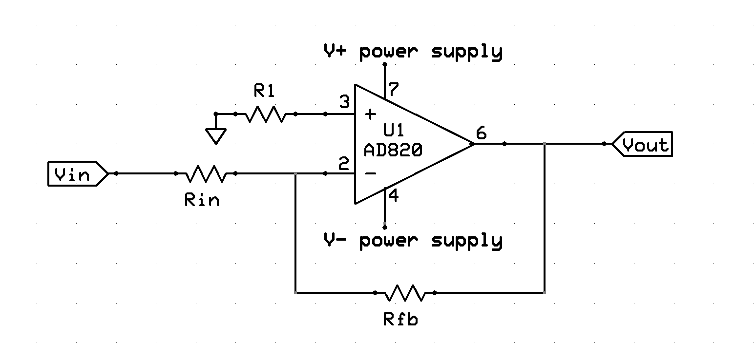
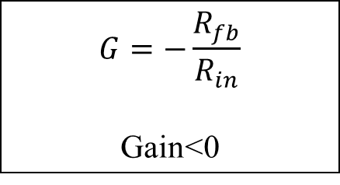
Inverting Amplifier
Inverted op amps have Vin connected to the negative terminal.
Signal is inverted over 0V.(flipped).
Note: the gain is negative so it is important to consider the sign of Vin and if Vs- is negative or zero
$$G=−\frac{R_{fb}}{R_{in}}$$
Gain<0

Slide 16
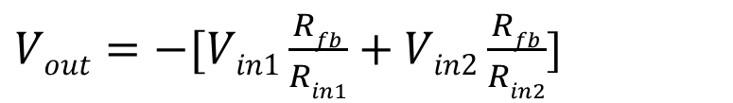
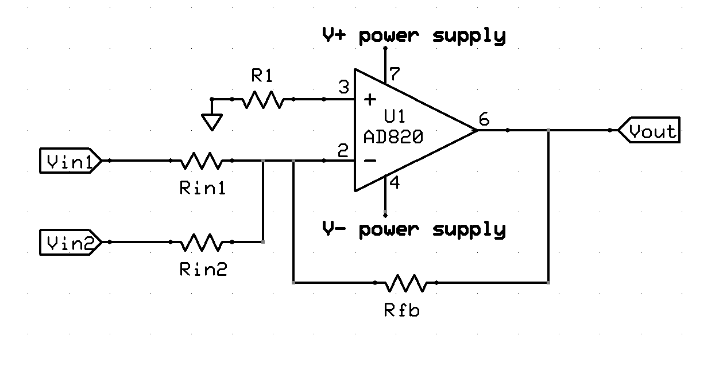
Summing Amplifier
Summing op amps have multiple inputs connected to a single input.
The output is a weighted sum of the inputs.
Can be inverting (shown here) or noninverting,

Slide 17
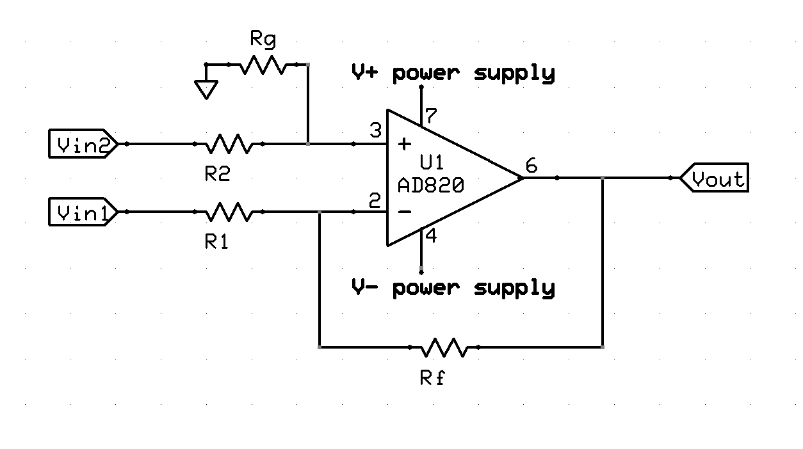
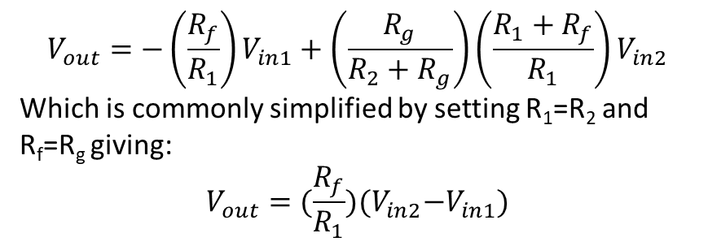
Difference Amplifier
$$V_{out}=−{\left(\frac{R_{f}}{R_{1}}\right)V}_{in1}+\left(\frac{R_{g}}{{R_{2}+R}_{g}}\right){\left(\frac{R_{1}+R_{f}}{R_{1}}\right)V}_{in2}$$
Which is commonly simplified by setting R₁=R₂ and R_{f}=R_{g} giving:
$$V_{out}={(\frac{R_{f}}{R_{1}})(V}_{in2}−V_{in1})$$
It amplifies the difference between the two signals.

Slide 18
Other Amplifier Variations
A common variation is to add an offset to previous examples, which shifts the entire signal by a constant amount up and down
  We will do this in the Temperature Calibration Activity
By adding capacitors and or inductors, you can make the gain of a circuit depend on a frequency, which allows you to filter out undesirable signals (like quickly changing noise from radio)
It is also common to send the output of one amplifier to the input of another to achieve the desired output

Slide 19
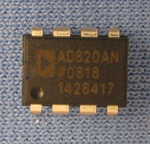
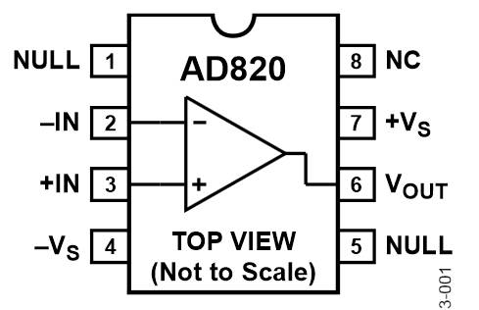
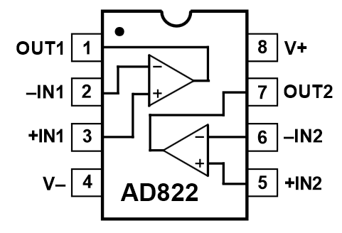
Operational Amplifier ICs
Commonly come in Single(1x), Dual(2x), and Quad(4x) Packages
In those cases, the amplifiers share a common set of power supply pins and have individual input and output pins
To the right, we can see the single and dual versions of a common Op Amp
  Notice the physical package is the same, but the pins are not, in particular, the power pins are different

