Slide 1

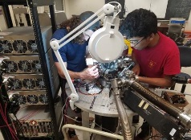

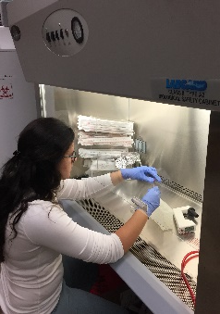

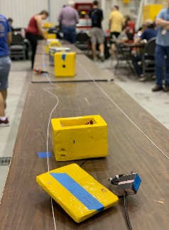
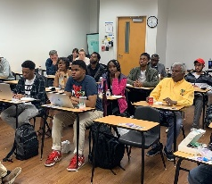
LaSPACE
Guide to Oral Presentations
Colleen H. Fava, LaSPACE Assistant Director
colleenf@lsu.edu
Presentation to the
2022-2023 LaACES @ LSU
326 Nicholson Hall, LSU
Thursday, February 9, 6:00 pm

Slide 2







Guide to Oral Presentations:
Summary of Content
The goal of this lecture is to provide basic concepts and strategies for the drafting and delivery of a quality oral presentation using PowerPoint.
    Major content areas covered:
      Content Development & Delivery
        Communication & Rhetorical Strategy
        Planning & Structure
      Design
        Graphic Elements & Color
        Parallel Structure
        Incorporating Graphics/Using Visuals
      Execution
        Resources / Tools
        Body Language
        Effective Speaking
LSU rev20230208
L17.01
Slide 1 of 23

Slide 3
Communication &
Rhetorical Strategy
Communication employs rhetorical strategies to convey specific information via various modes of discourse to a particular community to achieve a desired outcome.
Simplified: LaACES team gives a presentation to LaACES management to defend the contents of their of PDR in order to obtain permission to proceed with payload development.
Rhetorical Strategy refers to the use of context-dependent tools and devices to most effectively communicate information to a given audience.
Simplified: LaACES team structures the presentation to mirror the PDR document while highlighting the most critical elements of each PDR section.
LSU rev20230208
L17.01
Slide 2 of 23

Slide 4
Communication
Modes & Media
Communication Modes refers to the means of communication (visual, linguistic, spatial, aural, gestural) while the Communication Medium is the channel (photograph, essay, furniture arrangement, podcast, dance) through which the information is communicated.
Most Communications Artifacts are Multimodal, and the most common modes are visual and linguistic.
Most STEM Professionals are expected to master the following Communications Media: Papers, Presentations, Posters, & Proposals.
LSU rev20230208
L17.01
Slide 3 of 23

Slide 5
The Rhetorical Triangle (1):
A Strategic Approach to Communications
The Rhetorical Triangle is born of the classical oral tradition of appeals defined by Aristotle.
The three appeals (Logos, Ethos, Pathos) correspond to the three major components driving the creation of a given artifact.
The appeals contain various techniques for persuading your audience to accept your message.
LSU rev20230208
L17.01
Slide 4 of 23

Slide 6
The Rhetorical Triangle (2):
Aristotle & Contemporary Rhetoric
The importance of each point on the triangle will vary depending on the big picture, but Purpose, Persona, & Audience will always matter as you develop your project.
Logos
  Logic/Stats/Idea/Message
Ethos
  Authority/Credibility/ Trust
  Pathos
  Emotion/Value/Stories
Purpose
  Content & Goals
Persona
  Your role and manner
Audience
  Who is listening & Why
Purpose
Logos
Pathos
Ethos
Audience
Persona
LSU rev20230208
L17.01
Slide 5 of 23

Slide 7
The Rhetorical Triangle (3):
The “So-What!?” of Your Presentation
Effective use of the triangle should lead to the overall message or the “So-What” of your presentation.
Persona + Audience + Purpose
(Who am I? Who am I talking to? What am I trying to accomplish?)
        Each component is critical & required
        Each impacts the other
        The 3 combine to form your message
        Use your message to build your presentation
        Use devices to establish & stay on message
        Start Building!
Purpose
Audience
Persona
LSU rev20230208
L17.01
Slide 6 of 23

Slide 8
Presentation Structure (1):
Mapping Your Story
Now that you have defined the Message (i.e. Purpose, Persona, & Audience) for your presentation, you are ready to map your story.
Standard Story Structure
  Beginning: Introductions, Set up, Goal(s)
  Middle: Body of the Talk, Evidence, Staying on Message
  End: Restating the Goal(s), Major / Important Conclusions, Results, Future Work
    Credits / Epilogue / Bonus Scenes: Q and A
LSU rev20230208
L17.01
Slide 7 of 23

Slide 9
Presentation Structure (2):
Introductory Content
The Introductory Content introduces the Presenter(s) as well as the overall content of the talk:
  Comprehensive Title Slide:
      Title
      Names & Titles of Presenter(s)
      Context
      Location
      Date & Time
  Slide #1 Summary Introduction:
      Mission Statement OR
      Bulleted List of Objectives OR
      Bulleted List of Content Areas OR
      Table of Contents
This is the land them or lose them moment.
Introduce yourself & your teammates.
Recognize your audience.
Paint the big picture & front-load with the so-what.
LSU rev20230208
L17.01
Slide 8 of 23

Slide 10
Presentation Structure (3):
The Body of Your Talk
The body of your presentation must follow the premises and promises established in your introduction.
Common Content Structure for a Research / Design Talk:
  Contextualize your project
  Share your specific research question(s)
  Reference the literature; science background
  Specify limitations & requirements
  Share and justify your materials & methods
  Present major & minor findings
  Account for alternative interpretations & errors
  Identify remaining tasks, if any, relevant to this work
  Identify your contribution to the field
  Identify future work on this or related content
  Open the floor for questions
LSU rev20230208
L17.01
Slide 9 of 23

Slide 11
Slide Design (1):
Designing PowerPoint Slides
Create a clean, consistent design theme that is easy to read and reinforces your message.
PowerPoint vs Other Platforms
  Easier conversion across the Office Suite
  Most people/computers have access
Template vs Unique Design
  Templates might have limited flexibility
  Color Schemes might not fully match the visual brand
  More difficult to incorporate original artwork, logos, images if the template is not editable
LSU rev20230208
L17.01
Slide 10 of 23

Slide 12
Slide Design (2):
Parallel Structure
Use parallel structure to create easy access to information for you and your audience.
Parallel Structure is the use of unifying design elements
Consistent use of the same colors, visual pattern(s), font sizes, and organization of elements makes the final product more cohesive and easier to navigate.
Include context &/or author info & slide numbers on all slides
Apply Parallel Structure:
Graphic Design Elements
Color Scheme
Font (Style, Size, Color)
Placement (Titles, Headings, Captions)
Bullet Styles
Borders
Figures (Photos, Graphs, Charts)
LSU rev20230208
L17.01
Slide 11 of 23

Slide 13
Slide Design (3):
Color Palettes & Readable Text
Use a color palette that is easy to read, and complements required images that you cannot control.
Select font styles, sizes, and colors that you and your audience can easily read.
Developing the Color Palette
  Use colors from photos, charts, & graphs
  Incorporate designs & colors that reinforce your subject
  Avoid “extreme” colors except as accents
  Keep the body design to two or three colors
  Use contrast for readable text
LSU rev20230208
L17.01
Slide 12 of 23

Slide 14
Slide Design (4):
Readable Text
Select font styles, sizes, and colors that you and your audience can easily read.
Font Style
  Use Sans-Serif Fonts (Arial, Helvetica, Lucida Sans)
  Use italics and other effects sparingly
Font Size
  Avoid fonts smaller than 18 point / larger than 72
  Use a descending scale with the title always the largest
Font Color
  Dark on light or light on dark
  Avoid bright & harsh colors
  Avoid low contrast colors
LSU rev20230208
L17.01
Slide 13 of 23

Slide 15
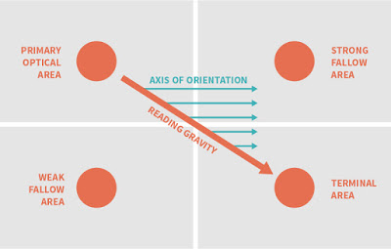
Slide Design (5):
Incorporating Visuals
Include, and directly reference, visual representations to convey information most effectively; include cues for the viewer and consider reader gravity.
Reader Gravity
Visual Tools:
Photographs
Videos
Schematics
Drawings
Graphs
Charts
Tables
Flowcharts
Figure 1. This diagram illustrates reader gravity, the typical way a Western Language person approaches a page.
Credit: http://betterposters.blogspot.com/2016/09/reading-gravity.htm
LSU rev20230208
L17.01
Slide 14 of 23

Slide 16
Slide Design (6):
Visual Integration Example
Use visuals that illustrate your point; lose those that don’t help. Create comprehensive captions. Use Cues.
These charts show student visits to the CxC Studio by day of the week during the 2009-2010 academic year.
Figure 2. Fall 2009 shows student attendance varies by weekday with a noticeable peak on Wednesdays.
Figure 3. Spring 2010 shows a more even distribution Tuesday through Friday with a noticeable dip on Mondays.
LSU rev20230208
Slide 15 of 23

Slide 17
Executing Your Presentation (1):
The Performance
An effective presentation is an effective performance.
The tools & resources you have access to will drive the limitations of your performance.
The quality of your performance is within your control.
Performance Tools & Resources
  Technology
  Supplements
  Physical Space
  Time
  Personal Appearance
  Body Language
  Speech
Colleen’s pet peeve:
“I’m giving a PowerPoint.”
You are giving a presentation.
PowerPoint is just a tool you are using for your presentation.
LSU rev20230208
L17.01
Slide 16 of 23

Slide 18
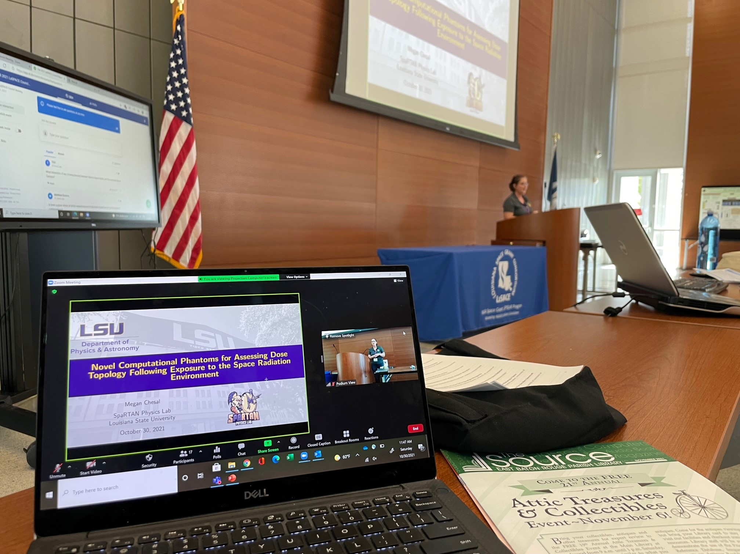
Executing Your Presentation (2):
Technology & Supplements
PowerPoint is a highly effective tool used in the execution of a presentation, but it is not the only tool.
What other tools could you use to supplement your talk?
Presentation Tools
  Handouts
  Manipulatives
  Whiteboards
  Computers
  Projectors
  Microphones
  Videos
  Websites
  PowerPoint Slides
Figure 4. LSU Physics PhD candidate, Megan Chesal, presenting at the Fall 2021 Space Grant Meeting. This image features several “tools” in support of the presentation.
LSU rev20230208
L17.01
Slide 17 of 23

Slide 19
Executing Your Presentation (3):
Presentation Environment
Effectively use space, time, and technology to meet your presentation goals.
  Space
    Where is your talk? Online? In-Person? Hybrid?
    What does the physical space look like?
    Are there restrictions on your movement due to the location and expectations of the audience (at a podium, walking around)?
  Time
    Maximum/Minimum times?
    Any flexibility? Any hard requirements?
  Technology
    Do you bring a computer, projector, flashdrive?
    Do you have to use the “house” machine?
    Is the operating system compatible? software? wi-fi?
LSU rev20230208
L17.01
Slide 18 of 23

Slide 20

Executing Your Presentation (4):
Dress for Success
Dress the part BUT there is more than one part!
The important thing is to know what your audience expects of you and meet that expectation.
Dress Tips
Ask the organizer
Ask the person who invited you
Check the website for guidance
Check the website for past event images
Ask people who have presented / attended before
Use your best judgment
Respect your comfort (zone)
Figure 4. The labelling of the images above give the impression that there is a right, wrong, and okay way to dress, but we know it’s more complicated than it appears.
LSU rev20230208
L17.01
Slide 19 of 23

Slide 21
Executing Your Presentation (5):
Body Language
Say what you mean and mean what your body says!
Effective Signals and Postures
  Face your audience
  Make eye contact
  Look into the camera
  Attend to the entire room
  Check for text in chat boxes / raised hands
  Keep your body open and relaxed
  Lean forward
  Smile, nod, pause
  Do not create distractions
  Do not succumb to distractions
  Be honest and enthusiastic about your subject
Tip
Pay attention to the people you are talking to and you will likely achieve positive body language naturally.
LSU rev20230208
L17.01
Slide 20 of 23

Slide 22
Executing Your Presentation (6):
Verbal Language
Say what you mean and believe what you say!
Effective Speaking
  Speak toward your audience
  Avoid “uh”s and “um”s
  Speak slowly, clearly (enunciate)
  Check the correct pronunciation of terms
  Consider your audience’s experience level
  Acknowledge mistakes and quickly move on
  Expect challenges and technical difficulties
  Use the allotted time; use ONLY the allotted time
  Use meaningful pauses
  Use logical transitions between slides (& speakers)
  Monitor your audience’s engagement
  Be honest and enthusiastic about your subject
Tip
Respect your audience, your subject matter, and yourself.
LSU rev20230208
L17.01
Slide 21 of 23

Slide 23
Executing Your Presentation (7):
Practice Makes Practically Perfect
Say what you know and know what you’re saying!
Practice
Step 1: Practice while silently reviewing your slides
Step 2: Practice out loud and time yourself
Step 3: Practice out loud and time yourself in front of an audience
Step 4: Repeat Steps 1-3 as needed
Practice will
  Improve the flow of your speech
  Reduce errors, inconsistencies, and structural flaws
  Reduce nervousness
  Identify content gaps
  Improve your understanding of the content
Tips
Fail to prepare: be prepared to fail.
Practice is the best way to show respect for your audience, your subject, and yourself.
LSU rev20230208
L17.01
Slide 22 of 23

Slide 24
Thank you! Questions?
Colleen H. Fava, LaSPACE Assistant Director
colleenf@lsu.edu
Slide 23 of 23

