Slide 1
Basic Power System Design

Slide 2
What is a Power System?
When designing a power system, there are three types of components we need to consider
The loads that consume the power
Sensors, microcontroller, amplifiers, transmitters, etc.
The source of electrical power
Batteries, solar panels, bench supplies
Converters and distribution
The conductors through which the power flows
The devices that raise and lower the voltage between different parts of the power system
Power Source
Power Converters
Loads

Slide 3
Design Requirements
The requirements for the power system should flow in the opposite direction of the actual power
Loads are selected based on science and technical requirements
Then select regulators capable of supplying the loads
Select a source that meets the needs of the regulators and loads
Power Source
Power Converters
Loads

Slide 4
Important Load Characteristics
Start determining all of your loads (what do you need to power)
Maximum load current
The highest instantaneous current we expect each device to consume.
Average load current
The typical or average current draw from a device. This can be found on the component’s datasheet or measured directly.
Voltage levels
The voltage required for power. This can be found on the datasheet or component listing.
Duty cycle
Percent or ratio of a specified period of time that a device is active or powered.
Some devices can be turned on and off instead of running continuously
This is especially significant for heaters that require high current but only need to turn on occasionally

Slide 5
Period Duration and Duty Cycle
Duty cycle is defined as the ratio of the time powered over a specified period of time. The duration of the period is the period duration.
To calculate, just divide the time the particular component must be powered or in high power mode by the total period.
To find the average current, just multiply by the duty cycle, for example, a 50 mA load with a 20% duty cycle would have a 10mA average current.
$$Duty Cycle= \frac{T_{powered}}{T_{period}}$$

Slide 6
Selecting Power Regulators/Converters
In most cases, you will need to convert from one voltage to another within a power system
Loads may require different voltages, i.e., 3.3V or 5V
The power source voltage is different than what is required by the loads
For example, solar cell and battery voltages are determined by their chemical makeup
Many power source voltages vary with loading or state of charge (battery output voltage decreases over time)
You can often minimize resistive losses in wires by using higher voltage and lower current (the power in watts is conserved)
For these reasons, power systems will have devices to raise or lower the supplied voltage (Power converter or voltage regulator)

Slide 7
Important Power Converter Characteristics
Output Voltage
This should match the loads you intend to supply.
Some regulators have a variable output set by some connected resistors or other components.
There will also be a spec on how variable this output voltage will be. May be given as ripple voltage, an output range, or a % tolerance.
Input Voltage
This is typically a range, i.e. 12-20V.
Peak Output Current
The maximum current the current can supply at once.
Efficiency
Ratio of Output Power (in Watts) to Input Power
Voltage converters use some power to work, so you supply more power at the input than comes out of the output

Slide 8
Converter Efficiency
Power Loss
Neither voltage nor current is conserved from converter input to output, but Power is.
An ideal converter would be 100% efficient.
In general, a higher efficiency is preferred.
The lost power is converted to heat inside the converter
In a vacuum environment, a low-efficiency regulator may not be able to meet specs because there is no ambient air to cool the regulator.
Efficiency is typically affected by the difference between the input and output voltage and load
Input Power
Output Power
Power Converter
$$\text{η}=\frac{P_{output}}{P_{input}}=\frac{P_{input}+P_{loss}}{P_{input}}$$

Slide 9
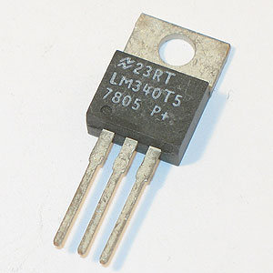
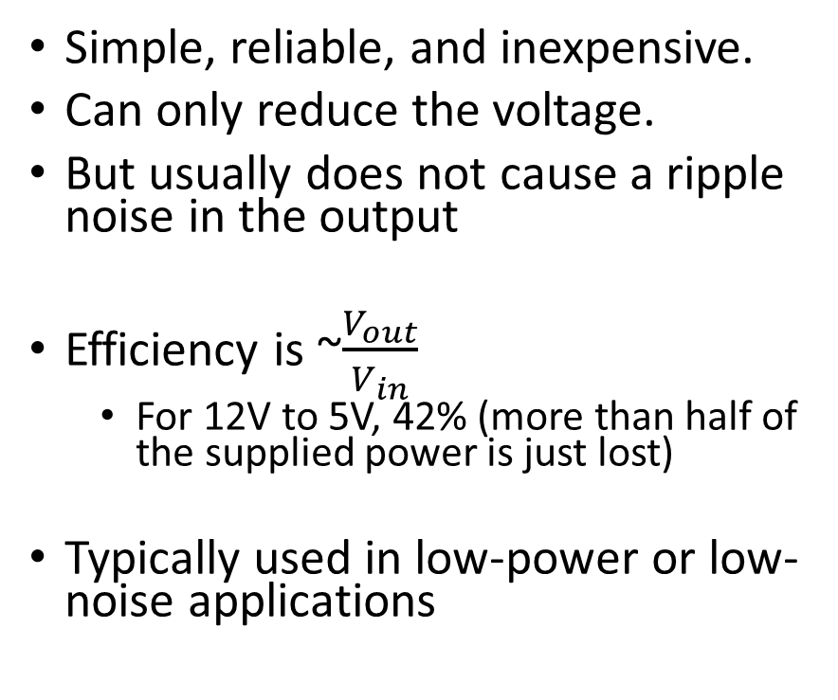
Linear Regulators
Simple, reliable, and inexpensive.
Can only reduce the voltage.
But usually does not cause a ripple noise in the output
Efficiency is ~$\frac{V_{out}}{V_{in}}$
For 12V to 5V, 42% (more than half of the supplied power is just lost)
Typically used in low-power or low-noise applications

Slide 10
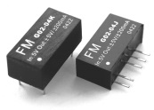
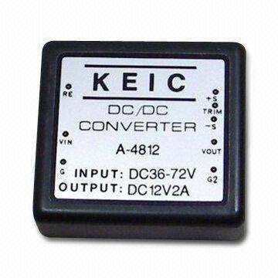
DC/DC Converters
Use a rapid-switching circuit to output the desired voltage
Switching can cause a rippling voltage that may need to be filtered
May raise (Boost Converter) or lower (Buck Converter)
High Efficiency (~80-90%)
Can be used to generate high voltages (100s to 1000s of volts) at very low currents for some applications

Slide 11
Working with Converters
Group by Output Voltage
Select all the loads that would be supplied by a single regulator.
Add the peak currents of all the loads; your regulator must have a peak output current greater than that number.
Multiply by output voltage to determine peak output power.
Calculate Average Output Power
Add all loads, the average currents, and multiply by the output voltage.
That is output power in watts.
Calculate Input Power
Divide the output power by converter efficiency, and the result is the input power.
Divide average input power by input voltage to find average input current.
Divide peak input power by input voltage to find peak input current.
Repeat this for all regulators until you are at the battery or other supply voltage.

Slide 12
Power Budgets
You should now be able to calculate a power budget
A power budget is a table of all electronic components, their required voltages, their current draws, and their consumed power. It may also contain information on how long a component will be powered(duty cycle).
By adding all of the peak currents at battery voltage, you can determine the required current rating
By adding the average currents and multiplying by total duration, you can determine total power capacity needed

Slide 13
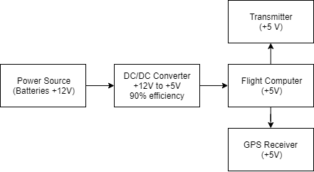
Power Budget Example
For the following example, the system below will be used. It is a simplified version of a beacon used during flight. It must run for 8 hours
Furthermore, we know the following information:
The Flight Computer draws 50mA continuously at 5V
The GPS Receiver draws 140 mA continuously at 5V
The transmitter draws 80 mA when in standby, at 5V
The transmitter draws 1050mA when transmitting at 5V
The transmission lasts 2 seconds.
Transmission occurs once every 30 seconds
Power source is a 12V Battery
A 12V to 5V converter with 90% efficiency will be used

Slide 14
Power Budget Example – Constant Draw Devices
In this example, we have two devices with 100% duty cycle: the flight computer and the GPS receiver.
The flight computer draws 50mA at 5V for a power consumption of 0.25W
The GPS receiver draws 140mA at 5V for a power consumption of 0.7W

Slide 15
Power Budget Example – Duty Cycle
In this example, the transmitter has two states – transmit and standby.
The transmitter will draw its max current for 2 seconds every 30 seconds. If we set the period duration to 30 seconds, we find that the transmitter has a duty cycle of roughly 7%
The standby duty cycle will be the time it doesn’t transmit. This makes the standby duty cycle 93%
$Duty Cycle \left(Transmit\right)=\frac{T_{transmit}}{T_{period}}=\frac{2 seconds}{30 seconds}$ = 6.67% ≈ 7%

Slide 16
Power Budget Example – Duty Cycle Current
Current Draw
To calculate the average current for a mode, multiply the current by the duty cycle of the device. This should be repeated for each mode and then summed. (This is just a time-weighted average)
The transmitter is in standby 93% of the time and transmits 7% of the time.
While in standby, the transmitter draws 80mA. While in transmit, it draws 1050mA.
Adding the two values we get a 149 mA average current
$$I_{cycle}=I_{s}∗Duty Cycle$$
Duty cycle current
$$I_{standby}=80 mA∗0.93=75 mA$$
$$I_{transmit}=1050 mA∗0.07=74 mA$$

Slide 17
Power Budget Example – Peak and Average Power
To find the peak current and power, we just add the highest currents for each mode
Peak Current at 5V: 1050mA+140mA+50mA = 1240mA
Peak Power at 5V: 1240mA * 5V = 7440 mW
To find the average current and power, we add all of the average currents
Average Current at 5V: 1050mA+140mA+50mA = 339mA
Average Power at 5V: 339mA * 5V = 1695 mW

Slide 18
Assembling the Budget
Once the power consumption of every device has been estimated, calculated, or measured, create a table to display all the information.
Component Name | Voltage | Peak Current | Peak Power | Average Current | Average Power
Flight Computer | 5 V | 50 mA | 250 mW | 50 mA | 250 mW
GPS Module | 5 V | 140 mA | 700 mW | 140 mA | 700 mW
Transmitter (Standby) | 5 V | N/A | N/A | 75 mA | 375 mW
Transmitter (Transmit) | 5 V | 1050 mA | 5260 mW | 74 mA | 370 mW
Total At 5V |  | 1240 mA |  | 339 mA | 1695 mW
For an 8-hour mission duration, the example system requires 2,840 mA-hr of battery capacity.

Slide 19
Power Budget Example – Converter Efficiency
To find the peak current and power at 12V, need to divide by the converter efficiency
Peak Power at 12V: 7440 mW / 0.9 = 8267 mW
Peak Current at 12V: 8267 mA / 12V = 689 mA
We do the same for averages
Average Power at 12V: 1695 mW / 0.9 = 1883 mW
Average Current at 12V: 1883 mW / 12V = 156 mA
If there was another regulator (12V to 3.3V, for example), you would do the same process and sum the currents and power at 12V

Slide 20
Calculating the battery draw
Now add a section or separate table for values at battery voltage (example shows rows for other regulators, but lists their draw at 0 to show)
Component Name | Voltage | Peak Current | Peak Power | Average Current | Average Power
5V Regulator Loads | 12 V | 689 mA | 8267 mW | 156 mA | 1883 mW
3.3V Regulator Loads | 12 V | 0 mA | 0 mW | 0 mA | 0 mW
Other Regulator Loads | 12 V | 0 mA | 0 mW | 0 mA | 0 mW
Total At 12V |  | 689 mA |  | 156 mA | 1883 mW
So our power source (battery pack) must have a current rating of 689 mA

Slide 21
Power Budget Example – Capacity Calculations
The average current is used to calculate the battery capacity required.
This could be done by multiplying power by time to get energy in Joules.
But battery capacity is typically given in terms of Amp-Hours
So in this case, for an 8-hour mission
156 mA * 8 Hours = 1255 mAHr battery is required.

Slide 22
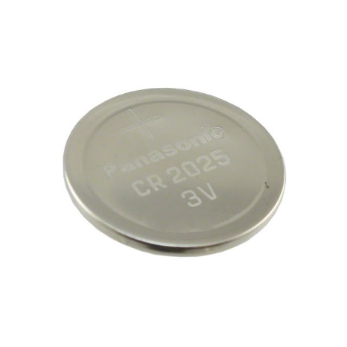
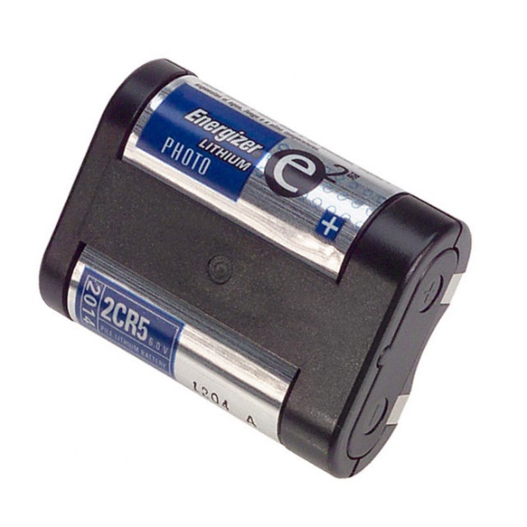
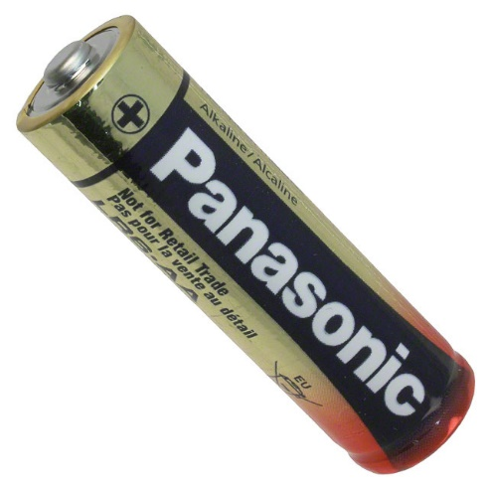
Power Sources – Batteries
Batteries are power supplies with one or more cells that store energy chemically. They come in many different forms and packages.
Batteries are often used in experiments where power cannot be reliably supplied from external sources such as the power grid.

Slide 23
Terminal Voltage
Terminal Voltage is the potential difference across the terminals of a battery.
Terminal voltage is highly dependent on the battery’s chemical composition.
Battery voltage decreases as the battery discharges
A partially discharged battery show full voltage when the battery is unloaded but quicky drop

Slide 24
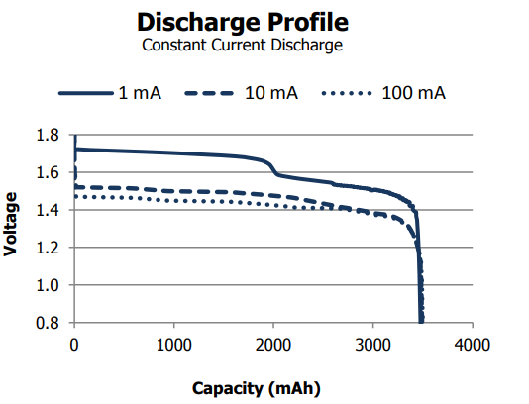
Discharge Characteristics
As the battery discharges, the voltage decreases.
There is usually a very rapid initial drop
Then the battery maintains a relatively steady voltage for a while
Finally, the voltage rapidly drops to 0 when the battery is mostly discharged
Due to internal resistance and heating terminal voltage is lower under higher loads

Slide 25
Capacity
Battery Capacity is the measurement of the charge stored within a battery, usually measured in A-hr or mA-hr.
A battery rated for 2900 mA-hr should deliver 290 mA for 10 hrs.
The cutoff for this capacity is usually right before the rapid drop in voltage

Slide 26
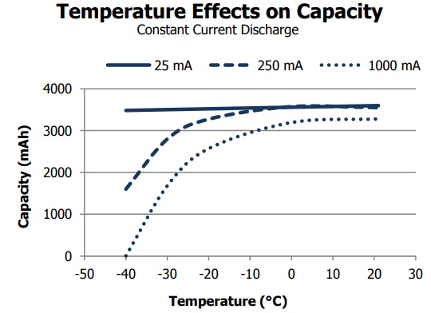
Temperature Effects
Low temperatures will cause a lower terminal voltage and decreased battery capacity
A 20% reduction in battery capacity is a good rule of thumb for the temperatures seen during a LaACES flight.
You could heat the batteries, but the heater may consume more power than loss in capacity.
The effect typically becomes worse as the temperature decreases.
Usually, the capacity and voltage will recover as the battery warms back up
If your batteries get too cold, they may be unable to provide adequate power.

Slide 27
Combining Battery Packs
Batteries may be combined in series or in parallel
When batteries are connected in series, the terminal voltage increases, but the capacity does not increase
All batteries simultaneously draw the same current
Connecting batteries in parallel increases the capacity, but the terminal voltage is not changed
The batteries split the current

Slide 28
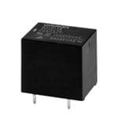
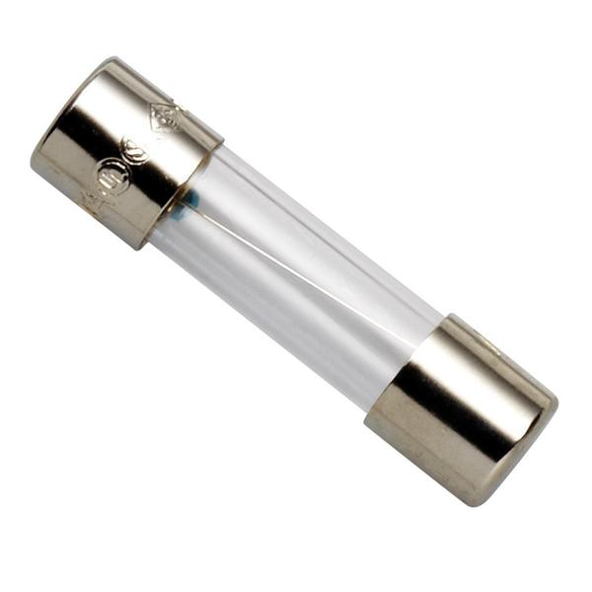
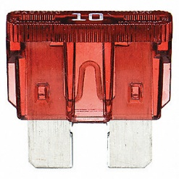
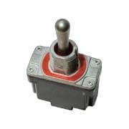
Advanced Power Components
More advanced power systems focus on the control and monitoring of the power. They may also include protections to isolate sensitive devices or prevent cascading damage from failed components.
Relays and switches are examples of components that are used to control the flow of power in systems. Fuses protect components from overvoltage and overcurrent conditions.

Slide 29
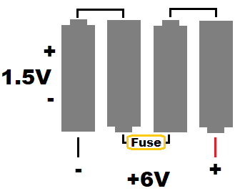
Recommended Battery Packs
LaACES Payloads typically use a battery pack of 2x2CR5 lithium cells connected in series with a resettable fuse.
This yields a 12V battery pack with ~1500mAhr capacity
This weighs ~85g
Anderson PowerPole connections make a secure connector that will not come loose during flight
9V lithium batteries have been used by teams
Alkaline batteries are not recommended due to low capacity and poor temperature performance
Rechargeable batteries are not acceptable due to fire risk.
6V
+12V

