Slide 1
Working with Surface Mount Components

Slide 2
Surface Mount Technology
An alternative to the through-hole components we used in the fall is to use components soldered to the surface of the circuit board
  SMD (Surface Mount Device) – The actual components
  SMT (Surface Mount Technology) – The overall technology
Advantages
  Smaller and lighter components allow circuits to be smaller
  Easier automated assembly
  More space available for routing board traces (components only on one side)
Disadvantages
  Easier to lose components
  Cannot be prototyped and tested easily like a breadboard
  More challenging to solder by hand

Slide 3
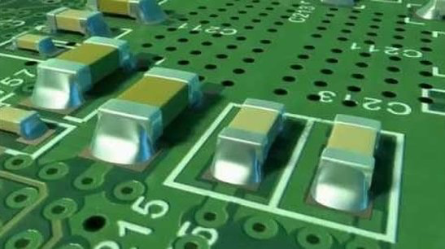
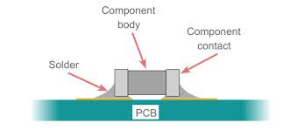
Surface Mount Soldering
In surface mount soldering, the component sits on top of the PCB
Solder Pads are exposed sections of copper (or other bare metal
Solder flows around and below the component onto the pad

Slide 4
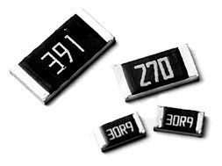
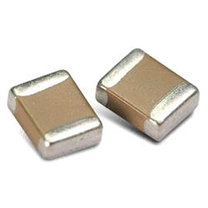
Two-terminal SMD
Resistors and Capacitors
  Case Code usually reported in XXYY format, where XX is the length, and YY is the width in mm or thousandths of an inch (MILS)
  VERY important not to mix up imperial and metric values! Ex. 0603 can be 0.6mm x 0.3 mm OR 0.06 x 0.03 in
  Both would be called a 0603 package
Other two-terminal devices, like diodes, may have their own package sizes and dimensions
Since the

Slide 5
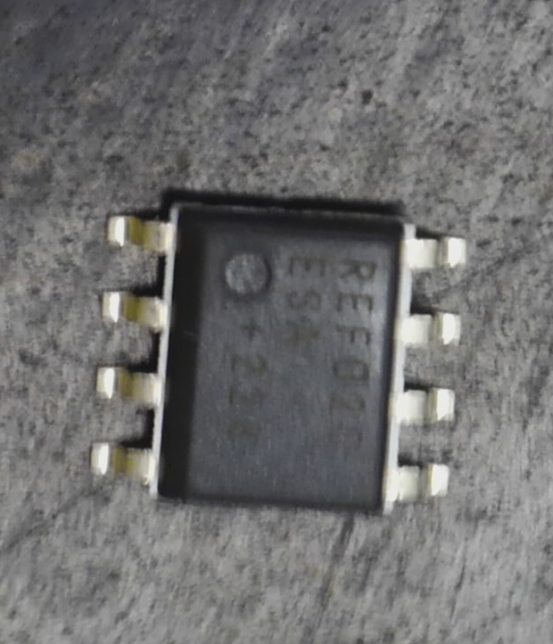
Multi-terminal SMD
Used for Integrated Circuits
Standard SMD footprints (large to small)
  Small outline integrated circuit (SOIC)
  Small outline transistors (SOT)
  Dual Flat No-Lead (DFN)
  Ball Grid Array (BGA)
SOIC (Package we will use) has the same basic layout and pin numbering as the DIP (Through-hole) Package
1 8
2 7
3 6
4 5

Slide 6
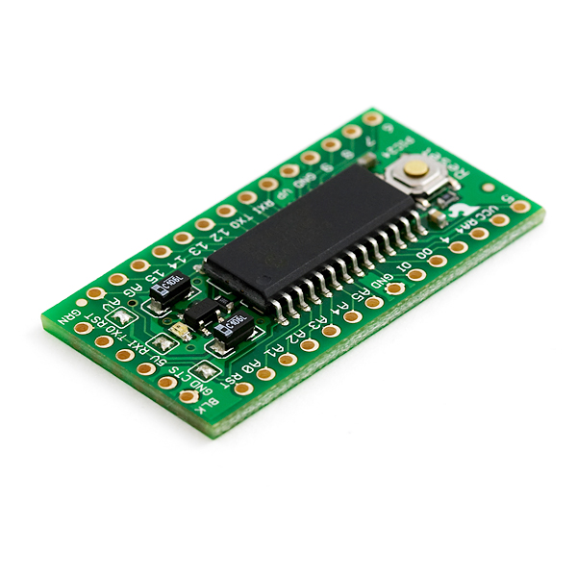
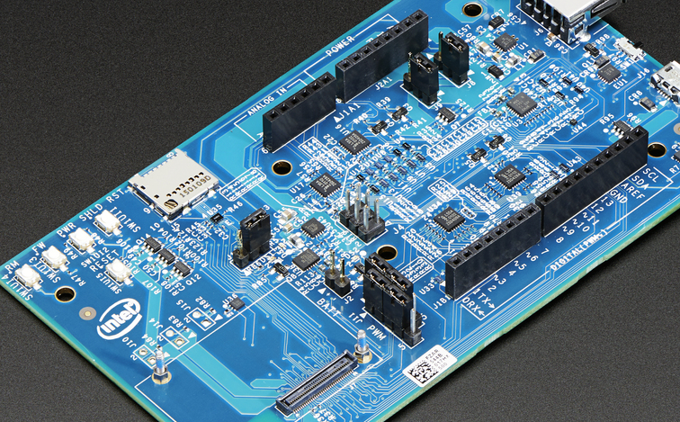
Prototyping with Surface Mounted Device (SMD) components
Difficult to prototype SMD components without a PCB board
Can solder wires directly to the leads
  Requires very fine wire and tricky soldering
Instead, you usually buy a pre-soldered board with a connector or through-hole pins (Called a breakout board)

Slide 7
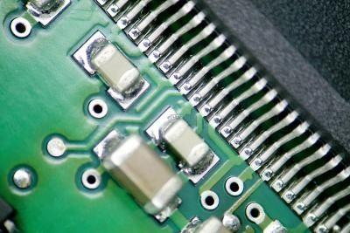
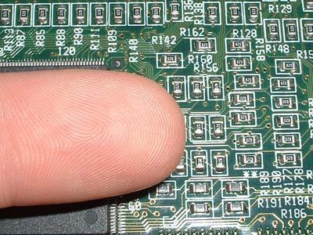
Surface Mount Soldering
Because of the small size of the components, preparation is key
SMD soldering tips:
  Work on a clean and well-lit surface to prevent you from losing components
  Use Tweezers or forceps to handle components
  Secure the board while working
  Clean and prepare the PCB before soldering
  Add solder slowly and sparingly

Slide 8
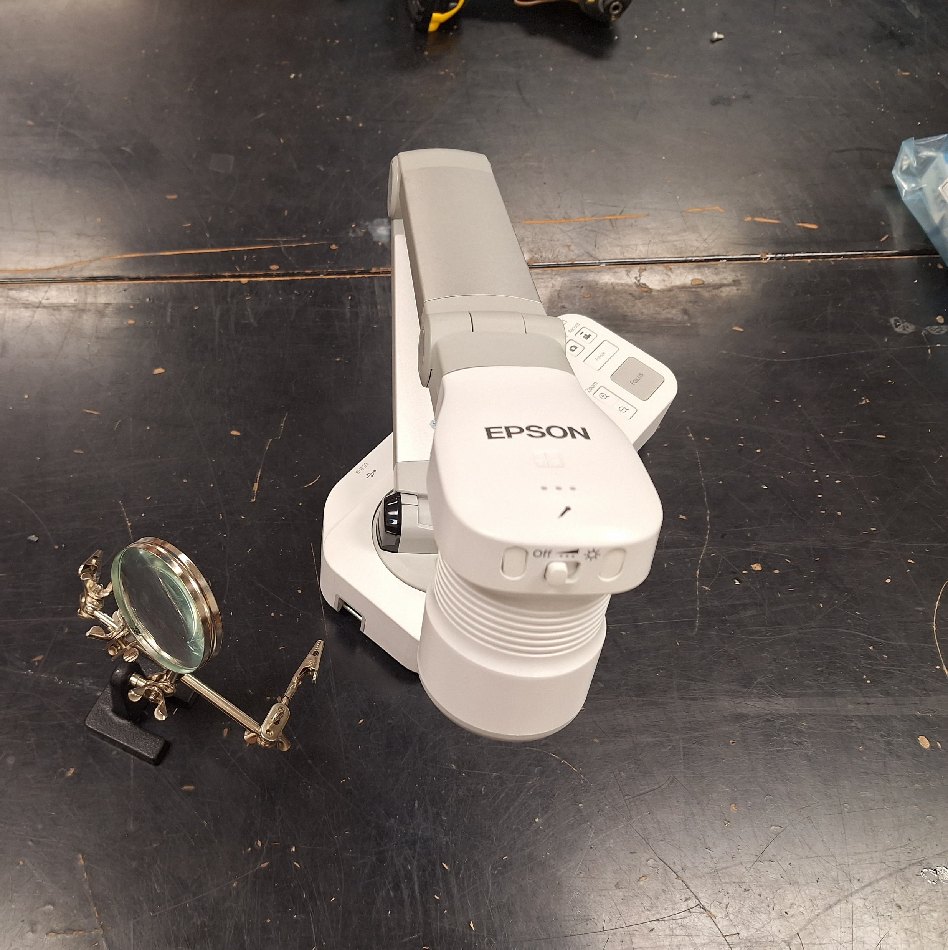
Use Magnification and Lighting
Work somewhere with adequate overhead lighting or use a benchtop light source
Have a hands-free magnifier or camera/microscope
  Headband-mounted magnifiers are great
Document-style webcams with a good zoom work well with a laptop or moniror

Slide 9
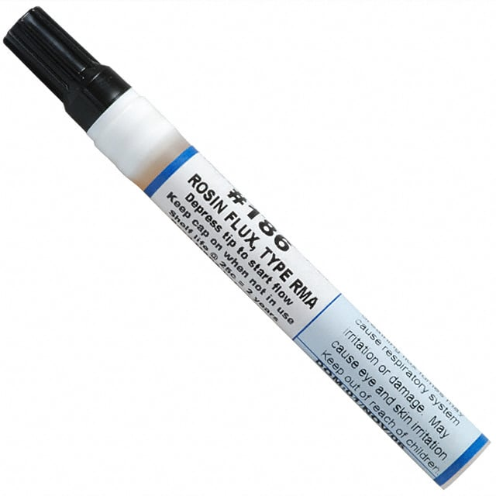
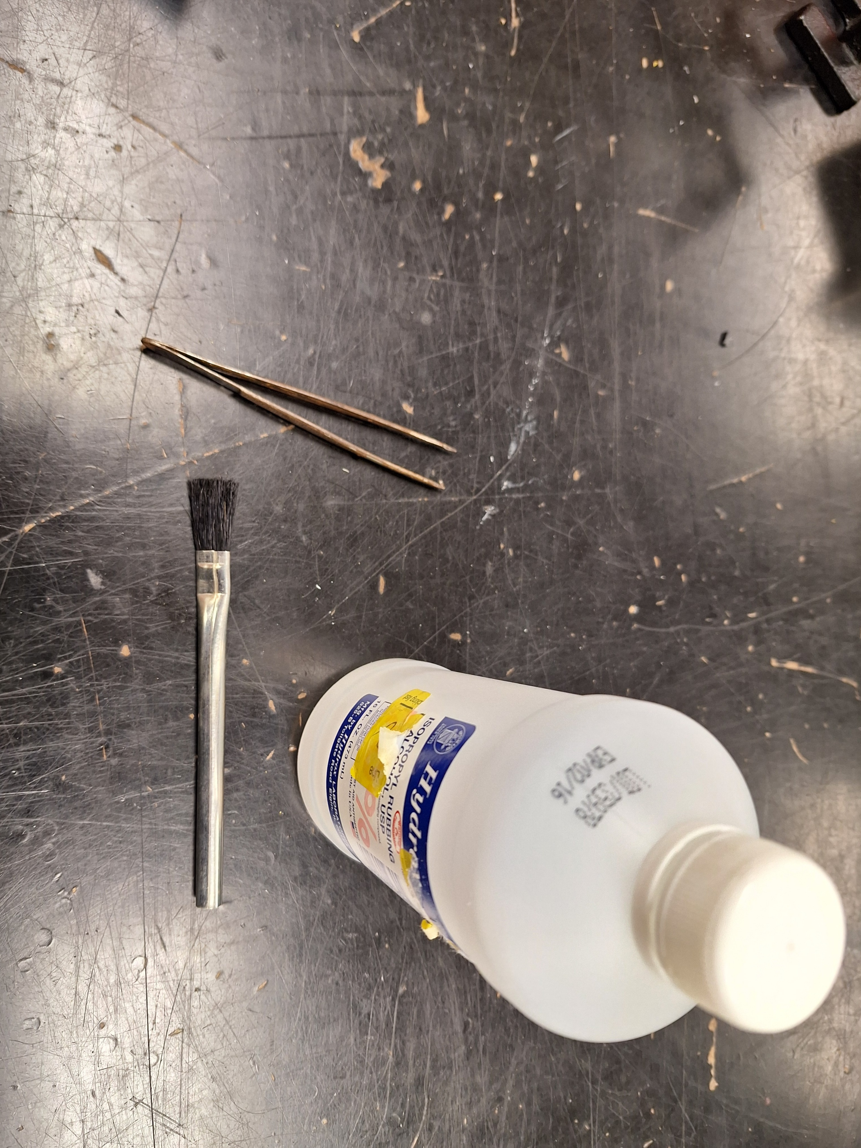
Prepare the PCB surface for work
Make sure the board is clean and free of foreign matter
May need to clean the surface of the board using a brush and isopropyl alcohol
  70% ok, but 90%+ is better
If your solder does not have flux core, be sure to add flux
  Additional flux can sometimes help, (even with rosin core flux solder )

Slide 10
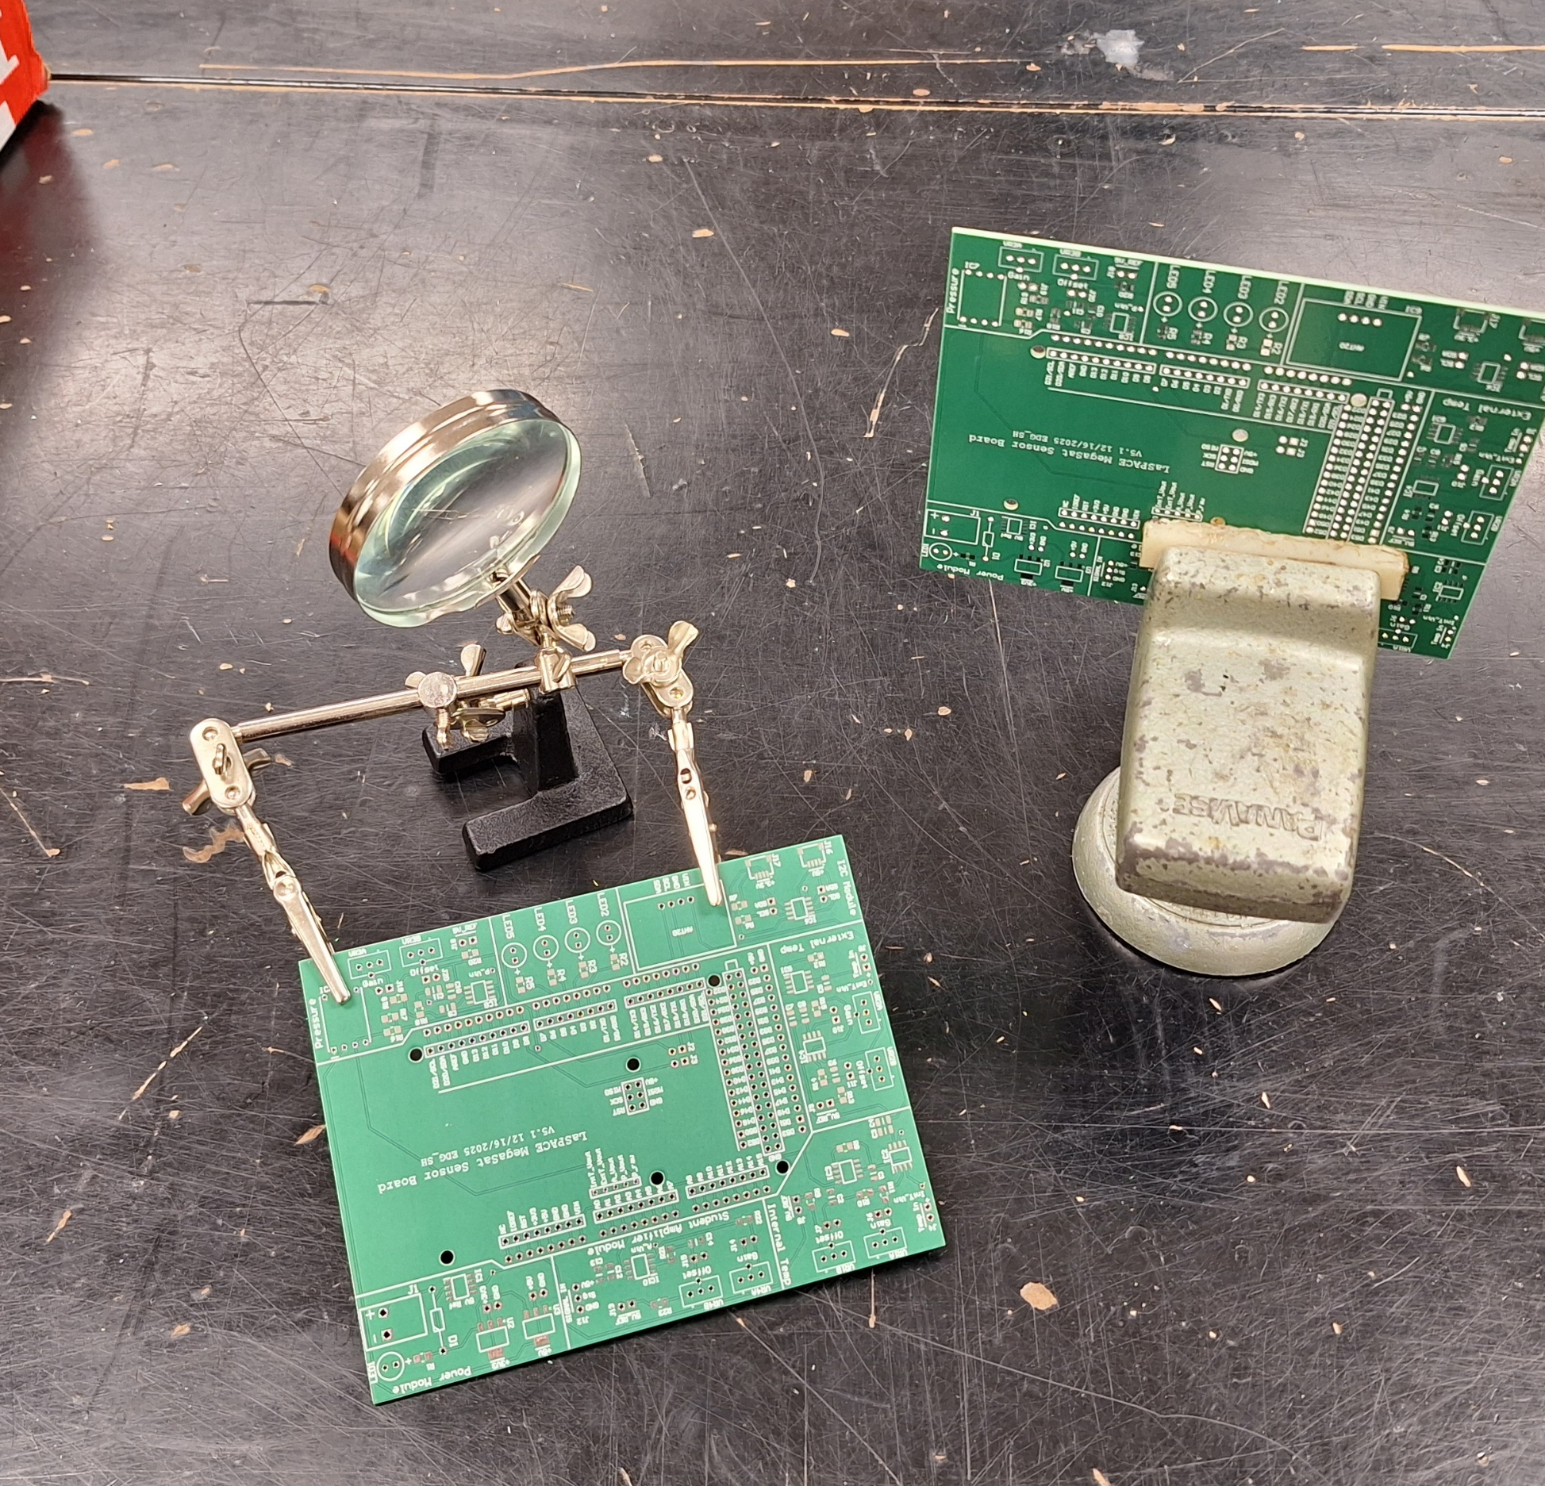
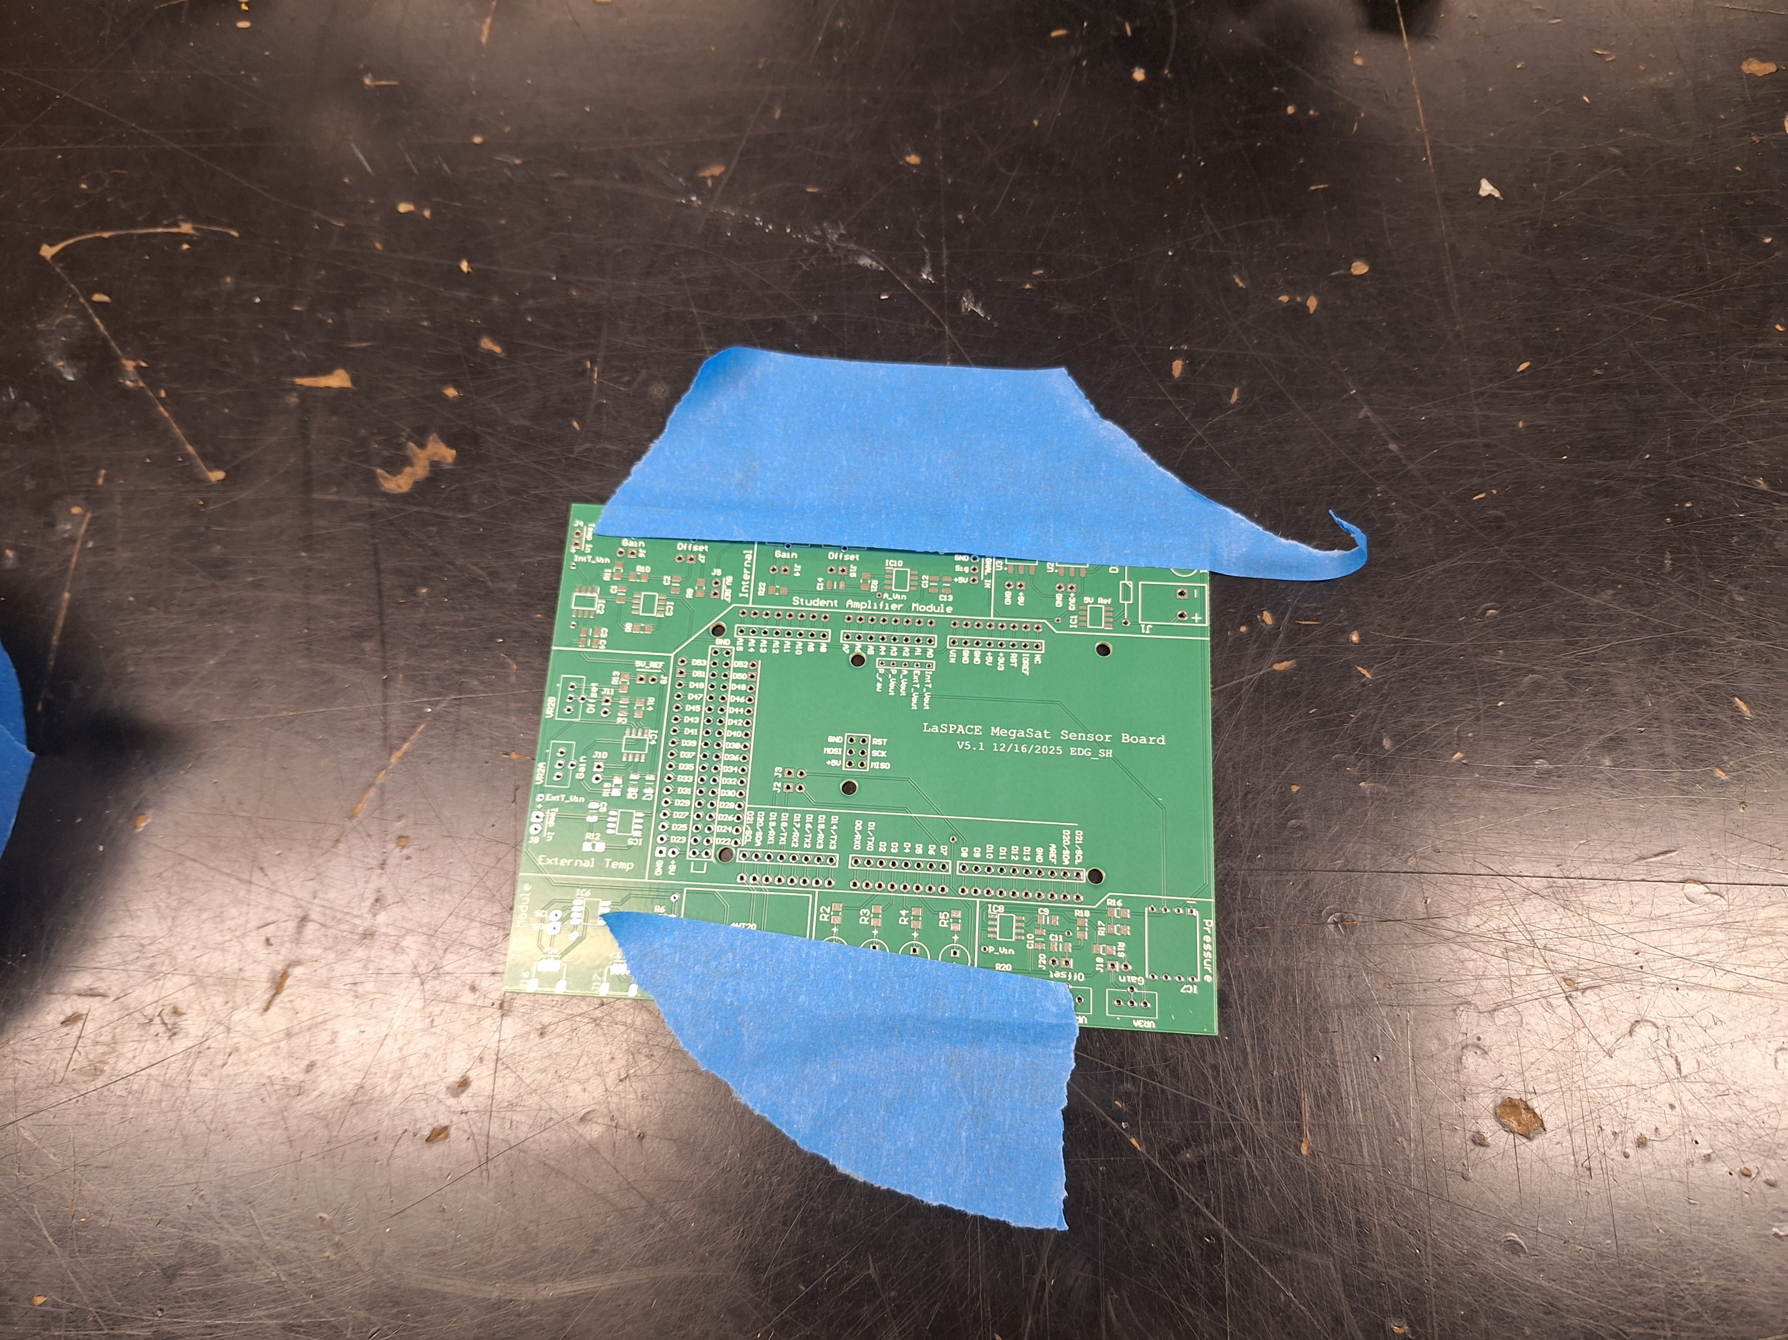
Secure your work
Have something to securely hold the board while working on it
But be able to reposition the work as needed
Clip style holders
Masking tape works for a board like the MegaSAT where most components are only on one side

Slide 11
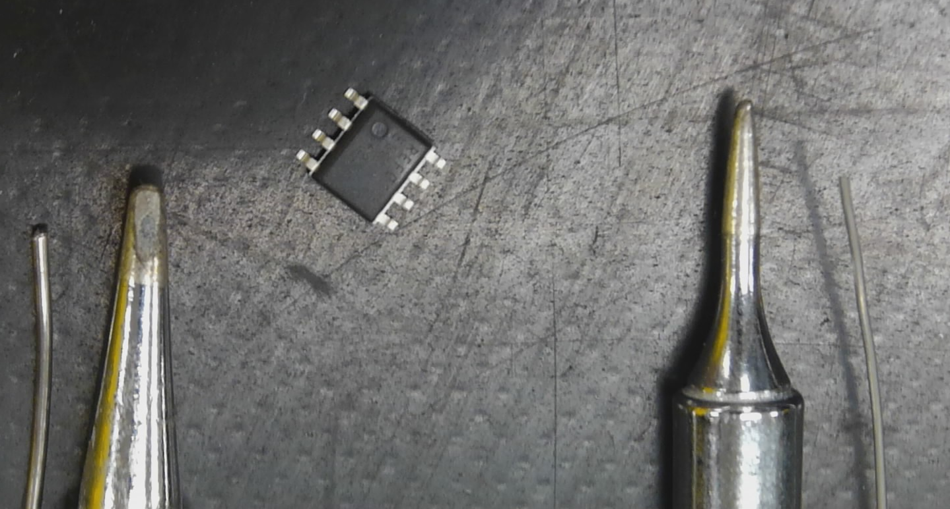
Solder Tips and Solder
Size
Solder tips and solder come in a variety of sizes
In most cases, you will want the smallest tip and thinnest solder available in your lab
Don’t forget to check the tip before switching on the iron
You may wat to switch to larger tips for larger connectors (large power pins)
The left solder and tip are larger than the pins of the SOIC chip

Slide 12
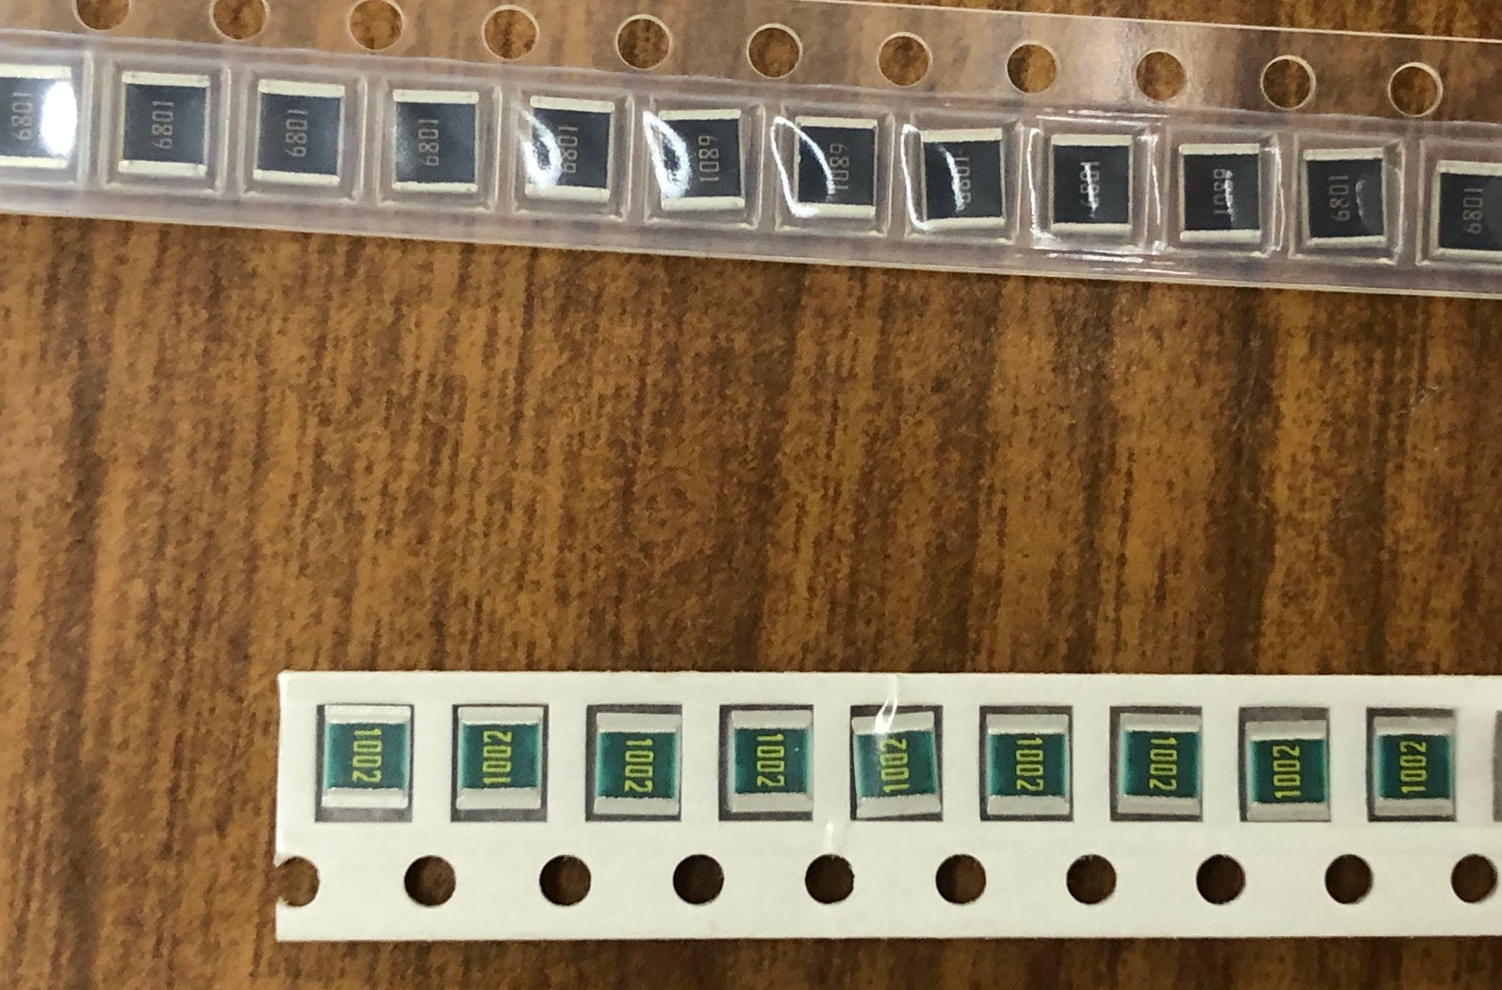
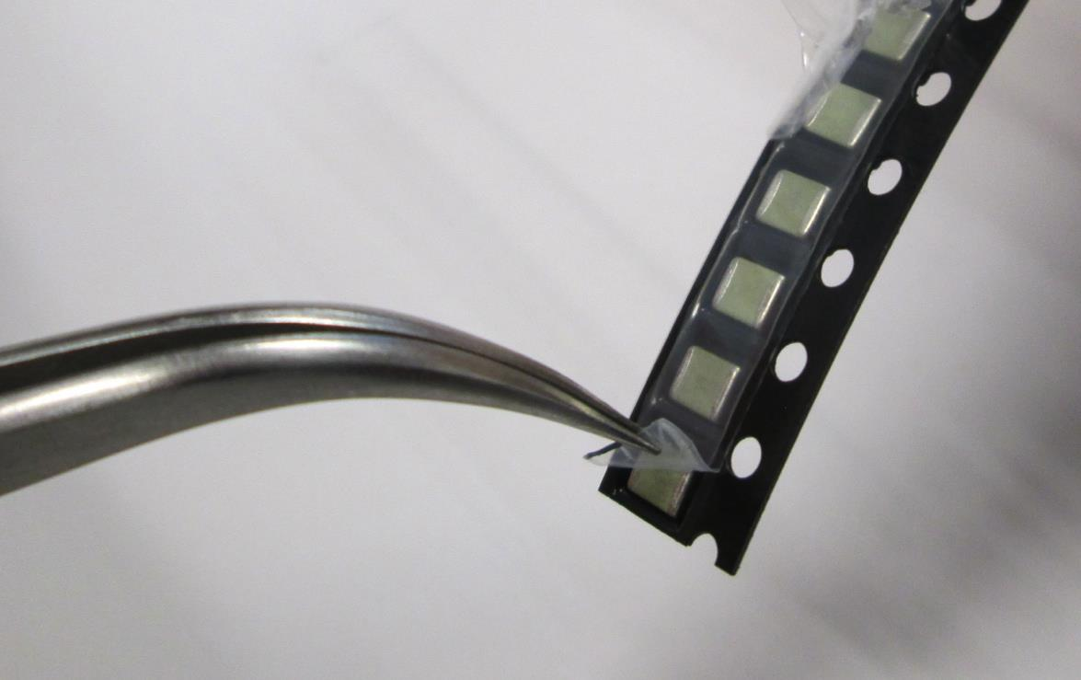
Remove components from packaging
Most SMD’s are packaged in strips.
Use a pair of tweezers to peel back the plastic to free one SMD at a time as you need them.
A small, shallow tray or lid can be used to hold components while working.

Slide 13
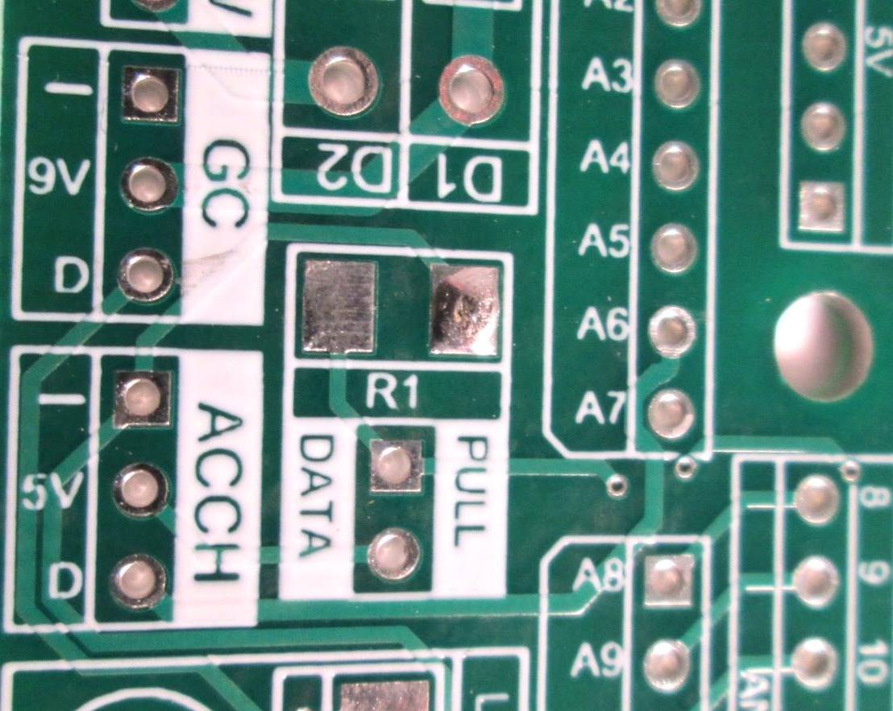
Add solder to a single pad of the component
Put a small amount of solder on the pad
Like through-hole, preheat the pad slightly with the iron first, then add the solder
This pad will be used to hold the component in place

Slide 14
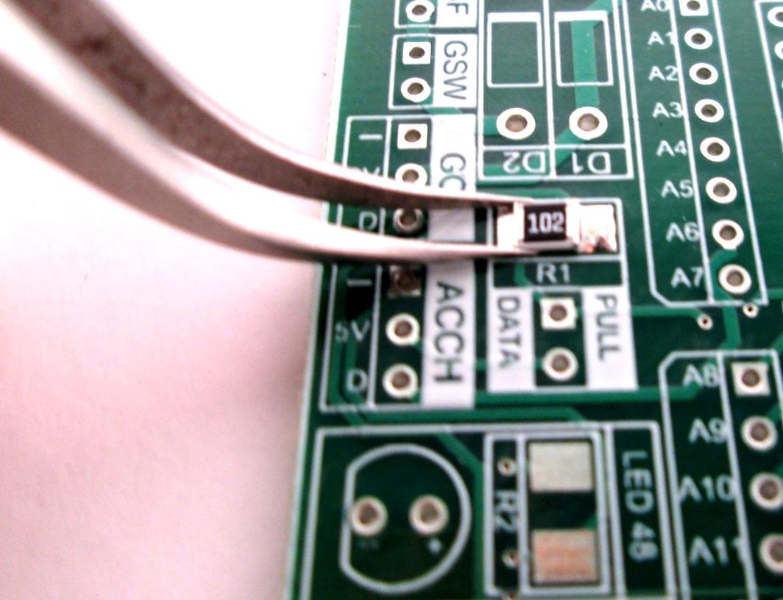
Placing the Component
Use tweezers to hold the SMD on the pad
We are going to remelt the solder to fix the component in place

Slide 15
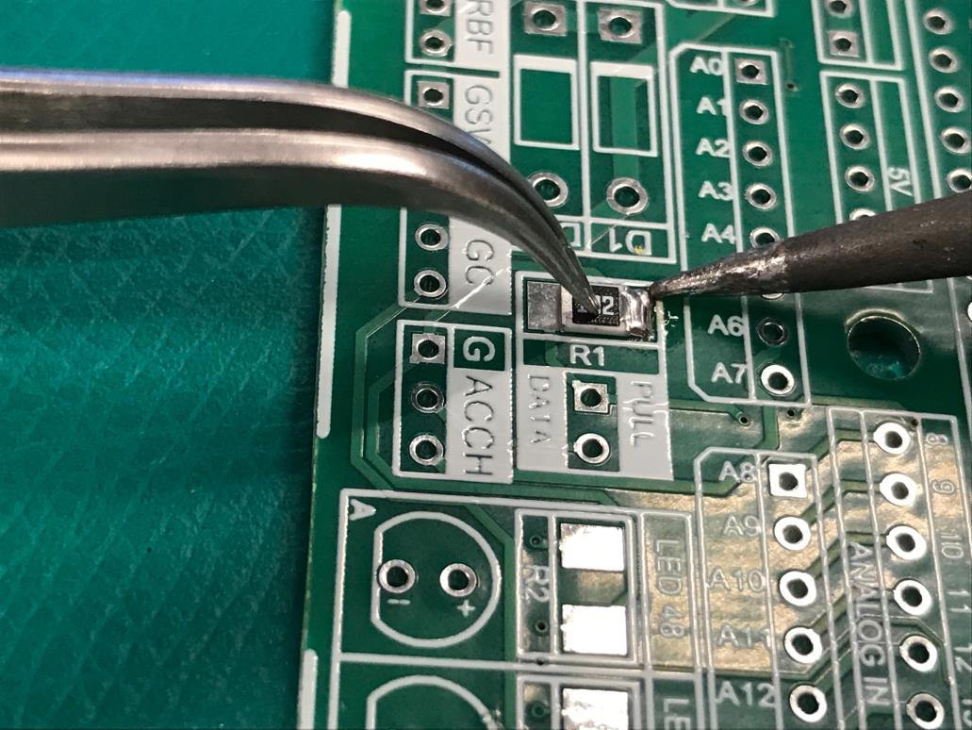
Remelting the solder
While holding the component down with tweezers, heat the pad to remelt the solder
Take care not to press down too hard and send the component flying
This will allow you to push the part flush to the board
Remove the iron while continuing to hold the component in place
The solder will cool, harden, and should hold the part in place
Make sure the part is straight on the pad before moving on. If it is not straight, reheat the solder and adjust the position
Hold the part in place even after you remove the iron while the solder cools.

Slide 16
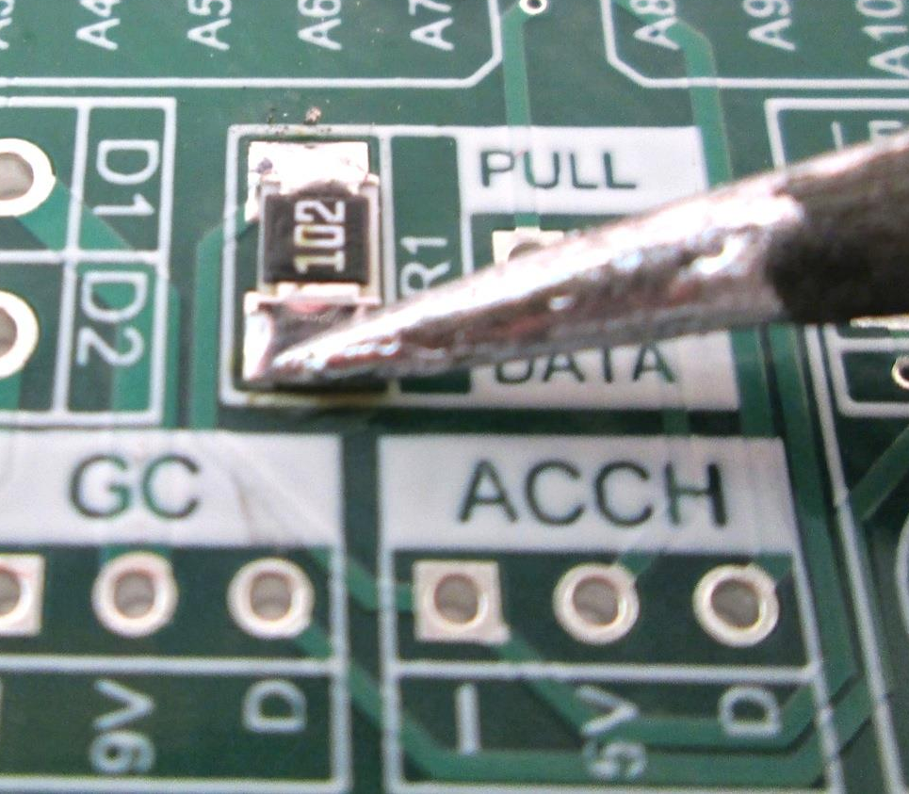
Soldering the second pad
Heat the other pad slightly and apply solder on the other pad
No tweezers should be needed as the solder should hold it in place
At this point check if the first pad needs additional solder, add if necessary

Slide 17
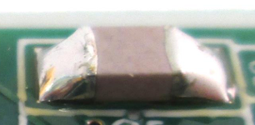

Good SMT Joints
Good surface mount solders have:
  No cracks, gaps, or graininess, and should be shiny
  Just enough solder to make the connection
  Component should relatively flush with the board

Slide 18
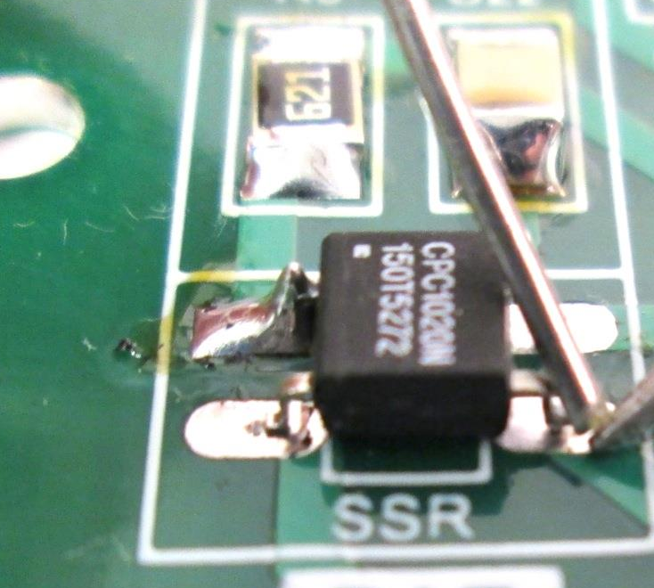
Multi-terminal or Multi-Pin components
Multiple-terminal SMD follows the same basic procedure as two-terminal SMD.
Apply solder, using one pin to hold the component in place
Then check to see that all the pins are aligned with the pads before continuing.
  Once multiple pins are soldered, the component will be very difficult to move

Slide 19
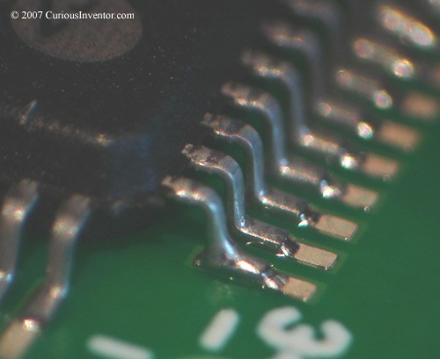
Completing soldering the remaining the pins
Multipin SMD
Apply solder to the remaining pins
Use solder sparingly
  It is easier to add solder and remove it
  The pin and pad do not need to be fully covered
To prevent heat-damaging components or the PCB you can alternate sides or give the component a short time to cool off
Make sure you reposition your hands or the board as you work
  There is no reason to awkwardly reach over the chip when you can simply rotate the board

Slide 20
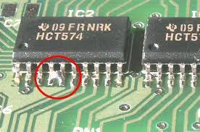
Correcting Bridged Pins
Short
With surface mount soldering, the two most common issues are shorts between adjacent pins
The excess solder can often be removed by repeated remelting and cleaning your solder tip
  A small amount of solder will wick onto the tip
  If there is a large amount of solder braid or solder pump can be used – carefully
Also be sure to watch for pins or terminals floating above the board, not connected

