Slide 1
System Design

Slide 2
What is system design?
High-level design identifying the system processes, functional components, and their interfaces
Derived from system requirements
Provides an overview of the project
Define the components that are needed
Establish how components “communicate” with other components
Determine how to modularize the project into discrete work packages
Identify critical interfaces that must be well defined
Used to provide initial cost, schedule & resource estimates
Little or few implementation details
As system design is refined, and lower-level subsystems are included, implementation issues may need to be addressed

Slide 3
System design steps
Define project goal and objectives
Develop the project system requirements
Identify the major system components that satisfy the system requirements
Identify the major system interfaces
Refine the system design
Define subsystems making up each component
Specify interfaces between subsystems
Establish management controls for the system interfaces

Slide 4
Traceability Matrix
Shows the relationship between requirements and the components that satisfy these requirements
Commonly used in software engineering, but has application to hardware as well
Used to ensure that the system design properly addresses the project needs and does not incorporate any unnecessary components
Format of the matrix can vary widely, but generally includes the following for each requirement
Identification number
Description of the requirement
Description of the component that satisfies the requirement
Description of proof that verifies a components or system satisfies the requirement

Slide 5
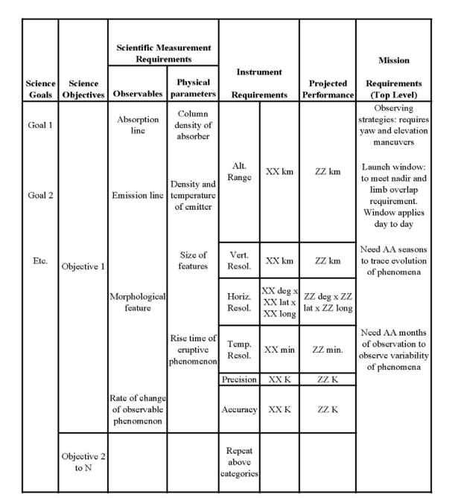
Sample NASA Flight Mission Traceability Matrix

Slide 6
System design steps
Define project goal and objectives
Develop the project system requirements
Identify the major system components that satisfy the system requirements (Initial System)
Identify the major system interfaces (Initial System)
Refine the system design
Define subsystems making up each component
Specify interfaces between subsystems
Establish management controls for the system interfaces

Slide 7
Initial System Design
Development of the initial system design can, at times, go hand-in-hand with refinement of the system requirements
Functions needed to satisfy the science requirements define the initial system
For example, to perform any payload will probably need these functions
You will need a sensor (detector system)
You will need to power the sensor (power system)
You will need to read data from the sensor (data acquisition system)
You will need to store the data (data archive system)
You will need to control the sensor, readout, and storage (control system)
You will need to analyze the data (ground data system)
As the design develops, you will determine specific detailed requirements for the above systems
For example, the power system will need to supply volts & milliamps to the sensor, data acquisition, archive and control systems

Slide 8
Major System Interfaces
An interface describes the linkage between major subsystems or processes
There are multiple types of interfaces
Mechanical: How systems physically fit together
Power: What voltage and current flows between the systems
Electronic: The characteristics of electrical signals between systems
Data: Format and content of information transferred between systems
Thermal: How does heat flow between systems
Software: How modules communicate with other modules or hardware
The type and characteristics of all interfaces need to be identified and defined

Slide 9
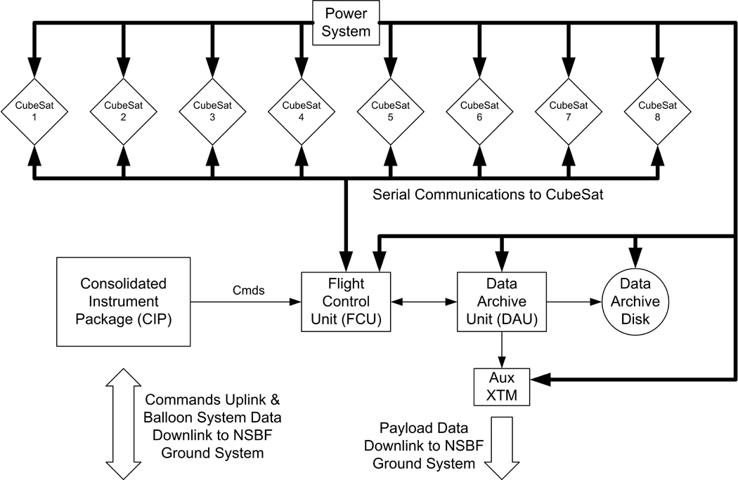
System Level Drawing Example
High-level overview of a balloon platform that could carry eight Cubesat payloads
Primary subsystems are identified (Power, CubeSats, FCU, etc.)
Directionality and content of major interfaces are identified

Slide 10
System design steps
Define project goal and objectives
Develop the project system requirements
Identify the major system components that satisfy the system requirements
Identify the major system interfaces
Refine the system design
Define subsystems making up each component
Specify interfaces between subsystems
Establish management controls for the system interfaces

Slide 11
Refining the System Design
After the major systems and interfaces are identified, the subsystems are described
The process is repeated for each of the subsystems (i.e. the boxes of the system diagram) defined in the top-level system design
For example, the Power Subsystem in the previous slide requires the following components
A source that supplies the energy for the entire platform
Separate supplies to convert the source power to the proper voltage and current required by the other systems (FCU, DAU, etc.)
Each of the subsystem interfaces is given a more detailed specification
How many and what kind of interfaces do the subsystems need?
What are the details (Voltage, current, logic levels, etc.) of the interface

Slide 12
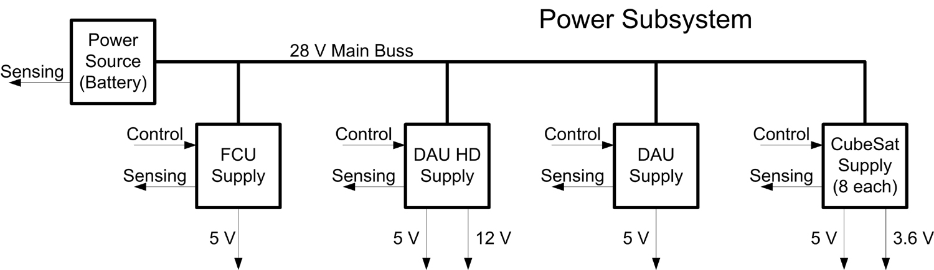
Subsystem Level Example
Subsystem design provides additional details
Major functional components are identified and expressed
Shows that system requirements are satisfied
Most important interface details are revealed
Still little hardware or implementation dependence

Slide 13
Moving to Component Specifics
The system design refinement process continues by specifying the major components of the subsystems
For example, the FCU supply in the power system might include the following major components
A relay to turn the supply on / off by computer control
A DC / DC converter to provide the required voltage from the source power
An inline sensor so that volts and amps can be monitored in real-time by the computer
This is not a schematic drawing
The type of component and ratings should be identified, but not specific parts
I.E. You know you need a 5V/2A relay but not a specific part number

Slide 14
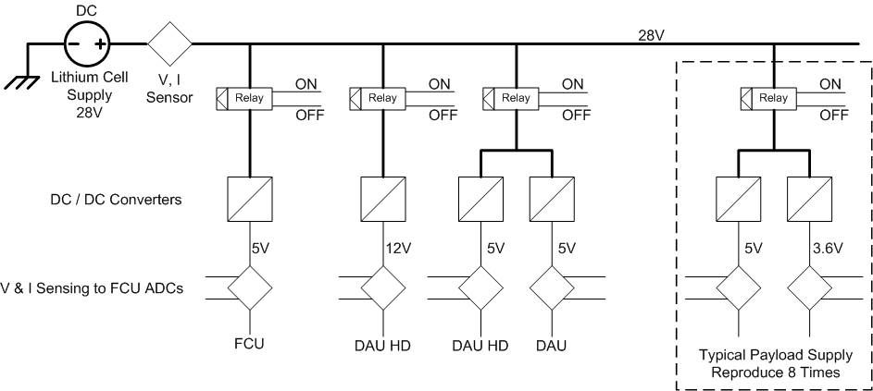
Refined Subsystem Example
Implementation and hardware details are starting to appear
Interfaces are close to being fully defined
Next step would be full hardware and interface specification

Slide 15
System design steps
Define project goal and objectives
Develop the project system requirements
Identify the major system components that satisfy the system requirements
Identify the major system interfaces
Refine the system design
Define subsystems making up each component
Specify interfaces between subsystems
Establish management controls for the system interfaces

Slide 16
Controlling Interfaces
Interfaces between systems need to be defined
An ICD can be helpful during system design
Written description of the interface that is modified only under specific, previously defined conditions and is used by team personnel for implementation
Written specification of the interface
Obtain agreement between stakeholders on the interface characteristics
Controlled ICDs should be used to help manage potential risks
When an interface error or mismatch could result in project failure
When stakeholders implementing the interface ends are separated in either geographic distance or time

