Slide 1
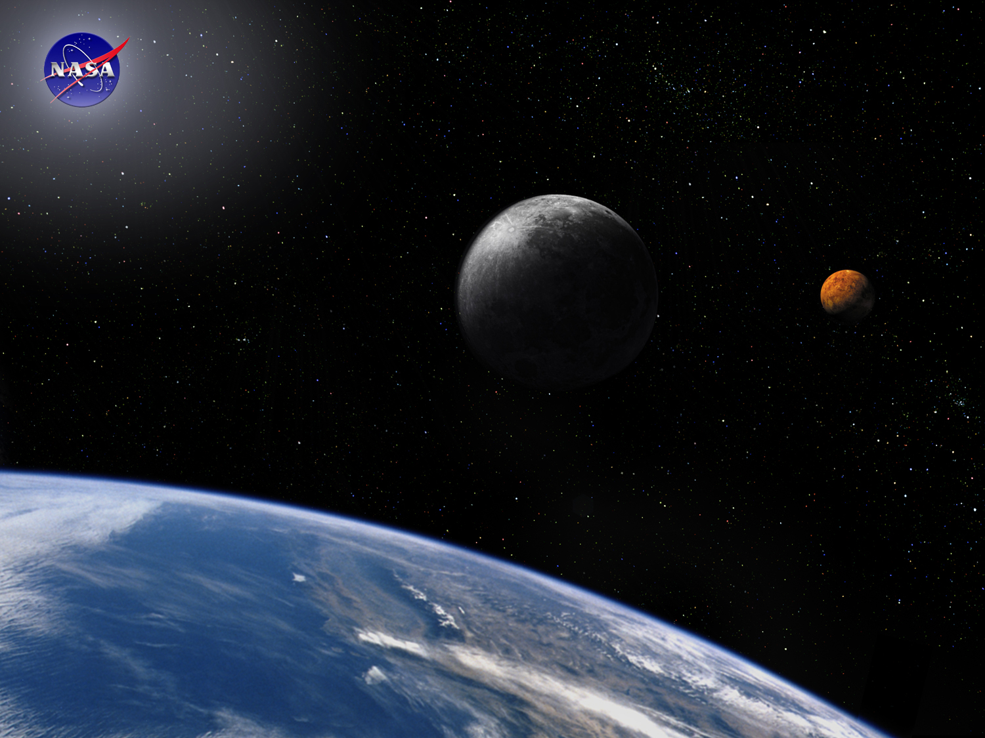
Requirements Module:
Writing Requirements
Space Systems Engineering, version 1.0
Notes:
Version 1.0
SOURCE INFORMATION:
The material contained in this lecture was developed by Lisa Guerra of NASA’s Exploration Systems Mission Directorate while on assignment in the Department of Aerospace Engineering at the University of Texas at Austin. As part of a course entitled, Space Systems Engineering, the lecture was piloted at UT-Austin in Spring 2008.
The content that follows was also reviewed and edited by Dr. Paul Graf, Adjunct Professor at the University of Colorado at Boulder.

Slide 2
Good Requirements Are SMART
  Specific -
    It must address only one aspect of the system design or performance
    It must be expressed in terms of the need (what and how well), not the solution (how).
  Measurable -
    Performance is expressed objectively and quantitatively
    E.g., an exact pointing requirement (in degrees) can be tested thus verified prior to launch.
  Achievable -
    It must be technically achievable at costs considered affordable
    E.g., JWST early designs specified an aperture requirement eventually descoped due to technical issues with deployment.
  Relevant -
    It must be appropriate for the level being specified
    E.g., requirement on the solar cells should not be designated at the spacecraft level.
  Traceable -
    Lower level requirements (children) must clearly flow from and support higher level requirements (parents).
    Requirements without a parent are referred to as orphans, and need to be assessed for necessity of inclusion.
Notes:
SMART Requirements; Mike Mannion, Barry Keepence; ACM SIGSOFT, SE Notes Vol 20, No. 2, April 1995

Slide 3
Rules for Writing Good Requirements
Requirements have mandatory characteristics:
  Needed
  Verifiable
  Attainable: technically, cost, schedule
Each requirement should
  Express one thought
  Be concise and simple
  Be stated positively
  Be grammatically correct; free of typos and misspellings
  Be understood only one way; they are unambiguous
  Use consistent terminology to refer to the system/product and its lower level entities
  Comply with the project’s template and style rules

Slide 4
Distinguish Between ‘Desirements’ and Requirements
Desirement – something that would be nice to have but is not mandatory to accomplish the mission
Requirement - something that must be done for the mission to be successful
Customers and stakeholders often blur the distinction between what is necessary and what would be nice to have
Develop the problem statement independently of the solution
Customers, stakeholders, design engineers and even systems engineers often have solution biases – Desirement space
Be Careful - Customers or stakeholders may have a good idea, but early implementation solutions may prove impossible, impractical or sub-optimal when looked at in detail - capture what is necessary for mission success and then develop solutions to meet those needs.

Slide 5
More Rules for Writing Good Requirements
What a requirement must state:
  WHO is responsible
  WHAT shall be done
  Or HOW WELL something shall be done
  Or under what CONSTRAINTS something shall be done
Requirement format: “WHO shall WHAT”
  Uses active not passive voice
Example product requirements:
  The system shall operate at a power level of…
  The software shall acquire data from the…
  The structure shall withstand loads of…
  The hardware shall have a mass of…
Use the correct terms:
  Requirements are binding - Shall
  Facts or Declaration of purpose - Will
  Goals are non-mandatory provisions - Should
  Do NOT use “Must”

Slide 6
Goodness Checklist: Is this Requirement…
Free of ambiguous terms?
  Examples: as appropriate, etc., and/or, support, but not limited to, be able to, be capable of
Free of indefinite pronouns?
  Examples: this, these
Free of unverifiable terms?
  Examples: flexible, user-friendly, robust, light-weight, maximize, adequate, small, portable, easily - other “ly” words and other “ize” words
Free of implementation?
  Requirement should state WHAT is needed, NOT HOW to provide it, i.e., state the problem not the solution.
Necessary?
  Ask “Why do you need the requirement?”; the answer may lead you to the real requirement.
Free of descriptions of operations?
  To distinguish between operations and requirements, ask “Does the developer have control over this?” “Is this a need the product must satisfy or an activity involving the product?”
Free of TBDs (To Be Determined)?
  Use a best estimate and a TBR (To Be Resolved) with rationale when possible.
Notes:
Compliance Automation or Ivy Hooks?
Supplementary reading suggestion: PRODUCT REQUIREMENTS DEVELOPMENT AND MANAGEMENT PROCEDURE; Langley LMS-Pilot Procedure PRDM; Revision: R3 V1; 11/16/04

Slide 7
Example Requirements: Good or Bad?
The aircraft shall have three engines (initial DC-3 requirement).
  The aircraft shall meet the operation requirements with a single engine out.
The lunar lander shall include an airlock.
  The lunar lander shall provide the capability for crew to ingress/egress while maintaining pressurization.
The crew shall have the capability to perform extra-vehicular activities (EVAs).
  The vehicle shall allow extra-vehicular activities during operations.
The spacecraft shall maximize lifetime.
  The spacecraft shall have a lifetime of at least three years.
The software shall display data in a user-friendly fashion.
  The software shall display data as described in ICD 2345 Table 3.1.
Notes:
The aircraft shall meet the operation requirements with a single engine out.
The system shall allow a change of thread selection during operations.
The system shall have a lifetime of at least three years.
The software shall display data as described in ICD 2345 Table 3.1.

Slide 8
Rationale Captures the Motivation and
Assumptions of a Requirement
The rationale of each requirement defines
  Why a requirement is needed
  What assumptions were made
  What design effort drove the requirement
  Other data that will be needed to maintain the requirement over time
Example
Requirement: “The truck shall have a height of no more than 14 feet.”
Rationale: 99% of all US interstate highway overpasses have a 14 foot or greater clearance. (Assumptions: The truck will be used primarily on US interstate highways for long-haul freight in the US.)

Slide 9
Requirements Validation
Requirements validation asks three questions:
  Do we have the correct problem?
  Do our requirements capture this problem?
  Are our requirements SMART?
Performed to assure the system requirements set is complete, consistent, and each requirement is achievable and verifiable.
Performed by subject matter experts, the system performing organization and the system authorized customer.
Does the requirement set completely address and accomplish the mission?
Are the requirements consistent with the established system boundaries and constraints?
When does requirement validation take place?
  Usually before the System Requirements Review (SRR)
Notes:
Definition of SRR
System Requirements Review (SRR) - A validation of the realism of the functional and performance requirements and their congruence with the system configurations selected to conduct the mission.

Slide 10
Requirements Verification and Requirements Validation
Requirement verification is establishing confidence that the requirement has been met.
  Requirements are verified by test, demonstration, analysis or inspection.
  Test is the most common method of verification and the technique that provides the most confidence that the system will indeed work as intended in its anticipated environment.
Requirement validation is a process of ensuring that :
  the set of requirements is correct, complete, and consistent,
  a model can be created that satisfies the requirements, and
  a real-world solution can be built and tested to prove that it satisfies the requirements.
If a systems engineer discovers that the customer has required a perpetual-motion machine, the project should be stopped.
Notes:
Requirements validation definition from: Requirements Development, Verification and Validation Exhibited in Famous Failures; Bahill and Henderson; Systems Engineering, 8(1):1-14, 2005.

Slide 11
Module Summary: Writing Requirements
Good requirements Are SMART: Specific, Measurable, Achievable, Relevant and Traceable
It is good practice to capture the rationale and preliminary technique for verification when writing requirements.
Requirement validation is a process of ensuring that: the set of requirements is correct, complete, and consistent.
Since the cost of reconciling undefined requirements grows as the project matures, undefined (TBD) and estimated (TBR) requirements should be resolved as early as possible.

