Slide 1
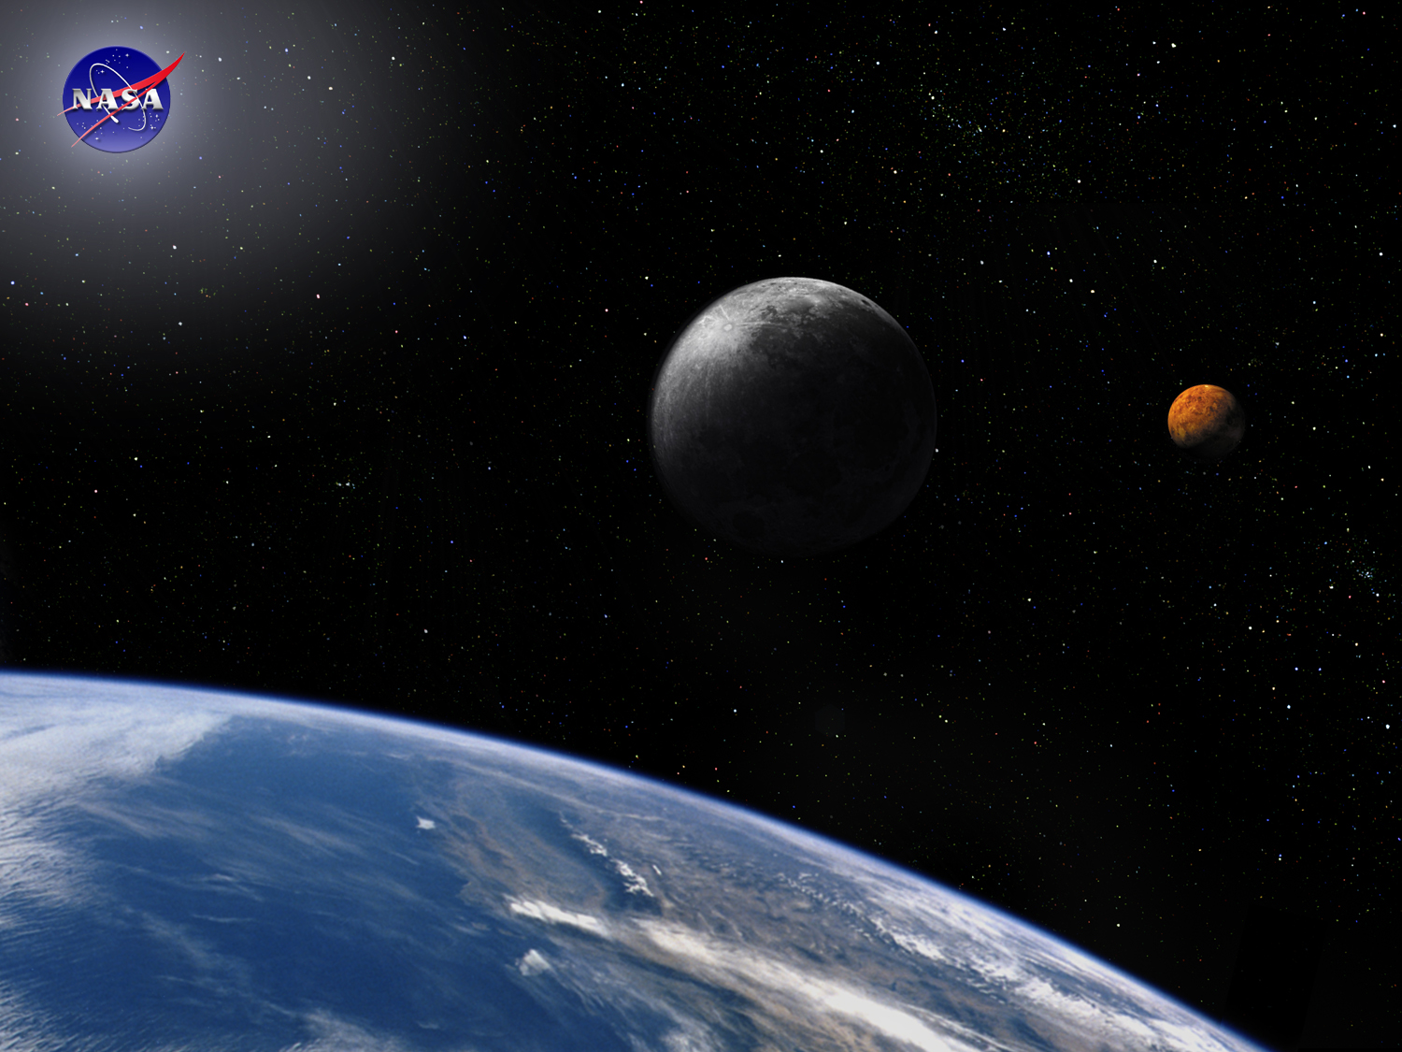
Requirements Module:
The Basics
Space Systems Engineering, version 1.0
Notes:
Version 1.0
SOURCE INFORMATION:
The material contained in this lecture was developed by Lisa Guerra of NASA’s Exploration Systems Mission Directorate while on assignment in the Department of Aerospace Engineering at the University of Texas at Austin. As part of a course entitled, Space Systems Engineering, the lecture was piloted at UT-Austin in Spring 2008.
The content that follows was also reviewed and edited by Dr. Paul Graf, Adjunct Professor at the University of Colorado at Boulder.

Slide 2
Module Purpose: Requirements - The Basics
Establish the role of good requirements in project success.
  Requirements capture the understanding of what is to be done.
Establish the significance of good requirements development.
  Poor requirements are the single biggest problem for projects.
  The later a problem is discovered the more costly it is to recover from.
Describe the different types of requirements.
Establish how requirements are distributed — allocation, flow-down and derived.
Define and understand the value of requirements traceability.
Recognize that system decomposition creates new interfaces that must be defined and owned.

Slide 3
The Importance of Requirements
Requirements problems are the single biggest cause of project problems.
Requirements define what is to be done, how well and under what constraints - get the requirements wrong and the design and hardware will be wrong.
Requirements drive…
  Cost - Design - Schedules - Skills required - Verification plans - Operational procedures - everything
It is amazing how many teams begin to solve a problem before there is agreement on what the problem is. Requirements and their associated constraints and assumptions quantify the problem to be solved - they establish how project success will be determined.

Slide 4
What is a Requirement?
Statement of some THING you want or need
OR
A characteristic of some THING you want or need
A requirement is also…
  A Contractually Binding Statement
  Documentation of Problem Space
  The Means We Use to Communicate
Mutual
Understanding

Slide 5
The Importance of Getting the Requirements Right
Requirement and concept development commit costs before they are incurred.
100
Costs Committed
80
Cost (%)
60
Costs
Incurred
40
20
0
Requirement
and Concept
Development
Detailed
Design
Production 
Time
Notes:
After Blanchard and Fabrycky; Systems Engineering and Analysis; 4th ed, 2006; figure 2.12 page 46
Note: x-axis is labeled to capture a 80% committed vs. 20% expended at the start of production – typical of a
multi-build project

Slide 6
Requirements Development
Is the Most Important Step!
Requirements are distributed from the broad mission scope into the architecture that defines the project
Requirements bound the scope of the problems to be solved so we know when we have done well enough
A hierarchy of traceable requirements ensures that the project is building only what is required, i.e., no frivolous activities
A hierarchy of negotiated requirements ensures a balanced system design
Requirements are the basis for the project’s verification and validation efforts
  Poorly written or unverifiable requirements are trouble!

Slide 7
Requirements Traceability and Hierarchy
Once mission level requirements have been decomposed to lower levels, traceability identifies the relationship between requirements.
Knowing the source and dependencies between requirements is valuable since if a requirement changes, traceability can be used to determine the implications of that change.
Total
Solution
Level 1
Level 2…
Level 3
System
Subsystem A
Assembly A1
Assembly A2
Subsystem B
Assembly B2
Reqt 1.0
Level 1
Reqt 2.1
Level 2
Reqt 2.0
Reqt 2.2
Reqt 2.3
…
Reqt 2.3.1
Reqt 2.3.2
Level 3
Reqt 3.1.1
Reqt 3.0
Reqt 3.1
…
Reqt 3.1.2
Reqt 3.1.3
…
Reqt 3.1.4
Notes:
9903
7

Slide 8
Types of Requirements
Functional - Requirements which define what an item must do.
  The system shall provide communications between the ground and the spacecraft.
Performance - Requirements which define and quantify how well an item must accomplish a particular function.
  Provide communications over what range, with what data rate and how often
Constraints - Requirements that capture operational, environmental, safety or regulatory constraints.
  The communications system shall use X-band frequencies.
  The communications system shall operate with a base plate temperature of at least -30 C and at most 40 C.
  The maximum RF power density shall be less than 10 watts/m²
  Design standards (e.g., metric units, programming language, etc.)
Verification - Requirements capture how confidence will be established that the system will perform in its intended environment.
  All performance and functional requirements shall be met while the system is in a vacuum chamber with 2.5 Kwatts/m² of visible light illuminating the z-side.
Notes:
Source: Goddard Green Book; NASA Engineering Management Council (EMC) 1992

Slide 9
Module Summary: Requirements — The Basics
Requirements define the problem to be solved and establish the terms by which mission success will be measured.
Requirements problems are the single biggest problem on development projects so care in creating good requirements always pays off.
The later a problem is discovered the more costly it is to recover from.
Requirements are distributed within the system architecture via flow-down, allocation and derivation.
Requirements traceability is a technique of tracking the source and connections between requirements. It is used to assess the consequences of potential requirements changes.
When a system is decomposed into smaller segments, interfaces are created that must be defined and managed.

