Slide 1
Sample Payload Mission Targets

Slide 2
Need to begin thinking now!
Given the constraints, you need to think about and address issues throughout the academic year
Here we discuss some example payloads
Either previously developed and flown or
Should be feasible to develop and fly within the limitations of this program
Your team will have two weeks to develop your Pre-PDR
Research and write the scientific background for your payload
Determine your mission goal, objectives, and requirements
Establish a general schedule for payload development

Slide 3
Considerations for Mission Topic
Mission should be appropriate to the flight platform
Why do you need to fly this payload
Should not be an experiment that can be done in a vacuum chamber
Compatible with mission constraints
Low cost, light weight, lower power
Needs to be developed in a short amount of time
Must meet all LaACES payload requirements

Slide 4
Payload Payload Requirements and Bases
 | Requirement | Basis
Weight | Payload mass shall be less than 500 grams | FAA Total Weight Limit/FAA Individual Payload Limit
Density | Smallest payload surface must be larger than 10 in^2 | FAA Density Limit
Physical Interface | Payload shall have 2 vertical penetrations through the entire payload: -17 cm apart center to center -Inner Diameter 0.7 cm to 1.0 cm (to allow for plastic grommet) - Greater than 1 cm from any payload wall | Flight String integrations
Data | Enough data storage for 4 hours of recording | 2.5 Hours of flight + setup time
Power | Enough power capacity for 4 hours | 2.5 Hours of flight + setup time

Slide 5
Some possibilities
Radiation Intensity as a function of altitude
Measure intensity of UV bands as a function of altitude to deduce properties of the ozone layer
Directly measure concentration of O3, NOx, COx gases as a function of altitude using solid state sensors
Develop a system to measure air flow (e.g. hot wire anemometer) at high altitudes (i.e. very low pressure).
Investigate methods to optimize atmospheric temperature measurements
Develop an inertial sensing system which will provide sub-minute of arc orientation knowledge
Downlooking environmental studies like tree or water cover

Slide 6
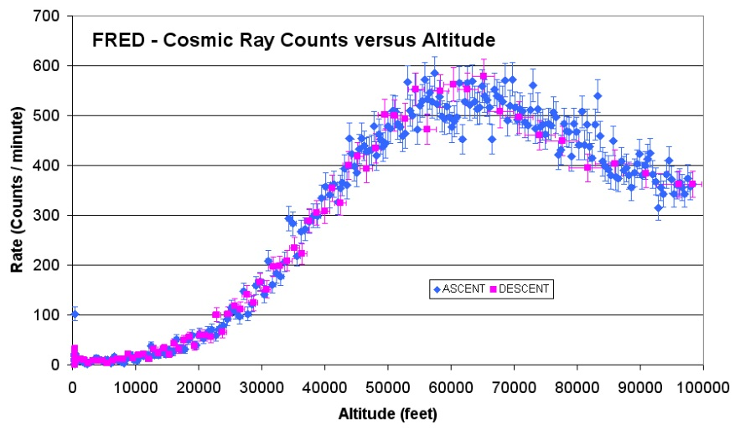
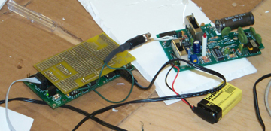
Radiation Intensity vs Altitude
This payload would determine the radiation flux as a function of altitude on ascent and descent
Cosmic rays are high energy nuclei that originate outside our solar system.
CR interact in Earth’s atmosphere producing a shower of particles
The intensity of this radiation varies with altitude
Challenges: Can you measure beyond count rate? How can you determine particle type or energy?

Slide 7
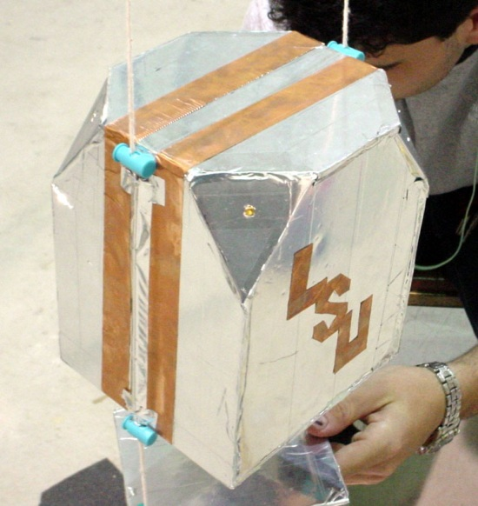
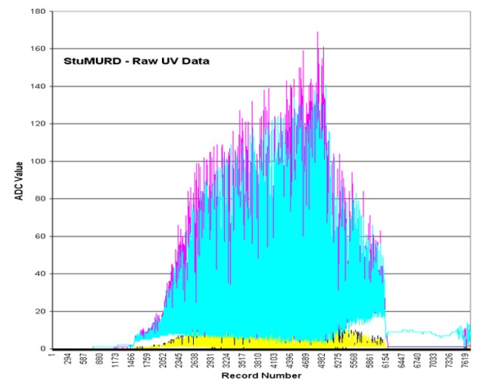
Measurement of Solar Spectrum in versus Altitude
Many wavelengths are absorbed or scattered by the atmosphere (UV/IR/Visible)
UV is absorbed by ozone in the upper atmosphere
Surprisingly there are few (none?) published measurements of UV intensity in the stratosphere.
This effort has the potential of generating a journal publication with the team as authors!
One or more sensors (or the appropriate wavelength sensitivity) would monitor UV from the Sun.
Challenges
You will need to take into account the rotation of the ballooncraft, most sensors will vary depending on where they are pointing
To calibrate your sensor, you will need an appropriate wavelength source

Slide 8
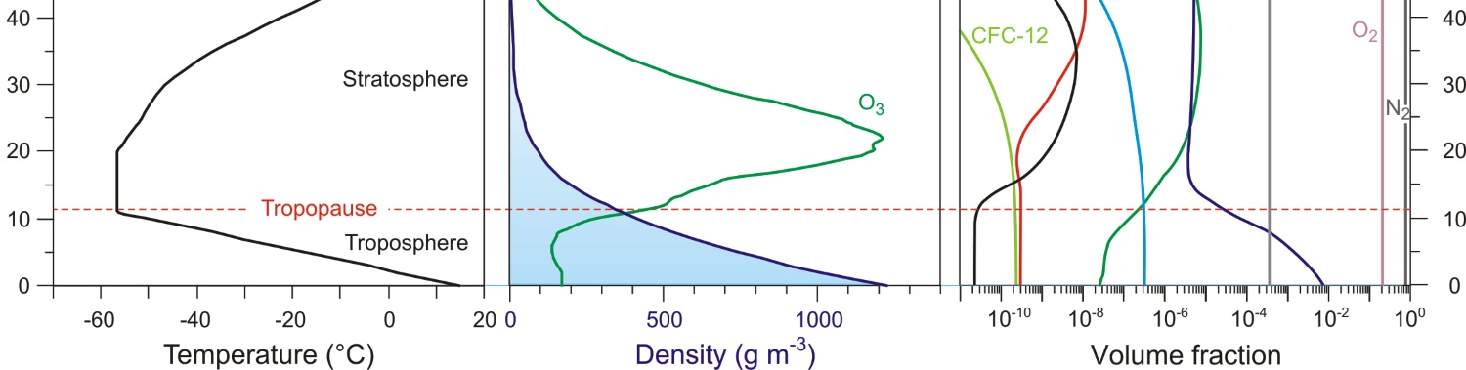
Measure Atmospheric Components (Gases, Aerosols,
Challenge: Most commercial sensors are designed and calibrated for 1 Atm, and will require correction for lower pressure
The gas composition of the atmosphere changes as a function of altitude
The increase in temperature above the Tropopause is related to the ozone layer
Correlate stratospheric temperature with ozone concentration
The aerosol particle density also changes as a function of altitude
Determine how to measure aerosol characteristics (density, size distribution) as a function of altitude
NO₂
Altitude (km)
NO
CO₂
N₂O
O₃
H₂O

Slide 9
Air Flow Sensing
Payload would measure the air flow or ‘wind speed’ as a function of altitude
Investigate various techniques used to build hot-wire anemometers
Investigate methods to calibrate a hot-wire anemometer sensitive enough to measure small ‘wind speeds’
Payload can use the upward movement of the payload to generate the wind across the anemometer but will there even be any horizontal flow or will the balloon match the airflow
Challenge: How do you calibrate wind speed measurement with changing the air pressure?

Slide 10
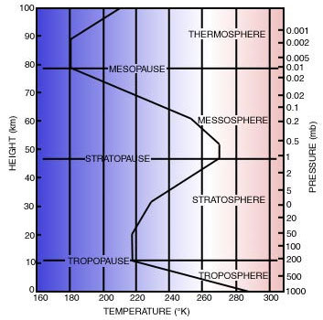
Accurate Atmosphere Temperature and Pressure
The temperature and pressure of the atmosphere vary as a function of altitude
Challenge: Temperature measurement in the stratosphere is complex because low pressure and high solar radiation
Many factors influence the measured temperature
Sensor color
Airflow around the sensor
Where the sensor is placed
Periodic shadowing and sunlight exposure
Density of the surrounding air

Slide 11
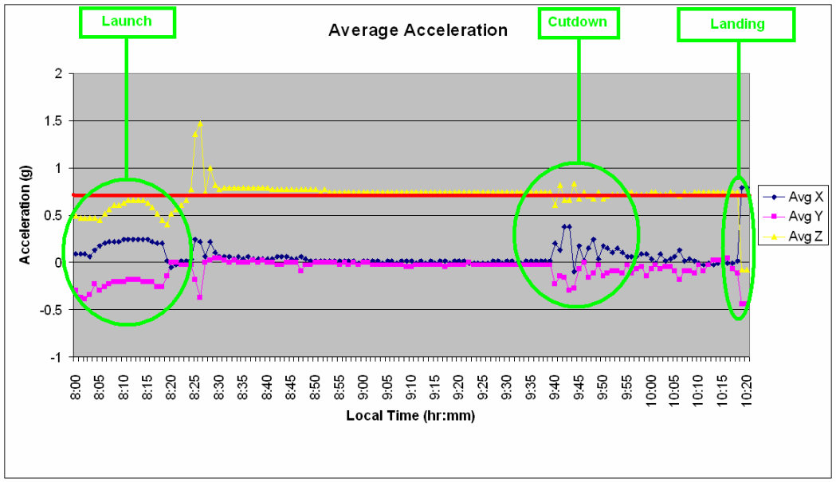
Minute of Arc Inertial System
Develop an inertial attitude sensing system that would be accurate to less than one minute of arc
Investigate the rotation and turbulence of the payload during flight
Use some combination of magnetometer, tilt sensors, gyroscopes, accelerometers, and a sun sensor
Develop a system that would determine payload attitude
Payload motion is chaotic and rapid
Conversely, attempt to build a stabilization system to minimize rotations or pendular motion
Challenge: weight and power constraints

Slide 12
Additional Ideas
Take 5 minutes to brainstorm possible missions now
Concentrate on big picture science questions and do not worry about the implementation
When doing background research for Pre-PDR you will look at possible implementations and feasibility

