Slide 1
Second Semester of the LaACES Program (2026)

Slide 2
2nd Semester Tasks
Develop a student-led team organization with defined roles, responsibilities, and rules
These will be formalized in a “Team Contract.”
Learn the basic Project Management skills to manage the payload development
Develop a functioning payload based on the MegaSAT sensor board
This includes all electronics, software, and mechanical requirements
Design, fabricate, calibrate, and test Payload to meet all program and payload requirements
Documenting this via the PDR, CDR, and FRR Documents
Complete Thermal Vacuum System Testing
Prove payload is worth flying at Flight Readiness Review
Analyze and present flight results immediately following the flight

Slide 3
Deliverables Schedule for LaACES Spring 2025 (LSU Team specific other campuses should adapt)
Deadline
Team Contract January 16, 2026
Pre - PDR January 30, 2026
PDR February 13, 2026
PDR Presentation February 19, 2026
Pre - CDR March 13, 2026
CDR April 3, 2026
CDR Presentation April 7, 2026
Thermal / Vacuum Test (at LSU) April 17, 2026
FRR May 15, 2025
LaACES Launch Trip May 17, 2026 – May 22, 2026
FRR Defense Presentation (at CSBF) May 18, 2026
Notes:
Changed FRR location from MSU to CSBF; changed the format of the Good Friday note. Deleted April 17th I think you should list all options or none, so I deleted and replaced with TBD/April 18. It

Slide 4
Payload Flight Requirements and Bases
 | Requirement | Basis
Weight | Payload mass shall be less than 500 grams | FAA Total Weight Limit/FAA Individual Payload Limit
Density | Smallest payload surface must be larger than 10 in^2 | FAA Density Limit
Physical Interface | Payload shall have 2 vertical penetrations through the entire payload: -17 cm apart center to center -Inner Diameter 0.7 cm to 1.0 cm (to allow for plastic grommet) - Greater than 1 cm from any payload wall | Flight String integrations
Data | Enough data storage for 4 hours of recording | 2.5 Hours of flight + setup time
Power | Enough power capacity for 4 hours | 2.5 Hours of flight + setup time

Slide 5
Expected Flight Conditions
 | Parameter | Notes
Maximum Altitude | 100,000 ft | May be reduced based of flight trajectory
Ascent Rate | 1000 ft/min | Typical launch within 10% of target ascent rate
Maximum Temperate | 35° | Ground conditions Eastern Texas/West Louisiana in May
Minimum Temperature | -60° C | Previous Flights minimum usually between -60° and -50° C
Minimum Pressure | 10 mBar | Typical Pressure at 100,000 ft, may vary significantly
Launch Location | 31.78 N, 95.72W | CSBF, Palestine, TX
Launch Time | 7:00 Local (CDT), May 19, 2026 | Tues. Launch, Wed. Backup

Slide 6
Payload Flight – Waiver Requests
Waiver request form to can be found on the LaACES website by the review templates
https://laspace.lsu.edu/laaces/laaces-document-center/
Waivers must be specific
Ex. “Increase weight allowance to 600 grams” not “heavier payload”
Must be appropriately justified
Ex. include a weight budget table and show how a goal or objective cannot be met without the waiver
Do not assume waiver will be granted

Slide 7
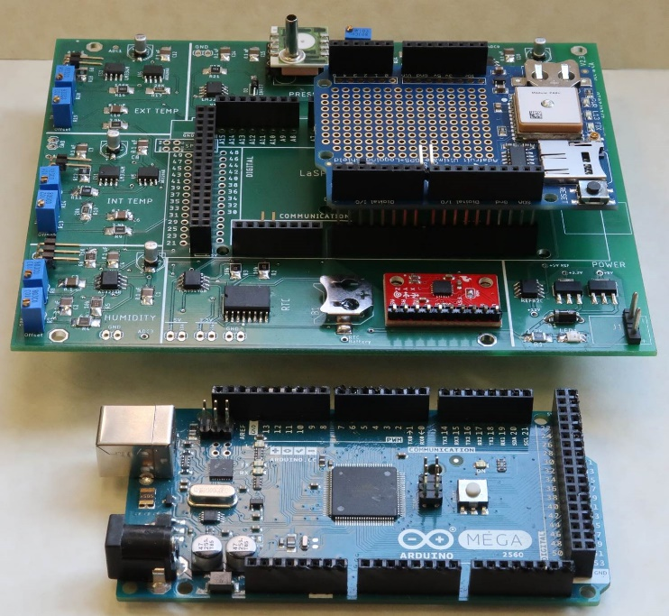
LaACES MegaSat Core
The core of the payload will be the LaACES MegaSat, which includes a baseline set of sensors
Will include the Adafruit Ultimate GPS Logger shield for GPS data throughout the flight and recording flight data on an SD card.
Teams are encouraged to add additional sensors as needed using the prototyping areas or adding boards (a protoshield or custom PCB) to the stack
Construction of the MegaSat shield is done in parallel with other required activities
During payload development, teams should ensure:
MegaSAT systems are considered and included in all design documentation
To budget the time needed to construct, test, calibrate the MegaSat shield in work plans
LaACES MegaSat payload stack

Slide 8
Payload Development Requires Team Cohesion
The first activity for the Project Management unit is to have each team produce its own “Team Contract”
Teams will need to identify and write down their “rules of engagement” for how they will operate as a project team
The Team Contract should include items such as meeting schedule, document management, roles, task management, as well as joining and leaving a team

Slide 9
Payload Development Requires Management
Project Management lectures and materials are in Part II, Unit 7
https://laspace.lsu.edu/laaces/student-balloon-course/
These lectures and materials cover the basics of project management necessary to develop a payload and complete the design reviews
This process is an abbreviated version of the NASA Spaceflight Project Life Cycle
These materials will be covered in January

Slide 10
Supplemental Materials: Payload Structure and Design
Some additional materials that can aid in the design and construction of a payload are included in Unit 8
This includes:
Surface Mount Soldering
Detailed assembly instructions for the MegaSAT
Construction techniques and recommended materials for the payload box
Estimating power draw and calculating a power budget
These lectures and materials are available for reference only (These will not be covered in a formal session)
https://laspace.lsu.edu/laaces/student-balloon-course/

Slide 11
The Project Reviews
There are at least three major reviews during a project
Preliminary Design Review (PDR)
Critical Design Review (CDR)
Flight Readiness Review (FRR)
Teams will make 15 minute oral presentations covering these materials in addition to submitting their written documents
The Pre-PDR and Pre-CDR divide the reviews into more manageable sections
Each review has a somewhat different objective and emphasis and provides a check on project progress for all stakeholders
Templates are provided for all review documents. Read all instructions contained within the template carefully!
The required documents will be rated as Pass / Fail. A “Fail” on any document means the team will very likely not fly
Teams should expect to revise and resubmit their reviews

Slide 12
The Project Reviews Document Templates
The templates provide a sequence of payload documentation from the initial organization and justification to the final defense of the payload flight worthiness
Each template ADDs to the previous template so it is important for a student team to fully complete one document before moving on to the next.
Pre-Preliminary Design Review (Pre-PDR) template
Preliminary Design Review template (PDR)
Pre-Critical Design Review (Pre-CDR) template
Critical Design Review (CDR) template
Flight Readiness Review (FRR) template
These templates can be found on the LaACES Document Center at https://laspace.lsu.edu/laaces/laaces-document-center/
Will talk about these reviews and expectations in the Project Management overview lecture.

