Slide 1
Using MicroSD Cards for Storage
Using the SD Card, SD Library, and basics of data formats

Slide 2
Volatile vs. Nonvolatile
There are two main types of memory:
  Volatile and Non-Volatile
Volatile Memory resets when power is lost
  Ex. RAM on the Arduino where program variables are stored
By contrast, Non-Volatile Memory keeps its data until overwritten or erased
  Ex. Flash memory – where the code is uploaded on the Arduino (256 KB of storage)

Slide 3
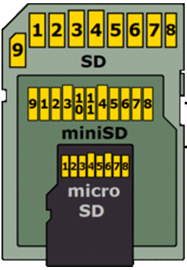
SD Cards
The Secure Digital (SD) standard dates back to 1999
In the early 2000s, SD storage was expensive for not much storage size
  ~$365 for 64 MB of storage
SD Cards are now inexpensive, lightweight, and small, so they are excellent for our needs
  A 32 GB microSD card <$10
Comes in 3 sizes
  Full-sized – Often, the slot size on computers and older devices
  Mini – Very uncommon
  Micro – Most commonly used today

Slide 4
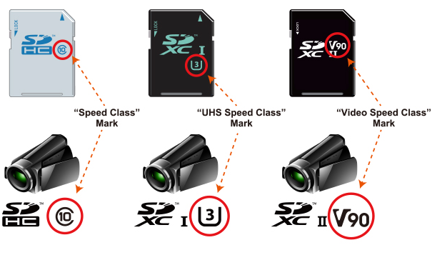

Class Markings
SD Cards will have two types of markings, for speed and Storage Capacity
Speed Markings (shown on the top)
  These are not critical for our applications since the lowest speed is much faster than the Arduino
The capacity will be marked by nothing (2 GB Max), HC(32 GB Max), XC(2 TB Max), or UC(128 TB Max)
  These are important because they determine the File System and the Arduino Library is only compatible with two file systems
Speed markings
Capacity standard markings in increasing size

Slide 5
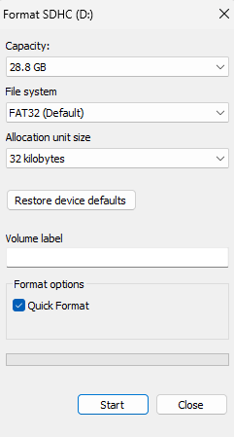
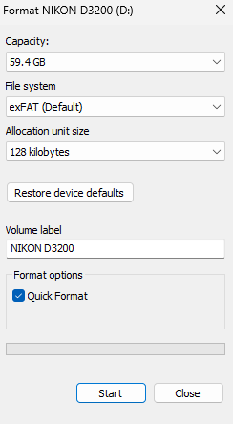
SD Cards File Systems
An SD card (or any storage device) stores data in files and folders just like your computer
The file system is how the data for those files is organized, accessed, written, etc.
The file system places maximum limits on the total storage size and on the single file size
For SD cards you are likely to encounter one of the versions of the File Allocation Table (FAT)
  Total Size Under 2GB: FAT16
  2- 32 GB: FAT32
  >32 GB: exFAT
Some utilities will allow you to choose other formats, but they may not work properly with all cards
Two SD cards as shown in the Windows file format utility, notice the two different file systems

Slide 6
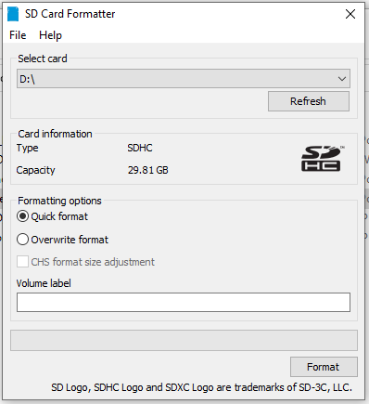
Using the SD Formatting Utility
At some point, you may need to format the SD to reset it
  A Downloadable Utility from the SD card Association
  You operating system will also have some kind of formatting tool
Formatting the card will completely erase all the data on the card
When the SD card is inserted into the computer, the Card should appear under the Select card dropdown
  Card Information will update, showing the size, label, and Capacity type
  The label is just the text name the card displays and is not critical

Slide 7
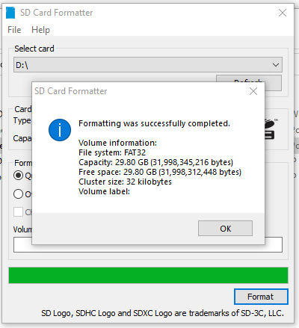
After Formatting
The utility will automatically select the appropriate file system for the size card
  It does not allow you to manually choose
Quick formatting will just mark the old data as free to overwrite
Overwrite will actually write blank data (takes longer but may be desired for security reasons)
After formatting, you should get a completion message
  Could fail, for example if the card is removed part of the way throug
You can see here that the 32GB SD card was formatted in FAT32

Slide 8
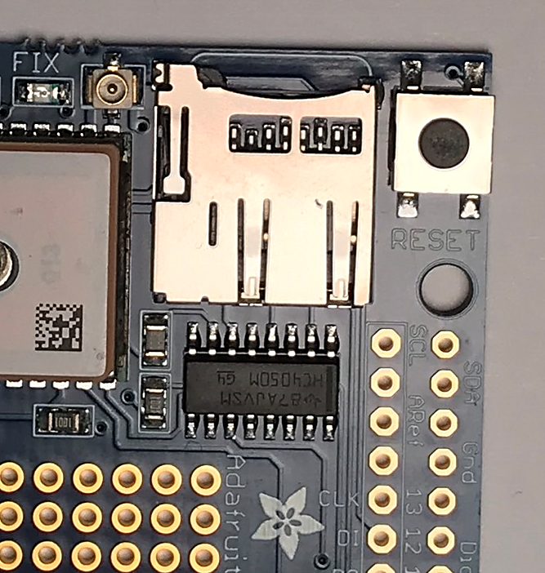
SD Card Slot
The GPS shield has a microSD card slot
  The card should be inserted contacts down, labeled side up
  Cards are keyed and should fully slide in the correct orientation
Communication between the Mega and the SD card uses SPI
  The SD Card uses 3.3V Logic, the chip next to the slot is a level shifter
When inserting the card, ensure that it latches with a click
  To release, you just press the card in again
If not fully inserted, the Arduino will not be able to communicate the card, no data will be logged
To read the data, just eject the card and insert it into a computer (may need an adapter) and open the files
The Adafruit Ultimate GPS Logger Shield’s microSD socket.

Slide 9
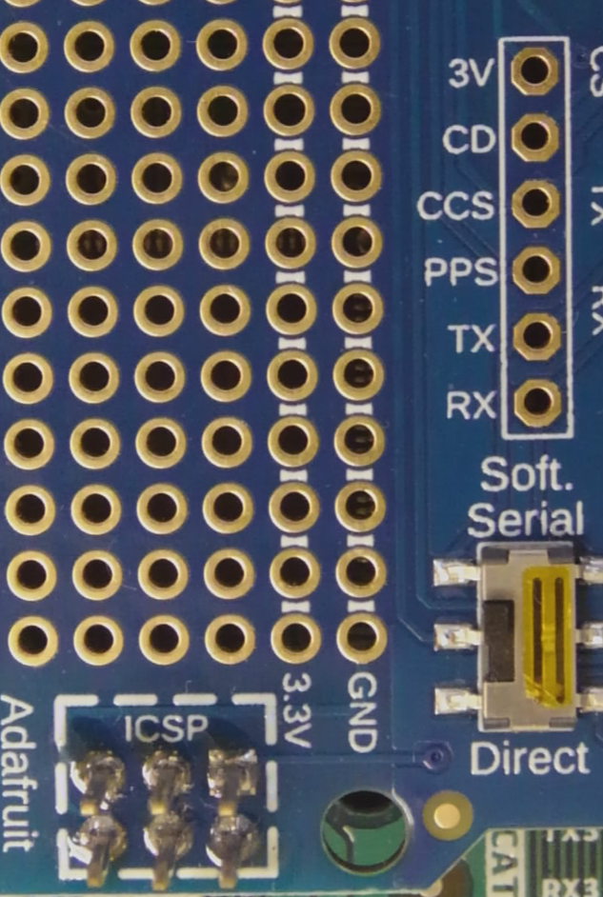
SD Card Physical Pins
SPI communication requires 4 lines: MISO, MOSI, Clock, and Chip Select
MISO, MOSI, and Clock are on the middle 6 pins connected to 50, 51, and 52
CS is pin 10, on the right header
  Although this is a free parameter in the library, only pin 10 is wired to the SD on the shield, using another pin would require wiring a jumper

Slide 10
SD Library: Basics
The Library should have been installed with the Adafruit_GPS library and is just called SD
  https://docs.arduino.cc/libraries/sd/
The Library introduces two new variable types (classes)
SD Class
  This is used to set up communication and deal with the SD card and file system
File Class
  This is an individual file, so used for reading, writing, data, and closing
  We can read data from the files using the library, but usually it is simpler just eject the card and look at the data on a computer

Slide 11
SD Library: Limitations
Card must be FAT32 or FAT16
  ExFAT cards will not be recognized
  Maximum Storage size will be 32 GB (which should be sufficient for a full 4 hours of flight time)
File names must follow the 8.3 Name Format
  (Up to) 8 Characters – a period – 3 more characters
  Letters, numbers, dashes (-), and underscores _ : Ok
  Avoid spaces, additional periods, special characters ($, &, *, etc.)
  Recommend numbering your data files (DATA0.csv, DATA1.csv, DATA2.csv …) or using times (GPS_1215.dat, GPS_1225.dat, ..)
  The 3 characters after the period are called a file extension
The SD library can work with subfolders, but it is not necessary or recommended

Slide 12
SD Library:
SD Important Functions
begin(CS_PIN)
  Used to start communication with SD card, you must give it the correct pin for the Chip Select (which will be 10 for the Adafruit_GPS) – Will not error if you forget the CS Pin, will instead just fail to communicate
  Returns either a 1 (success) or 0 (failure)
open (Filename, mode)
  Filename is the name you would like to open, can be an existing file or a new file (which will create the file)
  Mode is used to open a file for reading or writing; two constants exist FILE_WRITE and FILE_READ
  Will return a File variable for the opened file, so will want to place that in a variable to actually write data
exists(Filename)
  Determines if the file already exists on the SD card

Slide 13
SD Library:
File Functions
print(data) and println(data)
  These functions work similarly to the serial port functions, but instead of writing the data to the file they are called on, write the data as character strings by default, just like Serial.print()
  println() adds the <cr><nl> so that the next data will be written on a new line in the file
flush()
  By default, the library saves the characters to a buffer and waits until full to send to the SD card
  This function forces any data to be sent to the SD card when called, similar to forcing a save
close()
  Flushes any data and then closes the file
  Will have to call open again before writing new data

Slide 14
General Process
Data to SD Card
SD card communication initialized in setup()
  SD.begin(CS);
Open/create SD file
  myFile = SD.open(filename, FILE_WRITE);
Write data to the file – same as printing to Serial Monitor
  myFile.println(“This sentence will be written to my SD file”);
  May want to occasionally call flush()
When finished, close the file
  myFile.close()

Slide 15
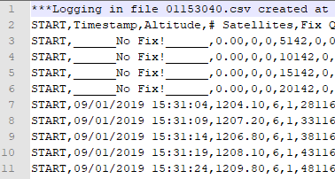
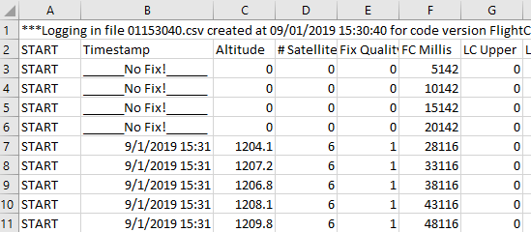
File Extensions
The file extension just tells your computer what program to use to try and open the file (.docx for Word, .xlsx for Excel, .mp4 for VLC media player)
We will be saving our data as a string of characters rather than the raw binary bytes
  We can always open the data in Notepad to look at it or copy it, but we can make our lives easier with the .csv extension
CSV is a comma-separated values file
  Will open in Excel by default, you can then save as XLSX to save formulas or graphs
  Each line of text will be a separate row
  Commas separate the data into separate columns
This is an example of a .csv file. Left – opened in a notepad. Right – opened in Excel, the commas are used to separate the columns.

Slide 16
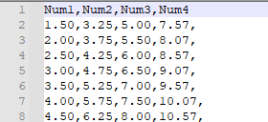
Designing a Data Format
You will choose how you organize and write your data in your files
Plain text allows you to easily view the data and can often spot if an error occurred during writing
At the beginning of each file, write the column names as the first line
Consider a start and stop marker (could literally be “START” and “STOP”) so you can tell if data finished writing
Think about decimal places, by default print() will show 2 for floats, do you need + and – signs
If your data points become disordered (a software error caused you to write data on the first file), is there anything in the data to allow you to resort (timestamp each datapoint)?
  Maybe a column for filenumber, a column for data point, etc.
How much space does your data take up, is your SD card large enough

