Slide 1
Using the Adafruit GPS Library

Slide 2
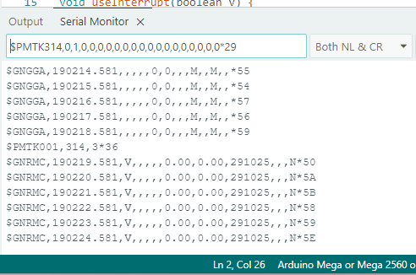
Communicating with the GPS
All communication to and from the GPS is done via text Serial messages
We can also connect our serial monitor directly to the GPS with the “Direct” switch
This has the advantage of letting us look at the raw output in the Serial monitor
We can also send commands using the Serial Monitor text box
With the switch in “Direct” can talk directly to GPS, including sending commands and seeing response (the PMTK001 line).

Slide 3
Input/Output Strings
Output (Data from GPS)
Input (Data to GPS)
NMEA Sentences
By default, transmits the GGA, GSA, RMC, VTG sentences every 1 second
You can change which sentences are output
You can also set the update rate to be faster or slower than 1 Hz
The GPS will also transmit an acknowledgment response to any commands
Commands are also sent as text strings
Just like NMEA starts with $, uses commas, and ends with a checksum and <cr><lf>
Commands are called PMTK packets
Full Command list reference
https://laspace.lsu.edu/laaces/wp-content/uploads/2021/10/PMTK_Packet_User_Manual.pdf

Slide 4

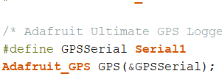
Adafruit_GPS Variable
The library adds a new variable type Adafruit_GPS
These are called classes
When you create the Adafruit_GPS variable, you must give it the Serial Port where the GPS is connected
The & is required (this is sending the memory location of Serial1 rather than sending a copy to the function)
In this example, GPS is a variable name
We often want to use a define statement like the lower example
This tells the compiler that everywhere we use GPSSerial, we mean Serial1
That way, if we decide to change the serial port, we only have to change the #define statement

Slide 5
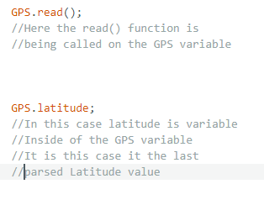
GPS Functions Functions and Variables
Similar to the RTC library we used in the I2C activity, the library defines functions that act on the Adafruit_GPS variable (in this example, GPS)
Notice the parentheses
The library also defines variables inside the Adafruit_GPS variable that allow you to access pieces of data from the GPS
These will have no parentheses
The documentation
https://adafruit.github.io/Adafruit_GPS/html/class_adafruit___g_p_s.html#ae39fbc538a1ee3ba1c8108bf49065c3f

Slide 6
Important GPS Functions (In all of these, assume a Adafruit_GPS variable named GPS)
GPS.begin()
Initialized the GPS
GPS.sendCommand()
Sends a command to the GPS
GPS.read()
Reads one character from the GPS serial port
GPS.newNMEAreceived()
Tells you if a complete NMEA sentence has been received
GPS.lastNMEA()
Gives the last complete, valid NMEA received
GPS.parse()
Pulls the information out of the NMEA and updates the variable values for the data in that NMEA (e.g. GPS.hour, GPS.altitude)
Can’t update data that is not in NMEA you parse

Slide 7
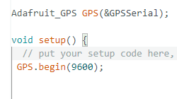
begin()
GPS.begin(baudrate);
This works similarly to Serial.begin()
Should be part of your setup()
Initializes the GPS variable and tells the Arduino what baudrate to use when talking to the GPS
Default GPS baudrate is 9600
Just like the serial ports, you need to call begin before using the GPS

Slide 8
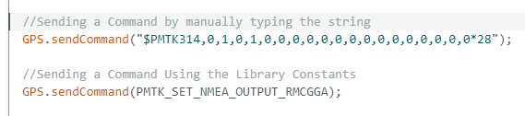
sendCommand()
GPS.sendCommand(command);
The argument is the character string to send to the GPS as a command
You can manually type the command string into the argument (top example)
This can be difficult, especially since you need to calculate the checksum characters at the end
The library defines strings for most of the common commands, so those can be used like the lower example
These are contained in the Adafruit_PMTK.h file
https://github.com/adafruit/Adafruit_GPS/blob/master/src/Adafruit_PMTK.h
Commands should normally be sent in setup() after the GPS.begin() to ensure the GPS is configured with your desired settings
Both the above lines are sending the same command, the top manually and the bottom using one of the library strings

Slide 9

read()
GPS.read();
No argument
Works similarly to Serial.read()
Reads one character (which is 1 byte) from the GPS Serial Port and returns it
Will return 0 if there are no characters to read
But does two other important things
Copies the character to the internal string used by the LastNMEA() function
Then it checks if a complete and valid NMEA has been received
When a complete NMEA has been read, the values for newNMEAreceived() and lastNMEA() get updated
In this case we are copying the read character into the variable c, but because read also copies the character

Slide 10
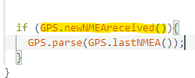
newNMEAreceived()
GPS.newNMEAreceived();
No Arguments
Returns True or False depending if a new NMEA has been received
Reading the last character with GPS.read() changes it to True
Outputting a NMEA with lastNMEA() changes it to false
Usually you use newNMEAreceived(), lastNMEA(), and parse() in combination to update the GPS data
First use newNMEAreceived() to check for a NMEA sentence

Slide 11
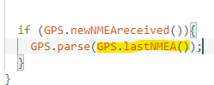
lastNMEA()
GPS.lastNMEA();
No arguments
Returns the character string of the last complete and valid NMEA received
This includes the checksum and the <NL> and <CR> at the end
This turns the newNMEA() back to FALSE
Every time read() gets to the end of an NMEA, this value gets overwritten
Then you use lastNMEA to get the NMEA string

Slide 12
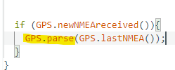
parse()
GPS.parse(NMEA String);
Give the NMEA text string as
This breaks up the text string and updates the values of internal variables like GPS.hours or GPS.latitude
But it can only update data that is in that NMEA
Ex. calling parse on an RMC will update Time, Date, Latitude, Longitude, but not Altitude
Also, if the data is blank (when the GPS does not have a fix), it will not be updated
In both cases, the value will remain unchanged, so if the GPS loses a fix on ascent, it will look like it stopped moving
Finally, you give parse() the NMEA string and it will extract the data

Slide 13
Common Useful Internal GPS Variables
GPS Variable | Value
GPS.latitude | Latitude (in Degrees and Minutes Format DDMM.MMMM, does not tell hemisphere)
GPS.longitude | Latitude (Degrees and Minutes Format DDMM.MMMM, does not tell hemisphere)
GPS.latitudeDegrees | Latitude (Decimal Degrees, - sign for South)
GPS.longitudeDegrees | Longitude (Decimal Degrees, + sign for West)
GPS.altitude | Height in meters above MSL
GPS.year | Year (two-digit format, 25 for 2025)
GPS.month | Month (1, 2, 3 .. 12)
GPS.day | Day of the Month (1, 2, 3 .. 31)
GPS.hour | Hour (Times with GMT/UTC so +5/6 Hours from Central depending on DST)
GPS.minute | Minutes
GPS.seconds | Seconds
GPS.satellites | Number of Satellites Tracked

Slide 14
GPS Data Flow
Initialize GPS using begin()
When a complete NMEA has been received newNMEAreceived() will become True
Get the most that NMEA using lastNMEA()
Call give that NMEA to the parse() function to update GPS Data
Call read() on the GPS repeatedly
Configure the GPS using sendCommand()

Slide 15
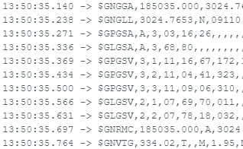
GPS Timing Concerns
With all NMEA outputs on, we can use the serial monitor timestamp to see that it takes the GPS ~0.75 seconds to transmit all of that data
Since each character takes ~1ms to send and there are ~700 that makes sense
The Serial receive buffer only holds 64 characters
We need to parse each sentence (or save it another way)
GPS will just continuously automatically transmit its data every 1 second; it will not wait for the Arduino

Slide 16
Strategies to Avoid Missing Data
Turn off unnecessary NMEA Sentences
By getting rid of the data we do not need, it will be less likely that the data we do need will be overwritten
Call GPS.read() often
Since each character ~takes about 1 ms to transmit, we should call read about that often
Check for newNMEAreceived() and call GPS.parse() often
If we have 2 sentences transmitted every 1 second, we should check for a new NMEA at least twice a second, but 3 or 4 times would be
Because of this, you want to avoid large using the delay() function with the GPS

Slide 17
Interrupts
We can use a special function called an Interrupt to call read() every 1 ms
An interrupt is a function that gets executed automatically when a certain condition occurs
They “interrupt” the normal flow of the program
This is the timers for the delay() and millis() functions work
The trigger is tied to hardware, such as a pin changing from high to low or an internal clock reaching a certain value
When a trigger occurs, the program stops what it is doing, runs the function called an Interrupt Service Routine (ISR)
When the ISR finishes the program resumes where it left off
https://docs.arduino.cc/language-reference/en/functions/external-interrupts/attachInterrupt/

Slide 18
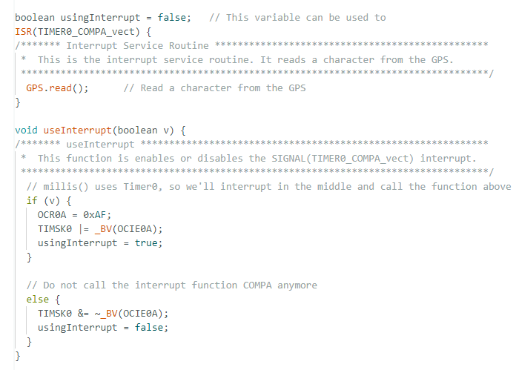
Interrupt Example
The code to the right will set up an interrupt to call GPS.read() ~1 ms
The top box is the ISR
The useInterrupt() function at the bottom enables/ disables the interrupt
The interrupt is off by default, so useInterrupt(true); should be called in setup()
The actual operations involve manipulating the setting registers on the AtMega2560
the same timer is used for millis() and delay(), so if you have a typo, you may cause those functions to work incorrectly
This code is available on the LaACES website and can be inserted at the top of your code below the #include statements
The top function that is triggered by the interrupt, in this case it is triggered by a timer. Because the timer is the trigger, the function does not have a name and will not be called in the loop() or setup()
The bottom function turns the timer trigger on and off. Calling useInterrupt(true); turns it on and useInterrupt(false); turns it off

