Slide 1
The Global Positioning System (GPS)

Slide 2
What is GPS?
GPS (Global Positioning System) uses a constellation of satellites that orbit the Earth
A GPS receiver receives highly precise timing signals from these satellites and calculates its position in 3-dimensional space (Latitude, Longitude, and Altitude)

Slide 3
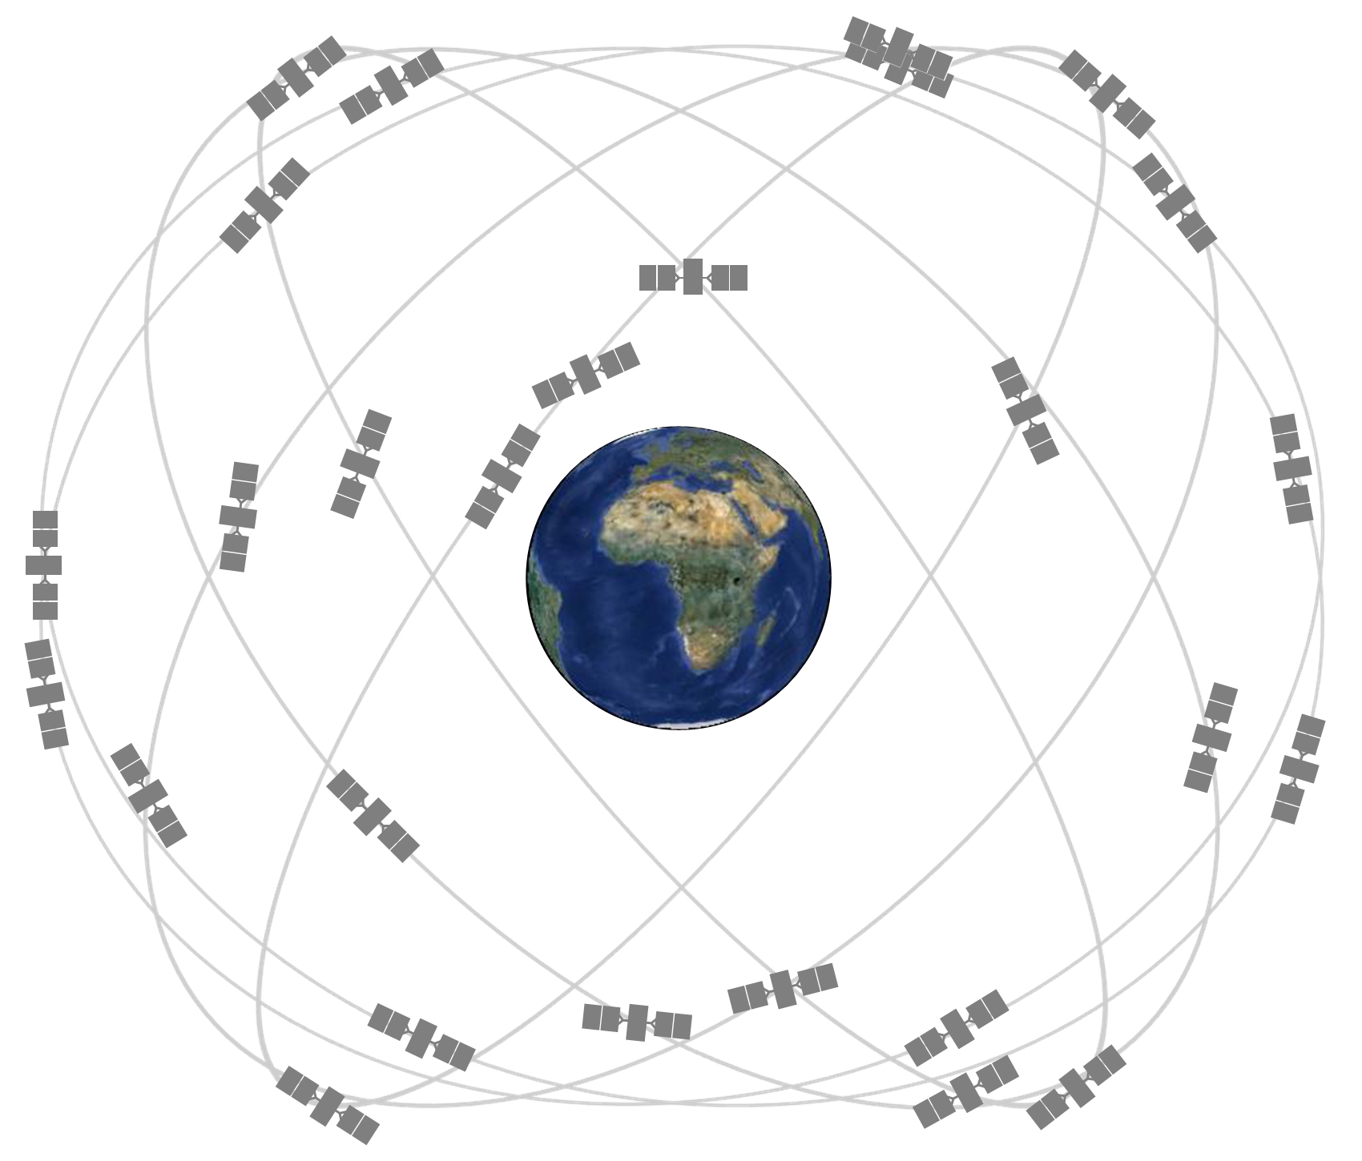
GPS Satellite Constellation
Minimum operation of the GPS system is a 24-slot constellation (6 orbits x 4 slots)
Normal operation is 31 active satellites
These satellites orbit in 1 of 6 orbital planes
These planes have an altitude of ~20,000 km
Each satellite orbits the Earth twice a day (12-hour orbit)
The current status of the constellation, along with status messages, can be viewed online
https://www.navcen.uscg.gov/gps-constellation
The 24-slot satellite constellation. This configuration should ensure at least 6 satellites are visible form any point on Earth

Slide 4
GPS Operation Restrictions
Civilian Restrictions
Receivers capable of operating above 18 km AND 515 m/s could be used as weapons guidance and require a State Department export license
A GPS should disable itself when it exceeds these limits
Some receivers would shut themselves off with either condition, leading to failure during balloon flights
A balloon payload will travel below the speed limitation, so receivers should function throughout the flight
We have occasionally seen the Adafruit GPS fail at 10 km, but this seems to be unrelated

Slide 5
Other Satellite Positioning Systems
Russia – GLONASS (Global Navigation Satellite System)
Global coverage since the 2000s
European Union – GALILEO
25 - Active satellites as of 2025
China – BeiDou Navigational Satellite System
Global coverage since December 27, 2018
Japan – QZAA (Quasi-Zenith Satellite System)
Currently, only 4 satellites in orbit – regional coverage
India – NAVIC (Navigation with Indian Constellation)
Currently 7 satellites in orbit – regional coverage
Multi-Constellation receivers use the term Global Navigation Satellite System (GNSS)
Because of technology improvements, even inexpensive receivers like the Adafruit GPS can receive multiple constellations

Slide 6
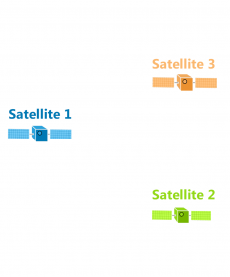
How Does GPS Work?
GPS satellites broadcast radio signals that include their location and time
Satellites’ time is very accurate due to atomic clocks onboard
GPS devices receive these signals and use the arrival time to calculate the distance between themselves and a satellite
So the distance D from the orbiting satellite can be calculated
D = speed of light * (t _{received} – t _{transmitted})
Each Satellite broadcasts its location and time of broadcast

Slide 7
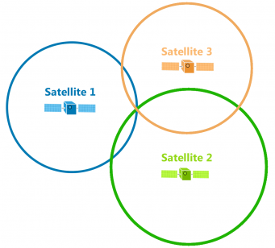
Trilateration
For each satellite, draw a circle of radius D around it
The GPS receiver must be somewhere on the circle
The same process is repeated for all actively tracked satellites
Since the GPS receiver must be somewhere on each sphere, the intersection of these circles is the receiver’s position
D3
D1
D2
The circles represent the distance from each satellite. The intersection of the three circles, as shown by the red arrow, is the location of the GPS receiver

Slide 8
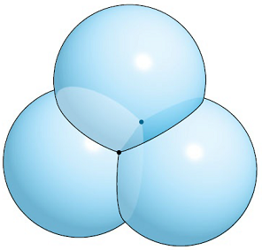
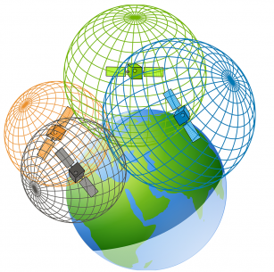
Trilateration Continued
In 3D, so each satellite is the center of a sphere, not a circle
The intersection point of 3 spheres has two possible positions
To achieve a fix in 3 dimensions, a GPS receiver must track 4 satellites at a minimum
With 3 satellites in view, a GPS receiver can determine its latitude and longitude by assuming it is “close” to the surface of the Earth
This is called a 2D fix
With 4 satellites, a GPS receiver can find its latitude, longitude, and altitude
This is called a 3D fix
Top – The intersection of 3 spheres is two points, not one point. This means 3 satellites are not enough to obtain a 3D fix
Bottom – Shown are the spheres that represent the distance from each satellite. It is the intersection of 4 spheres that give a GPS receiver its position

Slide 9
GPS Accuracy
Because GPS requires such precise timing, the accuracy of position is by
Atmospheric Conditions
Clock Errors
Signal Blockage and Multipathing
Satellite Geometry (Dilution of Precision)
Most smartphone GPS are accurate to within ~5m (16ft). This accuracy gets worse near large objects, such as buildings and trees
High precision GPS receivers can be accurate to within a few centimeters

Slide 10
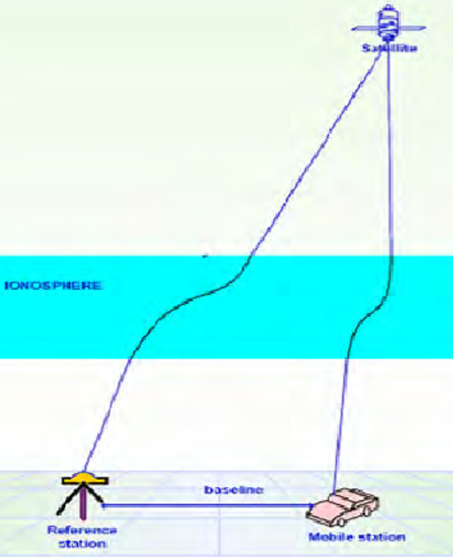
Atmospheric Conditions
The GPS signal is not traveling through a vacuum to the receiver but has to travel through the layers of the atmosphere
In the ionosphere(layer of charged particles in the atmosphere), signals of different frequencies are deflected or travel at slightly different speeds
These effects can be measured by ground stations and corrections broadcast to receivers
In the troposphere (lowest region of the atmosphere) changes in humidity and air pressure also cause slight variations in signal speed
These are localized to specific weather between a satellite and receiver, so are difficult to correct
Shown is an exaggerated view of the GPS signal path. Notice that the delay can be measured by a reference station and a correction broadcast to a mobile receiver

Slide 11
Clock Errors
Satellite clock errors: GPS satellites have atomic clocks on board
These are extremely accurate but can drift over time
The errors are minimized by calculating clock corrections at fixed monitoring stations. These monitoring stations transmit their corrections + the GPS signal to GPS receivers
Receiver clock errors: GPS receivers don’t have atomic clocks; they have quartz crystal clocks
The accuracy of these clocks varies from receiver to receiver
The error from this clock can be corrected by comparing the arrival times of two satellites whose transmission times are known exactly

Slide 12
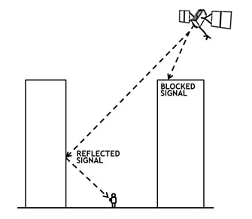
Signal Blockage
The signal has to get to the receiver to be used
Satellite signals can be blocked by buildings, bridges, trees, etc.
Reflected signals also cause errors; this is called multipath. The original signal is blocked, but the receiver receives a reflected signal, and the reflected signal’s path will be longer
Using GPS indoors or near buildings, the signal will be degraded
Having difficulty inside? Move the receiver closer to a window
This is not a concern during flight, but receiving signals in the lab can be a challenge
The direct GPS signal is blocked from the receiver by a tall building. Another GPS signal is reflected off a second building and is then received. This effect is greatly exaggerated in the picture.

Slide 13
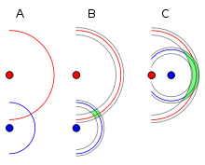
Satellite Geometry
These effects cause uncertainty
Geometric Dilution of Precision (DOP) is an error caused by the position of the satellites
The figure shows this effect
In A, someone has measured their distance from two satellites and draws circles with corresponding radii
In B, error causes the circles to have thickness, but because of the position of the receiver, the possible region (in green) is small
In C, the distance error is the same, but now the overlapping region is much larger, so the positions are less well known
An example of DOP. A user knows the distances between themselves and two satellites (red and blue dots)
With perfect precision, the user knows their exact position.
For a given error, the circles gain some thickness. In B, there is a small region of uncertainty
In C, the same error give a much larger Dilution of Precision, solely do to the location

Slide 14
GPS Receiver Output
The standard output for a GPS receiver is an ASCII text string over UART
The standard format for the transmitted information is a National Marine Electronics Association (NMEA) sentence
Usually spoken Knee - Mah
Each NMEA Sentence is a text string of predefined data in order, separated by commas
Different NMEA sentences will have different information
Starts with a $ and ends with <CR><LF>
Several references are available online giving the format
https://cdn.sparkfun.com/assets/a/3/2/f/a/NMEA_Reference_Manual-Rev2.1-Dec07.pdf

Slide 15
Common NMEA Sentences: Information provided
There are many different NMEA sentences but here are the most common (with GGA
RMC – Recommended Minimum
Time, status, latitude, longitude, speed, track angle, date, magnetic variation
GGA – Essential data
Time, latitude, longitude, fix quality, number of satellites being tracked, HDOP, altitude, height of geoid, time since last DGPS update, DGPS station ID number
GLL – Geographic Latitude and Longitude
Latitude, longitude, time, status
GSV – Satellites in View
Number of satellites in view, satellite PRN number, elevation, azimuth, Signal Strength
Notice how is we want a date AND an altitude we need both GGA and RMC

Slide 16
Example NMEA Sentence: GGA Layout
$GPGGA,002153.000,3342.6618,N,11751.3858,W,1,10,1.2,27.0,M,-34.2,M,,0000*5E
$GPGGA,hhmmss,llll.ll,a,yyyy.yy,a,N,xx,H.H,A.A,M,g.g,M,S.S,IIII*hh
1 , 2 , 3 ,4, 5 , 6, 7,8, 9, 10, 11,12,13,14,15 16
GPGGA Message ID, indicates GGS. For a GNSS fix (GPS + other constellations) will be GNGGA
hhmmss.ss Time of fix hh:mm:ss UTC
llll.ll Latitude: ll degrees 07.038 minutes
a Direction. N = North. S = South.
yyyy.yy Longitude: 11 degrees 31.000 minutes.
a Direction. E = East. W = West.
N Fix quality: 0 = no fix. 1 = GPS fix. 2 = Differential GPS fix. 4 = Real-Time Kinematic (RTK) fixed integers. 5 = RTK float integers. 6 = Dead reckoning. 7 = Manual input mode. 8 = Simulator. 9 = WAAS. Ours will be 0, 1 or 2
xx Number of satellites being tracked (0 to 12)
H.H Horizontal dilution of position as unitless number
A.A Altitude above Mean Sea Level (MSL)
M Meters (units for altitude)
g.g Relationship between geoid and WGS84 ellipsoid, this is a correction for the earth not being a sphere
M Meters (units for 11)
S.S Time (seconds) since last DGPS update, this is a position correction from a ground station
III DGPS station ID number, an ID for the ground station used in the correction
*hh Checksum in hex, this is the result of a checksum calculation on the previous bytes in the string, by repeating the calculation you can verify you did not miss any characters in the string

