Slide 1
Expanding the Arduino
Adafruit GPS Logger Shield

Slide 2
Expanding the Arduino Mega
You can enhance your project by adding additional boards to the microcontroller stack
The Arduino header layout has a standard pin footprint
These boards are called “Shields”
Commercial shields are available to perform specific tasks – Like combination SD card and GPS Shield we will use
They can be used for prototyping before adding a more permanent component to your PCB
Custom shields can be designed, like the MegaSat Shield we provide teams, to include a base set of sensors

Slide 3
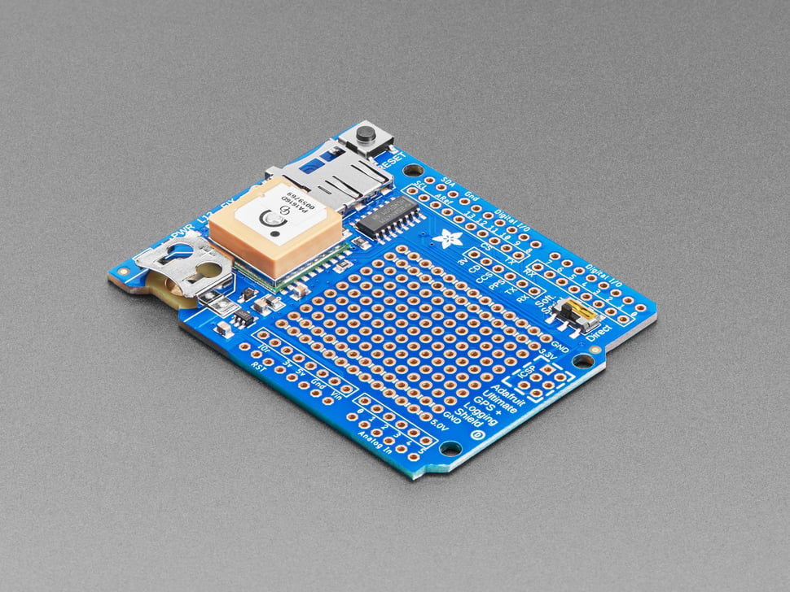
Adafruit Ultimate GPS Logger Shield
This shield has a GPS receiver and an SD card for storing data
Footprint designed for Arduino Uno, but can be used with other boards (like our Mega)
Because it is half-length, usually will mount it to the top of the stack

Slide 4
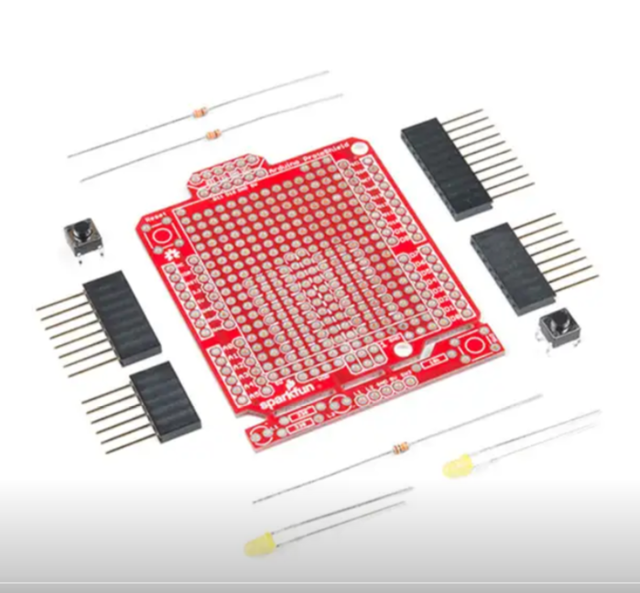
Proto-Shields
Contain pads for soldering a semi-permanent version of a circuit you want to add to the microcontroller stack
Take care when selecting, often the pads will not have any internal connections requiring jumper wires for all connections
Will have the standard header layout to connect to Arduino
Allows a flight-ready soldered circuit without having to do a full PCB design
An Arduino Protoshield (not assembled)

Slide 5
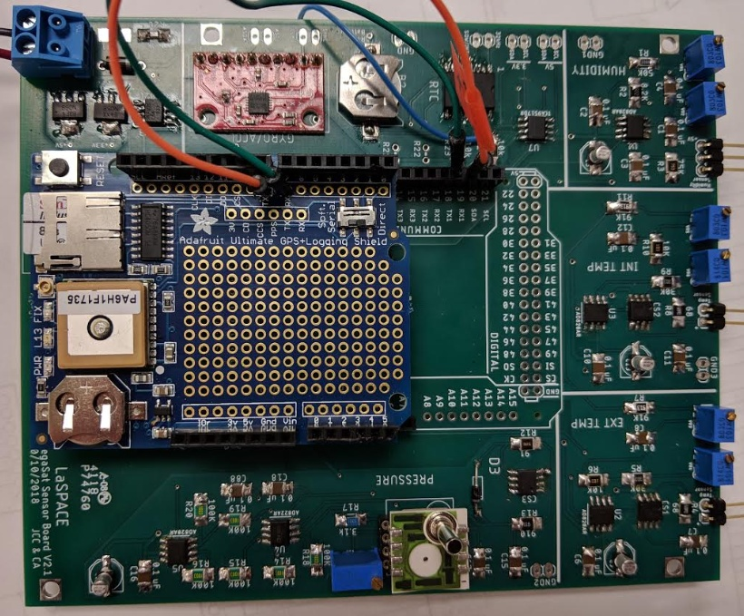
LaACES MegaSat
The MegaSat was designed by the LSU physics department as a custom shield for teams to have a baseline payload
Contains a base set of environmental sensors common to many payloads
Also provide breakout interfaces for adding additional detectors
An assembled MegaSat prototype board assembled in the stack with the GPS shield and Arduino (on bottom), note this is an older version of the board,

Slide 6
Selecting Shields
Shields that perform specific functions are available from retailers such as Adafruit, Sparkfun, and Amazon
Often, these manufacturers will have written Arduino libraries for these
When using multiple shields, you must keep track of which pins are being used by which shields to avoid conflicts
Make sure you select a shield that is compatible with your microcontroller
There are differences between the Arduino Mega and other Arduino microcontrollers, such as the UNO, so some shields are not automatically interchangeable

Slide 7
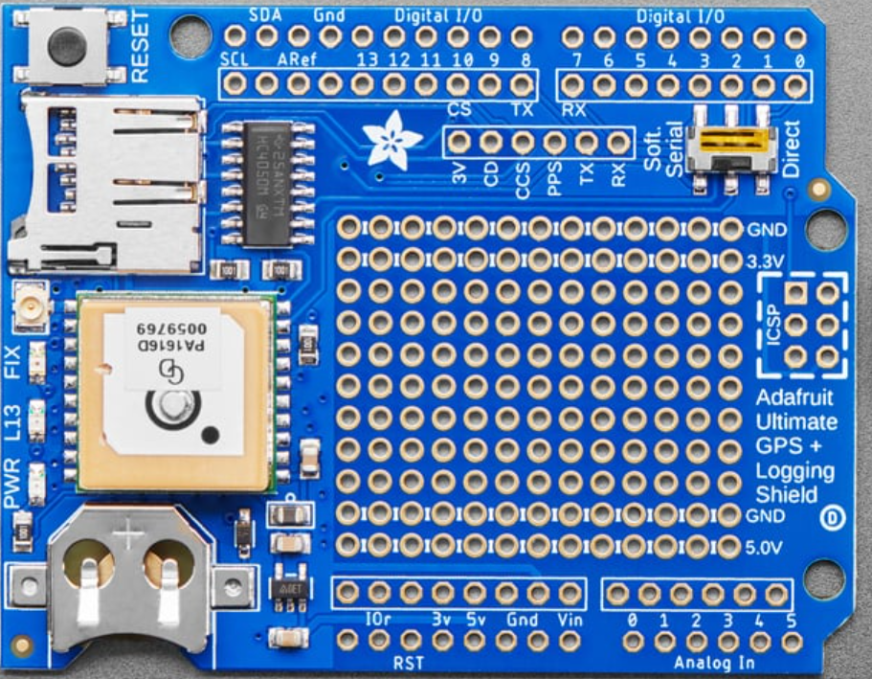
Adafruit Ultimate GPS Logger: Major Components
This is the Arduino Ultimate GPS Logger Shield. It comes with
microSD socket
Connector for external antenna
Antenna and GPS unit
Coin cell holder
Prototyping area with solder pads (Yellow line)
The Adafruit Ultimate GPS Logger Shield. From top to bottom, the red arrows show the microSD socket, the external antenna connector, the GPS unit, and the coin cell battery holder. The yellow dashed line shows the prototyping area

Slide 8
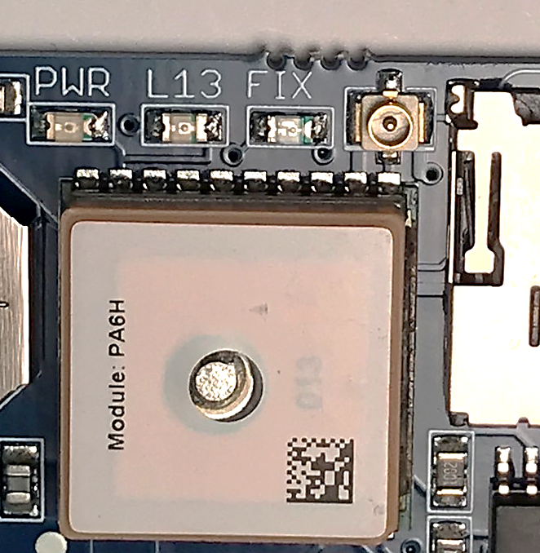
GPS Receiver and Antenna
The GPS shield has a built-in ceramic antenna. For the LaACES payloads, this antenna should be adequate
This will receive GPS signal through light obstruction like foam, but should be flown on top, facing up
Payload shielding or sensitivity requirements may require an external antenna
This connector is called a uFL connector
Actual GPS receiver chip is underneath the antenna and is GlobalTop PA6H
The red arrow is pointing to the Adafruit Ultimate GPS Logger Shield’s external antenna connector. It is located between the microSD socket and the FIX LED.

Slide 9
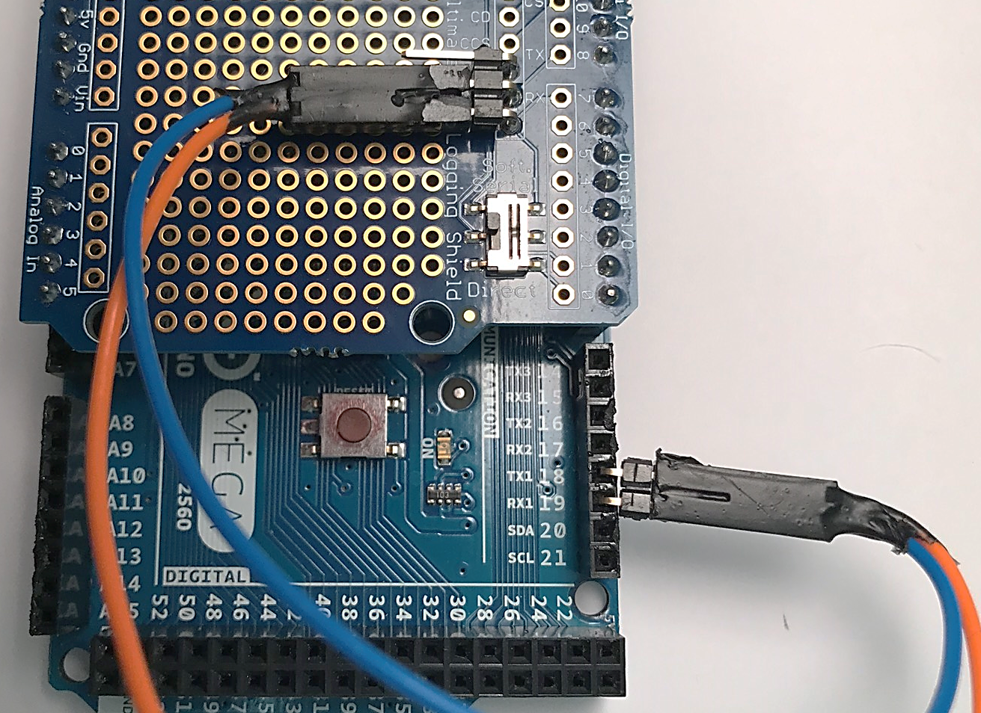
Soft-Serial/Direct Switch
You communicate with the GPS using the UART/Serial protocol with text strings
Remember, UART is a one-to-one protocol, so you cannot have the Arduino, GPS, and a Laptop all connected to 1 Serial Port
If the Arduino is using the Serial Monitor, it will not be able to use the GPS default connection
The switch changes which Arduino pins the GPS is connected to
In “Direct”, it connects to pins 0 and 1, aka Serial (the same as the USB)
In “Soft-Serial”, it connects to pins 7 and 8
The communication switch on the Adafruit Ultimate GPS Logger Shield. The jumpers connect the RX and TX breakout pins to Arduino pins 18 and 19 allowing use of Serial1 to talk to the GPS

Slide 10
Direct Connect/Software Serial Switch
Direct Connect connects the Shield to the Arduino’s Serial 0 channel(TX0, RX0)
In general, we want to use TX0, RX0 for computer to Arduino communications
Direct connect does allow us to communicate directly with the GPS on the Serial Monitor, bypassing the Arduino
Software Serial connects the GPS to pins 7 and 8 of the Arduino and TX and RX on the breakout
We will install jumpers that allow us to connect this output to Serial1, Serial2, or Serial3
This arrangement is based on the Arduino UNO, which only has one Hardware serial port on pins 0 and 1

Slide 11
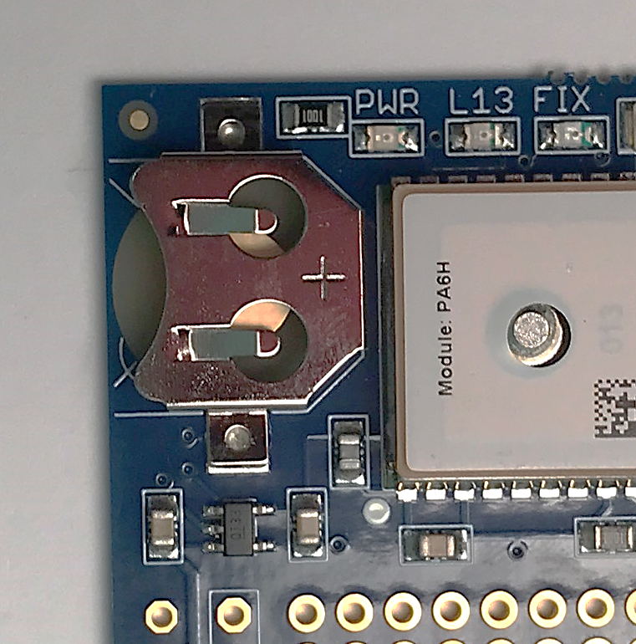
Coin Cell Battery Holder
The GPS has a number of settings that can be changed by sending it commands
If the GPS loses power, it will return to the default settings
By installing a battery in the coin-cell slot, the GPS will keep its settings on restart
This will also allow the GPS’s internal clock to be accurate even with no satellite fix, assuming it had a fix in the past
It will automatically set its time when it gets a satellite fix
The Adafruit Ultimate GPS Logger Shield’s coin cell battery holder. Notice the + sign on the top indicating the battery should be installed positive side up.

Slide 12
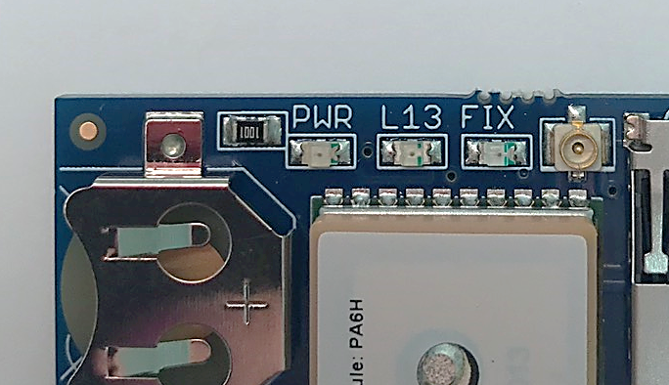
LEDs on GPS Shield
There are 3 different LEDs on the GPS shield
Green (PWR)
Power LED. If it’s not on, the shield doesn’t have power
Yellow (L13, same as built-in Arduino LED)
Red (GPS Fix Status )
Blinking every second, GPS does not have a fix
Blinking once every 15 seconds, GPS has a fix
3 indicator LEDS are located

Slide 13
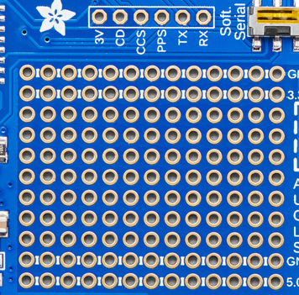
Prototyping and Breakout Areas
There is a small prototyping area on the GPS shield
Next to the Prototyping area are six breakouts
3V: 3.3 volts but comes from a 5V to 3.3V regulator on the GPS shield not the Arduino 3.3V
CD: Detects if an SD card is physically installed
CCS: Card chip select line. It is connected to digital 10
PPS: This is a pulse per second output when the GPS has a fix
TX: GPS “Soft-Serial” transmit line
RX: GPS “Soft Serial” receive line
Figure 6: Shown is the prototyping and breakout areas on the Adafruit Ultimate GPS Logger Shield. The red dashed box is surrounding the prototyping area. The yellow dashed box surrounds the breakout area. The RX and TX breakout pins are used for Software Serial communication

Slide 14
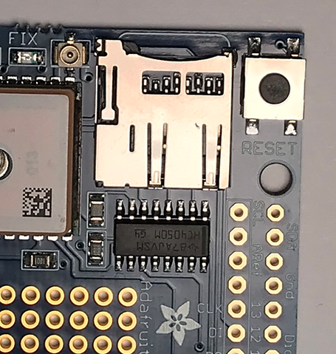
SD Card
The GPS shield has a microSD card slot
Allows the storage of flight data payloads
Communication between the Mega and the SD card uses the SPI protocol
SD card slides in and locks, press it in again to release
Data is saved in regular files on the SD card, allowing reading of flight data by
The Adafruit Ultimate GPS Logger Shield’s microSD socket. The SD card will latch once fully inserted with a click. To eject, simply push the card in again

Slide 15
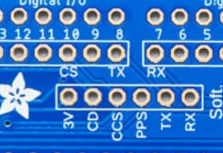
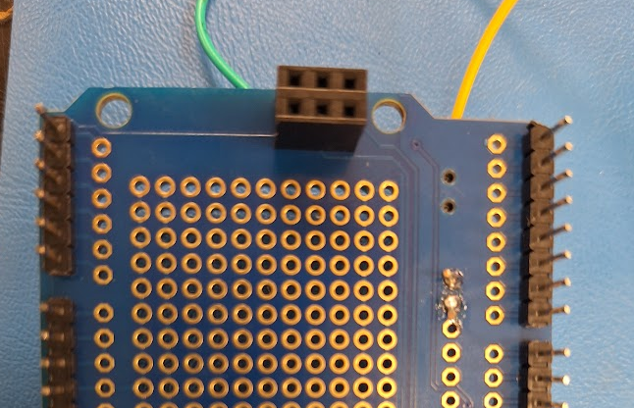
SD Card Communications
SPI communication requires 4 lines: MISO, MOSI, Clock, and Chip Select
On the Mega2560, MISO, MOSI, and SCK are digital pins 50, 51, and 52
This connection is made via the 6-pin header in the middle of the Arduino
The header should be soldered with the sockets down to mate with the pins on the Arduino
CS is freely selectable in software, but the SD card is connected to pin 10, so that should be chosen in software

Slide 16
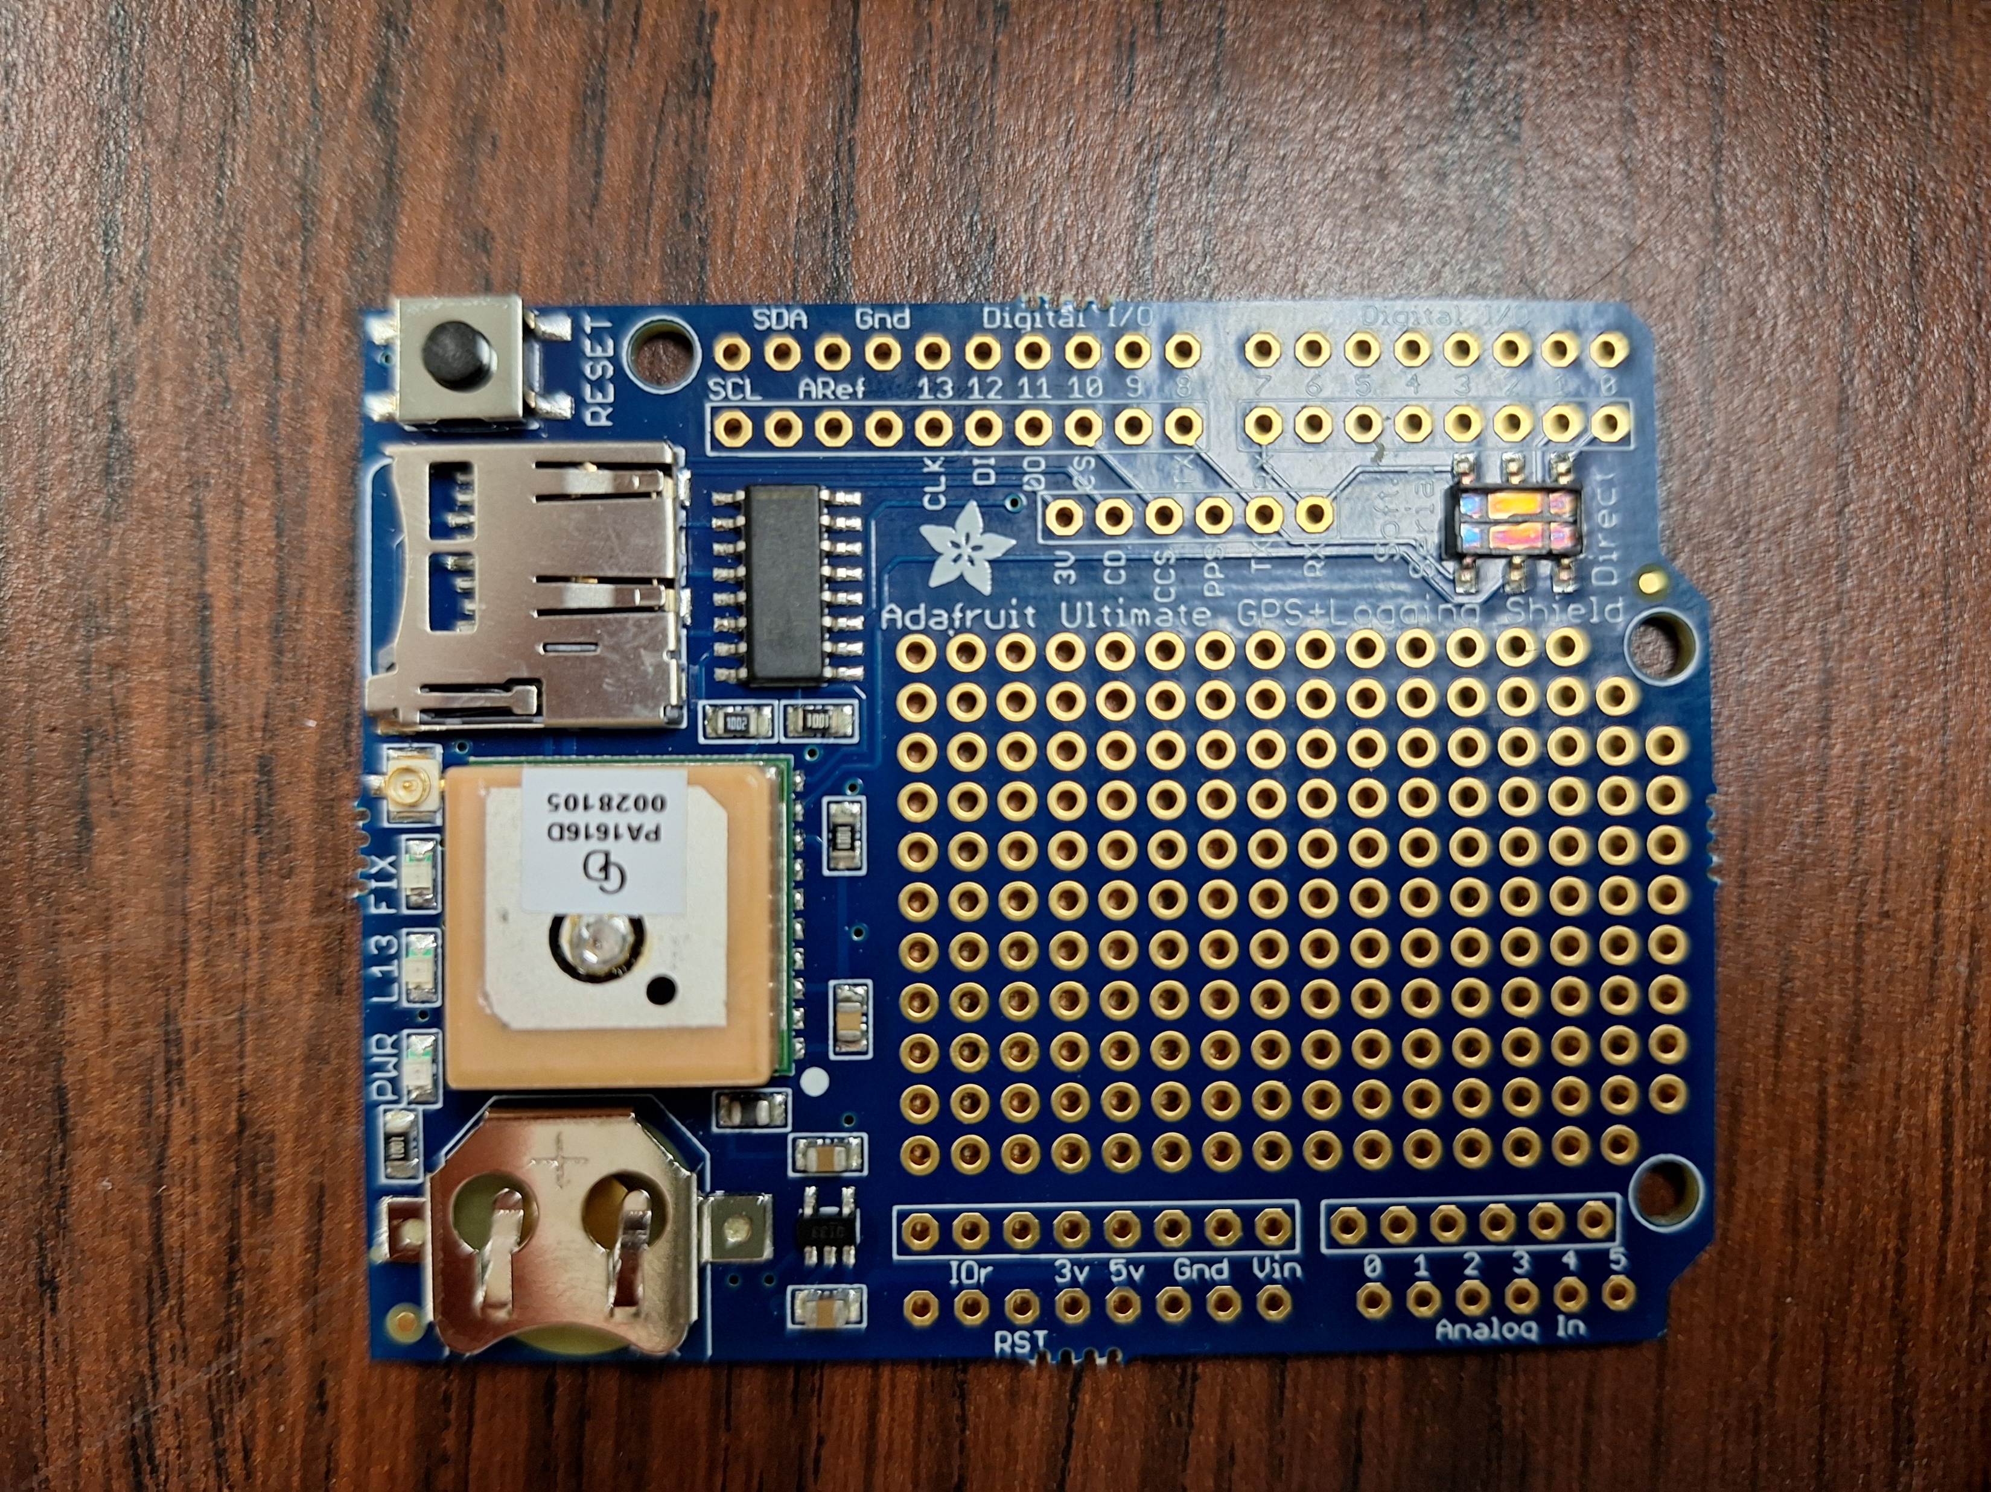
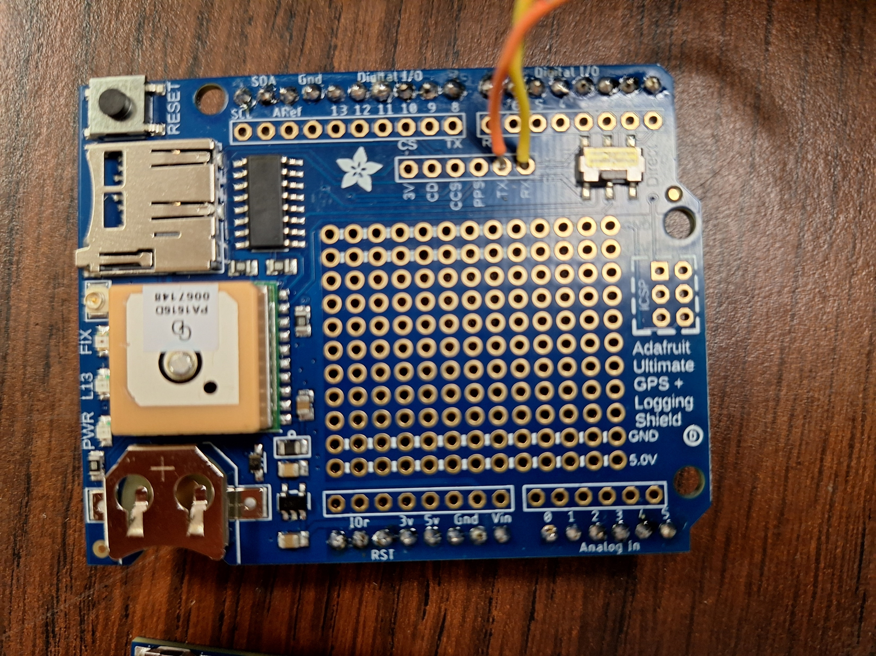
Identifying Old Revision (No longer used)
Old Revision
Lacks 6-Pin Header below GPS
Do not use
New Revision
Modified Prototyping Area with 6 Pin ICSP header
This is the current version

Slide 17
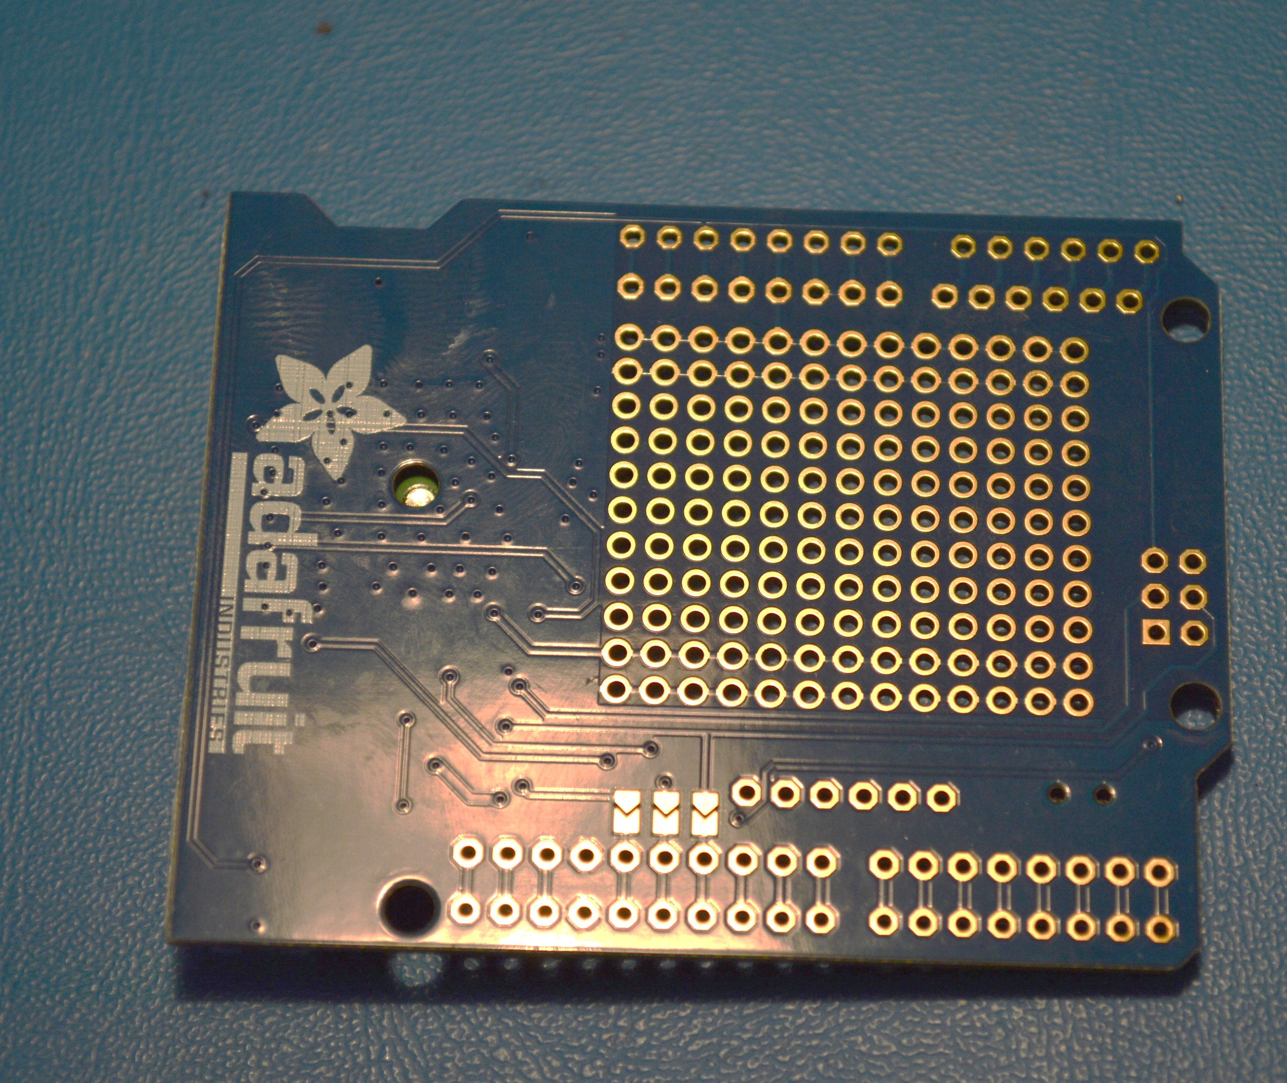
SPI Jumpers
New board revision also has jumpers on the back side to connect SPI to pins 11, 12, and 13
This is how the old board worked
The chevron-shaped pads circled in red to the right
To connect, you would simply bridge across the pads
This would be done to use with an UNO or if you had a shield that blocked the 6-pin header
Should not be needed for standard LaACES config

