Slide 1
Lecture 03.10
Analog Signals and Data Acquisition

Slide 2
Sensors
Our ultimate goal is to study some phenomena by making measurements of some physical quantity during the balloon flight
So we need to:
  Measure something
  Convert that to an electrical signal
  Digitize the signal
  Record the digitized measurement
We will use some kind of sensor to accomplish steps 1 and 2
In this case, a sensor is a device that measures a physical property and generates an output signal corresponding to the measured quantity

Slide 3
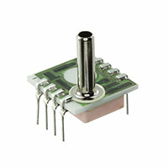
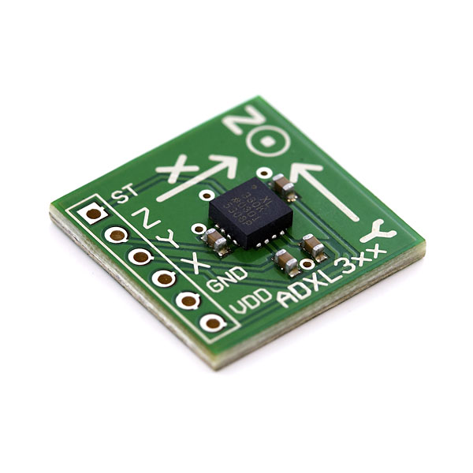
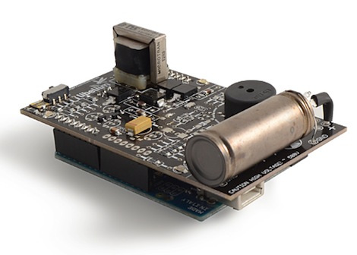
Example Sensor Inputs:
Physical Variables
Temperature
Pressure
Humidity
Light Intensity
Radioactive Particles Counts
Acceleration
Altitude
Electric or Magnetic field strength
Pressure Sensor
Accelerometer
Geiger Counter

Slide 4
Electrical Signal Outputs
Example output signals, the electrical signal can vary in:
  Voltage (Most common)
  Current (ex. Photodiodes)
  Variations with time (common when transmitting over radio)
    Pulse Width
    Frequency
    Number of pulses (like a radiation counter)
The most common output you will see is an analog voltage output, just like the diode temperature sensor we built

Slide 5
Transfer Function and Span
Transfer Function: The mathematical relationship between the measured quantity and the output signal
Span: The width of possible values the sensor is being used for (both in physical quantity and voltage)
Example Diode Temperature sensor:
Transfer Function:
V_{diode}=-0.0014*T+0.7724V
Notice this is the reverse of the calibration equation which would go from voltage to Temperature
Minimum Value: -50 °C (0.842V)
Maximum Value: +50 °C (0.702)
Temperature Span: 100 °C
Voltage Span: 0.14V

Slide 6
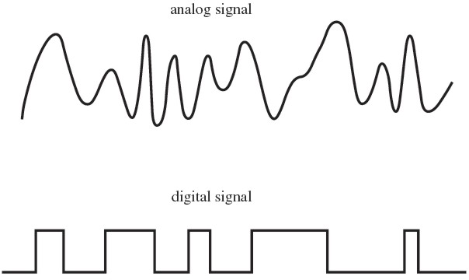
Digital vs Analog
Our temperature signal is an analog signal
It is smooth & continuous
So it can take any value between the minimum and maximum
Even though we can only measure ~0.001, we assume it takes values in between 0.001 and 0.002
This is contrasted with Digital Signals
  Can only take values from a finite set of values
  For example: 0V or 5V

Slide 7
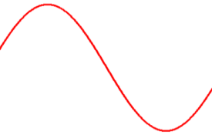
Converting between Analog and Digital Signal
We need a way to convert the analog voltage into a binary number so we can store or manipulate the data on the Arduino.
The device that does this is called an Analog to Digital Converter or ADC
There is also the reverse, Digital to Analog Converter or DAC
Analog Signal
ADC
Digital Signal
DAC
10011100001

Slide 8
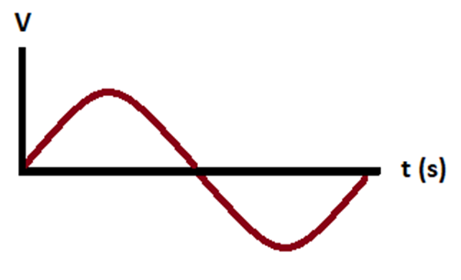
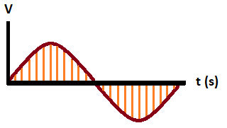
How Does ADC Work
We begin with a varying analog signal; in this case, a sine wave
At a single point in time the voltage is measure, this is usually called a sample
Each sample gets converted to a number based on the amplitude of its voltage

Slide 9
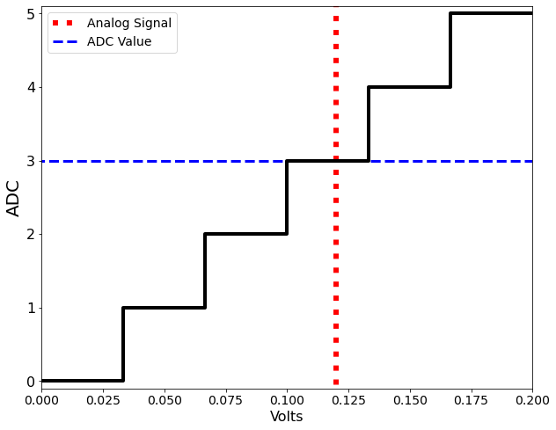
ADC Conversion
The takes its voltage range and splits it up into discrete sections (called bins) that are numbered 0, 1, 2, 3, etc.
  Normally this is linear and increasing with voltage
The sample voltage is compared to the minimum and maximum values for each bin to find out which one it falls in
ADC then sends that bin number to the microcontroller or whatever device is trying to read the voltage
The returned value is just a unitless number
  Usually this will be called ADC units or Bins

Slide 10
ADC Resolution
The number of integer bins is called the resolution of the ADC
Typically, this is given in bits; the Arduino Mega has a 10 10-bit ADC
To calculate the number of ADC bins, use the formula 2^{N}, where N is the number of bits
2¹⁰ = 1024, the Arduino ADC has 1024 possible values
  Typically, the first bin is numbered 0 so the ADC values are from 0-1023

Slide 11
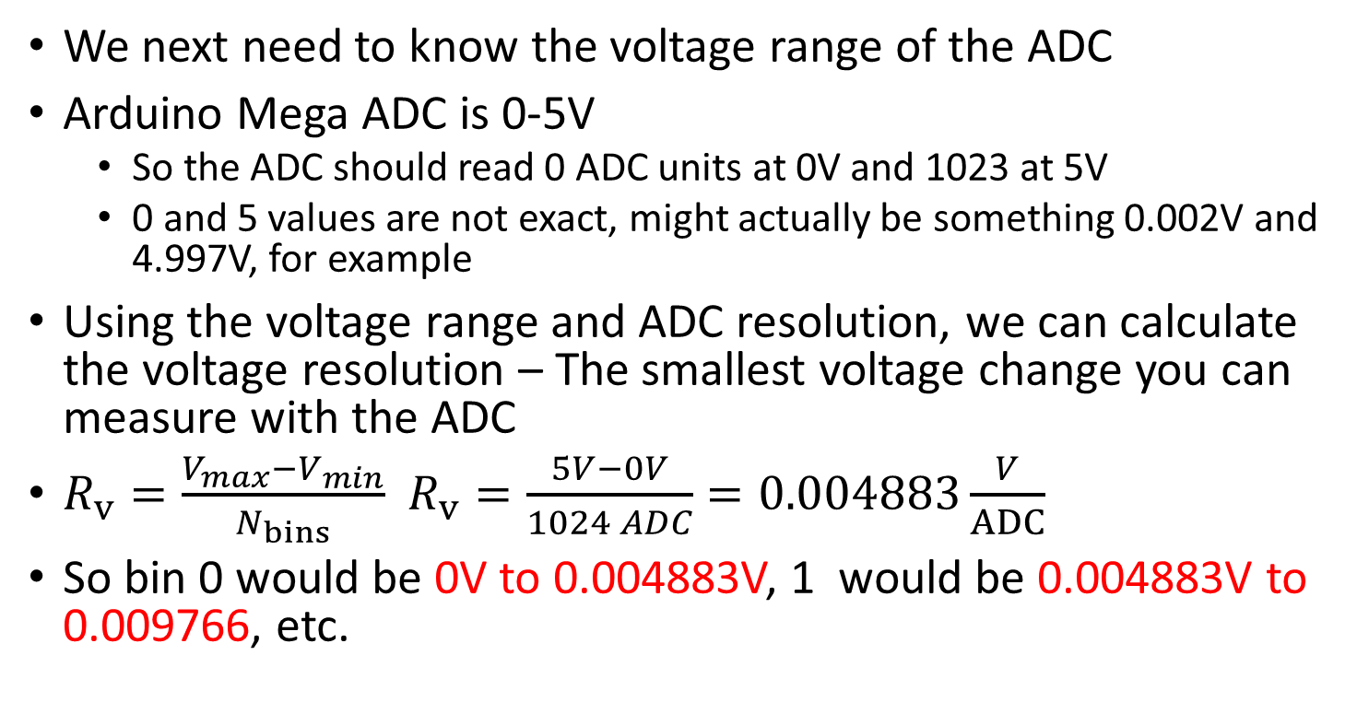
Voltage Range and Resolution
We next need to know the voltage range of the ADC
Arduino Mega ADC is 0-5V
  So the ADC should read 0 ADC units at 0V and 1023 at 5V
  0 and 5 values are not exact, might actually be something 0.002V and 4.997V, for example
Using the voltage range and ADC resolution, we can calculate the voltage resolution – The smallest voltage change you can measure with the ADC
$R_{v}=\frac{V_{max}−V_{min}}{N_{bins}}$ $R_{v}=\frac{5V−0V}{1024 ADC}=0.004883\frac{V}{ADC}$
So bin 0 would be 0V to 0.004883V, 1 would be 0.004883V to 0.009766, etc.

Slide 12
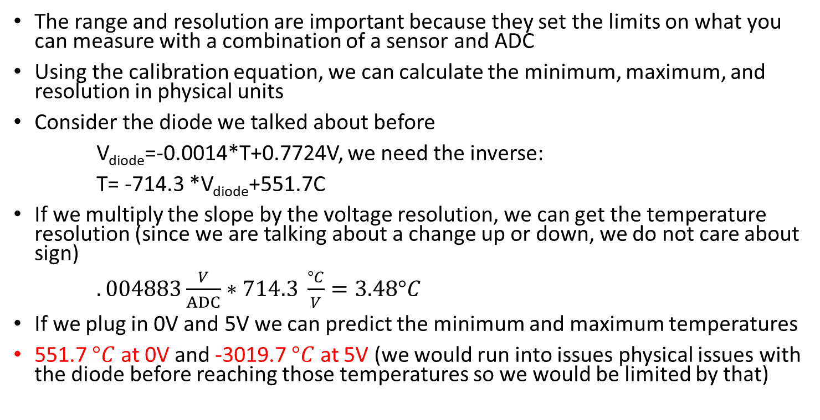
Physical Unit Range and Resolution
The range and resolution are important because they set the limits on what you can measure with a combination of a sensor and ADC
Using the calibration equation, we can calculate the minimum, maximum, and resolution in physical units
Consider the diode we talked about before
V_{diode}=-0.0014*T+0.7724V, we need the inverse:
T= -714.3 *V_{diode}+551.7C
If we multiply the slope by the voltage resolution, we can get the temperature resolution (since we are talking about a change up or down, we do not care about sign)
$.004883\frac{V}{ADC}∗714.3 \frac{°C}{V}=3.48°C$
If we plug in 0V and 5V we can predict the minimum and maximum temperatures
551.7 $°C$ at 0V and -3019.7 $°C$ at 5V (we would run into issues physical issues with the diode before reaching those temperatures so we would be limited by that)

Slide 13
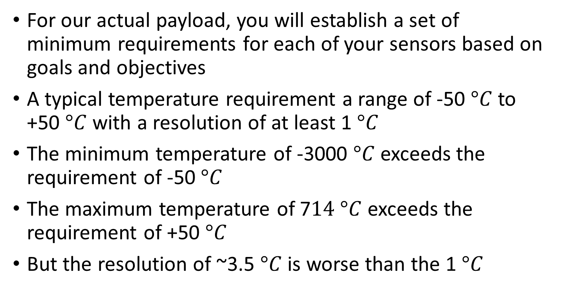
Range and Resolution vs Requirements
For our actual payload, you will establish a set of minimum requirements for each of your sensors based on goals and objectives
A typical temperature requirement a range of -50 $°C$ to +50 $°C$ with a resolution of at least 1 $°C$
The minimum temperature of -3000 $°C$ exceeds the requirement of -50 $°C$
The maximum temperature of 7$14 °C$ exceeds the requirement of +50 $°C$
But the resolution of ~3.5 $°C$ is worse than the 1 $°C$

Slide 14
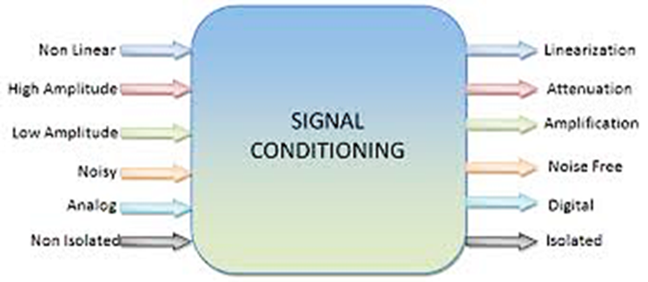
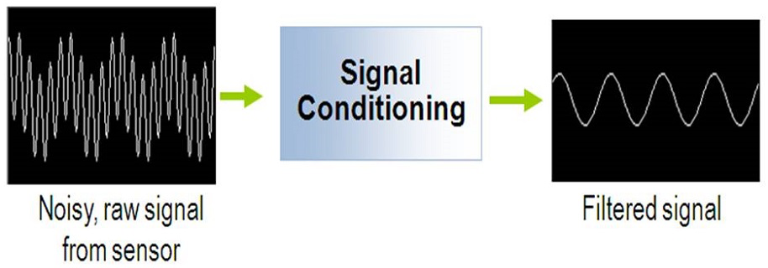
Signal Conditioning
These and other issues are solved by Signal Conditioning Circuits
Signal Conditioning circuits are between the Sensor and the ADC
  Sometimes the sensor and signal conditioning are all combined in a single component
The amplifying circuits we built are a type of signal conditioning

Slide 15
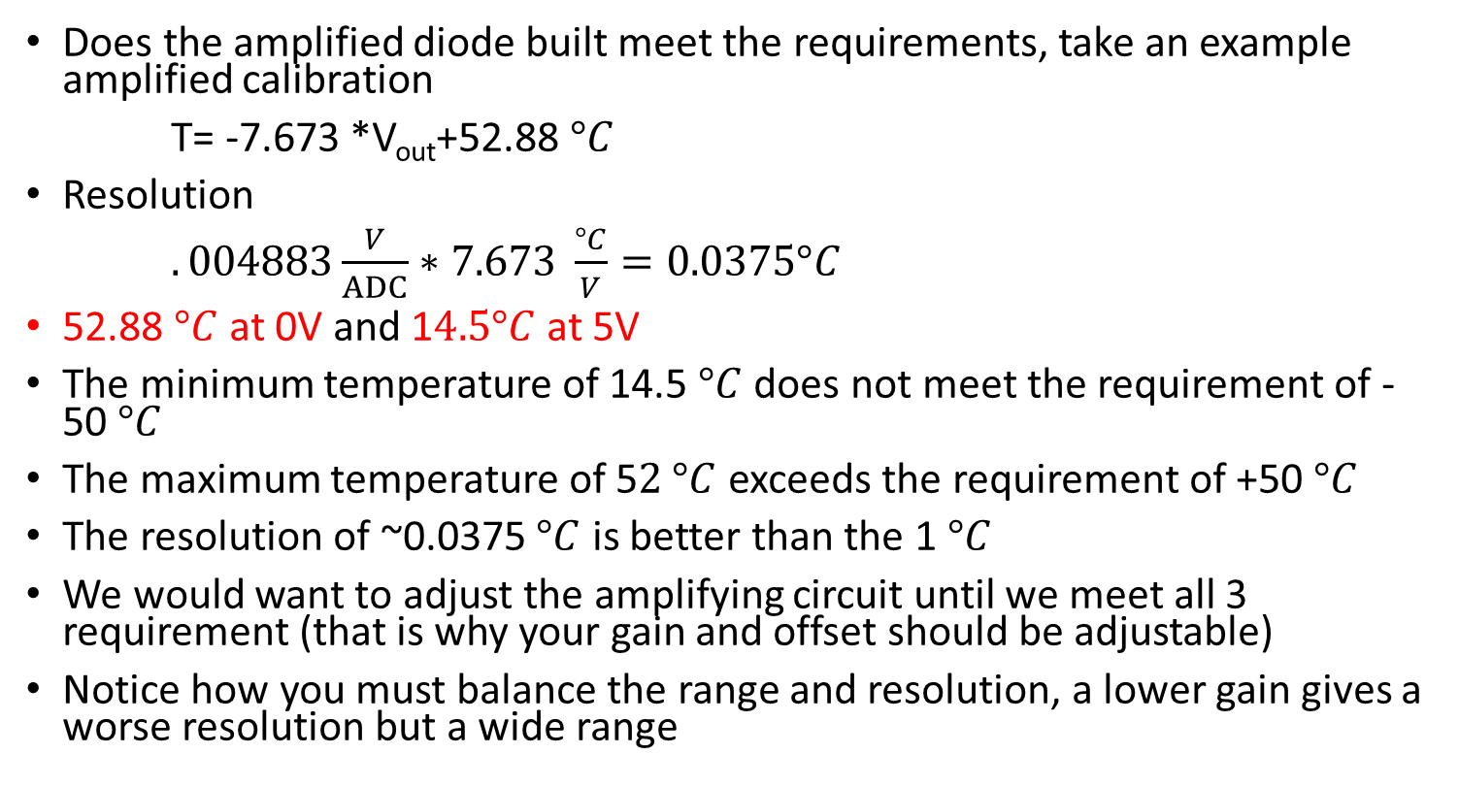
Conditioned Range and Resolution
Does the amplified diode built meet the requirements, take an example amplified calibration
T= -7.673 *V_{out}+52.88 $°C$
Resolution
$.004883\frac{V}{ADC}∗7.673 \frac{°C}{V}=0.0375°C$
52.88 $°C$ at 0V and 1$4.5°C$ at 5V
The minimum temperature of 14.5 $°C$ does not meet the requirement of -50 $°C$
The maximum temperature of 5$2 °C$ exceeds the requirement of +50 $°C$
The resolution of ~0.0375 $°C$ is better than the 1 $°C$
We would want to adjust the amplifying circuit until we meet all 3 requirement (that is why your gain and offset should be adjustable)
Notice how you must balance the range and resolution, a lower gain gives a worse resolution but a wide range

Slide 16
Sampling rate
Besides the range and resolution, we also need to consider how often the ADC should sample the sensor
This is called the sample rate
  The ADC requires a small amount of time, called the Conversion Time, for each measurement.
  That sets the upper limit on the sample rate
  To select a sample rate, you determine the fastest change you expect to see, and then double that for you sample rate
  The doubling is called the Nyquist-Shannon sampling theore,

Slide 17
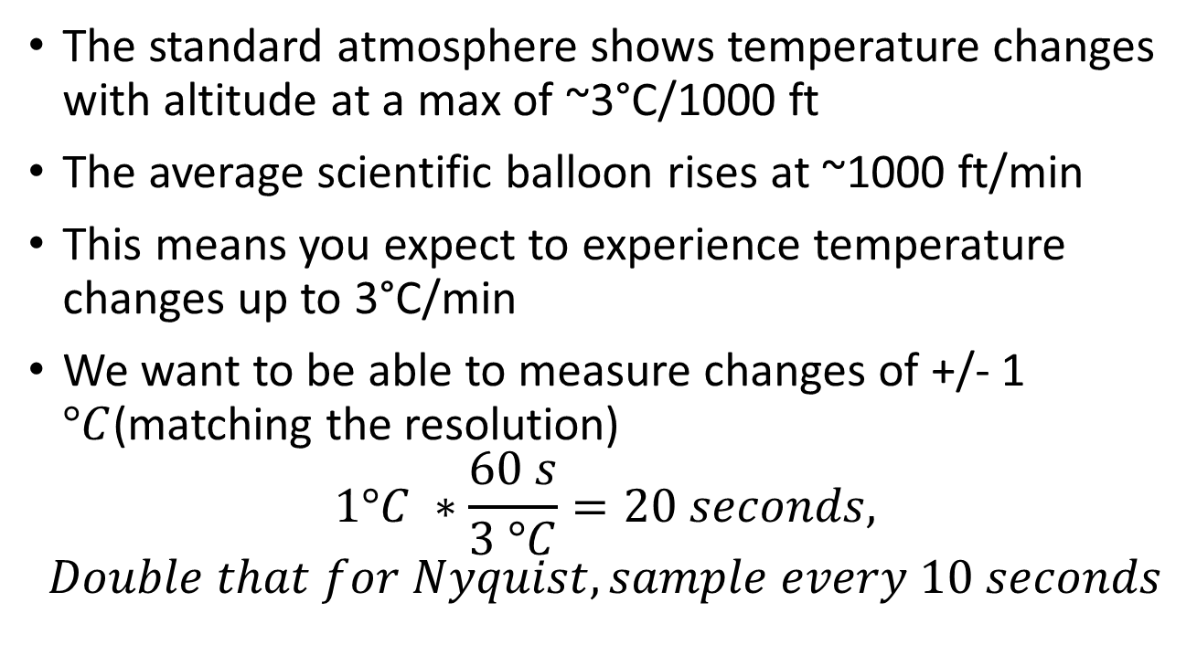
Choosing Sampling Rate: Example
The standard atmosphere shows temperature changes with altitude at a max of ~3°C/1000 ft
The average scientific balloon rises at ~1000 ft/min
This means you expect to experience temperature changes up to 3°C/min
We want to be able to measure changes of +/- 1 $°C$(matching the resolution)
$$1°C ∗\frac{60 s}{3 °C}=20 seconds, Double that for Nyquist, sample every 10 seconds$$

Slide 18
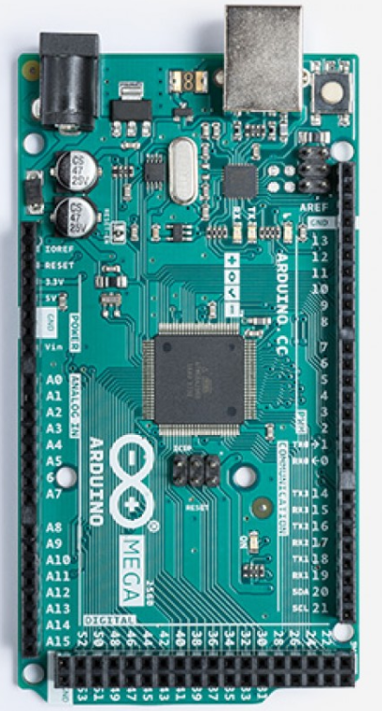
Arduino ADC
The Mega provides sixteen ADC Pins
Pins are numbered A0 to A15
Each ADC Pin is referenced to the GND pin as 0V
Each is a 10-bit ADC
0-5V Range
Each pin might have slightly different performance
  0 ADC at 0.002V on A2, 0 ADC at 0.004V on A3 for example
Conversion time ~104 uSeconds
Arduino Mega Analog pins are located below the power header.

Slide 19
Arduino ADC Function https://docs.arduino.cc/language-reference/en/functions/analog-io/analogRead/
Single function analogRead(pin)
Constants are defined for each of the analog pins to allow the use of A0 to A15 instead of a pin number
  analogRead(A3)
When called, returns the ADC bin as an integer from 0 to 1023
  int ADC_reading = analogRead (A2); //example usage
Even though ADC is 10-bit, a 16-bit variable is required to store it
Notes:
\

Slide 20
Calibration
When setting up the readout circuitry, you will likely have several intermediate calibrations at each step
These will allow you to set up offset and gain, or determine if your ADC will meet your requirements
Physical Quantity
Sensor
Signal Conditioning Circuit
ADC
Stored Digital Value
Final Calibration
What you actually need is the final conversion between the stored number and the physical measurement, so you should always calibrate the completed system

Slide 21
Digital to Analog Converters (DACs)
A DAC works the reverse of the ADC; you send the DAC an integer number, and the DAC converts that to an output voltage
Some Arduinos include a built-in DAC, but the Arduino Mega does not
Instead, it uses a technique called Pulse Width Modulation to give an analog like signal on the digital pins

Slide 22
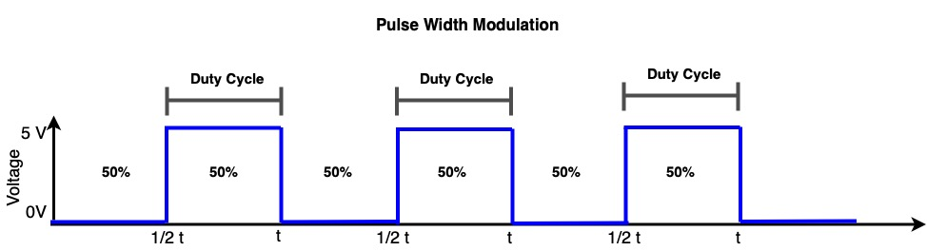
How PWM Works https://docs.arduino.cc/language-reference/en/functions/analog-io/analogWrite/
The function outputting an analog signal is analogWrite(pin, value)
A pulse repeats on the output pin predefined period
The integer value determines what percent of the time the pulse on and off (this is called the duty cycle)
  At 0, it is at 0% so the pulse is always off
  At 255, is at 100% so the pulse is always one
So, on average, you get a voltage between 0 and 5V
  While not a true analog signal for many applications, this average will work the same

