Slide 1
Lecture 3.07
Digital Communication Protocols

Slide 2
Digital Communication
We have seen the basics of how to send a single bit of data using a single digital pin. But we will need to use multiple pins and time-varying signals to send more complex data to and from the microcontroller
The format of the signals is called a communication protocol
First, we want to define some terms we will use describe the protocols

Slide 3
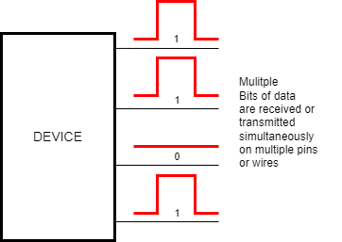
Parallel Interface
Multiple bits of data are transmitted or received at the same time (in Parallel)
The group of data lines is called a bus
Width of data bus is usually 1 or byte-wide (8 data bits)
Became less common as speeds increased

Slide 4
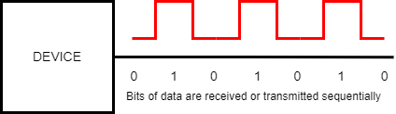
Serial Interface
Data bits arrive one after another on a single interface (in Series)
All of the communications protocols we will discuss are serial
The Serial library is an example of A serial communication protocol it is not the only one
  Outside of this slide, when we use serial, we usually will mean the specific Serial library

Slide 5
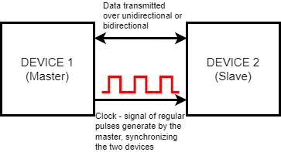
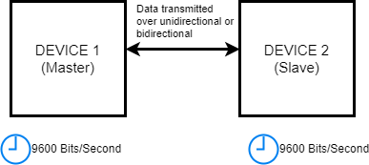
Synchronous vs Asynchronous
Synchronous Communication
One device(called the master) transmits a clock signal to one or more (slave) devices
In time with the clock signal, devices either read input pins and set the value of output pins
Trigger on the rising or falling edge of the clock signal
Asynchronous Communication
To start a communication, some initiating signal is sent (can be as simple as going from high to low)
Each device then checks the data at some interval measured by an internal timer
  Each device must agree on the rate of data transfer and how many bits of data are being sent per transmission

Slide 6
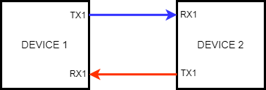
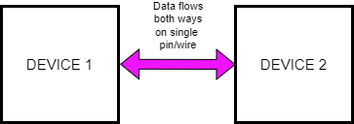
Bidirectional vs Unidirectional
Unidirectional
Devices have separate pins for each direction of data flow
  Send data on transmit (TX) pins
  Listen for data on receive (RX) pins
One device’s transmit must be connected to another’s receive
Bidirectional
Devices share a common data line to both Transmit and receive data
This usually means one device needs to coordinate
  Usually used with a synchronous clock signal since that allows the master device to control data flow

Slide 7
Hardware vs Software Implementation
Software
You could implement communication with a combination of digitalWrite() and digitalRead() functions
Any digital pin could be used
With software, you could come up with your own data transmission protocol
Has significant disadvantages
  Very slow
  Your program will not cannot do any other operations while sending or waiting for data
  Hardware implementation is usually preferred
Hardware
Most microcontrollers have internal circuitry that will automate the process of sending and receiving the data
  Have special sections of memory called buffers
  When bits are received, they are automatically copied to the buffer until the software checks the buffer
  When transmitting can quickly queue the data into the buffer and it is automatically sent at the correct rate until the buffer is empty
Since it is dependent on hardware, restricted to specific pins on the microcontroller

Slide 8
Arduino Communication Protocols
The Arduino Mega hardware supports 3 protocols: UART(Serial), SPI, and I2C.
Each of these are A serial protocol and groups the transmitted data into bytes
UART (Universal Asynchronous Receiver Transmitter)
  Unidirectional
  Asynchronous
SPI (Serial Peripheral Interface)
  Unidirectional
  Synchronous
I2C (Inter-Integrated Circuit)
  Bidirectional
  Synchronous

Slide 9
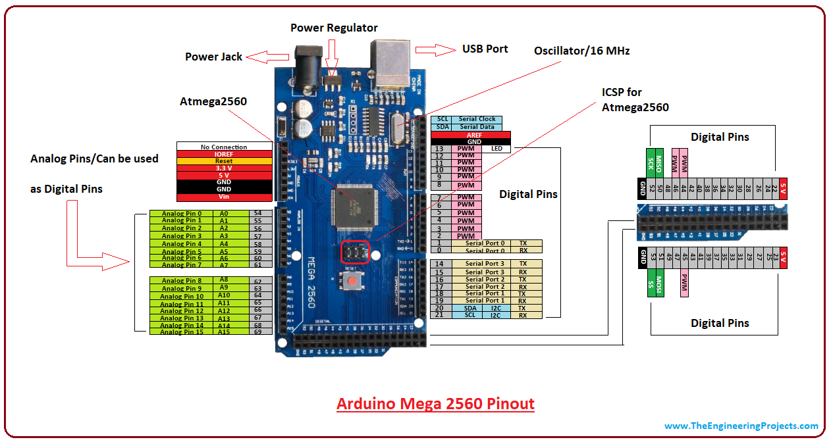
Arduino Mega Serial(UART) Pins
Uses Pairs of TX and RX pins grouped in “Ports”
The Arduino Mega has four hardware serial ports
  Serial on pins 0(RX) and 0
  Serial1 on pins 19 (RX) and 18 (TX)
  Serial2 on pins 17 (RX) and 16 (TX)
  Serial3 on pins 15 (RX) and 14 (TX)
Each serial port can only talk to one other device

Slide 10
Serial Library for the Arduino Mega
We have already been using this library to talk to the talk our computer with Serial.print()
The reason we have to set the baud rate is that this is asynchronous
In addition to the computer, this is how we will talk to the GPS
In general, bytes are sent one at a time with the data
  1 character at a time, for example
  The print function changes its argument into a series of bytes and sends them to the serial buffer
  You read data in 1 byte at a time until the buffer is empty
  Either device can just start sending data
https://docs.arduino.cc/language-reference/en/functions/communication/serial/

Slide 11
I2C Pins
I2C uses a single data line on Pin 20 called SDA (Serial Data)
The Arduino acts as the master device, generating a clock signal on Pin 21 called SCL (Serial Clock)
The second set of SCL and SDA pins is connected to the first to provide compatibility with other microcontrollers
The single Master device (Arduino) can be connected to multiple slave devices
  Each device has must a unique 7-bit code called an address

Slide 12
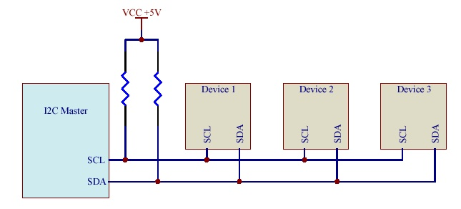
I2C Communications
The library used for I2C is called Wire https://docs.arduino.cc/language-reference/en/functions/communication/wire/
The Master device starts the clock and sends a Start Byte
  The start is the 7-bit address of the target slave device; the final bit indicates that the master wants to Read or Write data
  In Write, the Master sends bytes of data and then sends a stop signal
  In Read, the Slave device replies with a data byte, then the Master sends a Stop or Continue signal. If continue, the Slave sends another data byte
Usually, you use a device library to handle the communication

Slide 13
SPI Pins
Again, the Arduino acts as a Master Device generating a Clock Signal on Pin 52 SCK (Serial Clock)
SPI uses two unidirectional data lines
  MISO (Master In Slave Out) on pin 50
  MOSI (Master Out Slave In) on pin 51
SPI can also have multiple slave devices
  Each slave uses a 4th Pin SS (slave select) or CS (chip select) to tell the slave to activate
  Any digital pin can be used but a different pin must be used for each slave

Slide 14
SPI Programming
The SPI library is called SPI
  https://docs.arduino.cc/language-reference/en/functions/communication/SPI/
SPI communications are much less standardized than Serial or I2C
  Different clock settings
  Different data sizes and formats
We will use SPI for writing data to the SD Card but the SD library will handle the SPI communications
CS0
Master
MOSI
Device 1
MISO
CS1
Device 2
CS0
CS1
CLK

Slide 15
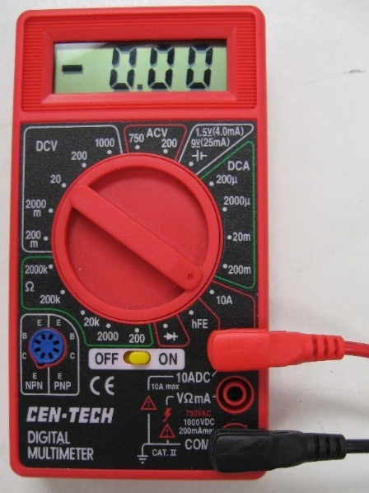
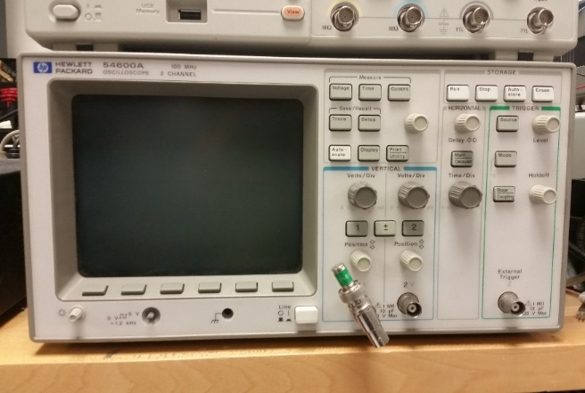
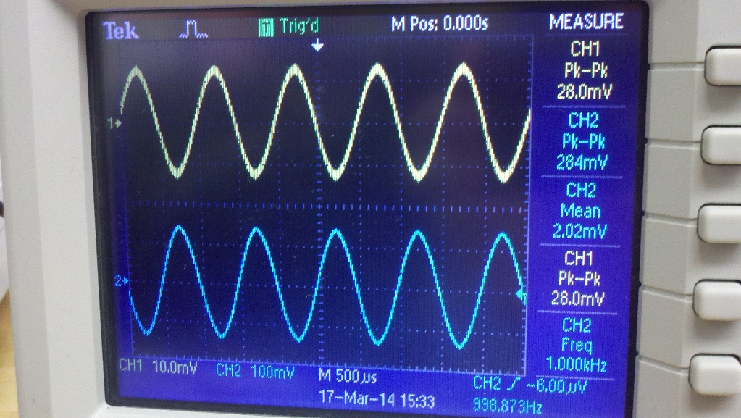
Measure Communication Signal
You will need to measure these digital signals
These signals are very fast, with a single transmitted bit only lasting a few microseconds
This is too fast to be measured by a multimeter
Instead, we will use a device called an oscilloscope to plot the voltage signal as a function of time
The scope can capture a very small time interval of voltage data and keep it displayed until cleared
If you are having trouble with digital communications, your first step will be to use a scope to look at your data
We will cover oscilloscope operation in an activity.

