Slide 1
Basic Digital I/O

Slide 2
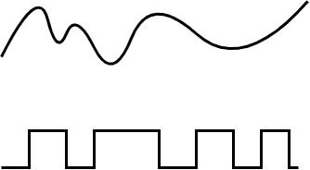
Digital vs Analog Signal
I/O stands for “input & output,” This is how we will communicate information to and from the microcontroller
Digital means that it comes in a discrete set of possible values
For the Arduino (and most microcontrollers), these are 0 and 1
This is opposed to an analog signal, which can take any possible value with in some range
IF you look at a signal as it varies with time
Analog will be a smooth continuous wave
Digital will be a series of square pulses with sharp, sudden changes
Analog Signal
Digital Signal

Slide 3
Characteristics of a Digital Signal
To use digital signals as input or output we need to specify some details
How is the signal being transmitted?
What is a physical connection?
Is it a voltage, current, infrared light?
What defines 1 and what is a 0?
These are logic levels, for the Arduino these are based on voltage
What do the 1s and 0s mean
For anything other than a single, simple On/Off you need to define some kind of communication protocol

Slide 4
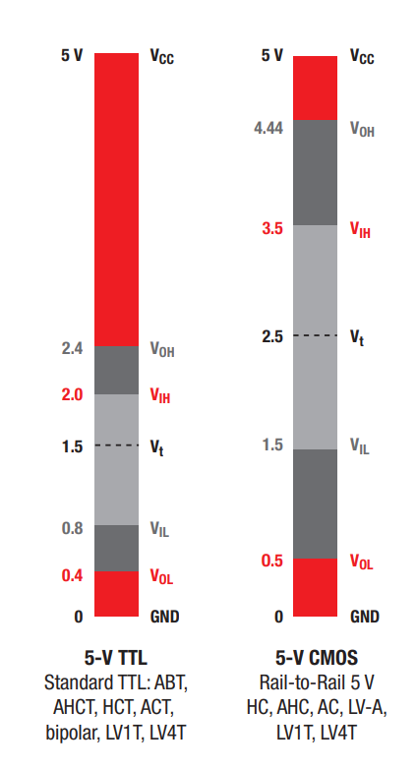
Logic Levels Defining 0 and 1
The manufacturer of a digital device will give a set of specifications that define the voltages for High(0) and Low (0)
These are called the “Logic Levels”
When discussing, you will often see terms like 5V TTL or 3.3V CMOS
This is the underlying technology (ex., TTL - Transistor to Transistor Logic) and nominal voltage level
Devices will further group devices into “Logic Families” that share logic levels and additional specs
For example, HCT uses the TTL levels but has additional high-speed capabilities
5V TTL and CMOS Logic levels for TI Devices
https://www.ti.com/lit/sg/sdyu001ab/sdyu001ab.pdf?ts=1758714419432
Notes:
Fun, Spark. “Logi

Slide 5
Logic Levels Output
V_{OH} (Voltage Output High) - Minimum voltage that will be seen when the output is high
So a digital 1 output will be between V_{OH} and V_{cc}
V_{OL} (Voltage Output Low) - Maximum voltage that will be seen when the output is low
So a digital 0 output will be between 0 and V_{OL}

Slide 6
Logic Levels Input
V_{IH} (Voltage Input High) - Minimum voltage that will be considered high
Any voltage between V_{IH} and V_{cc} will be read as a 1
V_{IL} (Voltage Input Low) - Maximum voltage that will be considered a low
Any voltage between 0 and V_{IL} will be read as a 0

Slide 7
Intermediate Region
Notice the gap between V_{IH} and V_{IL}? Because of this gap, there is a sharp distinction between 0 and 1
This makes digital signals less susceptible to errors caused by “background noise,” which would normally affect an analog signal
Also notice the outputs are more restricted than the inputs, this allows for slight voltage drop or rise between the output and input

Slide 8
Mismatched logic levels
Look more closely at the two levels to the right
Consider TTL output to CMOS input
The TTL High output could be 3.0V (>2.4V), but this will fall in the intermediate range for CMOS input (<3.5V)
So even though both are “5V Logic,” they may fail to work together
This mismatch is even worse with differing voltage levels, ie. 3.3V and 5V
Devices called level shifters are used between the different logic levels

Slide 9
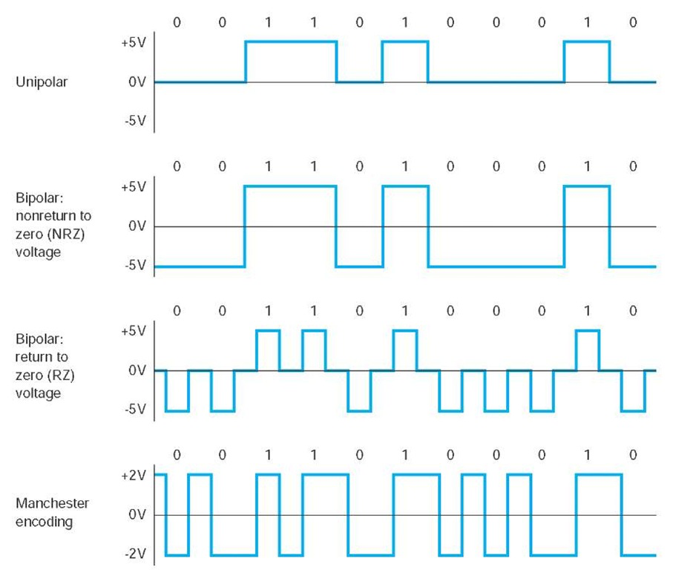
Unipolar Digital Signals
The voltage levels we just looked at are examples of unipolar signals
In unipolar, low is assigned to 0 voltage, a.k.a ground. The high is assigned to the output voltage
The idle state (when not actively transmitting) can either be High or Low

Slide 10
Bipolar Digital Signals
In some cases, you will see both positive and negative voltages used for a signal, called bipolar
The signal may or may not return to 0V when idle

Slide 11
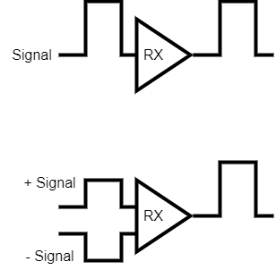
Single Ended Vs Differential
Signal can use a single wire and be measured compared to the device’s 0V (GND)
This is called Singled Ended
This requires a common ground between the transmitting device and the receiving device
An alternative is to use two lines and measure the difference
The signal is split and transmitted with opposite polarity, giving x2 the effective signal when received
Single Ended Signal
Differential Signal

Slide 12
Arduino Digital Signals
The Mega2560 Digital IOs have these characteristics
Voltage Signals
Unipolar
Single Ended
5V TTL Logic

Slide 13
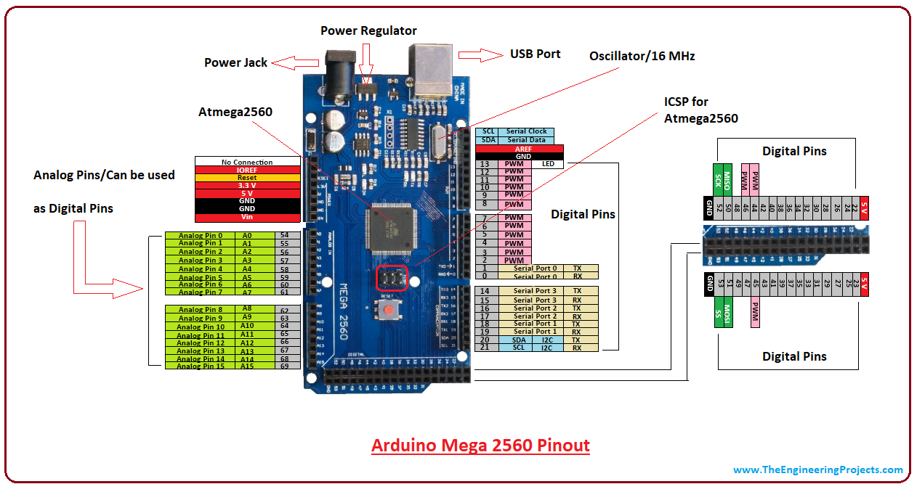
Digital Pins
Except for the power pins, all of the pins on the Arduino headers can be used for basic digital input output
Some of the pins have additional special functionality we will cover in later lectures
Pins A0-A15 can be used for analog input
Pins 0-1, 14-19 are for Serial Communication
Pins 20-21 I2C Communication
Pins 50-53 SPI Communication
Pins 2-13 can be used for analog output via a Technique Called Pulse Width Modulation (PWM)

Slide 14
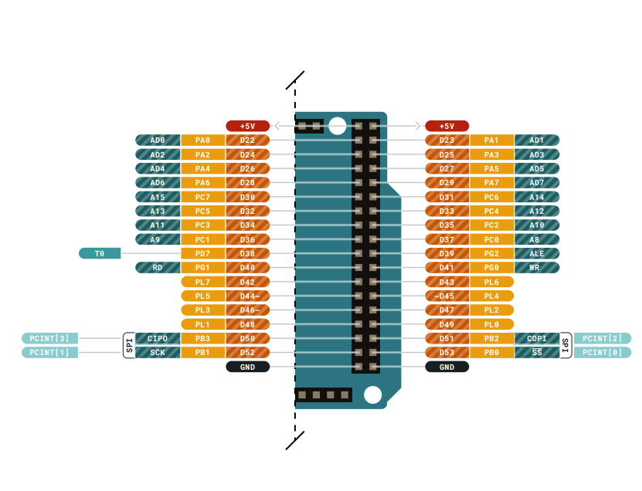
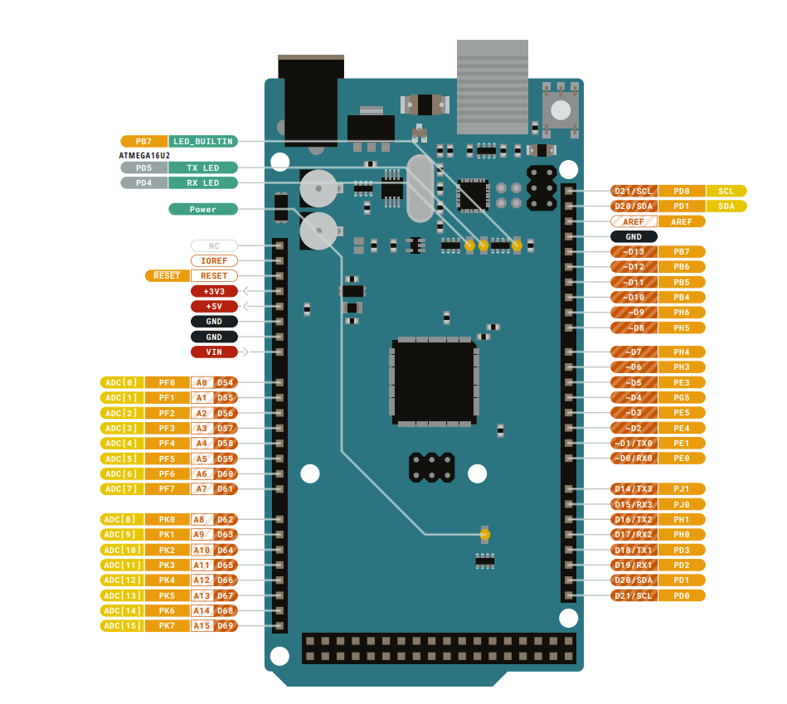
Arduino Mega Pin Layout
The full detail pinout can be found at:
https://docs.arduino.cc/resources/pinouts/A000067-full-pinout.pdf

Slide 15
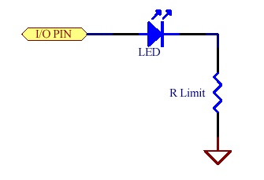
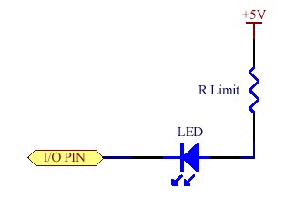
Digital Output Applications
To use a pin as an output, the Arduino controls the voltage of the output
Driving an LED with I/O pin as a current source.
Driving an LED with I/O pin as a current sink.
HIGH pin turns LED on.
LOW pin turns LED off.
LOW pin turns LED on.
HIGH pin turns LED off.

Slide 16
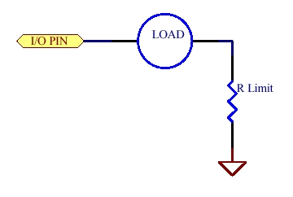
Output Pin as a Current Source
In this case, the pin supplies the current to the load
When a pin is HIGH, current flows from the pin through the load to GND
When a pin is LOW, no potential difference between the pin and GND, so no current flows
The Arduino can safely supply up to 40 mA
A current-limiting resistor may be needed in some applications to ensure the microcontroller is not damaged

Slide 17
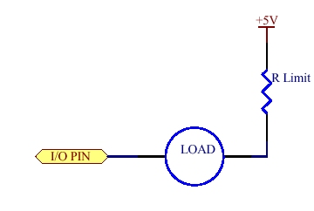
I/O Pin as a Current Sink
Sink in current sink refers to the pin’s ability to receive current
The current comes from some other source (External Power Supply, Arduino 5V pin)
When pin is LOW, current flows from the +5V power supply through the load into I/O pin
When the pin is HIGH, no potential difference between the pin and +5V, and no current flows
The Arduino can safely sink 40 mA, the same as the source limit
Again a current-limiting resistor may be needed in some applications to ensure the microcontroller is not damaged, especially if the external source is greater than 5V

Slide 18

Input Pins
Digital Inputs are even simpler
The Arduino measures the voltage at the pin and returns a 1 for 5V and 0 for 0V
Similar to a multimeter, in voltage mode, the input pin will have a high resistance, so very little current will flow when the pin is being read

Slide 19
Floating Inputs
So what happens if you try and read a pin that is not connected to anything
The unconnected pin is called “Floating”
The pin will be in an unpredictable HIGH or LOW state depending on small charge or discharge paths on the PCB, Radio Frequency noise, temperature effects, etc.
In most digital input applications, you want to remove the random effect and give a defined state by using a “Pull Up” or “Pull Down” resistor

Slide 20
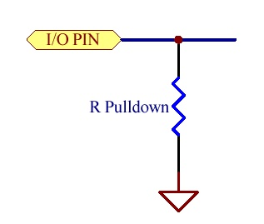
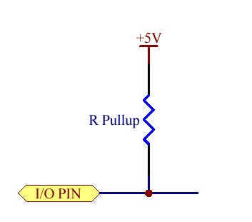
Pull Up/ Pull Down
Pull Up resistors:
Pull Down resistors:
Connect the I/O Pin to +5V to “pull up” the voltage to the 1 value when the input is idle
Connect the I/O Pin to 0V to “pull down” the voltage to the 0 value when the input is idle
Input
Signal
Input
Signal

Slide 21
Basic Digital I/O Functions
We must set the pins as Input or Output
The digital pins on the Arduino Mega are set to input as default (since this high resistance it is the safe state)
To use digital pins we have 3 different functions
pinMode(pin, mode) sets the pin as an input or output
INPUT and OUTPUT are defined as variables so they can be used in mode
digitalWrite(pin, value) is used set a pin to 5V or 0V
HIGH and LOW are again defined variables so you can use them for value
digitalRead(pin) reads the pin and returns either a 1 (for 5V) or a 0 (for 0V)
For all, pin the number of the pin as labeled on the Arduino

Slide 22
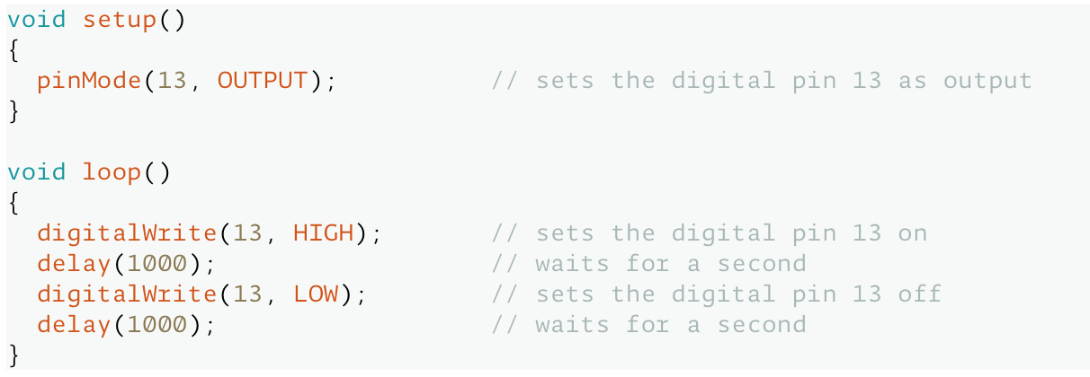
Configuring Pins Examples
Here is an example of setting pin 13 as an OUTPUT, and then “turns on” the pin for 1 second and then turns it off.
Notes:
Arduino, Arduino. “PinMode().” Arduino - Introduction, 2018, www.arduino.cc/reference/en/language/functions/digital-io/pinmode/.

