Slide 1
L3.03 Software Flowcharts

Slide 2
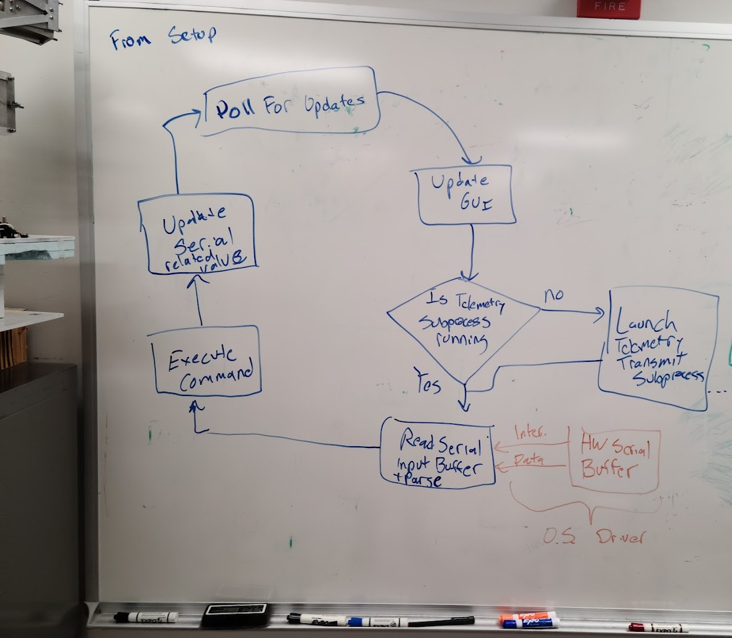
Planning Out Software
When writing software, your first step should not be to open your IDE and just start writing code
Good practice is to start with an outline of what the program needs to accomplish and in what order
This will allow you to figure out what variables, functions, and operations your program needs
An early flowchart for the revised HASP flight software, notice how no specific programming language is used

Slide 3
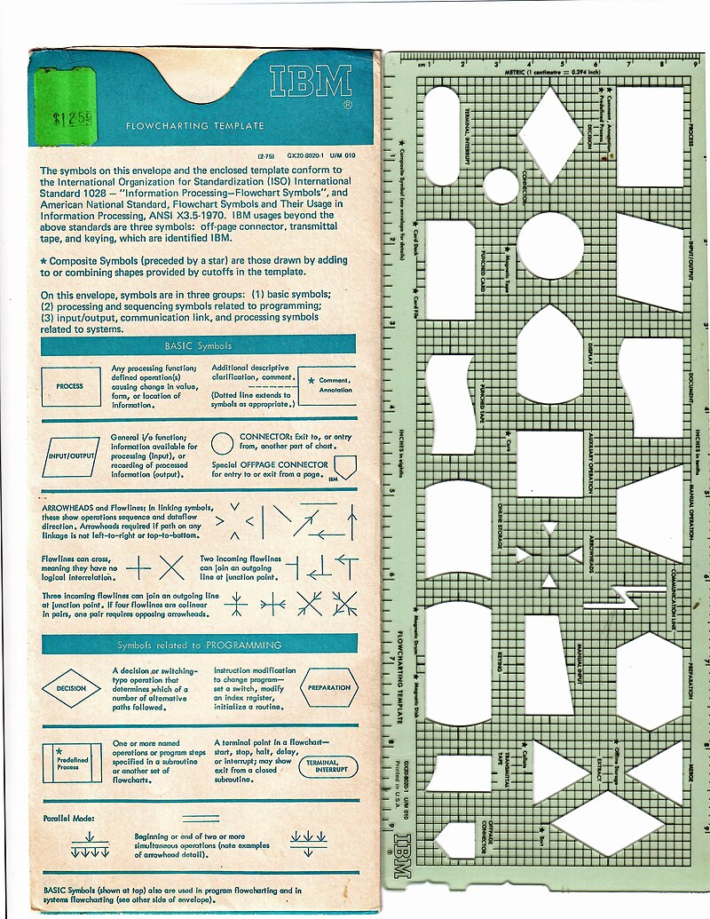
What is a Flowchart?
A flowchart is a graphical representation of a process
Each step in the process is represented by a box or block with arrows indicating the workflow from one step to another
Can be used to describe any process
  Originally used in 1920s to describe industrial processes to find bottlenecks
  Because a computer program is a highly structured process, a flowchart is a useful tool to describe or plan out a program
IBM Flowchart template from https://en.wikipedia.org/wiki/Flowchart#/media/File:IBM_flowchart_template.jpg

Slide 4
Basic Components of the Flowchart
A flowchart is made of 2 basic components: Blocks and Connectors
Block – Used to show a step in the program
  The shape details the type of action performed in the step
  The text inside provides the details of what happens in the step
Connector – Arrows connecting blocks
  Shows the flow from one step to another
  No action is occurring in the arrow
Start/ Stop
Input/
Output
Process
Step
Decision
Sub-process

Slide 5
Main Flowchart Symbols
Start/Stop Symbol
Step Symbol
Decision Symbol
Subprocess Symbol

Slide 6
Start and Stop
Indicates the starting or ending point of a program or subprocess
The start point to document any initialization that occurs
  Avoid generic steps like “Declare variables” or “include libraries”
The stop indicates where a program either finishes and stops, or where a subprocess returns to the program that called it.
Should be only one Start
If the function returns a value, be sure to indicate that in the Stop
Multiple endpoints may be possible

Slide 7
Process Step Symbol
Denotes a single step of a program accomplishing a single action
Should represent a single, simpler operation, ie. a single line of code
  Can be written in plain language instead of programming syntax
  Increment counter c+1
  Read analog pin A1
More complex operations requiring several steps should be multiple steps or a subprocess
Should only have a single arrow exiting it
  The next sequential step is specific
  May have multiple arrows leading to it

Slide 8
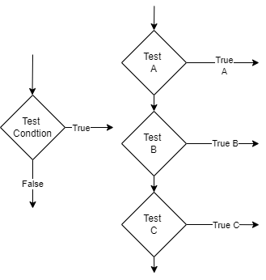
Decision Symbol
This corresponds to any sort of logical evaluation that occurs in a program
  If … statements are simple splits where two branches occur
  For and While loops should connect back to the decision point (the start of the loop)
Because Boolean logic can only be True or False, the decisions should only have two arrows leading out from it
  The only type of block that should have multiple arrows leaving it
  If you have more than two cases, you should have a series of decisions
Each branch leaving the decision should have a clearly defined condition for when that path will be taken

Slide 9
Subprocesses
More complex multistep operations – but allow a simpler diagram more readable diagram
  A separate chart should eventually explain what the subprocess does
  Should include the name and a brief description of what the subprocess does
Subprocesses will have their own start and stop blocks showing where they start and when they returns
Naturally map to functions within a program

Slide 10
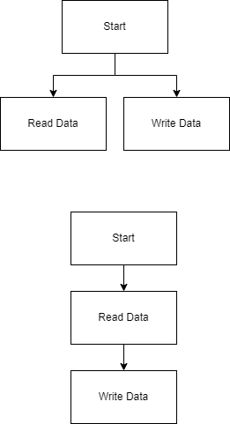
Arrows
Should only point in one direction
  Arrows can point back to early points of the flowchart
Each arrow should clearly show a starting point and an ending point
  Steps proceed sequentially
Blocks can have multiple arrows leading into them
Only decision points should have multiple arrows pointing out from them
  Arduino has no parallel computing
Try to avoid crossing arrow lines for clarity

Slide 11
Other Symbols
Several other symbols exist for use in flow charts
Many of these are for human input or more complex operations like reading and writing files
Since our goal will be an automated payload that writes a simple data stream, we will likely not need to use them
Input/
Output
Document
Database

Slide 12
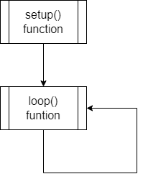
Uses of a Flowchart
Plan out the intended operation of a program
  Good to start with a sketched-out version, then add details as you develop
  Help organize and outline the flow of a program before we start writing code
  Allows planning out the usage of variables and functions
  Can be used to break up the
Document the function of an existing program
  Used to explain the operation of our program, ie, document our software in design documents
  Ensure the charts are readable by breaking into subprocesses and multiple pages
  Will be helpful for troubleshooting unexpected program behavior
A basic flowchart showing the operation of code on the Arduino

Slide 13
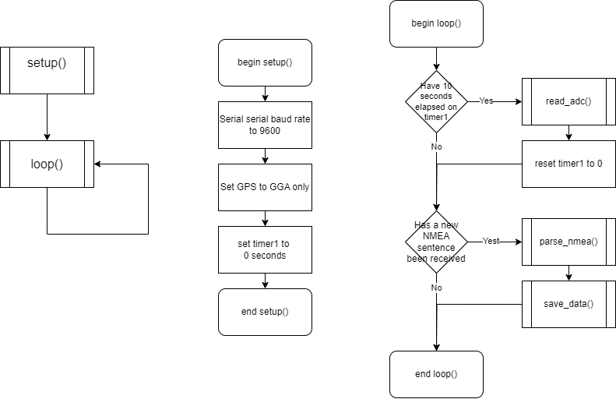
Designing your Flowchart
Start with the highest level with a plain English description of the steps
Identify your tasks
  What things does the program need to do?
  Identify the required steps to complete the task
Layout the flowchart
  Draw the steps in their logical order,
Test the flow of your design
  Follow through the steps and determine if accomplishes your goal
  You may realize you need to reorder steps or add additional stesp
A more realistic set of flowcarts describing a simple Arduino program, notice how the setup() and loop() functions have their steps detailed

Slide 14
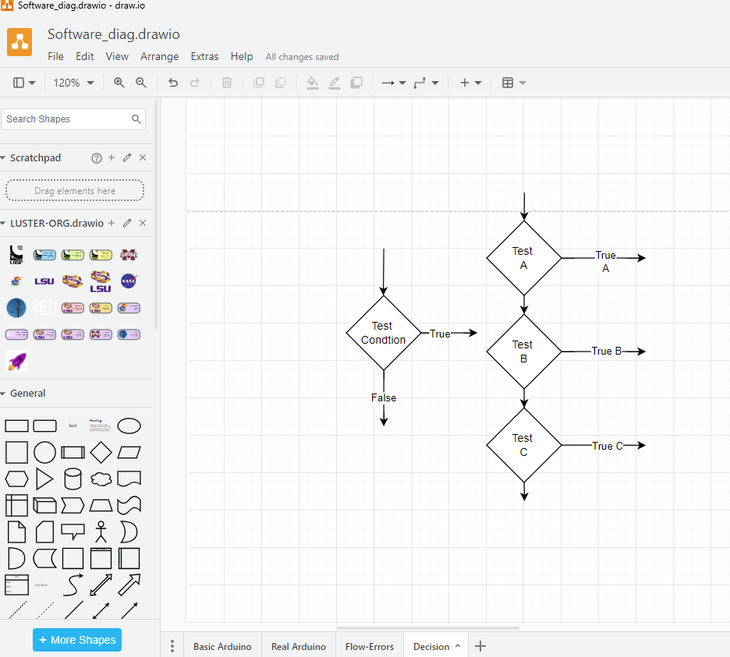
Flowchart Software
Drawing by hand on paper or whiteboard
  Useful during planning and brainstorming
  Take a photo and transfer to a more permanent medium
Microsoft Office Suite
  Visio – Standalone diagram software, part of the Office web
  Word and Powerpoint have the Shape tool have the flowchart symbols
Gsuite - https://docs.google.com/drawings
Recommended Draw.io/ diagrams.net
  Web App or Download
  Good library of shapes
  Arrows can be locked to blocks for easy moving around
  Can export drawing as image

