Slide 1
Introduction to the Arduino Hardware and IDE
Notes:
Label figures and move citations to appendix

Slide 2
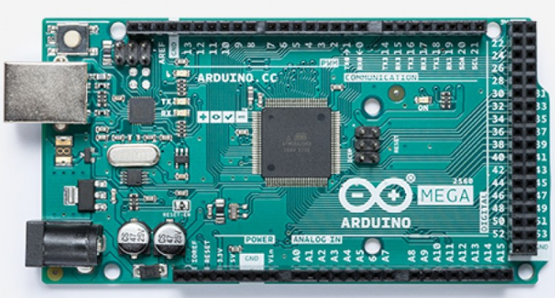
What is an Arduino?
Arduino is an Italian company that produces a number of microcontroller boards and a common programming interface for those microcontrollers
  The Microcontrollers on the board are produced by other companies like Atmel, Microchip, Broadcom
  Boards allow prototyping and
  easy access to I/O pins
  A few standard footprints allow
  3rd party boards called Shield to
  be used
  Arduino IDE allows common
  code to run on multiple
  microcontrollers
Arduino Mega Development Board which we will use

Slide 3
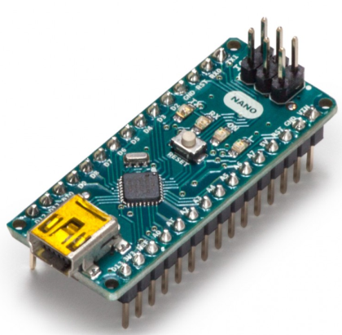
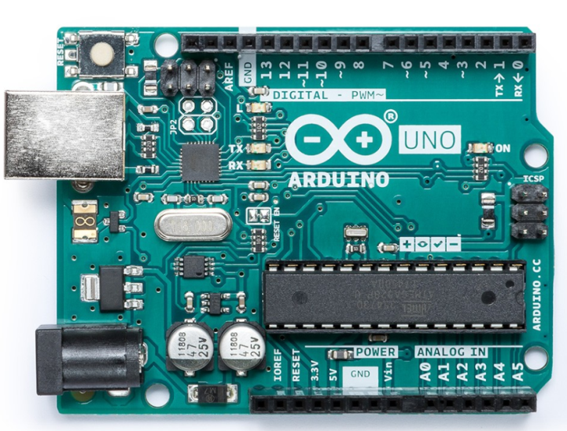
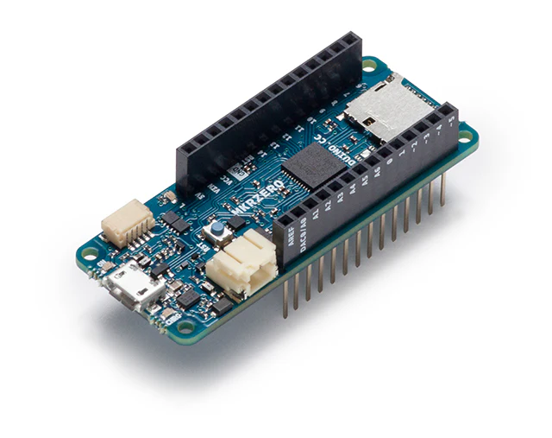
Different Arduino Footprints (Called “Families” as of 2025)
Arduino Nano microcontroller, Nano family, small size
Mega2560, Arduino Mega Family, large number of interfaces (both digital and analog), this is the microcontroller for LaACES
MKR Zero, MKR Family usually has radio-based networking
Arduino Uno, Classic Family, classic shields are compatible with Mega Family

Slide 4
Arduino Key Mega Specifications
Specification | Value
Supply Voltage | 7-12 V
Operating Voltage | 5 V
Programming Interface | USB-B (the square one)
Program Storage | 256 KiloByte Flash (Where the uploaded program is saved)
System Memory | 8 KiloByte SRAM (Where program variables are stored when running)
Digital IO Pins | 54 Pins (Bottom and Right Headers)
Digital Interfaces | 1xSPI, 1 x I²C, 4 x Serial UART (in the 54 digital pins)
Analog Inputs (ADC) | 16 Channel, 0-5V, 10 Bit ADC (Left Headers)
Arduino Mega microcontroller

Slide 5
Major Board Components
IO Pin Headers
  Provide a physical interface to the IO pins and shield stacking
  We will cover these interfaces in the coming weeks
12V DC Power Connection
USB Connection
Main Microcontroller
Reset Button
USB Interface Microcontroller
Arduino Mega2560 microcontroller board

Slide 6
Major Board Components
IO Pin Headers
12V DC Power Connection
  One method power connection for operation without a computer
USB Connection
Main Microcontroller
Reset Button
USB Interface Microcontroller
Arduino Mega2560 microcontroller board

Slide 7
Major Board Components
IO Pin Headers
12V DC Power Connection
USB Connection
  Provide a data connection to a computer for program uploads and serial communication
  Can power board at 5V
Main Microcontroller
Reset Button
USB Interface Microcontroller
Arduino Mega2560 microcontroller board

Slide 8
Major Board Components
IO Pin Headers
12V DC Power Connection
USB Connection
Main Microcontroller
  AVR Atmega2560
  Microcontroller that runs our program
Reset Button
USB Interface Microcontroller
Arduino Mega2560 microcontroller board

Slide 9
Major Board Components
IO Pin Headers
12V DC Power Connection
USB Connection
Main Microcontroller
Reset Button
  Pressing button restarts the program loaded on the microcontroller
USB Interface Microcontroller
Arduino Mega2560 microcontroller board

Slide 10
Major Board Components
IO Pin Headers
12V DC Power Connection
USB Connection
Main Microcontroller
Reset Button
USB Interface Microcontroller
  A second microcontroller (Atmega328)
  Acts as a translator between the main microcontroller and the USB
Arduino Mega2560 microcontroller board

Slide 11
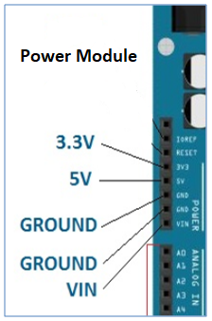
Power Header
Top left header provides common power connections
VIN: Input power from an external supply (7-12V like DC connector)
5V: Output 5V to shields and other external components
3V3: Output 5V to shields and other external components
IOREF: Provide reference voltage for a Digital High or 1, 5V on the Mega
GND: All grounds (including the USB and Power Connector) are connected together for a common 0V
Arduino Mega Power Header
Notes:
Can also power the Arduino using the Vin and ground pins. This bypasses the voltage regulator, which can be dangerous. If there’s a power surge and the voltage regulator is bypassed, the Arduino could get fried.

Slide 12
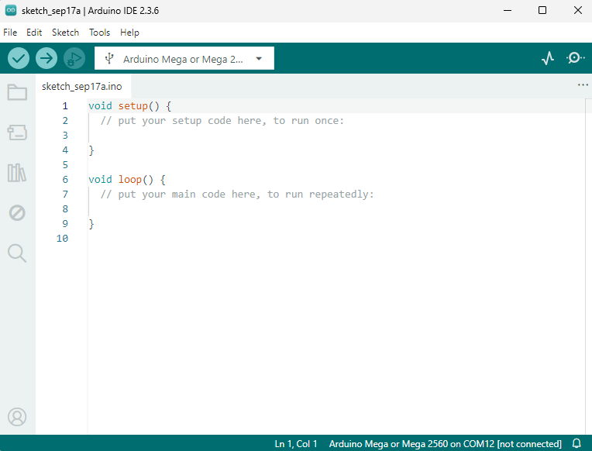
Arduino IDE
An IDE is an integrated development environment (IDE)
Combines several tools for writing code into a single program
  Source Code Editor
  Library Manager
  Compiler
  Debugger and troubleshooting tools
The Arduino IDE screen as seen when first opening a blank sketch

Slide 13
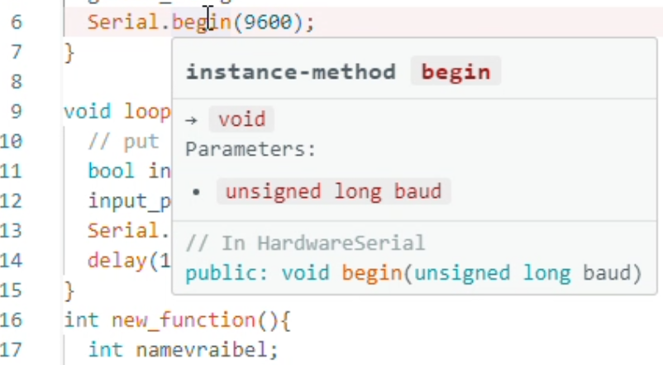
Source Code Editor
The main portion of the IDE window is the text editor used to write the code
The numbers on the left are just for reference (can be turned on and off)
Quality of Life Features:
  Text color-coded to differentiate functions, types, comments
  Closing parentheses and braces are automatically added
  Automatic indentation on new lines inside braces
  You can mouseover or right-click variables and functions to look at their definition (very useful for library functions)
The abbreviated definition for the begin() function, you could also jump to the definition (inside a library in this case) by right-clicking

Slide 14
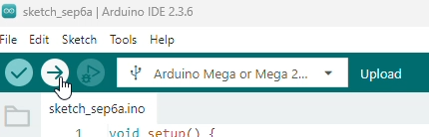
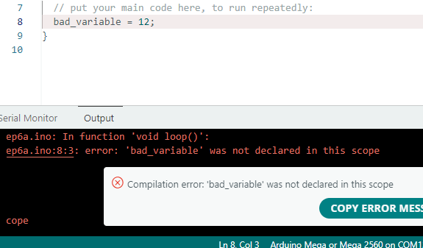
Compiler
Before code can run, it must be translated from the human-readable text into machine code (compiled)
Then the code must be uploaded to the microcontroller
  The verify button tries to compile the code to check for errors
  The verify compiles and then uploads the code to the connected microcontroller
  If the compiler encounters an error, a message will show up in the bottom of the window, with a line number and function reference
  The bottom window can be made larger or scrolled up if there is more text
  The compiler will stop at the first error encountered
Be aware the IDE autosaves (possibly overwriting an old version) when you verify or upload (this can be turned off)
The verify (check) and upload (arrow) buttons are found at the top the IDE window
Sample compiler error, here we can see the function void(), on line 8

Slide 15
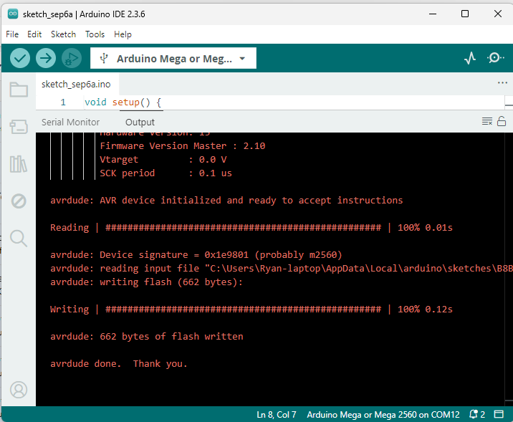
Uploading the code
To upload the code, the correct board and port must be selected in the dropdown menu to the right of the upload button
  The Arduino must be connected and powered
  Usually but not always the correct target be automatically selected when the USB is plugged in
  If not listed, you may need to pick the board and port under the tools menu
A successful upload will give you a success message, with the size of your program written to the flash memory
A failed upload will give an error message (usually a timeout)
Successful upload, the # symbols will actually fill in acting as progress bars

Slide 16
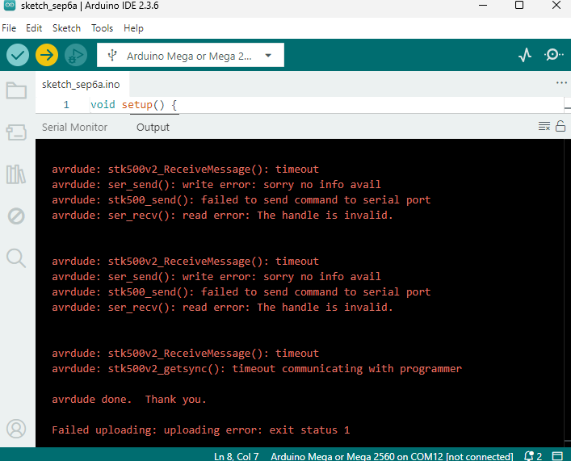
Uploading the code
To upload the code, the correct board and port must be selected in the dropdown menu to the right of the upload button
  The Arduino must be connected and powered
  Usually but not always the correct target be automatically selected when the USB is plugged in
  If not listed, you may need to pick the board and port under the tools menu
A successful upload will give you a success message, with the size of your program written to the flash memory
A failed upload will give an error message (usually a timeout)
Failed upload message (no Arduino was connected), notice how the dropdown menu still says Arduino Mega

Slide 17
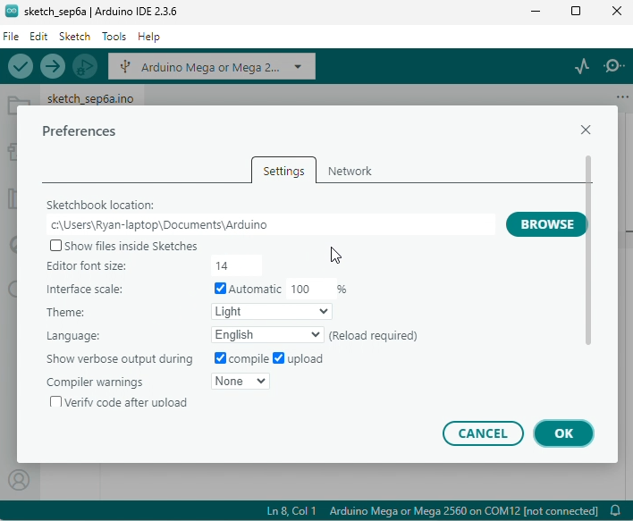
File Menu
The file folder expected options to save, open, close, etc.
The preferences window includes a number of important options
  The sketchbook location is the default location for your sketches (program files) and where library files will be installed
  Hitting browse will open that folder
  Editor Quick Suggestions will allow the IDE to suggest functions when you are writing code
  Autosave controls the autosave on Verify/Upload
Preferences window, opened via the file menu

Slide 18
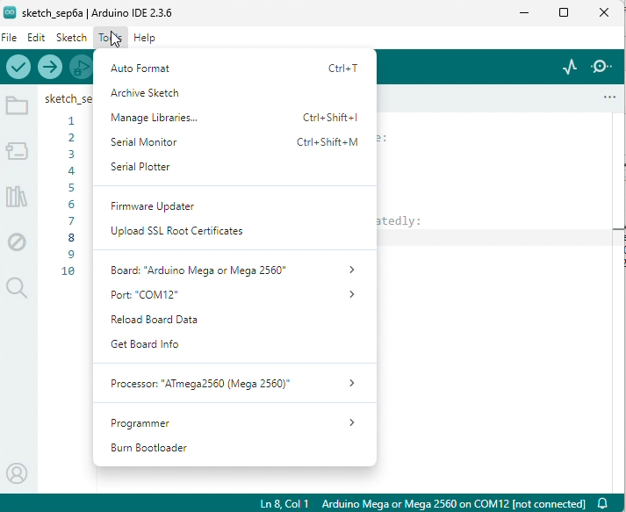
Tools Menu
This menu allows you to select the target board and port
  They should autoselect when the USB is plugged in, but this sometimes fails
  The Mega is listed under Arduino AVR Boards
  In Windows com ports will be listed as COM#
  In Mac/Linux, they will be listed as /dev/sTTY# (or similar)
  The number may change when unplugging and plugging in the Arduino
  Your computer may have COM ports unrelated to the Arduino
You can use the “Get Board Info” to check if you have the correct port, since that should give you the name of the microcontroller
The tools menu is primarily for settings related to communications with the Arduino

Slide 19
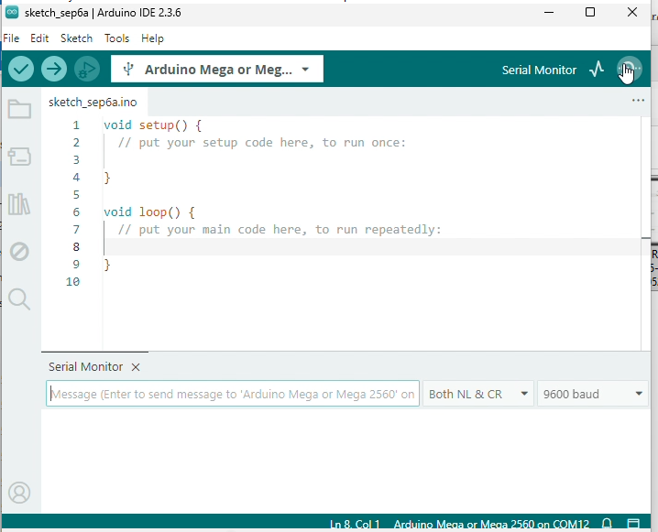
Serial Monitor
The Magnifying Glass on the top-right and the “Serial Monitor” option both will attempt to open a Serial Monitor for sending data to and from the Arduino
This uses the same port setting from the tools menu
Any text output to the Arduino Serial (AKA Serial0) port will be printed here
Any text typed into the message box will be sent to the Arduino when you hit enter
  The NL, CR drop-down allows you to add a Newline or Carriage Return (move the cursor to the left) when sending text to the Arduino
The baud setting is the rate of data transmission and must be the same in the serial monitor and Arduino (set by the program uploaded)
A successful connected Serial monitor, notice how the very bottom of the IDE shows the Arduino connected on COM12

Slide 20
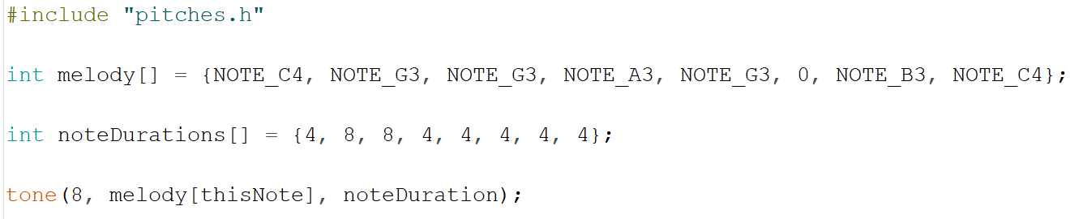
Libraries
Libraries are a collection of prewritten modules that have their own functions and variables for use in your program
The example below uses a library named pitches.h
  The #include line tells the compiler to use the library (notice the lack of semicolon)
The Notes are all variables defined in the library
The function tone() is a function that plays a note

Slide 21
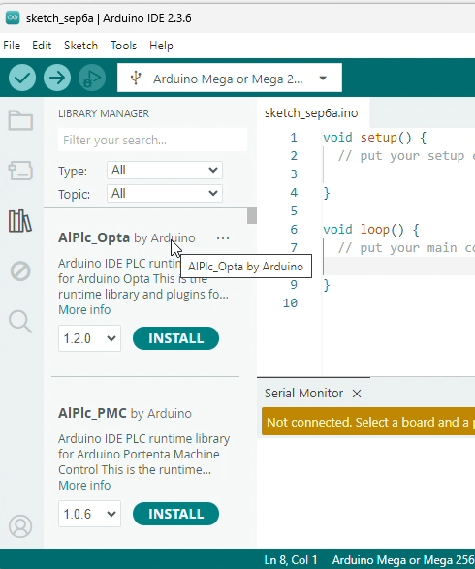
Library Manager
Libraries must be installed on your computer before they can be added to a program
The IDE includes a library manager accessed by the book icon on the left
  By typing in the search bar, you can look for a library in the online Arduino libraries
  The number dropdown allows you to pick a specific version
  Clicking install will download it and copy it to your sketchbook folder
  Clicking more info will take you to a documentation page for that library
Once installed, the library can be added by using the “Include Library” option under the sketch menu
  Many libraries also come with example sketches, which can be accessed by the “Examples” option under the File Menu

Slide 22
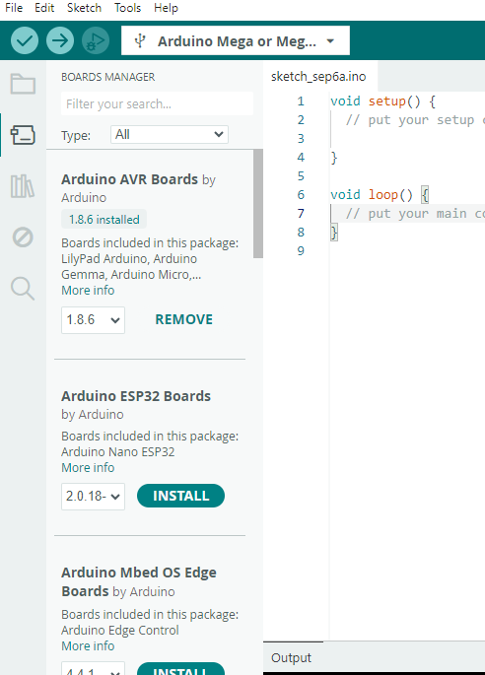
Board Manager
For each of the different Arduino Microcontrollers, there is a set of built-in libraries
These deal with the capabilities of the Microcontroller, like Serial ports, or IO pins
These also tell the IDE how to compile and upload the code
These libraries are managed by the “Board Manager” just above the Library Manager icon
Once installed, the board will be available to select under “Board Option” in the tools menu
  An include statement is not needed for the board libraries; they are automatically included by selecting a board

