Slide 1
Introduction to Programming

Slide 2
Binary Logic
Modern computers store data and perform operations using Boolean/binary logic
Boolean Logic values can take 2 values: True or False
Binary numbers have 2 possible values: 1 or 0
A single true or false value is a basic unit of information called a bit
In modern computing, individual bits are grouped in sets of 8 bits, called a byte
A series of bytes can be used to represent numbers, characters, images, video, etc.
Example of a byte: 0 0 1 0 1 1 0 1

Slide 3
Decimal vs Binary
The numbering system we are used to is called decimal, base 10
10 possible values: 0,1,2,3,4,5,6,7,9
Rightmost digit is the least significant (1s place)
Each digit to the left is a higher power of 10
9=9*10^{0,} 90= 9*10¹, 900=9*10^{2,} 9000= 9*10³…
Compared to binary, base 2
2 possible values: 0,1
Rightmost digit is the least significant (2⁰ place)
Each digit to the left is a higher power of 2
1=1*2⁰(1), 10= 1*2¹ (2), 100=1*²(4), 1000= 1*2³ (8)…
These are just ways of representing the numbers; the underlying numbers and operations(+,-,x,/) are the same
Notes:
We use base 10

Slide 4
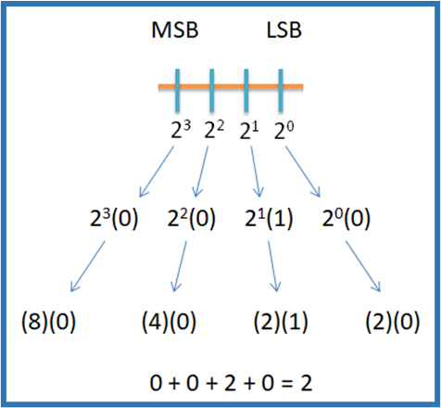
Reading a Binary number
To convert from binary to decimal, use a base of 2 and powers beginning with 0 at the left, counting upwards to the right
This technique is the same in decimal systems; it is similar to how “10” is 10 times larger than 1
For example, “2” in decimal can be represented in binary as “0010”
Figure 1: Convert binary to decimal
Example: Convert (0010)₂ to decimal = 2³(0) + 2²(0) + 2¹(1) + 2⁰(0)
= (8)(0) + (4)(0) + (2)(1) + (2)(0)
= (2)₁₀

Slide 5
Hexadecimal System
Hex Representation | Binary Representation | Decimal Representation
0 | 0000 | 0
1 | 0001 | 1
2 | 0010 | 2
3 | 0011 | 3
4 | 0100 | 4
5 | 0101 | 5
6 | 0110 | 6
7 | 0111 | 7
8 | 1000 | 8
9 | 1001 | 9
A | 1010 | 10
B | 1011 | 11
C | 1100 | 12
D | 1101 | 13
E | 1110 | 14
F | 1111 | 15
Sometimes your data may not be a meaningful representation other than the base binary
A string of 1s and 0s is not easily read by humans
To display in a more readable format, 4 bits are grouped together
4 bits gives you 2⁴ values
16 values in 0-15
This is called Hexadecimal or hex
2 hex numbers make a byte
A single byte goes from 0(0) to FF (255)
Hexadecimal number system

Slide 6
Negative Numbers
To represent negative numbers in binary, you take the left-most bit and use it for the sign, 0 for +, and 1 for -
There are common ways of doing this called One’s Complement and Two’s Complement
Two’s complement is the most common since it allows subtraction to be performed correctly, subtracting a number is the same as adding a negative number
Because computer variables have a finite number of digits, this can lead to errors
If you increase a binary number so that the leftmost bit becomes a 1, the computer may interpret it as negative (called an overflow)
So we either tell the computer the number can only be positive (unsigned) or make sure the variable has enough bits
This is a common error when using a timer or loop counter
A common type is an int, which stores values from 32767 to - 32768, so if you are storing milliseconds, it will overflow after ~30 seconds

Slide 7
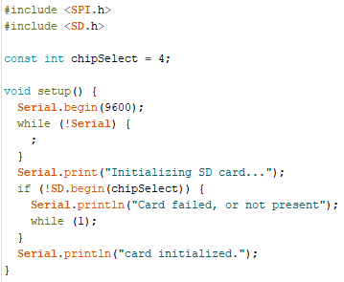
Common Programming Languages
There are many different languages
Vary in usage, strengths, and format
Common programming languages:
C and derivatives, C#, C++
Java, JavaScript
Python
Arduino uses a variation of C++
We will focus on learning Arduino C++, the programming language for Arduino hardware
Figure 2: An example of Arduino Code

Slide 8
Basic Parts of a Computer Program
Variables – The data you are working with
Operators – The way you change the data (simple)
Control Structure – How you control the flow of your program
Syntax – Markup characters and language
Functions – More complex combinations of the above elements

Slide 9
Variables https://docs.arduino.cc/language-reference/#variables
Variables are data values saved in memory to be changed or used during code execution
Usually changeable but can be declared as CONSTANT
Variables consist of three primary parts – the data type, the variable name, and the variable value
C++ requires an explicit type when a variable is created
Assigning a value at creation is not required
int Var = 42;
Data Type
Variable Value
Variable Name

Slide 10
Variables Scope https://docs.arduino.cc/language-reference/#variables
int Var = 42;
Data Type
Variable Value
Variable Name
Where a variable is created is called a definition
Variables can be defined inside of a function (called local) or outside of all functions (called global)
Global variables can be accessed by the whole program
Local variables can only be accessed by their function

Slide 11
Common Data Types https://docs.arduino.cc/language-reference/#variables
Data Type | Keyword | Size in Memory (bytes) | Range of Values | Note:
Signed Integer | int | 2 | -32768 to 32767 | Notice max value, above that it would roll over to negative, use unsigned int or long for larger number
Character | char | 1 | 0 to 255 | Each value corresponds to a printable character or keyboard operation called ASCII
String | String | varies | varies | This is different than an array of chars and behaves differently
Boolean | bool | 1 | True or False | Even though only 1 bit is required the minimum variable size is 1 byte
Floating decimal point number | float | 4 | -3.4 x 10³⁸ to 3.4 x 10³⁸ | Precision is limited to 6-7 digits, on Arduino Mega Double has same precision
Array | type[size] | varies | varies | An ordered group of multiple values of the same type, ex. int array_of_ints[5] is 5 integers
Commonly used C++ data types

Slide 12
Operators https://docs.arduino.cc/language-reference/#structure
Operators usually perform a single functional operation, such as adding or subtracting
Operator Types include:
Assignment
Arithmetic
Comparison
Logical
Bitwise (not covered here)
Compound (not covered here)
Operations must be defined for the variable types, and some operations may be undefined for some types

Slide 13
Assignment Operator https://docs.arduino.cc/language-reference/#structure
=
Performing an operation does not necessarily change the value of a variable
The assignment operator stores the result of the code to the right of the = in the variable to the left
X=7;
Stores the value 7 in the variable X
Nothing prevents you from trying to assign differing variable types to each other (like putting a char in an int) but sometimes the results may not be the expected.

Slide 14
Arithmetic Operators https://docs.arduino.cc/language-reference/#structure
Arithmetic operators are mathematical functions that take two operands, perform a calculation, and provide a result
Operator | Description | Example
+ | Adds two operands | A + B
- | Subtracts second operand from first | A – B
* | Multiplies operands | A * B
/ | Divides dividend by divisor | B / A
% | Modulus operator: Remainder of quotient | B % C
Arithmetic operators

Slide 15
Comparison Operators https://docs.arduino.cc/language-reference/#structure
Comparison operators are used to compare two values (called operands)
Produced a Boolean (True/False) result
Usually used in combination with a control structure
Operator | Description | Example
== | Equal to | x == y (x is equal to y)
!= | Not equal to | x != y (x is not equal to y)
< | Less than | x < y (x is less than y)
> | Greater than | x > y (x is greater than y)
<= | Less than or equal to | x <= y (x is less than or equal to y)
>= | Greater than or equal to | x > y (x is greater than or equal to y)
Comparison operators

Slide 16
Logical Operators https://docs.arduino.cc/language-reference/#structure
Logical operators manipulate True and False results into more complex operations
All Nonzero values are considered True (1 is true, but so is 617, 32, 100542)
Operator | Description | Example
&& | AND – If both operands are True, the condition is True; otherwise, it is false | If A = 1 and B = 0, then A && B = false
|| | OR – If either operand is True, the condition is true; otherwise, it is false | If A = 1 and B = 0, then A || B = true
! | NOT – If a condition is true, then !condition is false | If A || B = true, then !(A || B) = false
Logical operators

Slide 17
Control Structure https://docs.arduino.cc/language-reference/#structure
Control Structure is used to run code in a more complex sequence than simple sequential steps
Run the same code multiple times with a loop
For, while, and do while
Only run a portion of code if some condition is true
If … else
Uses comparison and logical operators to determine if a section of code will be executed or skipped over

Slide 18
Conditional Statements: If/Else
An if statement performs a logical check and executes the following code if true
May be combined with Else which executes code when the If is false
void setup() {
Serial.begin(9600); }
void loop() {
int A = 15;
int B = 10;
if (A >= B) {
Serial.println (A – B);
}
else {
Serial.println (B + A);
}
void setup() {
Serial.begin(9600); }
void loop() {
int A = 5;
int B = 20;
if (A >= B) {
Serial.println (A - B);
}
else {
Serial.println (B + A);
}
In this example, since A is greater than or equal to B, 5 will print out (A – B), but the second print will not be executed.
Now since B is greater than A, the first print will be skipped, and 25 will be printed (B + A)
Notes:
Corrected code explanation to match code. Adjusted figure 8 to show a difference because they were identical.

Slide 19
For Loops
A for loop executes repeatedly and increments a counter variable until the conditional statement is no longer true
The initialization happens once when the loop starts
The increment happens at the end of the loop
The logical check happens at the beginning of the loop (pretest condition)
void setup() {
Serial.begin(9600);
}
void loop() {
for (int i = 0; i <= 15; i++) {
Serial.println(i);
}
}
Output → 0 1 2 3 4 5 6 7 8 9 10 11 12 13 14 15
for (int i = 0; i <= 15; i++ )
Counter Initialization
Increment
Conditional
Statement
A for loop that prints 0 to 15. The variable i starts at 0 and increments every loop until i=16 and then the loop ends.
Note:++ is a compound operator i++ is the same as i=i+1

Slide 20
While Loops
A while loop will only run when the conditional statement is true, but it does not automatically increment or break the loop unless something in the loop changes a value in the conditional statement
while (carrier < 0) { Serial.print (carrier++) }
Conditional Statement
Loop Execution
int carrier = 0;
void setup() {
Serial.begin(9600);
}
void loop() {
while (carrier < 20) {
Serial.println(carrier++);
}
A do while loop is similar but performs the logical check at the end of the loop
A while loop that counts from 0 to 19
Notes:
Added pretest

Slide 21
Functions https://docs.arduino.cc/language-reference/#functions
A function is a code segment written to be executed elsewhere in the program
A function:
Can return a result, the function has type matching what it returns (void means no return)
Must have a unique name and cannot be defined inside another function
Any variables you want to pass into the function (called arguments) are used placed inside the parentheses
Functions can be predefined in libraries or written by the user
int giveme_seven (int argument) {
int local_var;
return 7;
}
void loop () {
int value=2;
int return_value;
return_value=giveme_seven(value);
Serial.print (return_value);
}
A very simple function that always returns the number seven. Normally argument and local_var would be used in the function.
A call to the function, when called it returns 7, which is assigned to the variable return_value and then printed

Slide 22
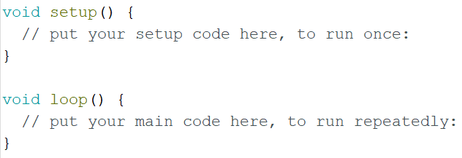
setup() and loop()
Arduinos uses two special void functions in every program
setup() runs one time when the program begins
loop() that runs continuously thereafter
Initial functions of a new sketch created automatically by the IDE

Slide 23
Syntax
Some code language is instructions to the compiler, which translates your code into machine code, or use for grouping
#include is used to add libraries of prewritten code to your program
{} curly braces are used to group code together for loops, functions, and if statements
; terminates a line
// and /* */ are used to indicate comments (text the computer will ignore, for documentation and notes)

Slide 24
Leaving Comments
Comments are used to explain what your code does, leave notes, document changes made, etc.
The clearer and more detailed your comments, the more useful they will be
If you can fit your comment on one line, then simply type two backslashes followed by your text
If you need more room, then use a backslash and asterisk combination to comment over multiple lines
// Leave a one-line comment like this
/* Use as many lines as needed in order to provide enough information for someone else to understand your code */

Slide 25
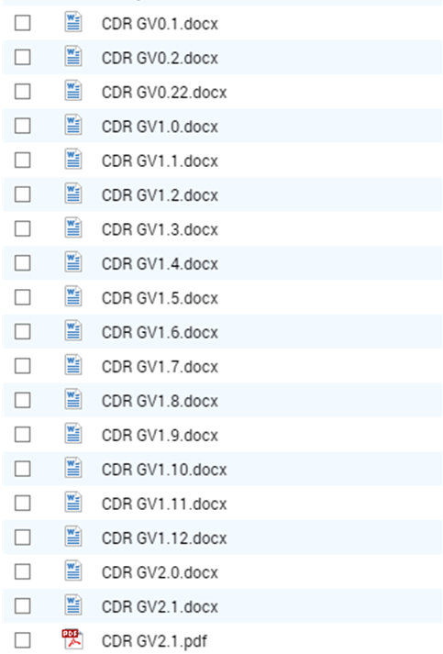
Version Control
While developing software, it is important to track the changes made within your code
For your code, it is recommended that you provide a version number (or date and time) in your filename
Change the name when you make changes to the code
Keep a log of the changes you make in your lab notebook or an outside document
Be aware that the Arduino IDE will automatically save when you compile or upload
git is a common version control system, but complex for LaACES

Slide 26
Troubleshooting Your Code
Check syntax and variable names (Upper and lower case matter)
Check punctuation: semicolons, brackets, and parentheses must be placed correctly
Ensure correct placement of conditional statements and loops
Use correct data types
Make sure global and local variables are accessible to the appropriate functions
Use print statements at intermediate steps to make sure the program is running the steps you think it should and calculating the value you expect

