Slide 1
Soldering Techniques

Slide 2
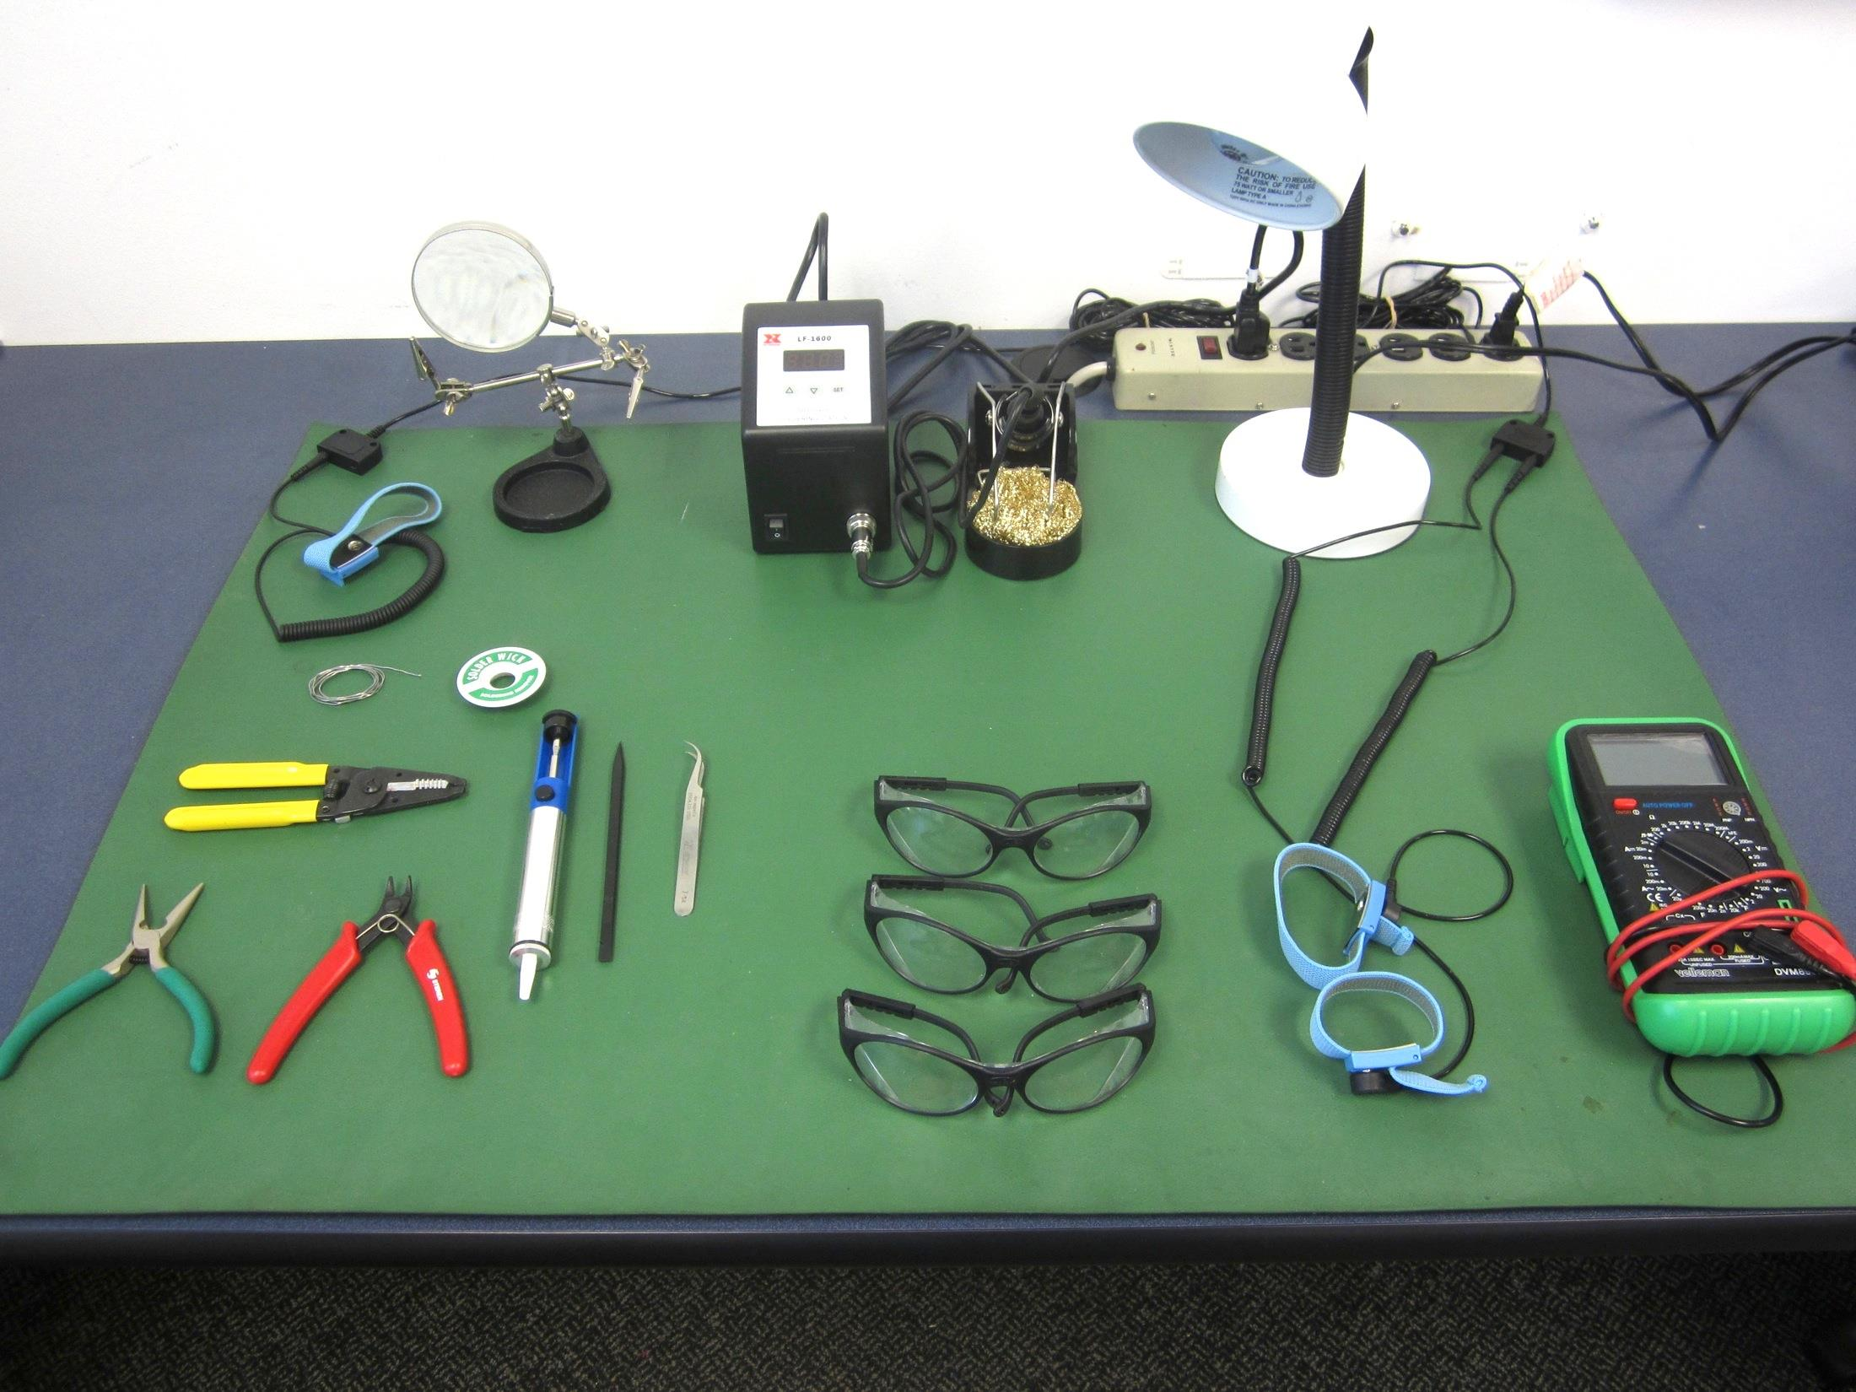
Recommended Tools
Soldering Iron
Solder
Safety Glasses
Multimeter
Light Source
Needle-nose pliers
Tweezers/Forceps
ESD Mat and strap
Solder wick
Solder Pump
Diagonal Cutters
Wire Strippers
Magnifier

Slide 3
Safety Precautions
Prior to assembly or any work, a clean and organized workstation is vital for safety and proper assembly
Soldering Irons are extremely hot; do not touch the tip, and place the iron in a stand when not in use
Always wear Safety Glasses while soldering
Be mindful of where the solder might drip and where your body is relative to the iron
Tie back long hair
Wear long pants
Wash your hands after handling leaded solder

Slide 4
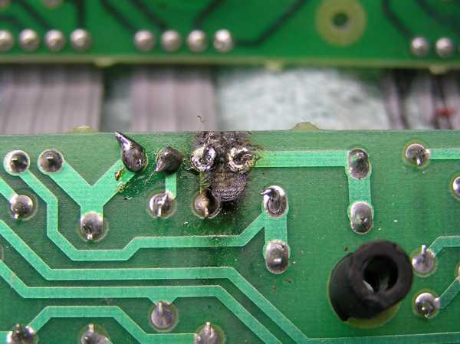
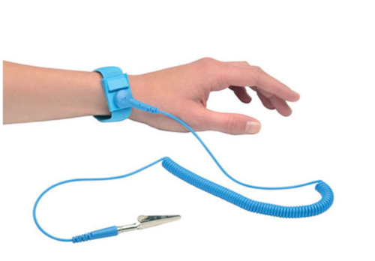
Safety (for the components)
Excessive heat can damage components and boards
Set your iron to an appropriate temperature for the solder you are using
Electrostatic discharge (ESD) can destroy or damage sensitive components.
Leave components in static shielding bags until ready for use
Use ESD wrist straps to ground yourself while working

Slide 5
Tips for Success
Use bright enough lighting to see the board and component marking
Install smaller components first
Install integrated circuits (IC’s) into sockets, not directly on the board
Choose a solder thickness and tip size appropriate to the component you are working with
It’s easier to add solder or re-melt than remove excess solder

Slide 6
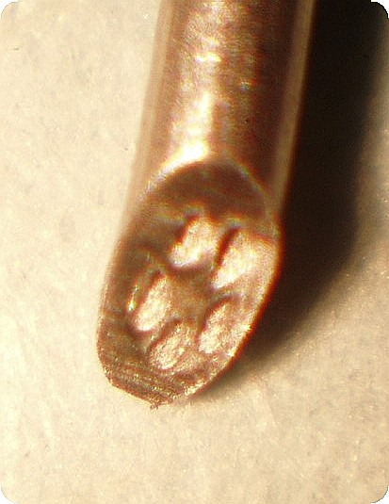
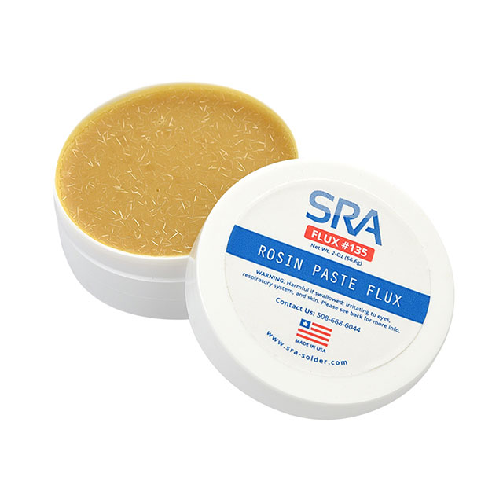
Types of Solder
Leaded solders
Primarily Lead and Tin
Starts melting ~350F
Lead Free Solder
Lead-free but higher melting temperature (~420F)
Can be more difficult to work
Solder Paste
Paste in syringe
Use for surface mounting component soldering with hot air or ovens
Solder flux
Rosin flux helps the solder flow and stick onto the PCB pads
Many solders have flux inside the solder, will be labelled “Rosin Core:
Notes:
.

Slide 7
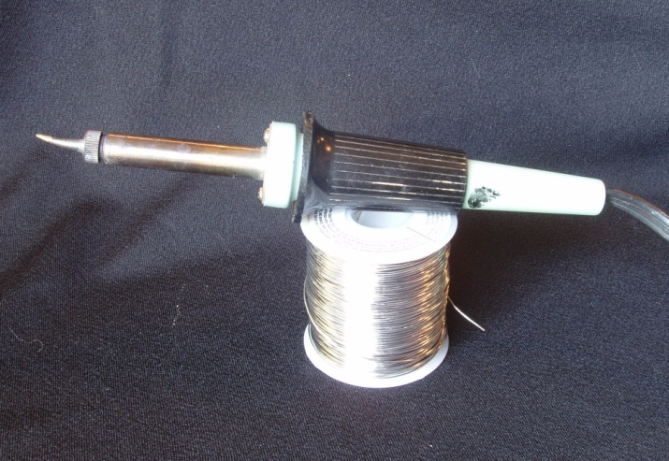
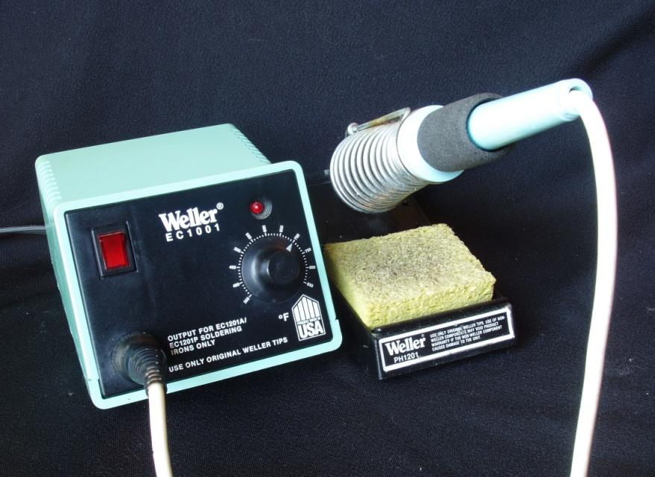
Soldering Irons
Constant Power Soldering Irons
Iron continuously heats and eventually reaches equilibrium temperature
Constant temperature
Tip heats to maintain a preset temperature
Temperature Controlled Solder Station
Adjustable Temperature Setting
Often includes a temperature display
30-watt Constant Power Iron
Temperature Controlled Solder Station

Slide 8
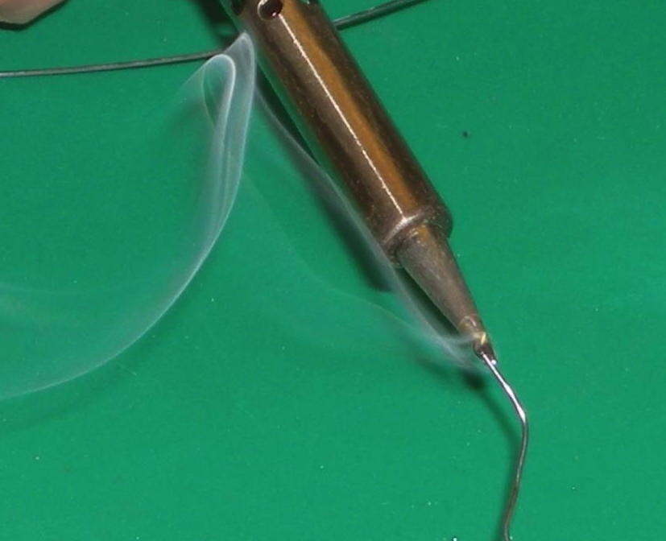
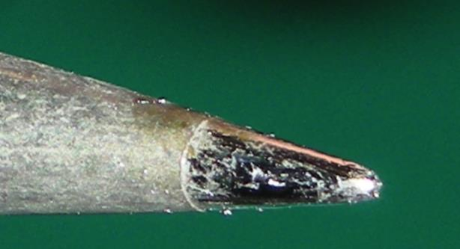
Soldering Tutorial Through-Hole Component
Due to its high temperature, the iron tip will rapidly form an oxidation layer that slows heat transfer
It will take a darker, dull appearance
Frequently during usage, “Tin” the tip
Melt a small amount of solder on the tip and then clean the tip on the sponge or metal scour
The tip should look shiny

Slide 9
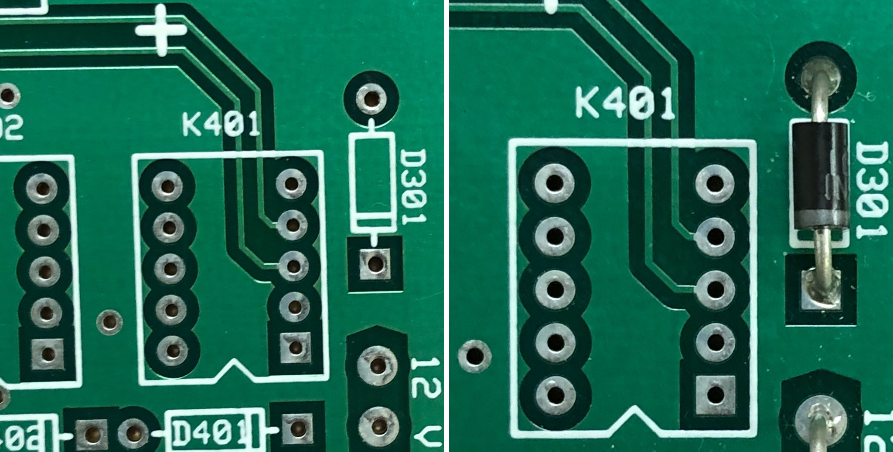
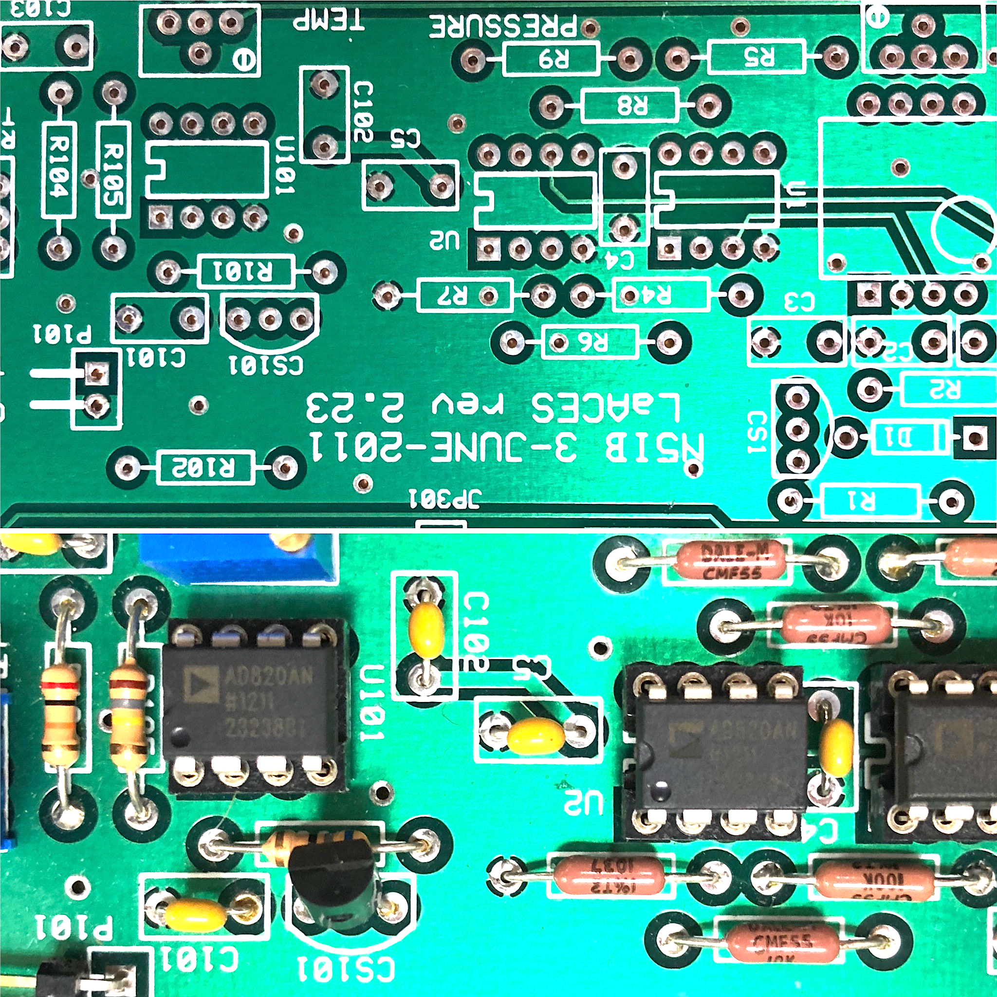
Identify component pads and orientation
Locate the pads for the component by finding the identifier on the silkscreen of the board
This is often a few letters and a number, for example, D301 for diode 301 to the right
Check the schematic if markings are unclear
Look for orientation or pin numbering marks
In the best case, the markings will be obvious, like lining the diode strip with the line on the board to the right
But sometimes markings may be ambiguous or have changed since the board was designed
Incorrectly installed components will not function properly and may damage other components in the circuit
Proper installed diode and integrated circuit

Slide 10
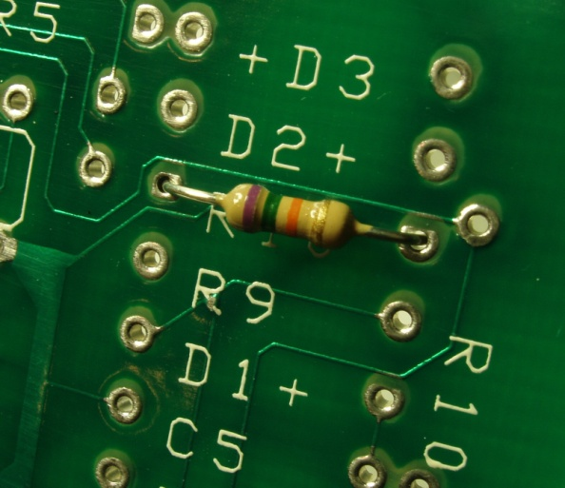
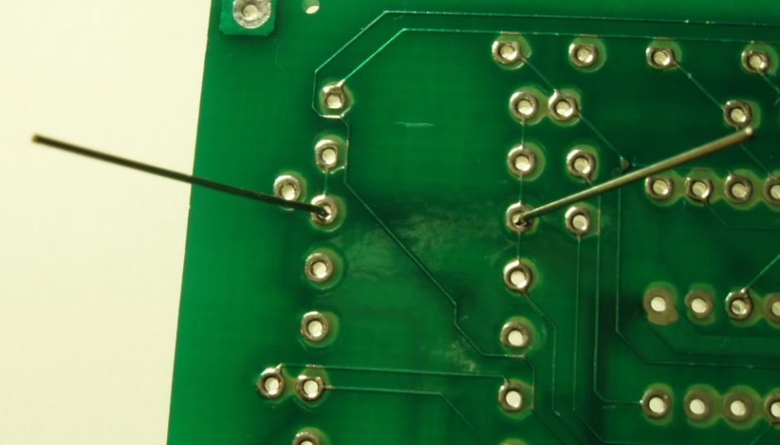
Install the Component
Insert the component’s leads through the holes in the circuit board
Most components should lie flush against the surface of the board
Do not force the component down as you may break a lead
Fix the component in place and flip the board over
Bending the component leads outward can help hold the component in place
Tape can also be used to hold components down, just be careful not to tape the metal leads, which will get hot during soldering

Slide 11
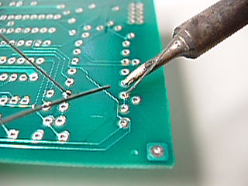
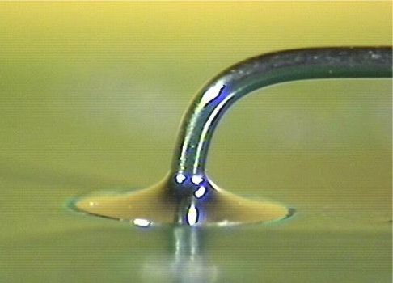

Heat Pads and Apply Solder
Apply the iron in contact with both the circuit board pad and the component lead
The iron should be in contact with both so both heated
Apply solder to the joint, not to the iron, and allow the heated joint to melt the solder
The solder should follow onto both the pad and the lead
You want a “Hershey kiss” of solder when you are done
Notes:
]

Slide 12
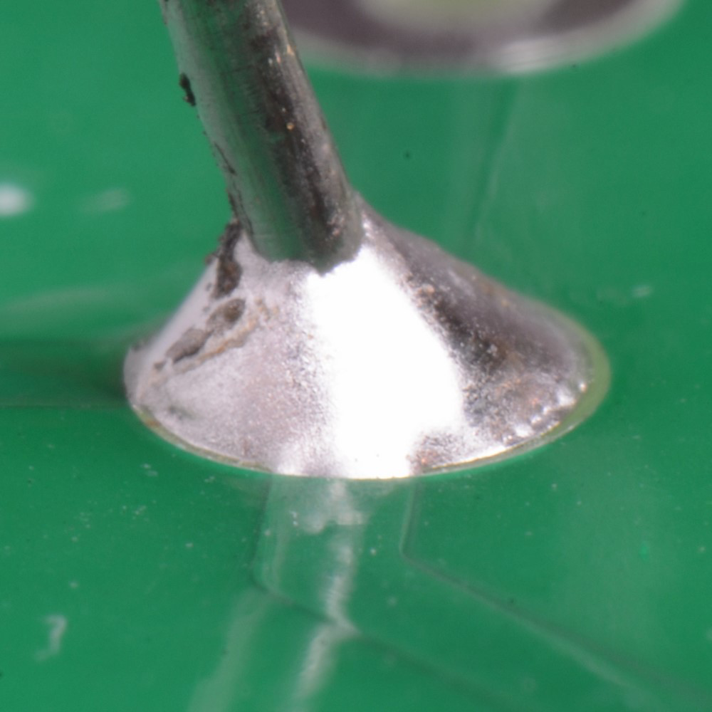
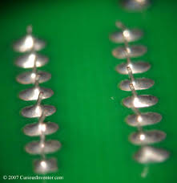
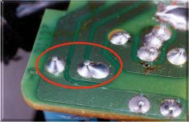
Inspect the solder
Inspect the solder joints. It should be uniform and shiny, with no cracks, gaps, or graininess. The images below are examples of good soldering.

Slide 13
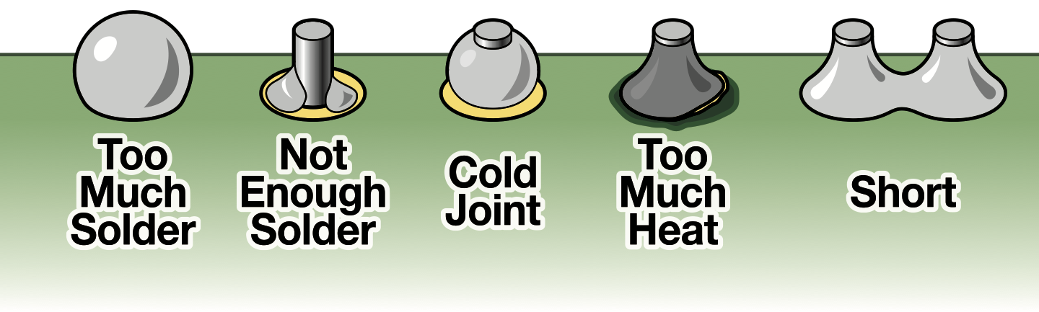
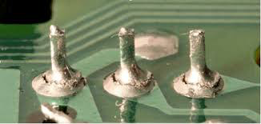
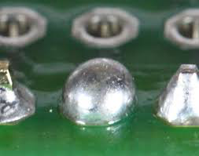
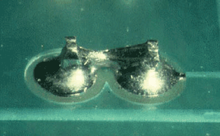
Bad Solder Joints

Slide 14
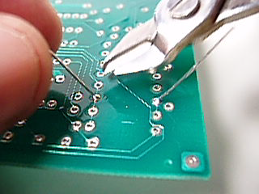
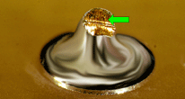
Trimming Leads
If solder is good trim the excess leads using a pair of diagonal cutters
When cutting hold the lead so it does not go flying when snipped
Avoid cutting into the solder joint itself; the mechanical force could peel the pad off the board
The goal it prevent leads from being able to create shorts, not trim a flat surface

Slide 15
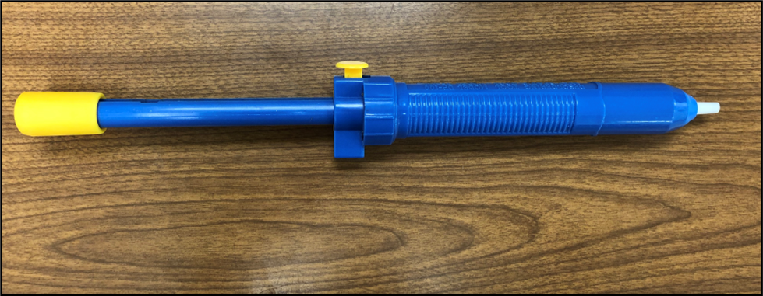
Solder Pump
If you need to remove excessive solder or remove a soldered component, one technique is a solder pump
A solder pump, or “solder sucker,” removes liquid solder from the board with a small spring-operated vacuum
Suction Release
Nozzle
Priming
Handle
Solder Pump

Slide 16
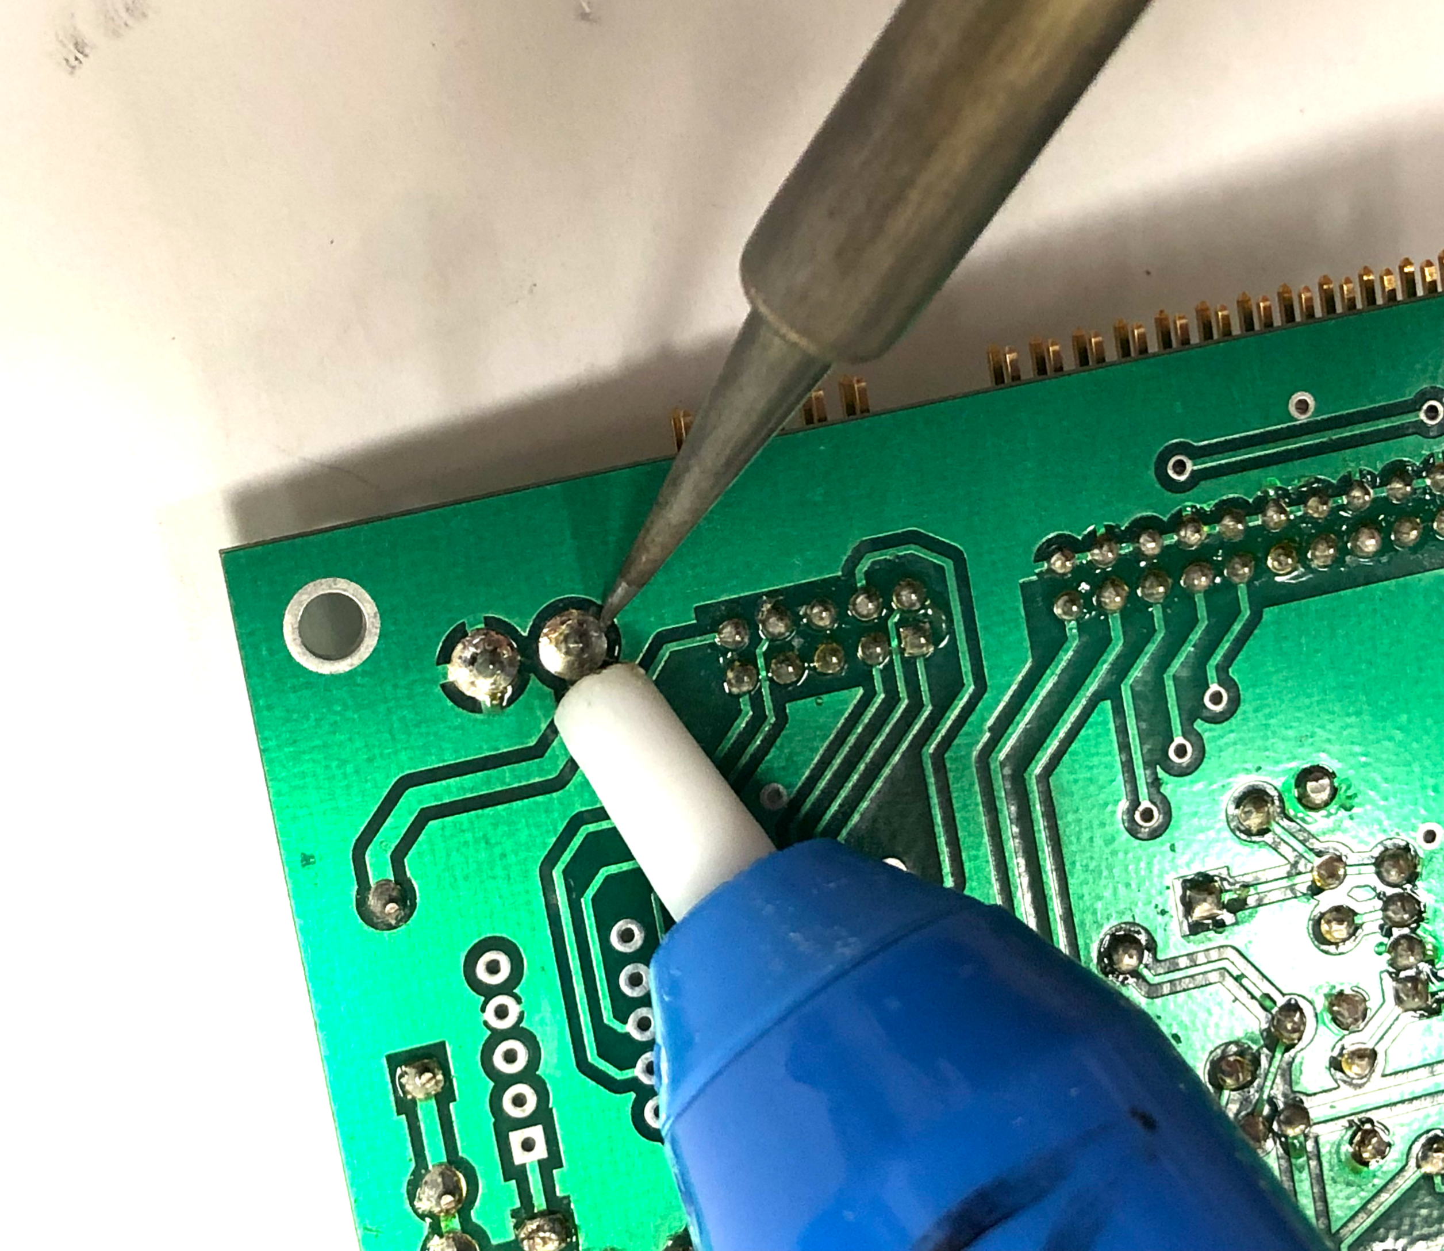
Using a solder pump
Compress the spring by pushing the priming handle down until you hear a click
Heat the excess solder until it becomes molten
Place the tip of the solder pump near or on the joint and press the suction release
The spring will push the plunger up and suck some of the solder into the pump
Eject the solder out of the pump by pressing down the priming handle
You may need to repeat to remove the desired amount of solder
Removing excess solder by sucking it up with a solder pump.

Slide 17
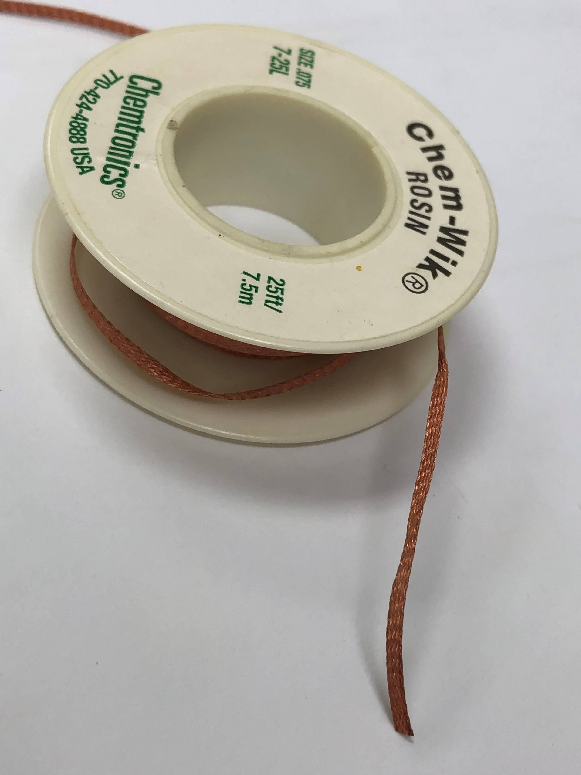
Solder Wick
Solder wick is copper braid that usually comes in spools
When the wick is heated, excess solder will naturally flow up the wick
To use:
Place the wick on top of the joint to be desoldered
Heat the wick by pressing it into the solder with the iron
The will flow onto the wick
Remove the iron and with wick from the joint simultaneously
If you allow the solder to cool, the wick will stick to the joint and potentially pull the pad away from the board as you pull the wick
A length of wick will now have solder on it, cut this off the spool and dispoe
Spool of Solder Wick

Slide 18
Removing Components
For multipin components, it is very difficult to remove enough solder to completely remove it at once
It is usually better to sacrifice the component by cutting its leads
Then the remaining pins can be removed one at a time
This will avoid damaging the traces on the circuit board, which are very difficult to repair

