Slide 1
MegaSat Development Board

Slide 2
What is the MegaSAT?
The MegaSAT is a microprocessor sensor board designed to provide a set of commonly useful sensors and interfaces for a LaACES Payload
By combining the MegaSAT, an Arduino Mega, and the Adafruit Ultimate GPS Logger Shield, teams build a solid baseline payload
The baseline MegaSAT can be expanded to add additional sensors to meet the team’s Science Goals
The Arduino is the control system, and the GPS Shield provides the Data Storage System and GPS System

Slide 3
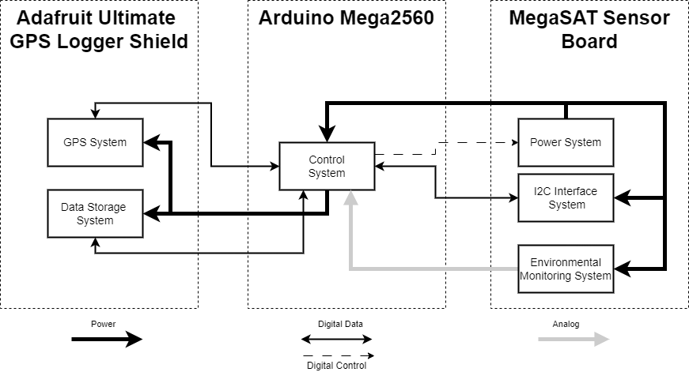
MegaSAT System Diagram

Slide 4
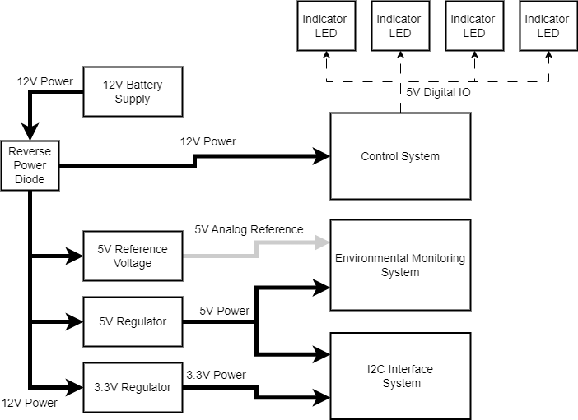
Power System
Power System receives voltage from the battery (12V or 9V)
Provides power to the Arduino
Provides 5V or 3.3V to loads on the MegaSAT
Also includes 4 LEDs connected to D2-D5 that teams can use as status indicators

Slide 5
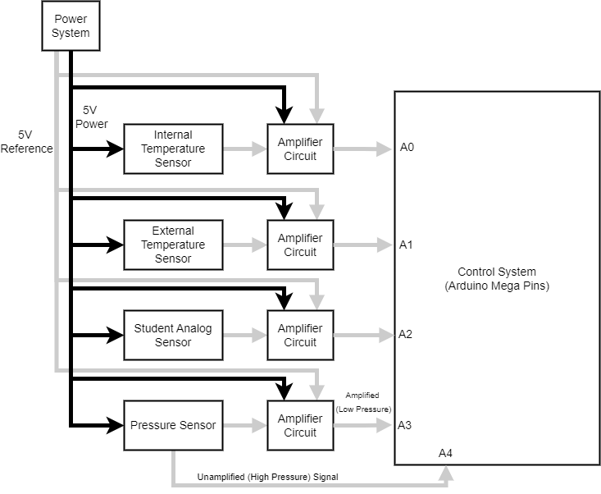
Environmental Monitoring System

Slide 6
Environmental Monitor System
Contains Analog Sensors for pressure and temperature
Each sensor includes an adjustable non-inverting Op Amp circuit to adjust range and resolution
Also includes a circuit with a 3 Pin connector (Power, Signal, Ground) and amplifier for connecting an additional analog sensor if needed

Slide 7
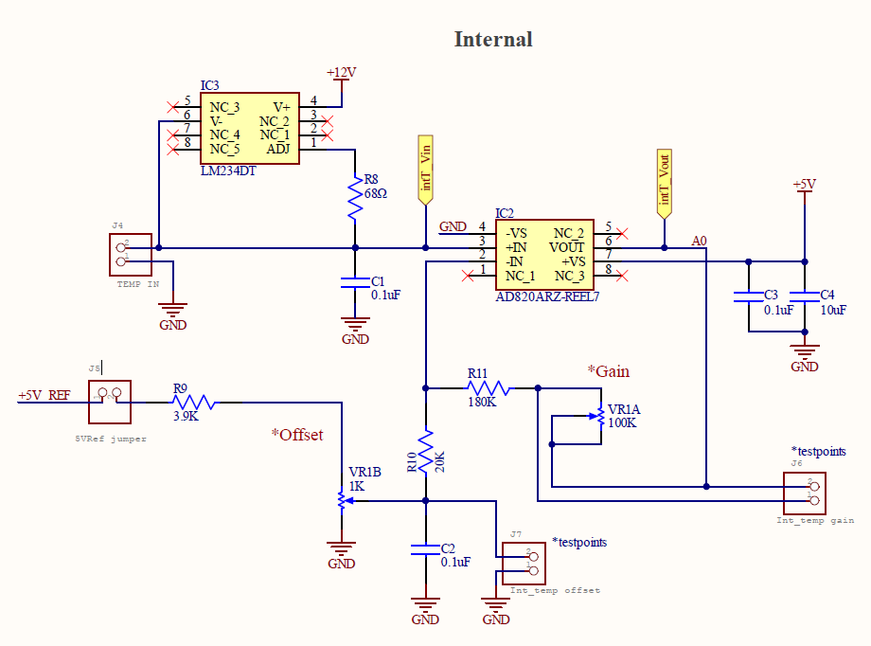
Temperature Circuits
1N457 diodes temperature with a constant current source for the temperature sensor
Improved version of the circuit used in fall calibration
Includes test points for setting the potentiometers
Two identical circuits
Typical use is one internal and one external

Slide 8
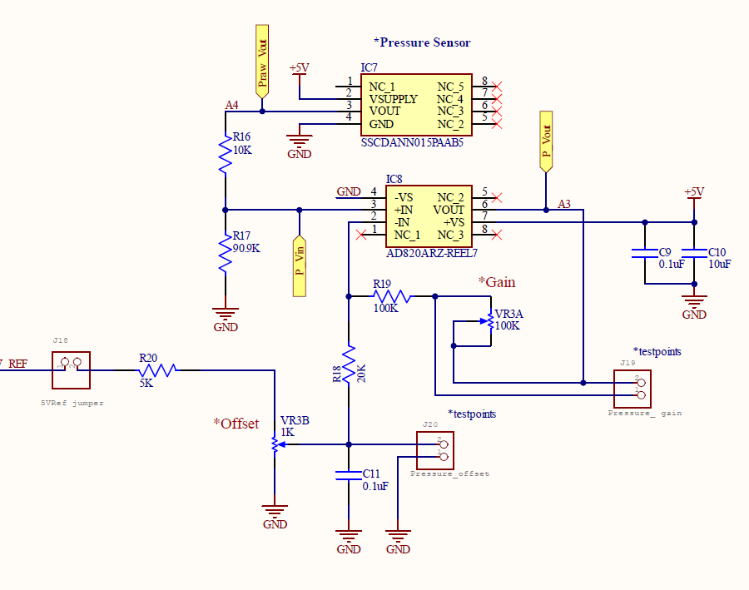
Pressure Sensor
Honeywell SSC series pressure transducer
0-15 psia range
0-5V unamplified output analog pin (A4) give coarse pressure reading
Amplified output to give increased sensitivity at low pressure (A3)

Slide 9
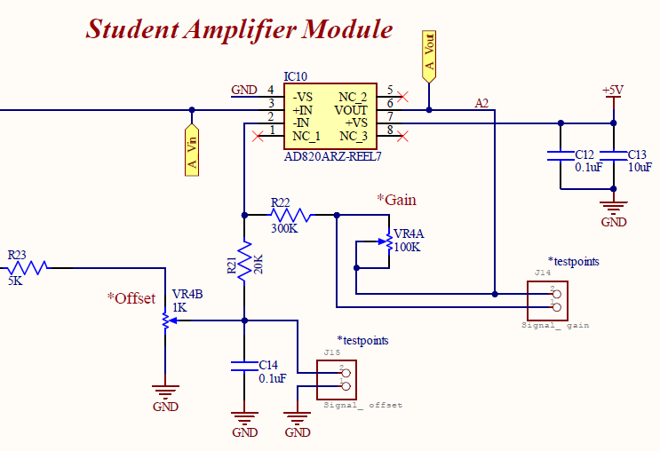
Student Sensor
Intended to provide amplification and power in case a team wants to add an additional analog sensor
Can provide power to a sensor (5V)

Slide 10
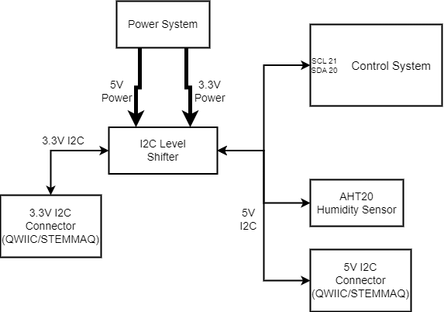
I2C Interface System
Provides an I2C connection from the Arduino at both 5V and 3.3V logic levels
AHT20 I2C Humidity Sensor
Kit includes a version for mounting on board or a version with longer leads for external mounting
Connectors used are compatible with QWIIC and STEMMAQ products from Adafruit and Sparkfun

Slide 11
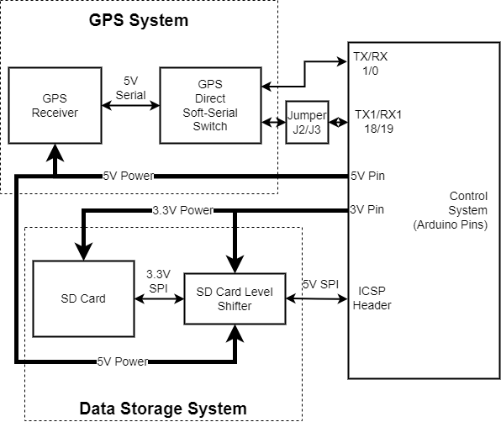
GPS and Data Storage Systems
GPS Shield provides GPS and Data storage
Pulls power from the Arduino voltage regulators, not the MegaSAT ones
Jumpers on the MegaSAT connect GPS to TX1/RX1 so wire jumpers used in the fall should not be required

Slide 12
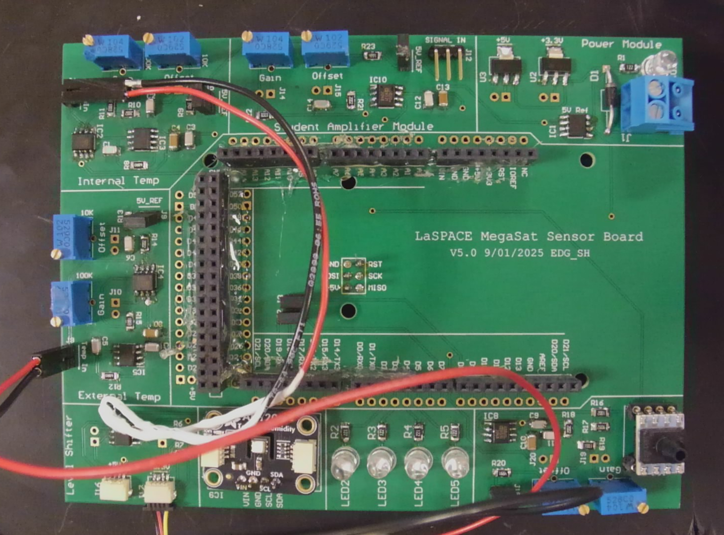
MegaSAT Layout
Student Sensor
Internal Temp
Power Module
External Temp
Pressure
I2C Connections
Indicator LEDS

Slide 13
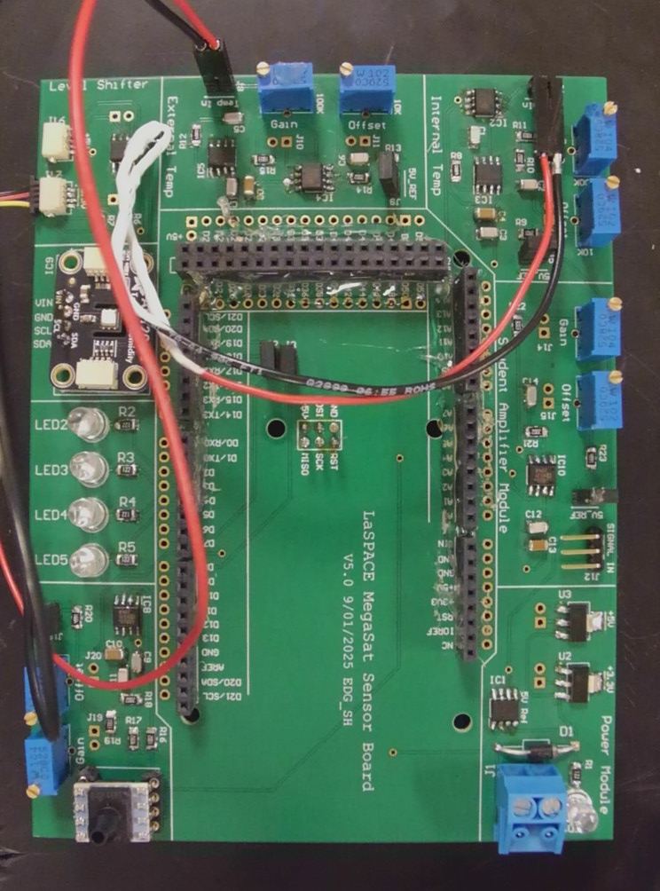
MegaSAT Physical Dimensions
The MegaSAT Shield 4.13 inches by 5.48 inches
A fully assembled stack with GPS, MegaSAT, and Arduino is ~1.4 in from the bottom of the Arduino to the top of the GPS headers

