Slide 1
The Louisiana Aerospace Catalyst Experience for Students (LaACES) Sounding Balloon Program
Louisiana Space Grant Consortium (LaSPACE)
Department of Physics and Astronomy Louisiana State University Baton Rouge, LA

Slide 2
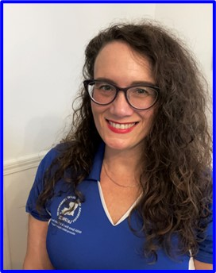
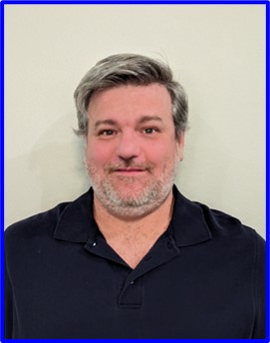

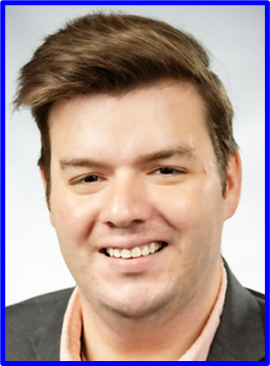
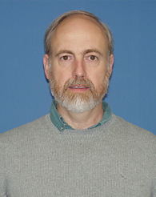
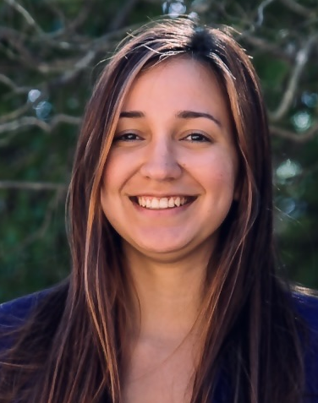
Introductions – LaACES Management
Colleen Fava
LaSPACE Director
Doug Granger
LaSPACE Assistant Director
Aaron Ryan
LaSPACE Flight
Program Manager
Jonathan Smith
Program Coordinator
Dana Browne
LaSPACE Associate / HAM Radio Expert
Sabrina Huezo
LSU P&A Electronics Engineer

Slide 3
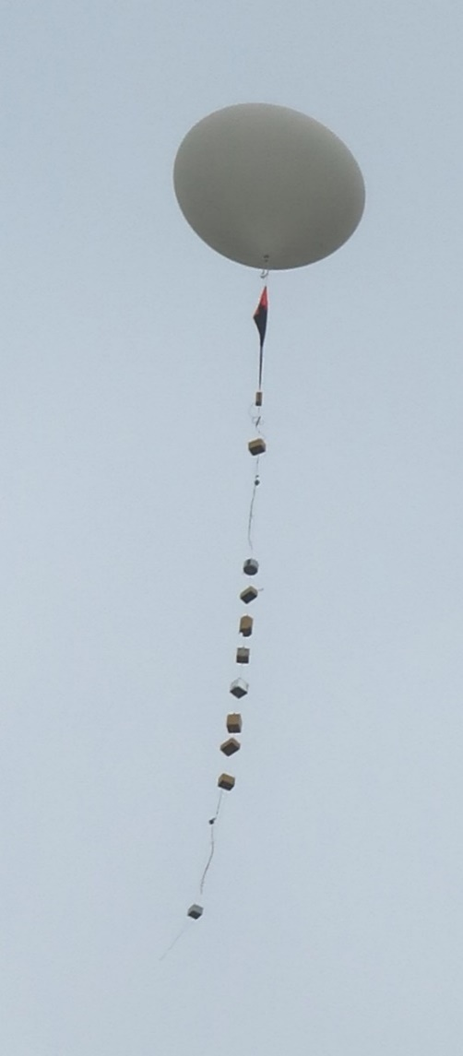
What is LaACES?
Louisiana Aerospace Catalyst Experiences for Students
A two-semester program that includes the Student Ballooning Course and building a payload
Students develop science experiments and fly them to 100,000 feet
Students gain practical skills in:
Electronics
Microcontroller programming
Project management
Writing and communication
Target entry level students enrolled in Science, Technology, Engineering, or Mathematics fields (STEM)

Slide 4
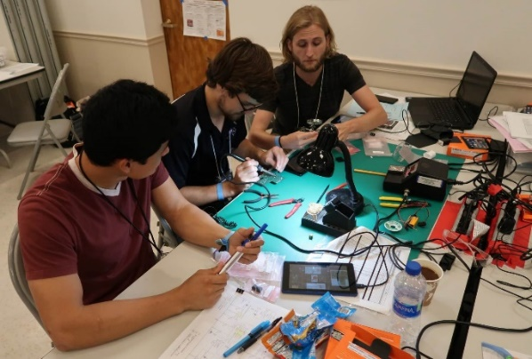
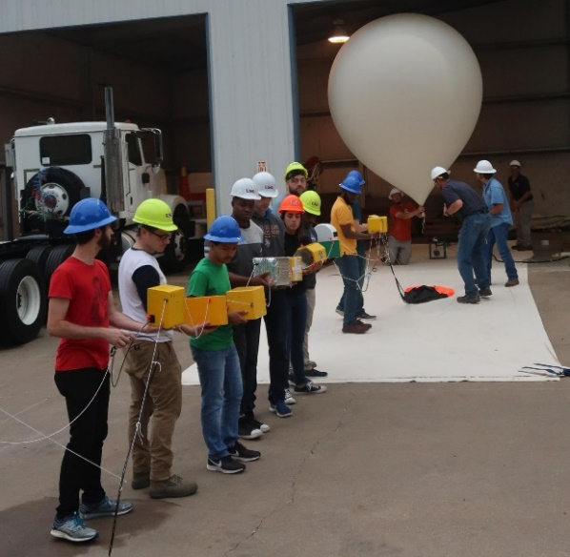
LaACES Goal & Objectives
Goal:
“To inspire students to pursue STEM related careers”
Objectives:
Provide students with an authentic flight project experience not normally available through the classroom
Develop student skills in electronics, real-time programming, communication, and project management
Guide students to work in teams and to use acquired knowledge to create a science payload for balloon flight
Students communicate their progress through required documents and presentations on a milestone schedule
Conduct annual flight operations where approved student team payloads are flown on a latex sounding balloon to an altitude of ~100,000 feet or the very “edge of space”

Slide 5
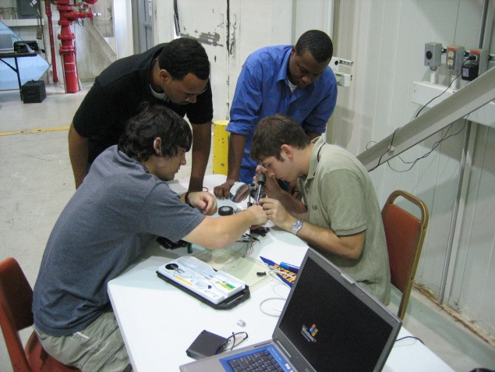
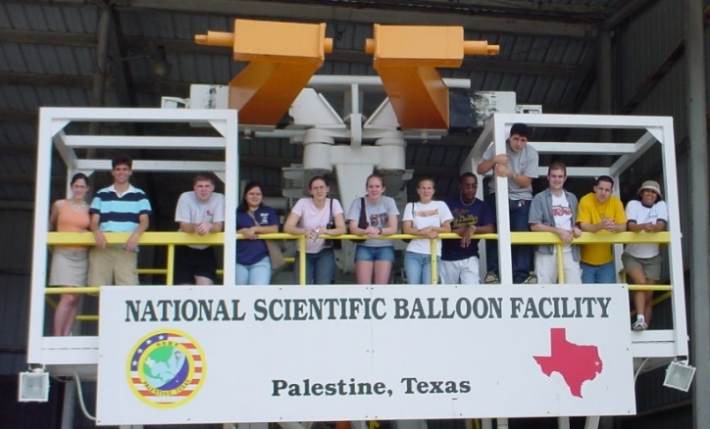
A Historical Look at LaACES
Evolved from the pilot program ACES implemented with NASA funding during 2002-2003 academic year
ACES involved only students at LSU
NASA approved LaACES funding in February 2004
Student Ballooning Course (SBC) developed in early 2004
Over 68 flights since 2004
Major revision of the LaACES electronics, lectures, and activities in 2018, field tested in 2019, and implemented in 2020-2021

Slide 6
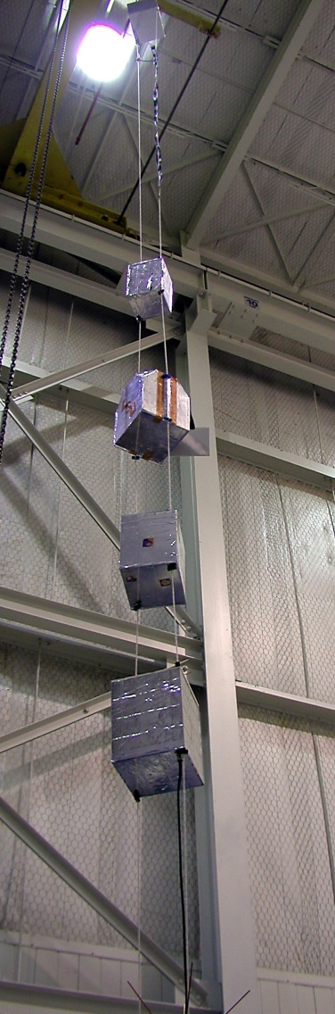
LaACES Structure
Involves students from Institutions across the state
Students are organized into teams of 3-4
Fall semester consists of bi-weekly 2 hour “classes”
Meet Tuesday / Thursday from 6 pm to 8 pm
Lectures and follow-on related hands-on activities
Additional work in the lab to complete activities
Lectures and activities cover electronics, programming, payload design, project management, balloon payload design, and science
Spring semester devoted to designing, developing, testing, and documenting a balloon payload
Students expected to devote 10-15 hours per week and will have specific deliverables due on milestone dates

Slide 7
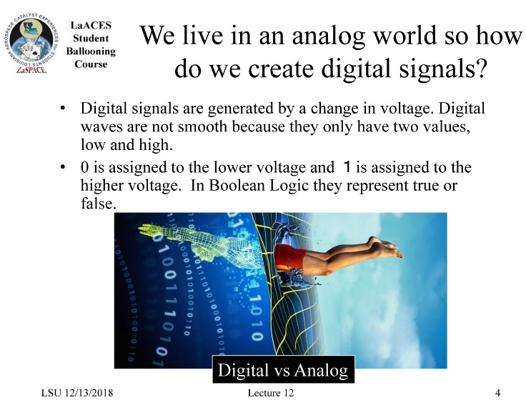
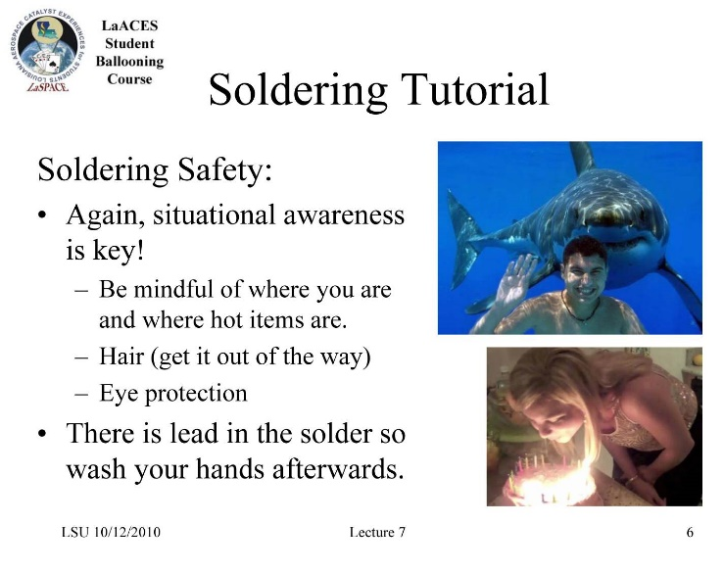
Fall Semester Tasks
Basic Electronics
Soldering
Reading schematics and datasheets
Prototyping, circuit building
Microcontroller Programming
Digital and Analog interfaces
Designing data formats
Using GPS and SD cards
Two major projects during fall are the SkeeterSat calibration report and the Capstone sensor report.

Slide 8
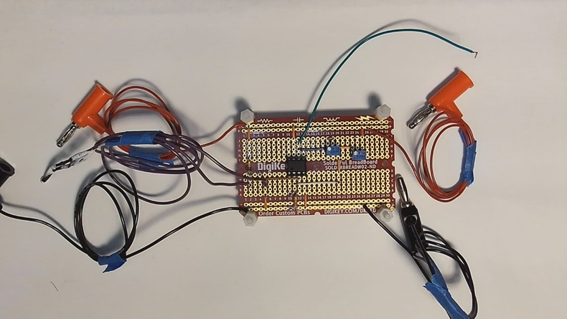
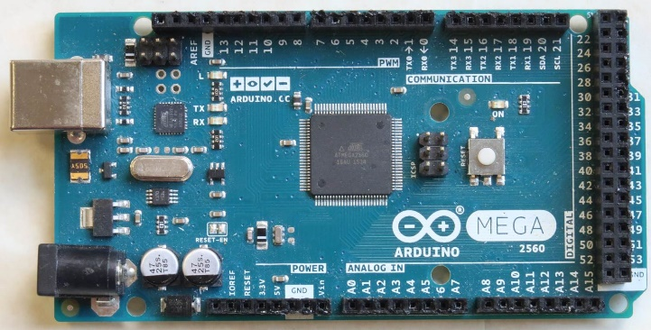
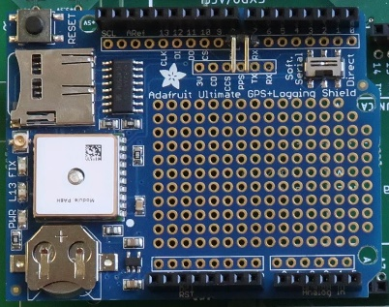
Fall SBC Hardware Components
The temperature calibration activity is an introductory circuit assembly activity to build and calibrate a simple temperature circuit. Used to learn basic electronics, assembly, troubleshooting, calibration, and documentation.
Arduino Mega2560 is a powerful microcontroller with 54 digital I/O lines, 16 channels of 10-bit ADC, and plenty of memory for complex programs. Used for learning programming and as a payload controller.
Adafruit Ultimate GPS Logger includes a GPS receiver (validated to at least 100,000 feet), internal GPS antenna, external antenna socket, a battery backup coin cell holder, and a prototyping area. It interfaces with the Arduino Mega and is used for time stamping data and data logging.

Slide 9
Spring Semester Tasks
Develop a realistic payload based upon the MegaSat stack
Work as a team during payload development
In January develop a “Team Contract” to define roles and responsibilities
Learn Project Management Techniques:
Writing Requirements, System Design, Tasks and Scheduling, Flowcharts, Risk Management
Payload Design Unit:
Mechanical Drawings, Fabrication, Materials, Power Systems
Payload Design, Development, Fabrication, Calibration, System Testing
Thermal Vacuum System Testing at LSU
Flight Readiness Review milestone and deliverable

Slide 10
Payload Flight Requirements and Bases
 | Requirement | Basis
Weight | Payload mass shall be less than 500 grams | FAA Total Weight Limit/FAA Individual Payload Limit
Density | Smallest payload surface must be larger than 10 in^2 | FAA Density Limit
Physical Interface | Payload shall have 2 vertical penetrations through the entire payload: -17 cm apart center to center -Inner Diameter 0.7 cm to 1.0 cm (to allow for plastic grommet) - Greater than 1 cm from any payload wall | Flight String Interface Integration
Data | Enough data storage for 4 hours of recording | 2.5 Hours of flight + setup time
Power | Enough power capacity for 4 hours | 2.5 Hours of flight + setup time

Slide 11
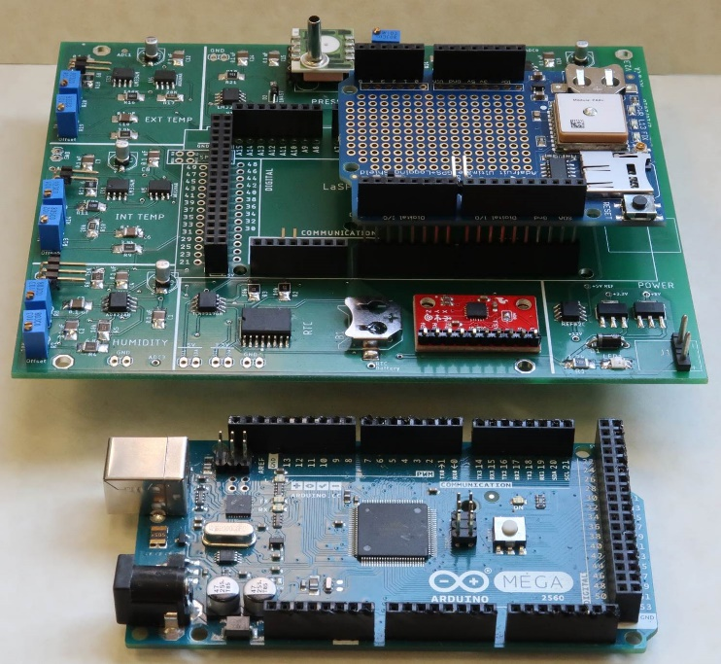
LaACES MegaSat Stack
The core of the payload will be the LaACES MegaSat that includes
Two temperature sensors, one humidity sensor, one pressure sensor, 3-axis accelerometer, 3-axis gyroscope, and a real-time clock with backup battery
Payload controller will be the Arduino Mega.
Will have the Adafruit Ultimate GPS Logger shield for GPS data throughout the flight and recording NMEA data on a SD card.
The prototype area on the Adafruit GPS shield or a separate proto-shield board can be used to interface with other sensors.
Construction of MegaSat shield is done in parallel with other required activities
The team will need to include in planning
The components that will be part of the payload
Time needed to construct the MegaSat shield
How to interface additional sensors to the Mega
LaACES MegaSat payload stack

Slide 12
Management and Communication
Management and communication are key components of successful projects
Communication skill building is embedded in LaACES
How to use and maintain your Laboratory Notebook
Technical report writing
Payload design reviews, documents, and presentations
Project Management and team-work are common in the technical workforce.
The project management lifecycle and structure
System design
Developing the project tasks, schedule, and costs
Risk management
Developing your team contract

Slide 13
Flight Certification Requirements
Student Teams will need to complete the following in order to be allowed to fly:
PDR, CDR, and FRR documents must be delivered by the milestone date and approved by LaACES Management
Payload must complete a thermal / vacuum system test in April
Deliver a payload meeting all flight string requirements
Successful FRR Defense, must be approved by LaACES Management

Slide 14
Project Phases & Major Reviews
All projects complete roughly the same phases from inception to completion
DESIGN
PDR
DEVELOPMENT
CDR
FABRICATION
INTEGRATION
OPERATION
FRR
TESTING

Slide 15
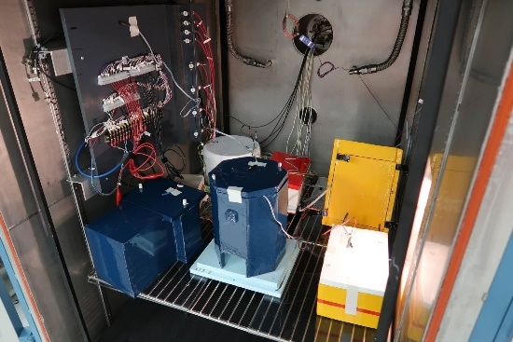
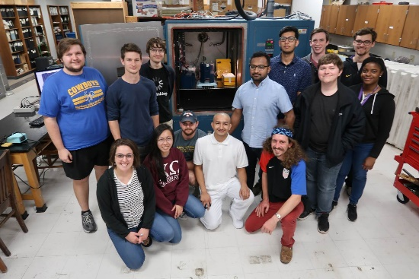
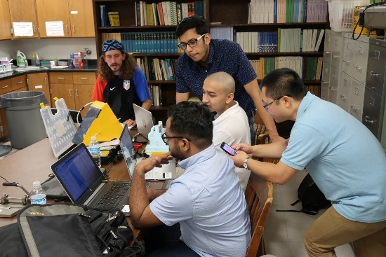
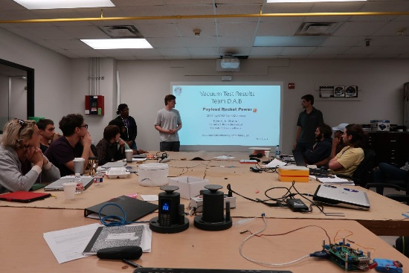
Thermal / Vacuum System Test
Use LSU thermal / vacuum chamber to simulate the extremes of balloon flight
All LaACES teams from across Louisiana come to this system test in late April
All payloads are supposed to be flight ready and configured for flight
Payloads are cold-cycled and heat-cycled while under the vacuum equivalent of 100,000 feet
Test data is analyzed and presented by the end of the day by all teams

Slide 16
Deliverables Schedule
Temperature Calibration Report October 10, 2025
Capstone Report December 7, 2025
PDR February 13, 2026
CDR April 3, 2025
Thermal / Vacuum Test (at LSU) April 24, 2026
FRR May 11, 2026
LaACES Launch Trip May 17, 2026 – May 22
FRR Defense Presentation (at CSBF) May 18, 2026

Slide 17
Example Science topics
Radiation Intensity as a function of altitude
Measure intensity of UV bands as function of altitude to deduce properties of ozone layer
Directly measure concentration of O₃, NO_{x}, CO_{x} gases as a function of altitude using solid state sensors
Develop a system to measure air flow (e.g. hot wire anemometer) at high altitudes (i.e. very low pressure).
Investigate methods to optimize atmospheric temperature measurements
Investigate thermal flow and conductivity of boundary layer around payload
Develop an inertial sensing system which will provide sub-minute of arc orientation knowledge

Slide 18
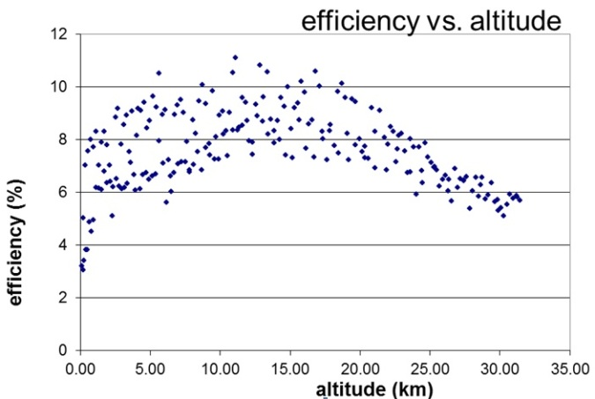
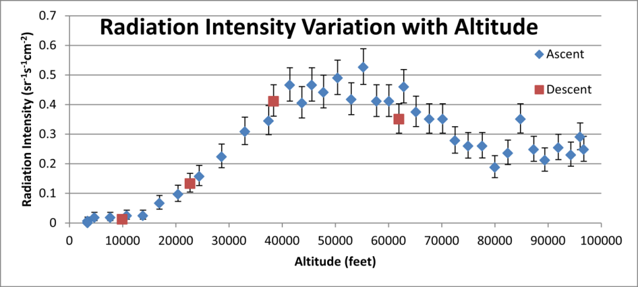
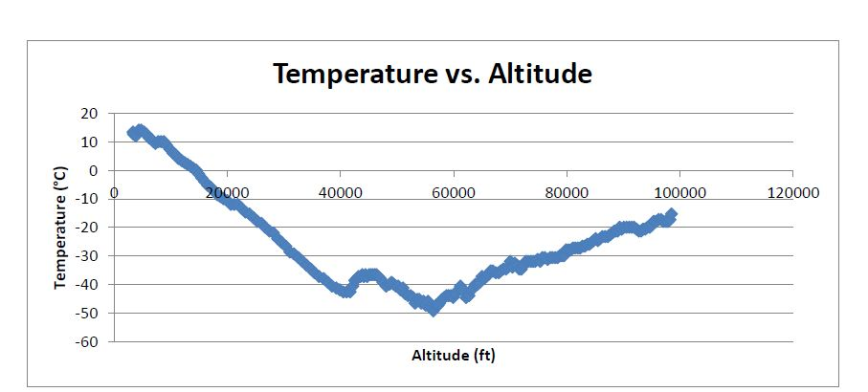
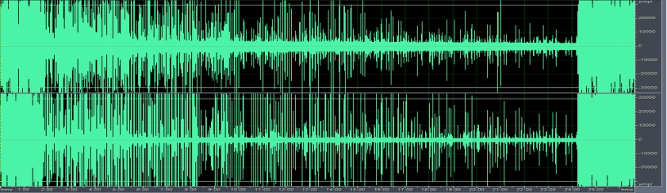
Different Science Topics can be Investigated
ACES07: Solar Cell Efficiency vs Altitude.
ACES16: Cosmic Ray Intensity as a function of Altitude
ACES06: Sound Waveform from Tropopause
(ascent) back through the Tropopause (descent.)
ACES16: Team Space Cadets, Temperature Altitude Profile.

Slide 19
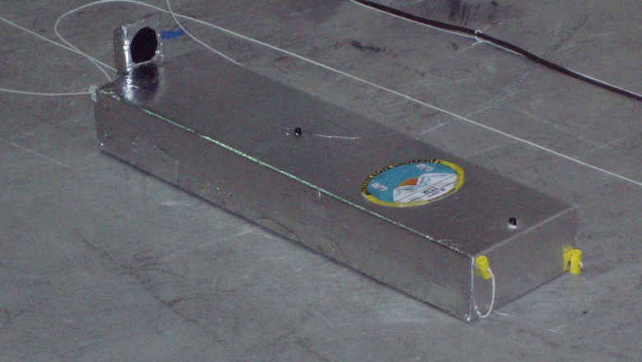
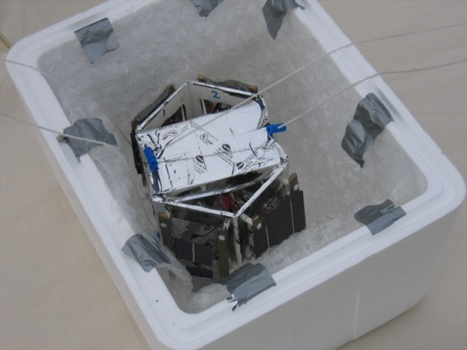
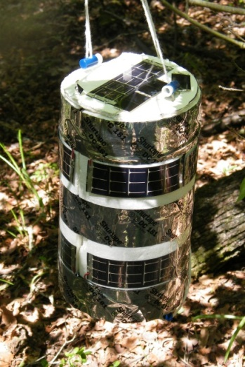
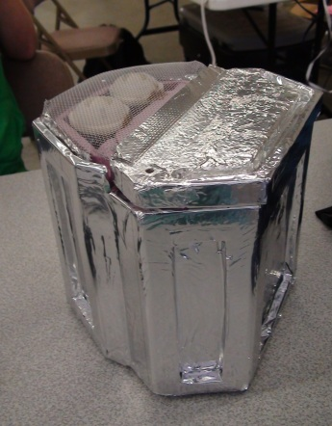
Completed Payloads
ACES12: University of New Orleans
ACES09-10: McNeese State University
ACES06: Louisiana State University
ACES16: Louisiana State University

Slide 20
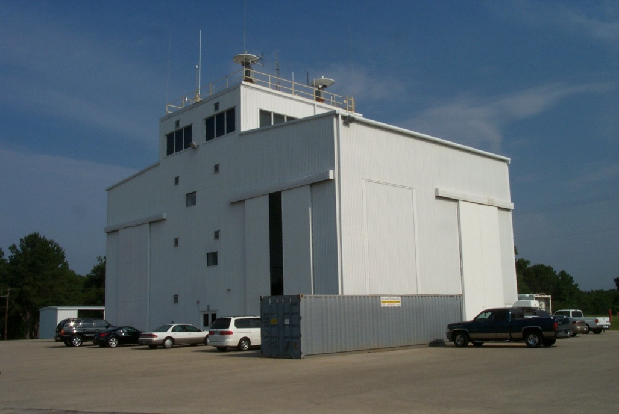
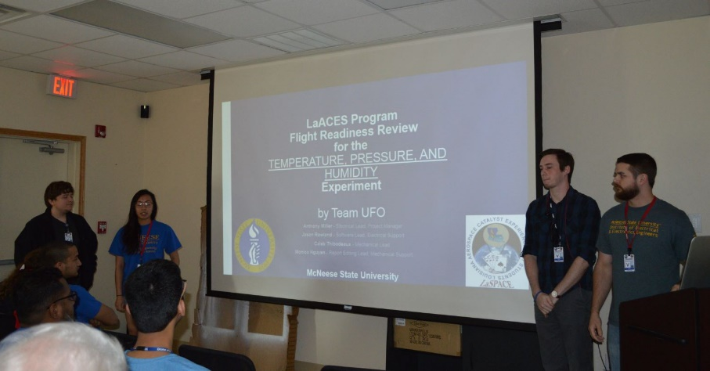
LaACES Launch Week
For 2025 National Scientific Ballooning Facility in Palestine, TX will host the LaACES Launch
Launch date set for the fourth week in May
Must successfully complete FRR prior to flight
Students presenting their FRR
ACES-01 was assembled and tested in this NSBF hanger

Slide 21
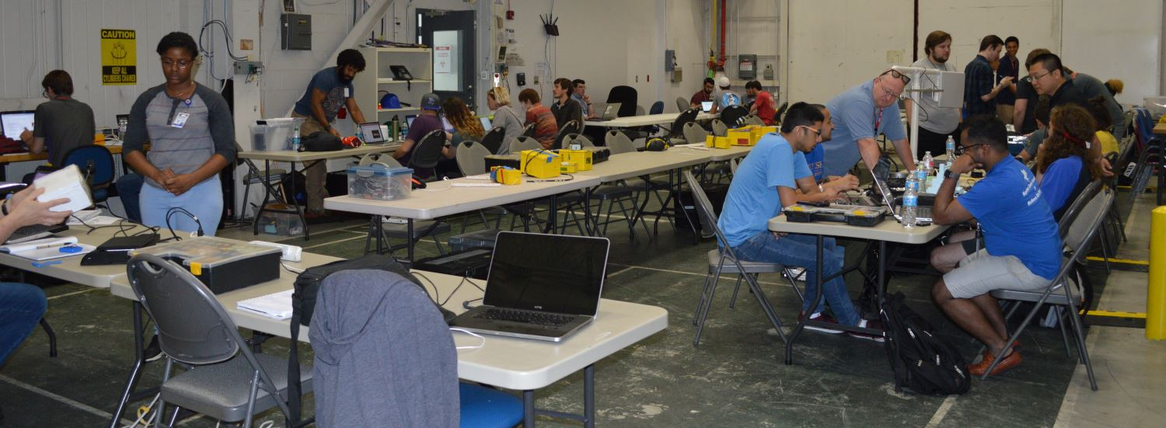
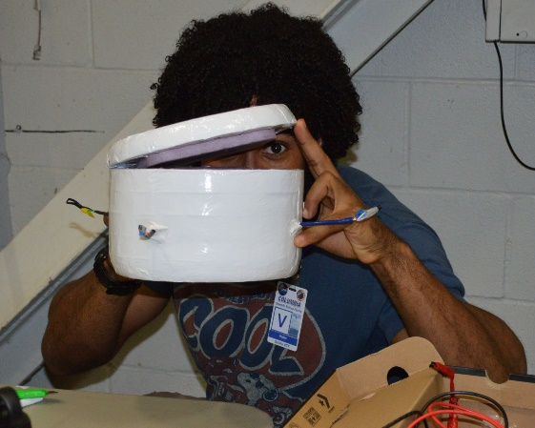
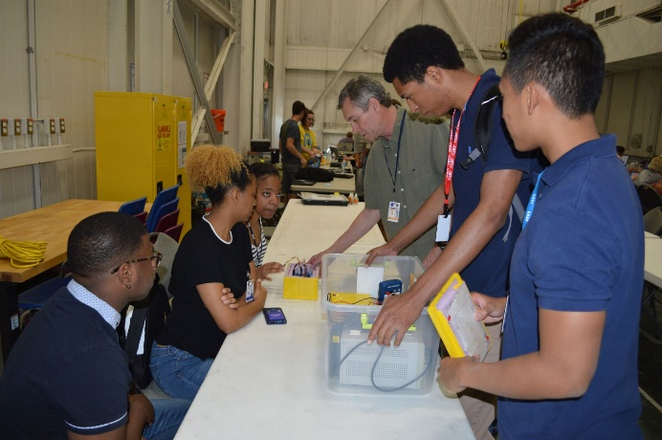
Launch Preparation
Teams perform last minute fixes, adjustments and initializations
Payloads must be on the flight string by Monday afternoon in order to be flown

Slide 22
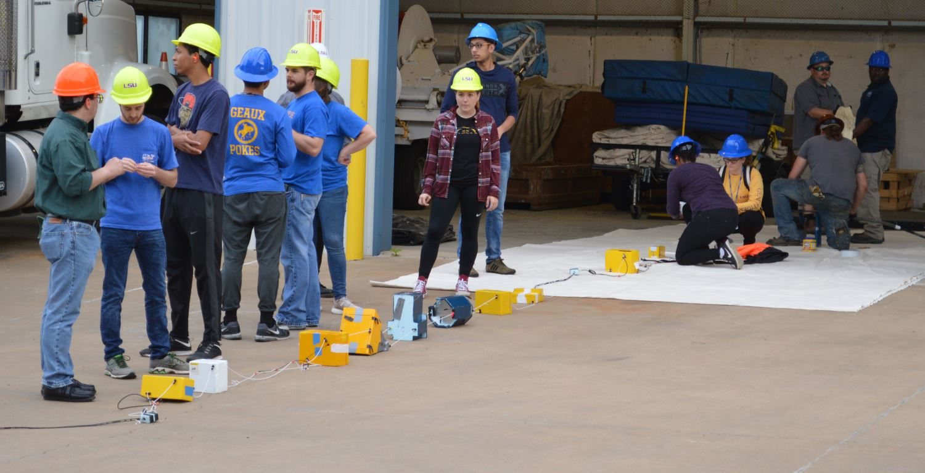
A Typical Flight String
“Tracker” radio beacon
Primary radio beacon
MSU UFO
Xavier
Balloon attach, cut, parachute
Iridium beacon
MSU Radio
Video camera
Test Arduino Beacon
MSU Tachyos
ACES-60 total suspended weight: 4.960 kg or 10.9 pounds

Slide 23
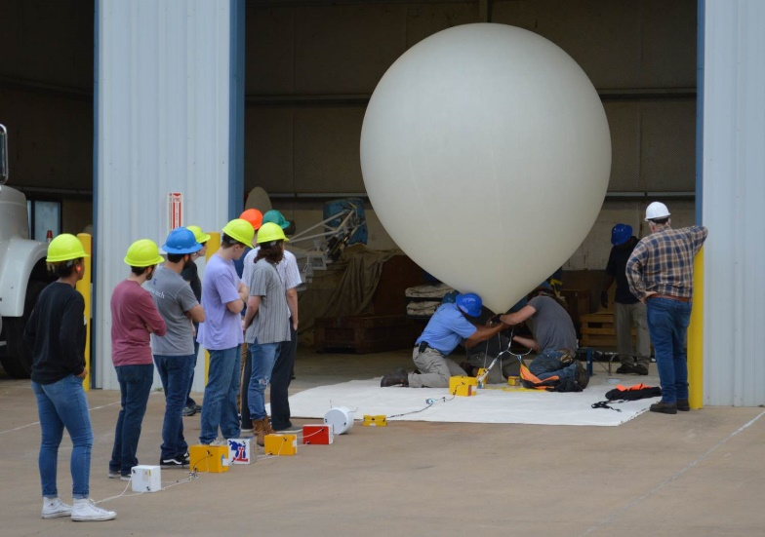
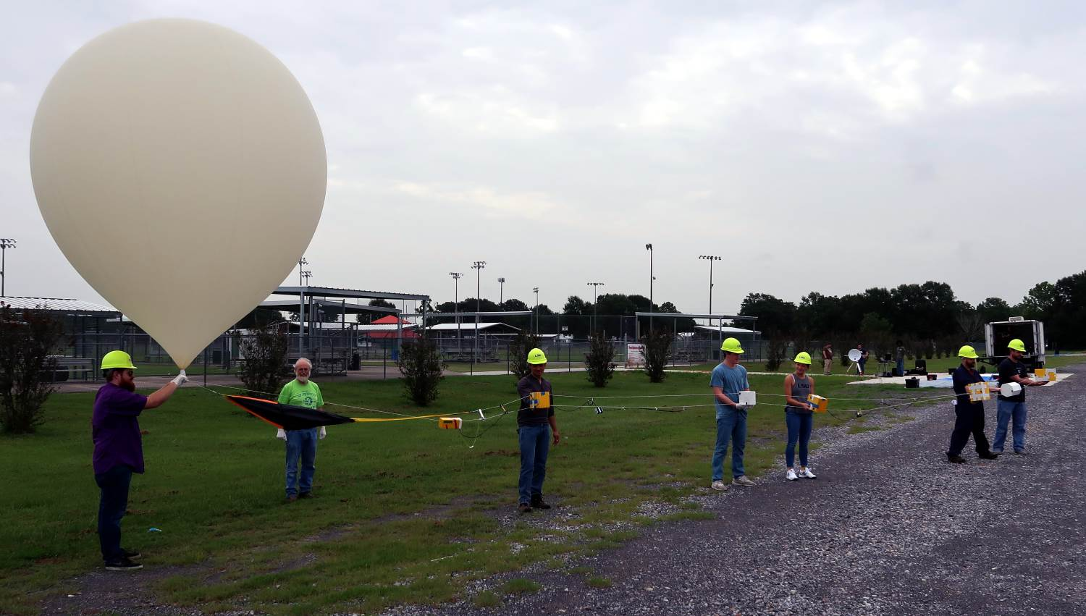
Launch Day
Can begin early Tuesday morning at 5 AM
Teams make final payload flight preparations (power on, tape box shut)
Teams will assist in inflation and holding the flight string for launch
Countdown… Launch!

Slide 24
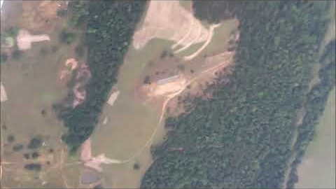

Slide 25
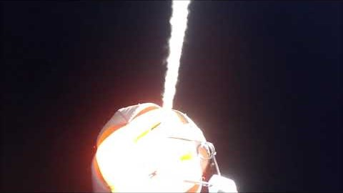

Slide 26
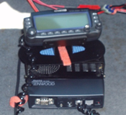
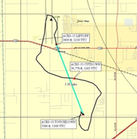
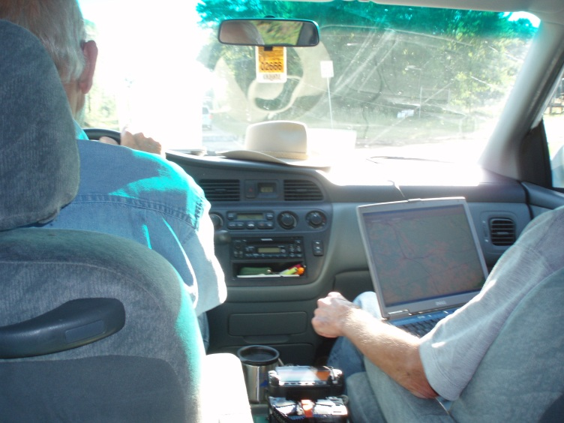
Tracking The Payload
Vehicles outfitted with Amateur Radio Band radios and tracking computers
Automatic Position Reporting System (APRS) report position and receives reported positions
The flight beacon reports the balloon’s position
Laptops track the balloon and chase vehicles
Chase vehicles stay within line-of-sight of the balloon
Cut down command is by the primary at preprogrammed altitude

Slide 27
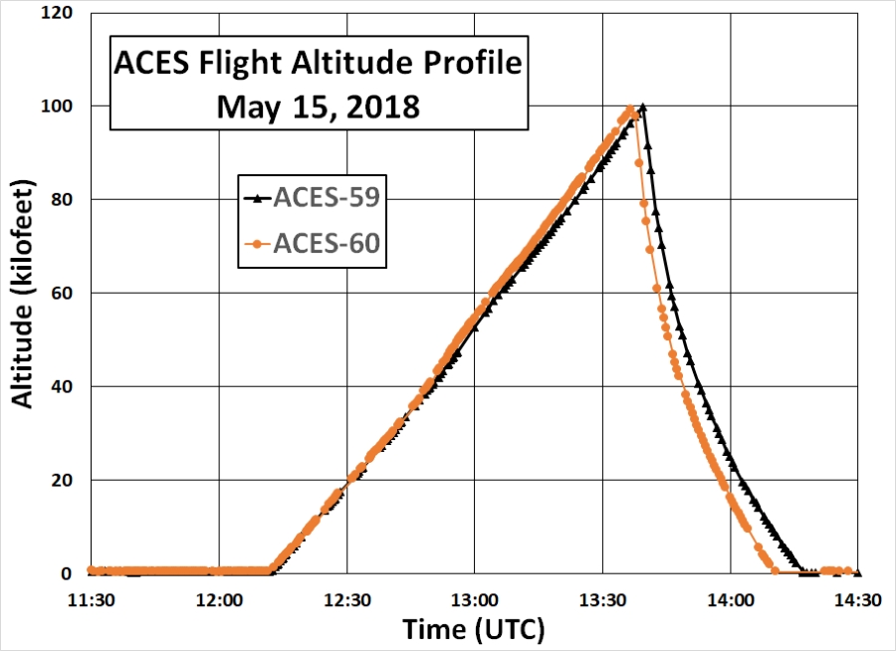
Typical flight profiles

Slide 28
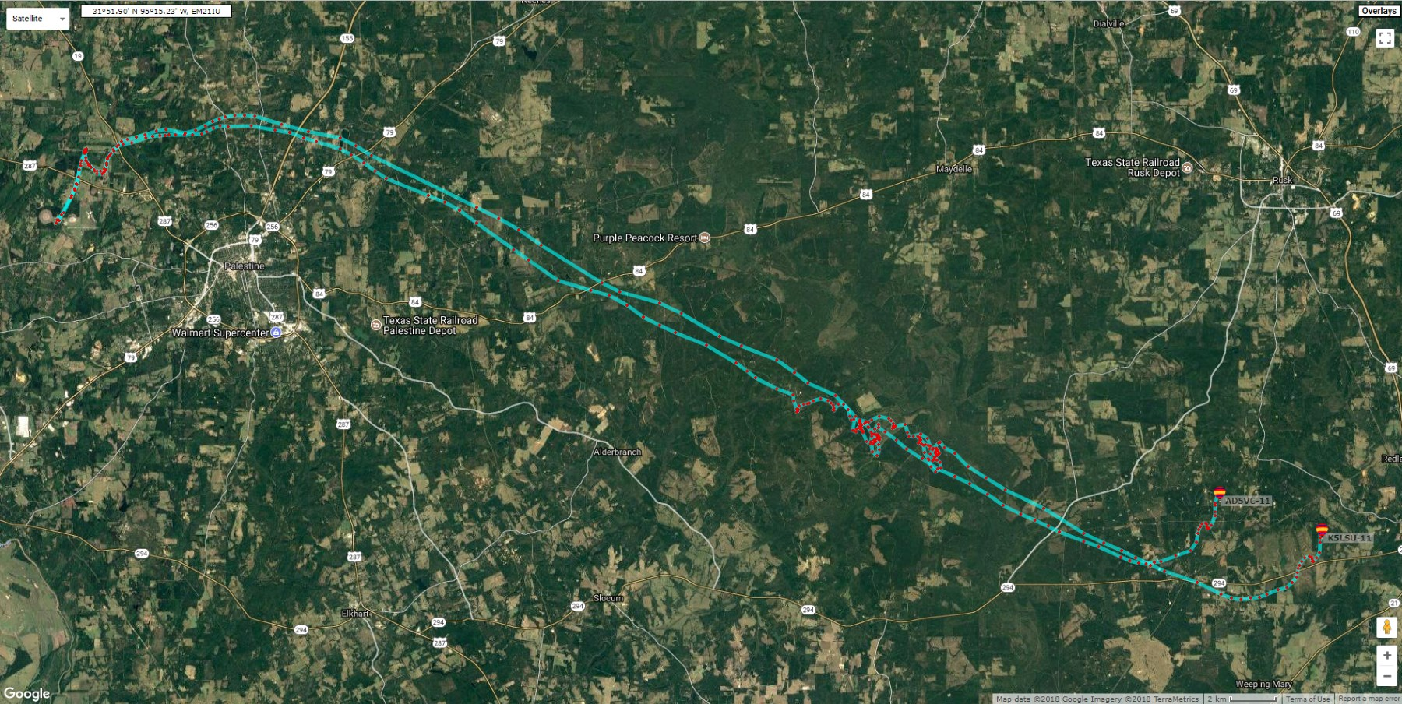
ACES-59 & ACES-60 Flight Paths

Slide 29
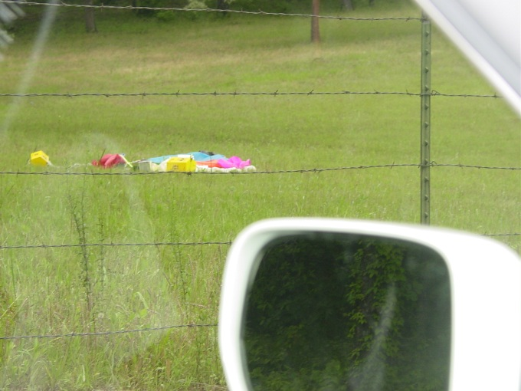
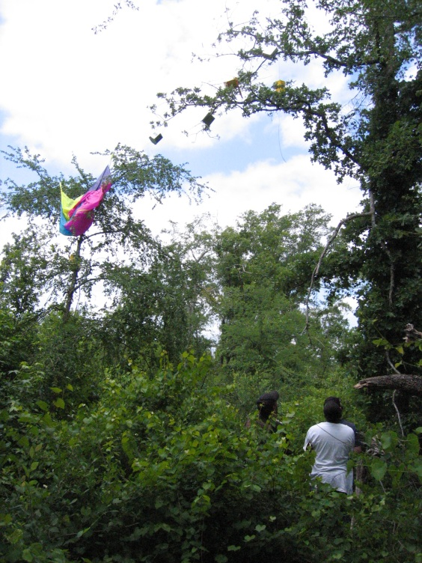
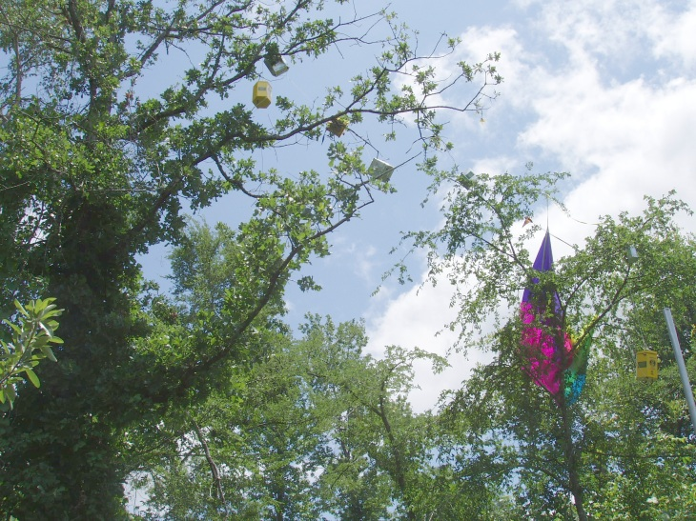
Recovery
Payload lands 45 minutes after cut-down command issued
The tracking team is at the landing site upon landing
Recoveries range from easy to very difficult
An assortment of recovery tools is brought to assist

Slide 30
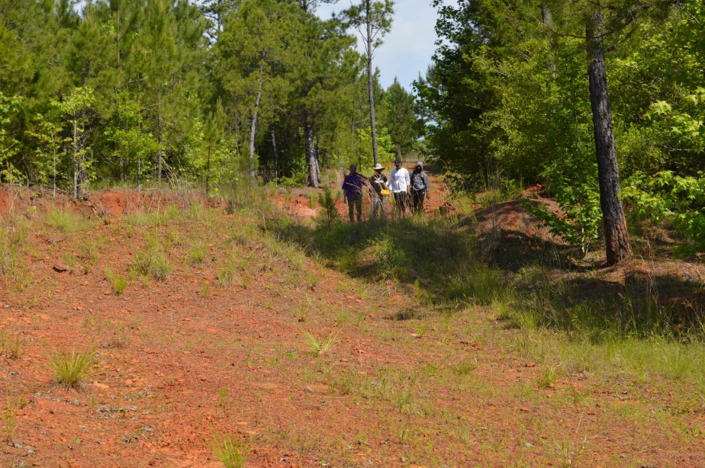
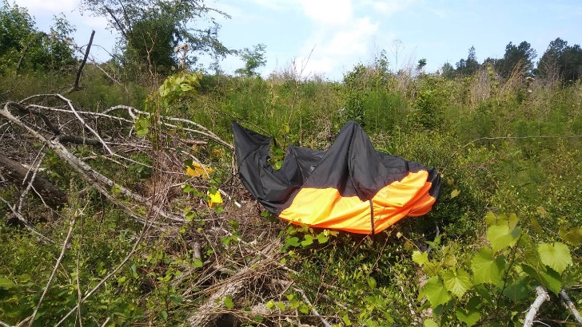
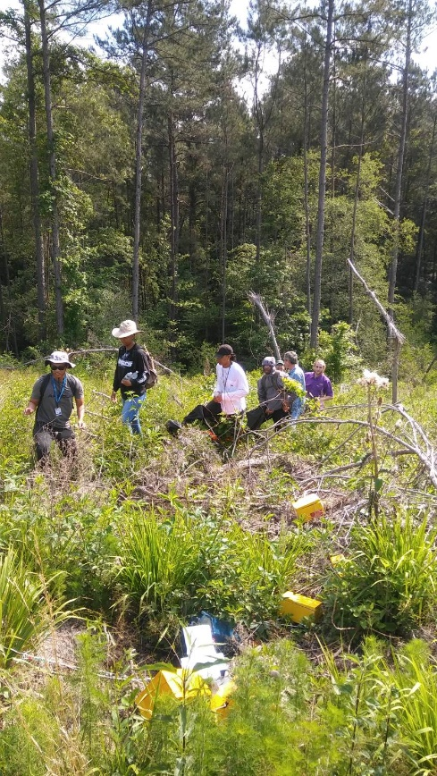


Sometimes recovery is easy

Slide 31




Sometimes not so easy

Slide 32





LaACES is always fun plus you end up learning something

