Slide 1
L02.03
The Operational Amplifier

Slide 2
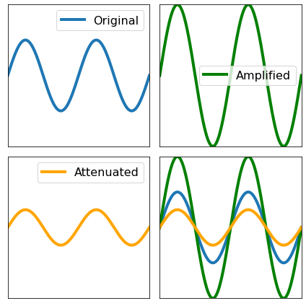
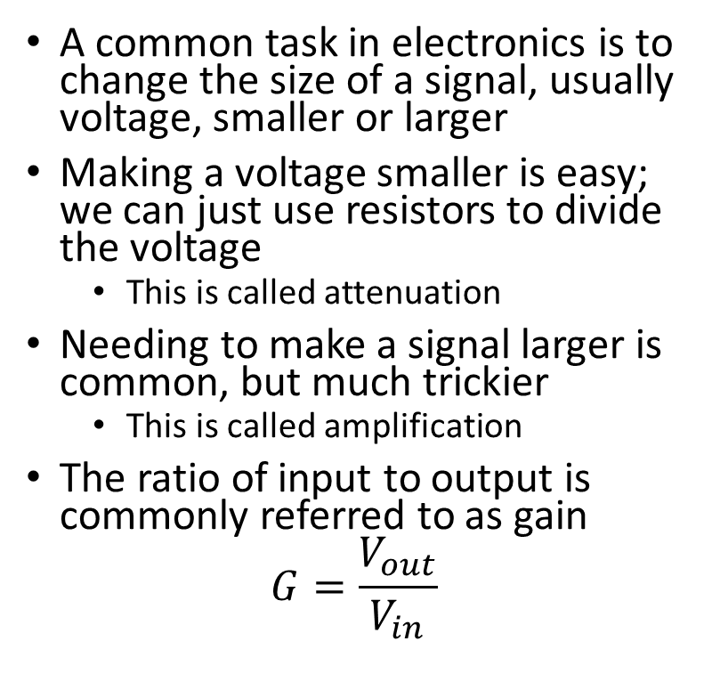
Amplification and Attenuation
A common task in electronics is to change the size of a signal, usually voltage, smaller or larger
Making a voltage smaller is easy; we can just use resistors to divide the voltage
  This is called attenuation
Needing to make a signal larger is common, but much trickier
  This is called amplification
The ratio of input to output is commonly referred to as gain
$$G=\frac{V_{out}}{V_{in}}$$

Slide 3
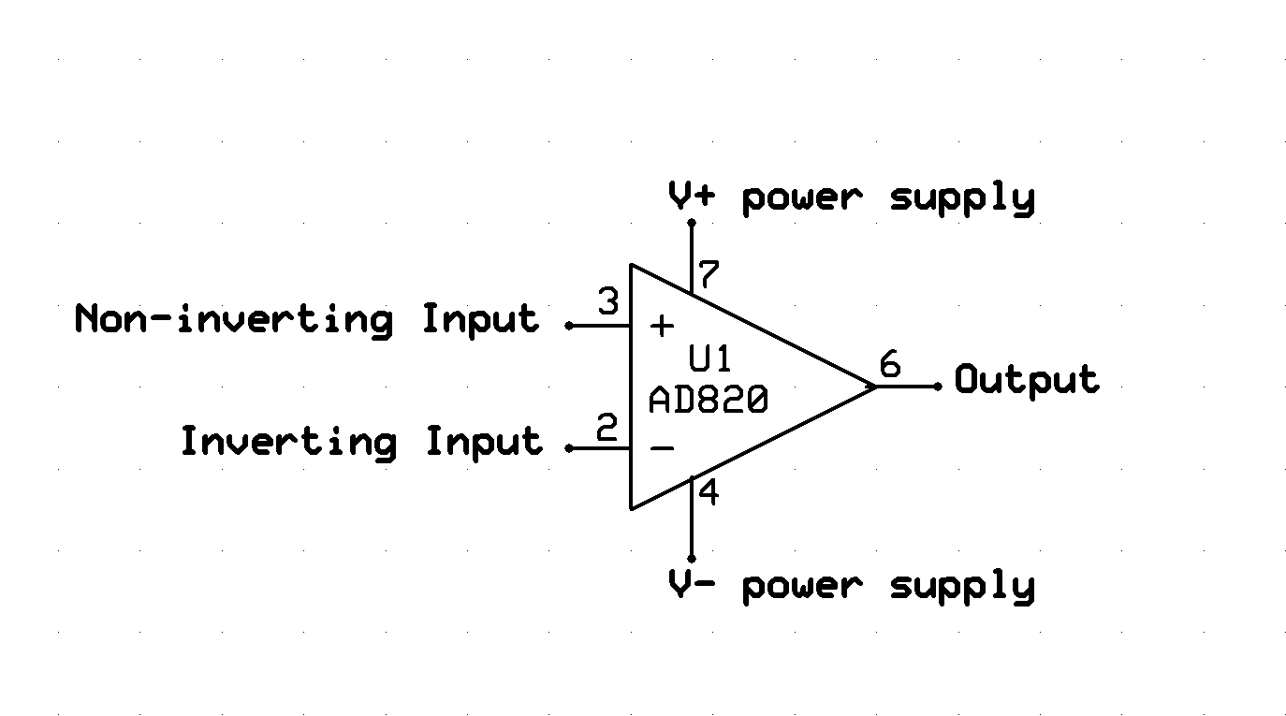
Operational Amplifier or “Op Amp”
A commonly used IC, the Op Amp, can be used to do this.
The symbol below is a standard Op Amp, only the part and pin numbers are specific to a particular model.

Slide 4
Op Amp Connections - Power
Vcc+ Supply
Vcc- Supply
  Often connected to 0V or GND
  Will sometimes be connected to a negative voltage for negative outputs
It is common not to draw these connections on schematics to simplify drawing
Power supplied by the output will be drawn via these connections

Slide 5
Op Amp Connections - Inputs
V_{in+} (V₊)
  Non-inverting input
V_{in-} (V₋ )
  Inverting input
The input signal V_{in} will be connected to one of these two pins

Slide 6
Op Amp Connections - Output
V_{out}
  The amplifying circuit will be set to change this the desired behavior
  Connects back to one of the inputs to create a feedback loop
  Maximum Out V_{out}=V_{cc+}
  Minimum V_{out}=V_{cc-}

Slide 7
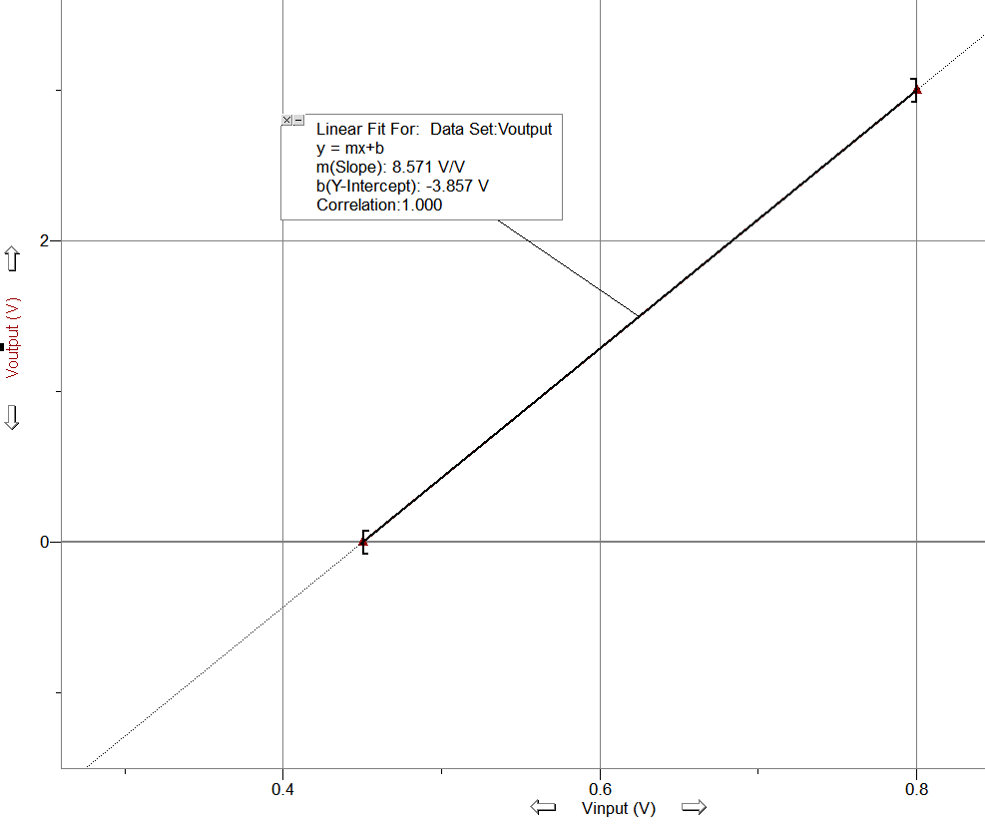
Transfer Function
Op Amps create a linear relation between V_{out} and V_{in}, with V_{out} on the Y-axis and V_{in} on the X-axis
The slope is called gain
The intercept is called the offset
You look at your input voltages, determine your desired output voltages, and then plot the line to determine your desired transfer equation

Slide 8
Op Amp Golden Rules
To determine the circuit needed to give us the transfer equation we use following rules:
Infinite Open Loop Gain. (V_{out} will vary to meet the other rules)
No voltage difference between the inputs. (V₊=V₋)
No current flow in or out of the inputs (I+=I-=0A)
By combining these with Ohm’s law and Kirchoffs Law, we can determine the resistor arrangement we need to give us the performance we want.
Set up the equations the solve for V_{out}

Slide 9
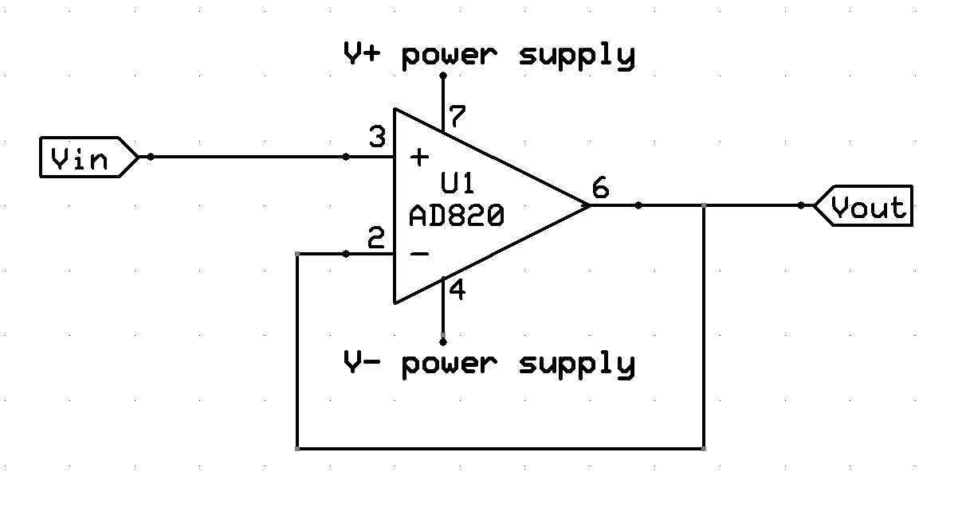
Signal Conditioning Circuit
Example 1: Buffer
Simplest Case:
Connect the V_{out} back to either input
V_{in}=V₊
V₊=V₋ (Rule II)
V₋=V_{out} (Directly Connected)
Therefore: V_{in}=V_{out}

Slide 10
Signal Conditioning Circuit
Buffer usage
This may seem like a silly example, but it is actually quite useful.
The input is isolated from the output by the Op Amp.
Current on V_{out} comes from the supply, not V_{in}. So a low-power Vin could be used to drive a high-power output.
Gain of Buffer
Vin = Vout
Gain=1

Slide 11
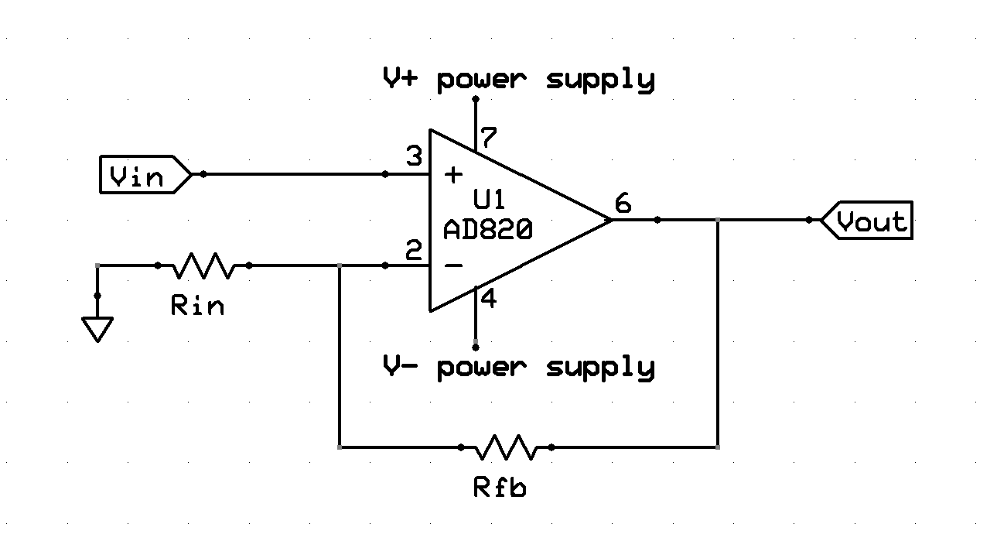
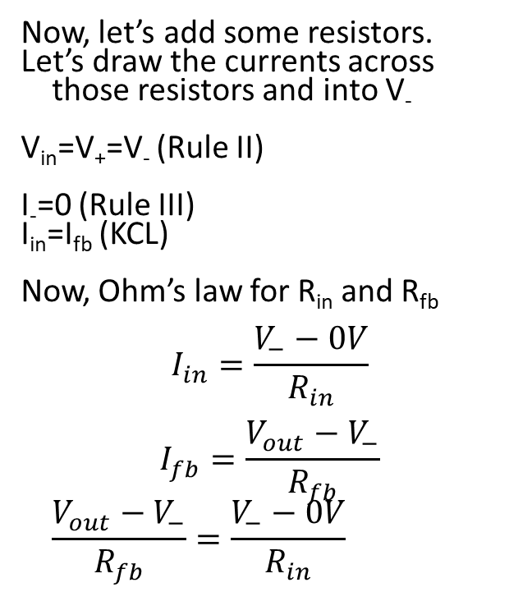
Non-Inverting Amplifier Example
Now, let’s add some resistors.
Let’s draw the currents across those resistors and into V₋
V_{in}=V₊=V₋ (Rule II)
I₋=0 (Rule III)
I_{in}=I_{fb} (KCL)
Now, Ohm’s law for R_{in} and R_{fb}
$$I_{in}=\frac{V_{−}−0V}{R_{in}}$$
$$I_{fb}=\frac{V_{out}−V_{−}}{R_{fb}}$$
$$\frac{V_{out}−V_{−}}{R_{fb}}=\frac{V_{−}−0V}{R_{in}}$$
I_{in}
I₋
I_{fb}

Slide 12
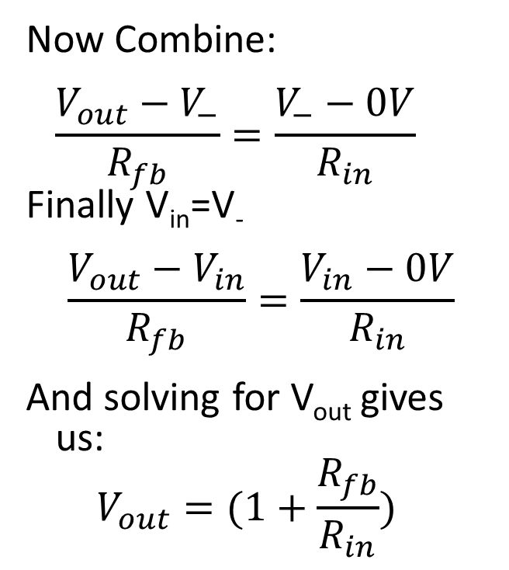
Non-Inverting Amplifier Example
Now Combine:
$$\frac{V_{out}−V_{−}}{R_{fb}}=\frac{V_{−}−0V}{R_{in}}$$
Finally V_{in}=V₋
$$\frac{V_{out}−V_{in}}{R_{fb}}=\frac{V_{in}−0V}{R_{in}}$$
And solving for V_{out} gives us:
$$V_{out}=(1+\frac{R_{fb}}{R_{in}})$$
I_{in}
I₋
I_{fb}

Slide 13
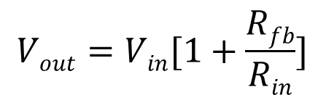
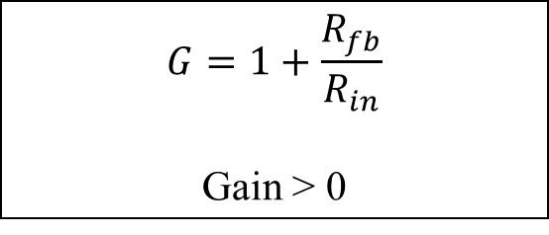
Non-Inverting Amplifier Usage
Non-inverting Op Amps have V_{in} connected to the positive terminal.
It does not flip the signal, so it is “Non-inverting”.
We could do a similar analysis to derive the equations more amplifiers but will just show some common types along with their transfer equations
$$G=1+\frac{R_{fb}}{R_{in}}$$
Gain > 0

Slide 14
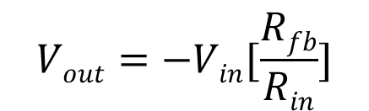
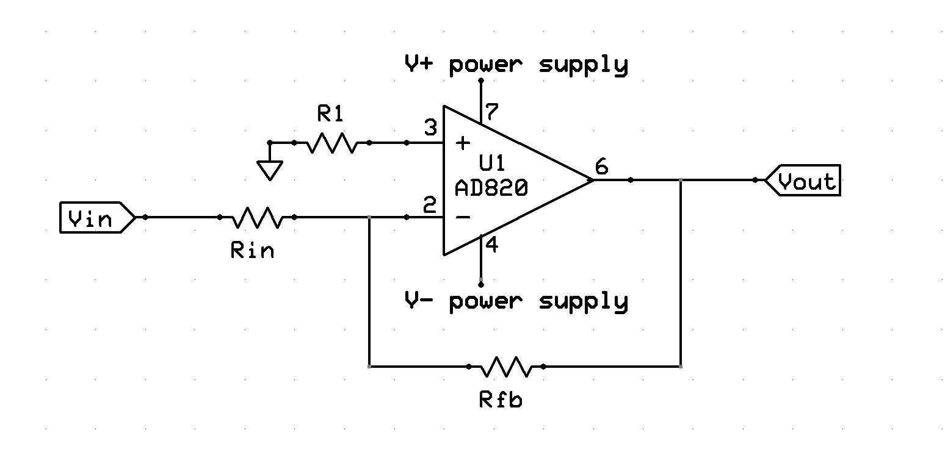
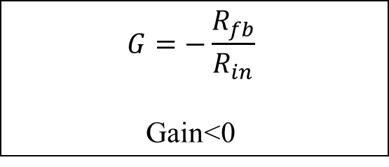
Inverting Amplifier
Inverted op amps have Vin connected to the negative terminal.
Signal is inverted over 0V.(flipped).
Note: the gain is negative so it is important to consider the sign of Vin and if Vs- is negative or zero
$$G=−\frac{R_{fb}}{R_{in}}$$
Gain<0

Slide 15
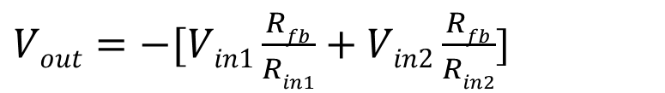
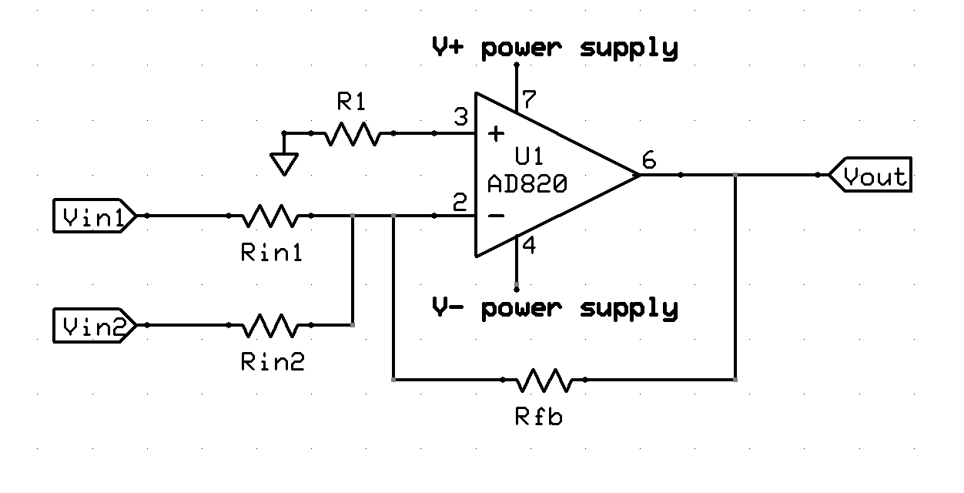
Summing Amplifier
Summing op amps have multiple inputs connected to a single input.
The output is a weighted sum of the inputs.
Can be inverting (shown here) or noninverting,

Slide 16
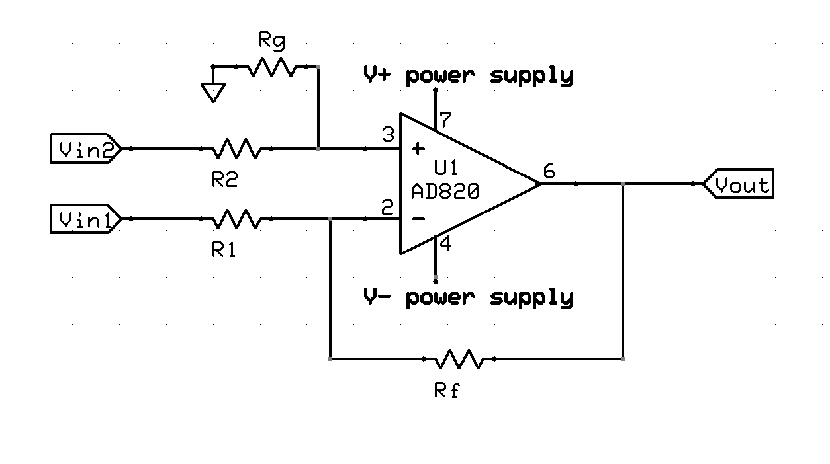
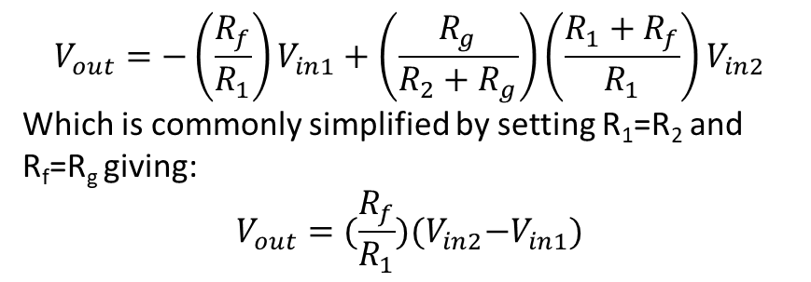
Difference Amplifier
$$V_{out}=−{\left(\frac{R_{f}}{R_{1}}\right)V}_{in1}+\left(\frac{R_{g}}{{R_{2}+R}_{g}}\right){\left(\frac{R_{1}+R_{f}}{R_{1}}\right)V}_{in2}$$
Which is commonly simplified by setting R₁=R₂ and R_{f}=R_{g} giving:
$$V_{out}={(\frac{R_{f}}{R_{1}})(V}_{in2}−V_{in1})$$
It amplifies the difference between the two signals.

Slide 17
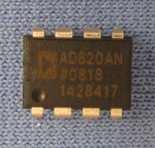
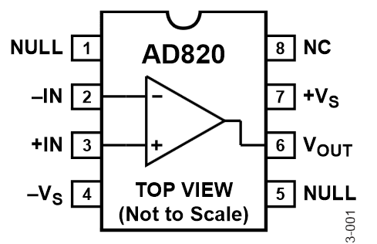
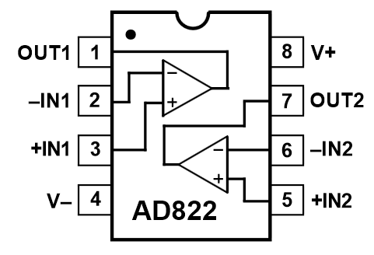
Operational Amplifier ICs
Commonly come in Single(1x), Dual(2x), and Quad(4x) Packages
In those cases, the amplifiers share a common set of power supply pins and have individual input and output pins
To the right, we can see the single and dual versions of a common Op Amp
  Notice the physical package is the same but the pins, in particular the power pins, are in different spts

Slide 18
Other Amplifier Variations
A common variation is to add an offset to previous examples, which shifts the entire signal by a constant amount up and down
  We will do this in the Temperature Calibration Activity
By adding capacitors and or inductors you can make the gain of a circuit depend on a frequency, this allows you to filter undesirable signals (like high frequency RF noise) out
It is also common to send the output of one amplifier to the input of another. Giving multiples stages of amplification.

