Slide 1
Lecture L02.02
Electronic Components and Schematics
Common Electrical Components, Basic Applications, and Schematic Symbols

Slide 2
Nets and Nodes
A line connecting one or more components is called a net or wire
It represents that the components are electrically connected
  Could be a physical wire, component leads, breadboard, or PCB connections
Where wires cross, the connection can be ambiguous
  A can be assumed to be connected
  Styles C and D to the right are preferred since they are clear
  Intersection E is ambiguous
A net

Slide 3
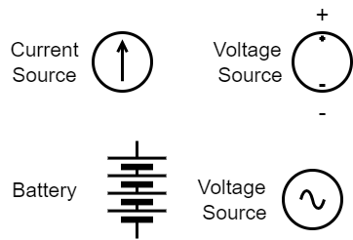
Power Sources
Voltage and Current Sources apply a fixed voltage or current where drawn
The could be batteries or power supplies or other sources
Batteries sometimes used the special symbol shown to the right
  The longer horizontal line represents the positive terminal

Slide 4
Symbols for Ground
The two triangular symbols are often used to indicate a common 0V for the circuit, which will call ground
When labeled “Earth” it indicates an actual connection to a conductor driven into the soil.
“Chassis” means an electrical connection to the metallic case of chassis of a device

Slide 5
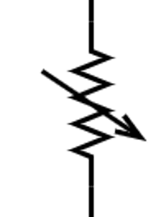
Adjustable and Variable components
Most common components have a variant that can change its value based on outside input
  This could be a manual adjustment, like a set screw or a response to temperature or light
This is usually indicated by an arrow drawn over the symbol
Note these are intentional, engineered changes, most components also have a temperature dependence, which is not a desired effect

Slide 6
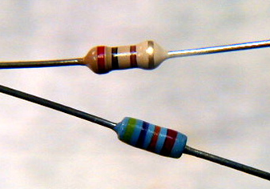
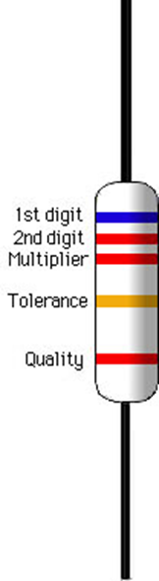
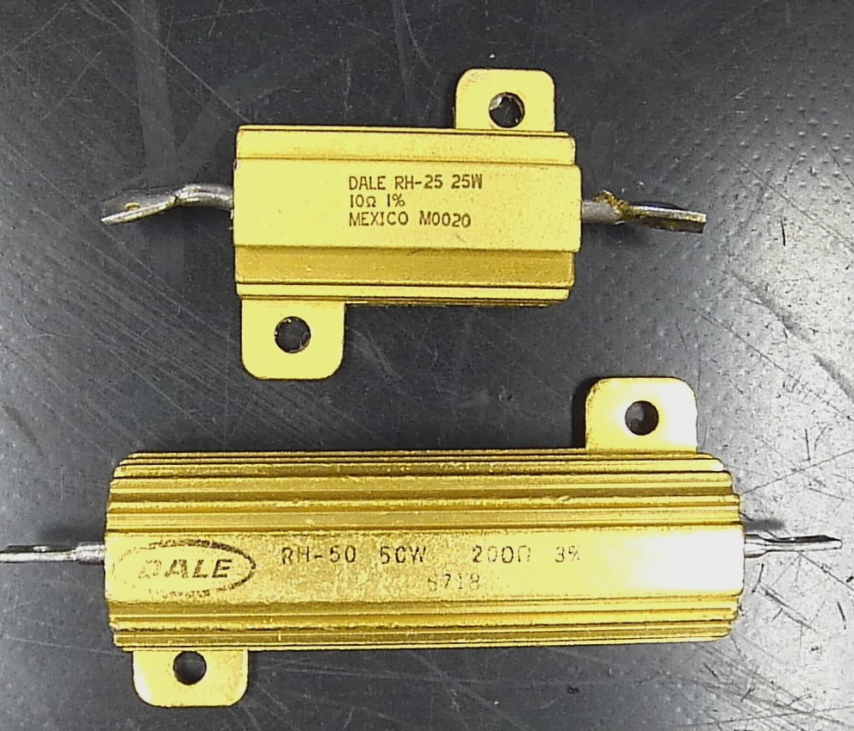
Resistors
Designed to provide resistance in a circuit for a broad array of applications
Because they dissipate power as heat high high-power rated resistors my have heat sinks
Nonpolarized
Commonly marked with value using a color code
  For exam to the right the RED-BLACK-BROWN-Gold Resistor
  Is 20x10¹ (200 Ohm) with a 5% tolerance
(uncommon)
0 1 2 3 4 5 6 7 8 9 5% 10%
Big Bears Run Over Your Gladiola Bed Vexing Garden Worms
Notes:
There have been various other ditties used in the past to remember the color code. Most are unsuitable for polite company.
When the tolerance band is not present, 20% tolerance is assumed.
Some precision resistors will have three “significant digit” bands before the multiplier band.

Slide 7
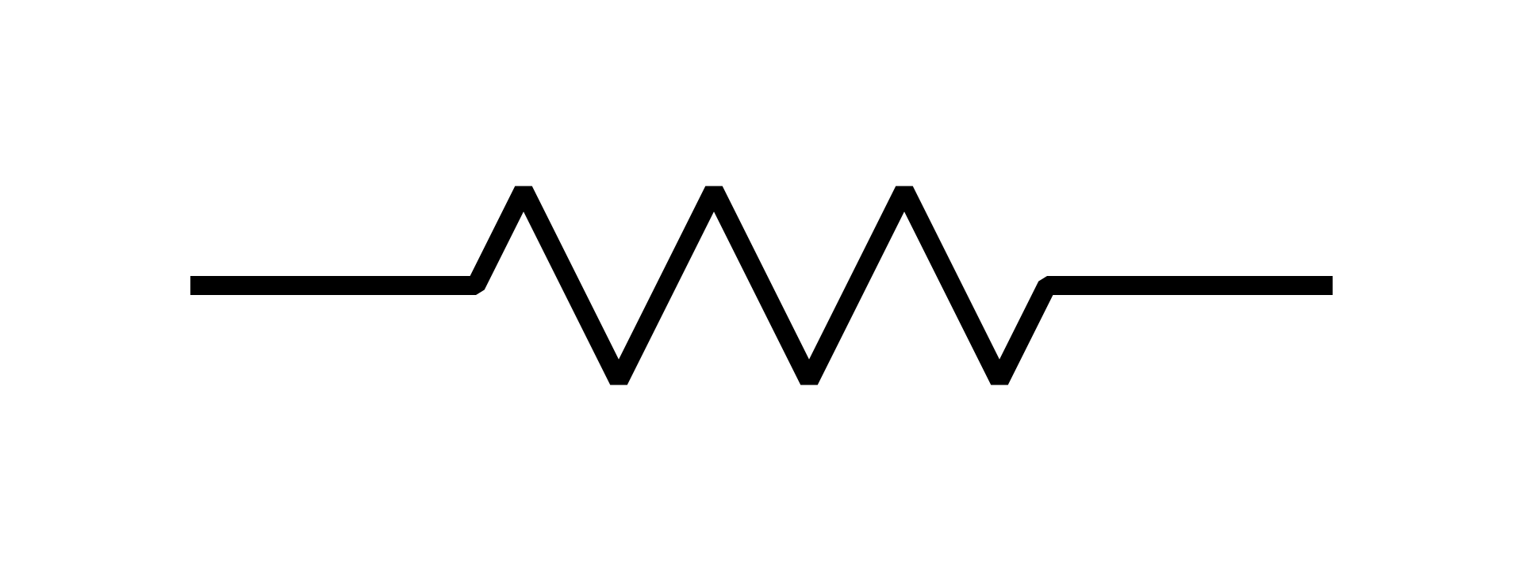
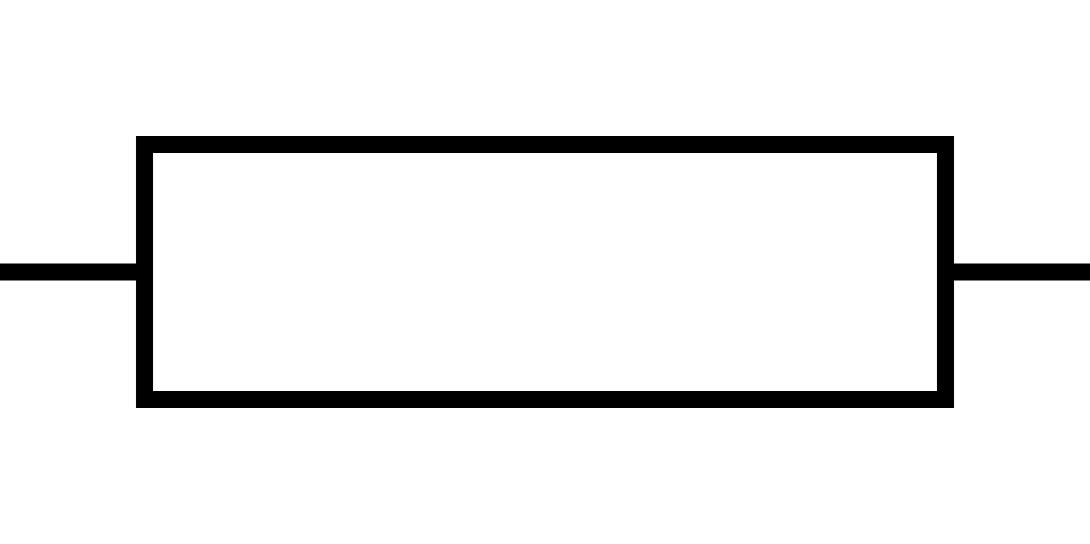
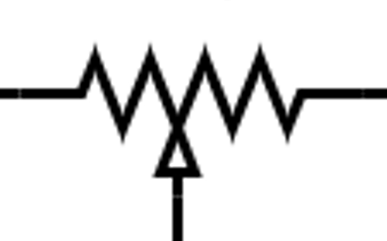
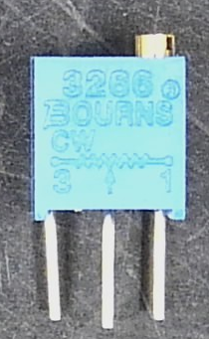

Resistor Schematic Symbols
Variable adjustable resistors called potentiometers are a very common component
  Have a knob or screw for adjusting the middle contact/lead
  The middle lead taps off the resistor creating resistors that always add up to a fixed total value
    For example in a 10KOhm “Pot” you could set A-B to be 3000 Ohm, B-C 7000 Ohm
    By connecting the middle lead to one end we can bypass the second half of the resistor, creating a variable resistor you can change from ~0-Max Value
Resistor Symbol
Common Variant
A B C
Potentiometers

Slide 8
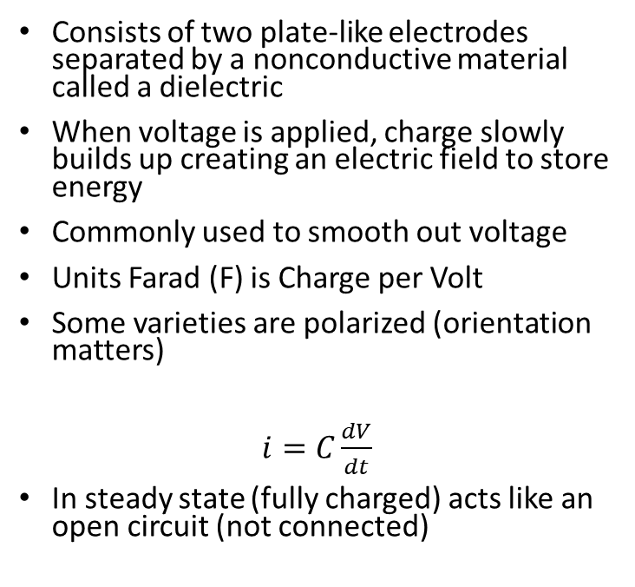
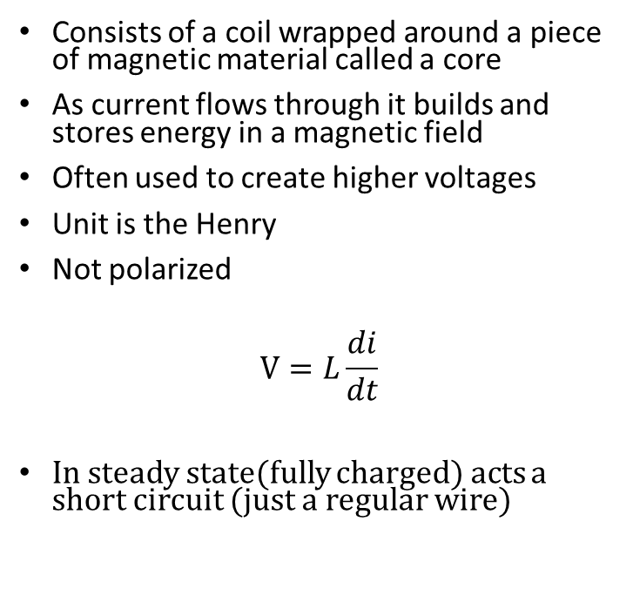
Capacitors and Inductors
Capacitors
Inductors
Consists of two plate-like electrodes separated by a nonconductive material called a dielectric
When voltage is applied, charge slowly builds up creating an electric field to store energy
Commonly used to smooth out voltage
Units Farad (F) is Charge per Volt
Some varieties are polarized (orientation matters)
$i=C\frac{dV}{dt}$
In steady state (fully charged) acts like an open circuit (not connected)
Consists of a coil wrapped around a piece of magnetic material called a core
As current flows through it builds and stores energy in a magnetic field
Often used to create higher voltages
Unit is the Henry
Not polarized
$$V=L\frac{di}{dt}$$
In steady state(fully charged) acts a short circuit (just a regular wire)
Notes:
The nanofarad (nF) is commonly used in Europe, but that nomenclature is rare in USA and Canada.
Polarized capacitors are often referred to as electrolytics because the plate and dieletric structures are formed by a chemical reaction involving an electrolyte.

Slide 9
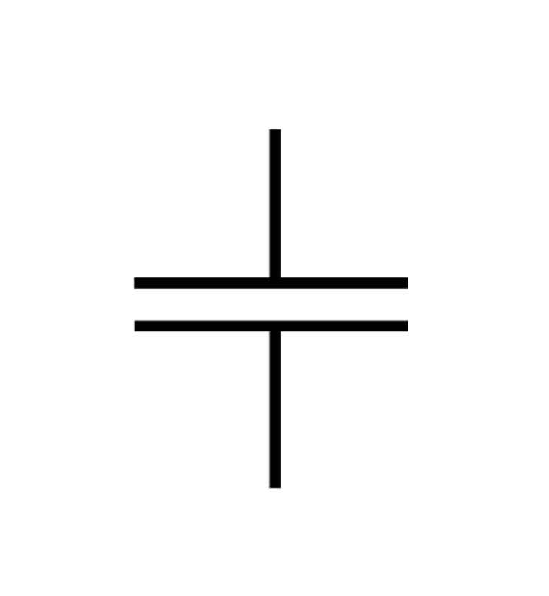
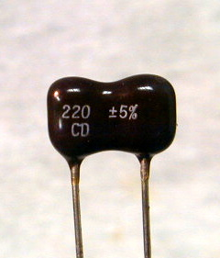
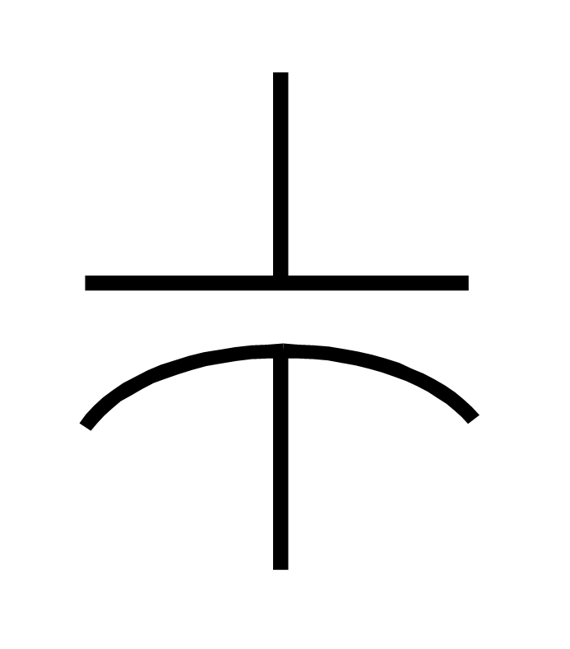
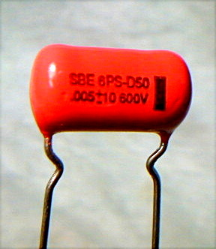
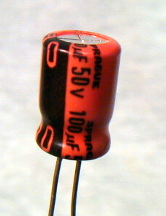
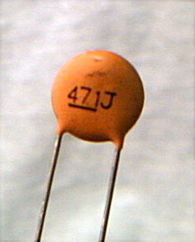
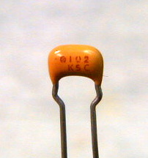
Capacitor Packages and Symbols
Nonpolarized Capacitors
Polarized Capacitors

Slide 10
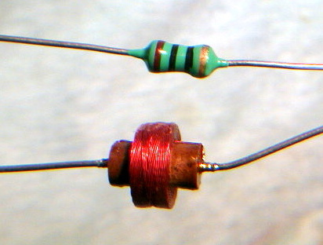
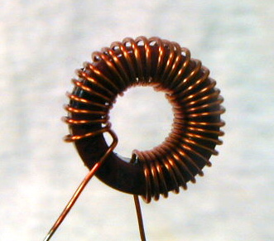

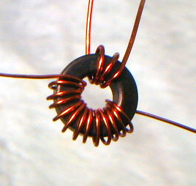
Inductor Packages and Symbols
A related component is a transformer
Two coils magnetically coupled by a common core
Allowes
Notes:
Ferrite and iron powder inductor cores are often made in the form of toroids, since a toroidal coils is self-shielding, that is, its magnetic flux is confined to the interior of the core. Toroidal transformers are widely used in high frequency circuits because of this self-shielding property.

Slide 11
Semiconductor Components
The previous components all worked are basic principles of electric and magnetic fields and linear relationships between current and voltage
The remaining devices use semiconductor materials (silicon, germanium, gallium, …) to create very non-linear behavior
  Older Vacuum tube-based versions are still used in some applications
Semiconductor devices
  Diodes
  Transistors
  Integrated Circuits

Slide 12
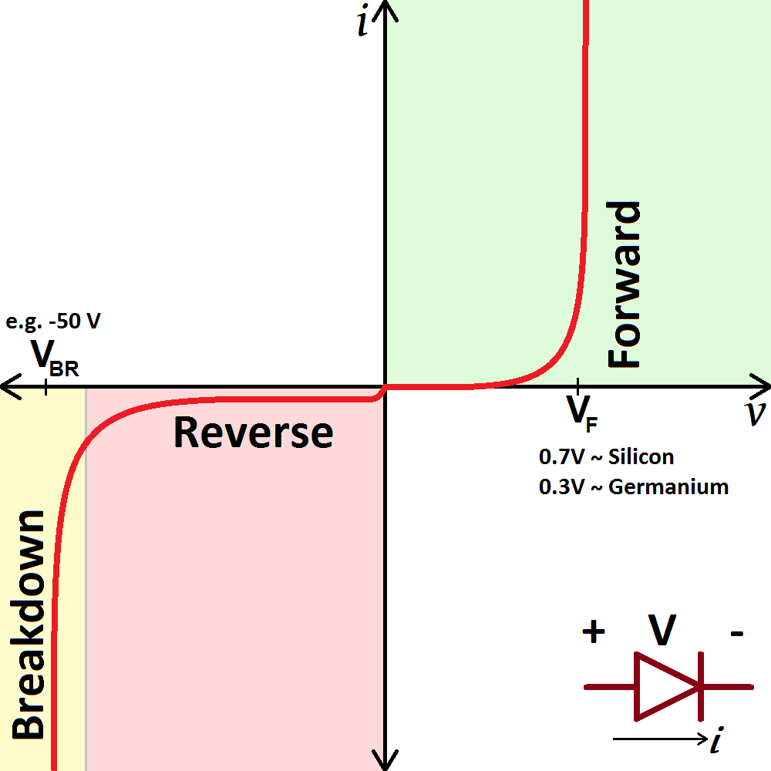
Diodes
Diodes create a small energy barrier to charge flow in the forward direction
Once overcome by reaching V_{f} that voltage drop remains the same regardless current, leading to vertical V vs I region
The diode blocks current in the reverse direction (except for a small trickle of current) until a higher breakdown voltage is reached V_{br}
These characteristics allow the diode to regulate the direction of current flow or create
Typical Diode Voltage Vs Current

Slide 13
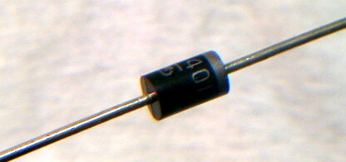
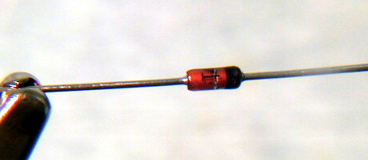
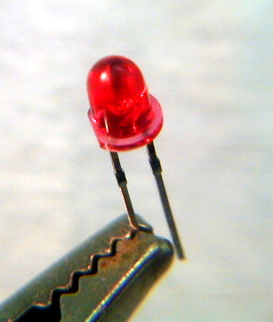
Diodes Appearance and Symbols
Diodes inherently have a direction with the (+) side called the Anode and (-) cathode
Physical Packages usually have a band or stripe for the cathode, matching the symbol
A common usage is to convert the energy into light
  Since V_{f} is fixed and the charge is fixed (electrons have –e), the wavelength of light emitted is fixed
Anode(+) Cathode(-)
Light-emitting diode (LED)

Slide 14
Transistors
Three terminal devices
The signal at the left terminal (Gate or Base) controls the flow of charge between the two other connections (Drain and Source or Collector and Emitter)
Commonly used either as a switch or an amplifier (creates a large signal from a small signal)
2 Types that differ on the underlying technology, Field Effect Transistors (FETs) and Bipolar Junction Transistors (BJT)
Each of those has 2 types that depend on the behavior of the Gate/Base to positive or negative signals
  NPN and PNP for BJTs
  N-Channel and P-Channel for FETs
Field Effect Transistor
Gate
Drain
Source
Bipolar Junction Transistor
Collector
Base
Emitter
Notes:
The first transistor was fashioned at Bell Labs in 1948.
The circuit symbols are, left to right,
- NPN bipolar junction transistor (BJT)
- PNP bipolar junction transistor
- N channel junction field effect transistor (JFET)
- P channel junction field effect transistor
- P channel metal oxide on semiconductor, insulated gate, field effect transistor (MOSFET or IGFET)
- N channel metal oxide on semiconductor, insulated gate, field effect transistor

Slide 15
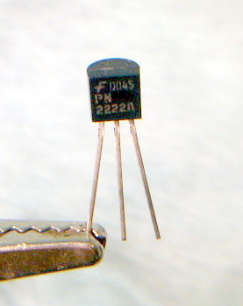
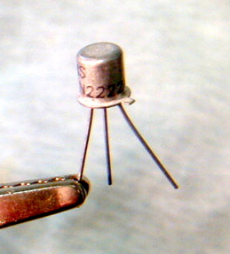
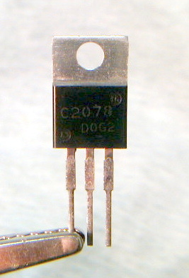
Terminal Designations and packaging styles
BJT PNP
Transistor
BJT NPN
Transistor
TO-92 package
TO-18 package
Physical form usually depends on the application rather than the type, so you usually cannot ID without looking up the part number
P-channel FET Transistor
N-channel FET Transistor
TO-220 package

Slide 16
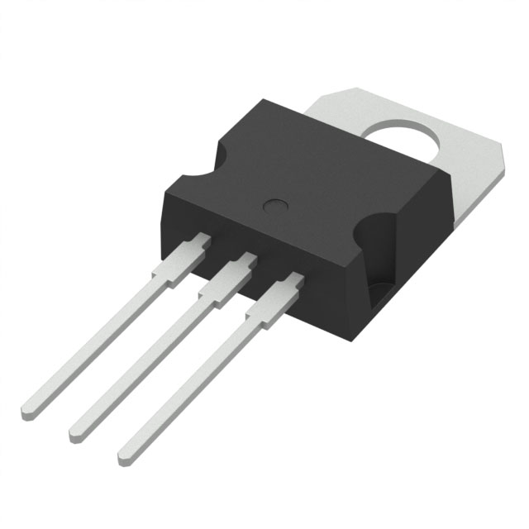
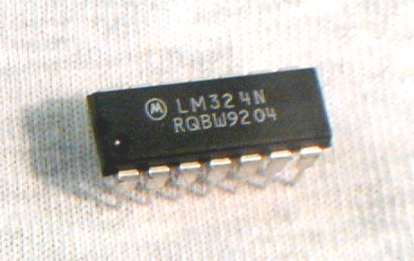
Integrated Circuits
Integrated circuits are purpose-designed devices that combine a specific circuit into a single discrete package
They can be general use, like an amplifier, or very specific, like a clock
  We will discuss one important type called and Op. Amp later
Come in a wide variety of physical shapes and sizes, but are marked with a manufacturer (Motorola Logo to the right), part number (LM324N), and lot number (RQBW9204)

Slide 17
Pin identification and numbering convention
Pin 1 is often identified with a dot or an indentation
The pin 1 end of the chip is often identified with a notch, with pin 1 being on the left when the notch is up
Pins are numbered sequentially in a counterclockwise direction
  Notice how pin is directly across from pin 7, and pin 14 across from 1 in the example to the right
Since the pins have different functions, you must pay attention to the numbering on schematics
ICs can be susceptible to ESD (Static electricity) damage (many actually are), so rigorous precautions should be taken.
Take care not to damage the pins when removing or installing the chip
Pin 8
Pin 14
Notch
Dimple
Pin 7
Pin 1
This is a common package called PDIP, where the pins come in 2 rows, designed to be soldered in through hole boards or installed in sockets

Slide 18
Switches
Switches are mechanical devices that physically move or break electrical continuity in a circuit
They are usually referred to by the number of moving switching elements (called poles) and the number of positions they can be in (called throws)
A dashed lined
Single Pole Double Throw
SPDT
Double Pole Double Throw
DPDT
Single Pole Single Throw
SPST
Double Pole Single Throw
DPST

Slide 19
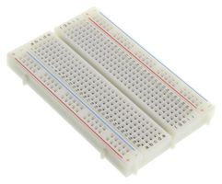
Solderless Breadboards
Used to construct and prototype TEMPORARY circuits
  After testing, you will want to transfer the circuit to a Printed Circuit Board (PCB) and solder it in place
Electrical components can be connected by inserting their leads into the holes
  Metal buses connect the holes along columns and rows in a specific pattern
  Some parts may have leads that are too thin to make good contact or too thick to fit in the hole
  Parts should slide in easily but stay secure
  Use solid core wire when making connections, stranded wire will be too limp to insert

Slide 20
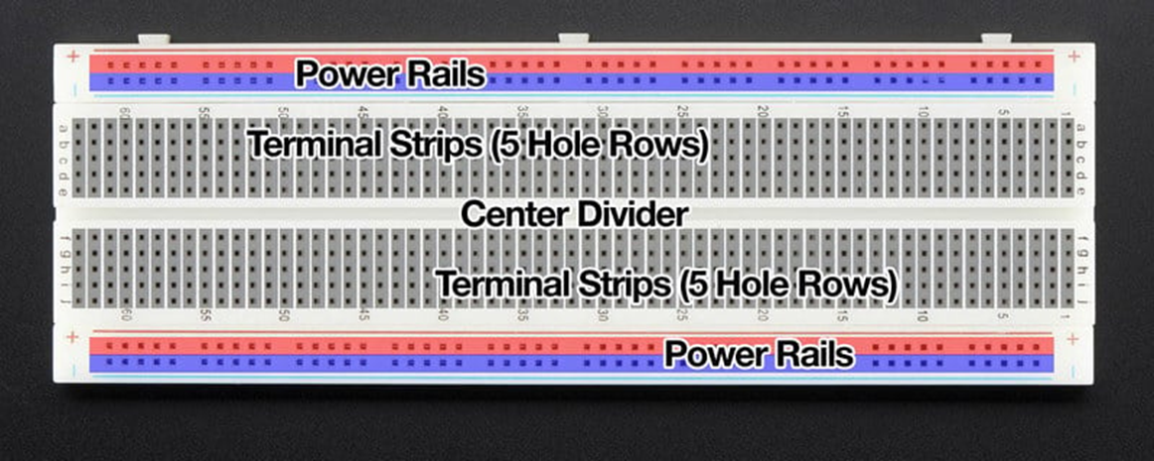
Breadboard Layout (Power Rails)
The top two and bottom two rows are connected horizontally across the length of the board
  Each row is separate and not connected to the others
These are usually connected to power since many components will need to connect to power
Even though the rows are marked with (+) and (-) feel free to ignore the markings
  I recommend using the top row for (+) power, using the different rows for different voltages (+5V and 3.3V, for example)
  Then use the bottom rows for negative/ground
  Most chips + and – pins are on opposite sides
  In this layout, power flows generally from top to bottom, which allows you to lay out your circuit cleanly
Connect the top rows to the (+) terminal of you power supply
Use the bottom rows for negative

Slide 21
Terminal Strips Layout
Terminal strips are connected in vertical columns
  Since the columns are connected to each other will very rarely want a single component’s leads connected to the same column
A gap in the middle separates the top and bottom strips
  Most components will be oriented horiztonally, unless they are long enough to jump across this gap
Terminal strips are connected in vertical columns
Center divider separates the top terminal strips from the bottom. The gap is sized to the common PDIP package. This allows installation of chip with each pin on a different terminal strip

Slide 22
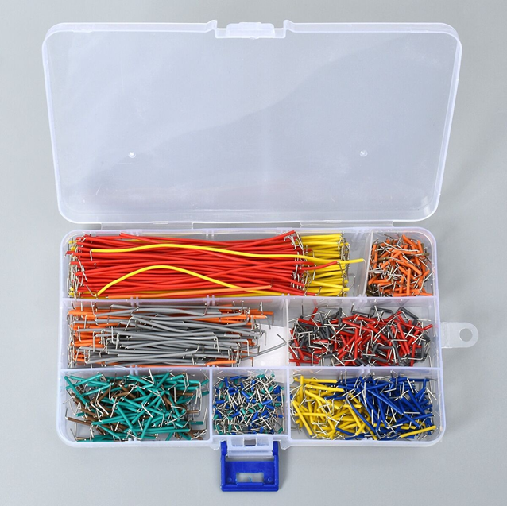
Jumper Wires
Pre-packes kits of wire can make the prototyping process
Solid wire pre-bent at 90 degrees makes installing these wires easier
They come in length matching the spacing of the breadboard holes

Slide 23
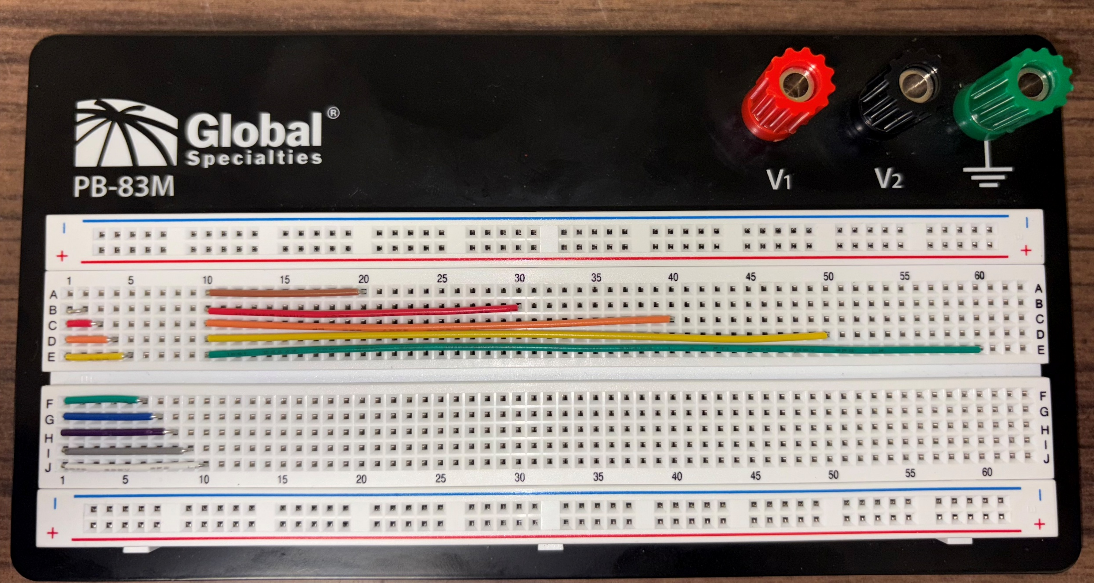
Jumper Length
Set of jumper cables will follow the same color convention as resistors, with the number of vertical or horizontal spaces
For example, an orange jumper will be able jump 3 spaces on the breadboard.
You can also use the wires diagonally or with bends as needed but the length may be slight off
The longer leads come in lengths of 20, 30, 40, and 50. These long wires are often useful for connecting devices of the board or “jumping” over other components

