Slide 1
Electrical Fundamentals
Lecture 02.01

Slide 2
In the LaACES program, you will almost certainly be building using electronics to store data, take measurements, and cause or observe changes in the environment.
This will be accomplished by measuring and manipulating a fundamental physical quantity called charge. In this lecture, we will talk about charge and a few other fundamental measurements used to describe the movement of charge in a circuit

Slide 3
Electric Charge
In the SI system, the unit of charge is the Coulomb (C)
Charge can either be positive (+) or negative (-)
  This is a fundamental physical quality; electrons and protons have opposite but equal charges
  Historically, the electron was assigned a negative charge
  A Coulomb is “large” charge compared 1 electron charge (e)
    1 e = 1.602X10⁻¹⁹ C
While electrons are usually the actual charged particles moving in a circuit, common practice is to describe things in terms of positive charges (the math is identical)
  You will likely encounter something called a hole, which is just the absence of an electron

Slide 4
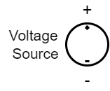
Voltage
Al Sharab
Voltage is the measure of potential energy a charge has per unit of charge
  It will sometimes be called Electrical Potential
The Unit is a Volt (V), which is 1 Joule (SI Energy) per Coulomb (SI Charge)
Voltage is defined so that a positive voltage means a positive charge has increased in energy
For example: a 1.5 V battery will cause an electron to increase its energy by 1.5x1.602x10⁻¹⁹ J (or 1.5 electron-volts)
Voltage sources usually increase the voltage, so choosing the negative terminal as 0 you would measure an increase in voltage at the positive terminal

Slide 5
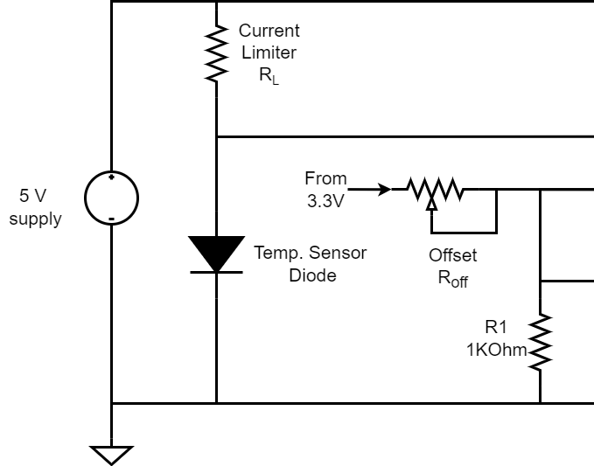
Measuring Voltage
There is no absolute 0 point in energy; we always measure Voltage as a difference relative to another point
  For single components, we often say voltage “across” the component, the difference in energy from one side to the other, ie, from the negative terminal of a battery to its positive lead
  For more complex circuits, we pick a point to be 0V (similar to picking the surface of the Earth to be 0 in gravitational potential)
  Often, you choose the negative lead of the power supply
  This may be referred to as “Ground” or indicated with special symbol
The upside-down triangle indicates ground, so discussing the circuit, we would assume voltage measurements were relative to that being 0V

Slide 6
Electric Current
Electrical current is the flow of charge through “something”
  That can be an electrical component, a wire, an individual pin of a chip, an arbitrary point in space
The unit of Current is 1 Ampere = movement of 1 Coulomb of charge per Time interval of 1 second
Current is defined as the direction positive charges are flowing

Slide 7
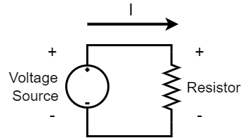
Electric Current (Direction)
Current is usually drawn with an arrow indicating the direction of flow
Often, you describe the current in relation the (+) voltage lead of a component
  We would say the current if coming “out” of the voltage source and “into” the resistor
When doing circuit analysis, you may not actually know the direction
  In that case, you pick a direction and if you get a negative value, that means the current is flowing in the opposite direction from arrow

Slide 8
Electric Resistance
Many materials and components have a simple proportional relationship between the current that passes through the component and the voltage across the component
Ohms’s Law V = R*I
V = Potential in Volts
I = Current in Amperes
R = Resistance in Ohms
The voltage will be 1V lower at the outlet of a 1 ohm (Ω) of resistance with 1 A current flowing through it compared to the inlet

Slide 9
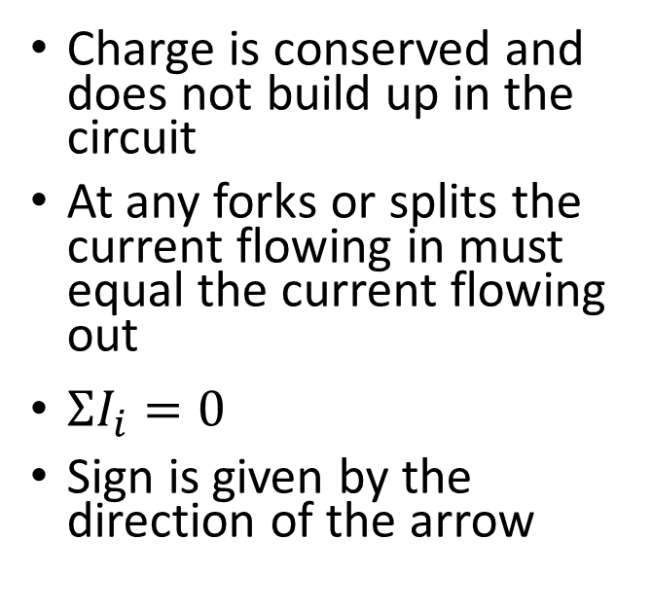
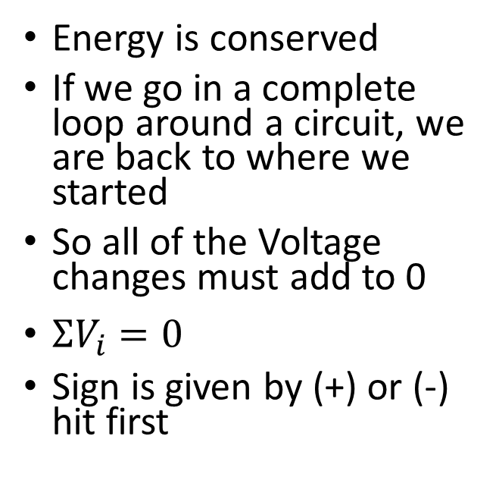
Kirchoff’s Laws
Voltage Law (KVL)
Current Law (KCL)
Energy is conserved
If we go in a complete loop around a circuit, we are back to where we started
So all of the Voltage changes must add to 0
$ΣV_{i}=0$
Sign is given by (+) or (-) hit first
Charge is conserved and does not build up in the circuit
At any forks or splits the current flowing in must equal the current flowing out
$ΣI_{i}=0$
Sign is given by the direction of the arrow

Slide 10
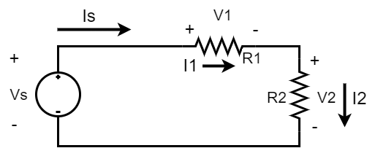
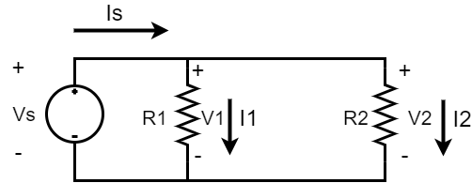
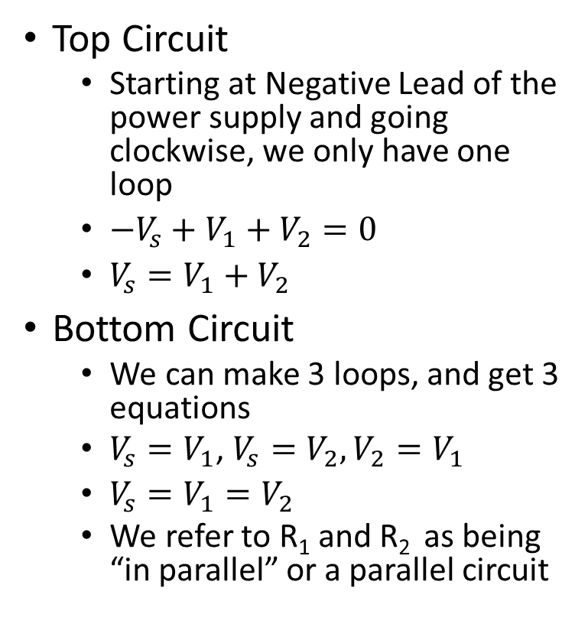
Kirchoff’s Voltage Law
Top Circuit
  Starting at Negative Lead of the power supply and going clockwise, we only have one loop
  $−V_{s}+V_{1}+V_{2}=0$
  $V_{s}=V_{1}+V_{2}$
Bottom Circuit
  We can make 3 loops, and get 3 equations
  $V_{s}=V_{1}$, $V_{s}=V_{2},V_{2}=V_{1}$
  $V_{s}=V_{1}=V_{2}$
  We refer to R₁ and R₂ as being “in parallel” or a parallel circuit

Slide 11
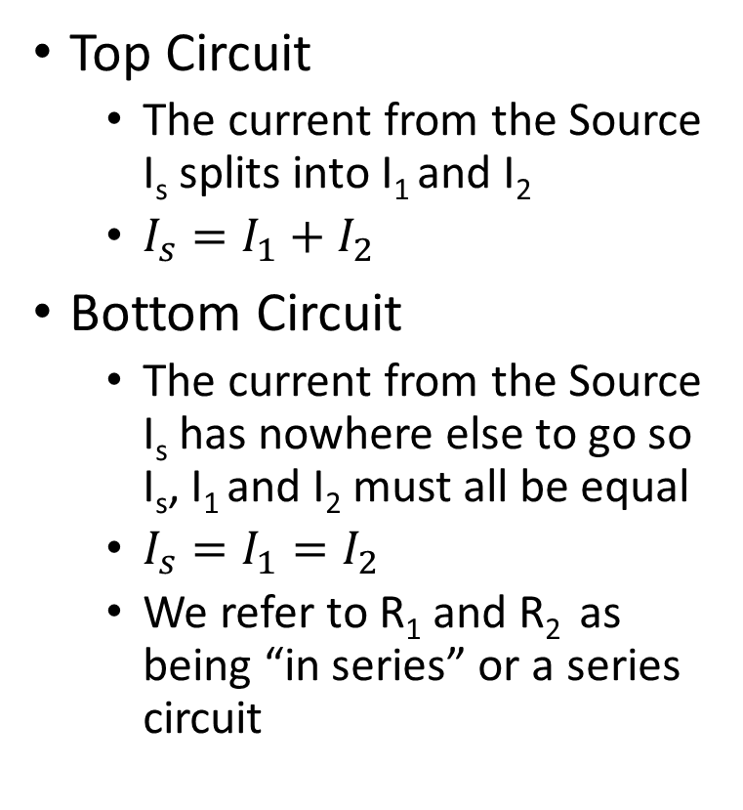
Kirchoff’s Current Law
Top Circuit
  The current from the Source I_{s} splits into I₁ and I₂
  $I_{s}=I_{1}+I_{2}$
Bottom Circuit
  The current from the Source I_{s} has nowhere else to go so I_{s}, I₁ and I₂ must all be equal
  $I_{s}=I_{1}=I_{2}$
  We refer to R₁ and R₂ as being “in series” or a series circuit

Slide 12
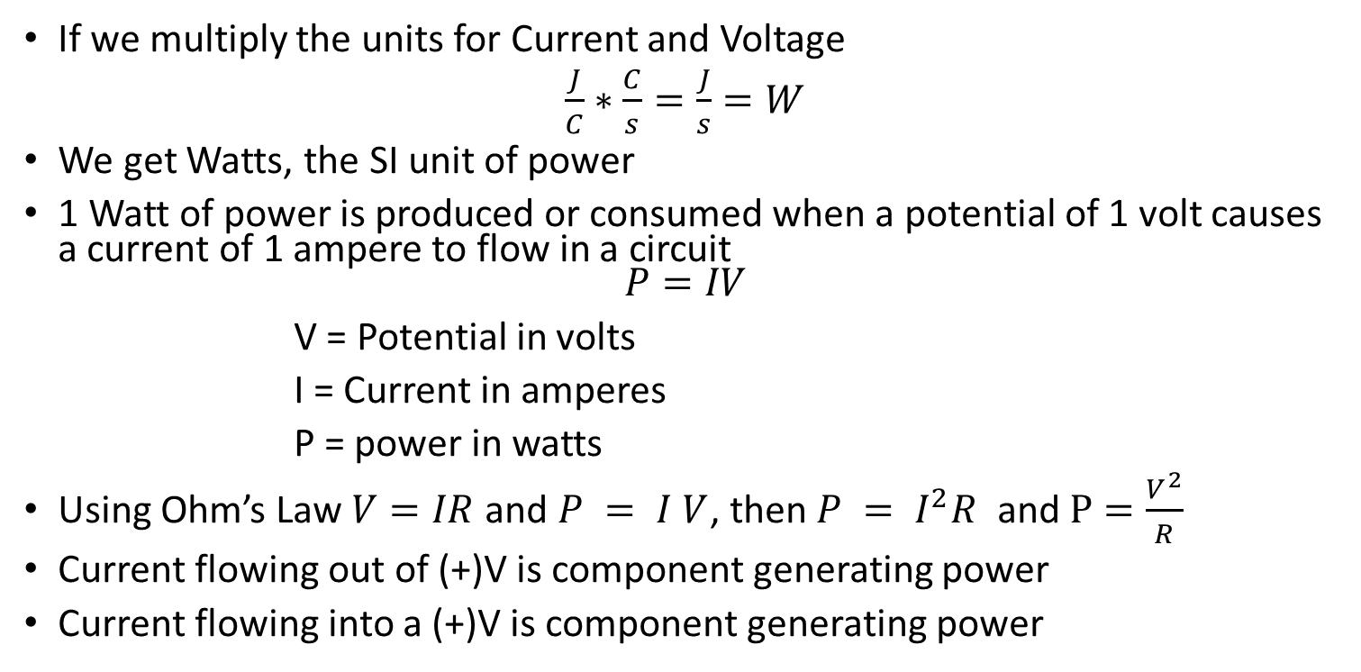
Electric Power
If we multiply the units for Current and Voltage
$\frac{J}{C}∗\frac{C}{s}=\frac{J}{s}=W$
We get Watts, the SI unit of power
1 Watt of power is produced or consumed when a potential of 1 volt causes a current of 1 ampere to flow in a circuit
$$P=IV$$
V = Potential in volts
I = Current in amperes
P = power in watts
Using Ohm’s Law $V=IR$ and $P = I V$, then $P = I^{2}R$ and $P=\frac{V^{2}}{R}$
Current flowing out of (+)V is component generating power
Current flowing into a (+)V is component generating power

Slide 13
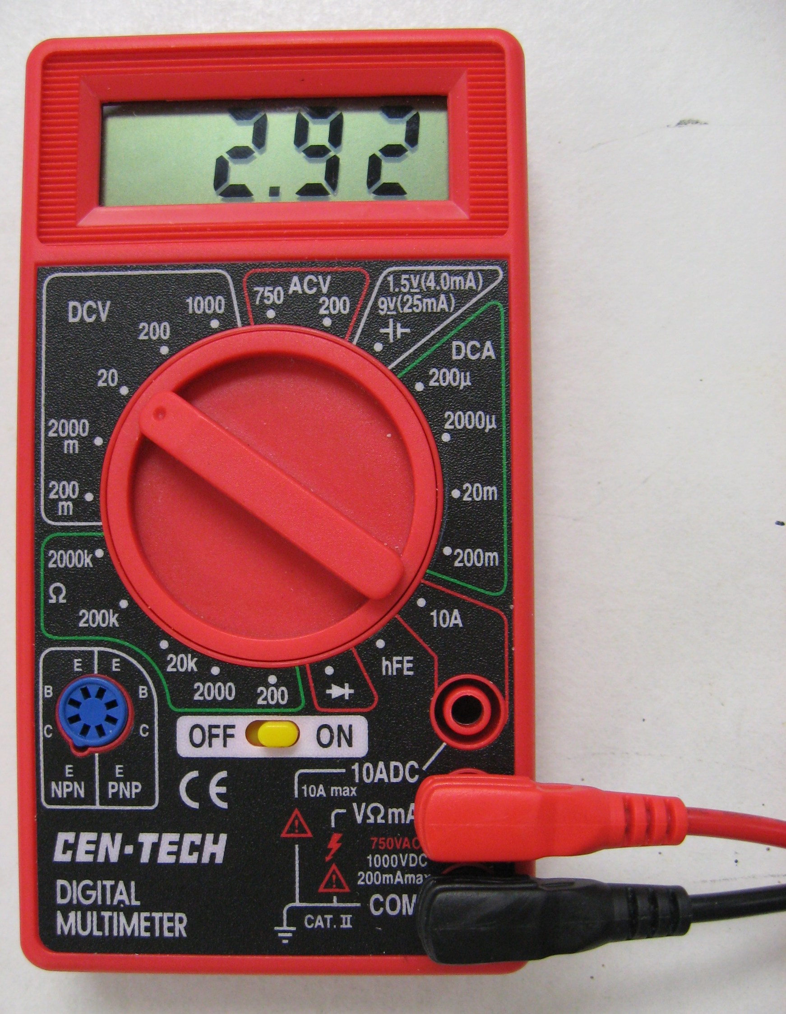
Taking Measurements
We use a tool called Digital MultiMeter (DMM)
Measures voltage, current, resistance, and other parameters depending on the model

Slide 14
Plugging in the Leads
Positive RED test lead is plugged into the plug labeled for the quantity being measured
  Usually, there are multiple plugs labelled with measurements. The example to the right uses one plug for 10A current and a second plug for everything else
The negative BLACK test lead is plugged into the COM (common) terminal
  Usually only a single negative
If you mix up the negative and positive, you will just get a negative number indicated by a minus sign
  Red and black leads are identical, the colors are just for easy ID

Slide 15
Select the measurement
Meters will usually have some kind of knob for selecting the value you want to measure
The example on the right has multiple settings for differing ranges, ie 2000 mV, 20 V, 200V, 1000V for voltage
Other meters will be autoranging
Also notice this meter has settings for DC and AC
  AC is Alternating Current where the value oscillates from positive to negative around 0 and it is more useful to know the amplitude
  For circuits we will almost always wait DC settings

Slide 16
Select the measurement
Meters will usually have some kind of knob for selecting the value you want to measure
The example on the right has multiple settings for differing ranges, ie 2000 mV, 20 V, 200V, 1000V for voltage
Other meters will be autoranging
Also notice this meter has settings for DC and AC
  AC is Alternating Current where the value oscillates from positive to negative around 0 and it is more useful to know the amplitude
  For circuits we will almost always wait DC settings

Slide 17
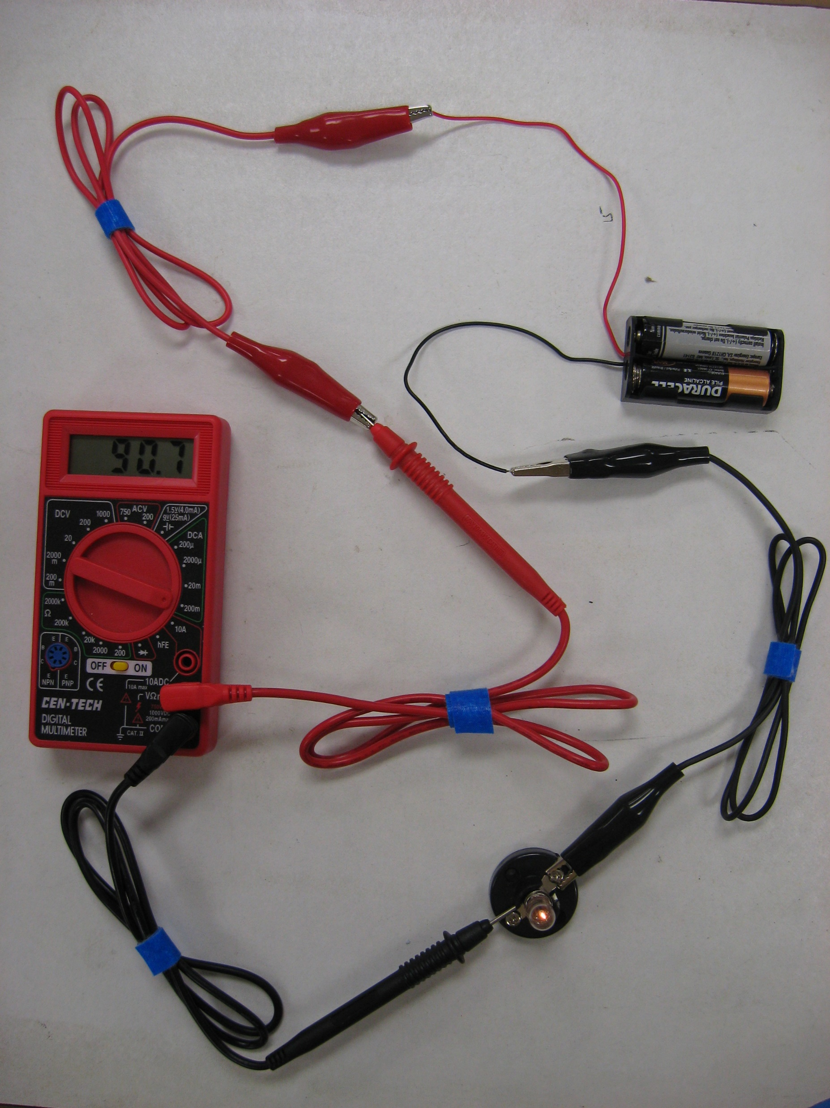
Taking Measurements
(Current)
The meter can only measure current if it flows through the meter
If we want the meter to match the circuit, it must be in series with the circuit where we are trying to measure current
We also do not want the meter to change the current when we measure, so therefore the meter should have resistance ~0 Ohms in this mode

Slide 18
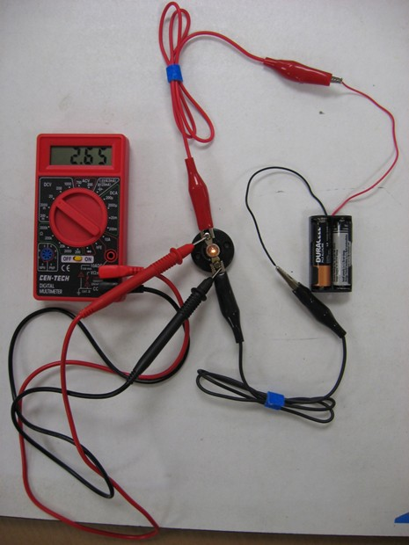
Taking Measurements
(Voltage)
We touch the leads at the two points where we are trying voltage difference
If we want the meter to match the circuit, it must be in parallel with the circuit where we are trying to measure voltage
We also do not want the meter to change the voltage by allowing alternate paths so the meter resistance should be large >10MOhm

Slide 19
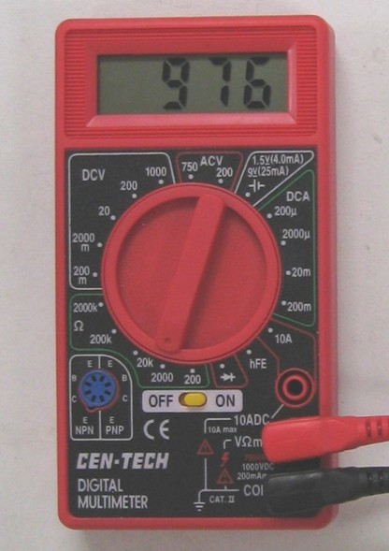
Taking Measurements
(Resistance)
For resistance, the meter acts as a small voltage source and measures the current
It then calculates resistance using Ohm’s law
But it assumes that it is only a voltage source and the measured component is the only current path
  To get an accurate measurement component must not be powered and will often need to be isolated from the rest of the circuit

Slide 20
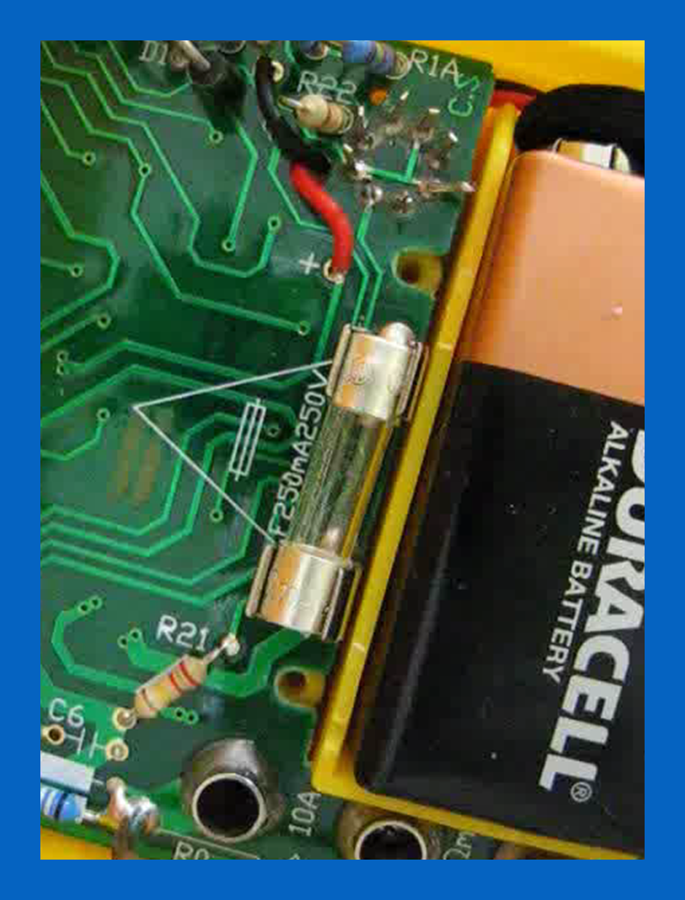
Multimeter Fuses
What happens if you set the meter to current (Low Resistance) and hook it into the circuit for Voltage (Parallel Circuit)
The current through the meter will become very large and potentially damage the meter or circuit
  For this reason, meters usually have fuses designed to break and stop current flow at a mix value
  These fuses will then need to be replaced
What happens if you set the meter to voltage (High Resistance) and hook it into the circuit for current(Series Circuit)
  In this case you will just make the current flow

