Slide 1
Second Semester of the LaACES Program (2025)

Slide 2
2nd Semester Tasks
Develop a student lead team organization with defined roles, responsibilities, and rules
These will be formalized in a “Team Contract”
Learn the basic Project Management skills to manage the payload development
Requirements Development, System Design, Tasks and Scheduling, Flowcharts, Risk Management
Develop a functioning payload based on the MegaSAT stack
This includes all electronics, software, and mechanical requirements
Design, Fabrication, Calibrate, and Testing Payload to meet all program and payload requirements
Documenting this via the PDR, CDR and FRR Documents
Complete Thermal Vacuum System Testing
Prove payload is worth flying at Flight Readiness Review
Analyze and present flight results

Slide 3
LaACES Program Payload Requirements
YOUR PAYLOAD SHALL:
Weigh less than 500 Grams
Have a weight/area ratio of > 13 g/cm² (This means a max weight payload sides must be larger than 39 cm²)
Be housed in a soft semi-rigid foam container (such as R3 insulation foam)
Have two unobstructed vertical penetrations, 17 cm apart, large enough to pass kite string through
Penetrations shall be sufficiently reinforced to prevent rip-out with 50lbs of force perpendicular to the axis of the penetration
Have sufficient power for 4 hours of operation
Have sufficient data storage for 4 hours of operation
Operate at pressures down to 10 mBar
Operate with outside temperatures of -50C
Operate with outside temperatures of 50C
Payload mechanical interface

Slide 4
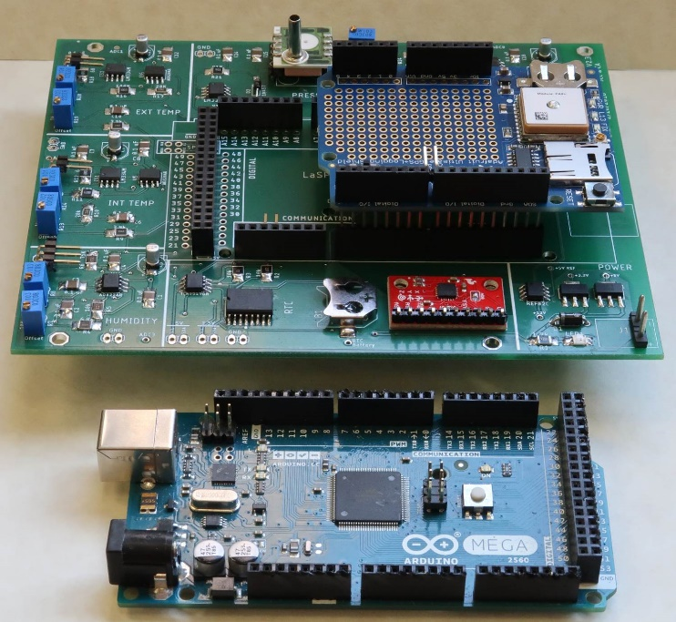
LaACES MegaSat Core
The core of the payload will be the LaACES MegaSat which includes
Two temperature sensors, one humidity sensor, one pressure sensor, 3-axis accelerometer, a 3-axis gyroscope, and a real-time clock with a backup battery
The payload controller will be the Arduino Mega.
Will have the Adafruit Ultimate GPS Logger shield for GPS data throughout the flight and recording NMEA data on an SD card.
The prototype area on the Adafruit GPS shield or a separate proto-shield board can interface with other sensors.
Construction of MegaSat shield is done in parallel with other required activities
During payload development teams should ensure:
MegaSAT systems are considered and included In design documents
To budget the time needed to construct the MegaSat shield
LaACES MegaSat payload stack

Slide 5
Payload Development Requires Team Cohesion
The activity for the Project Management unit is to have each team produce its own “Team Contract”
Students need to identify and write down their “rules of engagement” for how they will operate as a project team
The Team Contract should include items such as meeting schedule, document management, roles, task management, as well as joining and leaving a team

Slide 6
Payload Development Requires Management
Project Management lectures and materials are in Part II, Units 21 through 26
https://laspace.lsu.edu/laaces/student-balloon-course/
These lectures and materials include the following cover the basics of project management necessary to develop a payload and complete the design reviews
These materials will be covered in January

Slide 7
Supplemental Materials: Payload Structure and Design
Payload design lectures are in Part II, Units 27 through 30
https://laspace.lsu.edu/laaces/student-balloon-course/
Units 27 and 28 are concerned with the fabrication, testing, and use of the MegaSAT
Include a highly detailed assembly manual
Units 29 and 30 include supplemental materials covering specific aspects of payload development (ie building a box, calculating a power budget)
These lectures and materials available for reference (These will not be covered in a formal session)

Slide 8
The Project Reviews
There are at least three major reviews during a project
Preliminary Design Review (PDR)
Critical Design Review (CDR)
Flight Readiness Review (FRR)
Teams will make 15 minute oral presentations covering these materials in addition to submitting their written documents
The Pre-PDR and Pre-CDR divide the reviews into more manageable sections
Each review has a somewhat different objective and emphasis and provides a check on project progress for all stakeholders
Templates are provided for all review documents. Read all instructions contained within the template carefully!
The required documents will be rated as Pass / Fail. A “Fail” on any document means the team will very likely not fly
Teams should expect to revise and resubmit their reviews

Slide 9
The Project Reviews Document Templates
The templates provide a sequence of payload documentation from the initial organization and justification to the final defense of the payload flight worthiness
Each template ADDs to the previous template so it is important for a student team to fully complete one document before moving on to the next.
Pre-Preliminary Design Review (Pre-PDR) template
Preliminary Design Review template (PDR)
Pre-Critical Design Review (Pre-CDR) template
Critical Design Review (CDR) template
Flight Readiness Review (FRR) template
These templates can be found on the LaACES Document Center at https://laspace.lsu.edu/laaces/laaces-document-center/
Will talk about these reviews and expectations in the Project Management overview lecture.

Slide 10
Deliverables Schedule for LSU LaACES Spring 2025
Deadline
Team Contract January 21, 2025
Pre - PDR January 31, 2025
PDR February 14, 2025
Presentation February 18,2025
Pre - CDR March 14, 2025
CDR April 11, 2025
Presentation April 15, 2025
Thermal / Vacuum Test (at LSU) April 25, 2025
FRR May 15, 2025
LaACES Launch Trip May 18, 2025 – May 23, 2025
FRR Defense Presentation (at CSBF) May 19, 2025
Notes:
Changed FRR location from MSU to CSBF; changed the format of the Good Friday note. Deleted April 17th I think you should list all options or none, so I deleted and replaced with TBD/April 18. It

