Slide 1
The Ultimate GPS Logger Shield – GPS
LaACES Student Ballooning Course

Slide 2
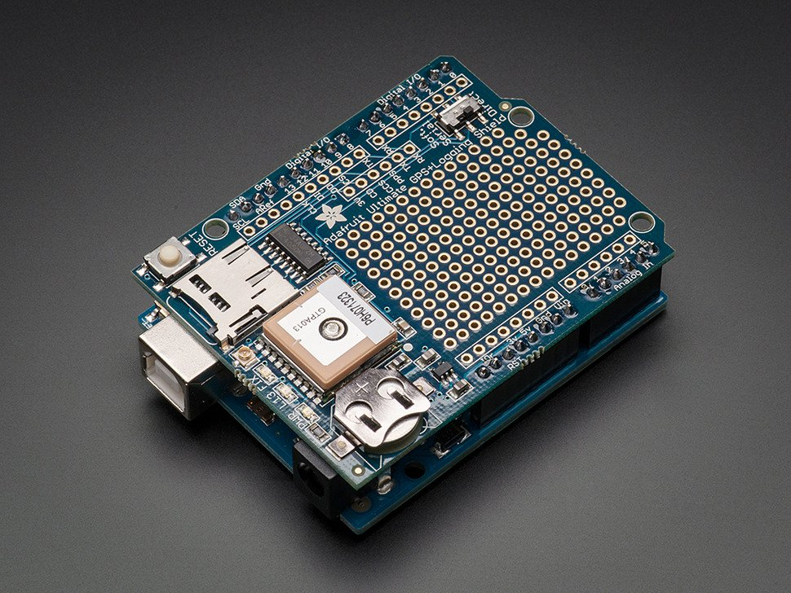
Introduction
Now that you’ve learned about the Global Positioning System, it’s time to learn about the GPS receiver you’ll be using - the Adafruit Ultimate GPS Logger Shield
Figure 1: Shown is the Adafruit Ultimate GPS Logger Shield. It is stacked on an Arduino Uno

Slide 3
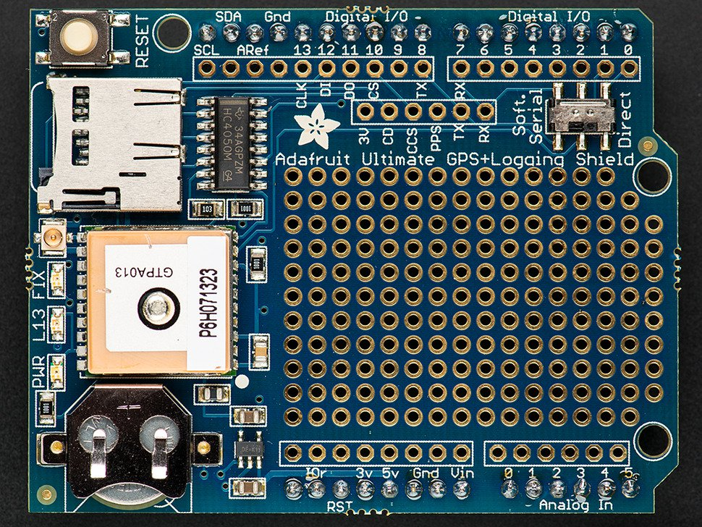
Adafruit Ultimate GPS Logger Shield Overview
This is the Arduino Ultimate GPS Logger Shield. It comes with
microSD socket
Connector for external antenna
Antennae and GPS unit
Coin cell holder
Prototyping Area (Yellow)
Figure 2: Shown is the Adafruit Ultimate GPS Logger Shield. From top to bottom, the red arrows show the microSD socket, the external antenna connector, the GPS unit, and the coin cell battery holder. The yellow dashed square designates the prototyping area

Slide 4
Antenna
The GPS shield has a built-in patch antenna. For the MegaSat, this antenna will suffice
Payload shielding or sensitivity requirements may require an external antenna.
Most GPS antennas will have an SMA connector, so a SMA to uFL connector will be required
The GPS shield detects external antennas and uses them automatically
Some NMEA sentences provide antenna status (internal, external, or that a problem exists)
Figure 3: The red arrow is pointing to the Adafruit Ultimate GPS Logger Shield’s external antenna connector. It is located between the microSD socket and the FIX LED.

Slide 5
Real Time Clock (RTC)
A Real Time Clock (RTC) is a computer clock that keeps the current time
When the GPS has a fix, the RTC sets itself to the current UTC time
If the GPS loses power, this ensures the GPS will keep the correct time
The GPS has a built-in RTC, but not a built-in battery. A coin cell battery is needed to ensure the clock does not reset on power loss
Also allows a “hot start”, if the GPS knows its old time and position it can find a fix more quickly
A new battery can run the RTC for 7+ years
Figure 4: Shown is the Adafruit Ultimate GPS Logger Shield’s coin cell battery holder. When inserting a coin cell battery, ensure the positive side is facing up, away from the Shield

Slide 6
LEDs on GPS Shield
There are 3 different LEDs on the GPS shield
Green (PWR)
Power LED. If it’s not on, the shield doesn’t have power
Yellow (L13, SD card access)
Solid when Arduino is bootloading
Flickers when SD card is being accessed
Red (FIX)
Blinking every second, GPS does not have a fix
Blinking once every 15 seconds, GPS has a fix
Figure 5: Shown are the three LEDs on the Adafruit Ultimate GPS Logger Shield. They are located next to the external antenna connector. From left to right, there is the power LED (lit when the Shield has power), the L13 LED (lit when the Arduino is bootloading and flickers when the SD card used), and the FIX LED (blinks at different frequencies corresponding to the GPS fix quality)

Slide 7
Prototyping and Breakout Areas
There is a prototyping area on the GPS shield, see Figure 6
Next to the Prototyping area are six breakouts
3V: Outputs 3.3 volts
CD: Card-detect output from the microSD socket. It is shorted to ground if there is not a card inserted
CCS: Card chip select line. It is connected to digital 10
PPS: This is a pulse per second output when the GPS has a fix
TX: GPS transmit line
RX: GPS receive line
Figure 6: Shown is the prototyping and breakout areas on the Adafruit Ultimate GPS Logger Shield. The red dashed box is surrounding the prototyping area. The yellow dashed box surrounds the breakout area. The RX and TX breakout pins are used for Software Serial communication

Slide 8
Direct Connect/Software Serial Switch
A switch on the selects which pins the GPS is connected to
Direct Connect connects the Shield to the Arduino’s Serial 0 channel(TX0, RX0)
In general, we want to use TX0, RX0 for communicating with Arduino
Direct connect does allow us to communicate directly with GPS on the Serial Monitor
Software Serial connects the GPS to pins 7 and 8 of the Arduino and TX and RX on the breakout
We will install jumpers that allow us to connect this output to Serial1, Serial2, or Serial 3
Despite its name the Software Serial does not change anything in the software, just where the GPS is connected
This is based on an Arduino UNO which only has one Hardware serial port

Slide 9
Communication: Direct Connect
Direct Connect connects the GPS serial Arduino’s USB-serial converter chip
To directly monitor GPS output:
Start with the switch on Soft Serial to upload a blank sketch
Then flip the switch down (Figure 7)
NMEA sentences will start showing up on the Serial Monitor
While using Direct Connect, you cannot upload sketches to the Arduino! The programming UART is being used by the GPS shield
Figure 7: Shown is the communication switch on the Adafruit Ultimate GPS Logger Shield. In this position, the Shield is communicating via Direct Connect. This method has the Shield using the main Arduino UART to communicate with the computer. Because of this, sketches cannot be uploaded while using Direct Connect

Slide 10
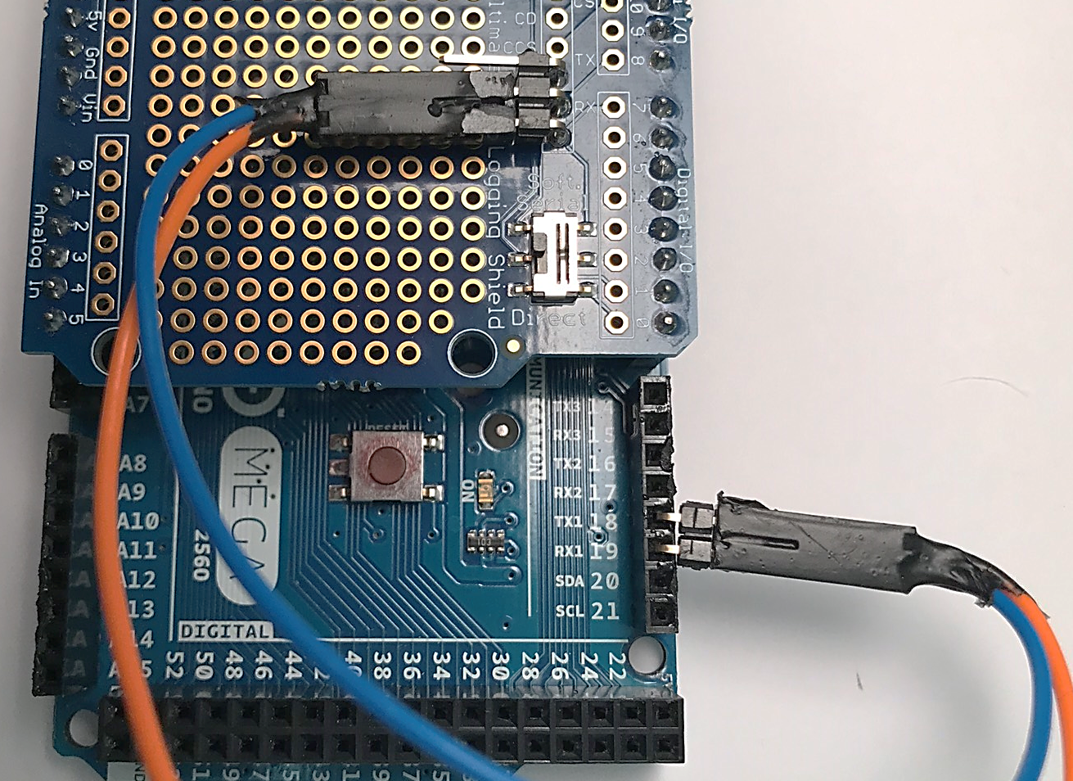
Communication: Software Serial
Software Serial allows sketches to be uploaded using the Arduino’s main UART because a different UART is used for GPS communication
The Shield switch should be on Soft Serial. Jumpers will be used to connect GPS TX and RX pins to one of the Mega other serial ports (Serial1, Serial2, Serial3).
Note that we want the TX of the GPS to RX of the Arduino and the RX of the GPS to the TX of the Arduino. A very common mistake is to have the TX and RX switched on one end
Figure 8: Shown is the communication switch on the Adafruit Ultimate GPS Logger Shield and jumpers connecting the RX and TX breakout pins to Arduino pins 18 and 19, respectively.

