Slide 1
Lecture 14.01 The Global Positioning System (GPS)
LaACES Student Ballooning Course

Slide 2
What is GPS?
GPS (Global Positioning System) is a constellation of satellites that orbit the Earth
Each satellite completes two orbits a day in one of six orbits
  Orbits designed so there are 6 satellites in view from most places on Earth
A GPS device allows a user determine his/her position by receiving the signals from multiple satellites

Slide 3
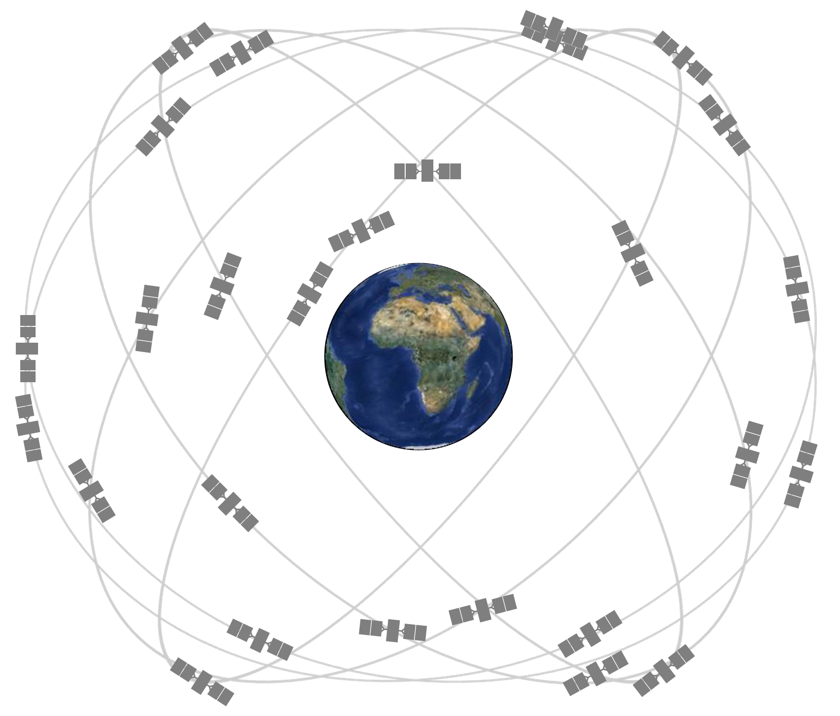
GPS Satellite Constellation
There are currently 31 operational satellites in the 24-slot constellation (6 orbits x 4 slots)
These satellites orbit in 1 of 6 orbital planes
  These planes have an altitude of ~ 20,200 km
  Each satellite orbits the Earth twice a day
In 2011, the Air Force completed the “Expandable 24,” a constellation expansion. 3 planes expanded to allow an extra satellite became part of the constellation baseline. GPS is now, effectively, a 27 slot constellation
Figure 1: Shown is 24-slot satellite constellation. This configuration ensures that GPS users can view 4+ satellites from almost any point on the planet

Slide 4
Motivations Behind GPS
World War II and the Cold War provided the justification for countries to research, develop, and deploy various navigational systems
Some predecessors to our current GPS include: LORAN, Decca, Sputnik 1, TRANSIT, SECOR, Timation satellite, and OMEGA
Development of these systems were driven by the military. Better systems were needed for missile accuracy and navigation for ships, submarines, and aircrafts

Slide 5
GPS History
1973: GPS project launched
  Created/owned by the United States government, operated by the Air Force
  Cold War arms race justified the billions of dollars to research, develop, deploy, and operate a constellation of navigational satellites
    Ballistic missile submarines needed accurate fixes of their positions before launching.
    Intercontinental ballistic missiles and strategic bombers required a more accurate and reliable navigational system
  Inventors: Roger L. Easton (Naval Research Laboratory), Ivan A. Getting (Aerospace Corporation), Bradford Parkinson (Applied Physics Laboratory)
1978: First satellites launched into orbit
1995: Full constellation of satellites in orbit

Slide 6
Selective Availability
In the 1990s, the US government degraded GPS accuracy for civilians on a global scale (Selective Availability)
  President Clinton turned off Selective Availability in May 2000
  According to the US government, they have no intention to ever use Selective Availability again
Civilian Restrictions
  Receivers capable of operating above 18 km and 515 m/s or that are designed / modified for use with missiles require a State Department export license
    These devices are classified as weapons
    Disabling operations above the limits exempts the receiver from a weapon classification

Slide 7
Non-US Positioning Systems
Russia – GLONASS (Global Navigation Satellite System)
  Global coverage since 2000s. Currently being restored to full availability
European Union – GALILEO
  30-satellite system to be completed by 2020
China – BeiDou Navigational Satellite System
  Global coverage since December 27, 2018
Japan – QZAA (Quasi-Zenith Satellite System)
  Currently only 4 satellites in orbit – regional coverage
India – NAVIC (Navigation with Indian Constellation)
  Currently 7 satellites in orbit – regional coverage
Different countries’ systems can be added to GPS devices
Multi-Constellation devices are called GNSS
More available satellites = quicker and more accurate fixes

Slide 8
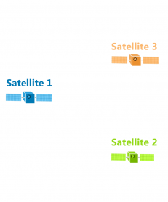
How Does GPS Work?
Trilateration used by GPS receivers to calculate their position
GPS satellites broadcast radio signals that include their location and time
  Satellites’ time is very accurate due to atomic clocks onboard
GPS devices receive these signals and use the arrival time to calculate the distance between themselves and a satellite
  D = speed of light * (t _{received} – t _{transmitted})
Figure 2: Shown are three satellites. For the trilateration example, we will assume these are the satellites observed by a GPS receiver

Slide 9
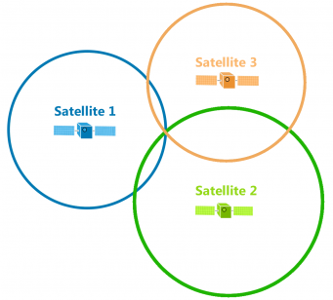
Trilateration
All of the possible points from a single location create a circle
For satellite 1, we can draw a circle with radius D1 around it. The GPS receiver must be somewhere on the circle
  Same process for satellites 2 and 3
Since the GPS receiver must be somewhere on each circle, the intersection of these circles is the receiver’s position
D3
D1
D2
Figure 3: Shown are the circles that represent the distance from each satellite. The intersection of the three circles, as shown by the red arrow, is the location of the GPS receiver

Slide 10
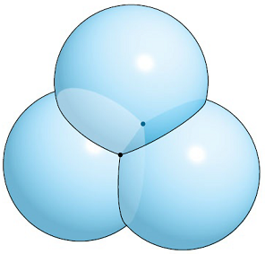
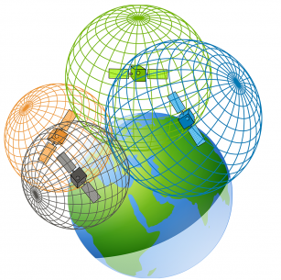
Trilateration Continued
We live in a 3D world, so each satellite is actually in the center of a sphere, not a circle
  The intersection point of all spheres is the position of the GPS receiver, but there are 2 intersection points with 3 spheres
To achieve a fix in all dimensions, a GPS receiver must be receiving information from 4 satellites
Figure 4: Top – The intersection of 3 spheres is two points, not one point. This means 3 satellites are not enough to obtain a 3D fix
Bottom – Shown are the spheres that represent the distance from each satellite. It is the intersection of 4 spheres that give a GPS receiver its position

Slide 11
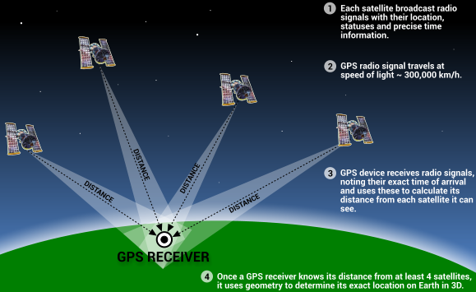
Finding Your Position Summary
GPS receivers get time and location information from satellites. By calculating the distance from themselves to each satellite, a receiver can find their position
With 3 satellites in view, a GPS receiver can determine its latitude and longitude.
  This is called a 2D fix
With 4 satellites, a GPS receiver can find its latitude, longitude, and altitude
  This is called a 3D fix
Figure 5: A GPS receiver needs 4+ satellites in view in order to calculate its latitude, longitude, and altitude. Once the receiver knows its position, it can calculate other information like speed or distance to destination

Slide 12
GPS Accuracy
Although GPS satellites are required to broadcast their signals with a certain accuracy, a device’s accuracy depends on a variety of factors
  Clock Errors
  Atmospheric Conditions
  Satellite Geometry
  Signal Blockage
  Receiver Quality
Most smartphone GPS are accurate to within 4.9m (16ft). This accuracy gets worse near large objects, such as buildings and trees
High precision GPS receivers can be accurate to within a few centimeters

Slide 13
Clock Errors
Satellite clock errors: GPS satellites have atomic clocks on board. These are extremely accurate but can drift. This drift produces errors
  The errors are minimized by calculating clock corrections at monitoring stations. These monitoring stations transmit their corrections + the GPS signal to GPS receivers
Receiver clock errors: GPS receivers don’t have atomic clocks; they have quartz crystal clocks. These are less stable and less accurate
  The error from this clock is eliminated by comparing the arrival times of two satellites whose transmission times are known exactly.

Slide 14
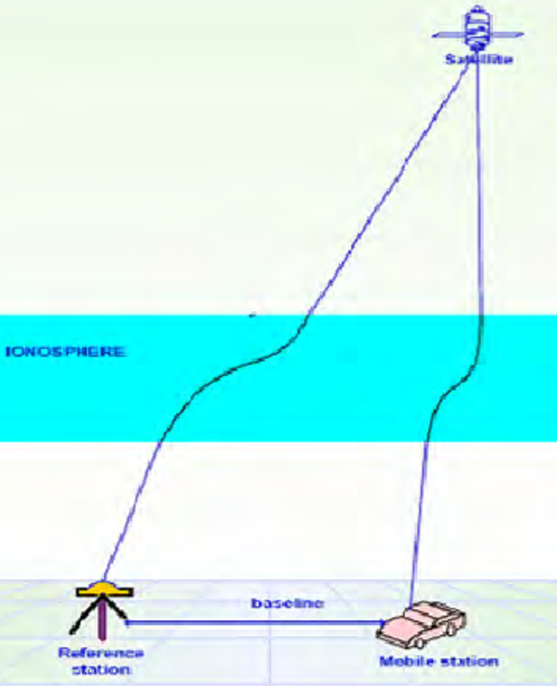
Atmospheric Conditions
Changes in atmospheric conditions affect the speed of GPS signals as they pass through different layers of the atmosphere
  The transmission can slightly bend like light trough a prism
  These speed changes result in errors in position and time
  When a satellite is directly overhead, these errors are minimized. Satellites near the horizon have a longer atmospheric path for their signals, so these errors are greater
Figure 8: Shown is an exaggerated view of the GPS signal path. Traveling through the atmosphere causes delays and deflections of the GPS signal

Slide 15
Atmospheric Conditions:
Ionosphere
In the ionosphere(layer of charge particles in atmosphere), GPS signals are both deflected and delayed. Due to the varying density of the ionosphere, the delays and deflections aren’t consistent over the signal’s path
Based off ionosphere models, GPS monitoring stations calculate and transmit corrections to satellites. This removes about 75% of ionosphere errors
The ionosphere delay of a signal depends on the signal’s frequency. By measuring the delay in multiple frequency bands, the dispersion error can be calculated

Slide 16
Atmospheric Conditions:
Troposphere
The delay caused by the troposphere depends on temperature, pressure, humidity, and the locations of the receiver and transmitter
  It is not frequency dependent. This means, unlike ionosphere errors, using multiple frequencies cannot remove this error
Hydrostatic component
  Dry gases in the troposphere cause errors. The error varies with temperature and pressure, but can be calculated using ideal gas laws
Wet component
  Water vapor and clouds also cause delays. The delay is small (10s of cm) but varies fast and is harder to model

Slide 17
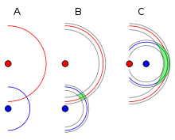
Satellite Geometry
Geometric Dilution of Precision (GDOP) is error caused by viewing satellites that are too close together
Figure 6 shows an example of this principle
  In A, someone has measured their distance from two landmarks, and then drawn circles with corresponding radii around the landmarks. Their position is the intersection of the circles
  In B, they have included error bounds in their circles. Their position is anywhere within the green shaded region
  C is the exact same as B, but the landmark positions have changed. Because of the landmarks’ positions, the error of the user’s position has increased drastically
Figure 6: Shown is an example of DGOP. A user knows the distances between themselves and two landmarks (red and blue dots)
By drawing circles around the landmarks corresponding to the known distances, the user can pinpoint their location as the circles’ intersection
There are errors associated with the distance measurements. This means there is uncertainty in the user’s position. The user’s position is somewhere in the green shaded area
With poorly positioned landmarks, the area containing the user’s position in can grow. This is Geometric Dilution of Precision

Slide 18
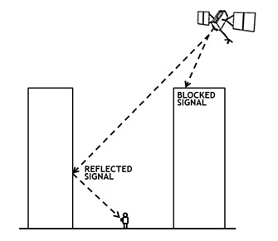
Signal Blockage
Satellite signals can be blocked by buildings, bridges, trees, etc.
Using GPS underground or indoors can also degrade the signal
  Having difficulty inside? Move the receiver closer to a window
Reflected signals also cause errors; this is called multipath. The original signal is blocked, but the receiver receives a reflected signal
Less common signal degradation culprits: radio interference, solar storms, satellite maintenance
Figure 7: Shown is an example of multipath. The real GPS signal is blocked from the receiver by a tall building. Another GPS signal is reflected off a second building and is then received by the user. Using this signal would result in incorrect position information for the receiver

Slide 19
Receiver Quality
GPS receivers that use more than one frequency result in more accurate positions than receivers only utilizing one frequency
Military receivers use dual-frequency
Most civilian receivers only utilize one frequency for GPS signals
  Dual-frequency GPS receivers are available for civilian use, but they are expensive. This has the effect of limiting the civilian use of dual-frequency GPS receivers to mostly professional applications

Slide 20
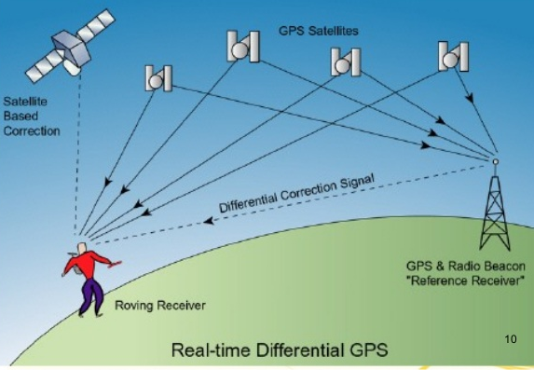
Differential GPS (DGPS)
DGPS is a system that provides corrections to position data. By using a fixed, known position of a GPS base station, a receiver can adjust real time GPS signals to eliminate errors
  This can result in accuracies on the centimeter level
  DGPS corrections are only applicable for positional data
Useful for surveying work
Figure 9: Shown is a caricature of DGPS. A receiver uses the normal 4 satellites to calculate its position. Then, signal from a beacon with a fixed, known location is used to help eliminate errors

Slide 21
GPS Applications
Location
Navigation
Tracking
Mapping and Surveying
Time Synchronization

Slide 22
GPS Communication
GPS signals encode data for receivers. A receiver can request specific types of information. The standard format for the transmitted information is a National Marine Electronics Association (NMEA) sentence
NMEA Sentences are text strings with predefined data in a certain order separated by commas
There are multiple NMEA sentences. The main 6 are: RMC, GGA, GLL, VTG, GSA, and GSV

Slide 23
NMEA Sentences:
Information provided
RMC – Recommended Minimum
  Time, status, latitude, longitude, speed, track angle, data, magnetic variation
GGA – Essential data
  Time, latitude, longitude, fix quality, number of satellites being tracked, HDOP, altitude, height of geoid, time since last DGPS update, DGPS station ID number
GLL – Geographic Latitude and Longitude
  Latitude, longitude, time, status
VTG – Velocity Made Good
  True track, magnetic track, ground speed
GSA – GPS DOP and active satellites
  Fix status, PRNs of satellites used for fix, PDOP, HDOP, VDOP
GSV – Satellites in View
  Number of satellites in view, satellite PRN number, elevation, azimuth, SNR

Slide 24
NMEA Sentence:
GGA Layout
$GPGGA,hhmmss,llll.ll,a,yyyy.yy,a,x,xx,x.x,x.x,M,x.x,M,x.x,xxxx*hh
0 , 1 , 2 ,3, 4 ,5,6,7, 8, 9,10,11,12,13,14 15
hhmmss.ss Time of fix hh:mm:ss UTC
llll.ll Latitude: ll degrees 07.038 minutes
a Direction. N = North. S = South.
yyyy.yy Longitude: 11 degrees 31.000 minutes.
a Direction. E = East. W = West.
x Fix quality: 0 = no fix. 1 = GPS fix. 2 = Differential GPS fix. 4 = Real-Time Kinematic (RTK) fixed integers. 5 = RTK float integers. 6 = Dead reckoning. 7 = Manual input mode. 8 = Simulator. 9 = WAAS.
xx Number of satellites being tracked
x.x Horizontal dilution of position
x.x Altitude
M Meters (units for 9)
x.x Relationship between geoid and WGS84 ellipsoid
M Meters (units for 11)
x.x Time (seconds) since last DGPS update
xxxx DGPS station ID number
*hh Checksum

Slide 25
NMEA Sentence:
RMC Layout
$GPRMC,hhmmss,A,llll.ll,a,yyyy.yy,a,x.x,x.x,ddmmyy,x.x,a,A*hh
hhmmss.ss Time of fix hh:mm:ss UTC
A Signal status. A = Active Signal. V = Void, no signal.
llll.ll Latitude: ll degrees 07.038 minutes
a Direction. N = North. S = South.
yyyy.yy Longitude: 11 degrees 31.000 minutes
a Direction. E = East. W = West.
x.x Speed over ground, knots
x.x Track angle (degrees, True)
ddmmyy Date of fix
x.x Magnetic variation 20.3 degrees
a Magnetic variation direction
A Positioning system mode indicator. A = autonomous. D = differential. E = estimated. M = manual input. N = data not valid.
*4A Checksum

