Slide 1
Lecture 11.01 Serial Communication Protocols

Slide 2
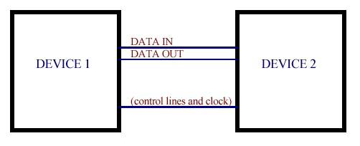
Serial Interface
Asynchronous serial can be implemented with data lines only.
Each device generates its own clock (Baud Rate Generator).
Handshaking lines can be used to signal status of devices.
Synchronous serial interfaces will have a separate Clock line.
Clock is generated by a Master device.
One bit is transferred for each clock cycle.

Slide 3
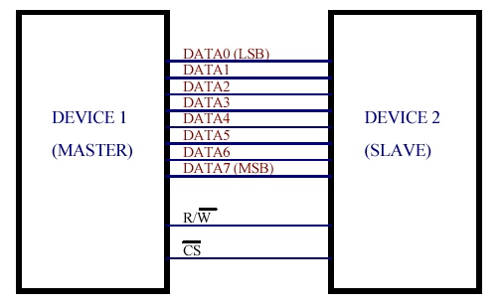
Parallel Interface
Data lines may be unidirectional or bi-directional.
Width of data bus is usually byte-wide (8 data bits).
A full byte of data is transferred on each R/W clock cycle.
Chip Select (CS) allows multiple devices to share bus.

Slide 4
Serial I/O on the Arduino Mega
Communications can be either via “Hardware” or “Software”
Hardware means there is dedicated circuitry in the microcontroller for handling signal
Software means the software must manually read and manipulate the pins
Because of this Software is significantly slower Hardware, but Software can usually work on any set of pins
Base Arduino Libraries will use the Hardware pins

Slide 5
Hardware Serial
Mega Supports Hardware UART, SPI, I2C protocols on certain pins
This means these pins are connected to hardware triggers (called interrupts) and memory (buffers) that can automatically receive the data
This means we don’t need to be actively “listening” all the time to receive this data
But the storage space is limited so if data is not copied into memory quickly (compared to speed its being sent) data can be overwritten and lost

Slide 6
Synchronous and Asynchronous Serial Communication
Synchronous means the devices involved use the same clock-signal when communicating, while asynchronous means the devices use their own individual clocks at set rate (Baud Rate).
Pins 0,1 & 14-19 use a Universal Asynchronous Receiver/ Transmitter (UART) for asynchronous communication.
These are the Serial software objects in Arduino IDE
No two clocks are perfectly matched, so asynchronous communication is slower because extra data must be sent periodically to ensure both devices are in sync.

Slide 7
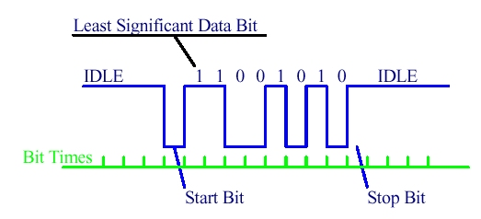
Asynchronous Serial Communication
Serial communication usually involves sending or receiving “characters” using the ASCII code. For example, the character “S” is represented by the binary number “01010011” or 0x53 in hexadecimal.
An asynchronous transmission of “S” begins with a start bit, followed by 8 data bits and ending with a stop bit. There are numerous options for number data bits, speed and an optional parity bit.

Slide 8
Serial Functions for the Arduino Mega
The Arduino website has excellent explanations of how these functions work and a plethora of examples of how to use them.

Slide 9
Arduino Mega Serial Ports
The Arduino Mega has four hardware serial ports
Serial1 on pins 19 (RX) and 18 (TX)
Serial2 on pins 17 (RX) and 16 (TX)
Serial3 on pins 15 (RX) and 14 (TX)
To use these pins to communicate with your personal computer, you will need an additional USB-to-serial adaptor, as they are not connected to the Mega’s USB-to-serial adaptor.
Notes:
https://www.arduino.cc/reference/en/language/functions/communication/serial/

Slide 10
Synchronous Serial I/O
Synchronous serial I/O uses a separate line for a CLOCK signal. The synchronous serial clock, data lines, and Arduino all use TTL logic levels, so no level converters or line drivers/receivers are required.
There are several protocols in use. Some use a bi-directional data line while others use separate Data-In and Data-Out lines. The Master generates the clock and initiates and controls data transfer.

Slide 11
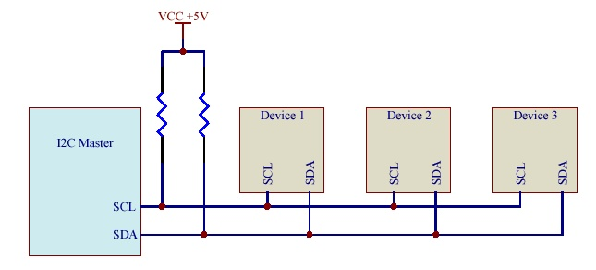
The I2C Bus
Inter-Integrated-Circuit or I2C (pronounced I-too-see or I-squared-see) is a synchronous serial protocol that uses a bi-directional data line and supports multiple slave devices controlled by a I2C bus master.
Defined by Phillips Semiconductor and became an industry standard.
The clock line is called SCL, the bidirectional data line SDA

Slide 12
I2C Addresses
The I2C bus master generates SCL and initiates communication with one of the slave devices. Each device has a unique address for device selection.
Each slave device has a 7 bit address that uniquely identifies it.
Some addresses are “hard-wired” into the chip design and one or more pins on the device. These pins can be wired High or Low to select an address that doesn’t conflict with other devices on the I2C bus. Others maybe set via software
Pull-up resistors are required on both the clock and data lines. Some chips may have internal pull-up resistors on specific pin. Arduino Mega has these

Slide 13
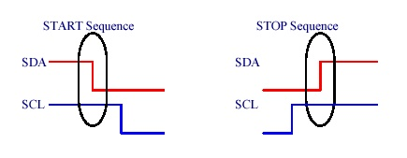
I2C START and STOP
A specific sequence signal the beginning and end of the transmission
A START sequence begins a bus transmission by transitioning SDA from High to Low while SCL is High.
A STOP sequence ends a transmission. The Stop sequence occurs when the master brings SDA from Low to High while SCL is High.

Slide 14
I2C Reads and Writes
There are 2 basic types of communications a read and a write
In a read the Master is requests data from the slave, the slave then responds with data bytes
In a write the Master sends data bytes after the address which the are then interpreted by the slave device
In both cases there can be multiple data bytes
All transmissions are grouped into individual bytes

Slide 15
I2C Write Sequence
A typical I2C bus sequence for writing to a slave device:
Send a START sequence
Send the I2C device address with the R/W Low (for Write)
Send the data byte
Optionally send additional data bytes (after repeating START)
Send the STOP sequence after all data bytes have been sent
The Slave responds by setting the ACK bit (Acknowledge) after every byte.

Slide 16
I2C Read Sequence
Reading an I2C Slave device usually begins by writing to it. You must tell the chip which internal register you want to read.
I2C Read Sequence
Send the START condition
Send the device address with R/W held Low (for a Write)
Send the number of the register you want to read
Send a repeated START condition
Send the device address with R/W set High (for a Read)
Read the data byte from the slave
Send the STOP sequence

Slide 17
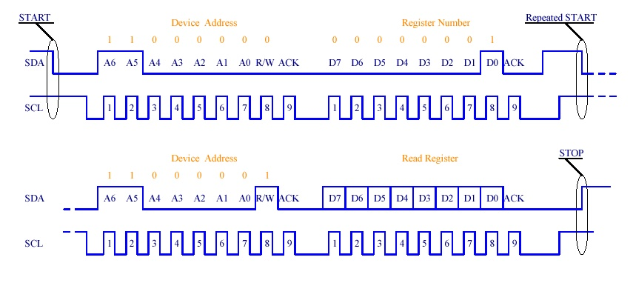
I2C Read example using device address 1100000 and reading register number 1.

Slide 18
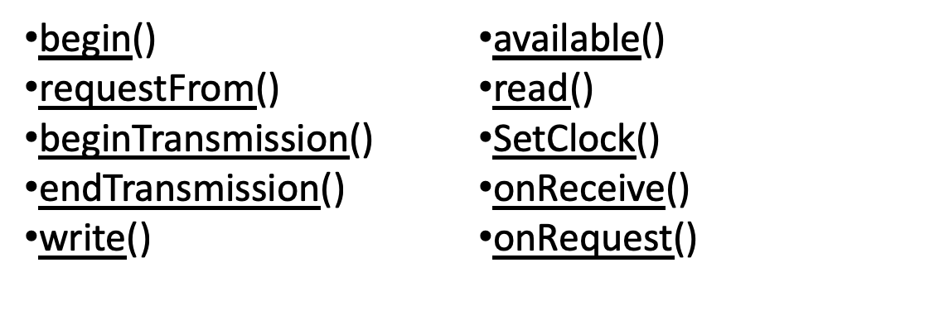
I2C Programming on the
Arduino Mega
The Wire library is used to communicate to devices using the I2C bus. The functions available are:
The Arduino website has excellent explanations of how these functions work and a plethora of examples of how to use them.

Slide 19
SPI Protocol
Developed By Motorola
Less standardized that I2C, varies device by device
4 Clock Modes
Clock can idle high or low
Can trigger on rising or falling edge
Devices are not fixed in individual bytes(ex. 13 bits long) but Arduino library reads an transmits in bytes so bitwise operation will be required (shifting and combining bytes)

Slide 20
SPI Pins
Master Controlled CLK line to synchronize signal
2 Unidirectional Data, MISO and MOSI
Can simultaneously transmit and receive
Each device requires a separate Chips Select (CS) pin, Master sets low to activate the device
CS0
Master
MOSI
Device 1
MI SO
CS1
Device 2
CS0
CS1
CLK

Slide 21
Level Shifting
Protocols can operate at different logic levels. For example, the Arduino Mega digital pins communicates with +5V, while the Raspberry Pi communicates with +3.3V. It is possible for a Raspberry Pi to communicate with a Mega through level shifting.
Level Shifting is the conversion of logic signals from one voltage level to another. It converts the “HIGH” voltage level of the input to a different voltage. In the example above, a level shifter would change the 3.3V logic to 5V logic or vice versa.
Level shifters may bidirectional or unidirectional and may work at different voltage levels and frequencies so be sure to check the datasheet to find on that works with your application.

