Slide 1
Lecture 10.01 Signals and Waveforms

Slide 2
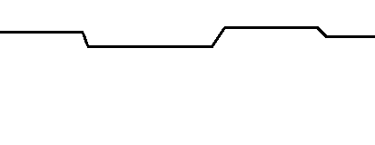
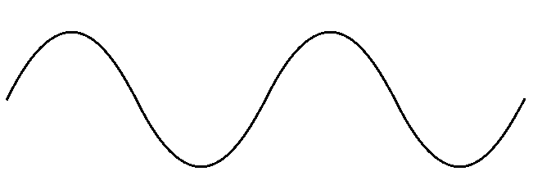
AC and DC Voltage
Electric signals can be classified on the behavior of their currents.
Direct-Current (DC) signals have currents that do not change direction. The voltage level may increase or decrease but will never change polarity
Alternating-Current (AC) signals have currents that change direction. The voltage polarity may change between positive and negative.
0 V
DC Signal
0 V
AC Signal

Slide 3
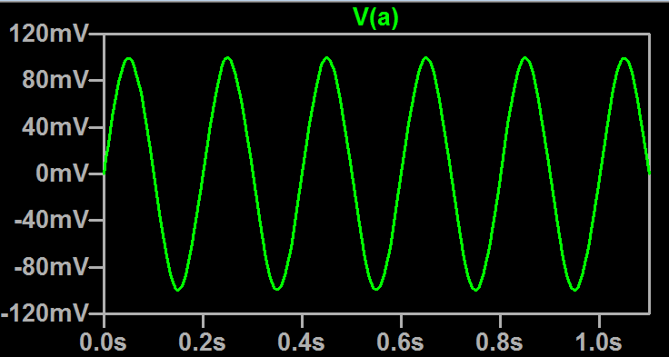
Waveforms
Waveforms are electric signals that vary with time.
Waveforms can exist in multiple mediums. However, the most common waveforms exist as a varying voltage or current.
A waveform is recorded by measuring its amplitude over a specified period of time.
Example of a voltage waveform over 1 second

Slide 4
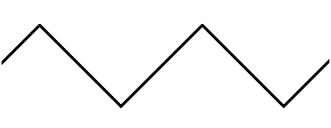
Signal Frequency and Period
Periodic signals are signals that repeat a pattern over a period of time.
How often the signal repeats itself is known as the frequency of the signal. It is measured in Hertz (Hz).
1 Hz is 1 complete cycle per 1 second.
The time it takes for a signal to repeat is know as the period.
Frequency and period are the inverse of each other.
Amplitude
0 V
Period
Amplitude
0 V
Period
$$Frequency= \frac{1}{Period}$$

Slide 5
Amplitude
The peak of the waveform is known as the amplitude. The amplitude is often measured in volts (V) or amps (A) depending on the source of the waveform.
The amplitude is distance from 0 so is usually referred to as positive even if the signal goes positive,
The frequency and amplitude of a signal are the most basic and common way to describe signal characteristics.
Amplitude
0 V
Period
Amplitude
0 V
Period

Slide 6
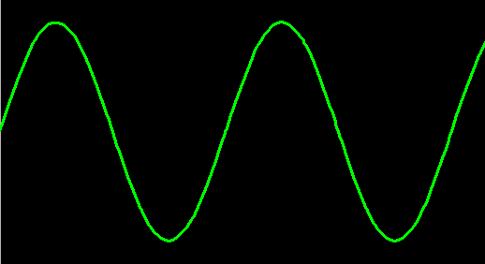
Analog Signals
Analog waveforms are continuous signals that vary over time.
Because analog signals can take any possible value, they are vulnerable to distortion and noise from the environment or other electronic systems nearby
Analog signals are common outputs from sensors.
Examples of various analog signals

Slide 7
Digital Signals
Digital waveforms are discretely valued signals that vary over time.
Digital waveforms typically have two states – logic HIGH and logic LOW (1 and 0).
Digital signals can convey messages and commands by alternating between high and lows for periods of time.
Digital signals are common outputs of CPUs, logic devices, and many ICs.
Examples of various digital signals

Slide 8
Clock Signals
In complex digital systems, a clock signal is used to synchronize operations between different ICs.
The frequency of the clock signal determines the rate at which operations are performed.
Many operations start or stop on the edge of a clock pulse.
This could either be on the rising edge or the falling edge.
Rising Edge
Period
Falling Edge

Slide 9
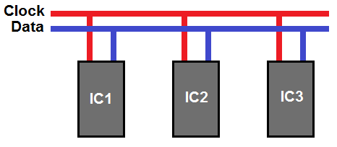
Synchronous Signals
Synchronous signals are signals that occur at the same rate at each other
Frequently, the synchronous signals are matched to a clock signal, where the clock dictates a unit of time.
It is important to note the timing of a signal. Some synchronous signals operate on the rising edge of a clock signal, while others operate on the falling edge.

Slide 10
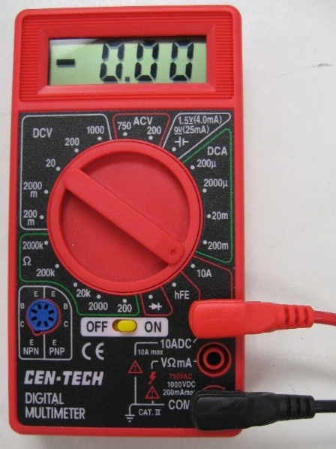
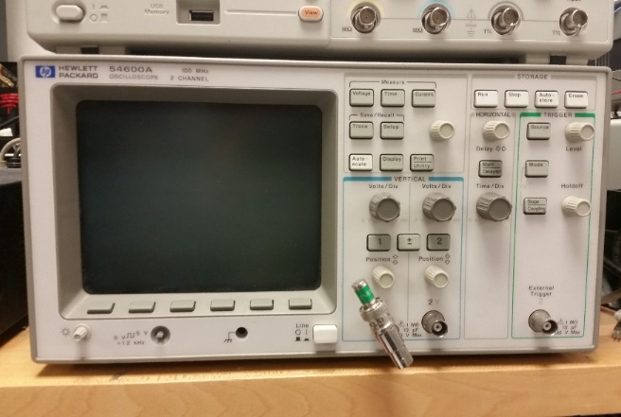
Measuring a Signal
Multimeters do not provide an accurate view of a signal. They return an average value of the signal.
This average value can be drastically different than the amplitude of the signal. It also does not convey the frequency of the signal. Though some maybe be able to measure the frequency or amplitude.
To accurately measure a signal’s waveform, an oscilloscope is used.

Slide 11
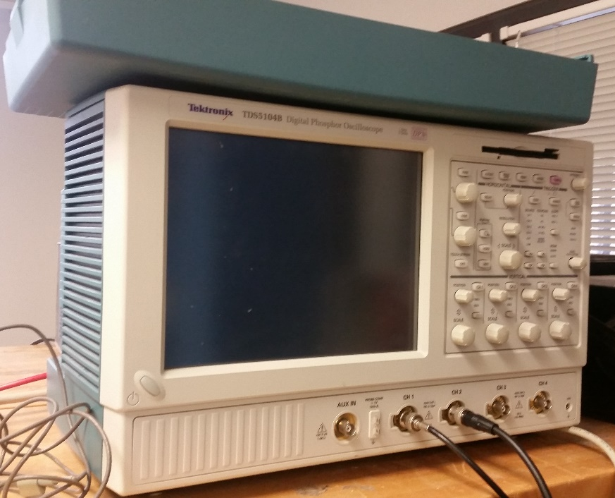
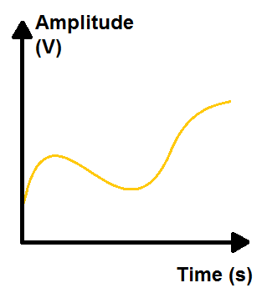
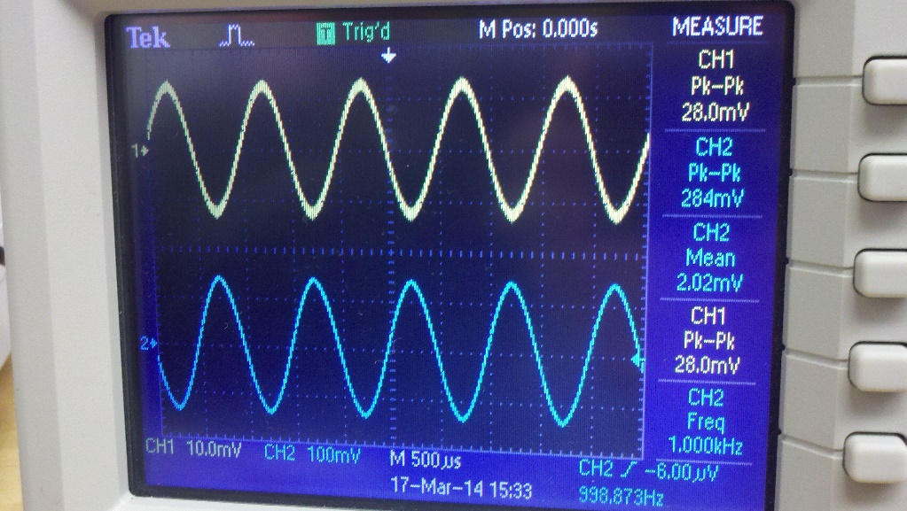
Oscilloscopes
Oscilloscopes displays signals as function of time. They show how a signal changes over time.
They graph signal voltages onto a 2-D plot with the signal voltage level as the vertical axis and time as the horizontal axis.
Oscilloscopes are useful for identifying issues with AC signals, timing conflicts, signal noise, and signal continuity.

Slide 12
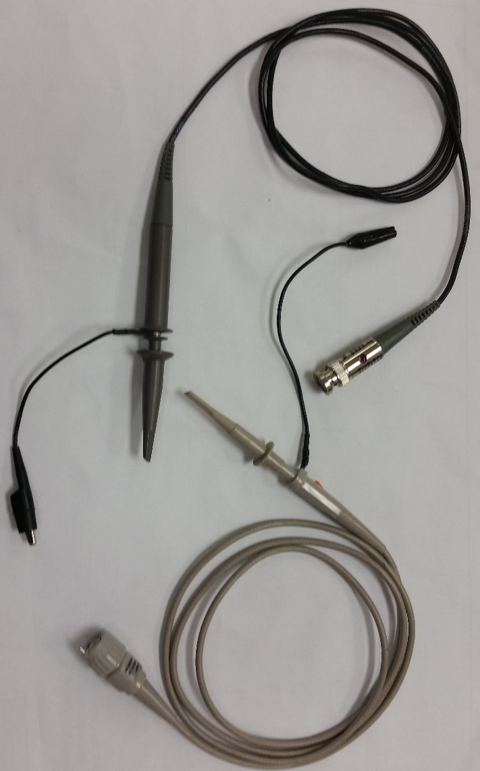
Oscilloscope Probes
Oscilloscopes measure signal using specific probes. These probes come in many varieties.
Each probe is marked with an attenuation factor. This will commonly be labeled as ‘10x’ or ‘100x’. You will need to match this value in the setting of your scope.
Each probe has three major parts: the BNC Connector, the probe tip, and the grounding clip. Remember voltage is measured in reference to a particular 0, set by the grounding clip in this case.
When measuring signals, the grounding clip should be secure to a nearby system ground before measuring with the probe tip.

Slide 13
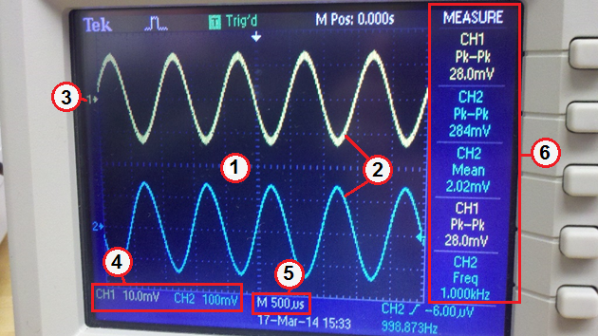
Oscilloscope Display
Each oscilloscope model may vary in available features, display, and control. When in doubt on how to operate your oscilloscope, refer to your user manual!
1 – Display Grid 2 – Signal Traces 3 – Channel Zero 4 – Vertical Scale 5 – Horizontal Scale 6 – Menu / Measurements

Slide 14
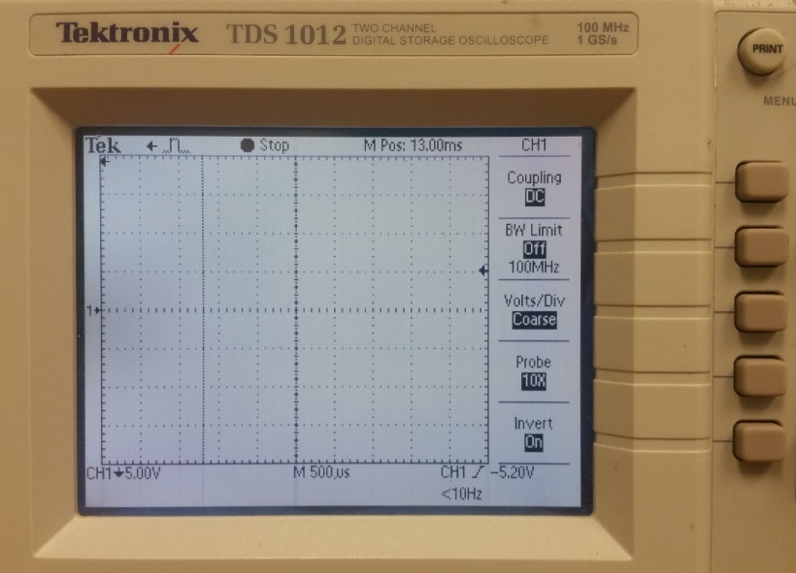
Oscilloscope Controls: Display Controls
Some oscilloscopes include automated displays that can view specific characteristics about the waveform on a particular channel.
Some examples include: Peak-to-Peak (Pk-Pk) Voltage, Mean Voltage, Frequency
These characteristics can be selected by accessing the Display menu. Each oscilloscope’s menus and selections may vary. Consult the user manual of your specific oscilloscope for additional help.

Slide 15
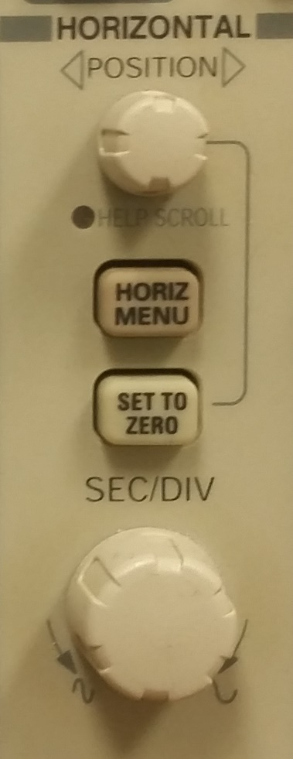
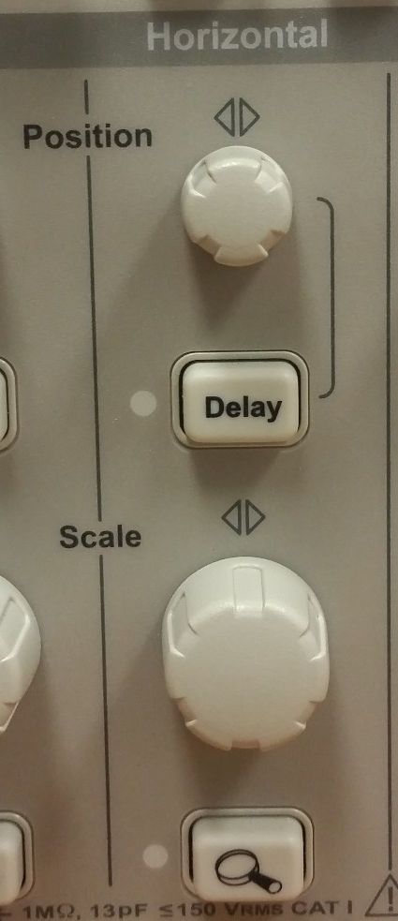
Oscilloscope Controls: Time Scale
Each channel of an oscilloscope can adjust the horizontal scale of the graph.
The resolution of the vertical axis is measured in second (or milliseconds) per division. This value is often displayed on the bottom of the display
The resolution can be changed by the turning the horizontal scale knob on the control panel. The seconds per division and any current waveforms should update on the display.

Slide 16
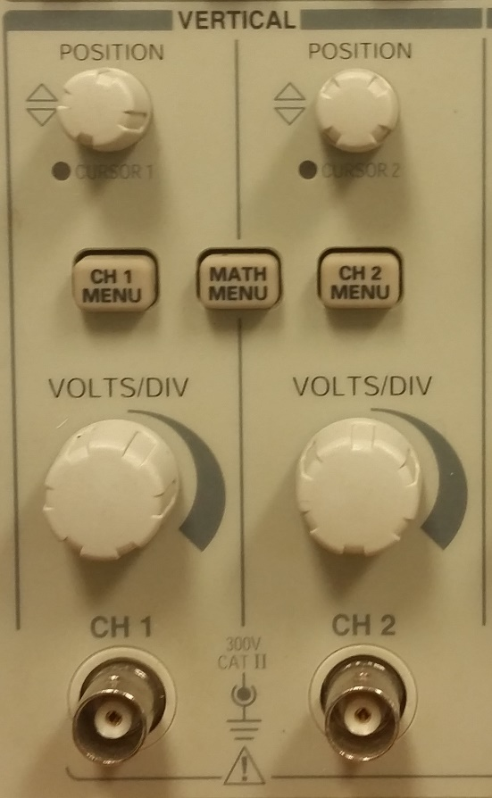
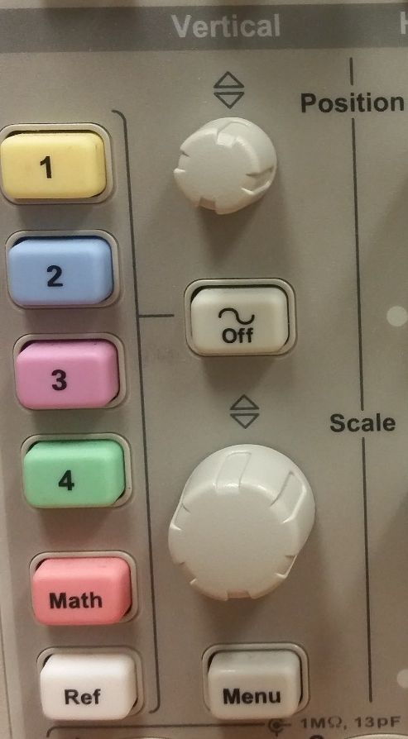
Oscilloscope Controls: Amplitude Scale
Each channel of an oscilloscope can adjust the vertical scale of the graph.
The resolution of the vertical axis is measured in Volts (or millivolts) per division. This value is often displayed on the bottom of the display
The resolution can be changed by the turning the vertical scale knob on the control panel. The volts per division and any current waveforms should update on the display.

Slide 17
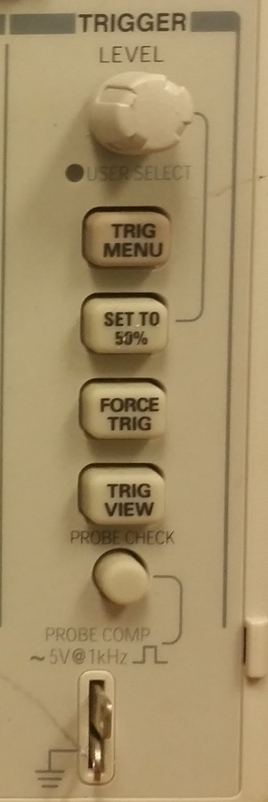
Oscilloscope Controls: Trigger Level
Oscilloscopes can be set so that the signal on the screen will only update after the signal exceeds a specific voltage value.
This voltage value is called the trigger level. It can be adjusted by turning a knob on the front of the oscilloscope.
The trigger level is frequently depicted as a horizontal line across the screen or a small arrow on the side of the graph.
This is important for capturing a signal that may be a brief burst followed by a long idle period.

Slide 18
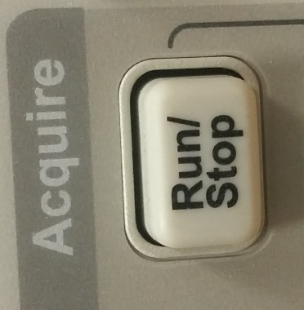
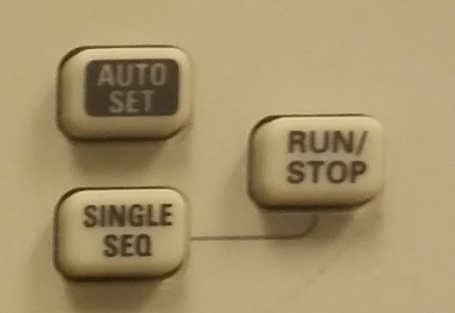
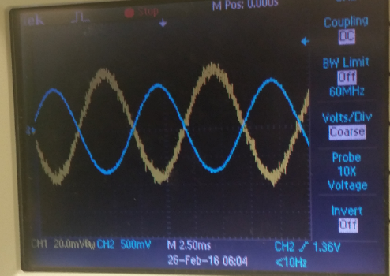
Oscilloscope Controls: Run/Stop
Some oscilloscopes include the ability to stop graphing the signal and pause data collection.
This function is accomplished by pressing the “Run / Stop” button on the oscilloscope.
Pressing the “Run / Stop” button will displays what the waveform was at the moment the “PAUSE” button was pressed. Pressing it again in this state will resume signal capture and update the display.
This is often used in combination with the trigger to pause or resume after a trigger occurs.

