Slide 1

Installing and Navigating the Arduino IDE
Notes:
Left out build automation; not sure what that means exactly. Did cover source editor automation features.

Slide 2
What is an IDE
An integrated development environment (IDE) is software designed to increase productivity by integrating useful tools into one application
These tools vary between different IDEs, but commonly include a source code editor, compiler, and debugger

Slide 3
Source Code Versus Machine Code
Source code is designed for human readability and uses textual syntax that is translated into machine code
Machine code is low-level binary data written for a computer that does not need additional translation

Slide 4

Source Code Editor
A text editor designed specifically for editing code
Features:
  Syntax highlighting and brace matching
  Automatic indentation
  Auto-complete word prediction that fills in common words or phrases as the programmer is typing
Brace matching: Clicking beside a brace puts a box around its counterpart (orange arrows)
Syntax highlighting groups elements by color; void is a data type and loop is a function (red box)

Slide 5
Compiler
Used to convert one language into another language
Converts the source code into machine code for the computer to read

Slide 6
Debugger
Software designed for testing the source code
Oftentimes, the debugger will offer suggestions based on expectations to help the programmer identify and resolve issues
Notes:
Add an example error message

Slide 7
Common IDEs
Arduino
Visual Studio
Eclipse
Komodo
Android Studio
NetBeans
Atom
BlueJ

Slide 8



The Arduino IDE
Arduino software is open source and can be downloaded for free at https://www.arduino.cc/en/Main/Software
Compatible with Windows, Mac OS X and Linux systems

Slide 9
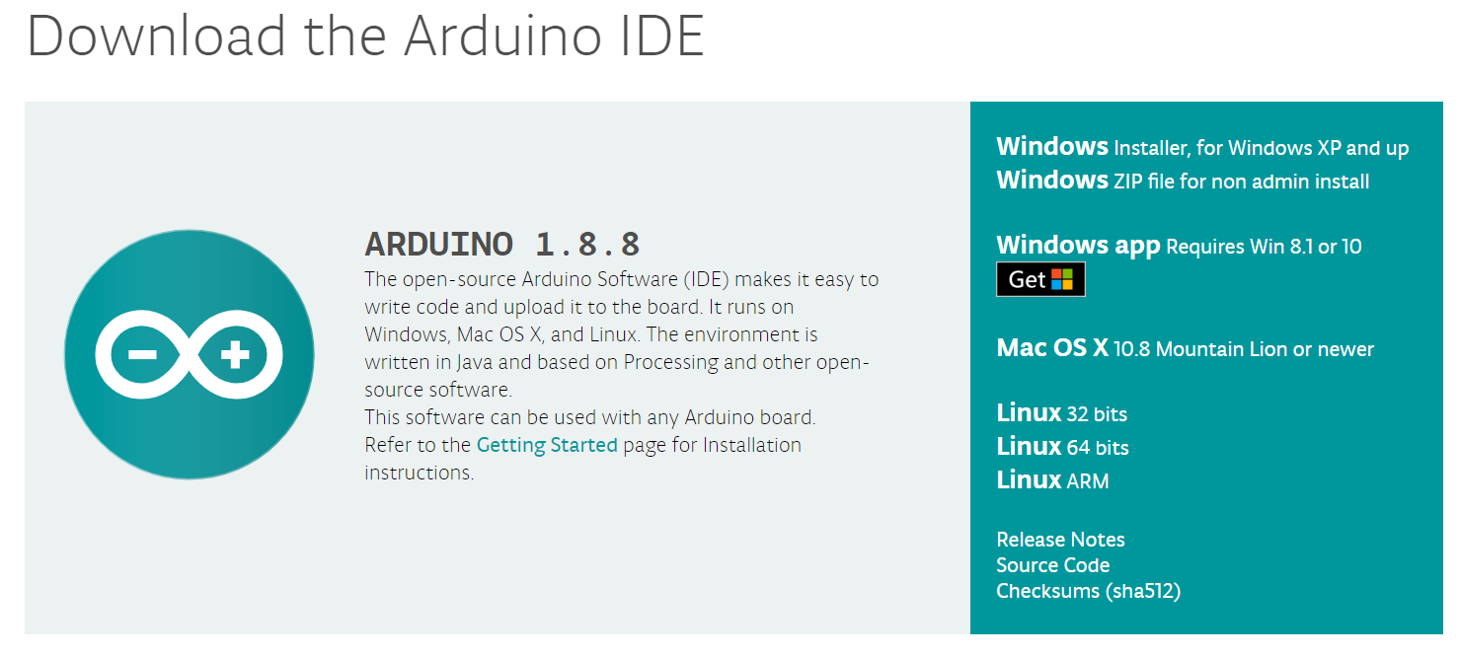
Choosing the Correct Package
Select download link for the appropriate operating system, recommend installer vs app

Slide 10
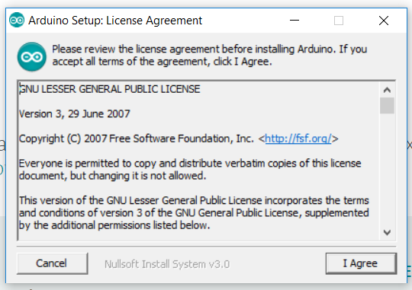
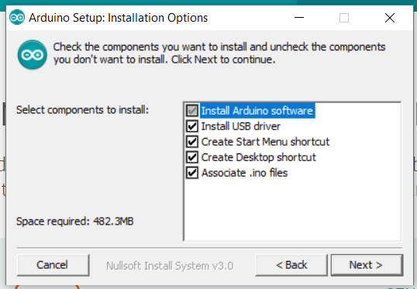
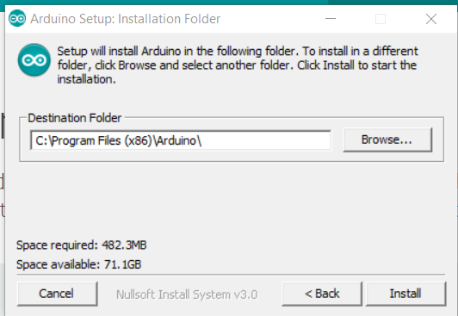
Installation
Follow on-screen instructions to run the installation software (example is for Windows)
1.
2.
3.

Slide 11
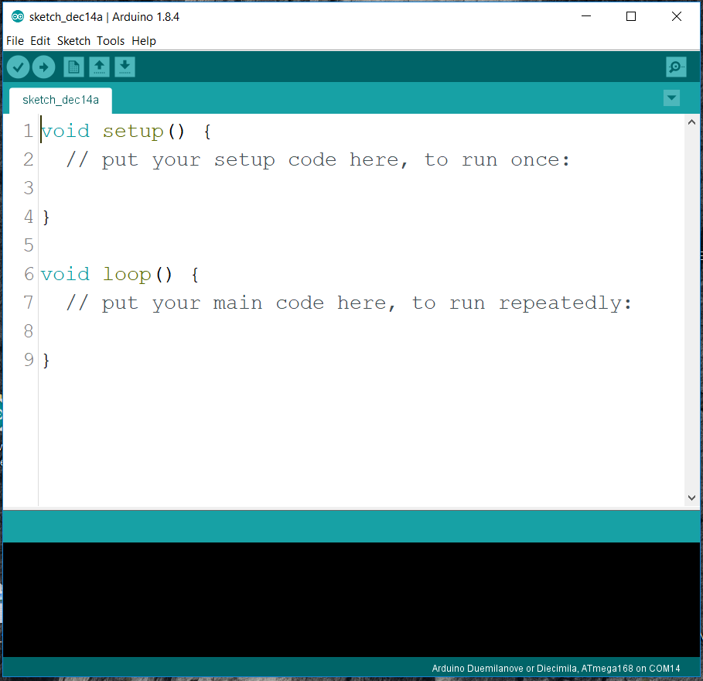
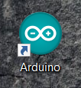
Opening the IDE
Locate the Arduino icon on your desktop and double click to open the program
Clicking this
Should give you this

Slide 12
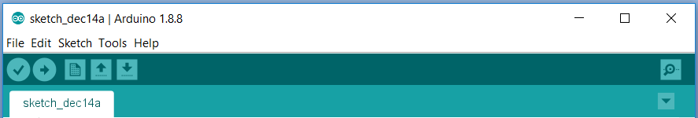
Navigation
The toolbar at the top of the IDE contains functions for file, edit, sketch, tools, and help
The next line gives shortcuts for verify, upload, new, open, and save
The tab at the bottom shows the name of the current sketch

Slide 13
The Serial Monitor
The icon of the magnifying glass in the top right-hand corner opens the serial monitor
This is a pop-up window that allows the programmer to see interactions as the code runs

Slide 14
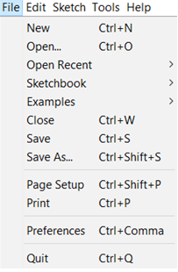
File
The file folder contains features such as new, open, save, and print
The sketchbook subfolder contains a collection of code written by the programmer
The examples subfolder contains fully functional code written for the programmer to assist with common tasks

Slide 15
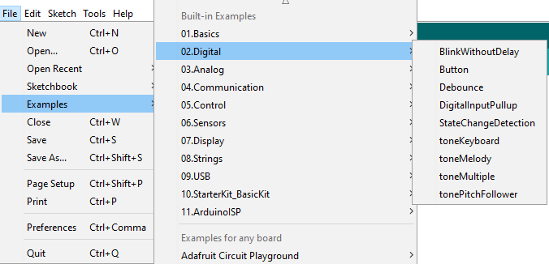
File: Examples
The examples subfolder covers a wide range of processes

Slide 16
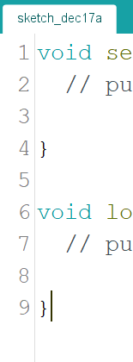
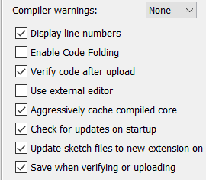
File: Preferences
The preferences subfolder allows you to customize the IDE
Display line numbers is a popular feature that adds or removes line numbers from the source code

Slide 17
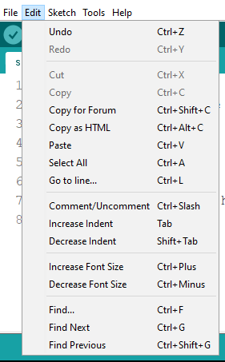
Edit
Edit provides shortcuts for useful features such as undo, redo, cut, copy, and paste
You can increase or decrease indentions as well as font size
A simple shortcut lets you comment or uncomment an entire section of highlighted code

Slide 18
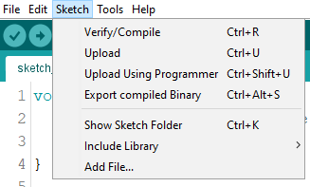
Sketch
Sketch provides shortcuts for verifying, compiling, and uploading code
It allows you to include libraries or incorporate files into the code as needed

Slide 19
Verifying and Uploading Code
Verifying checks for problems
Uploading verifies and sends the code to a microcontroller
It is recommended to verify often as it is easier to locate mistakes from a short line of code as opposed to an entire script

Slide 20
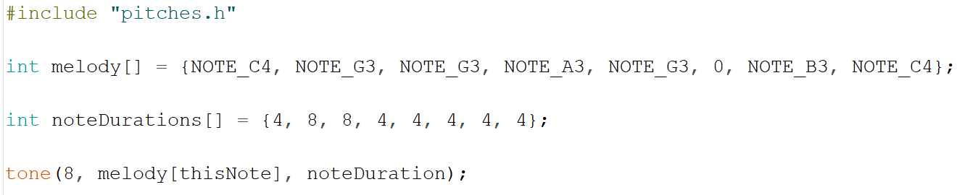
Libraries
Libraries are a collection of precompiled modules that use keywords to activate functions
The example below uses a library named pitches.h for its preset melody, duration, and notes without the need for additional code

Slide 21
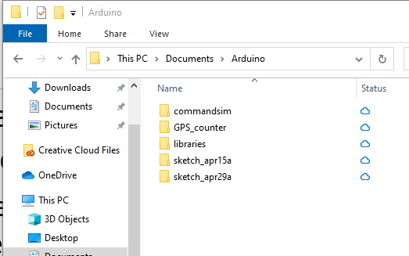
A few notes on libraries
There are actually a few places libraries are stored
  The default libraries(like SPI.h, wire.h, etc.) are in the Arduino IDE install directory
  User installed libraries go to a folder named libraries inside the sketchbook folder
  The sketchbook folder is set in the preferences menu option

Slide 22
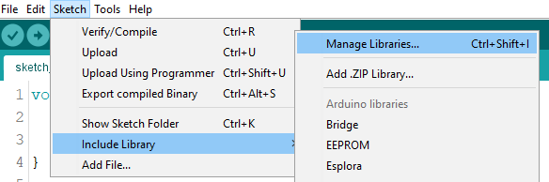
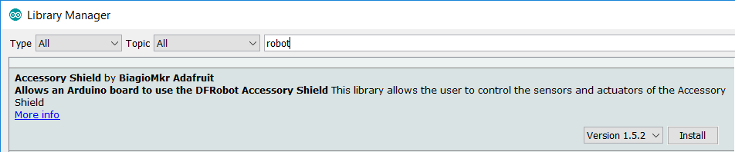
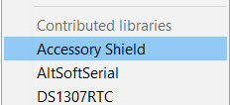
Add a Library via IDE
Select Manage Libraries subfolder
Type keyword to locate a library and select install to download
Locate and select new library in include library subfolder

Slide 23
Library naming
Libraries can also be installed by just copying the folder into the libraries folder (we will do this in a later activity)
The name of the folder must match the .h file
  ie. Folder named SD-master containing SD.h will not work, must rename the folder to just SD
User libraries (those inside the sketchbook folder) will override default libraries with the same name

Slide 24
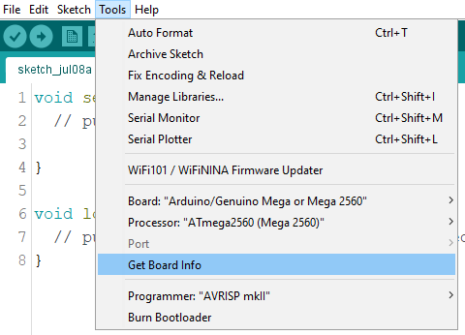
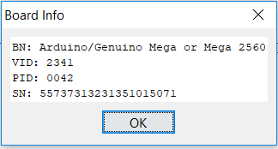
Tools
Tools is where the board and processor are selected
  Code will not run properly if this does not match your equipment
Use ‘Get Board Info’ if you are unsure about the microcontroller being used

Slide 25

Tools: Port
The serial port number is determined by the operating system when the USB cable is plugged in
The following link contains instructions for determining the correct port for Windows, Mac, and Linux:
http://www.me.umn.edu/courses/me2011/arduino/technotes/debug/arduinodebug.html

Slide 26
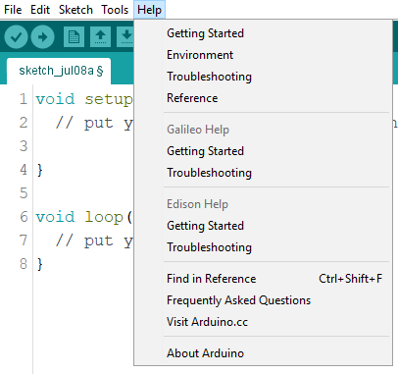
Help
If ever stuck, help offers links for getting started, frequently asked questions, and troubleshooting

Slide 27

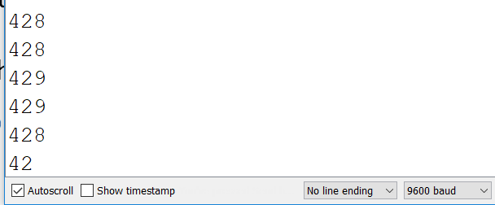
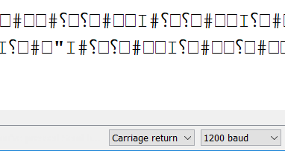
Baud Rates
The baud rate is the rate by which information is transferred
The serial monitor will display unintended caricature if the baud rate on the monitor is not set to match what is dictated in the code

Slide 28
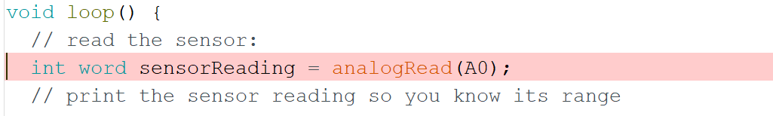
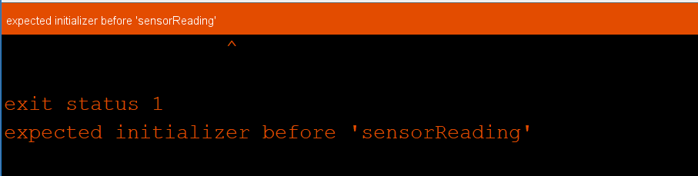
Debugging Code
The debug window provides information based on normal expectations
The example shows two conflicting data types assigned to one variable, int and word
The debugger highlights the potential error in the text window (top) and alerts the programmer in the debug window (bottom)
Notes:
Locate the official name for the upper and lower windows in the IDE

Slide 29
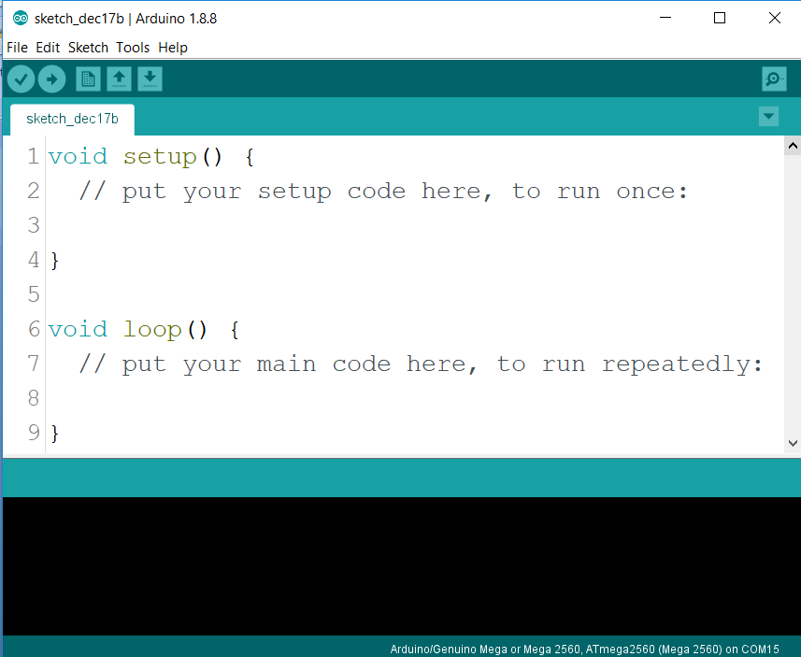
Getting Started
Arduino breaks the sketch into two parts, void setup () and void loop ()
Setup runs once whereas loop runs repeatedly

Slide 30
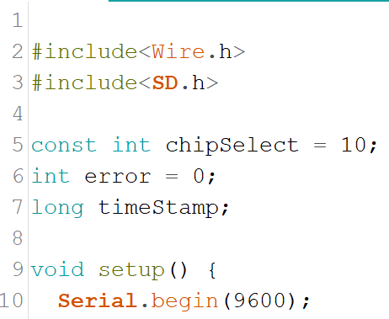
Global Declarations
Libraries and global variables go outside of the two main functions (setup and loop) and are visible to every line in the code
The following example defines the libraries needed to initiate an SD card reader on lines 2 and 3
It defines global variables on lines 5, 6, and 7

Slide 31
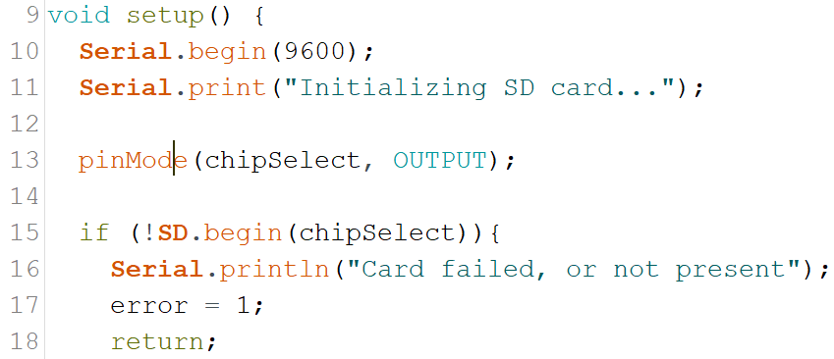
Void Setup
Functions that only need to run once go under void setup
Can declare baud rate and initialize system checks
In the example, the SD card writes via chipSelect (pin 10 defined on slide 28). If it fails to write, it prints an error message in the serial monitor (at a rate of 9600) and stops running the code

Slide 32
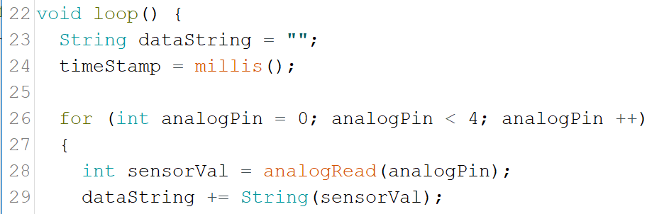
Void Loop
Location of the main code that will loop repeatedly
In the example, the variable dataString will store the reading from a sensor (sensorVal) with 4 measurements taken and it will create a timeStamp that repeats once every millisecond (millis); this will repeat indefinitely

Slide 33
Troubleshooting
Check syntax
  Missing semicolons, brackets, etc.
  Libraries
  Proper syntax and keywords; some libraries may conflict with one another
  Correct baud rate
  Case sensitive context
  Correct data types

