Slide 1
Arduino Mega
Notes:
Label figures and move citations to appendix

Slide 2
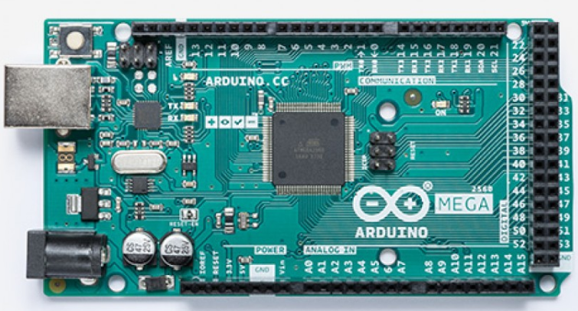
What is an Arduino Mega?
The Arduino Mega is a microcontroller development board designed for hobbyists and novices
It has a custom coding interface (IDE) for creating, uploading, and troubleshooting code
Multiple online tutorials are available for complex code and advanced development
Figure 1: Arduino Mega Development Board

Slide 3
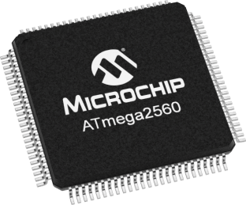
What is a microcontroller?
A microcontroller (MCU) is an integrated circuit that acts as a tiny computer
It contains a processor that can send and receive input, memory to store information, and programmable input and output (I/O) pins for working with external devices such as sensors and switches
Figure 2: ATmega2560 microchip

Slide 4
What is a development board?
Commercially available printed circuit board (PCB) designed to make it easier to interface with a microcontroller
Provides minimum hardware for connecting external devices such as a USB adaptor and integrated circuits for voltage regulation
Provides basic logic for programming and interacting with the device
Useful for small project design and development

Slide 5
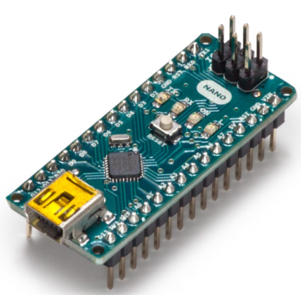
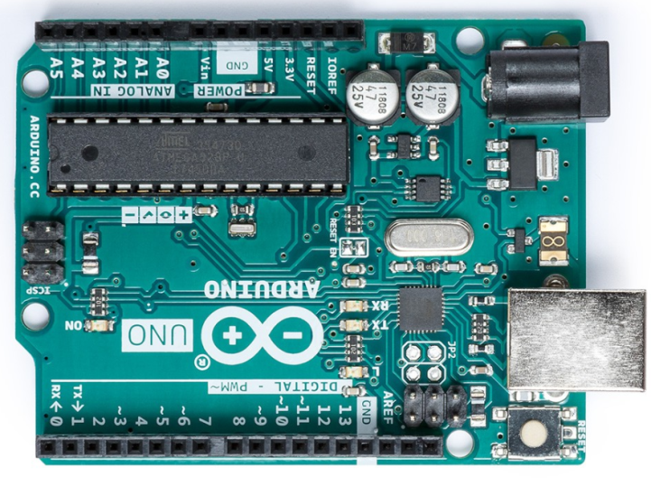
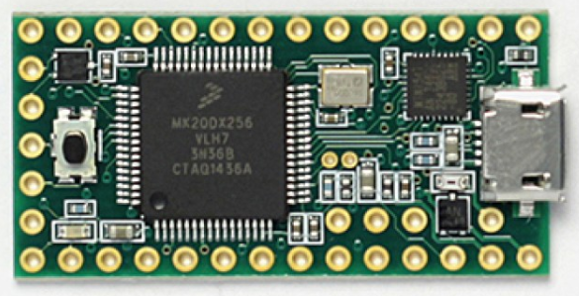
Arduino Development Boards
Figure 4: Arduino Nano microcontroller
Figure 3: Arduino Mega microcontroller
Figure 5: Arduino Teensy microcontroller
Figure 6: Arduino Uno microcontroller

Slide 6
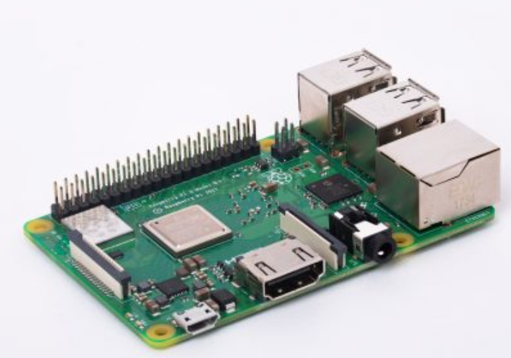
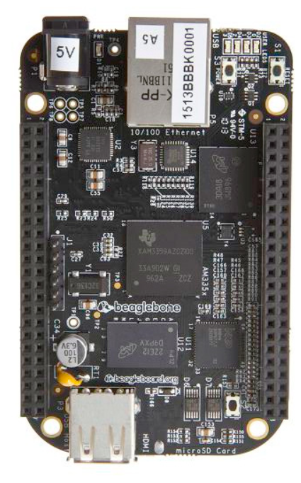
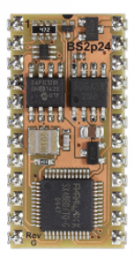
Other Development Boards
Figure 8: Raspberry Pi microcontroller
Figure 7: BeagleBone microcontroller
Figure 9: Basic Stamp microcontroller

Slide 7
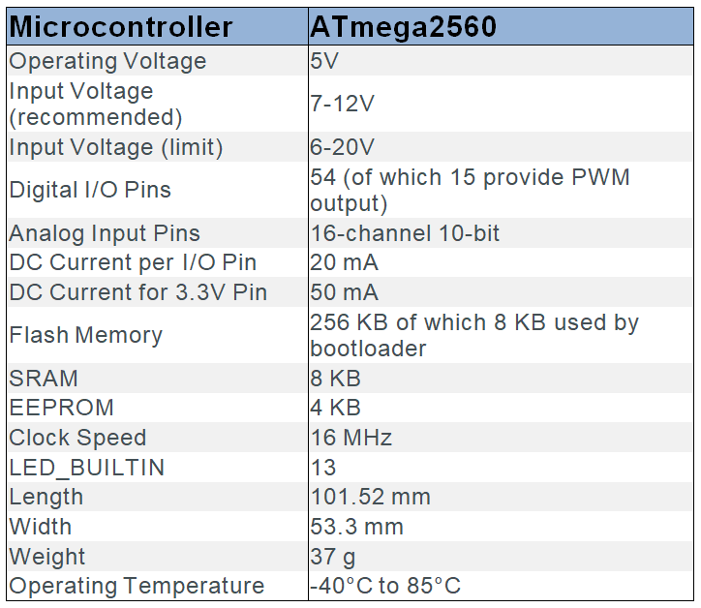
Arduino Mega Specifications
Figure 10: Arduino Mega specifications
Figure 11: Arduino Mega microcontroller

Slide 8
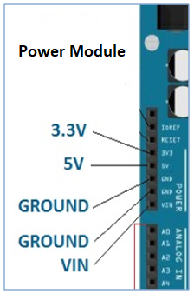
Powering the Arduino
The Mega can be powered via USB, battery or AC-to-DC wall adapter
Recommended supply of 7-12 VDC
Pin specific:
VIN: Provides power via an external supply
5V: Provides a steady 5V supply through the voltage regulator
3V3: Supplies 3.3 V with a maximum current draw of 50 mA
All of the I/O pins operate at 5 V and can provide or receive 20 mA (maximum 40 mA)
Figure 12: Arduino Mega power module
Notes:
Can also power the Arduino using the Vin and ground pins. This bypasses the voltage regulator, which can be dangerous. If there’s a power surge and the voltage regulator is bypassed, the Arduino could get fried.

Slide 9
Memory
The Mega offers 256 kB of self-programmable flash memory for storing code, with 8 kB dedicated to the bootloader
It provides 8 kB of static random-access memory (SRAM) for storing variables
There are 4 kB of electrically erasable programmable read-only memory (EEPROM) that can be used to read or write using the EEPROM library
Notes:
Flash memory -> Data retained if power is lost. This can be reprogrammed and erased. The Arduino sketch lives here.
Bootloader -> Loads the operating system when the Arduino is powered on.
SRAM -> Memory is retained as long as power stays on. If power is lost, this memory is lost. Variables are created and manipulated here.
EEPROM -> Long term memory storage. This memory is retained even if power is lost.

Slide 10
Interfacing with the Arduino
Communication with the Mega is achieved using stackable header pins that connect to the internal circuitry of the board.
Header Pins provide easy access to:
Power Inputs/Outputs
Analog-to-Digital (ADC) Channels
Digital I/O Pins
Serial Channels
Figure 13: Arduino Mega microcontroller

Slide 11
ADC Channels
The Mega provides sixteen 5V ADC channels for collecting information from external devices
Each of the channels can interpret most electric signals below 5V into a digital number called an ADC value
These values can be saved to variables on the Mega’s onboard memory
Figure 14: Arduino Mega microcontroller

Slide 12
Digital Input/Output
The Mega provides 54 digital input/output (I/O) channels
These allow for digital communication with external devices such as LEDs or switches
Some channels have dedicated functions such as serial communication, pulse-width modulation (PWM) output, and interrupts
Figure 15: Arduino Mega microcontroller
Notes:
PWM -> can control analog circuits.

Slide 13
More Digital I/O Features
For hardware serial (UART), there are 4 pairs of RX and TX pins to receive and transmit TTL serial data
SPI is available for MISO, MOSI, SCK and CS using the SPI library
TWI for SDA and SCL is available using the Wire library with a 5V I²C bus on pins 20 and 21
The Mega includes 15 PWM pins which provide an 8-bit output using the analogWrite() function
Notes:
SPI -> Serial peripheral interface, synchronous serial communication. Master-slave relationship. Master In Slave Out, Master Out Slave In, Clock line, Chip Select.
TWI -> 2 wire interface, one clock and one data line. I2C communication
UART = Universal Asynchronous Receiver/Transmitter

Slide 14
Serial Output
Communicating between the computer and Arduino is done by a serial link
Creating a serial link allows the computer to receive information stored on the Arduino
It is important that the computer and the Arduino have matching baud rates
Baud rates are determined by how many symbols are being transmitted per unit of time
Data transmitted by Serial(note there is no number ie. TX0,RX0) object is transmitted to the USB port
void setup () {
Serial.begin(9600);
}
Figure 3: Example of setting up a serial link with a 9600 baud rate
Notes:
Baud rate = bits/sec

Slide 15
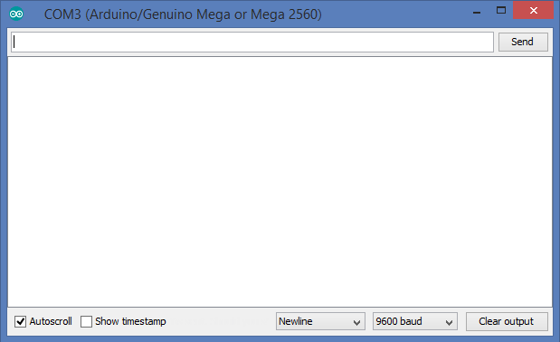
Serial Monitor
The serial monitor allows users to display text, numbers, and other symbols on the computer screen
It serves as the primary way of viewing your code’s output
Can be used to debug code by adding additional serial outputs at key points within the code (such as before and after a series of mathematical operations)
Figure 4: Arduino Serial Monitor display
Notes:
Baud rate in serial monitor must match baud rate declared in sketch, otherwise the output won’t make sense.

Slide 16
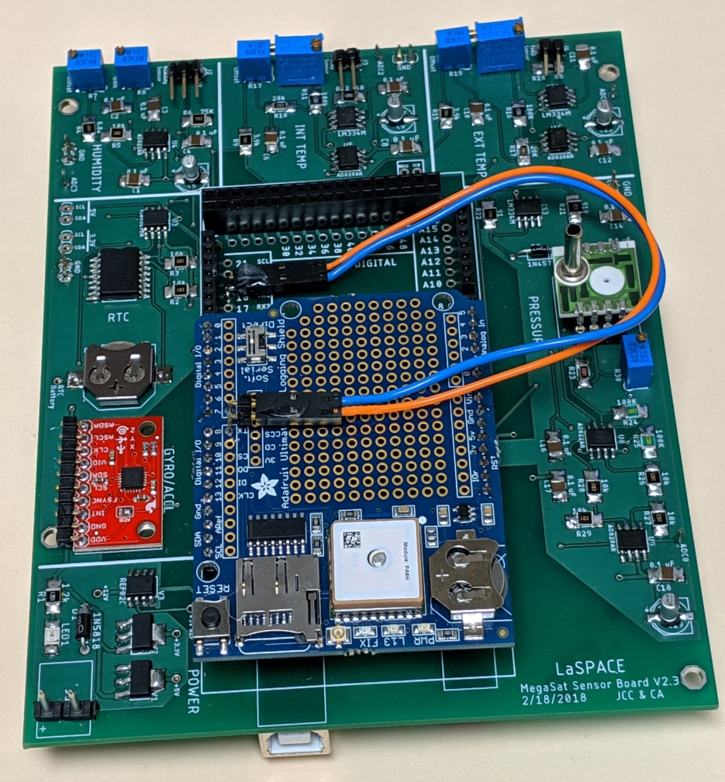
Arduino Shields
Shields are modular circuit boards designed to piggyback onto the Arduino in order to increase functionality of the microcontroller
The MegaSat was designed as a shield to attach directly to the Arduino Mega
Figure 16: MegaSat prototype shield connected to an Arduino Mega

Slide 17
Troubleshooting
Power
Supplying less than 7 V may cause the 5 V pins to drop too low which can create instability
Supplying over 20 V may damage the voltage regulator and cause the circuit to overheat
Connections
Refer to datasheets to ensure proper wiring
Programming
Ensure correct libraries, keywords, pin selection, syntax (more details provided in coding lecture)

Slide 18
Prototyping with Arduino
Arduino Playground is a great place to start
Sample code
Project ideas
Community forums to share and explore
Visit https://playground.arduino.cc/
Notes:
Insert a picture of a prototype from LaSPACE

Slide 19
Useful References
https://www.microchip.com/wwwproducts/en/ATmega2560
https://www.raspberrypi.org/products/raspberry-pi-zero/
https://www.raspberrypi.org/products/raspberry-pi-3-model-b-plus/
https://beagleboard.org/bone
https://www.parallax.com/catalog/microcontrollers/basic-stamp
https://store.arduino.cc/arduino-mega-2560-rev3
https://www.arduino.cc/en/products.compare
https://www.digikey.com/product-detail/en/adafruit-industries-llc/3295/1528-1787-ND/6238007?WT.srch=1&gclid=Cj0KCQiA_s7fBRDrARIsAGEvF8QAFYj__JyCsqkJJ1XszRI-9ANImmMkU4PB0q9k-idBikTjR7K_eDMaAoA-EALw_wcB
https://www.engineersgarage.com/blogs/comparison-between-serial-communication-protocols-spi-i2c-uartusrt-0
www.circuitstoday.com
https://learn.sparkfun.com/tutorials/arduino-shields/all
http://blog.sparkfuneducation.com/a-guide-to-development-boards-for-educators-microprocessors-vs-microcontrollers

