Slide 1
Introduction to Programming

Slide 2
Computer programming is the process of writing code
Code is executable program instructions that are interpreted by computers to perform specific actions

Slide 3
The World of Computer Logic
Most computers operate on binary logic – that is, they utilize bits to perform complex operations
A bit is a basic unit of information that can only be one of two values – 0 or 1
Multiple bits can be interpreted together to form larger units of information; for example, 8 bits form a byte
These series of bits can be used to represent numbers
Example of a byte: 0 0 1 0 1 1 0 1

Slide 4
Number Representations
A number representation is a writing notation for numbers. In everyday, we typically use the decimal number representation to count. We count 0, 1, 2, 3, 4, 5, 6, 7, 8, 9. We can show larger numbers by adding these digits together; for example, combining 4 and 2 produces 42
However, computers do not use the decimal number system. They operate on binary logic – they only use 0’s and 1’s. This is known as the binary number system. It follows the same logic as the decimal number system. As such, it is important to understand how numbers can be represented using binary
Notes:
We use base 10

Slide 5
Binary Number System
The binary number system is a base 2 number representation. Each digit in a binary number is a bit
Since all digits are either a “0” or “1”, it can be difficult to interpret what a number is at first glance. It can be useful to compare the number to the decimal number we are more familiar with
Each digit in a binary number can be read as 2^{n}, where n represents the total number of digits in the binary number
The rightmost digit is known as the least significant bit (LSB) and the leftmost digit is known as the most significant bit (MSB)
Binary | Decimal Number
000 | 0
001 | 1
010 | 2
011 | 3
100 | 4
101 | 5
110 | 6
111 | 7
Table 1: Binary number system

Slide 6
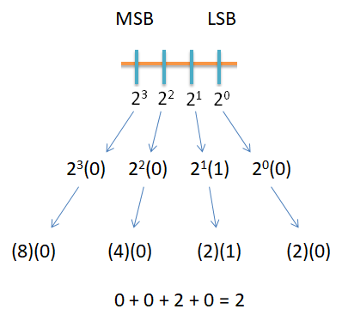
Conversion: Binary to Decimal
To convert from binary to decimal, use a base of 2 and powers beginning with 0 at the LSB, counting upwards to the MSB
This technique is the same in decimal systems; it is similar to how “10” is 10 times larger than 1
For example, “2” in decimal can be represented in binary as “0010”
Figure 1: Convert binary to decimal
Example: Convert (0010)₂ to decimal = 2³(0) + 2²(0) + 2¹(1) + 2⁰(0)
= (8)(0) + (4)(0) + (2)(1) + (2)(0)
= (2)₁₀

Slide 7
Conversion: Decimal to Binary
To convert from decimal to binary, divide by 2. If dividing by an even number, carry a 0. If dividing by an odd number, carry a 1
Divide the remaining whole number by 2 and follow the same carry rules; repeat until the remaining whole number is 0
Build the binary sequence from bottom to top
Divide | Carry
294 ÷ 2 = 147 | 0
147 ÷ 2 = 73.5 | 1
73 ÷ 2 = 36.5 | 1
36 ÷ 2 = 18 | 0
18 ÷ 2 = 9 | 0
9 ÷ 2 = 4.5 | 1
4 ÷ 2 = 2 | 0
2 ÷ 2 = 1 | 0
1 ÷ 2 = 0.5 | 1
Table 2: Convert decimal to binary
Example: Convert (294)₁₀ to binary = (100100110)₂

Slide 8
Hexadecimal System
Sometimes, it is useful to use a larger number representation
Hexadecimal (a base 16 representation) is often used because it can represent a byte with a single character, and can be much quicker to read and understand
This is a base 16, alphanumeric system which means that each digit can have one of sixteen different values (0, 1, 2, 3, 4, 5, 6, 7, 8, 9, A, B, C, D, E, F)
Hexadecimal | Binary Representation
0 | 0000
1 | 0001
2 | 0010
3 | 0011
4 | 0100
5 | 0101
6 | 0110
7 | 0111
8 | 1000
9 | 1001
A | 1010
B | 1011
C | 1100
D | 1101
E | 1110
F | 1111
Table 3: Hexadecimal number system

Slide 9
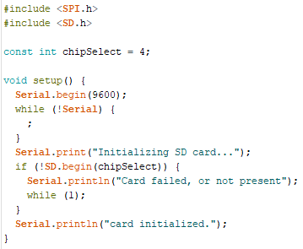
Common Programming Languages
There are many different languages that code can be written in. Each programming language varies in syntax (structure and format) and semantics (meaning)
Common programming languages include:
C, C#, C++
Java, JavaScript
Python
Arduino uses a variation of C++
We will focus on learning Arduino C, the programming language for Arduino hardware
Figure 2: A example of Arduino Code

Slide 10
Variables
Variables are data values typically saved in memory that can be changed based on code execution
Variables consist of three primary parts – the data type, the variable name, and the variable value
int Var = 42;
Data Type
Variable Value
Variable Name

Slide 11
Data Types
There are many different types of variables that store different kinds of data. The type of data stored within a variable depends on the variables data type
Data types are typically declared before the name of the variable. They define how you intend to use data and let the computer know how much room to set aside in memory. The amount of memory set aside is measured in bytes
Data Type | Keyword | Bytes | Range of Values | Numeric (N) or Alphanumeric (A)
Integer | int | 2 | -32768 to 32767 | N
Character | char | 1 | 0 to 255 | N
String | String | varies | varies | A
Boolean | bool | 1 bit | 0 or 1 | N
Floating | float | 4 | -3.4 x 10³⁸ to 3.4 x 10³⁸ | N
Array | name[] | varies | varies | A or N (depends on array type)
Table 4: Data type specifications
Notes:
Chars are stored as numbers. Look at an ASCII chart to see the conversion. ‘A’ = 65, so ‘A’+1 = 66
An array is a collection of the same type of variable. You could have an int array, a char array, a Boolean array, etc. You access elements of an array using the index. For Arduino, the indexing begins at 0, not 1.
Numbers can either be signed or unsigned. If an int is signed, the range of values is -32768 to 32767. If an int is unsigned, the range of values is 0 to 65535

Slide 12
2’s Complement
2’s complement is how negative numbers are stored. The MSB gives the sign of the number. 0 means the number is positive; 1 means the number is negative. To convert from a positive number to a negative number, invert all bits and then add 1
= 0001 1100
Invert -> 1110 0011
Add 1 -> 1110 0100
-28 = 1110 0100

Slide 13
Operators
Operators are one of the most common ways of manipulating the value of a variable. They represent a functional operation such as adding or subtracting
Common types of operators include:
Arithmetic
Logical
Conditional
Bitwise
Comparison

Slide 14
Arithmetic Operators
Arithmetic operators are mathematical functions that take two operands, perform a calculation, and provide a result
Operator | Description | Example
+ | Adds two operands | A + B = C
- | Subtracts second operand from first | A – B = C
* | Multiplies operands | A * B = C
/ | Divides dividend by divisor | B / A = C
% | Modulus operator: Remainder of quotient | B % C = D
++ | Increments integer by 1 | ++A = A + 1
-- | Decrements integer by 1 | --A = A - 1
Table 5: Arithmetic operators

Slide 15
Logical Operators
Logical operators use the laws of Boolean logic to compare two conditions and provide one result if true and another if false
Operator | Description | Example
&& | AND – If both operands are nonzero, the condition is true; otherwise, it is false | If A = 1 and B = 0, then A && B = false
|| | OR – If either operand is nonzero, the condition is true; otherwise, it is false | If A = 1 and B = 0, then A || B = true
! | NOT – If a condition is true, then !condition is false | If A || B = true, then !(A || B) = false
Table 6: Logical operators

Slide 16
Conditional Operators
A conditional operator will return one value if a condition is true and another if a condition is false
Most operators are conditional by nature because they compare entities and then proceed one way if a particular condition is met and another way if it is not
Example:
if (expression1) a = a1; // Test this first
else if (expression2) a = a2; // If above was false, test this
else a = a3; // If above was also false, do this
Notes:
Added example

Slide 17
Bitwise Operators
Bitwise operators are similar to logical operators, except they compare individual bits instead of the entire operand
Operator | Description | Example
& | Bitwise AND – If both bits are nonzero, the condition is true; otherwise, it is false | If a = 1 and b = 0, then a & b = false
| | Bitwise OR – If either bit is nonzero, the condition is true; otherwise, it is false | If a = 1 and b = 0, then a | b = true
^ | Bitwise XOR – If both bits are different, the condition is true; otherwise, false | If a = 1 and b = 1, then a ^ b = false
~ | Bitwise NOT – Inverts all bits of a number | If D = 0110, then ~D = 1001
Table 7: Bitwise operators

Slide 18
Comparison Operators
Comparison operators are used to compare two operands
These are typically found nested within a function
Operator | Description | Example
== | Equal to | x == y (x is equal to y)
!= | Not equal to | x != y (x is not equal to y)
< | Less than | x < y (x is less than y)
> | Greater than | x > y (x is greater than y)
<= | Less than or equal to | x <= y (x is less than or equal to y)
>= | Greater than or equal to | x > y (x is greater than or equal to y)
Table 8: Comparison operators

Slide 19
Functions
A function is a code segment in a program that contains instructions the computer will use to perform a task
To define a function:
Specify a data type for the return
Provide a unique name followed by a set of parenthesis
After the parenthesis, put the instructions that need to be executed inside a set of brackets
void setup () {
<insert instructions> }
Figure 5: Structure of a void function

Slide 20
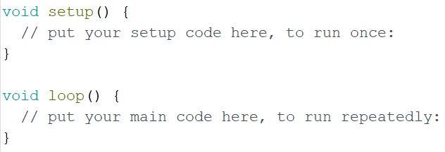
Void
Void is a special data type used for declaring a function that is not expected to return any information
Arduino uses two void functions to get you started; the main setup runs one time when the program begins, followed by a loop that runs continuously thereafter
Figure 6: Image of the Arduino start screen

Slide 21
Conditional Statements: If/Else
An if statement proceeds one way if a condition is met and another way if it is not met
void setup() {
Serial.begin(9600); }
void loop() {
int A = 15;
int B = 10;
if (A >= B) {
Serial.println (A – B);
}
else if ( (A < B) && (B != 0) ) {
Serial.println (B + A);
}
void setup() {
Serial.begin(9600); }
void loop() {
int A = 5;
int B = 20;
if (B >= A) {
Serial.println (B - A);
}
else if ( (A < B) && (B != 0) ) {
Serial.println (B + A);
}
Figure 7: In this example, if A is greater than or equal to B, then A – B will print. Otherwise, if B is not zero then B + A will print
Figure 8: In this example, if B is greater than or equal to A, then B – A will print. Otherwise, if B is not zero then B + A will print
Notes:
Corrected code explanation to match code. Adjusted figure 8 to show a difference because they were identical.

Slide 22
Loops
A loop is useful when repetitive operations are being performed because the instructions will repeat until a particular condition is met
Some loop commands pretest, which means they test for a condition at the beginning of the loop
Other loop commands posttest, which means they test for a condition at the end of the loop

Slide 23
For Loops
A for loop executes repeatedly and increments a counter variable until the conditional statement is no longer true (pretest condition)
void setup() {
Serial.begin(9600);
}
void loop() {
for (int i = 0; i <= 15; i++) {
Serial.println(i);
}
}
Output → 0 1 2 3 4 5 6 7 8 9 10 11 12 13 14 15
for (int i = 0; i <= 15; i++ )
Counter Initialization
Increment
Conditional
Statement
Figure 9: A for loop that counts from 0 to 15. The variable i starts at 0 and increments every loop until the condition stated in the loop is no longer valid.

Slide 24
While Loops
A while loop will only run when the conditional statement is true (pretest condition)
while (carrier < 0) { Serial.print (carrier++) }
Conditional Statement
Loop Execution
int carrier = 0;
void setup() {
Serial.begin(9600);
}
void loop() {
while (carrier < 20) {
Serial.println(carrier++);
}
Figure 10: A while loop that counts from 0 to 19
Notes:
Added pretest

Slide 25
Do/While Loops
A do/while loop only checks for a condition after some other action has occurred (posttest condition)
do { Serial.print (carrier) } while (x < 10)
Loop Execution
Conditional Statement
int x = 0;
void setup() Serial.begin(9600);
void loop() {
do {
Serial.print(“Waiting…”);
Serial.println(x++);
} while (x < 10) ;
Serial.println(“done”);
while(1) {};
}
Figure 11: A do/while loop that counts from 0 to 9

Slide 26
Leaving Comments
If you can fit your comment on one line, then simply type two backslashes followed by your text
If you need more room, then use a backslash and asterisk combination to comment over multiple lines
You can highlight a block of information and press ctrl + backslash to comment the entire block
// Leave a one-line comment like this
/* Use as many lines as needed in order to provide enough information for someone else to understand your code */

Slide 27
Good Comments
Figure 12: This an example of good commenting. Notice the comments explaining each step and the use of white space to help the user understand the code.

Slide 28
Bad Comments
Figure 13: This an example of bad commenting. The lack of comments make the code difficult for a user to follow and understand the purpose of this function.

Slide 29
Version Control
While developing software, it is important to track the changes made within your code. This is accomplished by version control.
Version Control is the practice of managing and recording changes to software or other frequently changed documents
Without version control, changes are more frequently lost, miscommunicated, or duplicated.
Version control helps facilitate effective communication in development teams.

Slide 30
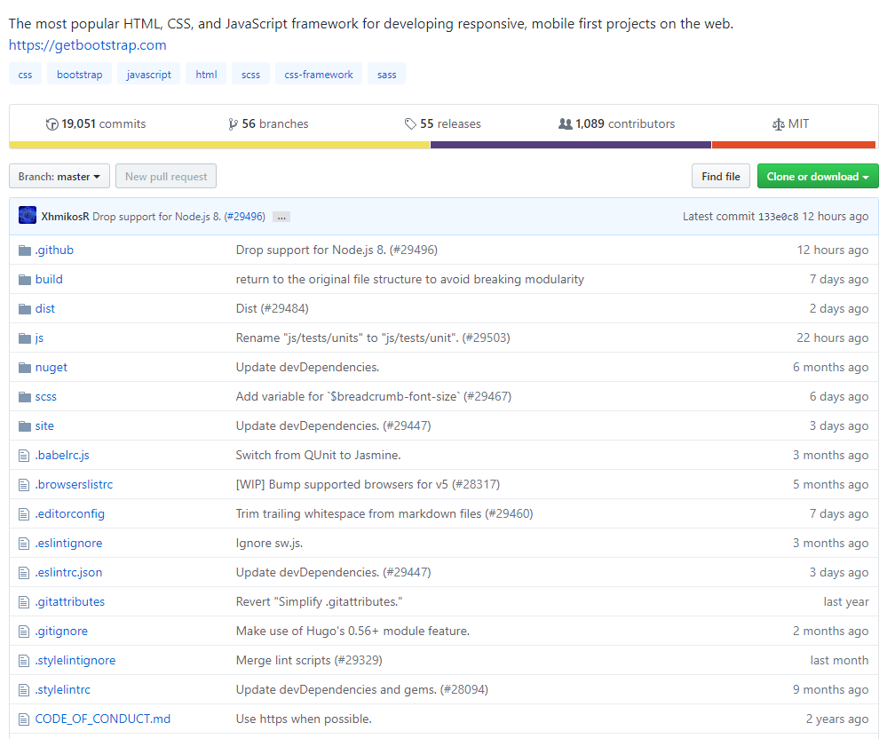
Version Control Systems
In large software projects, version control is often handled by a version control system developed by a third party. A version control system (VCS) is a software program that creates and tracks multiple versions of a codebase on a server.
Some examples of VCS software include GitHub, Subversion, and BitKeeper
Figure 14: Example of a GitHub repository for a large software program

Slide 31
Working Copies and Branches
In development, it is often useful for multiple programmers to edit software at the same time.
The initial copy of the software that the programmers begin with is called the working copy or baseline. The edited software that each programmer creates is known as a branch. Multiple branches may exist at the same time. A branch may become the working copy when the team agrees to shift to the new branch for further development work.
When a programmer is finished with his or her changes to the branch, they may compile a change list which summarizes all changes made to the software.

Slide 32
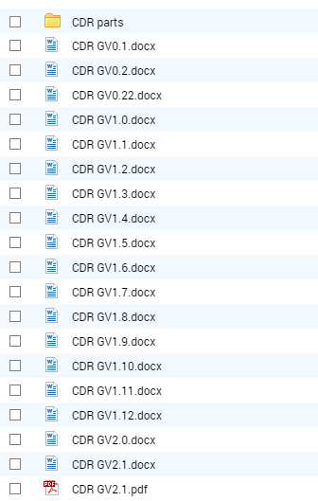
File Tags
In version control, a file tag is a series of numbers or letters that designate the version of an existing document or software. File tags often include a version number that in incremented with any changes or the date the file was modified.
The system for updating the file tag is defined during project creation and is followed throughout the lifetime of the project.
Figure 15: Example of a file tag system for iterations of a document

Slide 33
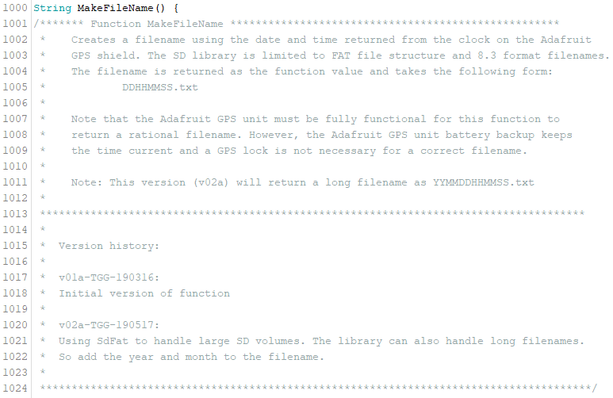
Function Version History
It is useful to track changes of a function. This can be done by implementing a change log inside the code
Figure 16: Example of a change log for a function. After the description of a function, include version history. This will tell a user when any changes were made and what those changes were.

Slide 34
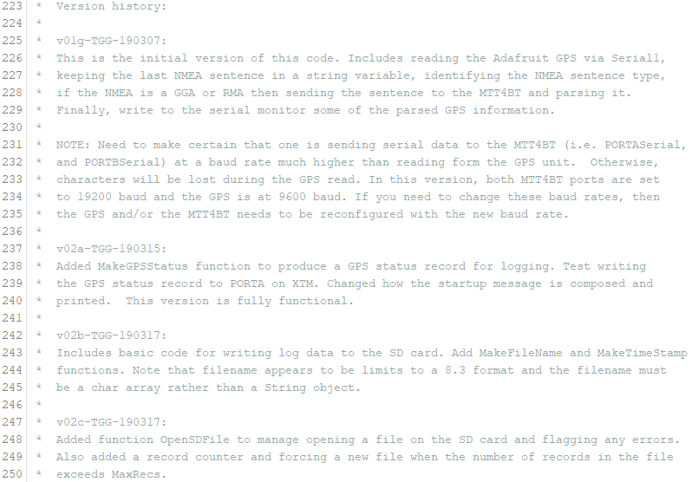
Sketch Version History
Like functions, sketch changes should be documented. This should be done in the beginning of the sketch
Figure 17: Example of version history for a sketch. Every time the sketch is worked on, a new section is added describing the changes that were made.

Slide 35
Troubleshooting Your Code
Check syntax
Check punctuation: semicolons, brackets and parenthesis must be placed correctly
Ensure correct placement of conditional statements and loops
Use correct data types
Make sure global and local variables are accessible to the appropriate functions

Slide 36
Good Bookkeeping
There is typically more than one way of writing a program to accomplish a particular task; as such, programmers tend to have their own styles
It is good practice to write your code in a manner that is easy for you to navigate through and clear enough for others to understand
Practice taking advantage of whitespace, utilize control characters, identify variables and functions using descriptive names, and always comment your code
Work to establish good habits while you are learning

Slide 37
References
For a list of Arduino keywords, visit https://www.arduino.cc/reference/en/

