Slide 1
Errors and Uncertainty
Part 2

Slide 2
What is a Distribution
Gives the relative chance (probability) getting a specific value when making 1 measurement of a particular quantity
  As you make repeated measurements you are pulling more possible values out of the distribution
You usually make a guess about the distribution for the measurement based on previous measurements, often assume the Normal Distribution
When you make a single measurement you sampling the distribution, with multiple samples we can start to make more accurate statements about the distribution
Shows how you should see the measurements to be distributed over all possible values if you were able to repeat the measurement and infinite amount of time
Only addresses the random error, systematic error is assumed to be small or 0

Slide 3
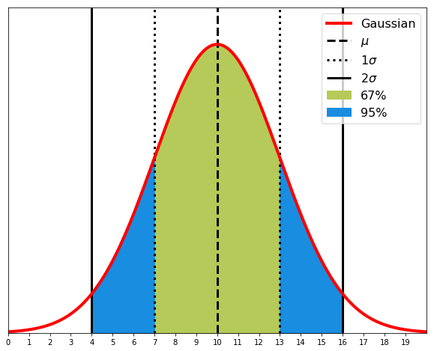
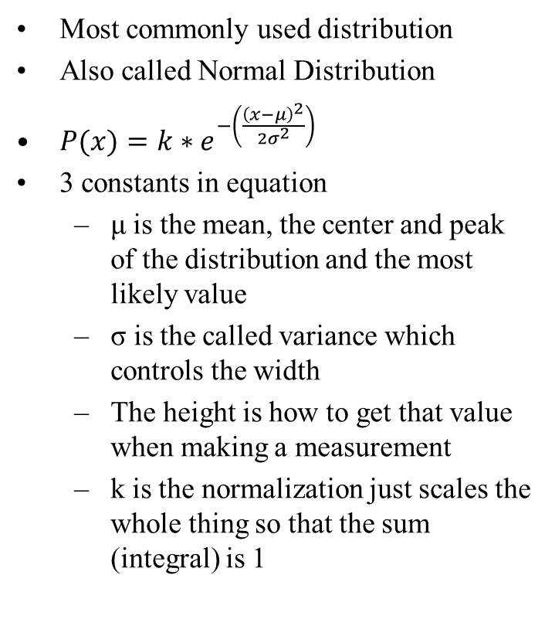
Gaussian Distribution
Most commonly used distribution
Also called Normal Distribution
$P(x)=k∗e^{−\left(\frac{{\left(x−μ\right)}^{2}}{2σ^{2}}\right)}$
3 constants in equation
  μ is the mean, the center and peak of the distribution and the most likely value
  σ is the called variance which controls the width
  The height is how to get that value when making a measurement
  k is the normalization just scales the whole thing so that the sum (integral) is 1
A Gaussian distribution with μ=10 and σ=3, the vertical lines show 1σ and 2σ from the mean. The green region contains about 67% of the total area and the combined green and blue contain 95% of the total area.

Slide 4
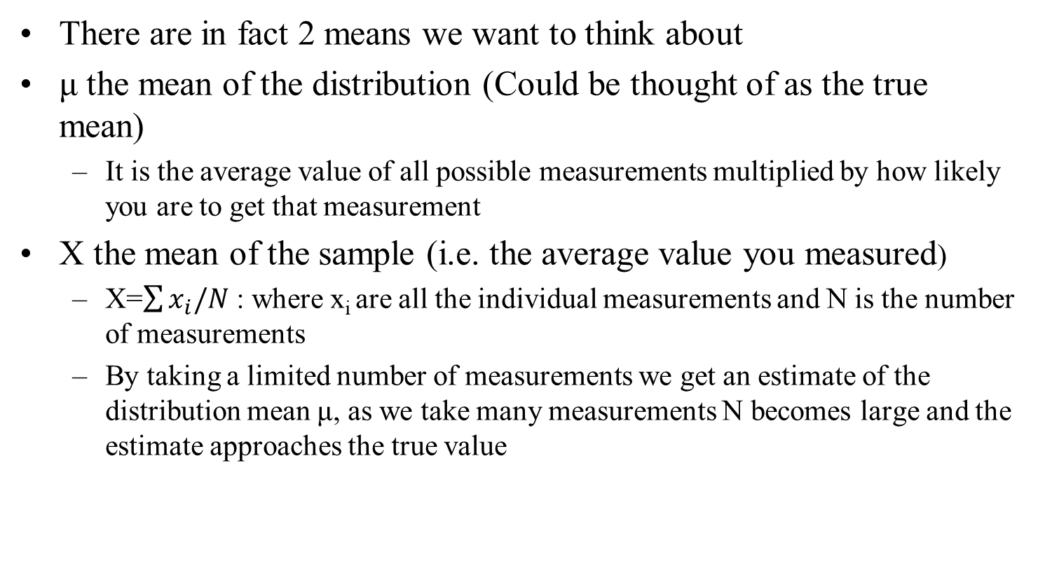
The Mean
There are in fact 2 means we want to think about
μ the mean of the distribution (Could be thought of as the true mean)
  It is the average value of all possible measurements multiplied by how likely you are to get that measurement
X the mean of the sample (i.e. the average value you measured)
  X=$\sum{x_{i}/N}$ : where x_{i} are all the individual measurements and N is the number of measurements
  By taking a limited number of measurements we get an estimate of the distribution mean μ, as we take many measurements N becomes large and the estimate approaches the true value

Slide 5
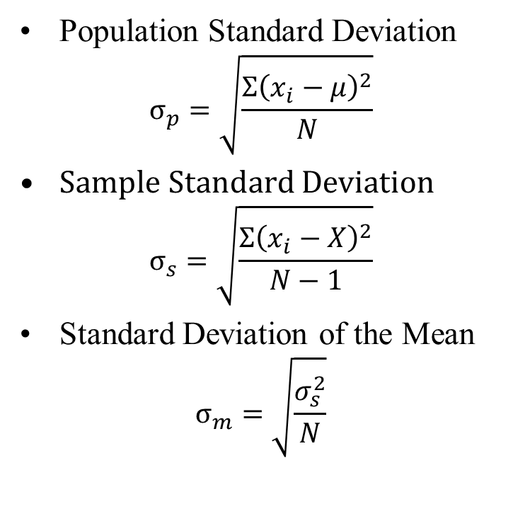
Standard Deviations
Standard Deviation by itself is a somewhat imprecise that could have different meanings in different contexts/fields
Because of this you want to be specific which one you are using (define the equation somewhere in your writing)
Not the same as the distribution σ
3 Standard Deviations with 3 Different meanings
Population Standard Deviation
$$σ_{p}=\sqrt{\frac{Σ{\left(x_{i}−μ\right)}^{2}}{N}}$$
Sample Standard Deviation
$$σ_{s}=\sqrt{\frac{Σ{\left(x_{i}−X\right)}^{2}}{N−1}}$$
Standard Deviation of the Mean
$$σ_{m}=\sqrt{\frac{σ_{s}^{2}}{N}}$$

Slide 6
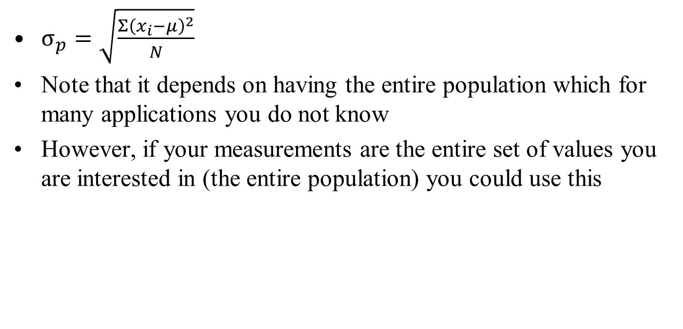
Standard Deviation (Population)
$σ_{p}=\sqrt{\frac{Σ{\left(x_{i}−μ\right)}^{2}}{N}}$
Note that it depends on having the entire population which for many applications you do not know
However, if your measurements are the entire set of values you are interested in (the entire population) you could use this

Slide 7
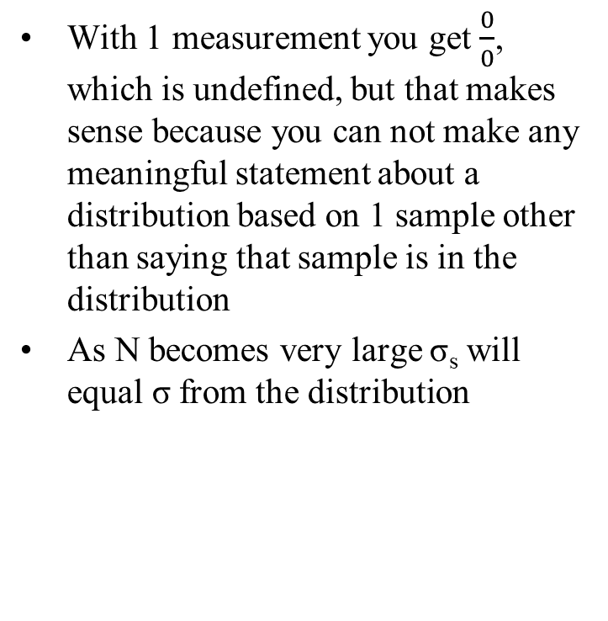
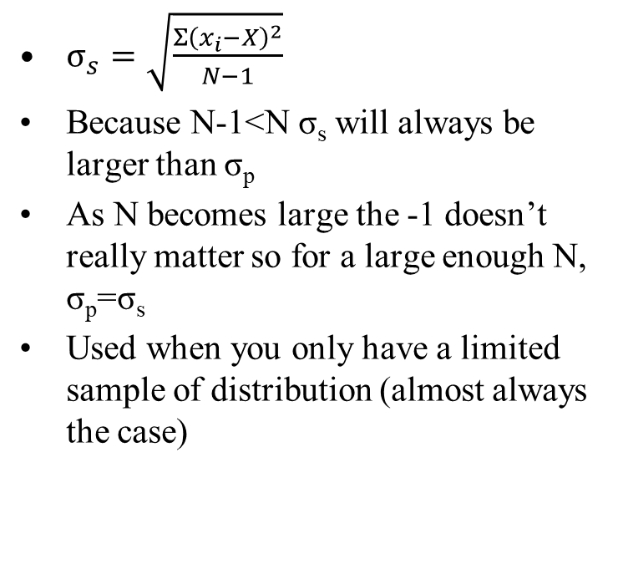
Standard Deviation (Sample)
$σ_{s}=\sqrt{\frac{Σ{\left(x_{i}−X\right)}^{2}}{N−1}}$
Because N-1<N σ_{s} will always be larger than σ_{p}
As N becomes large the -1 doesn’t really matter so for a large enough N, σ_{p}=σ_{s}
Used when you only have a limited sample of distribution (almost always the case)
With 1 measurement you get $\frac{0}{0}$, which is undefined, but that makes sense because you can not make any meaningful statement about a distribution based on 1 sample other than saying that sample is in the distribution
As N becomes very large σ_{s} will equal σ from the distribution

Slide 8
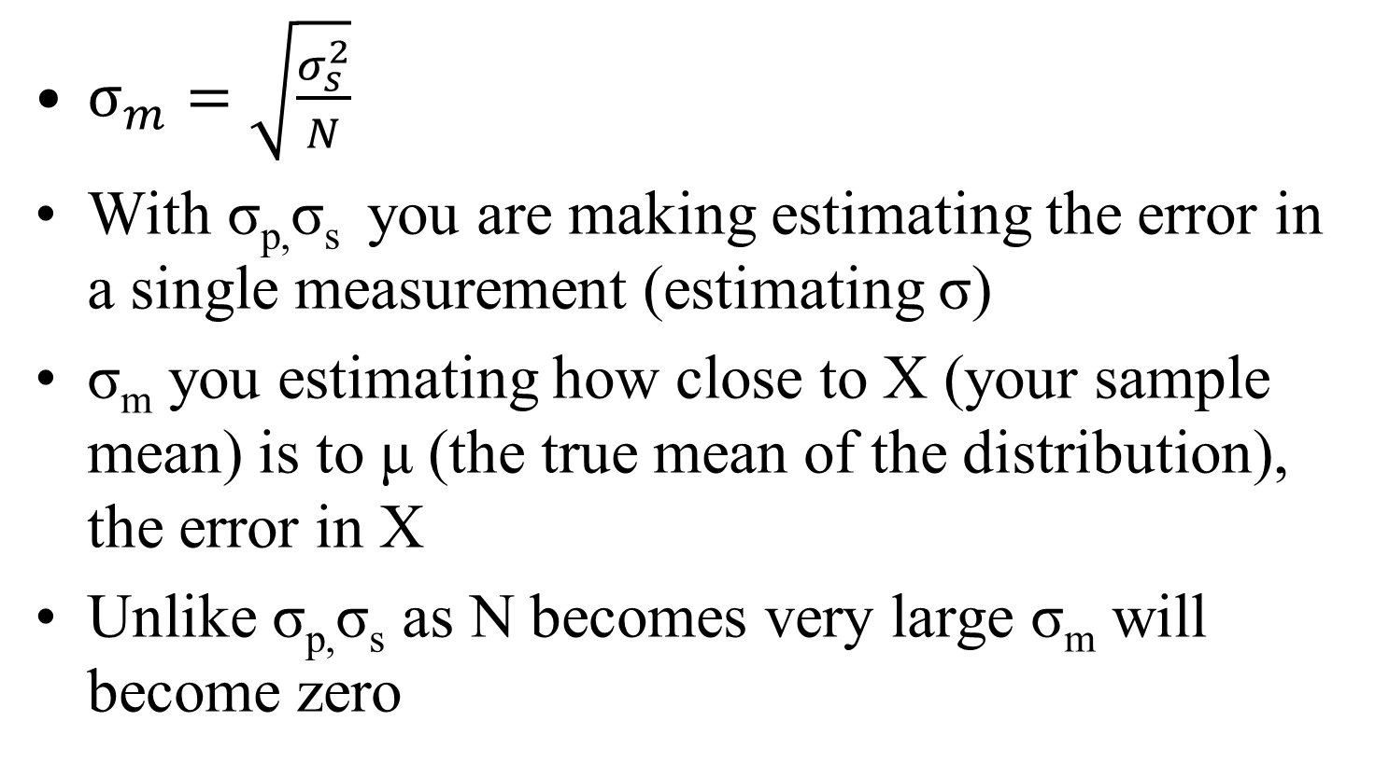
Standard Deviation of the Mean
$σ_{m}=\sqrt{\frac{σ_{s}^{2}}{N}}$
With σ_{p,}σ_{s} you are making estimating the error in a single measurement (estimating σ)
σ_{m} you estimating how close to X (your sample mean) is to μ (the true mean of the distribution), the error in X
Unlike σ_{p,}σ_{s} as N becomes very large σ_{m} will become zero

Slide 9
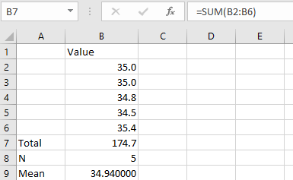
Example: Standard Deviation
Suppose we make 5 measurements of the temperature a with a digital thermometer that reads out to 0.1 Degrees
First calculate the sum

Slide 10
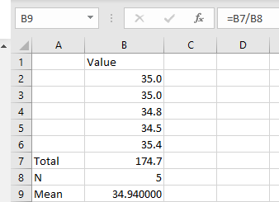
Example: Standard Deviation
Suppose we make 5 measurements of the temperature a with a digital thermometer that reads out to 0.1 Degrees
First calculate the sum
Next calculate the mean

Slide 11
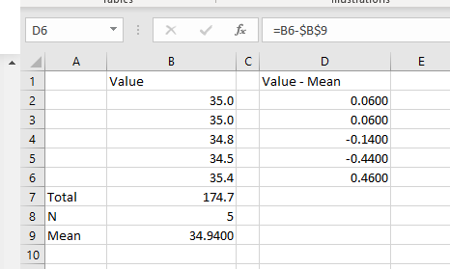
Example: Standard Deviation
Then you need to subtract the mean from each measurement

Slide 12
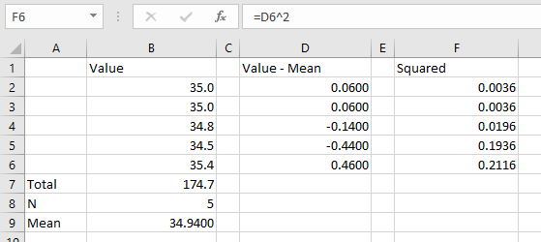
Example: Standard Deviation
Then you need to subtract the mean from each measurement
Then square each of them

Slide 13
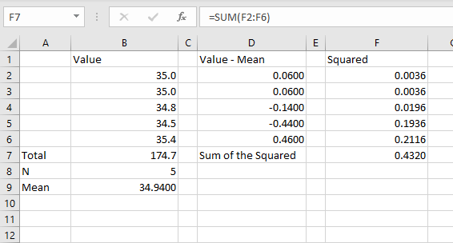
Example: Standard Deviation
Then you need to subtract the mean from each measurement
Then square each of them
Sum the squares

Slide 14
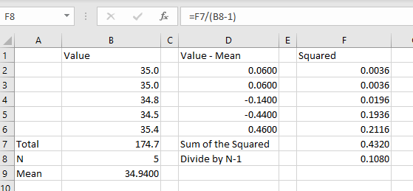
Example: Standard Deviation
Then you need to subtract the mean from each measurement
Then square each of them
Sum the squares
Divide by N-1

Slide 15
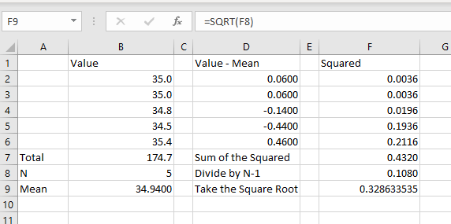
Example: Standard Deviation
Then you need to subtract the mean from each measurement
Then square each of them
Sum the squares
Divide by N-1
And take the square root

Slide 16
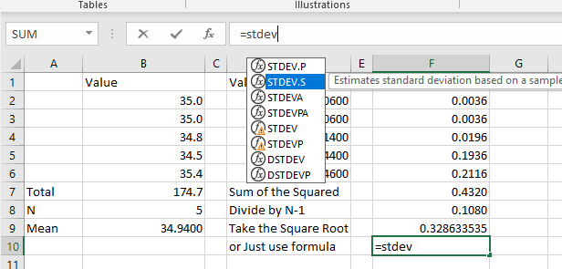
Example: Standard Deviation
Most programs have a built-in standard deviation function you can use
But be careful to use the correct (sample not population)

Slide 17
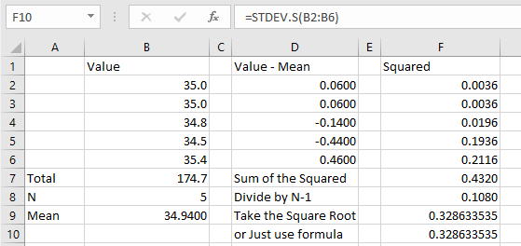
Example: Standard Deviation
Most programs have a built-in standard deviation function you can use
But be careful to use the correct (sample not population)
We can see gives the same result as doing it step by step

Slide 18
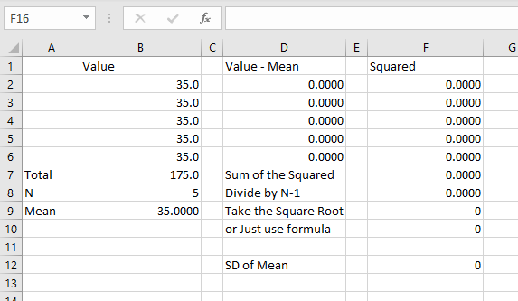
Example: Standard Deviation
But what if we did the measurement with a bulb thermometer that could only has 0.5 deg resolution
We get 0 for both the Standard Deviation and SD of the mean
Does that mean no error?

Slide 19
What if my Standard Deviation is 0(or very small)?
Let’s say I measure the length of a metal bar with a ruler 10 times with a ruler marked in mm and I get 12mm each time
Calculating the σ_{s} you get 0 so I know the bar is exactly 12 mm, no uncertainty, down to the smallest fraction of a mm, right?
NO! We have completely left out the other type of uncertainty, systematic
Since the ruler is only marked in 1mm increments we would probably want to estimate the systematic error to be at least that large
  Maybe you could argue 0.5mm but clearly if this was a digital measurement you couldn’t go smaller than the last displayed digit
  You would also want to include any accuracy given by the manufacturer specifications
Need to estimate the systematic uncertainty and add it to the random uncertainty
The steps of the measuring device are larger than the width of the distribution

Slide 20
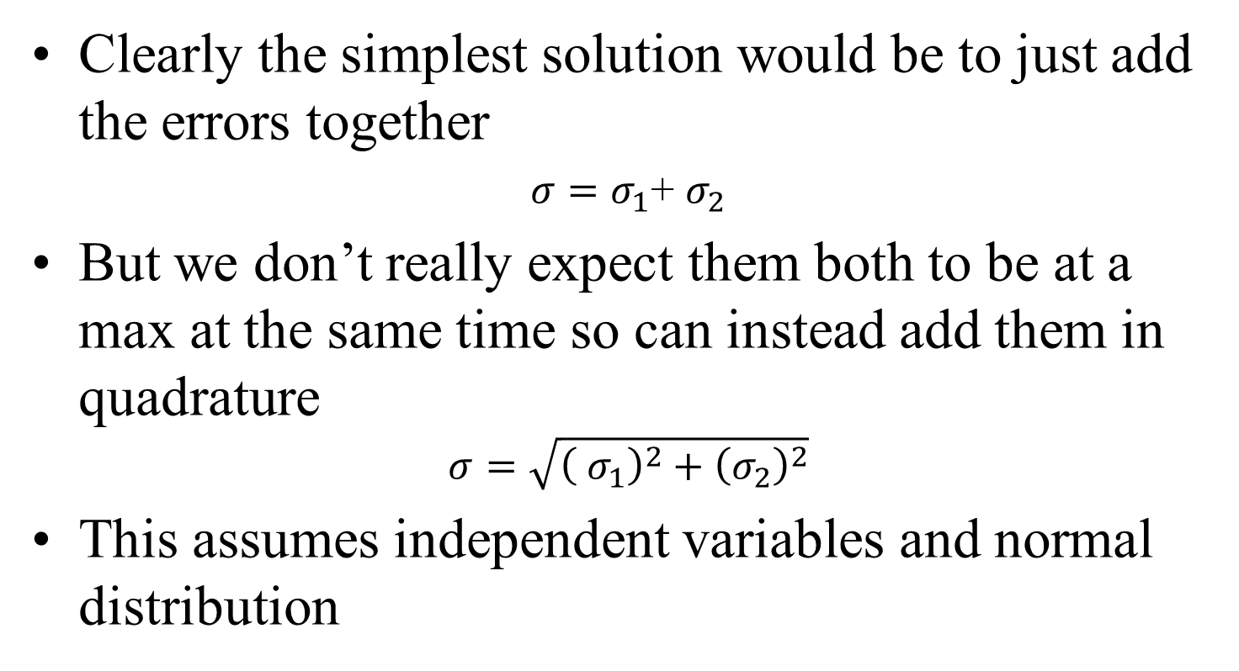
Adding Errors
Clearly the simplest solution would be to just add the errors together
$σ=σ_{1}$+ $σ_{2}$
But we don’t really expect them both to be at a max at the same time so can instead add them in quadrature
$$σ=\sqrt{{\left( σ_{1}\right)}^{2}+{\left(σ_{2}\right)}^{2}}$$
This assumes independent variables and normal distribution

Slide 21
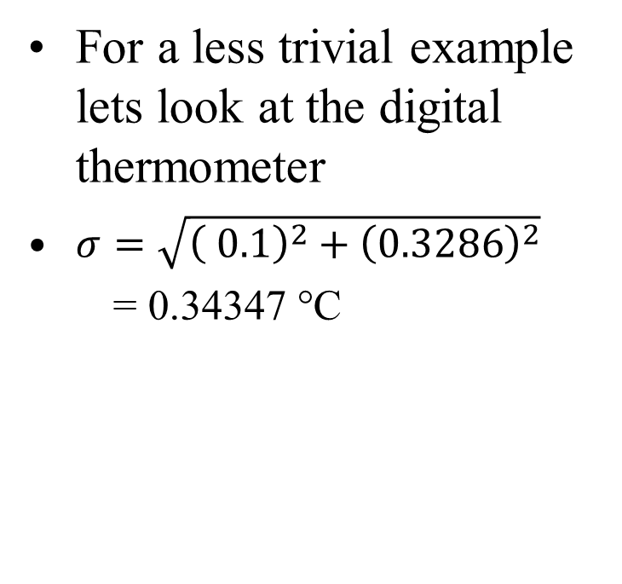
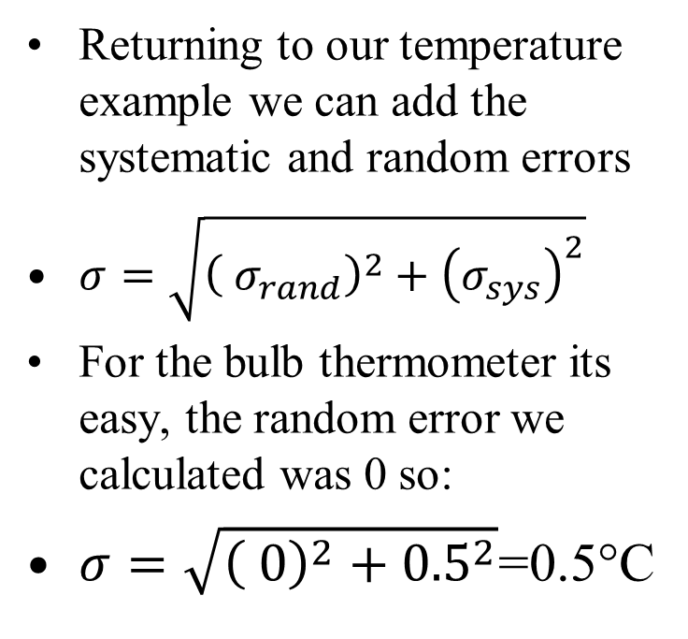
Example: Adding Error
Returning to our temperature example we can add the systematic and random errors
$σ=\sqrt{{\left( σ_{rand}\right)}^{2}+{\left(σ_{sys}\right)}^{2}}$
For the bulb thermometer its easy, the random error we calculated was 0 so:
$σ=\sqrt{{\left( 0\right)}^{2}+{0.5}^{2}}$=0.5°C
For a less trivial example lets look at the digital thermometer
$σ=\sqrt{{\left( 0.1\right)}^{2}+{\left(0.3286\right)}^{2}}$
= 0.34347 °C

Slide 22
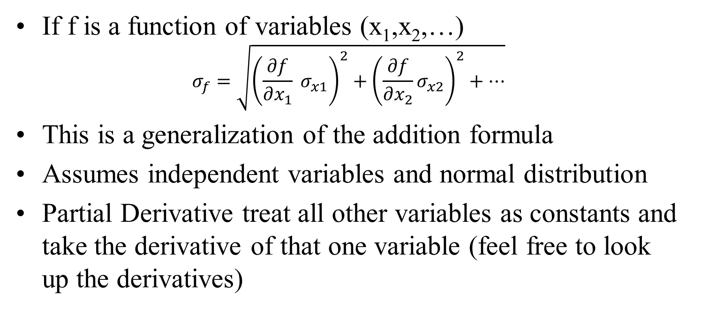
Propagation of Error
If f is a function of variables (x₁,x₂,…)
$$σ_{f}=\sqrt{{\left(\frac{∂f}{∂x_{1}} σ_{x1}\right)}^{2}+{\left(\frac{∂f}{∂x_{2}}σ_{x2}\right)}^{2}+…}$$
This is a generalization of the addition formula
Assumes independent variables and normal distribution
Partial Derivative treat all other variables as constants and take the derivative of that one variable (feel free to look up the derivatives)

Slide 23

Example Propagation of Error
We want to know the volume of a rectangular object with dimensions of 10 mm x 12 mm x 5 mm
The error for each measurement is dominated by systematic for each is 0.5mm
$V=l∗w∗h$
$V=$
$$10mm∗12mm∗5mm=600 mm^{3}$$

Slide 24
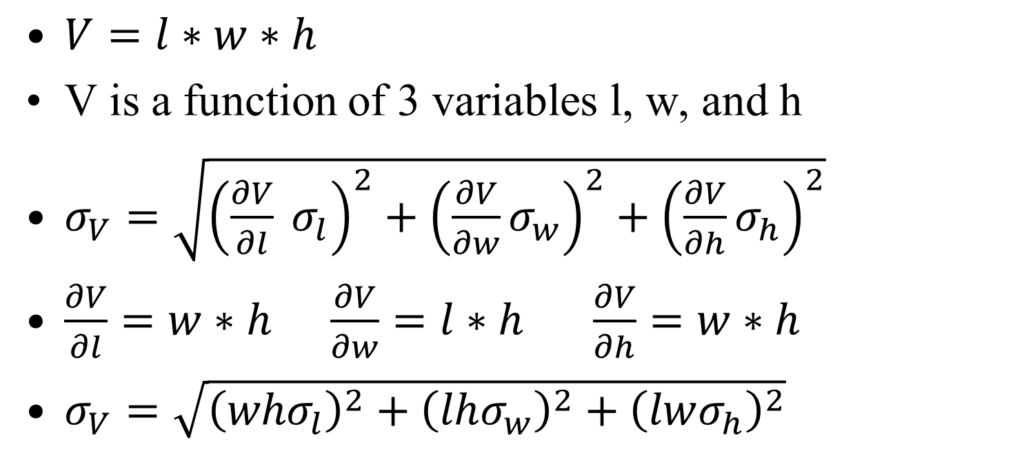
Example Propagation of Error
$V=l∗w∗h$
V is a function of 3 variables l, w, and h
$σ_{V}=\sqrt{{\left(\frac{∂V}{∂l} σ_{l}\right)}^{2}+{\left(\frac{∂V}{∂w}σ_{w}\right)}^{2}+{\left(\frac{∂V}{∂h}σ_{h}\right)}^{2}}$
$\frac{∂V}{∂l}=w∗h \frac{∂V}{∂w}=l∗h$ $\frac{∂V}{∂h}=w∗h$
$σ_{V}=\sqrt{{\left(whσ_{l}\right)}^{2}+{\left(lhσ_{w}\right)}^{2}+{\left(lwσ_{h}\right)}^{2}}$

Slide 25
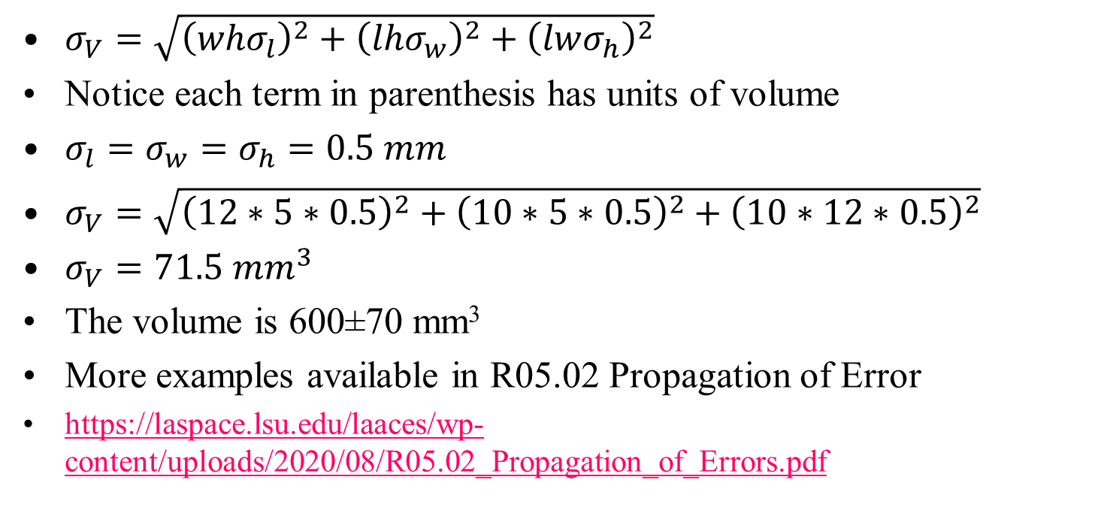
Example Propagation of Error
$σ_{V}=\sqrt{{\left(whσ_{l}\right)}^{2}+{\left(lhσ_{w}\right)}^{2}+{\left(lwσ_{h}\right)}^{2}}$
Notice each term in parenthesis has units of volume
$σ_{l}=σ_{w}=σ_{h}=0.5 mm$
$σ_{V}=\sqrt{{\left(12∗5∗0.5\right)}^{2}+{\left(10∗5∗0.5\right)}^{2}+{\left(10∗12∗0.5\right)}^{2}}$
$σ_{V}=71.5 mm^{3}$
The volume is 600±70 mm³
More examples available in R05.02 Propagation of Error
https://laspace.lsu.edu/laaces/wp-content/uploads/2020/08/R05.02_Propagation_of_Errors.pdf

Slide 26
But why Gaussian?
If there are other distributions, why do we usually assume a Gaussian Distributions
In the large number case (big N) other distributions become close to a Gaussian
There is good math for doing propagation and error handling
It is a good model for many physical measurements
  Can prove this is the case from a very many very small errors adding up from the Central Limit Theorem

Slide 27
Reporting Measurements
If I think the error in a measurement is 0.5 mm does it make sense to report the average as 12.003mm
The common practice is to round the error to 1 or 2 significant digit and then round the corresponding measurement to that digit
  We would report the values as 12.0±0.5mm
Do not round intermediate values used for calculations because you do not want to have rounding errors compound
Errors should have the same units as the measurement
You want to be clear about how you have calculated errors and what you mean with your ±, show your work

Slide 28
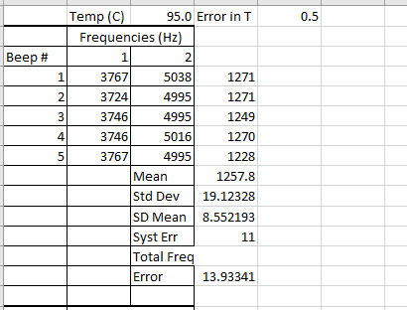
Putting it all together
Let’s assume, we first did repeated temperature measurements at one temperature to show the random error is small compared to the 0.5 error from our bulb thermometer
From the pixel size and signal width in software we estimate the systematic uncertainty of to be 11 Hz
We decide we need to take 5 independent frequency measurements at each temperature

Slide 29
Putting it all together
We will calculate the mean of our 5 frequencies and use that as our fitting point
We then need to calculate the standard deviation of that mean to determine the random frequency error for that mean value
The we need to add the systematic frequency error to the random to find the total frequency error
Doing this gives us our first datapoint (1257.8±14 Hz, 95.0 ±0.5°C)

Slide 30
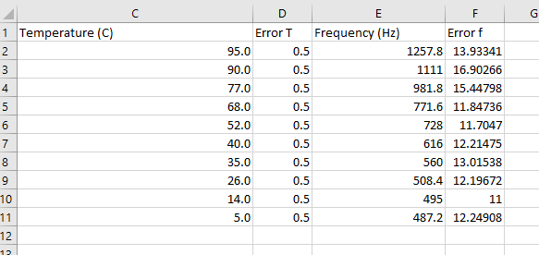
Calculating all our data points
Now repeat the process for all temperature and frequency measurements
This gives us a set of x (frequency) and y (temperature) points with a horizontal and vertical error for each datapoint

Slide 31
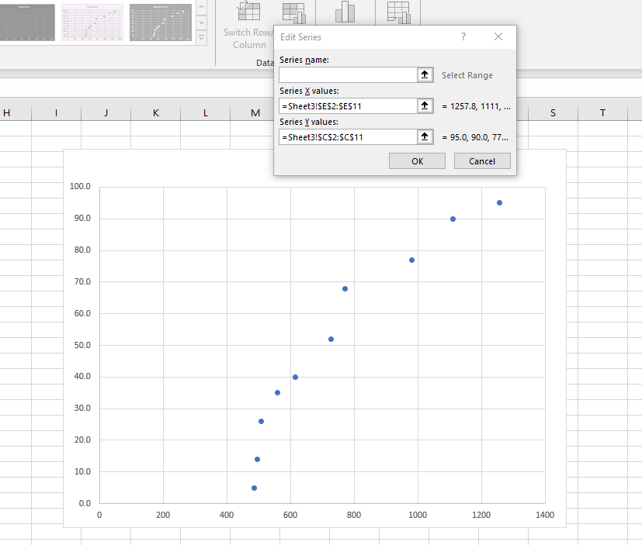
Plot the points
Now we want to plot all of the points together
Since the goal of the experiment is to be able to read a frequency and be able to tell what temperature the thermistor is, we want T as a function f
So we pick f as the x values and T as the y values

Slide 32
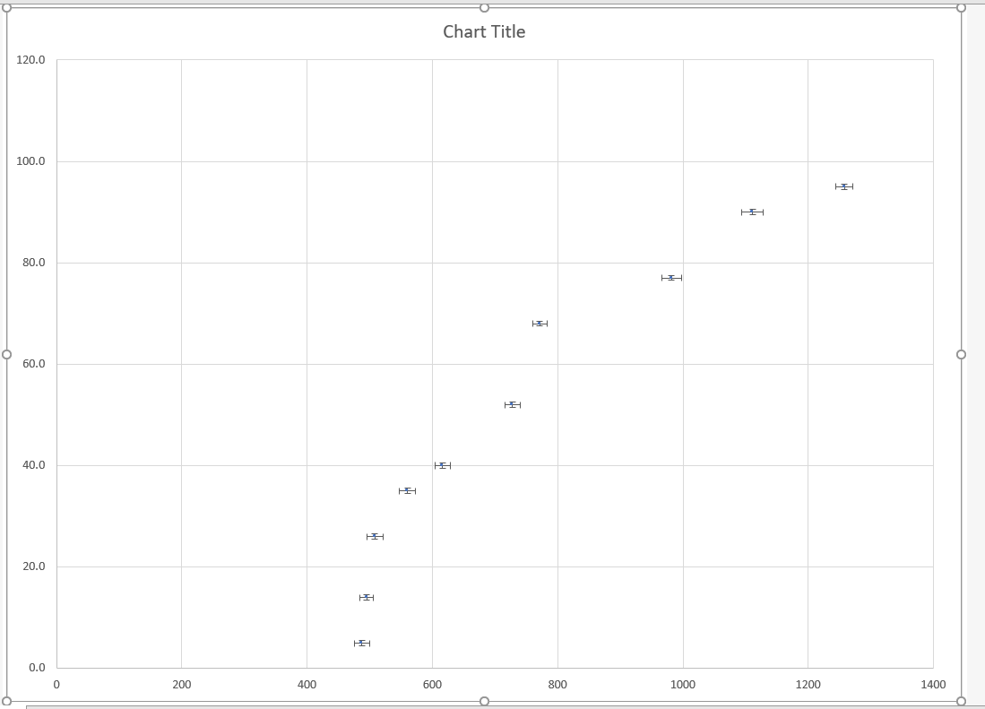
Add Error Bars
We add the error bars to our plot
Select in this case our error is symmetric, so we use the same value for both the positive and negative error
We want to select the option that lets use specify values for error and not a percentage, standard deviation, or fixed value for example
Add both horizontal and vertical error bars, using the errors we calculated
It may be necessary to adjust to point marker size or add a caption if the errors are small

Slide 33
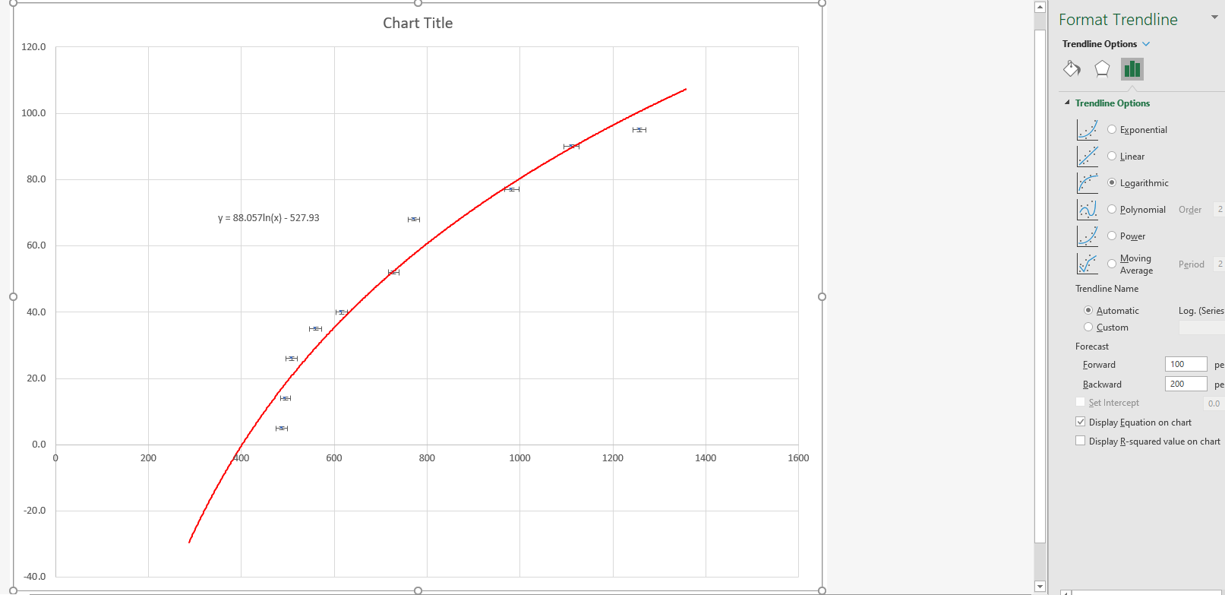
Adding a trendline
If appropriate we may want to add a trendline
Clearly the data is not linear
Ideally, we would have some theoretical basis for picking a particular fit but we can also try seeing what matches the data
Also probably want to show the equation of the fit on out plot

Slide 34
Finish the Plot and Draw Conclusions
Don’t forget to add the axes titles, units, plot title, etc.
If we have a good fit and correctly assessed our errors, we expect ~2/3 of our points error bars to overlap with our fit line (Remember 67% 1σ)
Many less than 2/3
  Maybe not a good fit function
  Possibly underestimated errors, missed systematics
Many more than 2/3
  Too many constants in your function
  Overestimated error, manufacturer specification often give “guaranteed to be this accurate” rather than a more scientific error

