Slide 1
Errors and Uncertainty Part I

Slide 2
Error In Scientific Measurements
When we discuss error in a scientific, we are making a statement about how confident we are the true value of a quantity is close to our reported value (our best guess)
It is quantitative numerical statement
I think there’s 95% that tree is between 10 and 12 ft. and my best guess is 11 ft.
Every measured quantity has some uncertainty to it
It is not incorrect measurement or human error, if you had evidence that a measurement was not correctly done why would you use it

Slide 3
Two Types of Error
Random (Statistical)
Systematic
Random fluctuation around a true or average value
Assumed to follow some kind statistical distribution
Because of that you can make mathematical calculations
Expect the errors or average out over many measurements
Examples: electrical noise, mechanical gage reading parallax, radioactive decay, …
NOT Random
Will not be reduced with increased measurements
No “correct” mathematical treatment
Examples: incorrectly calibrated measurement device, limits in measurement resolution

Slide 4
Assessing Random Error
We can measure the random error by looking at the standard deviation, the spread in repeated measurements
You can’t tell anything from single measurement
The Standard Deviation tells you how much spread between individual measurements
The standard deviation of the mean tells you the error when you average several measurements together
(Sample) Standard Deviation (Error in a SINGLE MEASUREMENT)
$$σ_{s}=\sqrt{\frac{Σ{\left(x_{i}−X\right)}^{2}}{N−1}}$$
Standard Deviation of the Mean (Error of the Average)
$$σ_{m}=\sqrt{\frac{σ_{s}^{2}}{N}}$$

Slide 5
Assessing Systematics
Could compare unrelated measurements or make measurements a very well know object using our measurement system (calibration)
Weighing a standardized weight
Manufacturers will often give a specification of accuracy in the manual for a piece of equipment
1% of Full Scale, 5% of measured value, 2 digits
The smallest possible increment able to be read with the measurement device
Scale markings, digital readout, Analog to Digital Resolution

Slide 6
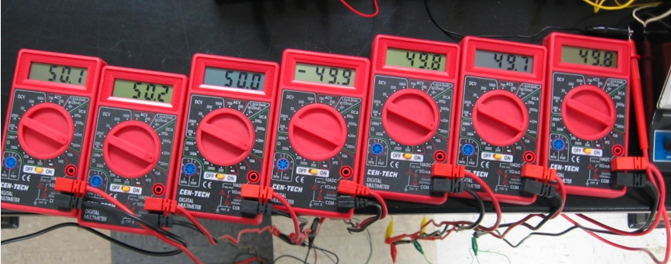
Example Ammeters in series
Several Multimeters placed in series to measure the same current
50.1, 50.2, 50.0, 49.9, 49.8, 49.7, 49.8 mA

Slide 7
Ammeters continued
Source of differences
DMM scatter is about 0.2 mA (50 ± 0.2 mA)
Manufacturer accuracy: 1% of full scale (2 mA)
Each individual DMM repeatable to 0.1 mA
The meter are consistent with each other within the specified systematic, but repeated measurement with the same meter will show same variation relative to others
One meter will consistently read 0.2 mA compared to another
The systematic error is large compared to the random error
Taking the standard deviation will ~0 mA because the random error is smaller than the scale of the meter

Slide 8
Other Sources of Systematic Error
Often the experimental setup itself can be a source of Systematic Error
When measuring a water bath temperature where was the thermometer relative to heater/temperature probe?
Letting the thermometer touch the glass will cause it be hotter than the SkeeterSat probe
Was quantity measured changing? (maybe heating or cooling)
If always read thermometer first
Fast enough to have a change larger than your error?

Slide 9
Minimizing Systematic Error
Since the systematic error limits the accuracy in our measurement minimize it in our experimental setup before we begin to take measurement
Use the smallest possible scale or highest resolution to measure the value
Measuring a 1.5 V battery with the 2V scale rather than 20V
Let the value stabilize if using a “slow” measurement or slow down the speed of the change
Water heats/cools slower than air, a large water bath slower than a small one
Try take the measurement in a consistent and unbiased way
High precision pressure gages often have a mirror behind the needle, if you are looking at the needle directly straight on the needle will block its own reflection

Slide 10
Independent Measurements
One important precaution is to ensure that all your repeated measurements are independent
Independent means that the value of one measurement is not affected by any of the other measurements
This is done to ensure that the random errors of the measurements do of each measurement have nothing to do with each other
For example. we can measure the wavelength above by measuring the peak to peak distance above. We can measure A to B, however then the distance B to C also depends on B so it is not independent of our first measurement. The distance from C to D is.

Slide 11
Fitting and Collecting Enough Data
We want to compare our measurements with a model (A mathematical representation of the data like a line or exponential curve)
Want to ensure that there is enough points to tell if the model is good representation (averaged measurements should be considered a single point)
In general for you can you can always perfectly fit a curve that as the same number of points as there are constants in its equation
Example a line has 2 constants, slope and y-intercept, and you can always connect a line between 2 points
Because you can just perfectly fit with any arbitrary points this doesn’t tell you anything meaningful about the data
Collect many more data points than constants you plan to use for fitting
The shape of the curve can be hard to determine if the point are too close together
Zooming in on a curve it will look like a line
If the point are closer than the error you will just be fitting the random errors
Maximize the total range of measurements you can make, sometimes the behavior changes over different ranges

Slide 12
How many datapoints to take
More data is always better, right? Not always
More data takes more time to collect and more time to process
Can be limited by systematics
Since systematic errors can not be averaged repeated measurements once $σ_{m}$ is smaller than the systematic error, more measurements will not decrease your total error
You can not measure a metal bar in nm with a ruler marked in mm no matter how many measurements you repeat
What range of data do you want the fit to be valid for
Interpolation (estimating between measured data points) is better than extrapolation (estimating below or above the range of measured values)
Sensor behavior may change over different ranges, uncertainties in fits get larger the farther you are from measured values

Slide 13
Have a plan for successful experiment
Set up your experiment to minimize your estimated systematics
Take repeated initial measurement to estimate random error
Estimate the number of repeated measurements you need to make
Determine the expected type of fit (linear, quadratic, exponential) and estimate number of data points you need over what range
Reviewing data sheets or theory of operation of the sensor
Record your measurement tool/scale so you can determine systematic error

