Slide 1
Assembly Techniques
Workstation Setup,
Safety,
& Soldering Tutorial

Slide 2
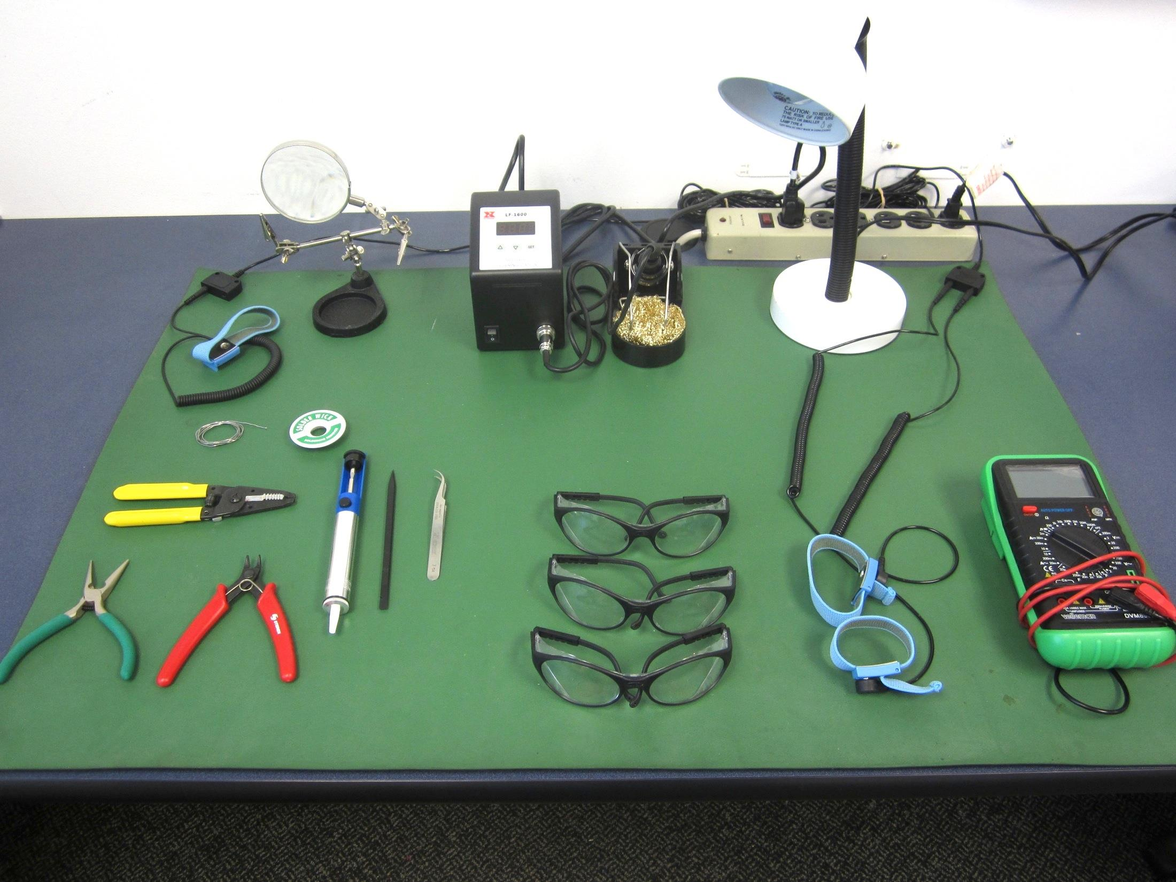
Workstation setup
Prior to assembly or any work, a clean and organized workstation is vital for safety and proper assembly

Slide 3
Items you need

Slide 4
Safety comes first.
Safety in the lab is like wearing your seatbelt; you regret not wearing it milliseconds after its too late.
Situational Awareness is key!
Be mindful of where you are and what hazards are around you.
Safety Glasses:
Hindsight is only 20/20 if you have both your eyes. Wear them!
Soldering irons can get in excess of 650℉
It takes 1 amp of electricity to cause fatal heart irregularities.

Slide 5
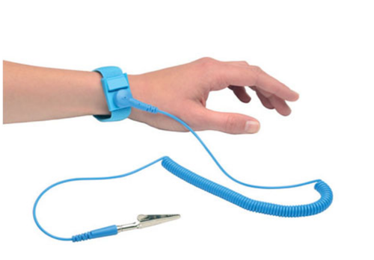
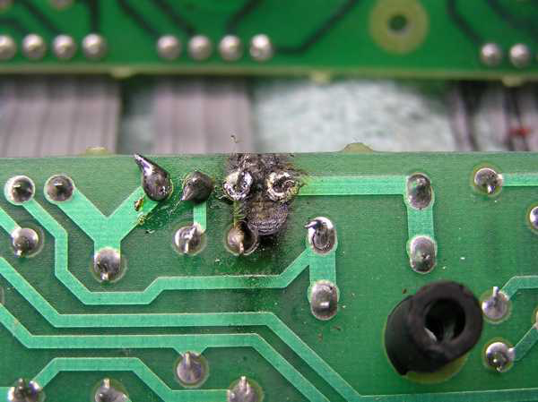
Safety (for the components)
Electrostatic discharge (ESD) can destroy electrical components.
Leave components in static shielding bags until ready for use.
ESD strap prevents you from “shocking” the components with static electricity.
Excessive heat from soldering can harm electrical parts.

Slide 6
Soldering Tutorial
Soldering Safety:
Again, situational awareness is key!
Be mindful of where you are and where hot items are.
Hair (get it out of the way)
Eye protection
There is lead in the solder so wash your hands afterwards.

Slide 7
Soldering Tutorial
Soldering – fastening metal objects together using molten metal (solder) as the glue.
Three requirements
Low melting point metal (wire solder)
Heat source (soldering iron)
Flux (to prevent surfaces from oxidizing)

Slide 8
Types of Solder
Tin-Lead solders
60% Tin, 40% Lead - solid at 361° F, liquid at 374° F
63% Tin, 37% Lead - eutectic point is 361° F
no “pasty” range so joint movement less a problem
Silver-bearing Solder
62% Tin, 36% Lead, 2 % Silver - solid at 354 ° F,
liquid at 372 F
often used for surface mount components whose
contacts contain trace amounts of silver
Notes:
.

Slide 9
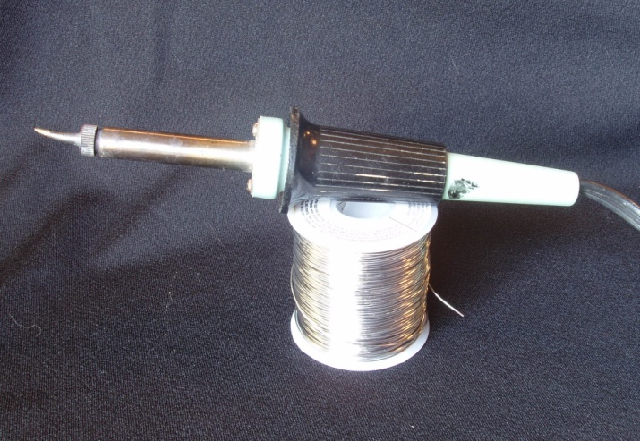
Soldering Irons
Constant wattage
Iron is continuously “ON” and eventually reaches equilibrium temperature
20 to 25 watt iron sufficient for circuit board assembly
Constant temperature
Tip incorporates a thermostatic element to maintain desired tip temperature
650 – 750 ° F appropriate for circuit board assembly
But wait…..even better…
Weller® 30 watt iron

Slide 10
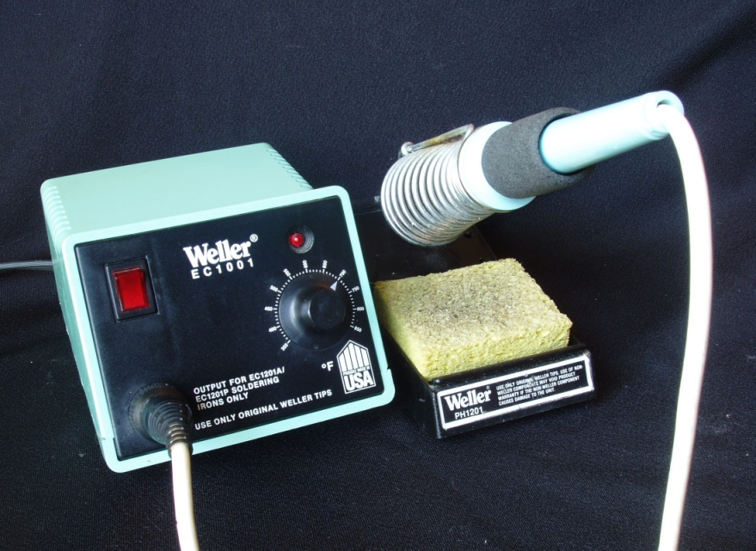
Soldering Irons
Temperature Controlled Solder Station
Feedback control maintains tip at desired temperature
Adjustable, often with analog or digital temperature display
Many have grounded tip to help prevent ESD damage
Weller® solder station

Slide 11
Types of Flux
Rosin Flux
Type R – ordinary rosin – most common
Leaves a residue that can be removed for cosmetic reasons if desired.
Type RMA – mildly activated rosin
Type RA – activated rosin – use with care
RMA and RA fluxes leave a slightly corrosive residue that generally should be removed (with a solvent) after soldering
Acid Flux – NEVER, EVER use this for electronics

Slide 12
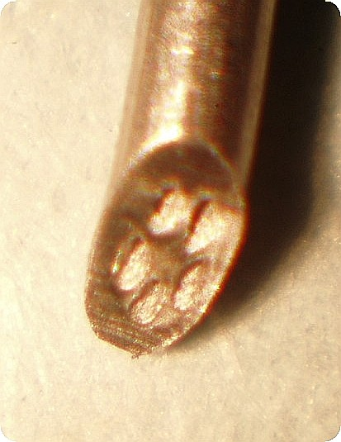
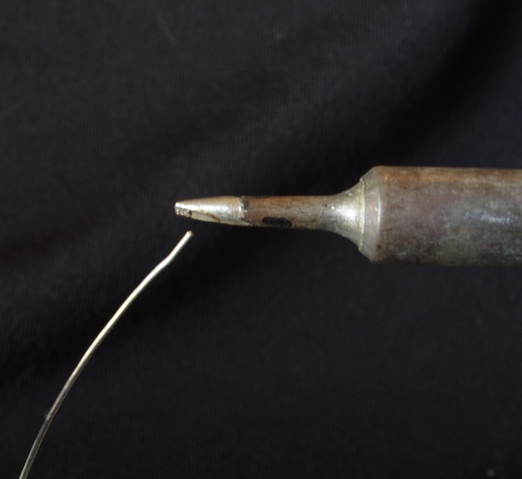
Flux-core solder
Most solder used for electronics assembly is in wire form, with the flux incorporated inside the solder.
Multi-core solder has several (usually five) separate flux channels within the solder.
For circuit board assembly use wire solder with a diameter of about 0.025 inch or less

Slide 13
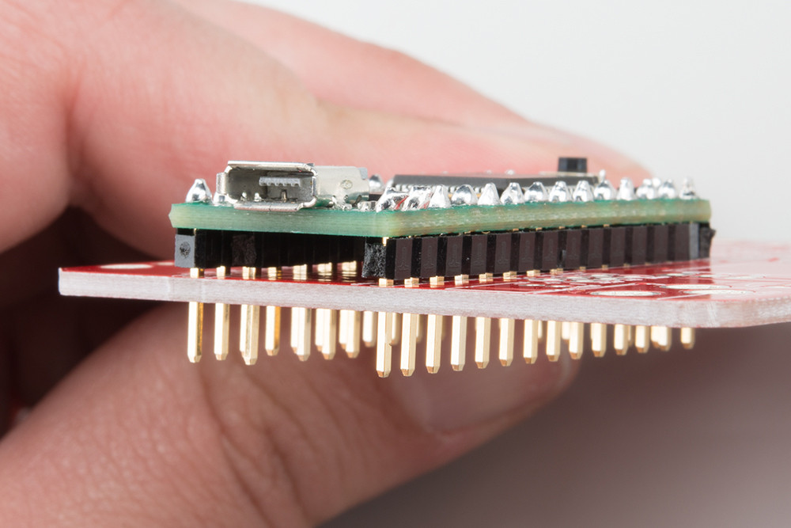
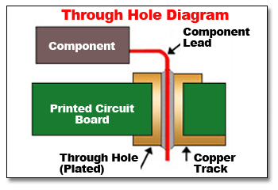
Two Types of Soldering
1st type: Through Hole
Component has metal leads that goes through the board.

Slide 14
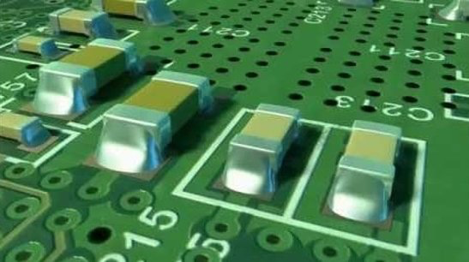
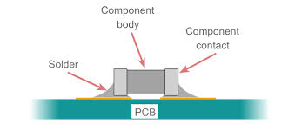
Two Types of Soldering
2nd type: Surface Mount.
Component has metal pads that rest on top of board.

Slide 15
Soldering Tutorial
Component Placement & Inspection
Inspect all components before and after soldering.
Components should be as close to the board as possible without stressing the leads.
Orient components so that their value markings can be easily read after installation. Have resistor color bands all reading in the same direction.
When IC chips are to be soldered directly on to circuit boards (a socket is not used) their pins are often slightly too far apart and must be gently aligned. Be sure to be grounded when handling ESD sensitive chips.

Slide 16
Soldering Tutorial
Soldering tips:
Easier to add solder or re-melt it vs. remove it
Easier to solder using the side of the iron, rather than the just the tip
Make sure the iron is heating both the pad and the pin
Good lighting
Install smaller components first.
Install integrated circuits (IC’s) into sockets, not directly on the board

Slide 17
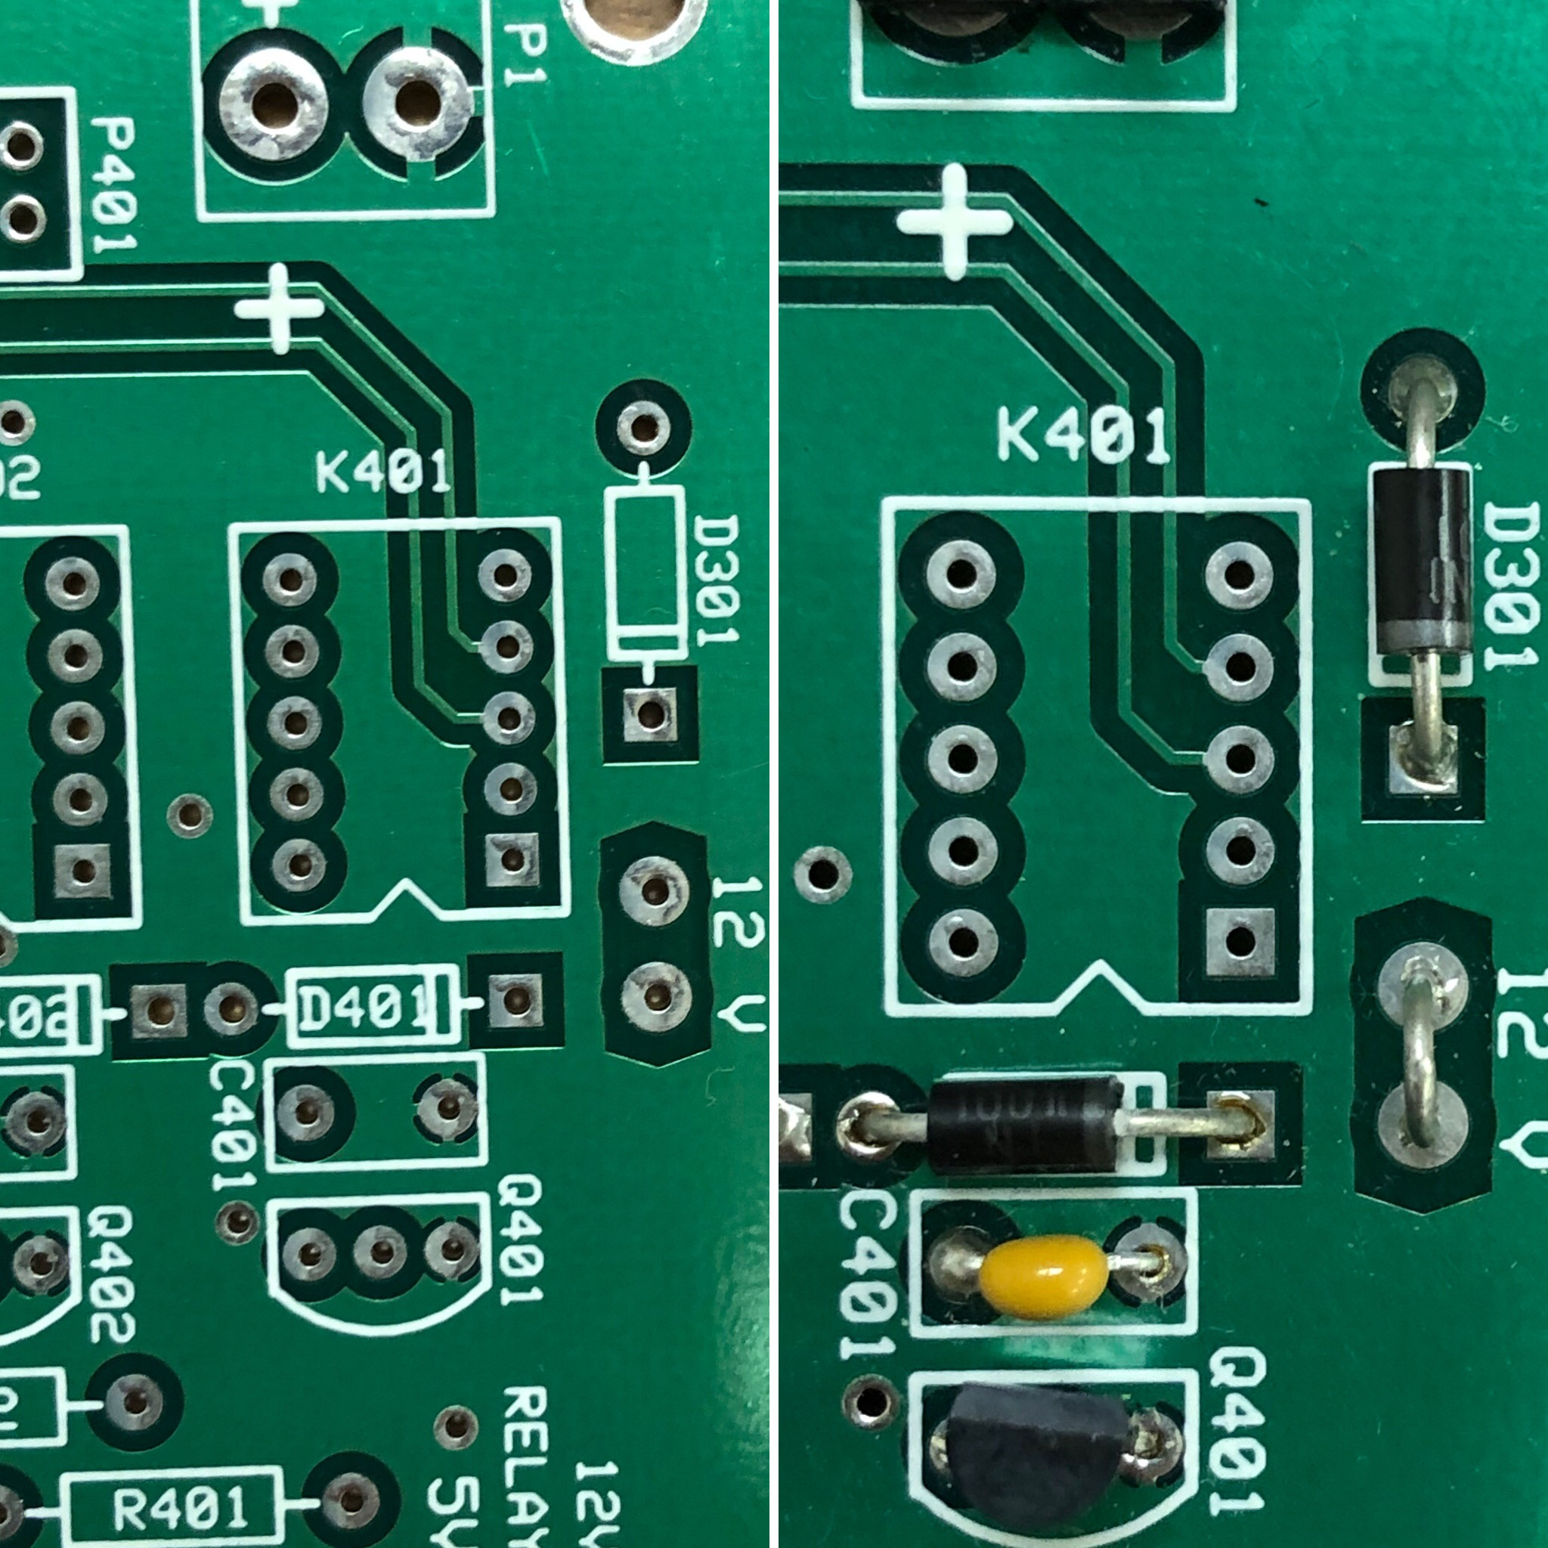
Soldering Tutorial Through-Hole Component
Some components are “polarized”, meaning they have a negative and positive lead. Make sure the polarized component is oriented correctly with the board.
Properly oriented polarized diode, before and after.

Slide 18
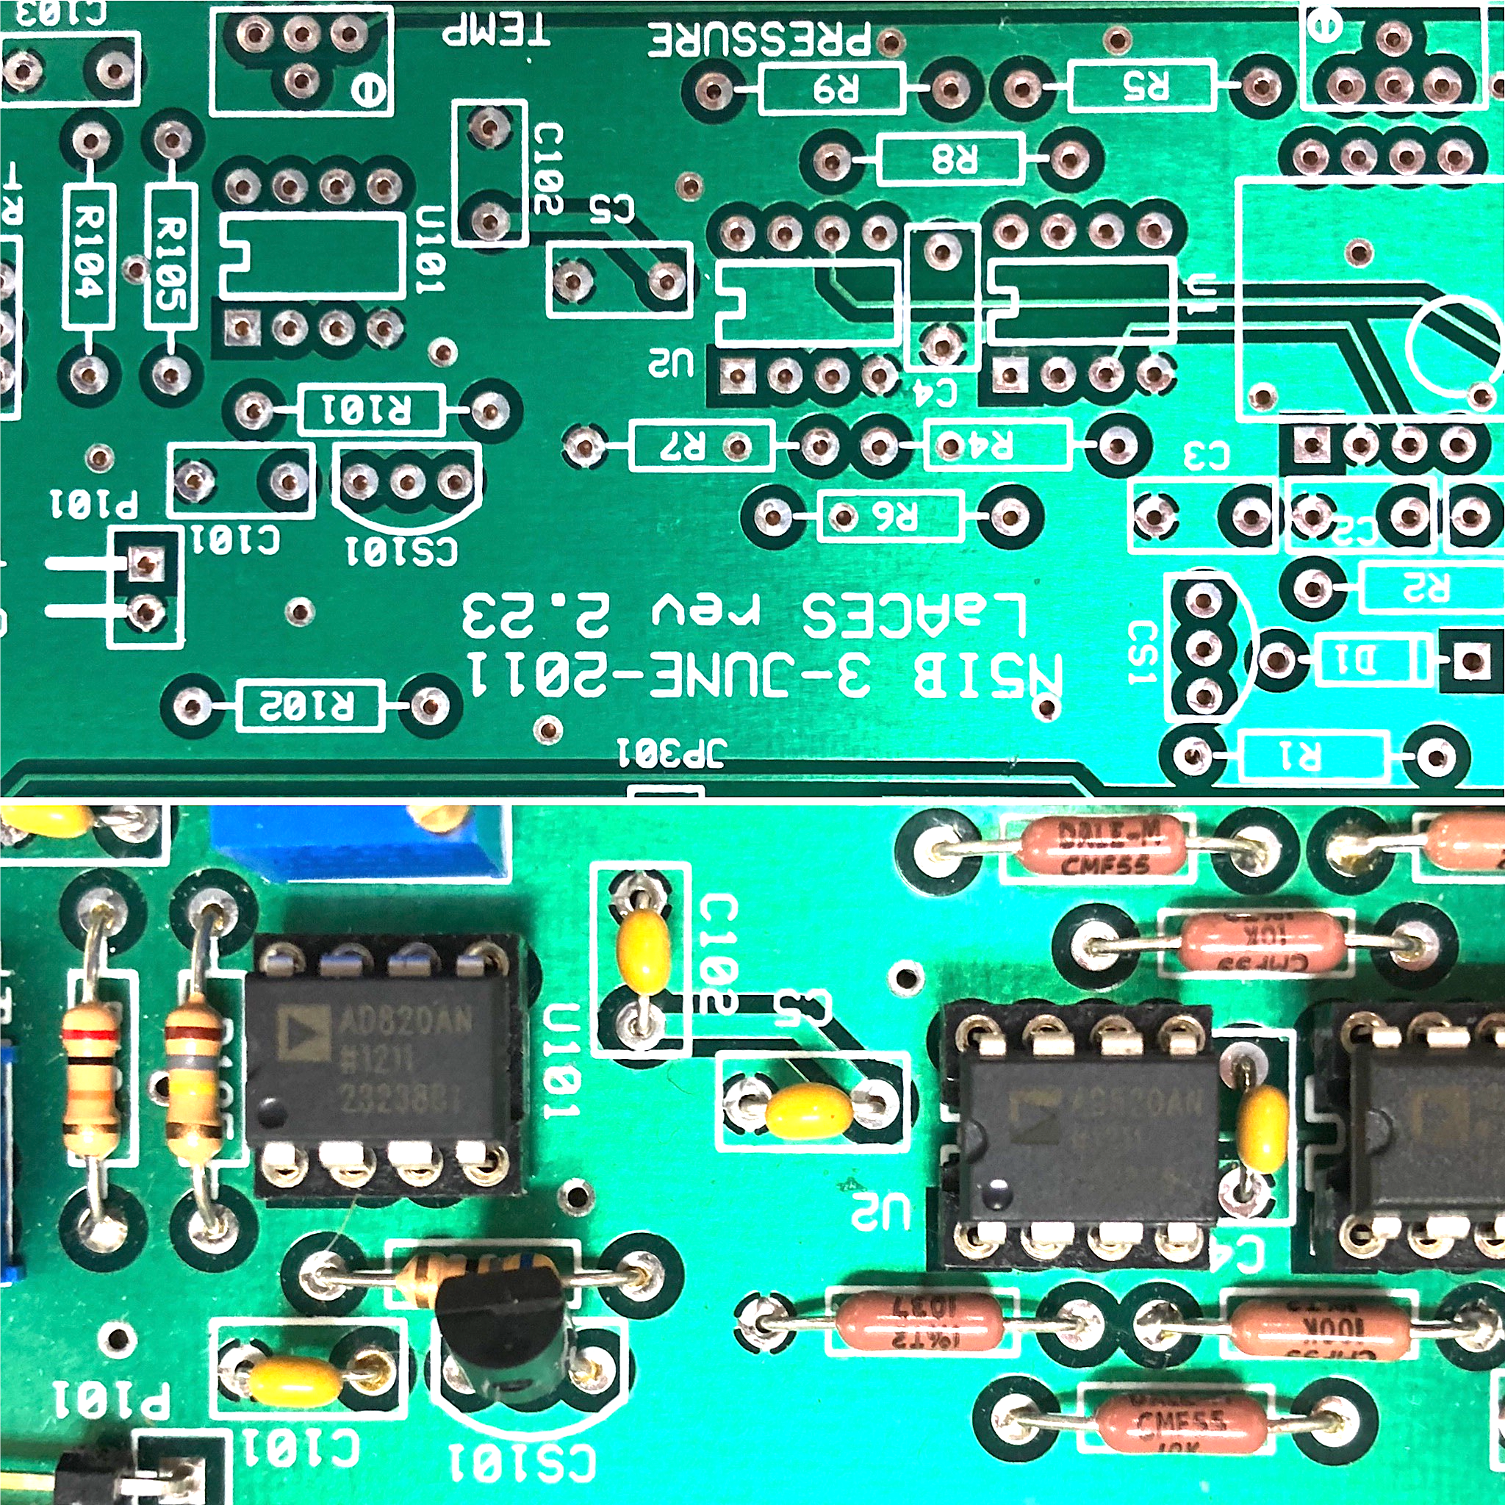
Soldering Tutorial Through-Hole Component
Some components have designated pin numbers. Make sure you align the correct pin with the correct hole. Pin-1 sometimes is designated with a dot on the component, as is the case of the photo to the right. Refer to datasheets and/or schematics to find pin-1 if need be.
Properly aligned IC’s, before and after.

Slide 19
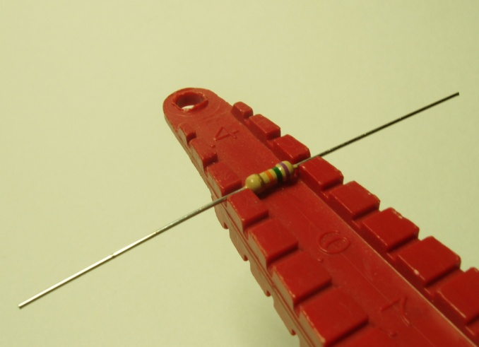
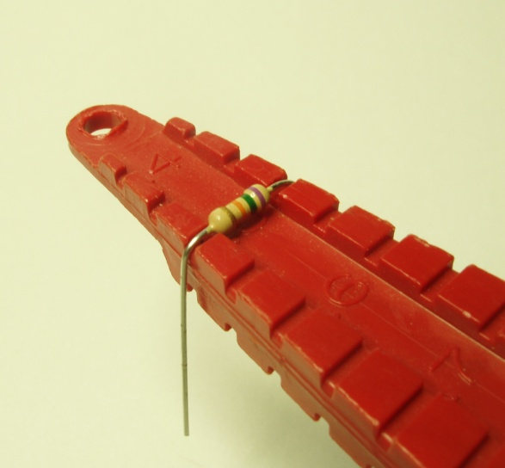
Soldering Tutorial Through-Hole Component
Use a lead bending jig, if available, to form the component leads to the correct spacing
If a bending jig is not on hand, grasp the leads, not the body, of the component with needle-nosed pliers and bend gently.

Slide 20
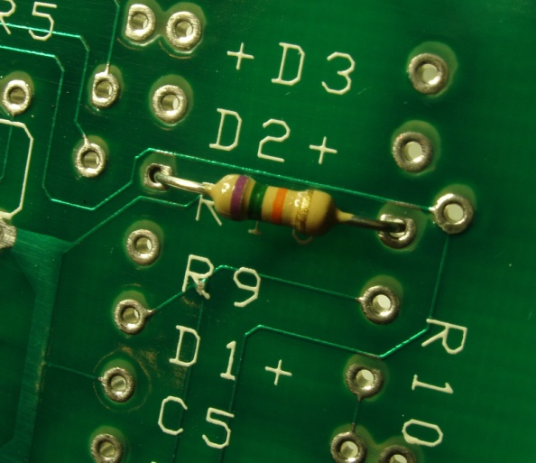
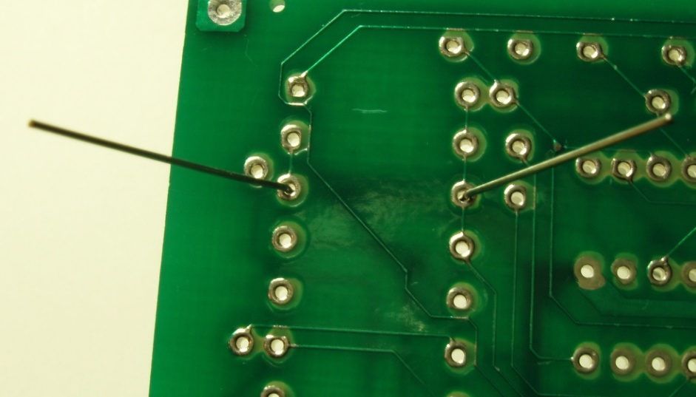
Soldering Tutorial Through-Hole Component
Insert the component’s leads through the holes in the circuit board. The body should lie flat against the board without having to force it down.
Turn the board over and gently bend the component leads outward to hold the component in place

Slide 21
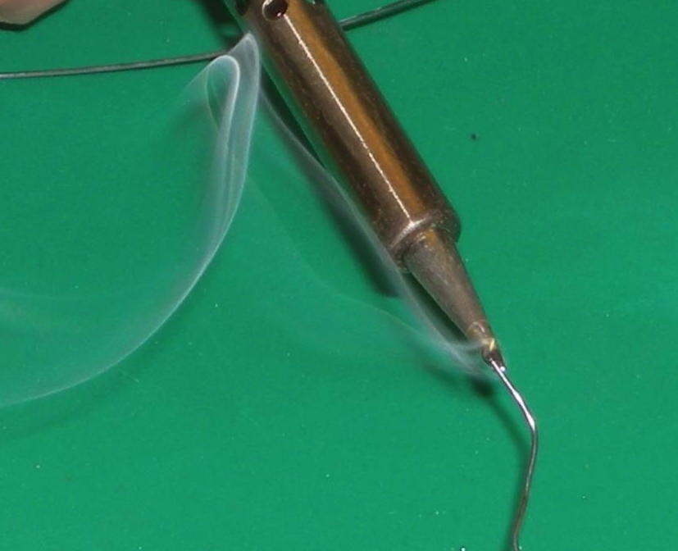
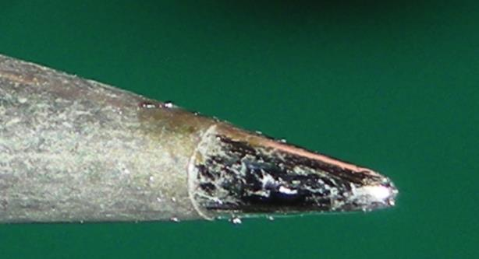
Soldering Tutorial Through-Hole Component
“Tin your Tip”
Once the iron is hot enough, “tin the iron tip” by melting an inch or so of solder on the tip and then cleaning the tip on the sponge.
Tip should look look shiny .
𝟭
𝟮

Slide 22
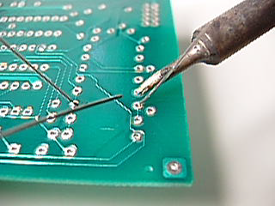
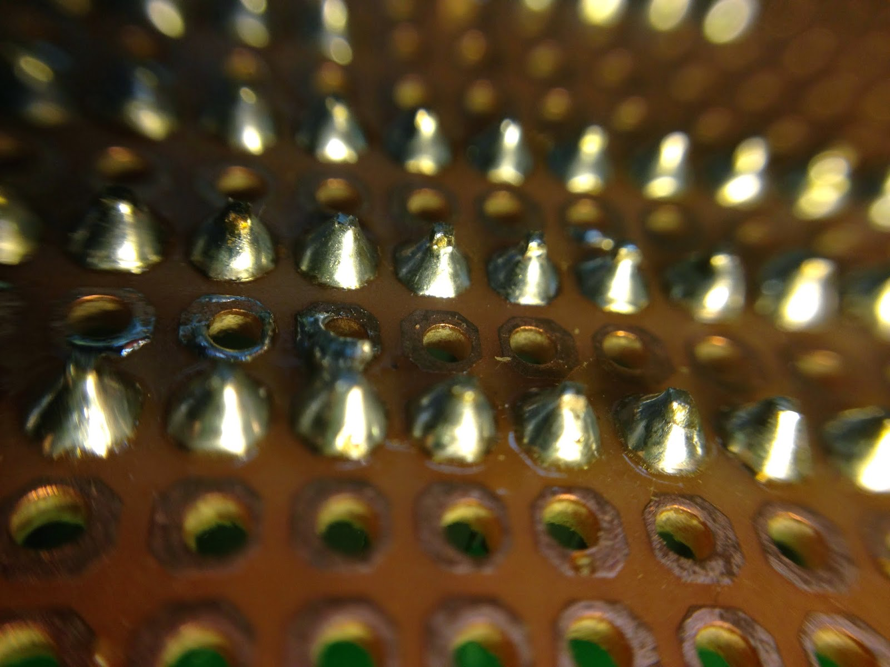
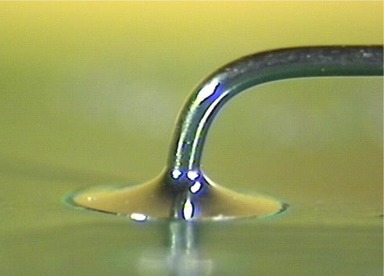
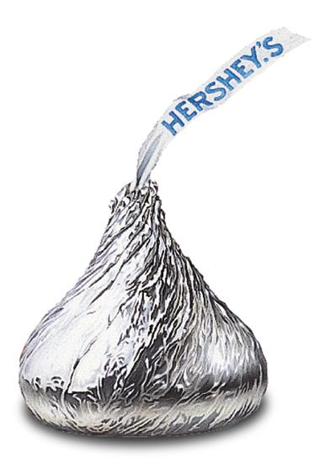
Soldering Tutorial Through-Hole Component
Apply the iron in contact with both the circuit board pad and the component lead. Apply solder to the joint, not to the iron, and allow the heated joint to melt the solder.
You want a “Hershey kiss” of solder when you are done.
Notes:
Click on the images to open a QuickTime movie clip. Note that you system must have QuickTime installed.

Slide 23
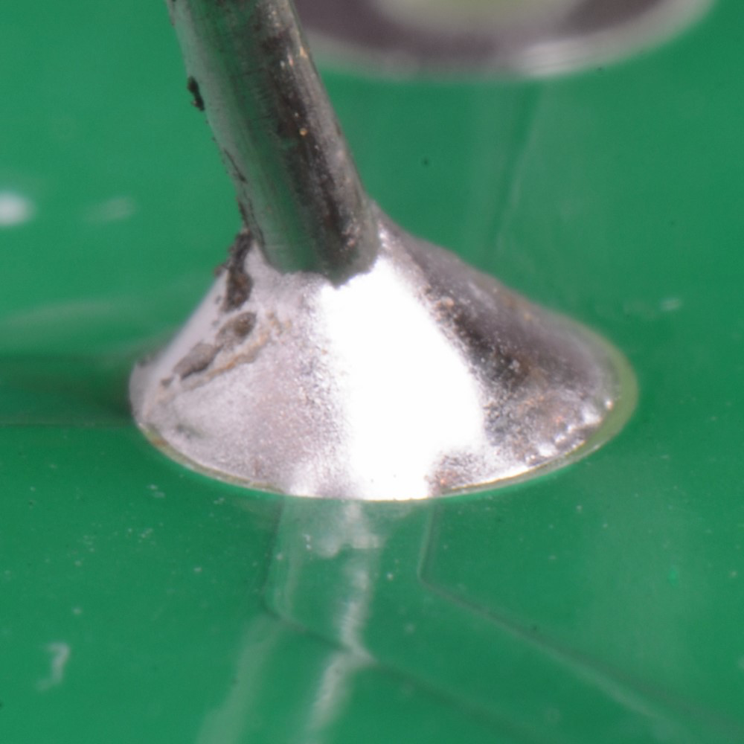
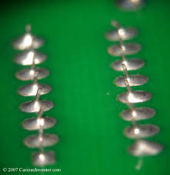
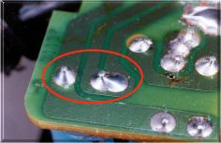
Soldering Tutorial Good Through-Hole Solder
Inspect the soldered. It should be uniform and shiny, with no cracks, gaps, or graininess. The images below are examples of good soldering.

Slide 24
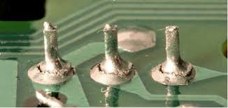
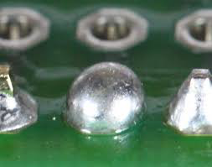
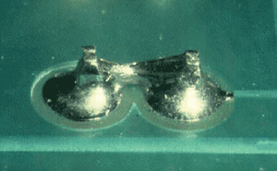
Soldering Tutorial Bad soldering 90 % of all failures are related to soldering problems

Slide 25
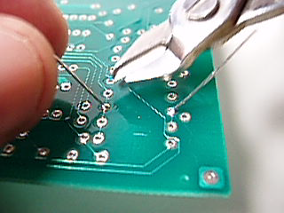
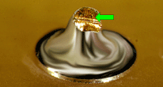
Soldering Tutorial Through-Hole Component
After inspection, if solder is good use a pair of wire cutters to cut off the excess lead length as close to the board as possible. Hold the lead so will not fly away when cut, a possible occasion for eye injury.
!! WEAR SAFETY GLASSES !!

Slide 26
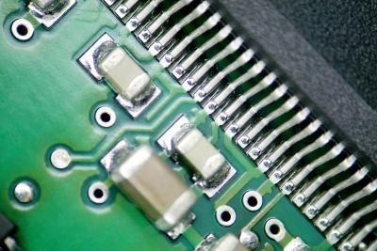
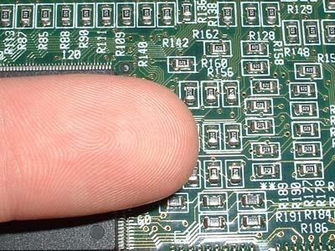
Soldering Tutorial Surface Mount Soldering
Surface mount devices (SMD) are notoriously tiny.
Most people prefer this method of soldering once they get the hang of it.
There are two main types of SMD, two-terminal and multiple-terminal. We will cover two-terminal first.

Slide 27
Soldering Tutorial Surface Mount Soldering
SMD soldering tips:
Work on a clean, well lit, and light colored surface to prevent you from losing small SMD’s.
Tweezers are your best friend.
Less solder is more
Coat the pad with a tiny bit of flux before soldering.

Slide 28
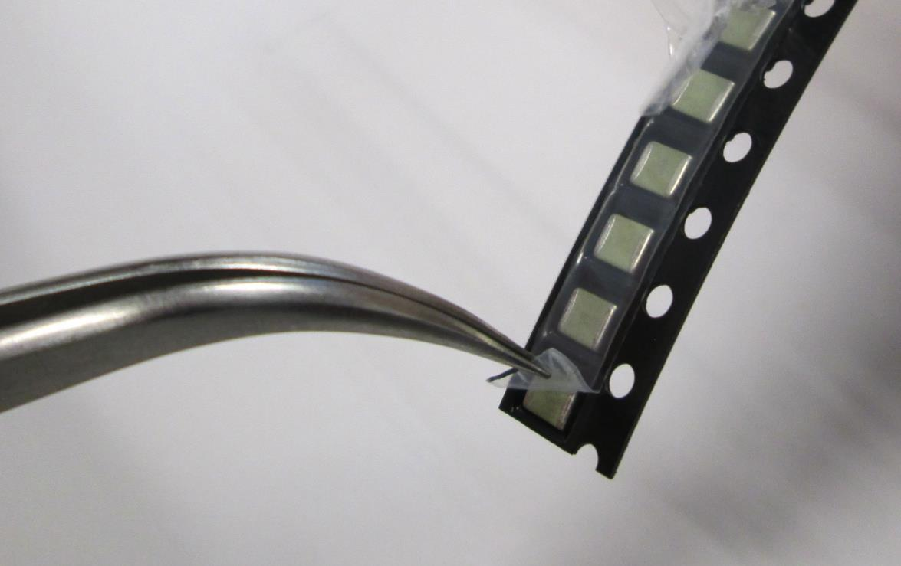
Soldering Tutorial Surface Mount Soldering
Many SMD’s are stored in strips, see photos below.
Use a pair of tweezers to peel back the plastic to free one SMD at a time as you need them.

Slide 29
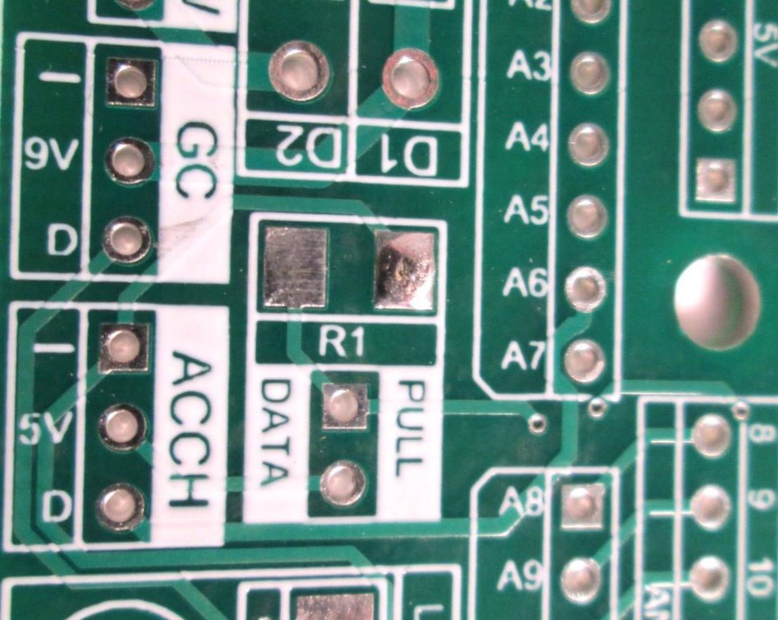
Soldering Tutorial Surface Mount Soldering
Put a small amount of solder on the pad. Like through-hole, this is easier if you heat the pad slightly with the iron first.
The solder will cool before you place the SMD on and that’s ok

Slide 30
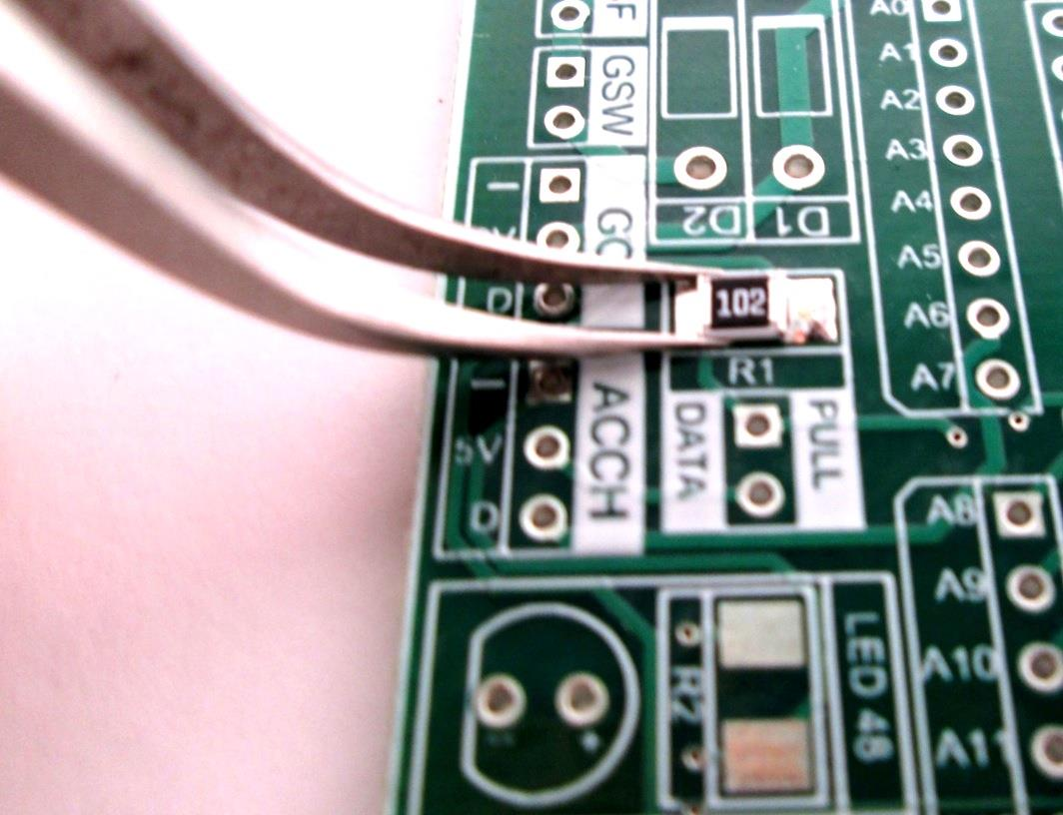
Soldering Tutorial Surface Mount Soldering
Use tweezers to hold the SMD centered on the pad

Slide 31
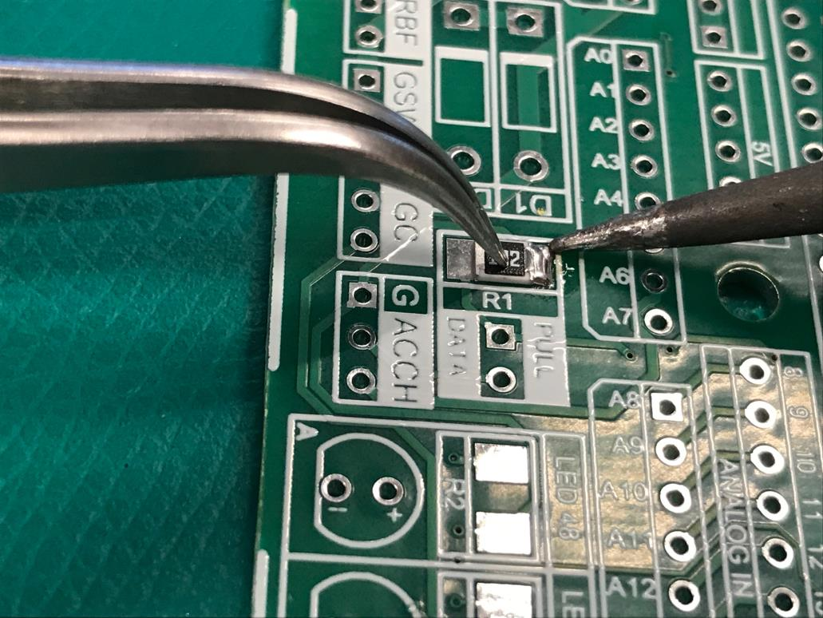
Soldering Tutorial Surface Mount Soldering
Press down firmly on the top of the part with the tweezers and reheat the solder. This will allow you to push the part flush to the board.
Hold the part in place even after you remove the iron while the solder cools.

Slide 32
Soldering Tutorial Surface Mount Soldering
Press down firmly on the top of the part with the tweezers and reheat the solder. This will allow you to push the part flush to the board.
Make sure the part is straight on the pad before moving on. If it is not straight, reheat solder and try again
Hold the part in place even after you remove the iron while the solder cools.

Slide 33
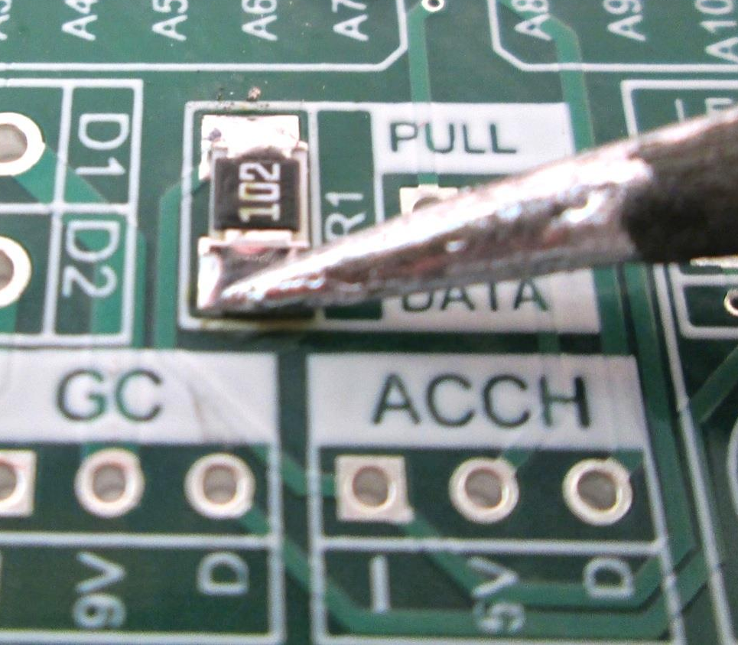
Soldering Tutorial Surface Mount Soldering
Heat the other pad slightly and put solder on the other end. No tweezers should be needed.

Slide 34
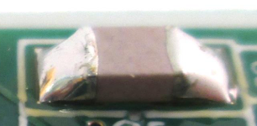
Soldering Tutorial Surface Mount Soldering
Good surface mount solders have:
No cracks, gaps, graininess, and should be shiny.
Just enough solder to make the connection
Component is flush with the board.

Slide 35
Soldering Tutorial Surface Mount Soldering
Multiple-terminal SMD fallow the same basic procedure as two-terminal SMD.
First, tack down one corner with solder. Then check to see all the pins are aligned with the pads before continuing.

Slide 36
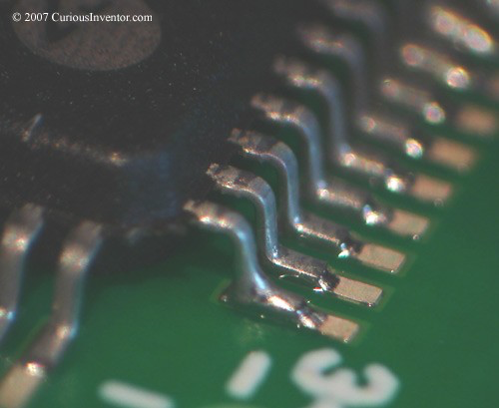
Soldering Tutorial Surface Mount Soldering
Continue to solder the remaining pins.
You will be surprised how little solder you need to make good connection.
If there are a fair amount of pins, feel free to give the component a break from the heat of the soldering iron.
Multipin SMD

Slide 37
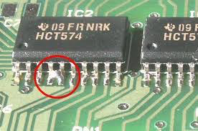
Soldering Tutorial Surface Mount Soldering
With surface mount soldering, the two most common issues are shorts and the component not being flush with the board.
Short

Slide 38
Soldering Tutorial Fixing Soldering Errors
So, after all your best efforts and careful inspection, you made a mistake…..
Don’t Panic… Remain Calm…
Components can be removed from a circuit board.
Rule of thumb: Components and solder are easier to fix/replace than the circuit board.

Slide 39
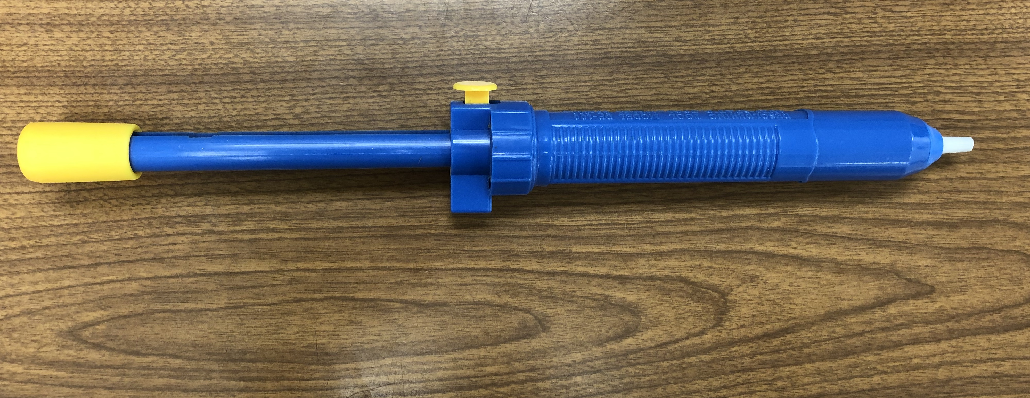
Soldering Tutorial Fixing Soldering Errors
A “solder sucker” removes liquid solder from the board with air pressure.

Slide 40
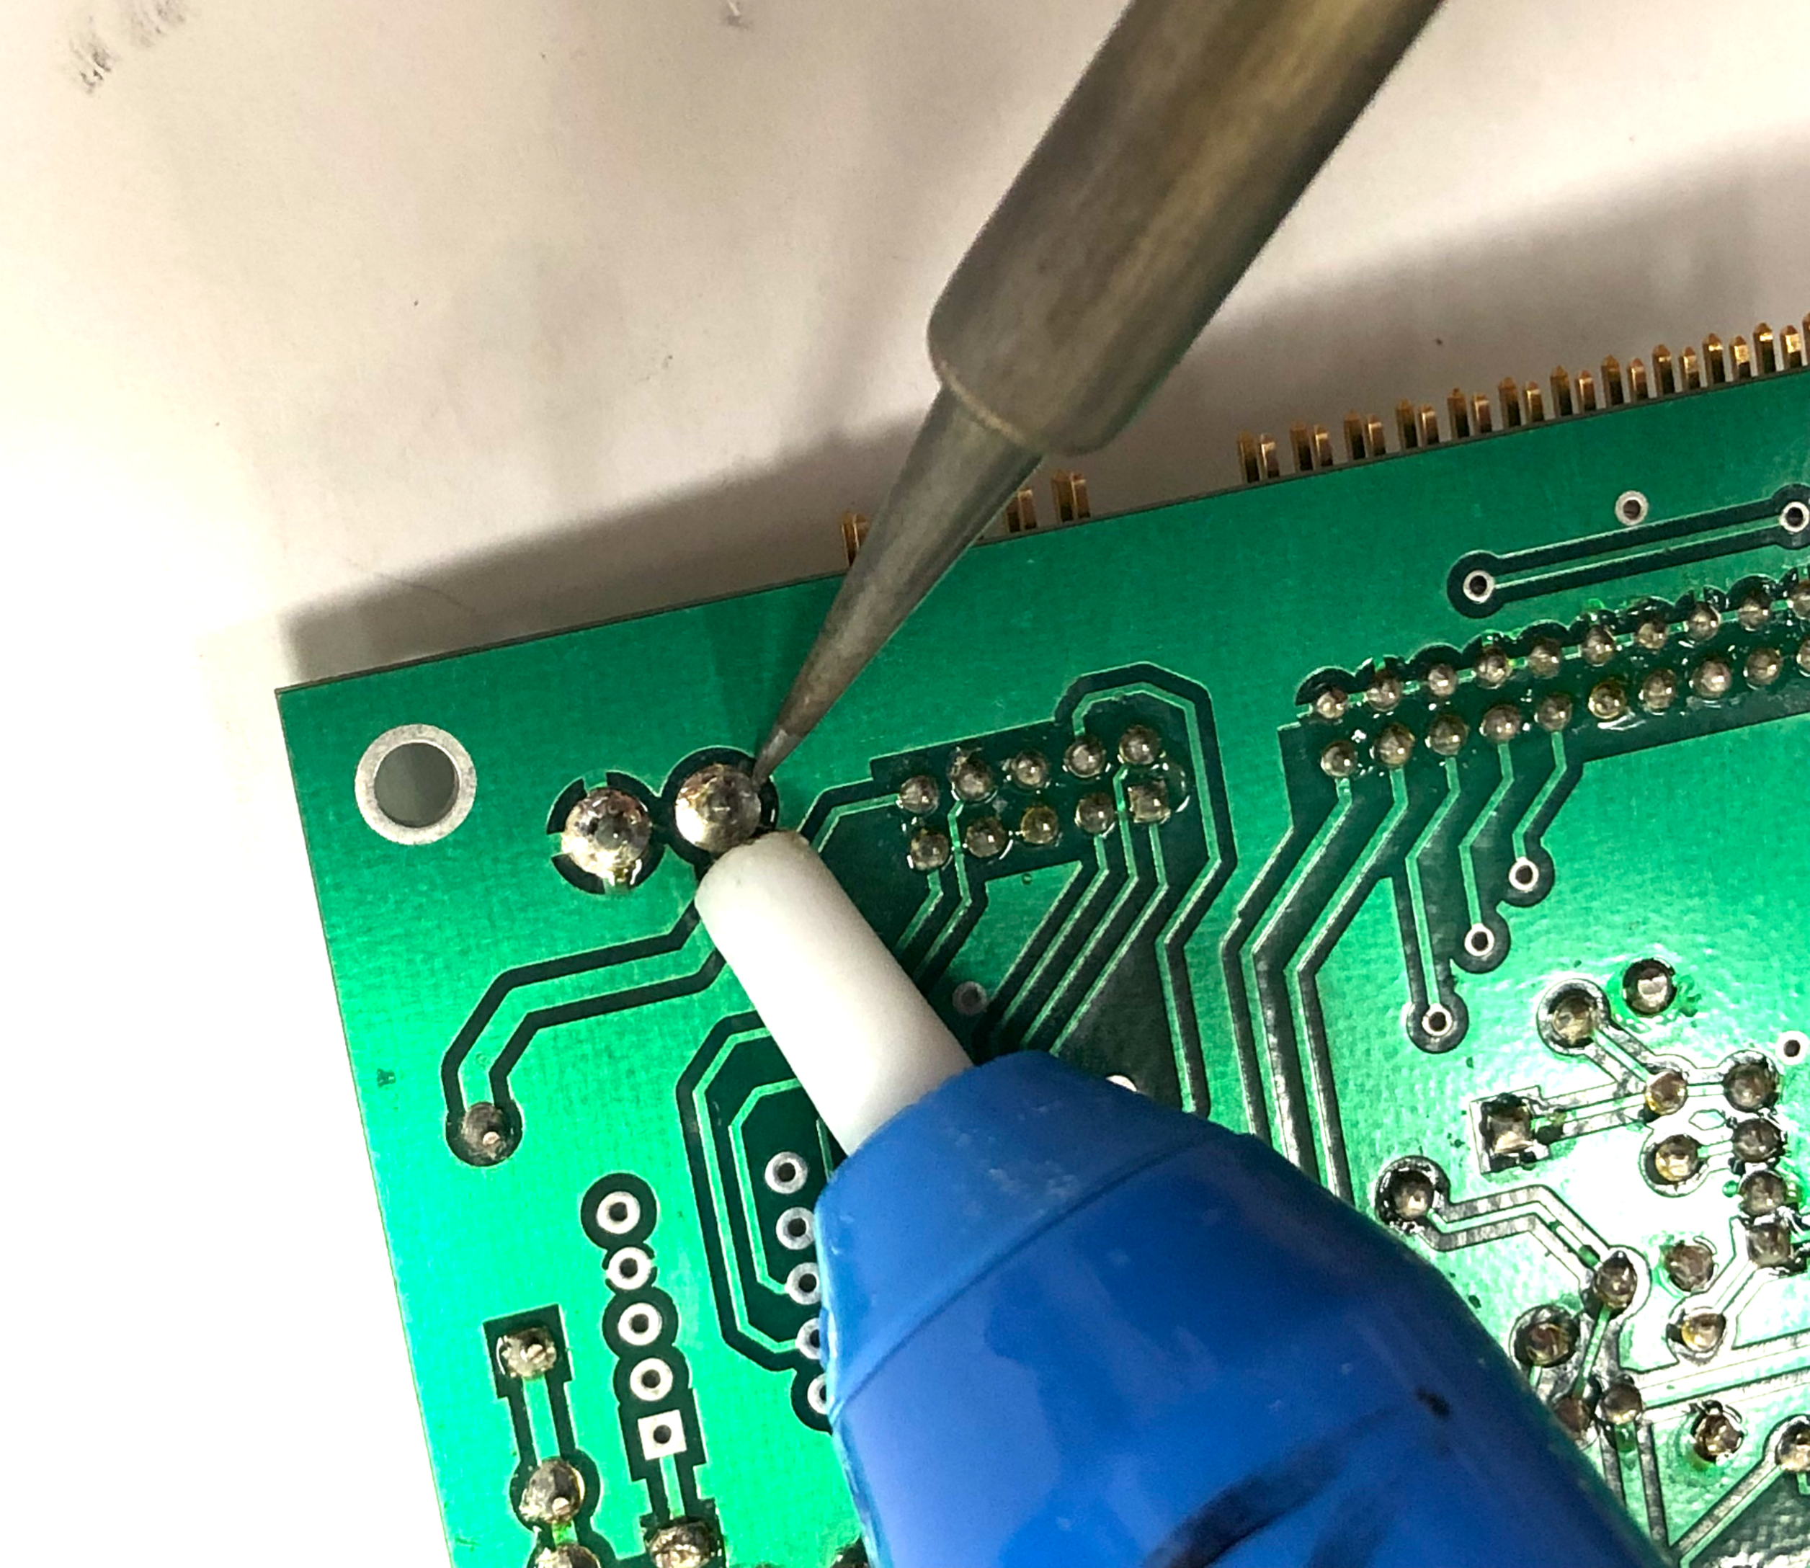
Soldering Tutorial Fixing Soldering Errors
Prime the solder sucker with a pump, and place the soldering iron on the solder that you wish to be removed. Once the solder is liquid, press the release button on the solder sucker and it will remove the solder.

Slide 41
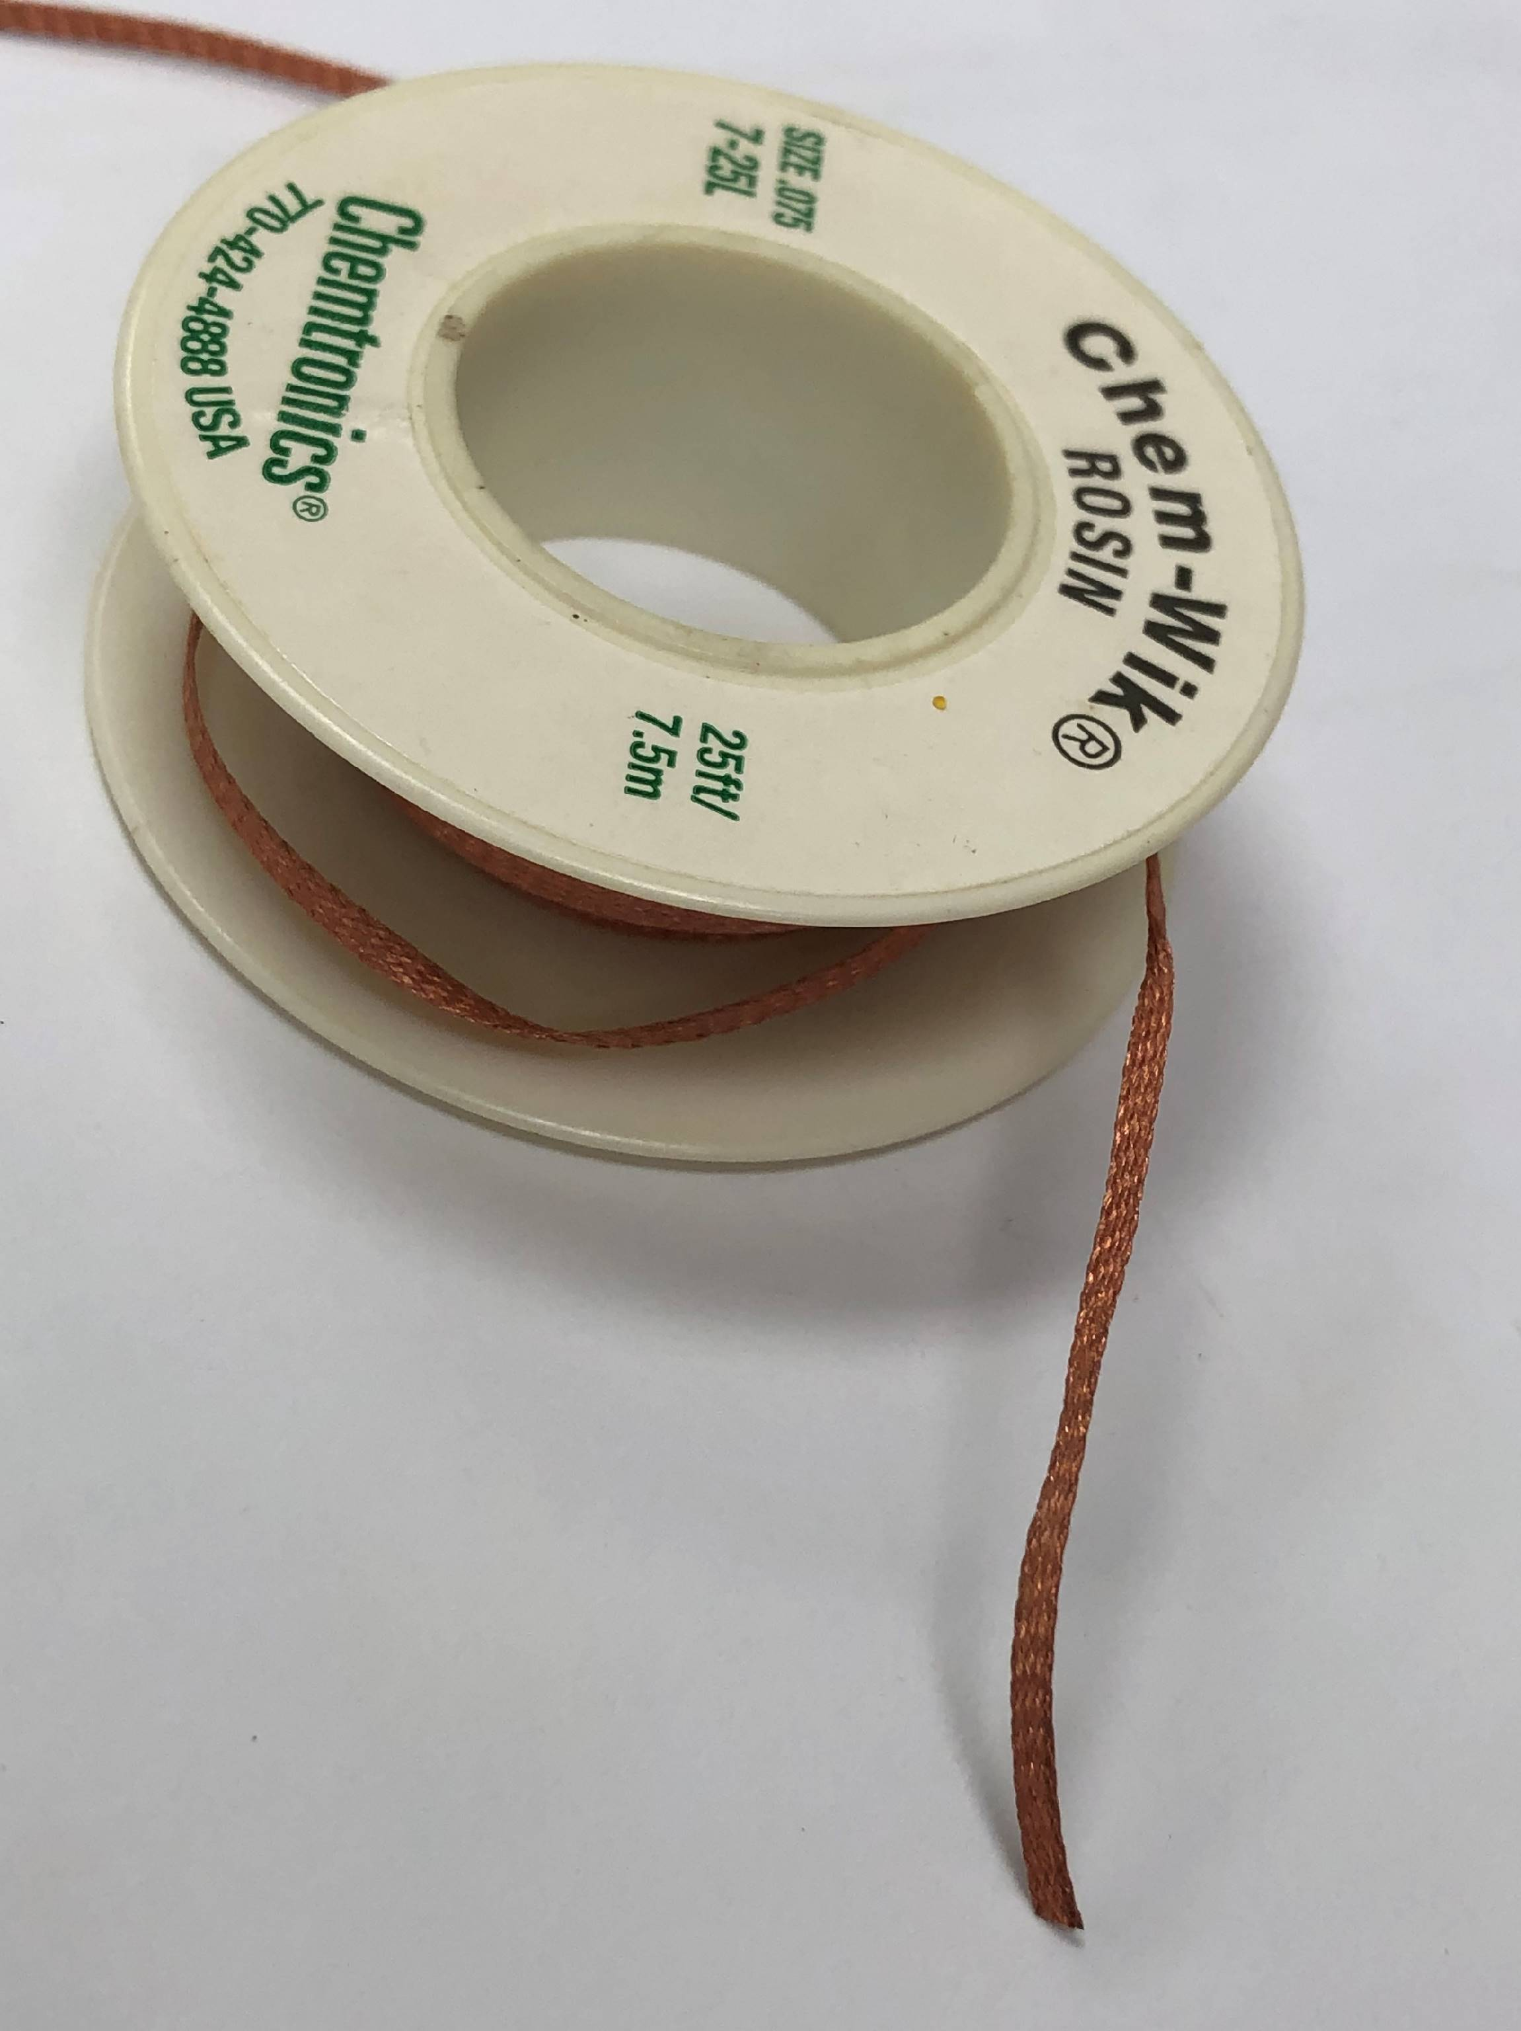
Soldering Tutorial Fixing Soldering Errors
Think of “solder wik” as a q-tip that can clean up any unwanted solder.
Just like the solder sucker, use the iron to melt the unwanted solder. Than use the solder wik to remove the unwanted solder.
Wik

Slide 42
Soldering Tutorial Fixing Soldering Errors
If in doubt, it’s usually wiser to sacrifice the component by cutting it’s leads off, then removing the leads one at a time. This will avoid damaging the traces on the circuit board, which are very difficult to repair.

