Slide 1
Lecture L02.03
The Operational Amplifier
Notes:
Prepared by Jim Giammanco
<giamman@rouge.phys.lsu.edu>
Students will learn to identify the most commonly used electronic components and to determine component values by interpreting the manufacturer’s markings. Students will also learn the precautions needed to protect components from electrostatic discharge, as well as when it is important to observe the polarity of a component when it is installed into a circuit.

Slide 2
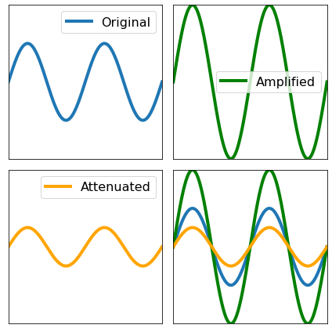
Amplification and Attenuation
When a signal is too small to be measured correctly, the signal can be amplified. Amplification is the process of increasing the amplitude of an electrical signal. (Gain >1)
Sometimes, a signal is strong enough to damage equipment or other devices or exceed the desired thresholds. Attenuation is the process of reducing the power of an electrical sensor.(Gain 0-1) Attenuation can occur when a signal is sent over long distances.
Notes:
https://www.geeksforgeeks.org/data-communication-transmission-impairment/

Slide 3
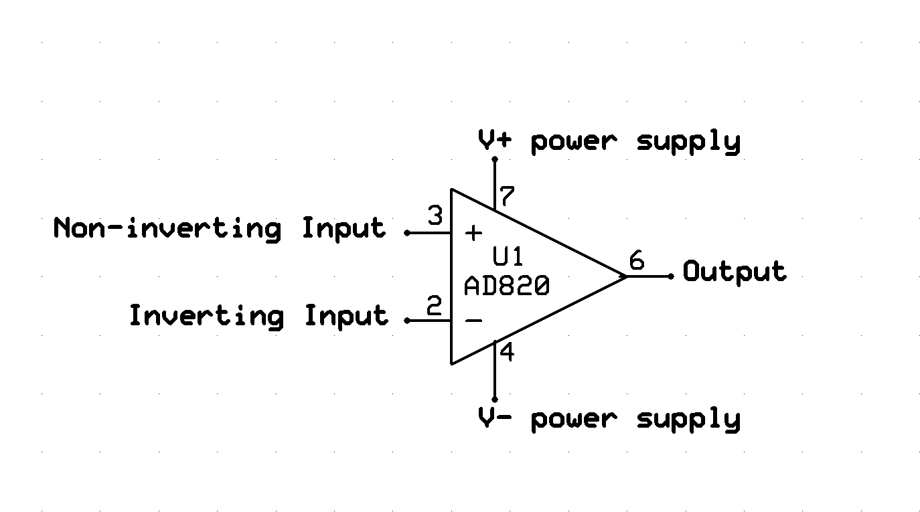
Signal Conditioning Circuit
Operational Amplifier or “Op amp”
Amplifying circuits are built using an IC called an op amp.

Slide 4
Op Amp Connections - Power
Vsupply+ (often called Vcc)
  Maximum output voltage will be slightly lower than this voltage
Vsupply-
  Maybe 0V or GND, can often be negative
  Mininum output voltage will be slightly higher than this voltage
Current at the output will be drawn via these connections

Slide 5
Op Amp Connections - Inputs
Vin+ (V+)
  Non-inverting input
  Input used when do not want to switch signal to negative
Vin-
  Inverting input
  Used when switching signal sign is desired
  Also used to for creating an offset or subtracting two signals
The input signal designated Vin will be connected to one of these pins

Slide 6
Op Amp Connections - Output
Vout
  The circuit will be designed to change this
  Will be connected back to one of the inputs to create a feedback loop
  Op Amp will vary Vout to satisfy the Golden Rules
  Limited between Vs+ and Vs-

Slide 7
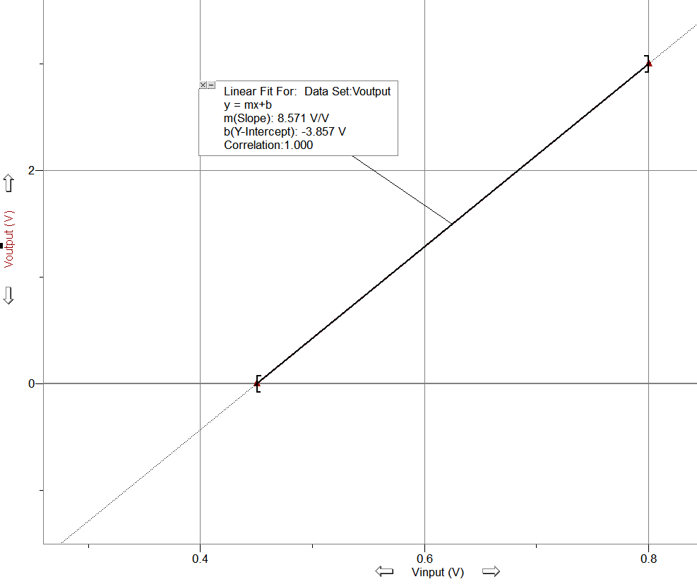
Transfer Function
The equation of between the input and the output of the amplifier is called the transfer function.
Usually, the transfer function is linear (at least over range)
The slope is the gain and the intercept the offset.
In the plot to the left we are amplifying a small (0.450-0.800 V) signal to 0-3V
Gain = 8.571
Offset = -3.857 V
Notes:
11.6 mA is 7.6 mA above the base. (7.6 mA)/(16 mA) represents 47.5% of the output span.
47.5 % of the temperature span is 80.8 degrees, so the temperature is 80.8 degrees above the base temperature (-20), or 60.8

Slide 8
Op Amp Golden Rules
If Vout is connected to one of the inputs forming a feedback loop, Vout will vary to satisfy the following rules:
The output changes to make the voltage difference between both inputs zero. (V+=V-)
The inputs draw no current. (I+=I-=0A)

Slide 9
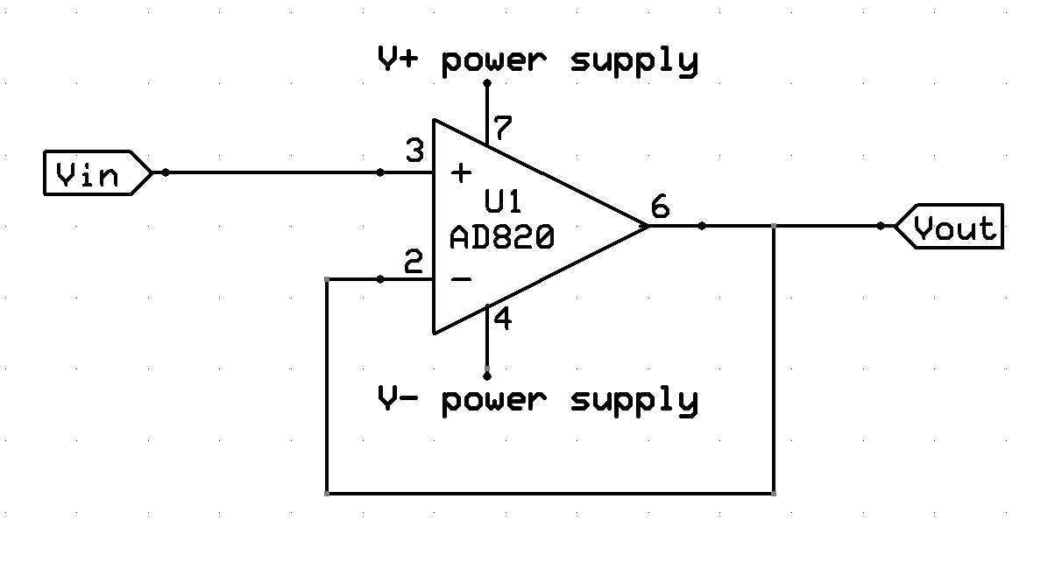
Signal Conditioning Circuit
Example 1: Buffer
No resistors so the equations are simple
Vin=V+
V+=V- (Golden Rule)
V-=Vout Therefore Vin=Vout

Slide 10
Signal Conditioning Circuit
Buffer usage
A buffer provides voltage or current isolation between to components to prevent the signal from affecting the performance of a component.
Current on V_{out} comes from the supply, not V_{in}.
Gain of Buffer
Vin = Vout
Gain=1

Slide 11
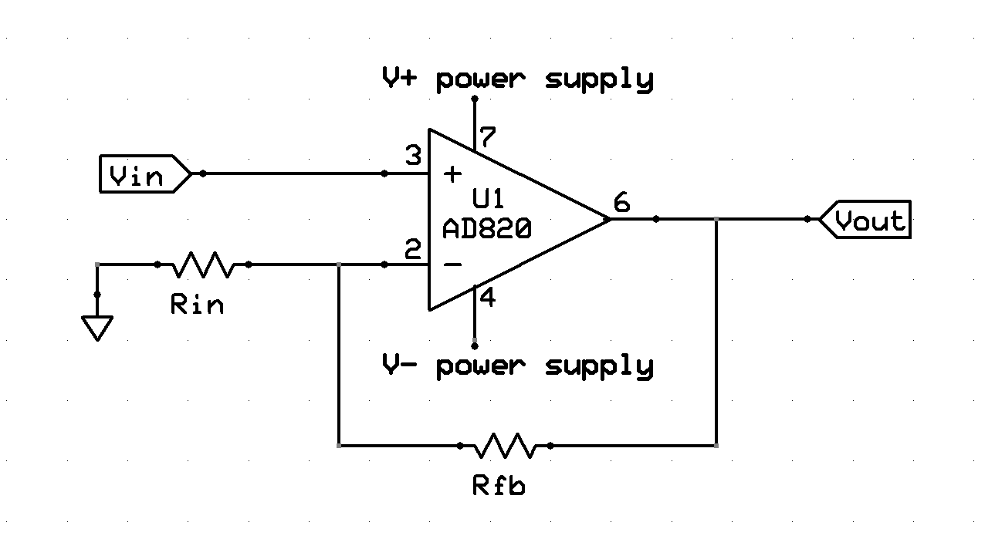
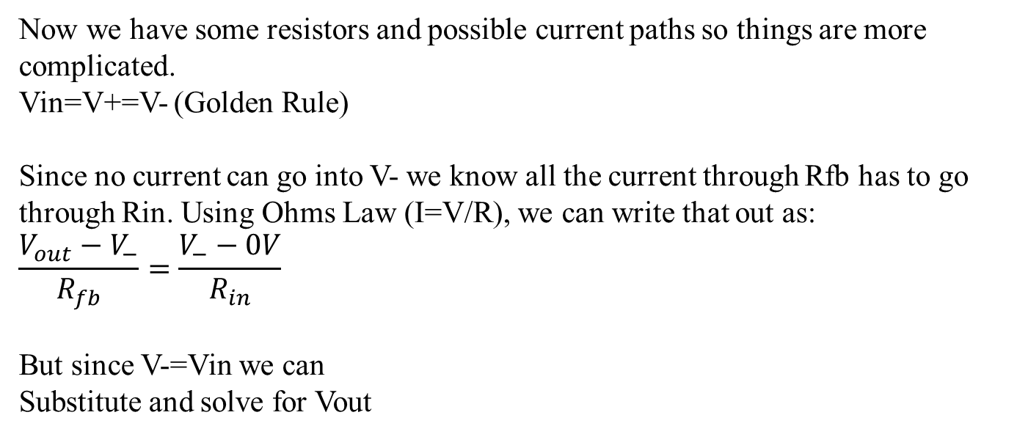
Signal Conditioning Circuit
Non-Inverting Amplifier Example
Now we have some resistors and possible current paths so things are more complicated.
Vin=V+=V- (Golden Rule)
Since no current can go into V- we know all the current through Rfb has to go through Rin. Using Ohms Law (I=V/R), we can write that out as:
$$\frac{V_{out}−V_{−}}{R_{fb}}=\frac{V_{−}−0V}{R_{in}}$$
But since V-=Vin we can
Substitute and solve for Vout

Slide 12
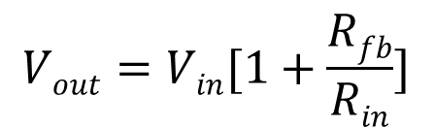
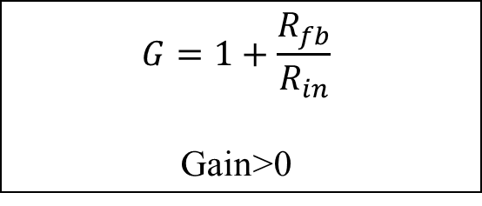
Signal Conditioning Circuit
Non-Inverting Amplifier Usage
Non-inverted op amps have Vin connected to the positive terminal. This is commonly used in electronics to amplify DC signal.
$$G=1+\frac{R_{fb}}{R_{in}}$$
Gain>0

Slide 13
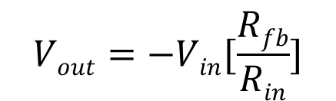
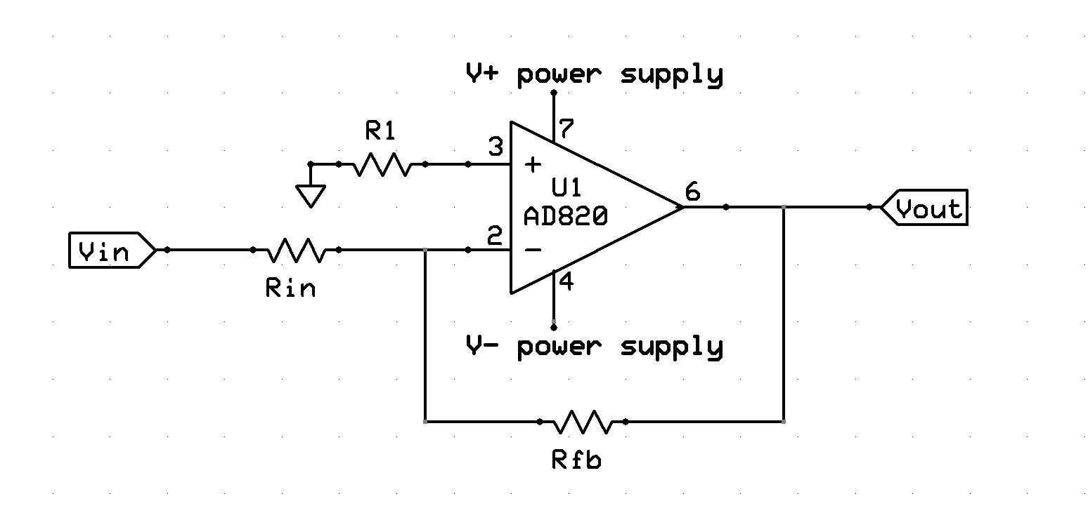
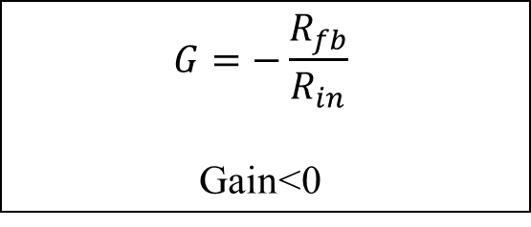
Signal Conditioning Circuit
Inverting Amplifier
Inverted op amps have Vin connected to the negative terminal.
Signal is inverted (flipped).
Note: the gain is negative so it is important to consider the sign of Vin and if Vs- is negative or zero
$$G=−\frac{R_{fb}}{R_{in}}$$
Gain<0

Slide 14
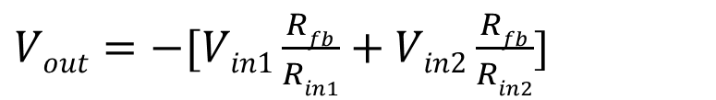
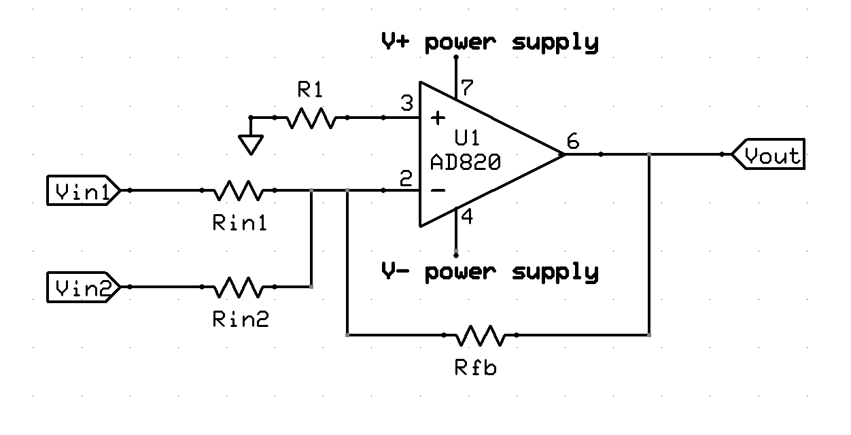
Signal Conditioning Circuit
Summing Amplifier
Summing op amps have multiple inputs are connected into a single terminal. Can be inverting (shown here) or noninverting.

Slide 15
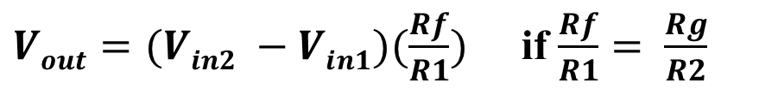
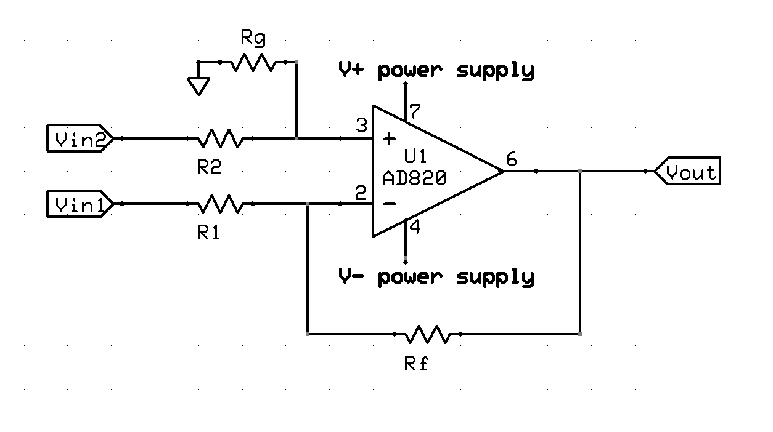
Signal Conditioning Circuit
Difference Amplifier
A difference op amp has an input into both the negative and positive terminals.
It amplifies the difference between the two signals.

Slide 16
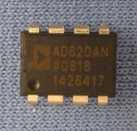
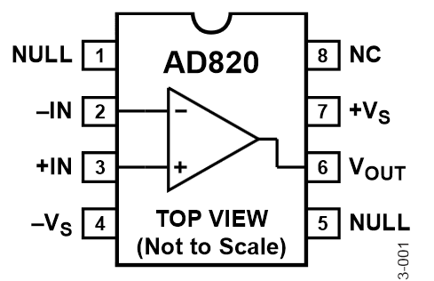
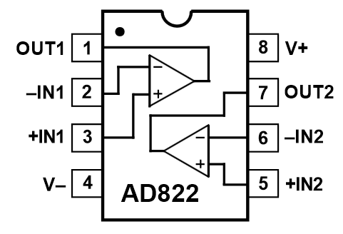
Operational Amplifier ICs
Available in Single(1x), Dual(2x), Quad(4x) Packages
May be Bipolar power supply (ex. +/-V_{s} = +/- 12V)
Single supply operation (ex. +12V, GND)
Variety of voltage and frequency ranges for different chips.

Slide 17
Other Types of Amplifying Circuits
A common variation is to add an offset to previous examples, which shifts the entire signal by a constant amount up and down.
By adding capacitors and or inductors you can make the gain of a circuit depend on a frequency, this allows you to filter undesirable signals (like high frequency RF noise) out
It is also common to have multiple stages of amplification; using a buffer to isolate an amplified signal from the rest of the circuit.

