Slide 1
Lecture L02.02
Electronic Components
Identification of components and handling precautions to protect them from damage due to electrostatic discharge
Notes:
Prepared by Jim Giammanco
<giamman@rouge.phys.lsu.edu>
Students will learn to identify the most commonly used electronic components and to determine component values by interpreting the manufacturer’s markings. Students will also learn the precautions needed to protect components from electrostatic discharge, as well as when it is important to observe the polarity of a component when it is installed into a circuit.

Slide 2
Passive Components
Resistors
Capacitors
Inductors
Diodes
Interface components

Slide 3
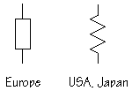
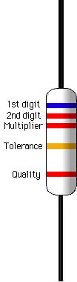
Resistors
Values specified in ohms (Ω), kilo-ohms (K), or mega-ohms (M)
Marked with value using a color code
0 1 2 3 4 5 6 7 8 9 5% 10%
Big Bears Run Over Your Gladiola Bed Vexing Garden Worms (go see now)
Notes:
There have been various other ditties used in the past to remember the color code. Most are unsuitable for polite company.
When the tolerance band is not present, 20% tolerance is assumed.
Some precision resistors will have three “significant digit” bands before the multiplier band.

Slide 4
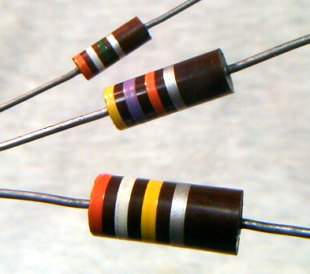
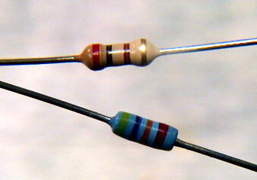
Resistor ratings
Physical size of resistors determines power handling ability
Commonly available as 1/8, 1/4, 1/2, 1,
and 2 watt components
Much higher powers available , usually as wirewound or ceramic encapsulated parts
Notes:
Good practice is to select a resistor whose power rating is at least two or three times the expected power dissipation. For most low power, low voltage circuits, ¼ watt resistors are appropriate. The three 10% tolerance carbon composition reistors shown are (top to bottom) ½ watt, 1 watt, and 2 watt. Their values are 3.9M, 47K, and 390K. The two smaller resistors are ¼ watt, the top is carbon film, 200Ω 5%, and the bottom is metal film, 47K 2%.

Slide 5
Resistor handling and installation
Resistors are not polarized and may be installed in either direction.
Resistors are not generally susceptible to ESD damage, so special precautions are not required.
Mechanical stress due to lead bending should be minimized.
Notes:
Good construction practice is to install all resistors with their color bands oriented in the same direction. This makes reading the color code on parts already installed much easier. Resistor leads should be bent by grasping the wire with needle node pliers and appling the bending force to the wire, not to the resistor body.

Slide 6
Capacitors
Values specified in microfarads (μF) or picofarads (pF)
Marked with actual value or a numeric code
Some varieties are +/- polarized
Notes:
The nanofarad (nF) is commonly used in Europe, but that nomenclature is rare in USA and Canada.
Polarized capacitors are often referred to as electrolytics because the plate and dieletric structures are formed by a chemical reaction involving an electrolyte.

Slide 7
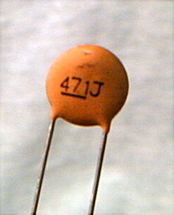
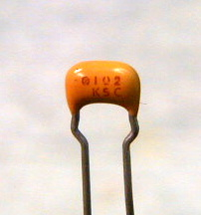
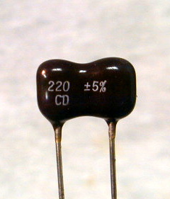
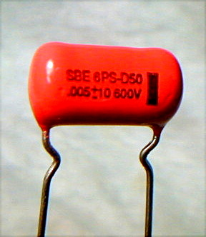
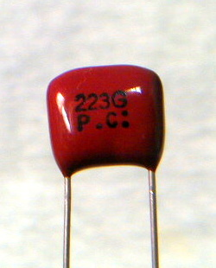
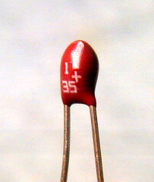
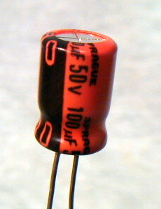
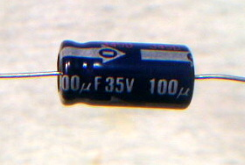
Capacitor types
Ceramic disk
Monolithic ceramic
Dipped siver-mica
Mylar
Mylar
Ceramic disk
Monolithic ceramic
Dipped silvered-mica
Mylar or polyester
Aluminum electrolytic (+/-)
Tantalum (+/-)
Solid tantalum, polarized
Radial aluminum electrolytic
Axial aluminum electrolytic
Notes:
Ceramic disk – 471J means 47 x 10¹ pf, or 471 pF, the J stands for 5% tolerance
Monolithic ceramic – 102 means 10 x 10² pf or 1000 pf, or 0.001 μF
Dipper mico – 220 means 220 pF
Mylar (left) - .005 means 0.005 μF
Mylar (right) – 223 means 22 x 10³ pF or 22000 pF or 0.022 μF
Solid tantalum – 1 35 means 1 μF at 35 WVDC
Radial aluminum – as marked 100 μF at 50 WVDC
Axial aluminum – as marked 100 μF at 35 WVDC

Slide 8
Capacitor ratings
Physical size of capacitors is related to voltage handling ability – WVDC – working voltage DC
Temperature coefficient may also be important – can be + or – or nearly zero
Temperature coefficient depends upon dielectric material
Notes:
NP0 (read N P zero) capacitors are the most temperature stable commonly available types. But they are gernerally only made in values up to a few hundreds of picofarads. Temperature stability is only an important consideration if the capacitor is part of a timing or frequency-determining circuit.

Slide 9
Capacitor handling and installation
Most capacitors are not polarized and may be installed in either direction.
Electrolytic capacitors ARE polarized and MUST be installed with proper polarity, else catastrophic failure!
Capacitors are not generally susceptible to ESD damage, so special precautions are not required.
Mechanical stress due to lead bending should be minimized.
Notes:
It is best to install capacitors in an orientation that will allow their marked value to be read after installation, if at all possible. Just as for resistors, apply lead bending force to the wire, not to the component body.

Slide 10

Inductors
Values specified in henries (H), millihenries (mH) and microhenries (μH)
A coil of wire that may be wound on a core of air or other non-magnetic material, or on a magnetic core such as iron powder or ferrite.
Two coils magnetically coupled form a transformer.
Notes:
Ferrite and iron powder inductor cores are often made in the form of toroids, since a toroidal coils is self-shielding, that is, its magnetic flux is confined to the interior of the core. Toroidal transformers are widely used in high frequency circuits because of this self-shielding property.

Slide 11
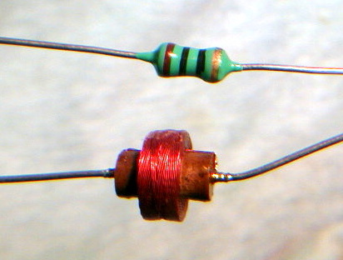
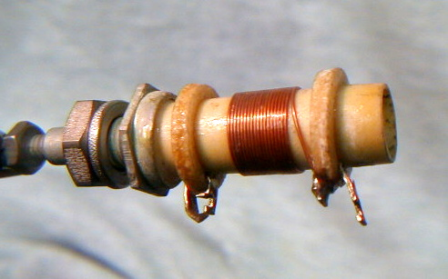
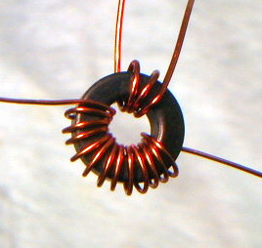
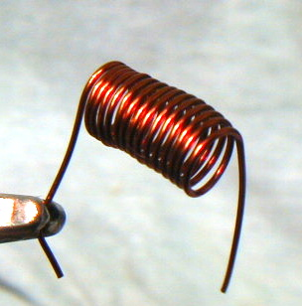
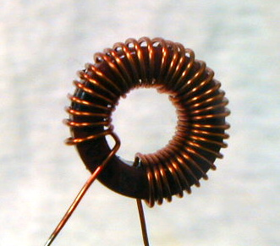
Inductor types
Molded inductor & air-wound inductor
Adjustable air-wound inductor
Ferrite core toroidal transformer
Air wound inductor
Iron powder toroidal inductor
Notes:
The molded inductor is marker brown-black-black-gold, meaning 10 x 10⁰ μH, or 10 μH, with 5% tolerance.
Other inductor types are often unmaked, with value indcated on packaging materials only.

Slide 12
Inductor ratings
Wire gauge and physical size of the coil determine the current handling capacity.
Core material will have a temperature dependence. Air is best, followed by iron powder, then ferrites.
Notes:
The temperature variability is due to changes in the permeability of the core material with temperature. A coreless, that is, air core, inductor will be the most stable. Other materials, such as plastics or ceramics, add mechanical stability and are nearly as temperature stable as air. Ferrites are the least desireable, as their permeabilty can change with both temperature and flux density (nonlinear behavior).

Slide 13
Inductor handling and installation
Inductors are not polarized and may be installed in either direction.
Inductors are not generally susceptible to ESD damage, so special precautions are not required.
Mechanical stress due to lead bending should be minimized.
Inductors in timing or frequency determining circuits should be installed in a mechanically rigid fashion.
Notes:
In the “old days” a drop or two of melted beeswax was used to secure a coil to prevent mechanical shifting of the windings.

Slide 14
Diodes
Anode(+) Cathode(-)
Most modern diodes are semiconductor devices but are considered passive since they do not contribute any amplification or gain to a circuit.
Notes:
Early diodes were vacuum tube devices. Now, almost all are semiconductors.
Symbols are, left to right, a light emitting diode (LED), common diode, and zener diode.
The arrow on the symbol represents the cathode (negative) lead, and the bar represents the anode (positive) lead.
In effect, the arrow points in the direction of conventional current flow (positive charge motion)

Slide 15
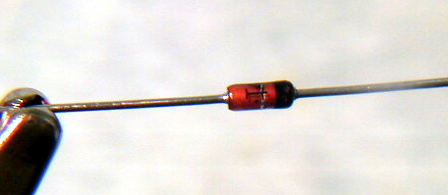
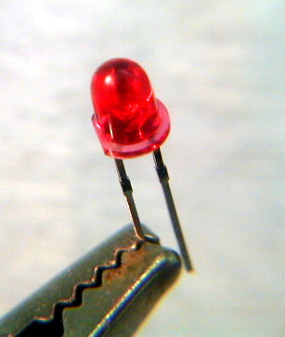
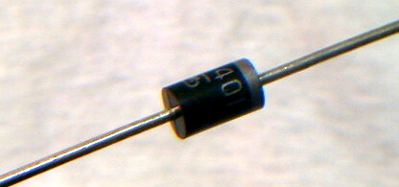
Diode types
May be classified by semiconductor material
silicon, germanium, gallium arsenide, etc.
Or classified by circuit function
Small signal detector or switching diode
Rectifier diode
Light-emitting diode (LED)
Notes:
The cathode (negative) lead of the cylindrical diodes is denoted by the banded end.
Note the flatted side of the LED. This usually denotes the cathode (negative) end of the diode. Often the anode (positive) lead will be slight longer than the cathode lead.

Slide 16
Diode Ratings
Peak inverse voltage (PIV)
Maximum forward current (I_{F})
Maximum forward voltage drop (V_{F})
Reverse leakage current (I_{R})
Notes:
Silicon diodes have a forward voltage drop of about 0.7 V, for germanium it’s about 0.4 V. Silicon rectifier diodes nay have reverse voltage ratings of a kilovolt or more, and maximum forward current of tens or even hundreds of amperes. For small signal electronics 100 V PIV and 50 mA forward current are typical. The forward drop of light emitting diodes depends on their color. Red is least, blue is most. Leakage current are usually in microamps or even nanoamps.

Slide 17
Diode handling and installation
Diodes are polarized and must be installed in with correct orientation.
Many diodes are modestly susceptible to ESD damage, so normal ESD precautions should be taken.
Mechanical stress due to lead bending should be minimized.
Notes:
It’s only the small signal diodes that may have some sensitivity to ESD.

Slide 18
Interface components
Switches
Plugs
Sockets
Panel controls
Notes:
In ballooning applications, avoid switches, connectors, or controls that may accidentally be changed or moved. Sockets are best avoided if possible, with direct soldered connections being preferred. Two wires twisted together mat be a better alternative than a switch, as it will be obvious on inspection whether the connection is “ON” or “OFF.”

Slide 19
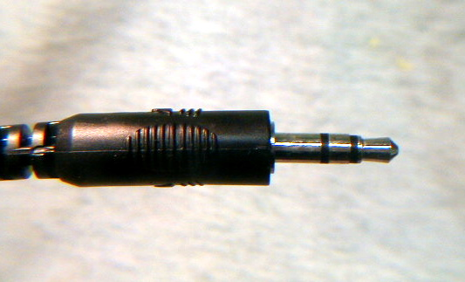
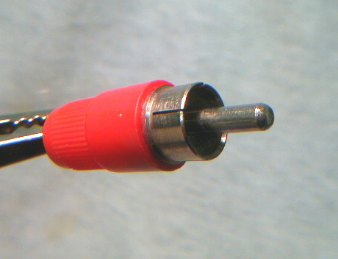
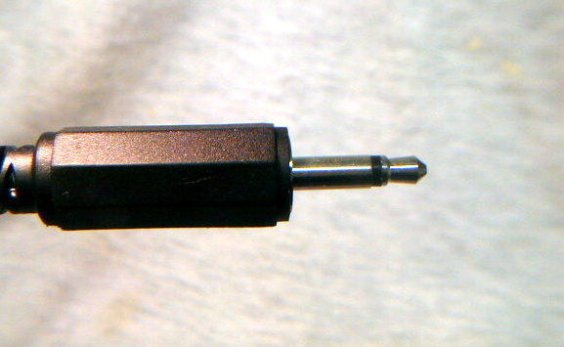
Two common plug styles
Sleeve Ring Tip
Shield Tip
1/8” stereo phone plug
RCA plug
1/8” mono phone plug
Sleeve Tip
Notes:
The phone plugs also are manufactured with diameters of ¼” and 3/32”
The 1/8” plug is frequently sold as 3.5 mm, and the 3/32” plug as 2.5 mm

Slide 20
Active Components
Transistors
Bipolar
Field effect
Integrated circuits
Analog
Digital
Microcontroller

Slide 21
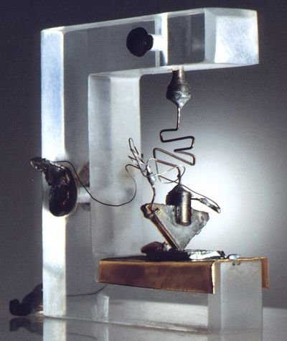
Transistors
Three terminal devices manufactured in a variety of package styles.
Can you find the three terminals of this, the very first transistor?
Notes:
The first transistor was fashioned at Bell Labs in 1948.
The circuit symbols are, left to right,
- NPN bipolar junction transistor (BJT)
- PNP bipolar junction transistor
- N channel junction field effect transistor (JFET)
- P channel junction field effect transistor
- P channel metal oxide on semiconductor, insulated gate, field effect transistor (MOSFET or IGFET)
- N channel metal oxide on semiconductor, insulated gate, field effect transistor

Slide 22
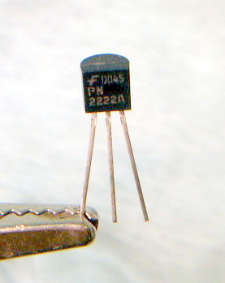
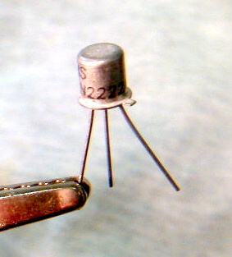
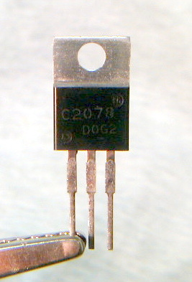
Terminal Designations and packaging styles
Collector
Base
Emitter
2N2222 in a TO-92 package
2N2222A in a TO-18 package
Drain
Gate
2SC2078 in a TO-220 package
Source
Notes:
Pinouts may vary from manufacturer to manufacturer. It is always best to consult the data sheets.
For the TO-18 package, the lead near the small tab on the can is almost always the emiiter.
The physical size of the package affect the power dissipation capability of the devices. TO-92 and TO-18 packages are limited to a few tens or hundreds of miliiwatts. The TO-220 package can dissipate several watts.

Slide 23
Transistor handling and installation
Transistors are polarized and must be installed in with correct orientation.
Most BJT transistors are modestly susceptible to ESD damage, so normal ESD precautions should be taken.
MOSFET (IGFET) transistors are very susceptible to ESD damage, so rigorous precautions should be taken.
Mechanical stress due to lead bending should be minimized.
Notes:
It’s only the small signal diodes that may have some sensitivity to ESD.

Slide 24
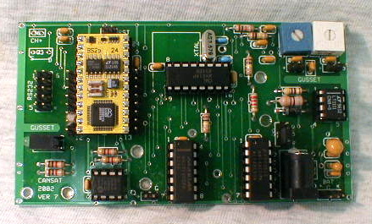
Integrated Circuits
Integrated circuits (ICs) are multi-terminal devices that provide an array of functions and applications far to numerous to list here.
Notes:
Pictured is a “CANSAT” circuit board, forerunner of the “BALLOONSAT” flight computer board.

Slide 25
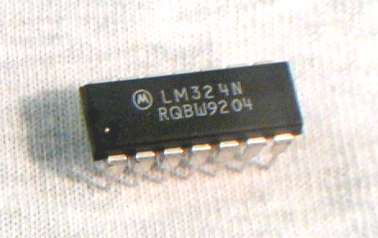
Pin identification and numbering convention
Pins are numbered sequentially in a counterclockwise direction.
Pin 1 is often identified with a dot or a dimple.
The pin 1 end of the chip is often identified with a notch.
Pin 8
Pin 14
Notch
Dimple
Pin 7
Pin 1
Notes:
When the label on the chip reads correctly from left to right, pin 1 will be in the lower left corner of the chip.
This is a DIP-14 package, meaning “dual-in-line, 14 pin”

Slide 26
IC handling and installation
ICs are polarized and must be installed with correct orientation. Observe pin 1 location on sockets or circuits.
Treat all ICs as if they are very susceptible to ESD damage (very many actually are), so rigorous precautions should be taken.
Leads generally should not be bent.
Notes:
Often the leads of an IC will need to be gently straightened in order to fit into a socket or into the holes of a printed circuit board.

Slide 27
Electrostatic Discharge (ESD) Protection
Ground your work surface
Use an anti-static mat
Ground your tools (i.e., soldering iron)
Many irons are constructed with a grounded tip
Ground yourself
Use a wrist or ankle strap, but always include a series resistor of high value to avoid any shock hazard.
Touch a grounded object before handling static sensitive components.
Notes:
A 1 meg-ohm resistor in series between the personal grounding strap and the earth connection provides an adequate path for static discharge, while limiting any accidental currents to a few microamps.

Slide 28
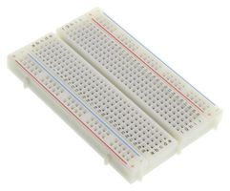
Solderless Breadboards
Used to construct and prototype TEMPORARY circuits.
Electrical parts (through hole) can be easily removed and added to the board.
Have a consistent connection along columns and rows.

Slide 29
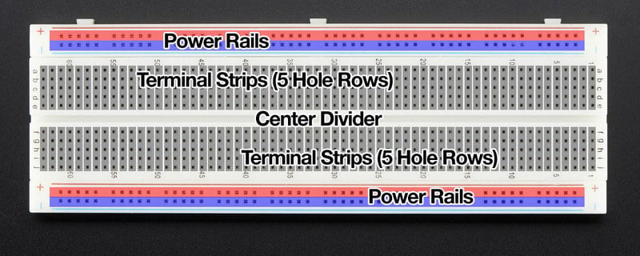
Power Rail Layout
Power rails are fully connected along the horizontal on the top and bottom
Make one power rail positive
Make the other negative

Slide 30
Terminal Strips Layout
Terminal strips are connected vertically and broken by center divider
Through hole elements are connected on the terminal strips (5 slots are connected vertically)
Center divider separates terminal strips (great for connecting multipin ICs between)

Slide 31
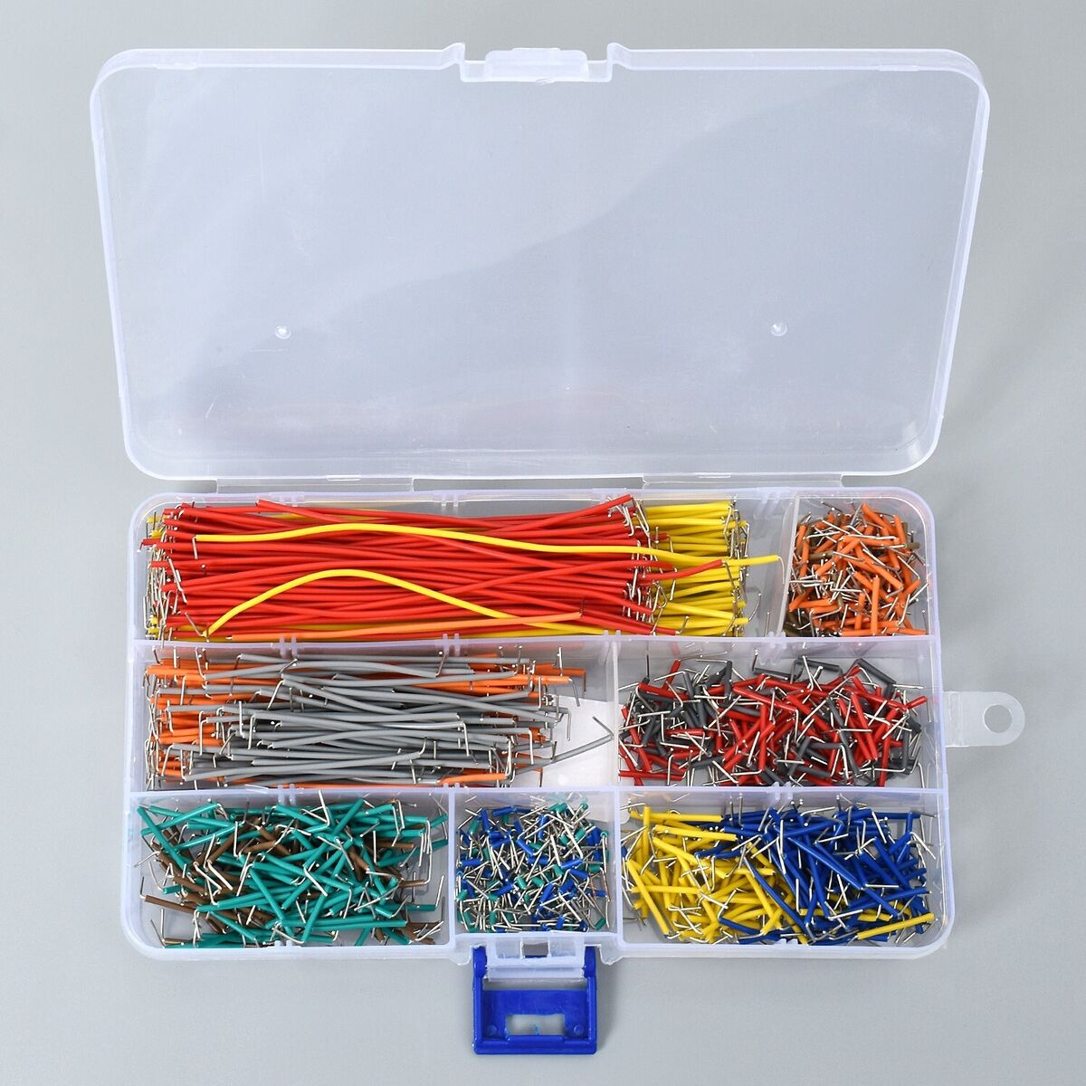
Using the Jumper Cable Kit while Breadboarding
Set of jumper cables will follow the same color convention as resistors.
For example, an orange jumper will be able jump 3 spaces on the breadboard.

