Slide 1
Introduction to Electronics
Lecture 02.01
Notes:
Prepared by Jim Giammanco
<giamman@rouge.phys.lsu.edu>

Slide 2
Electric Potential
1 volt = 1 joule of energy per coulomb of charge
Some examples:
flashlight battery – 1.5 V (DC)
car battery – 12 V (DC)
wall socket – 120 V (AC)
overhead power lines – 6,000 to 250,000 V (AC)

Slide 3
Electric Current
1 ampere = movement of 1 coulomb of charge per time interval of 1 second
Some examples:
Flashlight – 300 milliamps (DC)
Toaster – 10 amperes (AC)
Automobile starter – 150 amperes (DC)
Quartz wristwatch – a few microamps (10⁻⁶ ampere)
Enough to “shock” – a few milliamps (10⁻³ ampere)

Slide 4
Electric Resistance
1 ohm (Ω) of resistance allows a potential of 1 volt to cause a current of 1 ampere to flow in a circuit
Ohms’s Law V = I R
V = potential in volts
I = current in amperes
R = resistance in oms

Slide 5
Electric Power
1 watt of power is produced when a potential of 1 volt causes a current of 1 ampere to flow in a circuit
P = I V
V = potential in volts
I = current in amperes
R = resistance in ohms
P = power in watts
Using Ohm’s Law and P = I V, then P = I² R = V² / R

Slide 6
Electric Power
Some examples…
Quartz wristwatch – 0.000001 watt (1 microwatt)
Flashlight – 1 watt
Balloon radio beacon – 5 watts
Table lamp – 60 watts
27” television set – 130 watts
Hair dryer – 1100 watts
Clothes dryer – 5000 watts (5 kilowatts)
State of Louisiana – 8,000,000,000 watts (8000 megawatts)

Slide 7
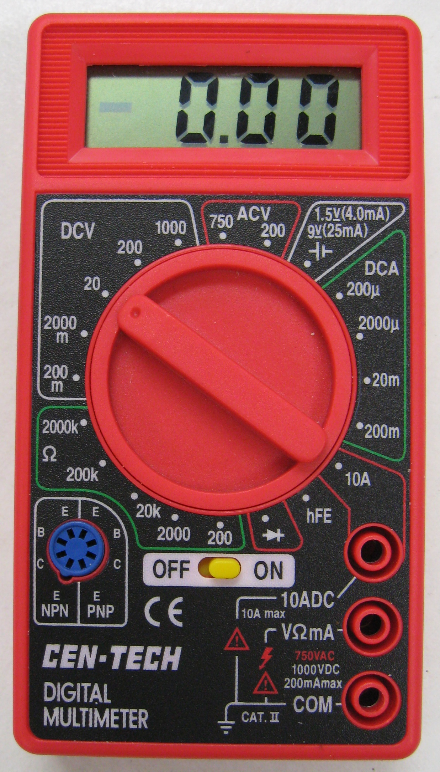
How To Use a Digital Multimeter
Digital MultiMeter (DMM)
Measures voltage, current, resistance,
sometimes other parameters
This one cost less than $5
AC and DC voltage
DC current
Resistance
Diode and Transistor properties
Battery tester

Slide 8
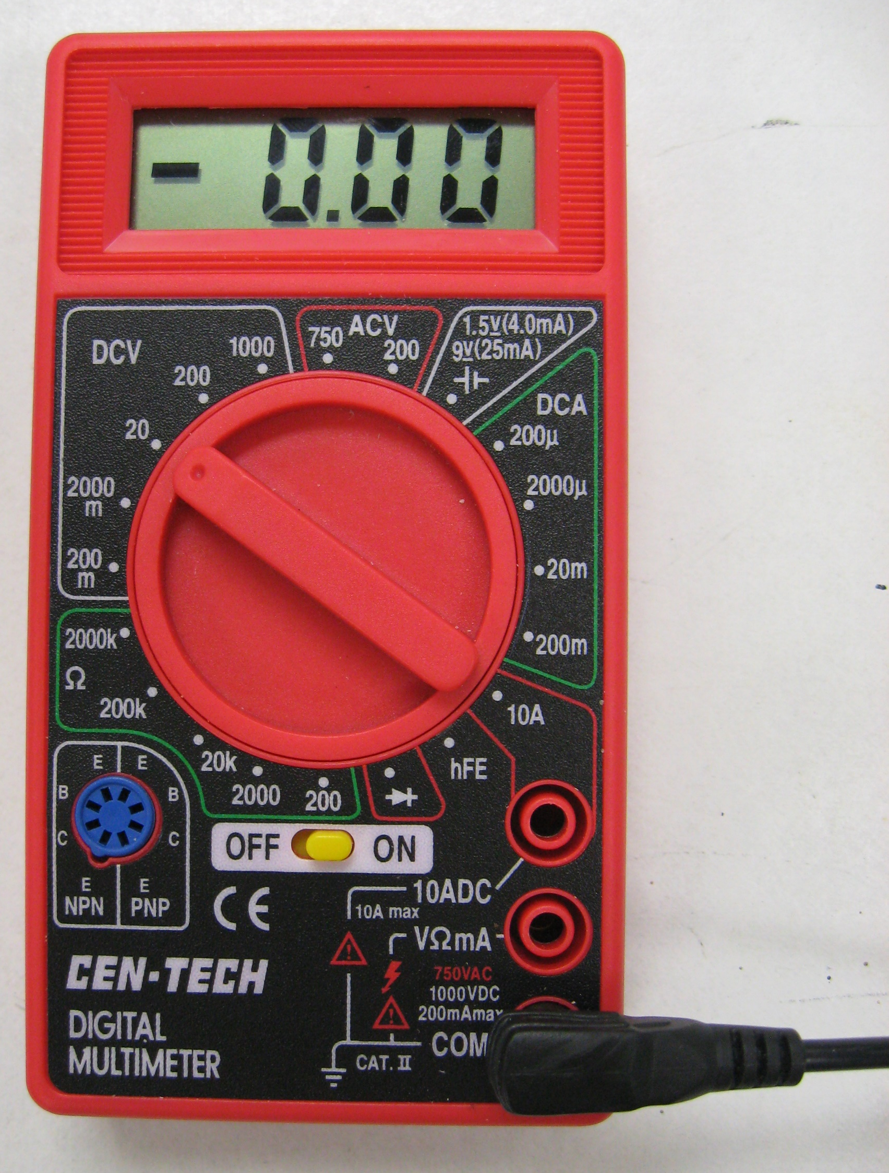
Taking Measurements
(Setup)
BLACK test lead is plugged
Into the COM (common)
terminal
Select the proper MEASUREMENT and RANGE if required
Some DMMs are autoranging and automatically adjust the range

Slide 9
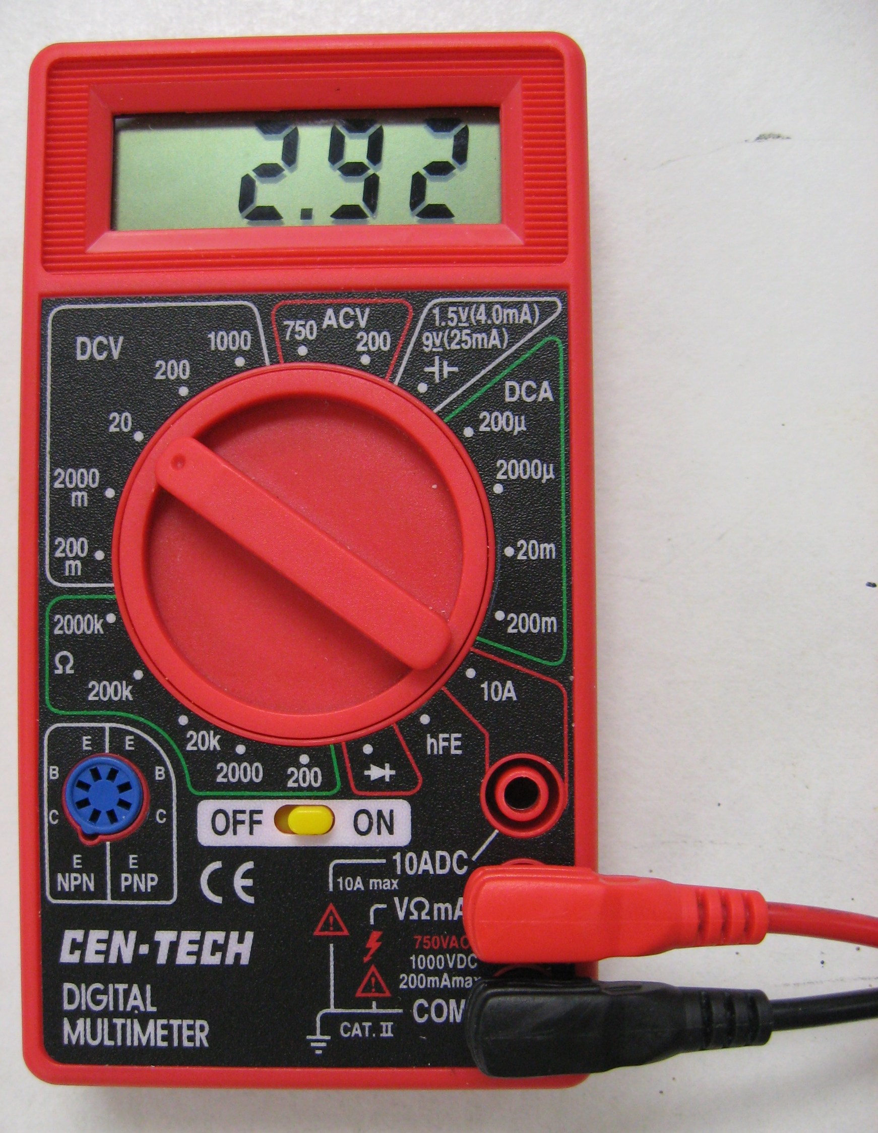
Taking Measurements
(Voltage)
RED test lead is plugged
into the VΩmA terminal for measuring voltage and resistance

Slide 10
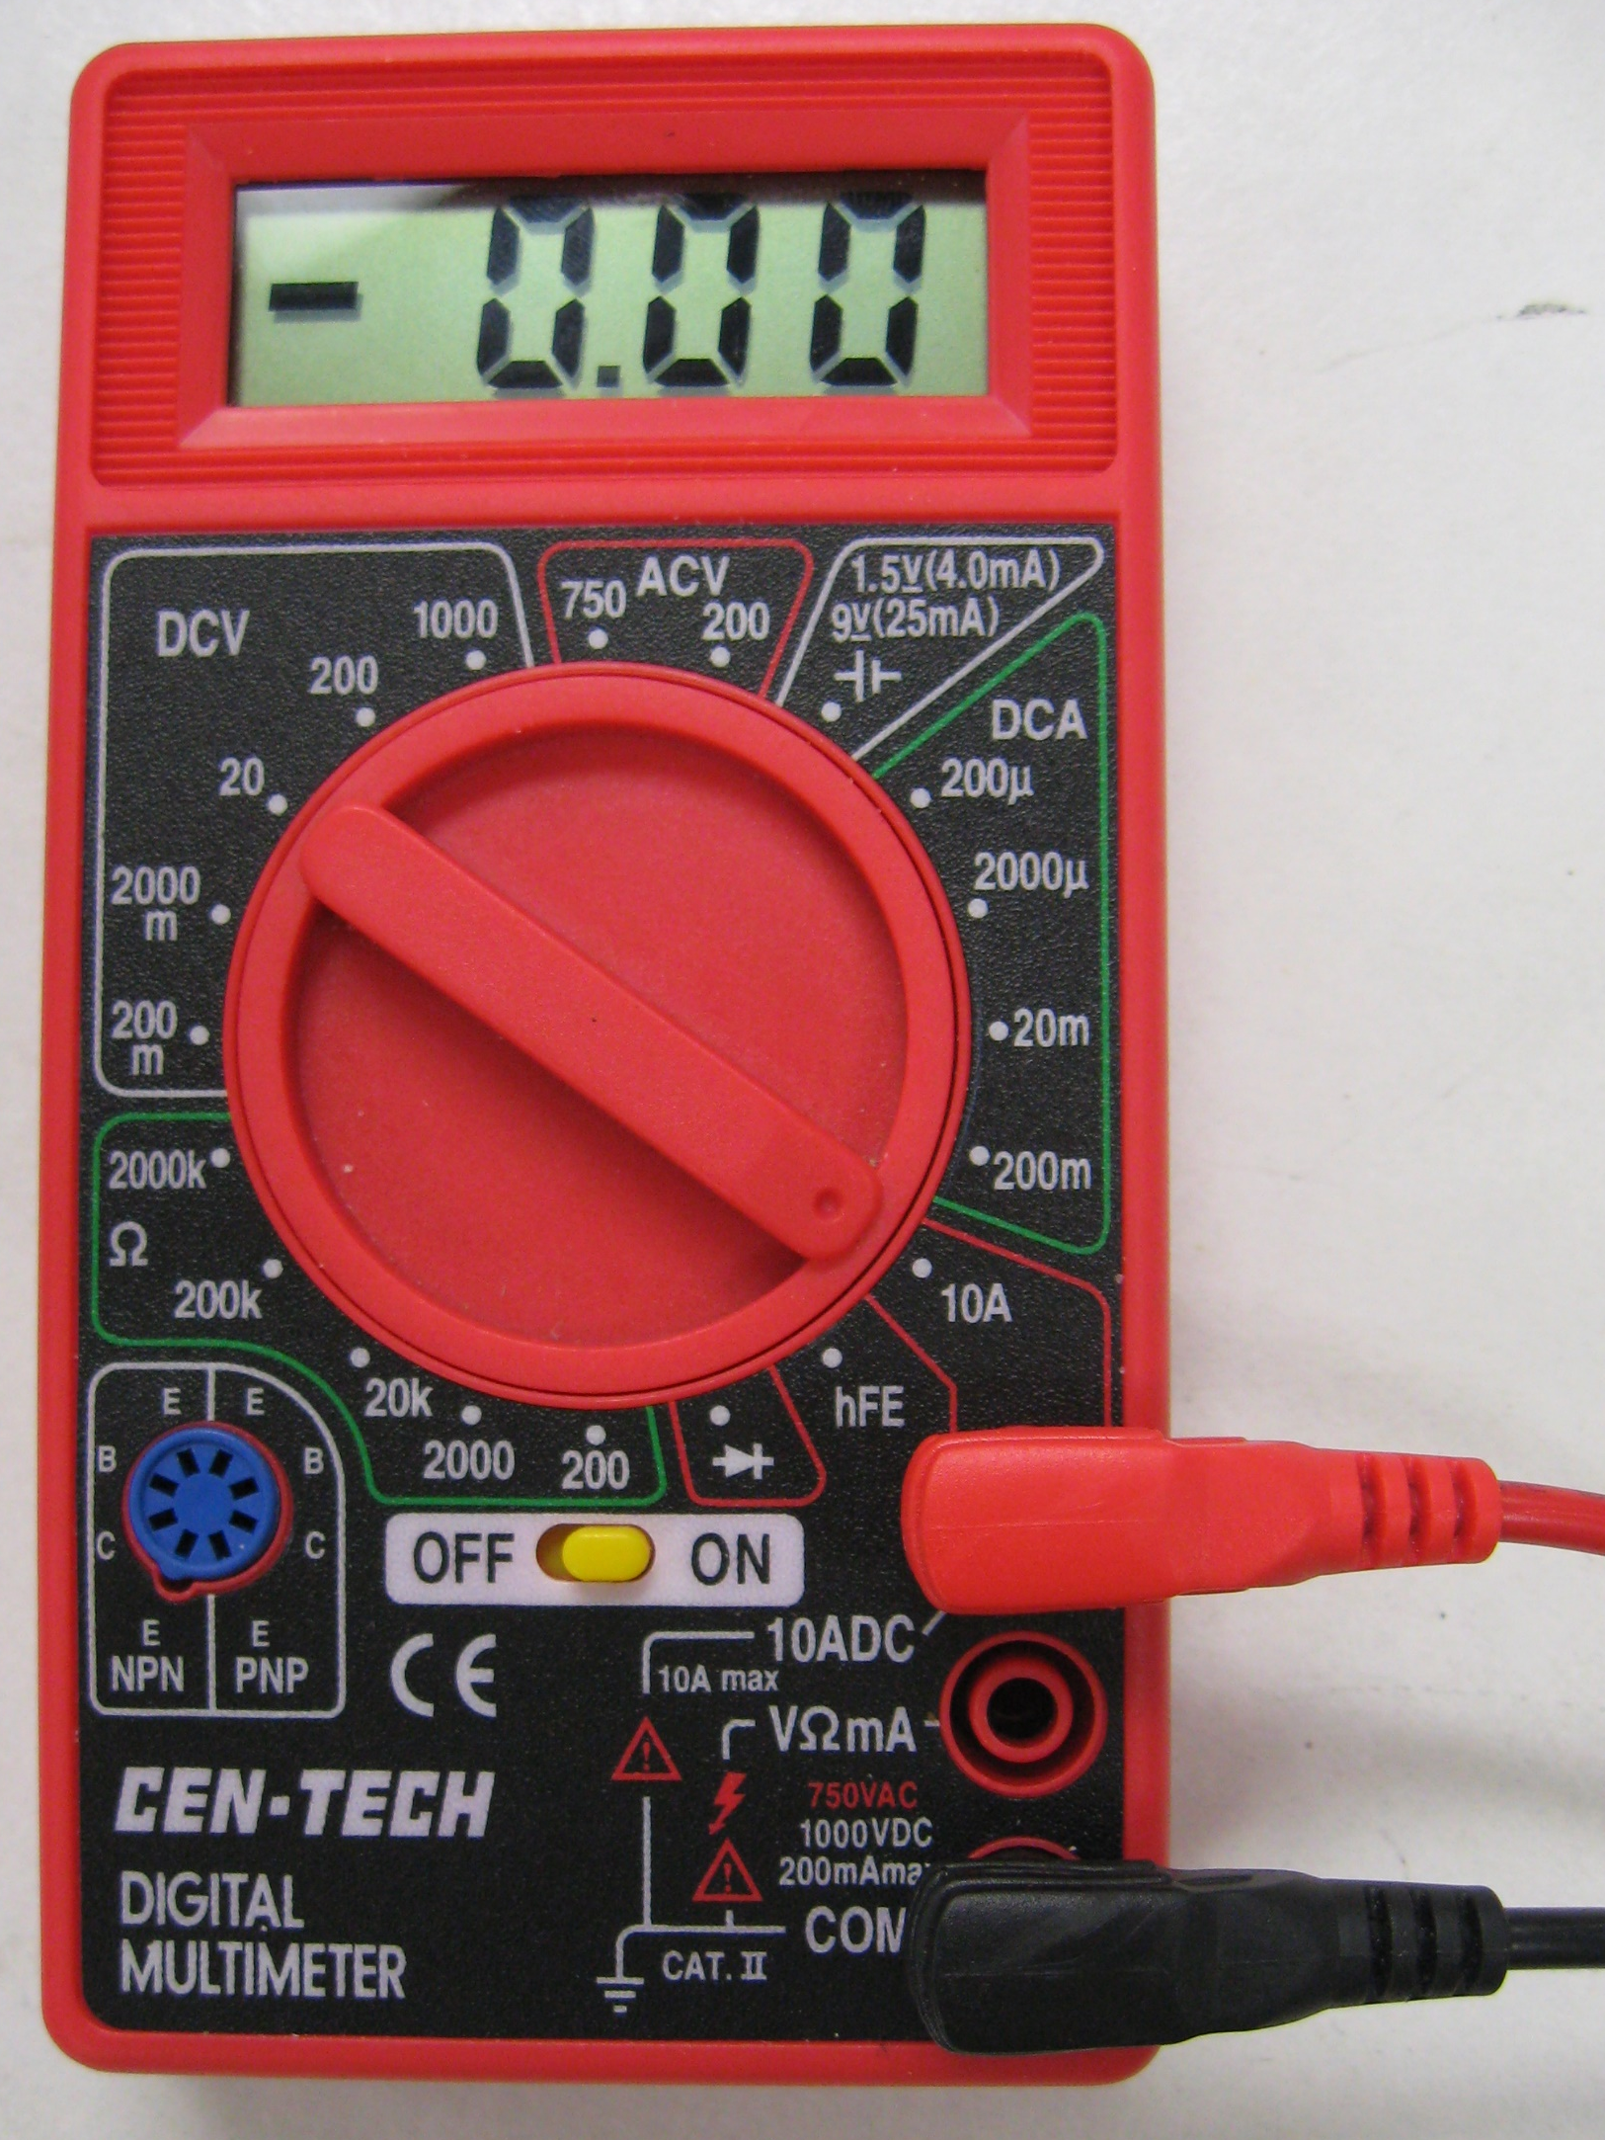
Taking Measurements
(Current)
Some meters have a common plug for voltage and current, others it is seperate
For large DC currents
(up to 10 amperes)
RED test lead is connected
To the 10ADC terminal
Current plugs are fused (fuses can be blown)

Slide 11
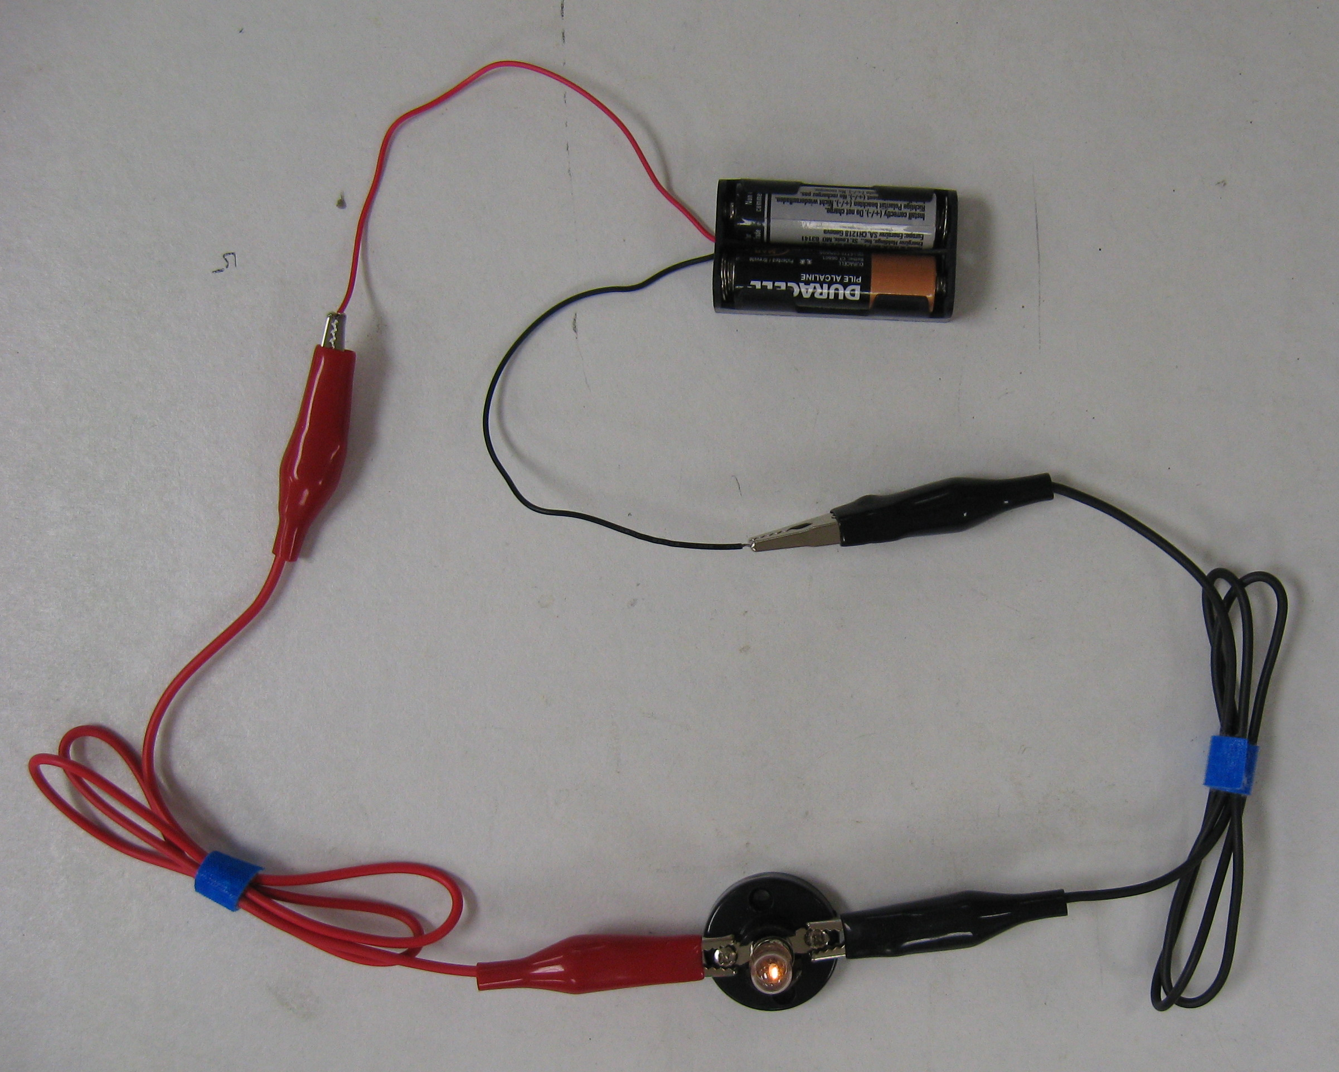
Voltage Measurement
Here’s a simple battery
and lamp circuit
Let’s measure the voltage
across the lamp

Slide 12
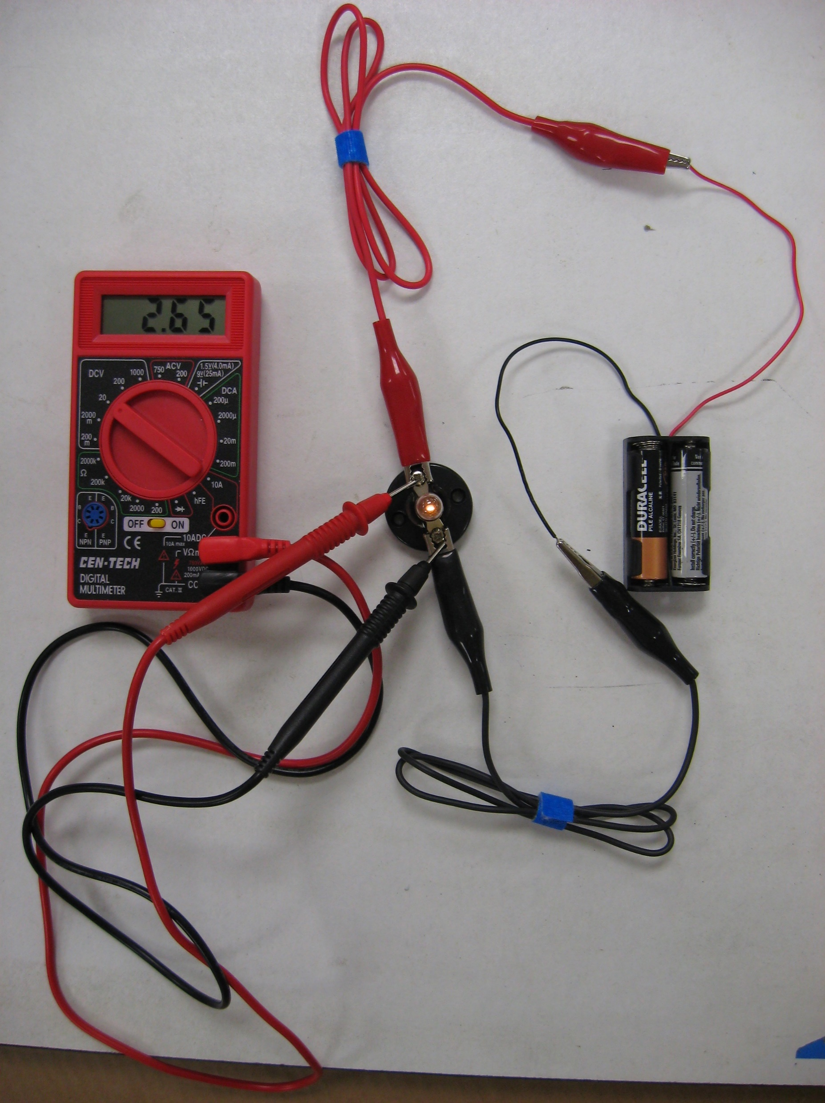
Voltage Measurement
Voltage measurements require the DMM to be connected in parallel (i.e., across) the circuit element whose voltage is being measured
Note there is a parallel path around the lamp through the multimeter
In this case the multimeter has a very large resistance so no extra current flows through it

Slide 13
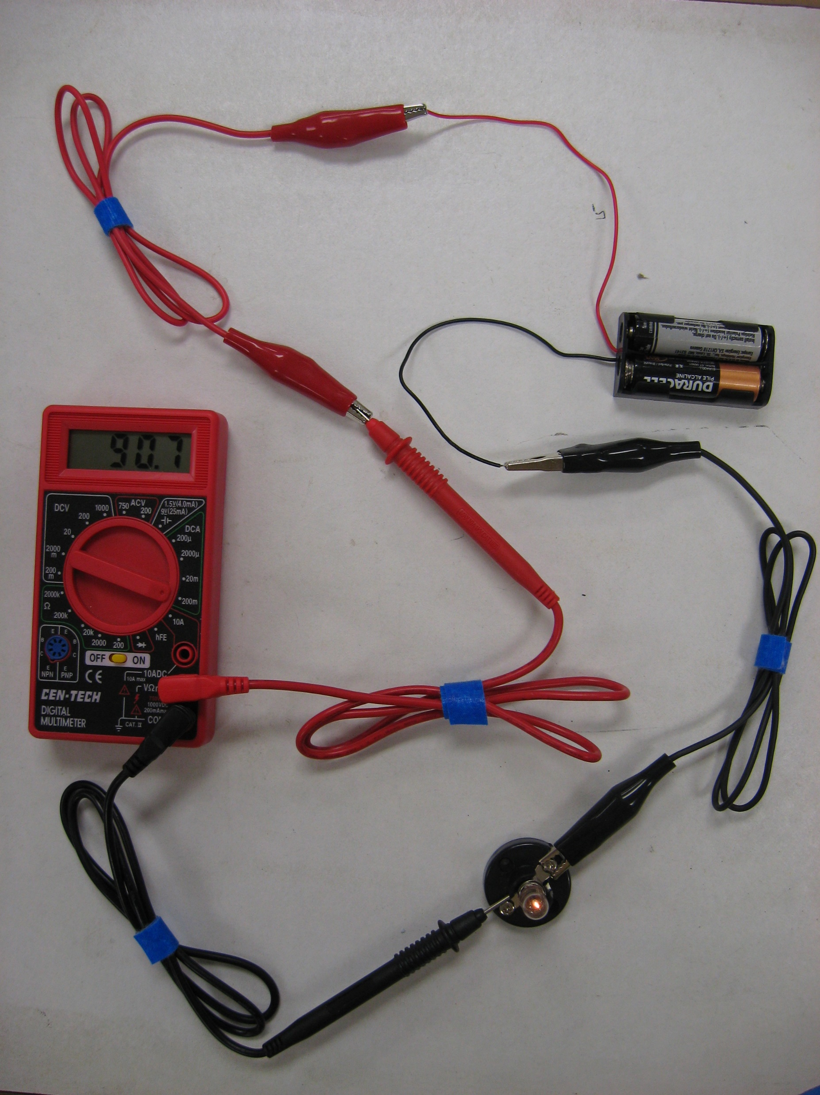
Current Measurement
To measure current, the DMM must be connected in series (i.e., in line with) the circuit element whose current is being Measured
The current in the circuit must flow through the meter before getting to the lamp
The meter has a very low resistance in order not to decrease the current flow

Slide 14
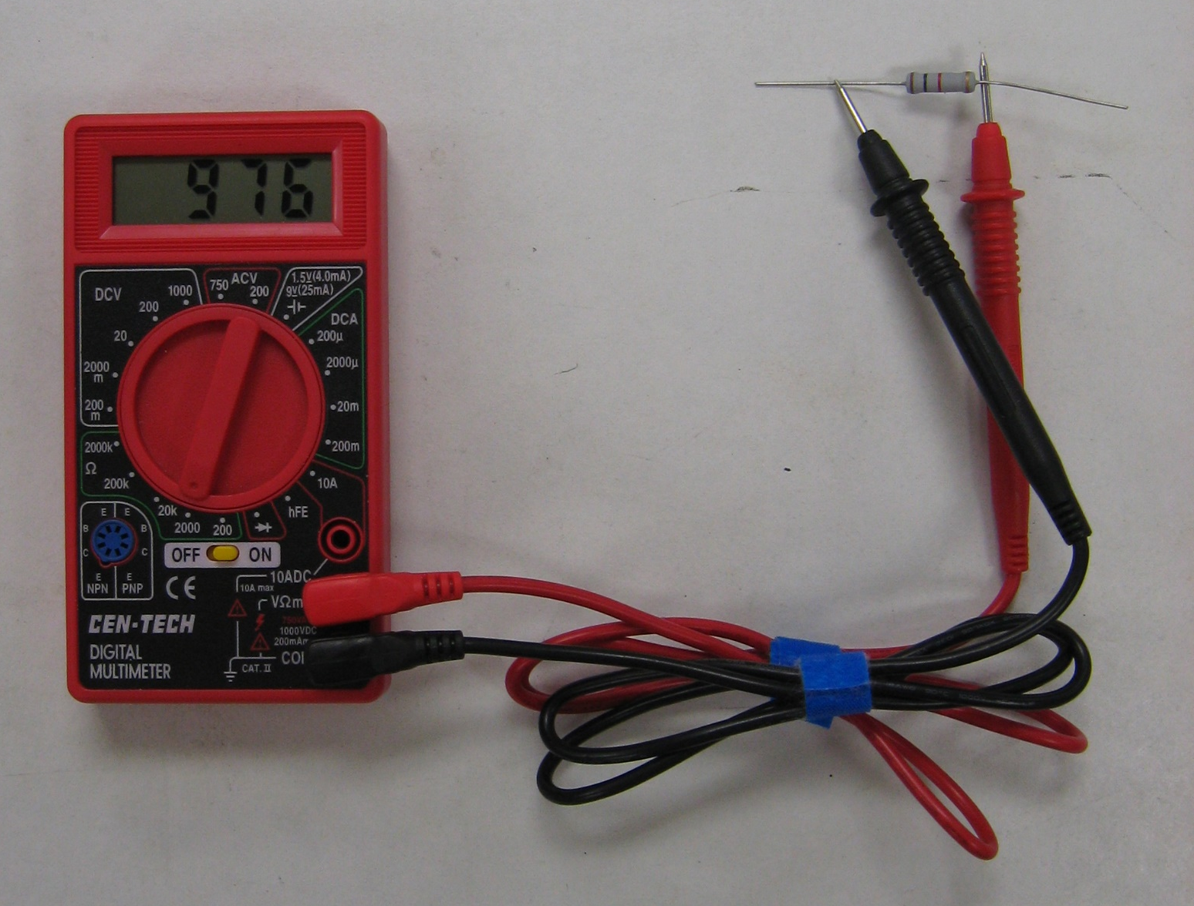
Resistance Measurement
Here’s how to measure the resistance of an
element
Note: the element is removed from its circuit
If the resistor has power the meter will not be able to accurately measure

Slide 15
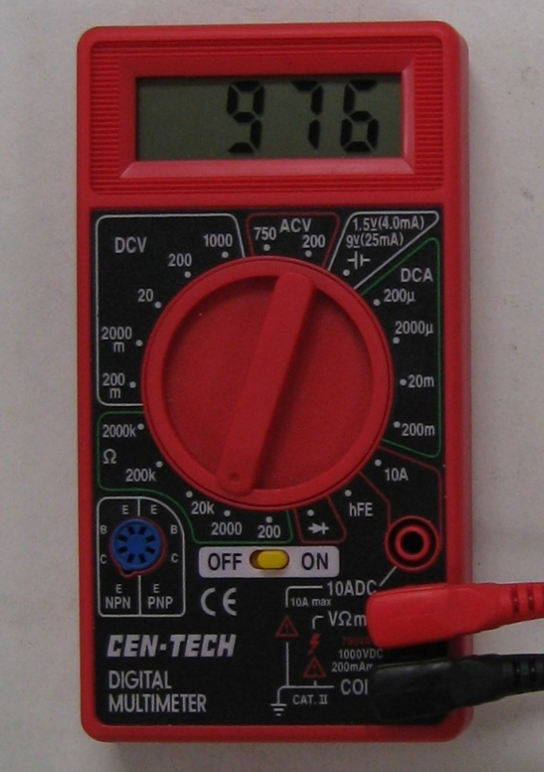
Resistance Measurement
The RANGE is 0-2000 Ω So the reading is interpreted as 976 Ω, or 0.976 K Ω
If the meter was on the 20k setting the meter would read 0.976 instead

Slide 16
*****WARNING*****
Don’t try this at home.

Slide 17
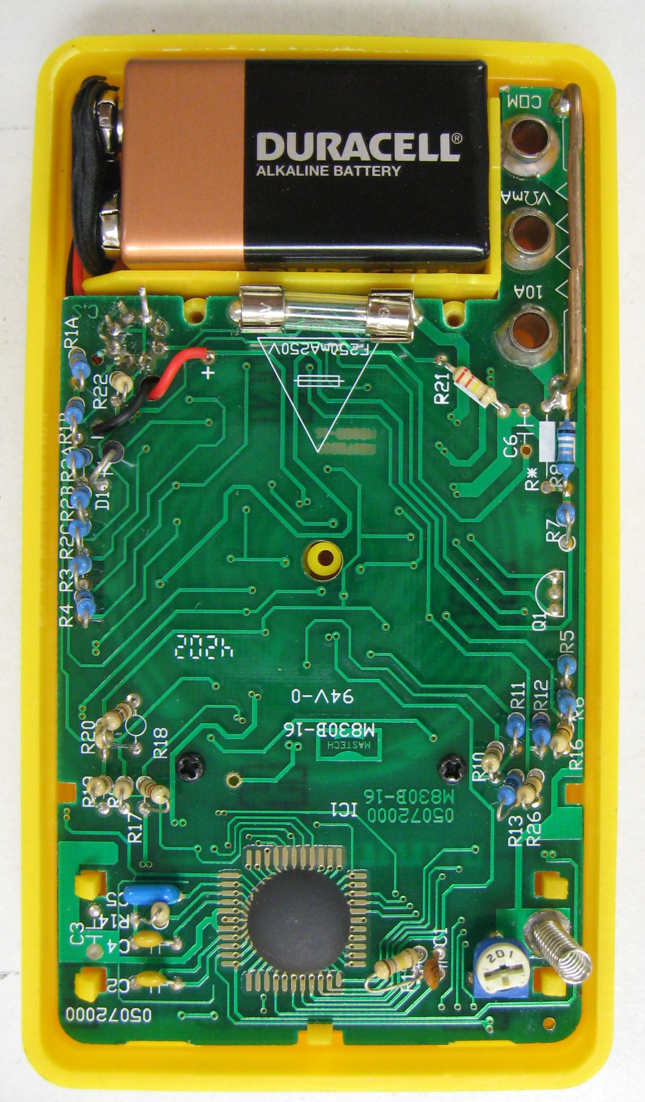
What happens if you connect a DMM,
set to read current,in parallel with a
voltage source, such as a battery?
Some V small R means large I
Some of the magic smoke may
Escape from your DMM. (You may damage your circuit or meter)
Fortunately, even this inexpensive
DMM includes a protective fuse.
So your DMM might not be destroyed.

Slide 18
