Slide 1
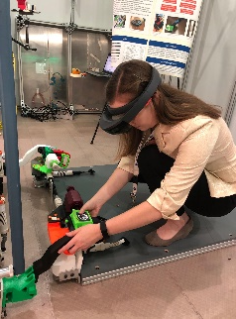
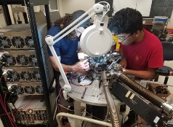
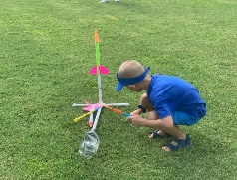
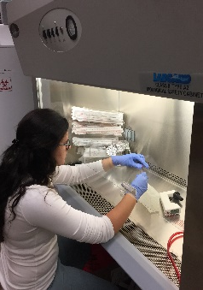
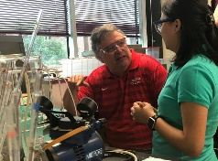
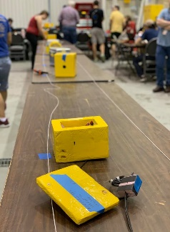
LaSPACE
LaACES Lab Notebooks
Documenting Your Work
Colleen H. Fava, Assistant Director
LaACES @ LSU 2022-2023
6:00 pm, Thursday, September 8, 2022

Slide 2
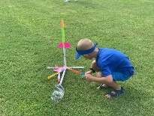
What is a Lab Notebook?
Complete record of procedures, data, and thoughts for your own reference, your team members, and to pass on to other researchers.
Document why experiments were initiated, how they were performed, expected results, actual results, and comments on results
Place to compile data/charts/photos/ideas
Place to collect clues & troubleshoot problems
Place to observe the whole picture and think
Additional reasons lab notebooks are kept by scientists and engineers
Legal document, to prove patents
Defense against accusations of fraud or lawsuits
Rev20220930
Slide 1 of 12

Slide 3
How will you use this Lab Notebook?
All the work you do and all the information you are provided each week is cumulative.
Proper documentation of processes & results will enable you to transfer information with relative ease to:
Lab Reports (first up: SkeeterSat Report Presentations)
Design Documents (PDR, CDR, FRR Written & Oral Presentations)
Lab notebooks will be reviewed periodically by LaACES staff to ensure you are making adequate progress. Regular documentation of your work will:
Secure your continued placement in the program
Ensure your submitted time sheets are approved
Rev20220930
Slide 2 of 12

Slide 4
“Your” is actually “Our” Lab Notebook
Lab Notebooks will remain in the Lab(Room 326) at all times, unless otherwise instructed by a staff member.
Scans and Photocopies are permitted if you want to take information home to review (esp over longer breaks)
Lab books will be periodically reviewed by faculty/staff (at least every 2 weeks) and must be accessible to your team members when we move into the preliminary design phase.
Rev20220930
Slide 3 of 12

Slide 5
Preparing a new Lab Notebook
Front and/or Inside Cover
Name (John Doe), Context (LaACES @ LSU), Beginning Date (September 9, 2021)
Create Table of Contents (ToC)
# first 3 pages front and back: ToC-1 → ToC-6
Number all Pages
Beginning with #1, number all pages following ToC pages
Establish Entry/ToC Format
Start/End Times, Date, Context, Entry Title (leave title blank until entry is complete)
Rev20220930
Slide 4 of 12

Slide 6
What goes in your Lab Notebook?
Lecture & Discussion Notes
Enter these notes sparingly. Lecture slides are available for future reference, but some equations or principles will be worth noting. Anything your instructors repeat is likely worth capturing.
Activities
Document the process and procedures of any in-house activities, explain why the experiment/activity is being conducted, document results and annotate explanations for successes and failures.
Research / Project Development
EVERYTHING! All the articles you read, hypotheses you develop, experiments you undertake, expected results, actual results, etc.
Rev20220930
Slide 5 of 12

Slide 7
Insert Attachments into your Lab Notebook
Use tape or glue to insert crucial materials into your lab book:
Computer generated data, Photographic data
Printed graphs
Datasheet templates
Assignment Sheets/Instructions
Notes (or pasted copies) of discussions, conversations, emails, readings related to experiment design or goals
Bibliographic information for resources
Annotations for names/locations of larger files
Always write the date and other identifying information on these materials in case they get separated! And be sure to log these insertions into your Table of Contents.
Rev20220930
Slide 6 of 12

Slide 8
Frequency of Entries in your Lab Notebook
Daily
Every day that you are working in the lab on exercises or project development, you should use the lab book as a general log. Document questions, observations, preliminary results, even failures.
Weekly
Review the previous week’s entries and add notes/clarifications as needed. Ensure continuity and connectivity between entries. Especially crucial in the second half of the project cycle.
Monthly
Review all entries to-date and add notes/clarifications as needed. Ensure continuity and connectivity throughout the lab book.
Rev20220930
Slide 7 of 12

Slide 9
Tips to Make Best Use of your Lab Notebook
Never, ever, remove a page
Fill consecutive pages
Cross out unused parts of pages
Record all info as accurately as possible
Do NOT omit any result, no matter how odd
Leave some space between lines and in the margins for future notes and elaborations (initial & date these)
Cross out mistakes lightly (might need to recover these later)
Write legibly (avoid felt tip pens)
Put a full date (avoid international date problems) with month spelled out and year included (Sept 9, 2021)
Time/Date stamp beginning and end of entry
Rev20220930
Slide 8 of 12

Slide 10
Lab Notebook FORMAT Review Checklist
Black or Blue ballpoint pen used
Other colored pens/highlighters used within reason
Legible handwriting
Table of contents up-to-date
Entries fully dated (Oct. 13, 2014, 6 pm–Oct. 13, 2014, 9 pm)
Clear headings identifying content areas
Written in first person
Complete sentences
Active verbs and precise description
Could the work be followed by another scientist
Is the researcher “thinking in the notebook”
Is the notebook stored safely & properly when not in use
Rev20220930
Slide 9 of 12

Slide 11
Lab Notebook CONTENT Review Checklist
Plans: tests to run, research to review, questions to answer
Ideas: a notebook is a repository of creativity (You are not limited to the ideas you implement)
Realities: deviations from the plan; adjustments
Observations: risk mitigation; procedures eliminated
Illustrations: sketches, graphs, and photographs
“Links” to the notebooks of others in your group
“Links” to instrument logbooks and data on disks
E-mails from collaborators (tape or paste them in)
Summaries of papers you have read (full citation)
Hints and tips you may get from science friends
Concerns, questions, failures, conundrums, etc
Rev20220930
Slide 10 of 12

Slide 12
Getting Started with your Lab Notebook
Tonight
Enter your name & course info, create a 6 pg ToC, and number the rest of the pages.
Moving Forward
Use the lab book as a general log every time you are in the lab. Document questions, observations, preliminary results, failures.
Get to the lab at least 15 minutes early and review your lab book: read previous entries to refresh your mind and clean up errors AND transfer any relevant information that was independently obtained outside of the lab.
Once every week or two, review previous week’s entries and add notes/clarifications as needed. Once a month review all entries to-date and add notes/clarifications as needed.
Buddy up with one or two other students and exchange lab notebooks regularly. Offer each other feedback and tips for improving the notebook.
Rev20220930
Slide 11 of 12

Slide 13
LaACES Lab Notebook Discussion
Thank you! Questions?
Rev20220930
Slide 12 of 12

